Slide 1
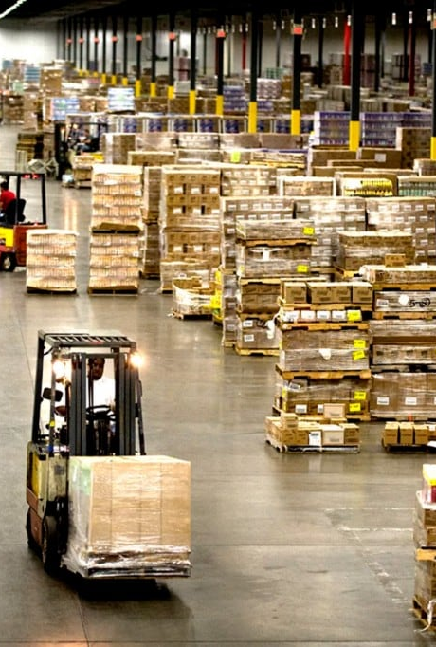
Simulation Modeling for Optimizing Inventory Management in a Retail Store
Data Modelling II - ANALYTICS
Group No:1
Professor: Bill Scott
This Photo by Unknown Author is licensed under CC BY-SA-NC

Slide 2
Team Members
KRIMA SHAH
MARGI PATEL
KEYUR SAVANI
JAINAM SHASTRI
RAHUL CHAVDA

Slide 3

Introduction
Importance of Inventory Management:
Ensures stock availability to meet customer demand.
Minimizes excess inventory that ties up capital.
Project Objectives:
Develop a simulation model to optimize inventory management.
Analyze different inventory management policies.
Optimize policies to reduce costs and maintain high service levels.

Slide 4
Dataset Overview
The dataset used in this project consists of various attributes crucial for inventory management analysis. The primary attributes are as follows:
Date: The date on which the sale occurred.
Store: The specific location of the store, identified as Store A, Store B, Store C, etc.
Product Type: The category of products sold, such as skincare, makeup, and haircare.
SKU: The stock-keeping unit identifier for each product, which uniquely identifies each item.
Price: The selling price of the product.
Availability: The number of units available for sale at the time.
Number of Products Sold: The quantity of each product sold on a given date.
Revenue Generated: The total revenue generated from sales on that date.
Customer Demographics: Information about the customers making purchases, providing insights into customer profiles.
Stock Levels: Current inventory levels for each product.
Lead Times: The time taken for products to be delivered from suppliers.
Various Costs: This includes shipping costs, holding costs, ordering costs, and stockout costs.
Dataset Size: 100 entries providing a comprehensive view across different stores and product types.

Slide 5
Data Preprocessing
Steps Taken:
Library Loading: Loaded essential R libraries (readr, dplyr, tidyr, lubridate)
Data Import: Imported sales data from a CSV file.
Data Cleaning:
Date Conversion: The Date column was converted to a proper date format to facilitate time-series analysis.
Numeric Formatting: All numeric columns were ensured to be in the correct numeric format.
Missing Values: A check for missing values confirmed that there were no missing entries in the dataset.
Duplicate Rows: A check for duplicate rows confirmed that all entries were unique.

Slide 6
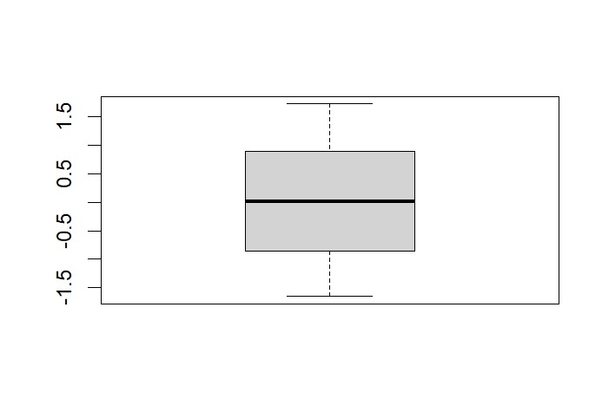
Data Scaling: Numeric columns were scaled to standardize their values, ensuring that they had a mean of 0 and a standard deviation of 1. This step is crucial for optimization algorithms that are sensitive to the scale of input data. Outlier Detection: Boxplots were used to visually inspect for outliers in key numeric columns, such as Price and Number of Products Sold. This step helps identify any extreme values that could skew the analysis. Summary Statistics: Summary statistics were generated to provide an overview of the central tendency and dispersion of the scaled data. This included checking the mean and standard deviation of each numeric column.

Slide 7
Model Development and Simulation Experimentation
Simulation Model Components:
Demand Simulation: Daily demand was simulated using a normal distribution with a mean of 20 units and a standard deviation of 5 units. This allows for variability in daily sales, reflecting real-world fluctuations.
Lead Time Variability: The model incorporates lead time variability, with lead times following a normal distribution (mean of 7 days, standard deviation of 2 days). This accounts for uncertainties in supplier delivery times.
Inventory Policy: The model implements a reorder point system. When inventory falls below a specified reorder point (50 units), a new order is placed for a fixed quantity (100 units).
Cost Factors: The model considers two main cost components:
Holding Cost: $0.50 per unit per day for maintaining inventory
Stockout Cost: $10 per unit per day for lost sales due to stockouts
Economic Order Quantity (EOQ): The model calculates the EOQ based on demand, ordering cost, and holding cost, providing a benchmark for order quantity optimization.

Slide 8
Simulation Results and Analysis
The simulation was run for 30 days, yielding the following key results:
Inventory Levels: The simulation tracked daily inventory levels, which were visualized in a plot. This visualization helps identify patterns in stock fluctuations and potential stockout periods.
Total Holding Cost: $44.78 This represents the cost of maintaining inventory over the 30-day period. The relatively low holding cost suggests that the inventory levels were generally kept low.
Total Stockout Cost: $1,154.80 The high stockout cost indicates that there were significant periods where demand exceeded available inventory, leading to lost sales opportunities.
Order Placement: The model tracked when orders were placed, allowing for analysis of ordering frequency and its impact on inventory levels.

Slide 9
Key Observations from Results and Analysis
The substantial stockout costs suggest that the current inventory policy may be too conservative, leading to frequent stockouts and lost sales.
The plot of inventory levels likely shows significant fluctuations, with periods of stockouts followed by inventory replenishment.
The high stockout costs indicate that the current reorder point (50 units) may be too low given the demand variability and lead time uncertainty.
The model calculates the EOQ, which can be compared to the fixed order quantity of 100 units to assess if order sizes are optimal.

Slide 10
Model Refinement and Policy Experimentation
Refining the initial simulation model involved testing multiple inventory management policies. The refined model incorporates:
Variable Lead Times: Normal distribution (mean = 7 days, std dev = 2 days).
Multiple Inventory Policies: Reorder Point Policy, EOQ Policy, and Just-In-Time (JIT) Policy.
Safety Stock: Buffer against demand and lead time variability.
Reorder Point Experimentation: Testing reorder points of 25, 50, 75, and 100 units.

Slide 11
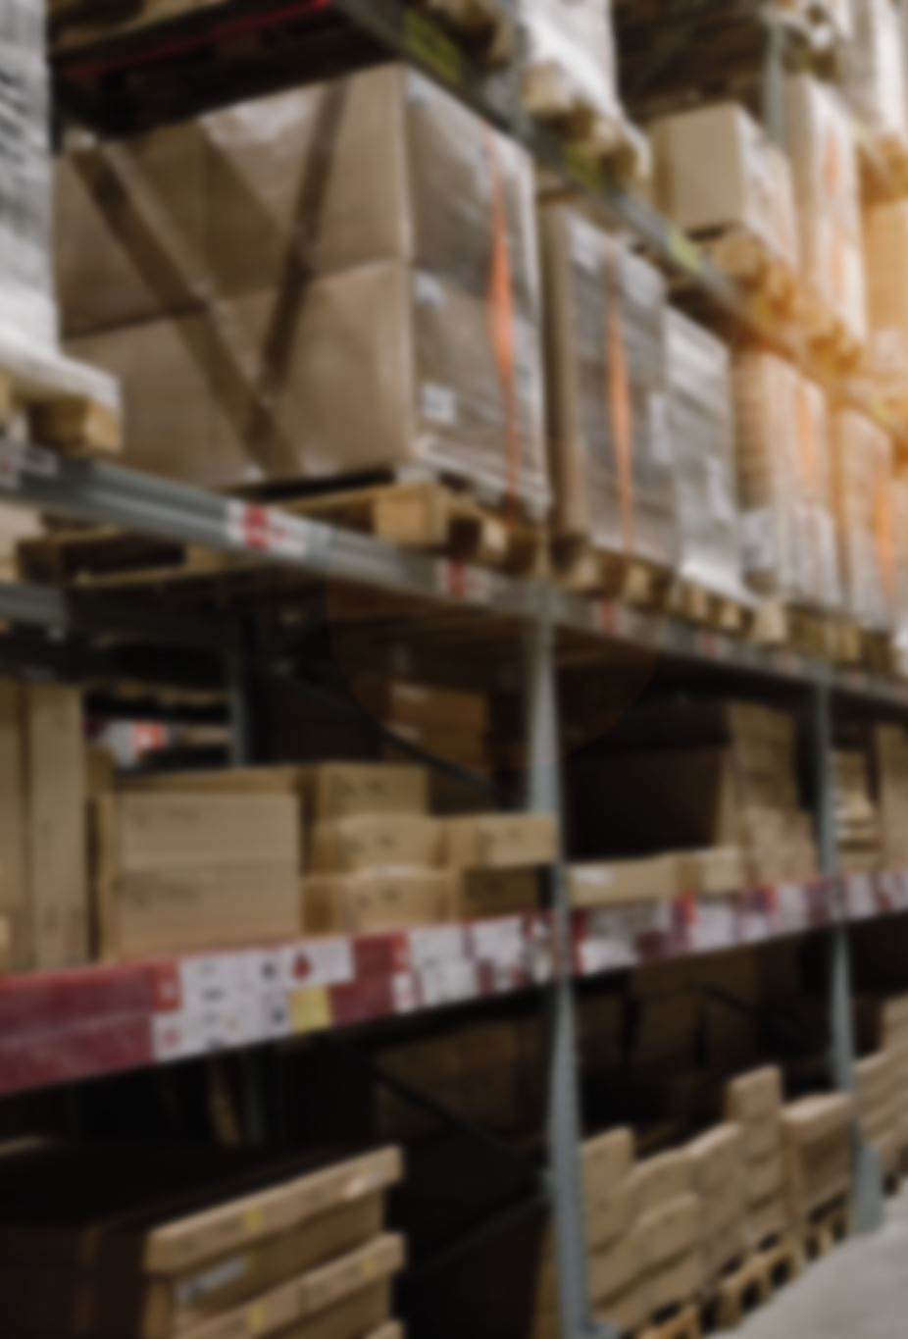
Comparison of Inventory Policies
The initial simulation comparing different inventory policies yielded the following results:
Total Holding Cost: $55.03
Total Stockout Cost: $0
These results suggest that the refined model has significantly improved inventory management. The elimination of stockout costs indicates effective maintenance of sufficient inventory to meet demand.

Slide 12
1. Reorder Point Experimentation
We conducted experiments with different reorder points to optimize the inventory policy. The results are as follows:
Key Observations:
Perfect service level across all reorder points.
Holding costs increase with higher reorder points.
Optimal reorder point: 25 units.
Reorder Point | Holding Costs | Stockout Costs | Service Level
25 | $58.61 | $0 | 100%
50 | $74.73 | $0 | 100%
75 | $86.63 | $0 | 100%
100 | $99.83 | $0 | 100%

Slide 13
2. Order Quantity Experimentation
We tested different order quantities while keeping the reorder point fixed at 50 units. The results are as follows:
Key Observations:
Holding costs increase with larger order sizes.
Service level remains perfect across all order quantities.
Optimal order quantity: 50 units.
Order Quantity | Holding Costs | Stockout Costs | Service Level
50 | $49.74 | $0 | 100%
100 | $74.53 | $0 | 100%
150 | $99.43 | $0 | 100%
200 | $122.67 | $0 | 100%

Slide 14
3. Safety Stock Experimentation
We tested different levels of safety stock while keeping the reorder point fixed at 50 units and the order quantity at 100 units. The results are as follows:
Key Observations:
Holding costs are relatively stable across different safety stock levels.
Service level remains perfect across all safety stock levels.
Optimal safety stock: 25-50 units.
Safety Stock | Holding Costs | Stockout Costs | Service Level
0 | $74.18 | $0 | 100%
25 | $71.68 | $0 | 100%
50 | $71.35 | $0 | 100%
75 | $74.17 | $0 | 100%

Slide 15
Performance Analysis
To understand the impact of different inventory policies, we visualized the results using line plots:
Holding Costs vs. Reorder Point:
The plot shows a clear upward trend in holding costs as reorder points increase.
Higher reorder points result in higher costs associated with storing unsold goods.
Holding Costs vs. Order Quantity:
This plot depicts a linear relationship between order quantity and holding costs.
Larger orders lead to higher storage costs.
Service Level vs. Safety Stock:
Service levels remain constant across different safety stock levels, indicating a robust system that meets customer demand without additional safety stock.
Stockout Rate vs. Reorder Point:
Stockout rates remain at 0% across all reorder points, confirming effective inventory management.

Slide 16
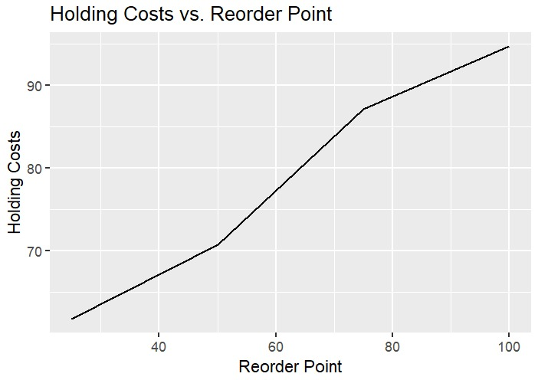
Holding Costs vs. Reorder Point
The plot shows a clear upward trend in holding costs as reorder points increase.
Higher reorder points result in higher costs associated with storing unsold goods.

Slide 17
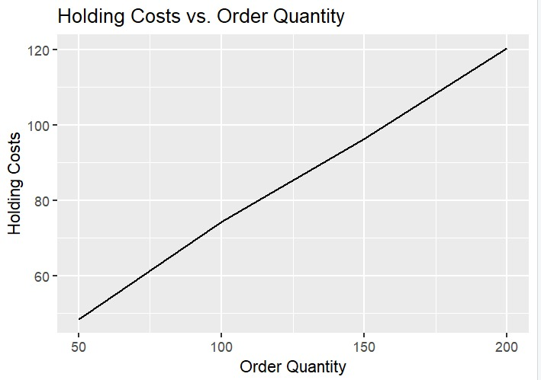
Holding Costs vs. Order Quantity
This plot depicts a linear relationship between order quantity and holding costs.
Larger orders lead to higher storage costs.
This plot depicts a linear relationship between order quantity and holding costs.
Larger orders lead to higher storage costs.

Slide 18
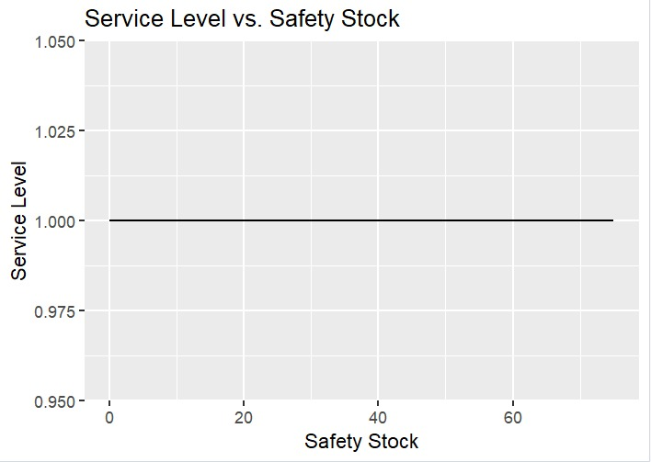
Service Level vs. Safety Stock
Service levels remain constant across different safety stock levels, indicating a robust system that meets customer demand without additional safety stock.

Slide 19
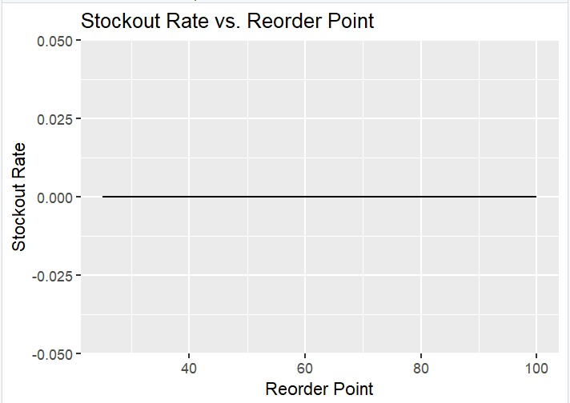
Stockout Rate vs. Reorder Point
Stockout rates remain at 0% across all reorder points, confirming effective inventory management.

Slide 20
Reorder Point Policy (ROP)
Metrics Evaluation:
Stockout Rate: Typically, low if the reorder point is set appropriately.
Holding Costs: Can be higher with conservative reorder points.
Service Level: Generally high if based on accurate demand forecasts.
Strengths:
Simplicity: Easy to implement and understand.
Stable Environments: Effective with predictable demand and lead time.
Weaknesses:
Risk of Overstocking: Potential for excess inventory if demand is overestimated.
Inflexibility: Less responsive to sudden changes in demand or supply disruptions.

Slide 21
Economic Order Quantity (EOQ)
Metrics Evaluation:
Stockout Rate: Not primarily designed to minimize stockouts.
Holding Costs: Optimizes holding and ordering costs.
Service Level: May need additional safety stock to achieve high service levels.
Strengths:
Cost Optimization: Minimizes total inventory costs.
Quantitative Approach: Clear mathematical basis for decision-making.
Weaknesses:
Assumption-Dependent: Relies on constant demand and known costs.
Inflexibility: Less adaptable to demand fluctuations and lead time variability.

Slide 22
Just-In-Time (JIT)
Metrics Evaluation:
Stockout Rate: Can be high without careful management.
Holding Costs: Very low, aiming to minimize on-hand inventory.
Service Level: High if the supply chain is reliable and responsive.
Strengths:
Reduced Holding Costs: Minimizes inventory costs.
Efficiency: Encourages continuous improvement and quality control.
Weaknesses:
Supplier Dependency: Requires a flexible and reliable supply chain.
Vulnerability: Sensitive to supply chain disruptions.

Slide 23
Optimization Results
Objective Value:
Achieved an optimized cost metric of 1.1032, balancing stockout and holding costs.
Variable Values:
The first two variables were minimized to zero, indicating reduced unnecessary expenses.
Third variable at 0.95, maintaining a service level at 95%.
Interpretation:
Costs minimized while maintaining a 95% service level.
Efficient inventory management balancing costs and customer satisfaction.

Slide 24
Strategy Recommendations
Dynamic Reordering Strategy:
Adjust reorder points to prevent excessive holding costs.
Maintain at least a 95% service level using real-time data analytics.
Economic Order Quantity (EOQ) Adjustment:
Optimal order quantity of 50 units resulted in the lowest holding costs.
Safety Stock Implementation:
Maintain safety stock levels between 25-50 units to buffer against demand variability.

Slide 25
Enhanced Optimization Techniques
Cost-Benefit Analysis:
Quantify savings from reduced holding costs.
Compare against risks of stockouts and lost sales.
Sensitivity Analysis:
Test variations in lead time, demand, and cost changes.
Measure impact on costs and service levels.

Slide 26
Recommended Policy
Dynamic Reorder Point with Safety Stock:
Key Components:
Adjust reorder points based on demand and supply fluctuations.
Include safety stock to maintain high service levels.
Benefits:
Cost Efficiency: Low holding and ordering costs.
High Service Level: Consistent 95% service level.
Adaptability: Responsive to changing market conditions.
Implementation Steps:
Use inventory management software for real-time adjustments.
Regularly update safety stock and reorder point calculations.

Slide 27

Thank You!

