Slide 1

GYANIX
Learning Portal
A classroom platform with free courses
and secure learning assistance
College project presentation
15 October 2026
Notes:
Introduce the project title and the team. Gyanix is a web application for managing classroom learning across students, instructors and administrators. The presentation explains the actual revised local implementation, its workflows, database and security controls, and the evidence from local QA. All published courses are free. The configured LLM integration is implemented, while real provider quality testing still needs credentials.
Source: README.md; Internship_Report.md; https://github.com/Jainesh-8305/gyanix-learning-portal
Cover: AI-generated conceptual illustration, not a screenshot of the application.

Slide 2
Project overview
One portal for the full classroom workflow
Students
Instructors
Learn through courses, assignments, quizzes and private study tools.
Prepare course content and review the work of their enrolled students.
Administrators
Assistant
Approve publication and manage platform access.
Explain website workflows using permitted documentation and context.
GYANIX LEARNING PORTAL
02
Notes:
Describe the portal as a place where classroom work stays connected. An instructor prepares a curriculum and sends it for approval. An administrator publishes it. Students enroll, study, submit assignments and view their own results. The application also provides private study notes, flashcards and contextual help. Explain that free enrollment does not remove access checks: publication state and membership still decide access to learning material.
Sources: README.md; Internship_Report.md
Repository: https://github.com/Jainesh-8305/gyanix-learning-portal
Evidence describes the revised local implementation as of 15 October 2026.

Slide 3
Problem statement
Scattered learning material
Notes, lesson links and assignments need a common home.
Unclear progress and feedback
Learners need visible deadlines, saved progress and their own results.
Separate responsibilities
Students, instructors and admins need different access.
Unverified scores and credentials
Scores, certificates and AI labels should reflect stored evidence.
GYANIX LEARNING PORTAL
03
Notes:
These are the design problems the project addresses, rather than measured claims about a surveyed college. Course material may otherwise be spread across videos, links and classroom messages. Manual checking makes it hard to follow deadlines or confirm progress. A shared system also needs clear boundaries so students cannot read other students’ private work and instructors only manage their own classrooms. The project brings these operations into one controlled workflow.
Sources: README.md; ARCHITECTURE.md
Repository: https://github.com/Jainesh-8305/gyanix-learning-portal
Evidence describes the revised local implementation as of 15 October 2026.

Slide 4
Objectives and scope
01
Accessible course enrollment
Every published course is free.
02
Organized teaching and learning
Curricula, deadlines, submissions and feedback remain connected.
03
Reliable assessment records
The server owns answer keys, attempts and certificate eligibility.
04
Private contextual assistance
The assistant retrieves only information permitted for the caller.
GYANIX LEARNING PORTAL
04
Notes:
Explain the intended outcomes without claiming deployment-scale results. Students should be able to enroll without payment and resume learning. Instructors should be able to manage a curriculum and grade submissions. Administrators should control publication. The application must enforce permissions on the backend, keep private study records separate, and make AI assistance clear about its sources and availability. External accreditation, payment processing and autonomous administrative actions are outside the project.
Sources: README.md; CHATBOT_SECURITY.md
Repository: https://github.com/Jainesh-8305/gyanix-learning-portal
Evidence describes the revised local implementation as of 15 October 2026.

Slide 5
User roles and responsibilities
Role | Main actions | Access boundary
Student | Enroll, learn, submit, practise | Own learning records
Instructor | Create courses, quizzes and assignments | Owned courses and submissions
Admin | Review courses and manage accounts | Authorized governance actions
Backend role and ownership checks apply to every protected workflow.
GYANIX LEARNING PORTAL
05
Notes:
Walk through the three roles and the separation between feature access and record ownership. An instructor role alone does not permit editing another instructor’s course. A student must also be enrolled before using protected classroom material. Admin operations remain separate from ordinary learning operations. The assistant follows these backend rules and cannot promote an account or perform administrative mutations.
Sources: README.md; backend/src/middleware/auth.js; backend/src/middleware/roles.js
Repository: https://github.com/Jainesh-8305/gyanix-learning-portal
Evidence describes the revised local implementation as of 15 October 2026.

Slide 6
Technology stack
Layer | Technology | Purpose
Frontend | Next.js 16, React 19, TypeScript | Pages and role workspaces
API | Node.js, Express 5 | Validation and business rules
Storage | MongoDB, Mongoose | Persistent records and queries
Client data | SWR, Axios, Zustand | Requests and session state
AI and runtime | OpenAI APIs, Docker | Optional assistance and packaging
GYANIX LEARNING PORTAL
06
Notes:
The frontend uses Next.js with React and TypeScript. Express implements the HTTP API on Node.js. MongoDB stores documents and Mongoose applies schemas and references. SWR handles client data requests and account-scoped caching. OpenAI Responses and embeddings are optional backend integrations. Docker provides repeatable production containers. The versions listed come from the project package files, rather than a claim about the newest public versions.
Sources: frontend/package.json; backend/package.json; docker-compose.yml
Repository: https://github.com/Jainesh-8305/gyanix-learning-portal
Evidence describes the revised local implementation as of 15 October 2026.

Slide 7
System architecture
Component | Responsibility | Connection
Browser workspace | Next.js pages and user interactions | Calls the Express API
API and permissions | Current identity, role and ownership | Reads authorized records
MongoDB | Courses, attempts, grades and private tools | Returns bounded data
Assistant service | Role-filtered retrieval and owned history | Calls OpenAI when configured
The API remains the permission boundary for both normal pages and chat.
GYANIX LEARNING PORTAL
07
Notes:
A browser sends a request to the Express API using a bearer token for protected operations. Authentication verifies the current account in MongoDB. Controllers then enforce role, ownership, publication and enrollment rules. Data services read or update the database. The assistant adds a controlled retrieval and optional provider step. The browser never receives the provider key and the model does not decide which records the caller may access.
Sources: ARCHITECTURE.md; backend/server.js; backend/src/services/chat.service.js
Repository: https://github.com/Jainesh-8305/gyanix-learning-portal
Evidence describes the revised local implementation as of 15 October 2026.

Slide 8
Data model and relationships
Relationship | Stored representation
User and Course | An instructor owns courses
Student and Course | Enrollment links each student to a course
Course and learning content | Embedded sections and lessons
Quiz and QuizAttempt | Each attempt belongs to one student and quiz
Assignment and submissions | Course work with student submissions
Certificate and private tools | Referenced completion proof and owned records
GYANIX LEARNING PORTAL
08
Notes:
MongoDB documents model the project’s major entities. Users can teach many courses and students can join many courses through Enrollment records. Course sections and lessons are embedded in Course. Each quiz has server-owned questions and each learner attempt stores its own lifecycle. Assignments embed their submissions. A certificate references its student, course, enrollment and passed assessment attempt. Private notes, flashcards and conversations always include an owner field.
Sources: backend/src/models/Course.js; backend/src/models/Enrollment.js; backend/src/models/Assignment.js; backend/src/models/Certificate.js
Repository: https://github.com/Jainesh-8305/gyanix-learning-portal
Evidence describes the revised local implementation as of 15 October 2026.

Slide 9
Free course lifecycle
01
Draft
Instructor prepares the curriculum and lesson media.
02
Review
Admin approves the submission or requests changes.
03
Publication
Approved content becomes available for enrollment.
04
Free enrollment
Student joins and receives permitted classroom access.
GYANIX LEARNING PORTAL
09
Notes:
Describe the complete route from content preparation to student access. An instructor saves a draft, adds lesson media and duration, then submits for review. An administrator can request edits or publish the course. A student enrolls directly or joins with a classroom code. Course publication and protected-material access remain enforced even though payment has been removed. Editing a published curriculum returns it to draft and archiving preserves learning history.
Sources: backend/src/controllers/course.controller.js; backend/src/controllers/enrollment.controller.js; audit/enhancements/evidence/browser-checks.json
Repository: https://github.com/Jainesh-8305/gyanix-learning-portal
Evidence describes the revised local implementation as of 15 October 2026.

Slide 10
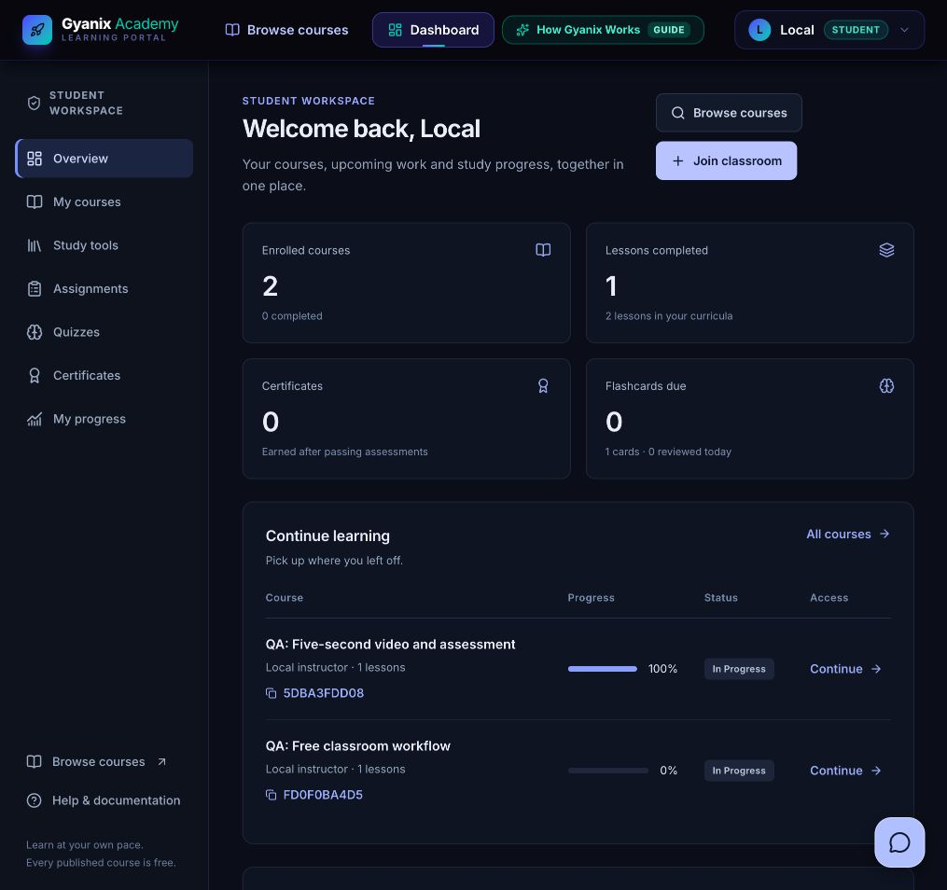
Student dashboard
A clear learning workspace
Courses, deadlines and study tools stay reachable through a consistent sidebar.
Actual saved data
Progress, attempts and certificates come from account-owned records.
Screenshot uses synthetic local QA accounts.
GYANIX LEARNING PORTAL
10
Notes:
Use the screenshot to point out the shared sidebar, summary metrics, course progress and upcoming work. The student dashboard uses one bounded backend summary response. Assignment rows show only this learner’s status and score. Notes, flashcards and revision practice remain accessible from study tools. The numbers shown are from local QA fixtures. They do not represent a deployed college or real student population.
Sources: frontend/src/app/dashboard/student/page.tsx; backend/src/routes/dashboard.routes.js; audit/enhancements/evidence/student-overview-viewport.png
Repository: https://github.com/Jainesh-8305/gyanix-learning-portal
Evidence describes the revised local implementation as of 15 October 2026.

Slide 11
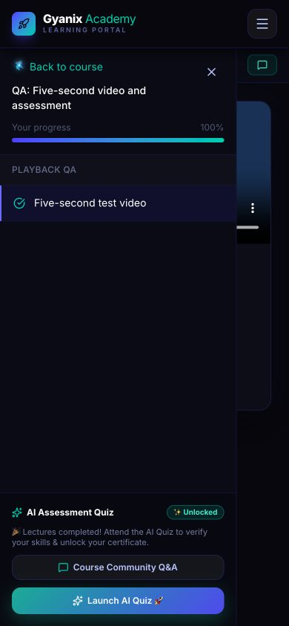
Lesson progress and completion
Saved curriculum
Only valid lesson IDs count toward progress.
Watch-session records
The API credits elapsed watch time through heartbeats.
Assessment gate
All lectures and a passed assessment support certification.
Project completion certificates have no external accreditation.
GYANIX LEARNING PORTAL
11
Notes:
The student can watch lessons and resume saved progress. The backend validates that a lesson belongs to the stored curriculum and records bounded watch-session heartbeats. Seeking to the end or inventing a lesson ID cannot satisfy the server checks. Completion of all lectures enables the certification assessment, and a passed stored attempt is also required before a project completion certificate can be issued. Heartbeats are a practical guard, not proof that a human paid attention.
Sources: backend/src/controllers/enrollment.controller.js; backend/src/services/assessment.service.js; audit/fixes/evidence/mobile-navigation-open.png
Repository: https://github.com/Jainesh-8305/gyanix-learning-portal
Evidence describes the revised local implementation as of 15 October 2026.

Slide 12
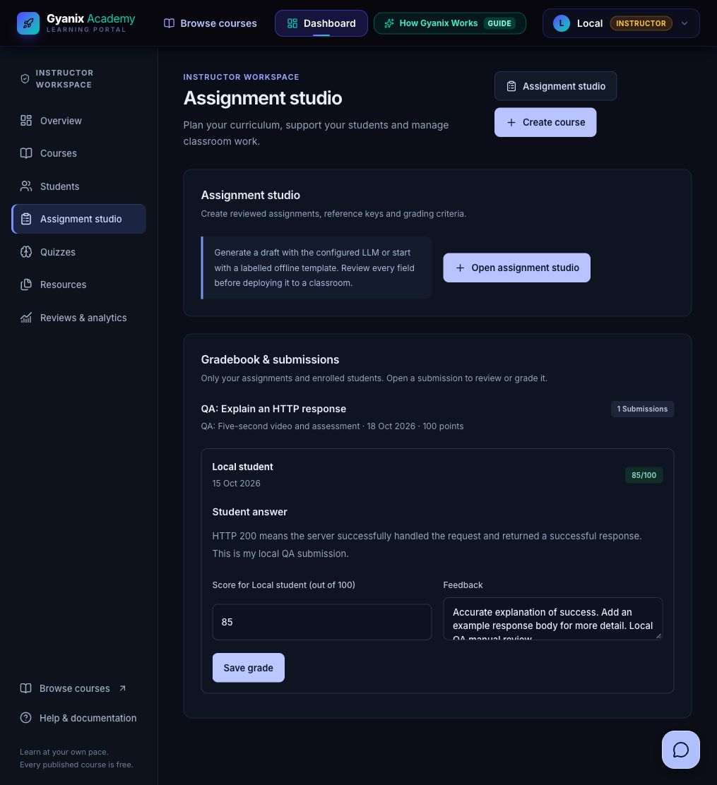
Assignments and instructor feedback
Instructor creates
Instructions, rubric, deadline and maximum score.
Student submits
Own answer and submission state.
Instructor reviews
Validated score and private feedback.
Verified example: manual review saved 85/100.
GYANIX LEARNING PORTAL
12
Notes:
Explain the lifecycle from assignment creation to feedback. The instructor sets instructions, a due date and a score range. A student submits an answer before the deadline. The instructor opens the gradebook, reads the submission and saves a score and feedback. The student then sees their own result. The demonstrated QA response received 85 out of 100 with a comment about adding an example. This is synthetic workflow evidence, not an academic grade for a real student.
Sources: backend/src/controllers/assignment.controller.js; frontend/src/components/workspace/InstructorGradebook.tsx; audit/enhancements/evidence/instructor-gradebook.png
Repository: https://github.com/Jainesh-8305/gyanix-learning-portal
Evidence describes the revised local implementation as of 15 October 2026.

Slide 13
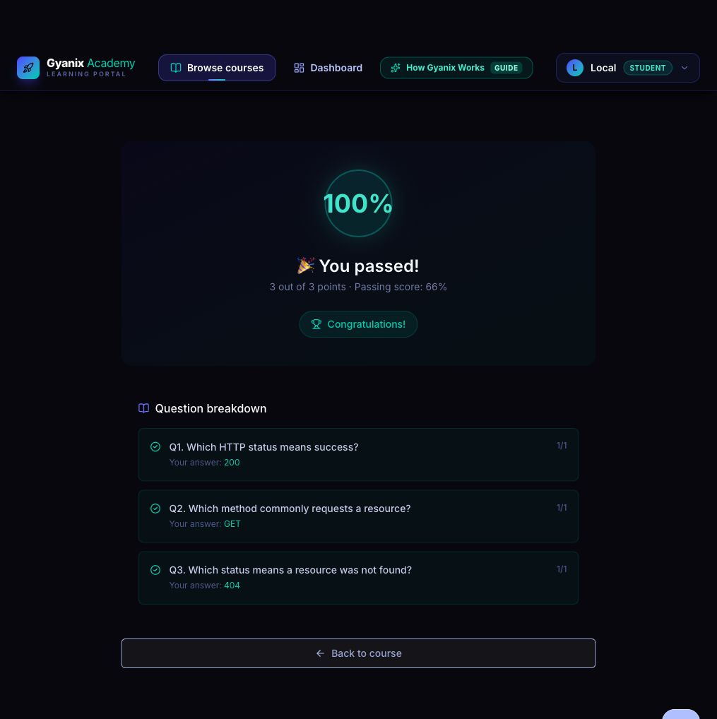
Quizzes and assessment integrity
Stored answer keys
The server scores each submitted attempt.
Persistent attempt state
Deadlines, attempt limits and replay checks apply.
Clear result history
Saved outcomes support progress and certificate checks.
GYANIX LEARNING PORTAL
13
Notes:
The UI can present questions and a countdown, but the backend owns correctness and eligibility. A saved attempt belongs to one learner and includes a server deadline and attempt limit. Submission scores against stored answer keys. Replays, expired attempts and forged question-key payloads are rejected. The screenshot shows a real UI submission of three local HTTP fixture questions, with all three answers scored correctly. Practice quizzes do not independently issue certificates.
Sources: backend/src/services/assessment.service.js; backend/src/models/QuizAttempt.js; audit/enhancements/evidence/student-quiz-result.png
Repository: https://github.com/Jainesh-8305/gyanix-learning-portal
Evidence describes the revised local implementation as of 15 October 2026.

Slide 14
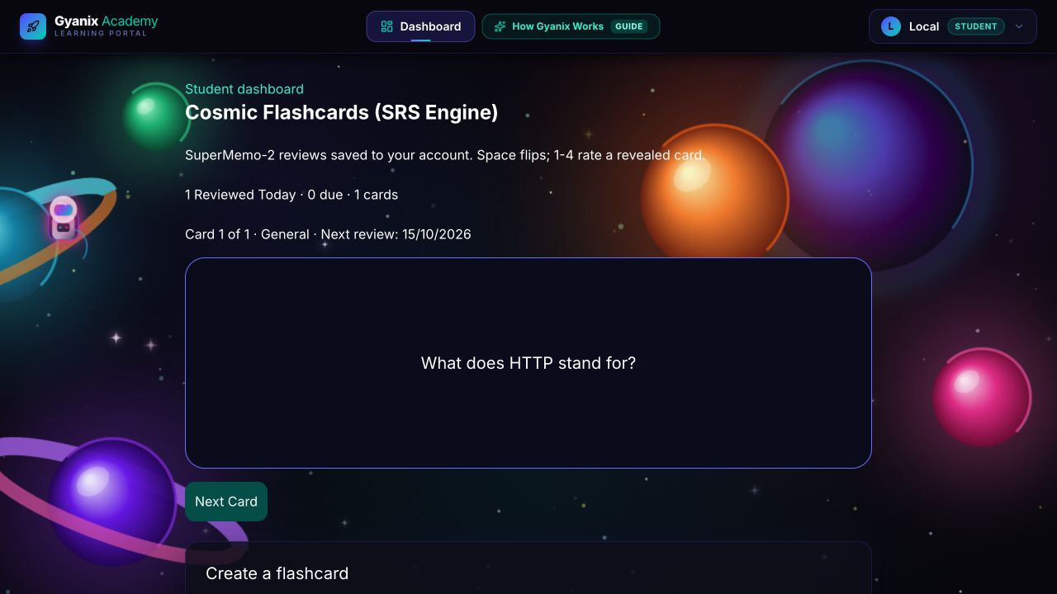
Private study tools
Notes and source summaries
Save private notes from text or readable PDF material.
Spaced repetition
Persist review quality, interval and the next due date.
Revision practice
Choose a topic and practise with 3, 5 or 10 questions.
Flashcard screen from the earlier fix-phase QA run.
GYANIX LEARNING PORTAL
14
Notes:
Describe the study tools as support for revision. Notes accept pasted text or readable PDFs. Corrupt or unsupported sources show errors, while offline templates clearly identify their mode. Flashcards persist in MongoDB for the current student and the SuperMemo-2 scheduler updates the next due date after a review. Revision quizzes offer a selected question count. Scanned PDFs need OCR and a video URL alone does not provide a transcript. The screenshot is from the earlier fix-phase QA run and shows persistence, while the current shared shell has since changed.
Sources: frontend/src/app/dashboard/student/notes/page.tsx; backend/src/services/srs.js; audit/fixes/evidence/flashcards-persisted.png
Repository: https://github.com/Jainesh-8305/gyanix-learning-portal
Evidence describes the revised local implementation as of 15 October 2026.

Slide 15
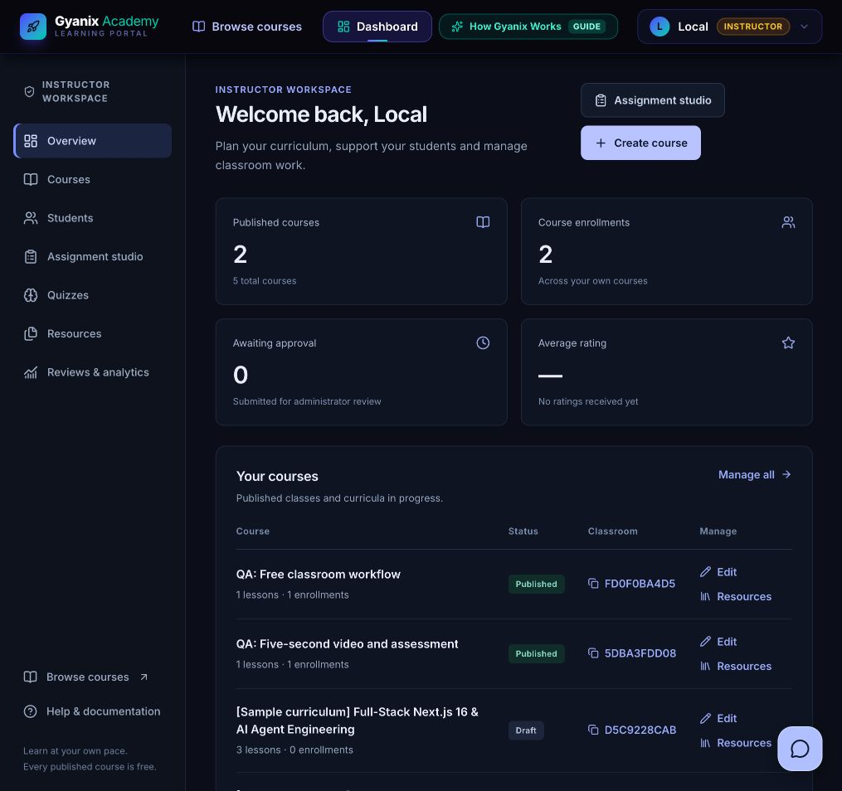
Instructor dashboard
Curriculum management
Create courses, add lessons and submit for approval.
Classroom support
Review rosters, submissions, quizzes and shared resources.
Course ownership checks apply on the backend.
GYANIX LEARNING PORTAL
15
Notes:
Show how the instructor workspace organizes teaching operations. Courses and their status stay visible in the overview. Dedicated navigation leads to student rosters, assignments and gradebook, quizzes, resources and review analytics. Heavy tools load when opened. Instructors can inspect and grade submissions for their own classrooms. They cannot manage another instructor’s course simply by changing a route ID. The screenshot contains local samples and synthetic QA courses.
Sources: frontend/src/app/dashboard/instructor/page.tsx; audit/enhancements/evidence/instructor-overview-viewport.png
Repository: https://github.com/Jainesh-8305/gyanix-learning-portal
Evidence describes the revised local implementation as of 15 October 2026.

Slide 16
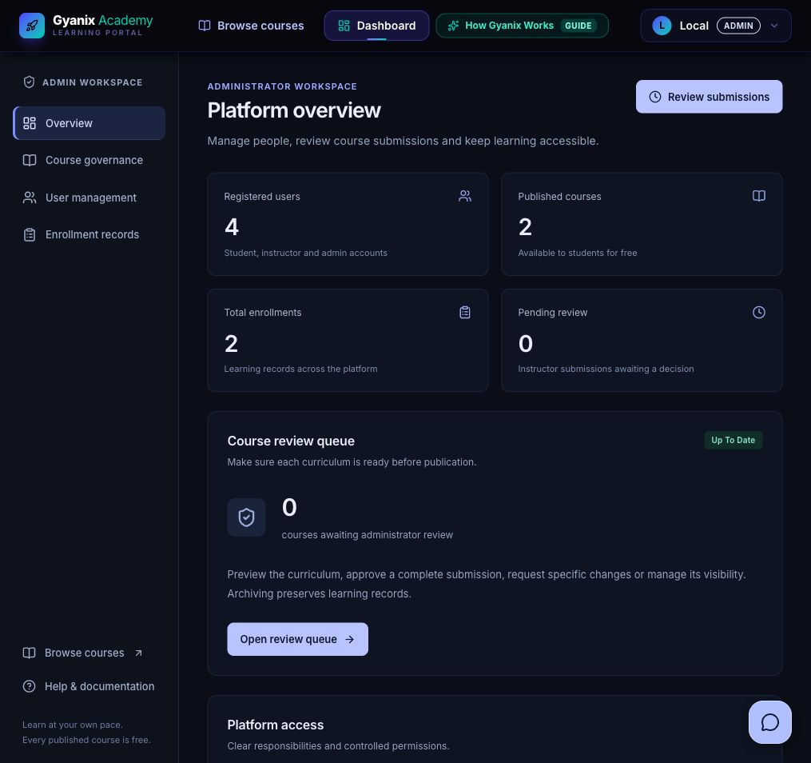
Administrator dashboard
Course governance
Approve complete curricula and give clear review feedback.
Account administration
Search users and inspect enrollment records.
Free access still requires course publication.
GYANIX LEARNING PORTAL
16
Notes:
The admin overview displays platform totals and the pending review queue. Administrators can preview course content, publish it, request edits, hide it or archive it. They can search accounts and manage the active status of permitted non-admin accounts, while administrator accounts remain protected from these ordinary controls. Enrollment records display membership and progress. Payments, receipts and revenue metrics are deliberately absent. Counts in the screenshot are from a local fixture database.
Sources: frontend/src/app/dashboard/admin/page.tsx; backend/src/controllers/admin.controller.js; audit/enhancements/evidence/admin-overview-viewport.png
Repository: https://github.com/Jainesh-8305/gyanix-learning-portal
Evidence describes the revised local implementation as of 15 October 2026.

Slide 17
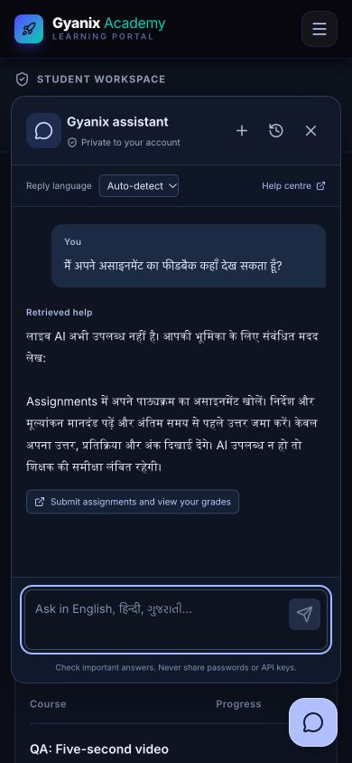
Floating multilingual assistant
Convenient access
A small icon opens a private chat window.
Language support
Hindi, Gujarati and English documentation is available locally.
Clear provider mode
Live model behavior depends on secure API configuration.
Live LLM language quality remains pending credentials.
GYANIX LEARNING PORTAL
17
Notes:
The assistant appears as a small corner icon on relevant signed-in pages rather than taking a dashboard card. The window supports language preference, owned history, new conversations and source links. English, Hindi and Gujarati help articles work locally. A configured LLM enables broader natural multilingual responses and contextual follow-ups. The visible screenshot intentionally says retrieved help because no provider key was configured during the recorded QA. Do not demonstrate it as a successful live LLM response.
Sources: frontend/src/components/assistant/ChatWindow.tsx; backend/src/services/chat.service.js; audit/enhancements/evidence/assistant-hindi-mobile.png
Repository: https://github.com/Jainesh-8305/gyanix-learning-portal
Evidence describes the revised local implementation as of 15 October 2026.

Slide 18
Retrieval-augmented generation
Relevant, permitted evidence accompanies the user’s question
01
Authenticate
02
Retrieve
Current account, active status and role
Role-filtered documents and permitted summaries
03
Generate
04
Respond
Recent owned turns and bounded evidence
Natural answer with validated source links
GYANIX LEARNING PORTAL
18
Notes:
Define RAG in plain language: retrieve relevant permitted evidence before asking a language model to answer. The backend authenticates the request, filters the help corpus by current role, ranks it using BM25 and optional semantic embeddings, adds a bounded authorized account summary and recent owned conversation turns, then calls the provider. Returned citations must match selected source IDs. Only reviewed static documentation is embedded or cached, so private student notes do not enter a shared vector index.
Sources: backend/src/services/knowledge.service.js; backend/src/services/chat-provider.js; backend/src/services/chat.service.js
Repository: https://github.com/Jainesh-8305/gyanix-learning-portal
Evidence describes the revised local implementation as of 15 October 2026.

Slide 19
Assistant permissions and privacy
Caller | Permitted evidence | Excluded information
Student | Own enrollments, notes and grades | Other students and reference keys
Instructor | Owned course summaries | Other instructors and private notes
Admin | Admin workflows and totals | Secrets and answer keys
Anonymous | No private assistant access | All private context
Database predicates enforce access before the model sees any evidence.
GYANIX LEARNING PORTAL
19
Notes:
Emphasize that retrieval restrictions happen before generation. Students receive shared or student help plus their own permitted summaries. Instructors receive their own course summaries and relevant instructor help. Admins receive reviewed admin workflows and platform totals, rather than unlimited secret access. The service excludes answer keys, passwords and bulk account emails. Browser fields cannot choose a different role, user or arbitrary history. Conversations also require the same owner and current role.
Sources: CHATBOT_SECURITY.md; backend/src/services/knowledge.service.js; backend/src/routes/chat.routes.js
Repository: https://github.com/Jainesh-8305/gyanix-learning-portal
Evidence describes the revised local implementation as of 15 October 2026.

Slide 20
Security and reliability controls
Identity and sessions
Record permissions
Private reset tokens and session revocation after password reset.
Current role, ownership, enrollment and course status checks.
Validated operations
Bounded processing
Allowed fields, numeric ranges, deadlines and persistent attempts.
Request quotas, provider timeouts and clear failure handling.
No public seed endpoint and no browser-visible provider keys.
GYANIX LEARNING PORTAL
20
Notes:
Security improvements address concrete issues from the audit. Password reset links are delivered privately and token versions invalidate older sessions after reset. Public seeding has been removed. Current database identity, role and ownership checks protect records. Input validation rejects unauthorized fields and invalid identifiers. Assessments keep keys and timing on the server. Provider timeouts, quotas, error states and explicit fallback labels reduce unexpected work and misleading success claims. These controls reduce risk without implying perfect security.
Sources: backend/src/middleware/auth.js; backend/src/controllers/auth.controller.js; backend/src/services/assessment.service.js; backend/test/chat.test.js
Repository: https://github.com/Jainesh-8305/gyanix-learning-portal
Evidence describes the revised local implementation as of 15 October 2026.

Slide 21
Performance improvements
Less startup work
Lazy tools and fewer global animations.
Bounded data requests
One student summary endpoint with ownership indexes.
Local snapshot, 15 October 2026. Counts uncompressed HTML-referenced assets, not end-user loading time.
GYANIX LEARNING PORTAL
21
Notes:
Explain both implementation choices and measured scope. Heavy studios and chat load only when requested. The student dashboard aggregates bounded summary data into one endpoint. Indexes and bounded queries limit database work. Global animated canvas and cursor loops were removed. The chart compares uncompressed scripts referenced by dashboard HTML before and after the added requirements. It is not a production LCP, INP or load-test result. Student and instructor totals reduced by roughly 13.7 and 10.6 percent, while the admin change is small.
Sources: README.md; audit/enhancements/evidence/performance-before.json; audit/enhancements/evidence/performance-after.json
Repository: https://github.com/Jainesh-8305/gyanix-learning-portal
Evidence describes the revised local implementation as of 15 October 2026.

Slide 22
Testing and QA results
Verification area | Recorded result
Backend regression | 115 passed, 0 failed, 0 skipped
Browser workflows | 19 recorded checks
Static and build checks | Strict lint, TypeScript and production build passed
Dependency audit | 0 advisories in both package snapshots
Containers | Build, non-root startup and health checks passed
Local fixture evidence dated 15 October 2026.
GYANIX LEARNING PORTAL
22
Notes:
Report the executed checks accurately. The latest local suite reports 115 backend tests passing with no failed or skipped tests. Nineteen browser checks cover role workflows, responsive layout, study tools and chat help. Both lint commands, TypeScript and the production build passed. Dependency audit snapshots reported zero advisories. Docker images built and started as non-root users. A local workflow created a course, obtained admin approval, enrolled a student for free and completed submission and grading. Live provider quality and external delivery are separate outstanding checks.
Sources: audit/enhancements/evidence/qa-summary.json; audit/enhancements/evidence/browser-checks.json; audit/enhancements/evidence/backend-tests.txt
Repository: https://github.com/Jainesh-8305/gyanix-learning-portal
Evidence describes the revised local implementation as of 15 October 2026.

Slide 23
Classroom demonstration sequence
01
Create and submit a course
Instructor adds curriculum and lesson media.
02
Approve the curriculum
Admin reviews and publishes the submission.
03
Enroll and submit work
Student joins for free and answers the assignment.
04
Review the result
Instructor grades, then student views private feedback.
GYANIX LEARNING PORTAL
23
Notes:
Use this as a presenter checklist rather than claiming an action happened live. Start with the instructor course editor and show a draft with lesson media. Then switch to the admin review queue and show publication. Switch to the student view to enroll directly, open a lesson and inspect an assignment. Finally show the gradebook and reopen the student result. Use only synthetic local accounts for the demonstration. If time is short, the included screenshots already show the verified workflow.
Sources: audit/enhancements/evidence/browser-checks.json
Repository: https://github.com/Jainesh-8305/gyanix-learning-portal
Evidence describes the revised local implementation as of 15 October 2026.

Slide 24
Current limitations and future scope
Current limitations
Validation still needed
Live LLM quality, SMTP inbox delivery and Cloudinary uploads need credentials.
Public hosting, production load, wider browser testing and accessibility review.
Next implementation work
Next evaluation work
Reviewed question banks, richer course content and optional scanned-document OCR.
Language and RAG evaluations with realistic classroom questions.
GYANIX LEARNING PORTAL
24
Notes:
Be candid about the remaining validation. The OpenAI integration and safe request assembly are implemented, but live multilingual fluency and semantic retrieval quality still require a valid provider key. SMTP inbox delivery and Cloudinary uploads also need separate credential-backed checks. The current evidence is local, not production-scale. Future work should prioritize those checks, teacher-reviewed question banks, course content, OCR if scanned documents are needed, and wider accessibility and browser testing. These are proposed next steps, not delivered capabilities.
Sources: audit/enhancements/evidence/qa-summary.json; README.md; CHATBOT_SECURITY.md
Repository: https://github.com/Jainesh-8305/gyanix-learning-portal
Evidence describes the revised local implementation as of 15 October 2026.

Slide 25
Project outcomes and questions
Free classroom access
Clear workflows for learning, teaching and administration
Backend permissions and stored assessment evidence
Questions
GYANIX LEARNING PORTAL
25
Notes:
Close by connecting the implementation to its original classroom purpose. The project supports free enrollment, a clear teaching and review lifecycle and private learner records. It preserves the full student, instructor and admin feature set while reducing unnecessary frontend work. It also adds a floating contextual assistant whose retrieval follows backend permissions. State that testing supports the local workflows and that live external-service checks remain pending. Invite the teachers to ask about architecture, database design, permissions, assessment integrity or the next evaluation steps.
Sources: README.md; audit/enhancements/evidence/qa-summary.json
Repository: https://github.com/Jainesh-8305/gyanix-learning-portal
Evidence describes the revised local implementation as of 15 October 2026.

Slide 26
Appendix: API modules
Module | Representative endpoint | Purpose
Session | POST /api/auth/login | Authenticate the current account
Student summary | GET /api/dashboard/student | Own learning overview
Free enrollment | POST /api/enrollments/:courseId | Join a published course
Assignments | POST /api/assignments/:id/submit | Submit permitted work
Assistant | POST /api/ai/chat | Role-filtered private conversation
GYANIX LEARNING PORTAL
26
Notes:
Use this slide for questions about endpoint design. These are representative routes taken from the source, not the complete API inventory. HTTP verbs communicate reads versus mutations. Authentication happens before protected handlers. Ownership and course state checks still apply inside the controller or service. A course ID or assignment ID supplied by the browser is never sufficient authorization on its own.
Sources: backend/server.js; backend/src/routes/auth.routes.js; backend/src/routes/dashboard.routes.js; backend/src/routes/assignment.routes.js; backend/src/routes/chat.routes.js
Repository: https://github.com/Jainesh-8305/gyanix-learning-portal
Evidence describes the revised local implementation as of 15 October 2026.

Slide 27
Appendix: persistent collections
Collection | Important stored fields
Enrollment | student, course, completedLessons, watchSessions
QuizAttempt | student, quiz, status, deadline and submitted result
Assignment | course, instructor, dueDate and submissions
Certificate | student, course, enrollment, assessmentAttempt
Private tools | Owner reference plus note, review or conversation data
GYANIX LEARNING PORTAL
27
Notes:
Use the stored-field examples to explain why the database supports reliable workflows. Enrollment keeps both the curriculum association and progress records. QuizAttempt separates the server-scored assessment lifecycle from presentation state. Assignment submissions live inside their assignment document. Certificate references let public verification check a genuine passed attempt without exposing the student email. Notes, flashcards and conversations include a user owner so data cannot leak across accounts.
Sources: backend/src/models/Enrollment.js; backend/src/models/QuizAttempt.js; backend/src/models/Assignment.js; backend/src/models/Certificate.js; backend/src/models/ChatConversation.js
Repository: https://github.com/Jainesh-8305/gyanix-learning-portal
Evidence describes the revised local implementation as of 15 October 2026.

Slide 28
Appendix: assessment and spaced repetition
Assessment eligibility
Review quality
Published course and membership checks precede the attempt.
Again 1, Hard 3, Good 4 and Easy 5
Server scoring
Next review date
Stored keys, deadlines and passed attempts support certificates.
SM-2 updates repetitions, ease, interval and dueAt per student.
GYANIX LEARNING PORTAL
28
Notes:
Explain two distinct algorithms. Course certification requires published enrollment, curriculum completion and a passing server-scored assessment. It cannot be earned by a client-posted percentage. Flashcard scheduling uses a SuperMemo-2 implementation with integer quality ratings from zero to five. A quality below three resets repetitions and schedules the next day. Successful early reviews use intervals of one day and six days, then the prior interval multiplied by ease. The ease factor has a lower bound of 1.3 and the updated schedule is persisted for that learner.
Sources: backend/src/services/assessment.service.js; backend/src/services/srs.js
Repository: https://github.com/Jainesh-8305/gyanix-learning-portal
Evidence describes the revised local implementation as of 15 October 2026.

Slide 29
Appendix: likely viva questions
Why check permissions on the backend?
A client can call an endpoint directly.
What is RAG doing here?
It supplies relevant permitted evidence to the model.
How do old sessions become invalid?
The API checks the current account token version.
What does the test suite prove?
Local behavior and boundaries, with live quality checks separate.
GYANIX LEARNING PORTAL
29
Notes:
Suggested answers: Frontend guards improve navigation, but a caller can invoke the API directly, so the backend must verify current identity and record ownership. Token-version checks revoke older JWTs after a password reset. RAG retrieves selected evidence at response time; this implementation does not train a new model. Free enrollment is a product decision, while publishing and membership checks still protect access. A mock provider test verifies data assembly and failure handling, but it cannot prove real language quality.
Sources: ARCHITECTURE.md; CHATBOT_SECURITY.md; backend/src/middleware/auth.js
Repository: https://github.com/Jainesh-8305/gyanix-learning-portal
Evidence describes the revised local implementation as of 15 October 2026.

Slide 30
Appendix: source code and local setup
https://github.com/Jainesh-8305/gyanix-learning-portal
Runtime
Start the app
Node.js 22.22+ and MongoDB 7
Install each package, configure private env files, then start the API and frontend.
Project documentation
Evidence
README, architecture and assistant security notes
Final audit report and dated local QA records
GYANIX LEARNING PORTAL
30
Notes:
The source repository identifies the original project. This deck describes the revised local implementation and the dated QA evidence rather than assuming the public branch already contains the revisions. Setup needs Node.js 22.22 or newer and MongoDB 7, separate npm installs, a private backend environment and a frontend API URL. Seed only local random test accounts. Never put provider keys in public frontend variables. The source documentation and detailed report support follow-up questions beyond the deck.
Sources: README.md; ARCHITECTURE.md; CHATBOT_SECURITY.md; audit/enhancements/Gyanix_Final_Audit_and_QA_Report.md
Repository: https://github.com/Jainesh-8305/gyanix-learning-portal
Evidence describes the revised local implementation as of 15 October 2026.

