Slide 1

Weather Prediction for Ahmedabad
Final Presentation
TEAM AMIGOS
Jainesh Patel - AU1841101
Umang Kamdar - AU1841069
Vatsal Patel - AU1841103
Shubh Shah - AU1841122

Slide 2
Introduction
In real life we need to deal with many uncertain weather problems. We use the weather prediction in agriculture sector, airport environment prediction and some other important events.
In order to forecast the chaotic nature of atmosphere we need to use some statistical approach. Only mathematical approach will not give us the insights of the weather prediction. We need past data of the temperature and other features like Humidity, Wind index and others.
We need to use algorithms which will include the past data and statistical calculations for predicting the weather.
We took a data-set of Ahmedabad city using API key. We collected the historical weather data of each day from 2015 to 2020.
We started with temperature prediction, then rainfall prediction and then at last did multivariate regression.

Slide 3
Problem Statement
Weather warnings are important to manage the resources accordingly.
Weather prediction and forecasting is becoming important day by day, as it's applications makes human life more comfortable.
Changes in weather conditions can highly disrupt food availability, reduce access to food, and affect food quality.
Thus in dealing with uncertain events like: Heatwaves, Droughts, Blizzards, Hurricanes, etc, We need a good Prediction model.
For weather prediction, the feature might be dependant on one another, so we cannot just rely on multiple regression, instead we move on to use multivariate regression.

Slide 4
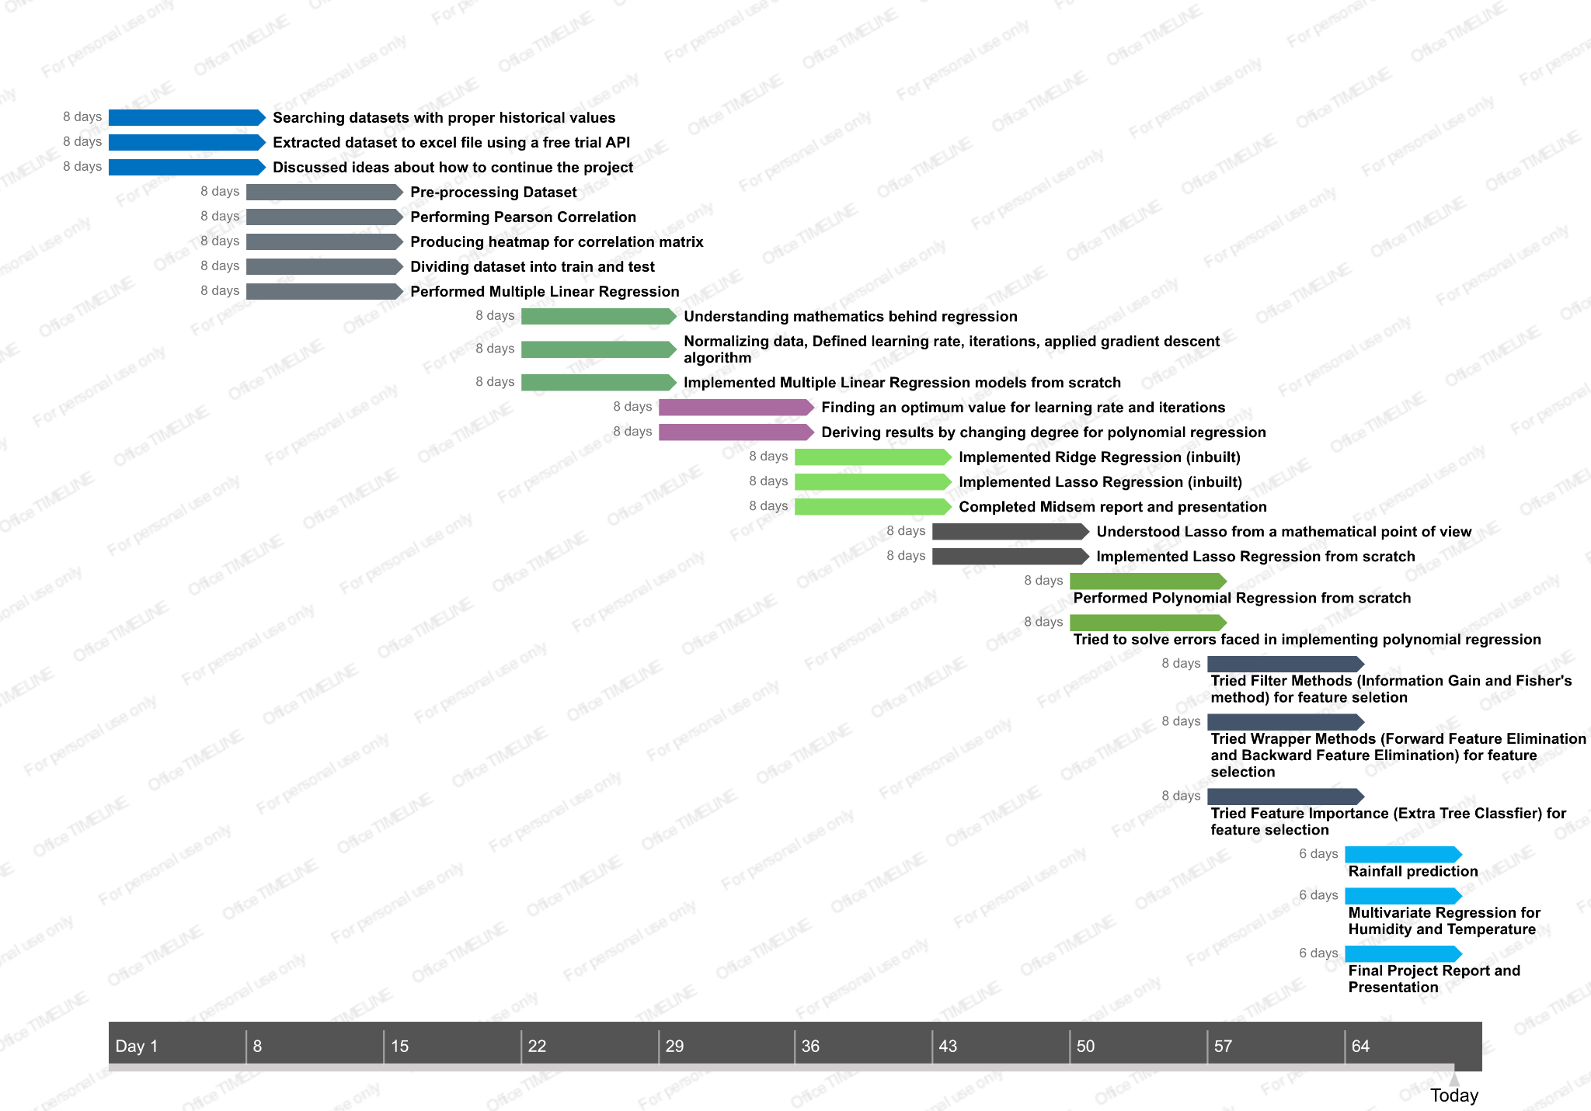

Slide 5
Existing Body of work
A simple weather prediction was performed using Multiple Linear Regression.In that model, a time-series data of weather was first collected. Temperature and relative humidity were predicted after doing feature selection based on correlation results. [1]
A two-level feature selection technique is proposed to get the significant features. The first level targets ranking the subset of features dependent on high information gain entropy in decreasing order. The second level broadens additional features with a better discriminative ability over the initially ranked features [3].
An R simulation was carried out whose results showed that the Wrapper Methods, Sequential Forward Selection and Sequential Backward Elimination were better than the Filter Methods, Correlation based Feature Selection and Information Gain in selecting the correct features [4].

Slide 6
Existing Body of work
Wrapper method is more accurate but it is computationally expensive so we prefer to use it when features are less than twenty [5].
The algorithms for regression techniques which are Ridge regression, Lasso regression are already available.
Three Machine Learning models - Multiple Linear Regression (MLR),Support Vector Machine (SVM) and Artificial Neural Network (ANN) were compared for finding better Weather Prediction model. It was concluded that MLR was better for temperature prediction than others. [2]

Slide 7
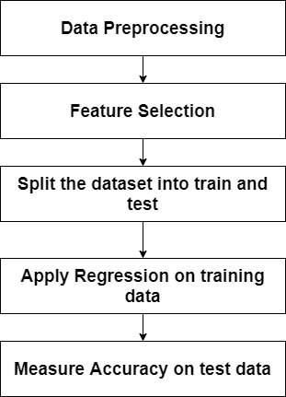
Approach
Training 80%
Testing 20%
Correlation
Extra Tree Classifier
Information Gain
Multiple Linear Regression
Backward Feature Elimination
Polynomial Regression
Ridge Regression
Lasso Regression

Slide 8
Approach
We started finding a dataset specifically for Ahmedabad city, with certain types of attributes from which we predicted the temperature.
As a data cleaning process, we removed a column which had all null values.
Next, we move to use different feature selection processes.
First of all, we performed pearson correlation and found the correlation coefficients matrix. We infer from it that some of the features are very highly correlated.
We decided a threshold and then reduced the number of attributes manually after seeing the correlation results. We removed some attributes based on our thinking which we thought were irrelevant and redundant to the data.

Slide 9
Approach
Next, we performed another feature selection technique called Extra tree classifier. We used the inbuilt library to perform this. We removed the features which were less important than the others.
After that, we tried Information gain technique for feature selection. It is a type of Filter method in which Reduction in Entropy is calculated after transformation of a dataset, which is further used to evaluate information gain of each feature against the target which is used for selecting feature.

Slide 10
Approach
Another feature selection technique which we have used is Backward feature elimination. It is a type of Wrapper method in which we feed all the features to the model. We check the performance of the model and then iteratively remove the worst performing feature one by one until we reach a stage where removing a feature results in no improvement in performance of the model. The performance metric used here to evaluate feature performance is pvalue. If the pvalue is above some threshold value, then we remove that feature, else we keep it.

Slide 11
Approach
Next, we used the regression techniques for temperature prediction to evaluate our model.
We split our dataset into training and testing data. Then we used the inbuilt Linear Regression, Polynomial Regression, Lasso regression and Ridge Regression methods from sklearn library on training dataset. We trained the model. We predict the values of temperature for test data set and find the accuracy on test dataset.
We also made our custom functions for Multiple Linear Regression and Ridge Regression by minimising the cost function using gradient descent algorithm.
Next, we did the same for rainfall prediction too.
Also, we did the multivariate regression to predict temperature along with humidity.

Slide 12
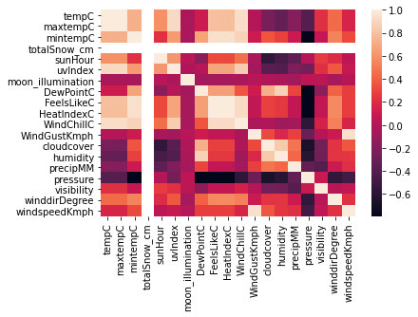
Initial Results
A heatmap which gives a clear view of the correlation between features.

Slide 13
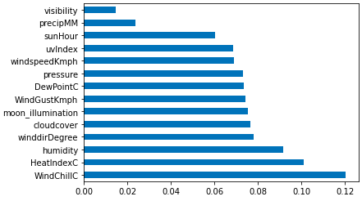
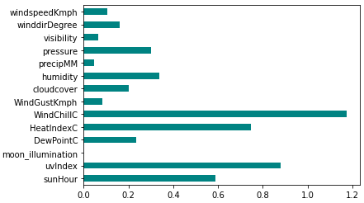
Initial Results
Features selection using Extra tree classification.
A bar chart which shows the information gain of every features using Information gain technique.

Slide 14
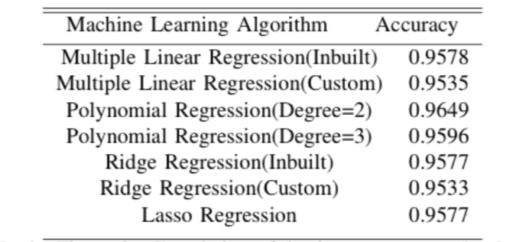
Initial Results
For different Regression techniques, we trained 80% of data and tested it on rest 20% of data.

Slide 15
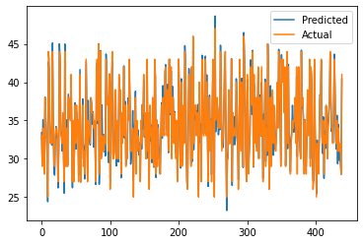
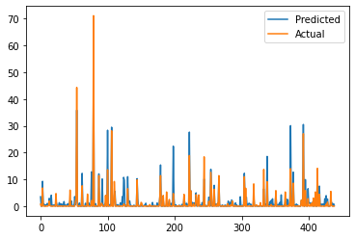
Initial Results
Polynomial_temperature_prediction Rainfall_prediction

Slide 16
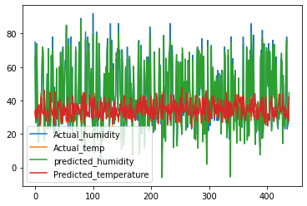
Initial Results
Multivariate Regression (Temperature and Humidity)

Slide 17
Conclusion
We found that among all the feature selection algorithms, the best accuracy was acquired by the Backward Feature Elimination.
We performed four regression techniques for temperature prediction and rainfall prediction.
We found that among all the regression algorithms, the best accuracy was acquired by the inbuilt polynomial regression with degree of 2. We found that degree 2 and degree 3 doesn't affect the accuracy much, but degree 2 is best.
Next, we found that the accuracy of Multiple Linear Regression, Lasso Regression and Ridge Regression were almost similar.
The accuracy result of custom made regression is also somewhat similar to inbuilt library functions.

Slide 18
Role of each group member
 | Jainesh Patel | Umang Kamdar | Vatsal Patel | Shubh Shah
Dataset collection | ✓ | ✓ | ✓ | ✓
Data Preprocessing | ✓ | ✓ | ✓ | ✓
Feature selection | ✓ | ✓ | ✓ | ✓
Multiple Linear Regression | ✓ |  | ✓
Polynomial Regression |  | ✓ |  | ✓
Ridge Regression | ✓ |  |  | ✓
Lasso Regression |  | ✓ | ✓
Multivariate Regression | ✓ | ✓ | ✓ | ✓
Rainfall Prediction | ✓ | ✓ | ✓ | ✓
Report | ✓ | ✓ | ✓ | ✓

Slide 19
References
[DATASET] Ahmedabad Historical Weather. Worldweatheronline.Com, 2021, https://www.worldweatheronline.com/ahmedabad-weather-history/gujarat/in.aspx.
[1] Paras, Sanjay Mathur. "A simple weather forecasting model using mathematical regression." Indian Research Journal of Extension Education 12, no. 2 (2016): 161-168.
[2] T. Anjali, K. Chandini, K. Anoop and V. L. Lajish, "Temperature Prediction using Machine Learning Approaches," 2019 2nd International Conference on Intelligent Computing, Instrumentation and Control Technologies (ICICICT), Kannur, India, 2019, pp. 1264-1268, doi: 10.1109/ICICICT46008.2019.8993316.
[3] Alhaj TA, Siraj MM, Zainal A, Elshoush HT, Elhaj F(2016) Feature Selection Using Information Gain for ImprovedStructural-Based Alert Correlation. PLoS ONE 11(11): e0166017.https://doi.org/10.1371/journal.pone.0166017
[4] Ibrahim, NuhuHamid, H.A.Rahman, ShuzlinaFong, Simon.(2018). Feature selection methods: Case of filter and wrapper ap-proaches for maximising classification accuracy. Pertanika Journal ofScience and Technology. 26. 329-340.
[5] A.Shetye,Medium. Available: https://towardsdatascience.com/feature-selection-with-pandas-e3690ad8504b.

