Slide 1

Temperature Prediction for Ahmedabad
Post Mid Sem Presentation
TEAM AMIGOS
Jainesh Patel - AU1841101
Umang Kamdar - AU1841069
Vatsal Patel - AU1841103
Shubh Shah - AU1841122

Slide 2
Introduction
In real life we need to deal with many uncertain weather problems. We use the temperature prediction in agriculture sector, airport environment prediction and some other important events.
In order to forecast the chaotic nature of atmosphere we need to use some statistical approach. Only mathematical approach will not give us the insights of the temperature prediction. We need past data of the temperature and other features like Humidity, Wind index and others.
We need to use algorithms which will include the past data and statistical calculations for predicting the temperature.
We took a data-set of Ahmedabad city using API key. We collected the historical weather data of each day from 2015 to 2020.

Slide 3
Problem Statement
Weather warnings are important to manage the resources accordingly.
Temperature prediction and forecasting are becoming important day by day, as it's applications makes human life more comfortable.
Industrial sector can also be a victim of climate change. Some Industries have temperature as a critical parameter to successfully complete the process.
Changes in weather conditions can highly disrupt food availability, reduce access to food, and affect food quality.
Thus in dealing with uncertain events like: Heatwaves, Droughts, Blizzards, Hurricanes, etc, We need a good Prediction model.

Slide 4
Existing Body of work
The algorithms for regression techniques which are Ridge regression, Lasso regression are already available.
A simple weather prediction was performed using Multiple Linear Regression. In that model, a time-series data of weather was first collected. Temperature and relative humidity were predicted after doing feature selection based on correlation results. [1]
Three Machine Learning models - Multiple Linear Regression (MLR), Support Vector Machine (SVM) and Artificial Neural Network (ANN) were compared for finding better Weather Prediction model. It was concluded that MLR was better for temperature prediction than others. [2]

Slide 5
Approach
We started finding a dataset specifically for Ahmedabad city, with certain types of attributes from which we predicted the temperature.
As a data cleaning process, we removed a column which had all null values.
We performed pearson correlation and found the correlation coefficients matrix. We infer from it that some of the features are very highly correlated.
We decided a threshold and then reduced the number of attributes manually after seeing the correlation results. We removed some attributes based on our thinking which we thought were irrelevant and redundant to the data.

Slide 6
Approach
We performed the Multiple Linear Regression on our dataset.
We split our dataset into training and testing data. Then we used the inbuilt Linear Regression method from sklearn library on training dataset we trained the model. We predict the values of temperature for test data set and find the accuracy on test dataset.
We made custom Multiple regression model by minimising the cost function using gradient descent algorithm.
We tried different regression techniques which are Polynomial regression, Ridge regression and Lasso regression.
We also made custom Ridge regression model which include regularisation term. We build the model by minimising the cost function for ridge regression using gradient descent algorithm.

Slide 7
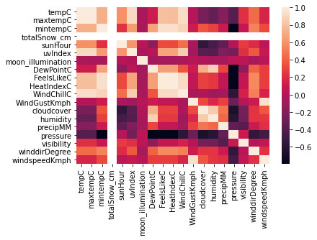
Initial Results
A heatmap which gives a clear view of the correlation between features.

Slide 8
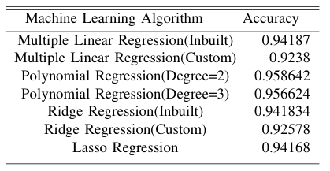
Initial Results
For different Regression techniques, we trained 80% of data and tested it on rest 20% of data.

Slide 9
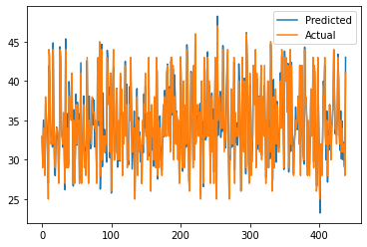
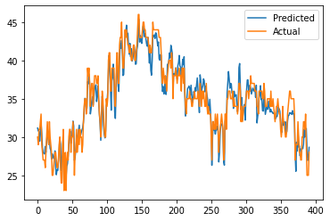
Initial Results
Multiple Linear Regression (Inbuilt) Ridge Regression(Custom)

Slide 10
Role of each group member
 | Jainesh Patel | Umang Kamdar | Vatsal Patel | Shubh Shah
Dataset collection | ✓ | ✓ | ✓ | ✓
Data Preprocessing | ✓ | ✓ | ✓ | ✓
Feature selection | ✓ | ✓ | ✓ | ✓
Multiple Linear Regression | ✓ |  | ✓
Polynomial Regression |  | ✓ |  | ✓
Ridge Regression | ✓ |  |  | ✓
Lasso Regression |  | ✓ | ✓
Report | ✓ | ✓ | ✓ | ✓

Slide 11
Future work
We will learn the mathematics behind Polynomial Regression and Lasso Regression and will try to implement the same algorithms.
We will find the better parameters for custom built Ridge Regression to get better result.
We will also look how we can predict the temperature value for next few days based on the dataset available.
We will also try to get more accurate model than the current model.

Slide 12
References
[DATASET] Ahmedabad Historical Weather. Worldweatheronline.Com, 2021, https://www.worldweatheronline.com/ahmedabad-weather-history/gujarat/in.aspx.
[1] Paras, Sanjay Mathur. "A simple weather forecasting model using mathematical regression." Indian Research Journal of Extension Education 12, no. 2 (2016): 161-168.
[2] T. Anjali, K. Chandini, K. Anoop and V. L. Lajish, "Temperature Prediction using Machine Learning Approaches," 2019 2nd International Conference on Intelligent Computing, Instrumentation and Control Technologies (ICICICT), Kannur, India, 2019, pp. 1264-1268, doi: 10.1109/ICICICT46008.2019.8993316.

