Slide 1
Airline On-Time Streaming Data Analysis
Arwa EL-Hawwat Rahul Dev Ellezhuthil Jaini Patel
Supervised by Professor James Abello Mondero, Harshini Bonam, & Haoyang Zhang for CS543 Group 6, Fall 2021

Slide 2
ABSTRACT
Airline consumers today are overwhelmed by the sheer number of carriers and flight patterns offered to them when choosing flights.
While they can easily compare costs and layovers at booking time, it can be much more difficult to predict delays on the day of departure.
Utilizing past airline data, we can extract a model to formulate possible delays and when they are most likely to occur. In addition, we are able to determine the likelihood of certain carriers or trip patterns to experience difficulties.

Slide 3
OVERVIEW OF PROJECT
Database querying in a streaming fashion.
Data is sourced from the 2009 Data Expo - Airline On-Time Performance [1]
Harvard Dataverse modified version [2]
Publicly available data on domestic United States flights provided by the American Statistical Association (AMSTAT)
Uses Pyspark as the querying background for data.
Uses Flask web application hosted on a Rutgers iLab machine for user interface and data visualization.

Slide 4
PROJECT OBJECTIVES
To query the data in a streaming fashion to be able to answer the following questions:
Which airline is the most reliable in terms of flight punctuality?
What were the worst months to fly historically?
What are the busiest airports in the United States?
What are the busiest flight paths in the United States?

Slide 5
OVERVIEW OF DATASET
Approximately 120 million records from October 1987 - April 2008. Data at rest.
30 columns:
Year, Month, Day
Airline Carrier Information
Airport Information
Timings and Delay information
4 additional files with detailed information about airplanes, carrier, airports and metadata for the dataset.

Slide 6
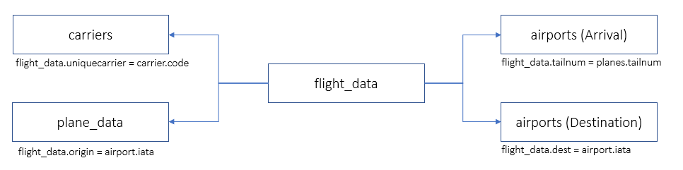
OVERVIEW OF DATASET

Slide 7
IMPLEMENTATION
Processing Raw Data
To simulate streaming processing, we decided to divide the original data by year using PySpark
Stored in a local Hive file system in Rutgers iLab machine
Streaming and processing operations were written as functions and queries in Python
Visualization
Web application using Python Flask framework
Connected to Apache Spark backend via Flask where data is queried then passed as JSON
Graph visualizations then computed through Python libraries like amCharts and Matplotlib

Slide 8
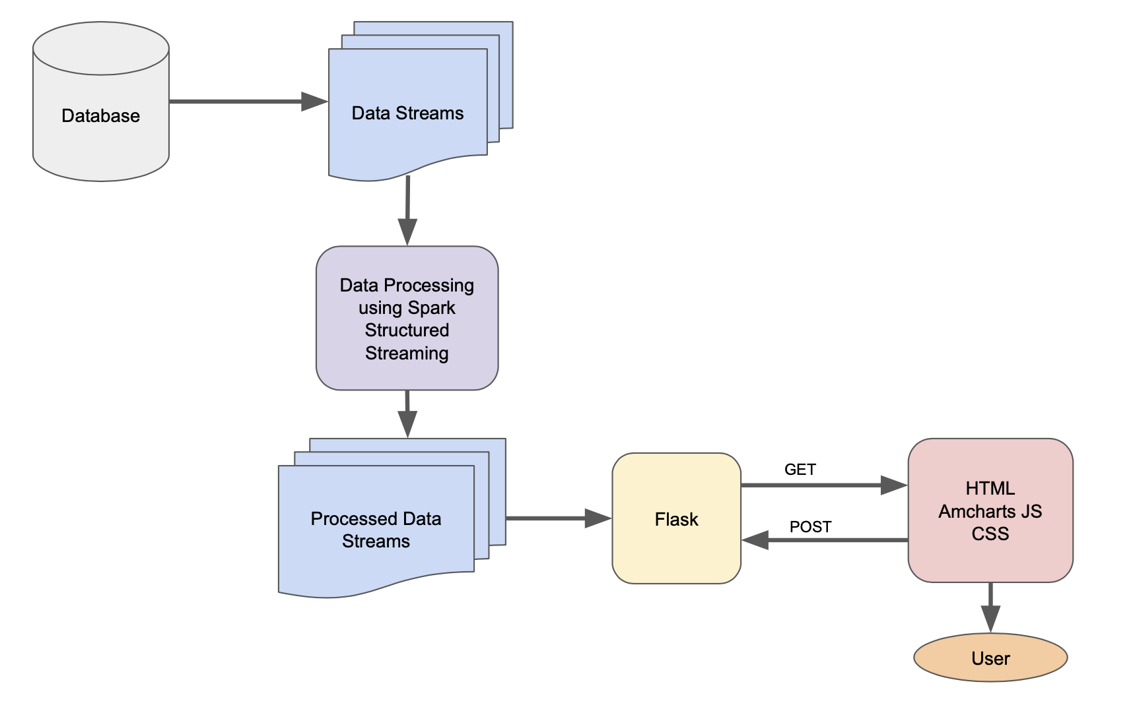
Data Flow Diagram

Slide 9
TOOLS
INTERACTIVITY
USERS
Spark Structured Streaming
Flask Web Application
Web Application
Drop Down Menu
Start Button
Interactive Plots:
Label selection
Tooltip
Airline staff, route planners, and pilots
US domestic travellers

Slide 10
PROJECT HIGHLIGHTS
The total number of flight records increased steadily from 1987 to 2008, which is understandable as travel increased as it became cheaper and more accessible.
In studying the percentage punctuality of different airline carriers, we noticed various fluctuations throughout the years for a majority of them ranging from around 10-20%.
Certain months, like during the holiday season or after global events, experienced an influx of delays and cancellations in reaction. These are most notably observed in the last quarter of the year.

Slide 11
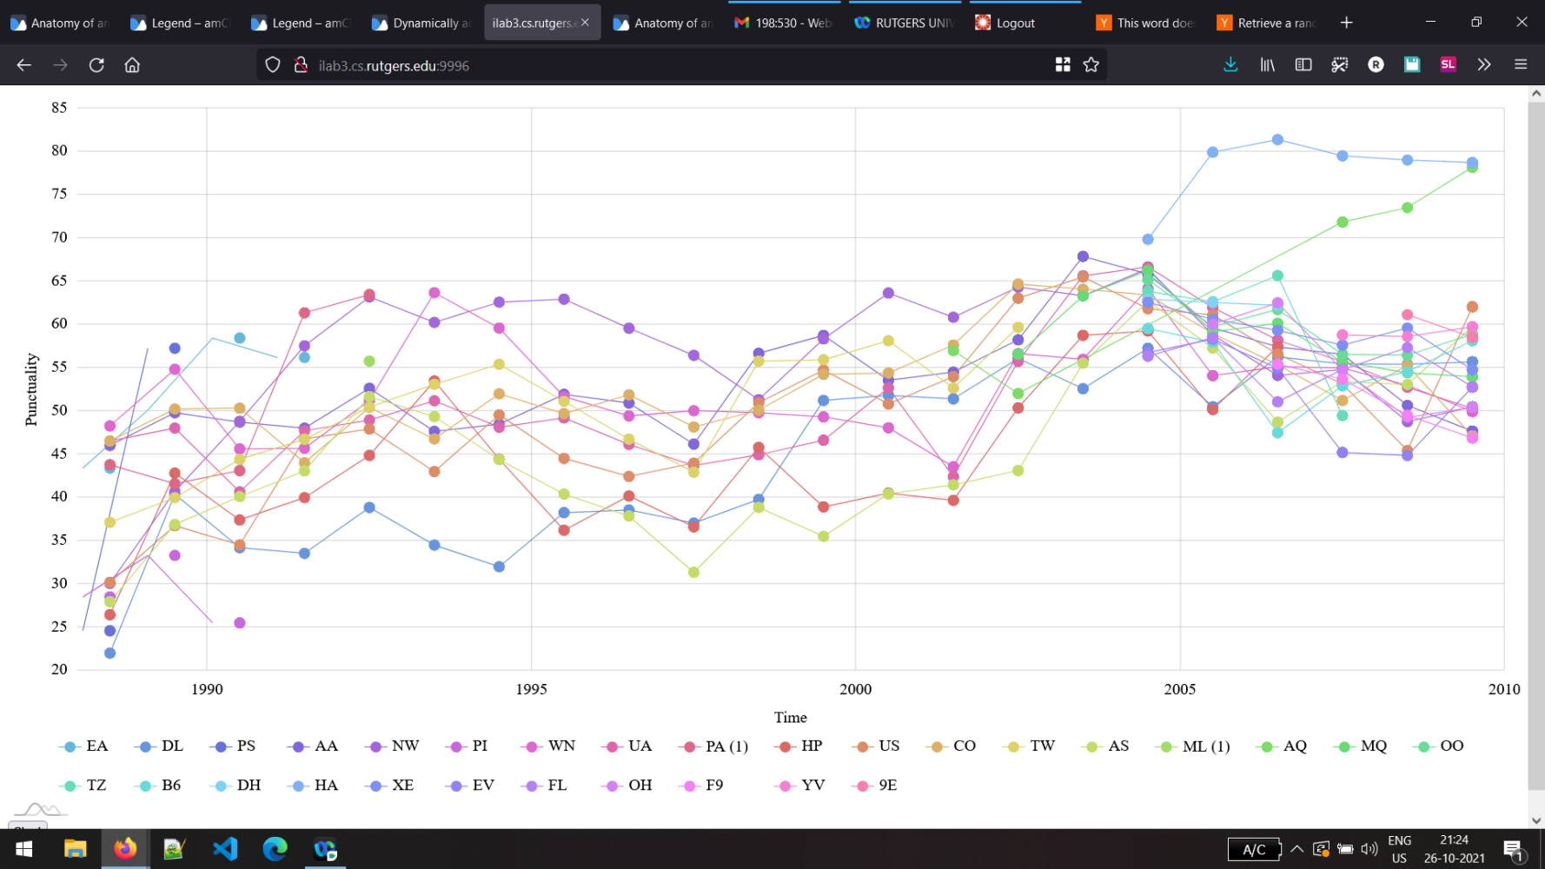
INSIGHTS
*Visualization of different US airline carriers and their calculated punctuality as a percentage from 1987 - 2008 using amChart

Slide 12
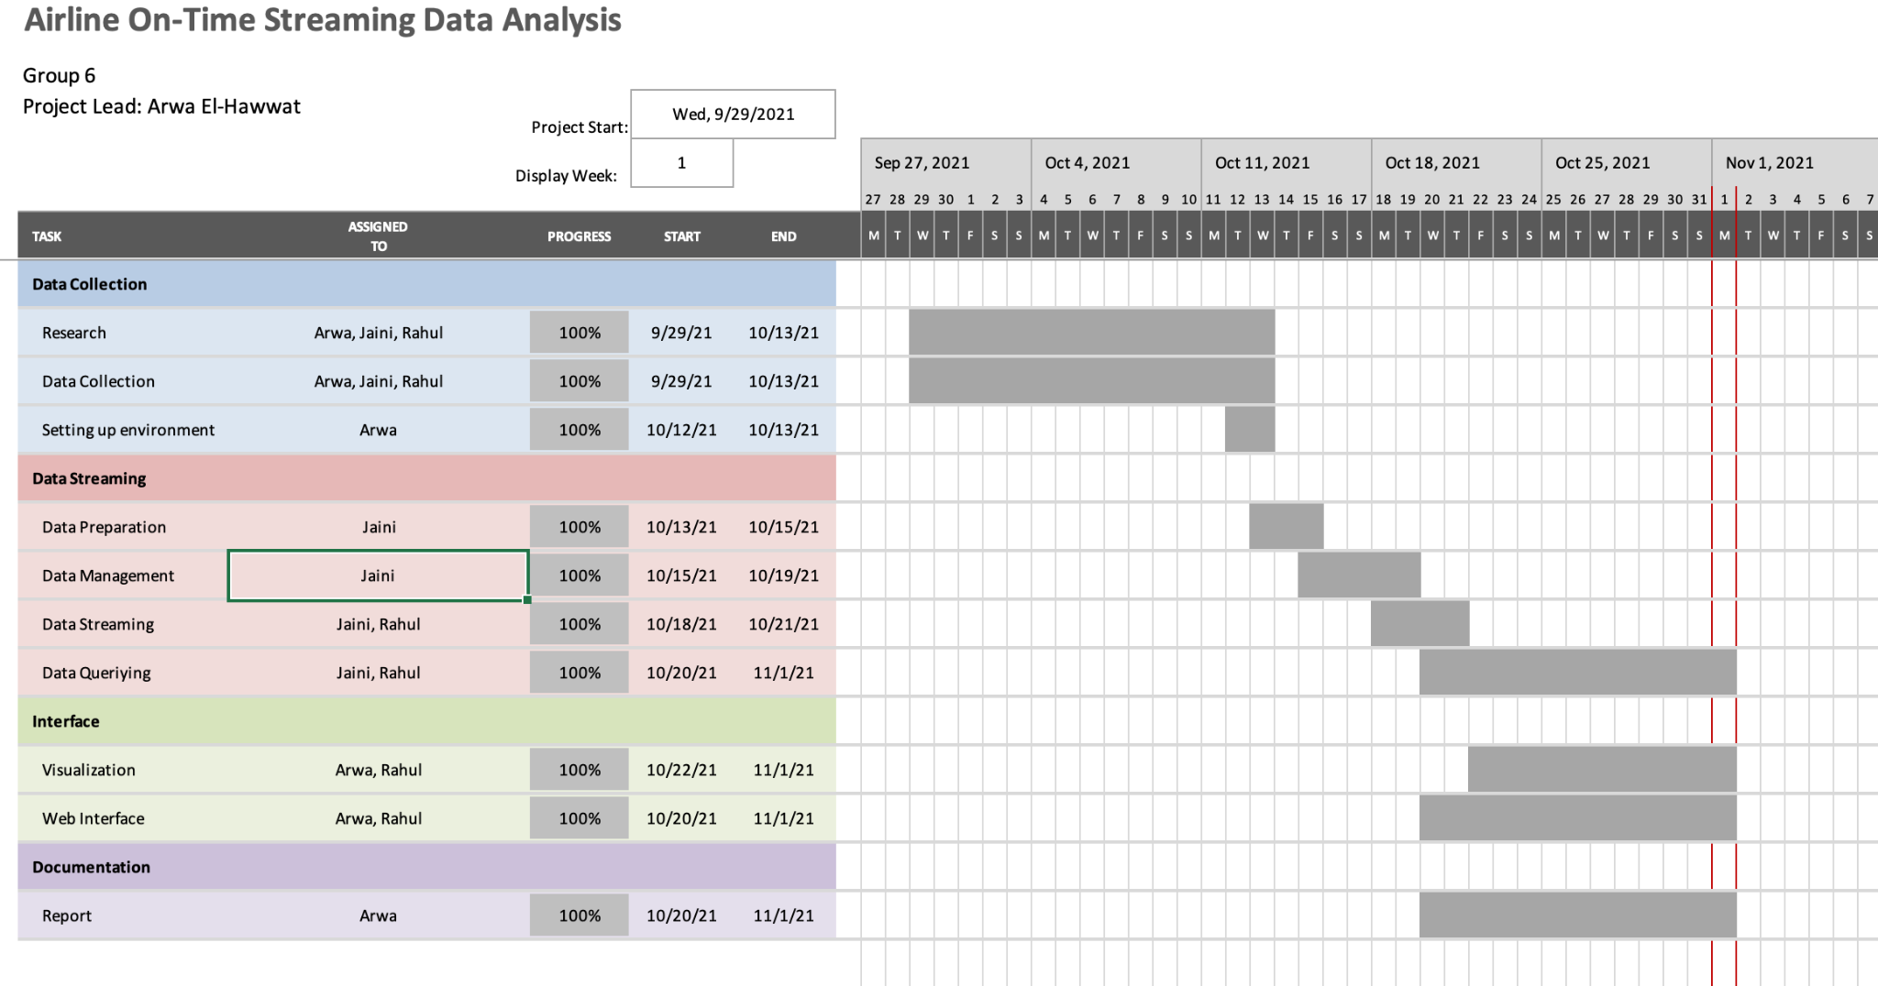
PROJECT TIMELINE

Slide 13
REFERENCES
[1] 2008, Data Expo 2009 - Airline on-Time Performance, American Statistical Association, https://community.amstat.org/jointscsg-section/dataexpo/dataexpo2009
[2] 2008, Data Expo 2009: Airline on time data, Harvard Dataverse, V1, https://dataverse.harvard.edu/dataset.xhtml?persistentId=doi:10.7910/DVN/HG7NV7
[3] Python Flask, https://flask.palletsprojects.com/en/2.0.x/
[4] amCharts JS library, https://www.amcharts.com/

Slide 14
THANK YOU!!

