Slide 1
Understanding Traffic Accidents in the US
CS526 Project - Group 3
○ Jaini Patel (jp1891)
○ Moriah Walker (maw305)
○ Arun Subbaiah (as3590)

Slide 2
About the Project

Slide 3
Objective
Road accidents - #1 leading cause of death in people of age from 20 to 45
Aim - To make use of visual analytics concepts learned in this class to create a tool that gives more understanding to all the stakeholders & help make policies that reduce the road accidents in the US

Slide 4
Questions we are trying to answer
Spatial-temporal distribution of accidents across the United States.
Accident-prone regions/counties/areas.
Unfavorable weather conditions for driving. i.e., weather conditions at which the maximum accidents happen.
Duration of the day when the accidents happen the most.
Age and gender distribution in the fatal accidents.
Common impact directions.
Correlation (if any) between fatal accidents and the age of the car.
Fatal accidents due to alcohol/alcohol usage.

Slide 5
Data

Slide 6
Source
Fatality Analysis Reporting System (FARS) & Crash Report Sampling System (CRSS) from National Highway Transport Safety Authority (NHTSA) Fatal accidents happened in the time range 2000 to 2019. Includes a set of 3 data
○ Accidents ○ Vehicles ○ Person

Slide 7
Dataset Stats
Fatality Analysis Reporting System
Stats | Accident | Vehicle | Person
Rows | 600K | 1M+ | 1.7M+
Attributes | 156 | 204 | 255
Size | 800MB | 1.4GB | 1.2GB

Slide 8
Data Summary
Number of Fatal Accidents between 2000 & 2019 | 691,597
Number of Fatalities | 760,153
Average Age | 41
Number of Fatal Accidents where Alcohol is involved | 165,717 (24%)

Slide 9
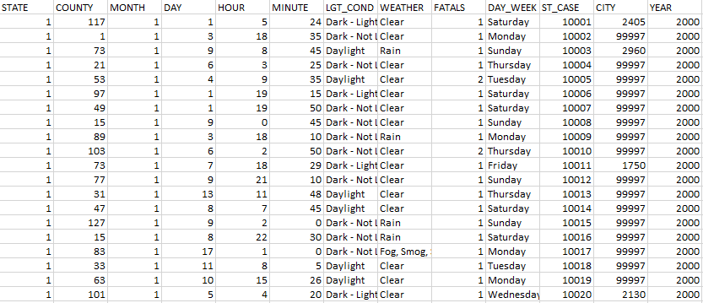
Data Snapshot

Slide 10
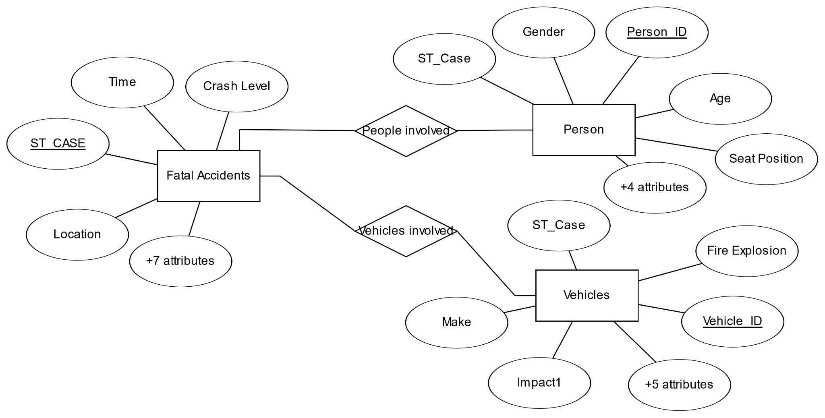
Entity Relationship Diagram

Slide 11
Data Preparation
Python Pandas Library to integrate the different datasets using their keys - ST_CASE, VEH_NO, PER_NO
Identified the required and more useful attributes and discarded the remaining attributes
PostgreSQL for Database - mainly because it can handle relatively large datasets and also has good relative speed.
Imported datasets into PostgreSQL and set up connections

Slide 12
Few Data Insights

Slide 13
38000
Avg. Deaths Per Year
2 - 3 AM
Sat & Sun Morning
Surge
During Summer
Fog & Crosswinds
More dangerous conditions
4
times more likely to die in road accidents if alcohol is involved
Data Insights

Slide 14
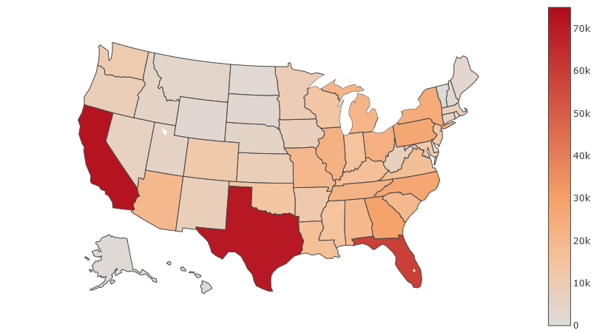
Total Accident Related Deaths over the last 20 years across US

Slide 15
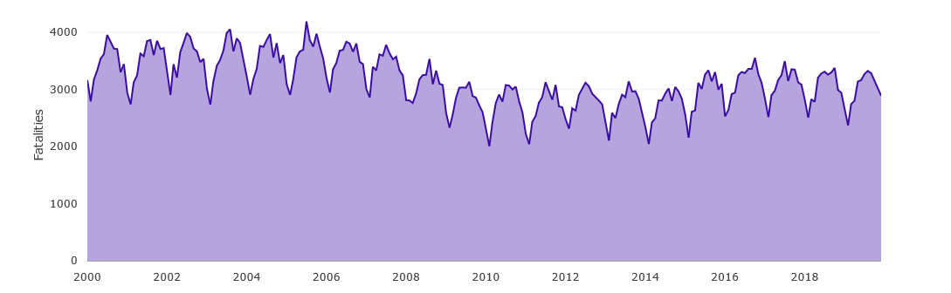
Distribution of Fatalities over time

Slide 16
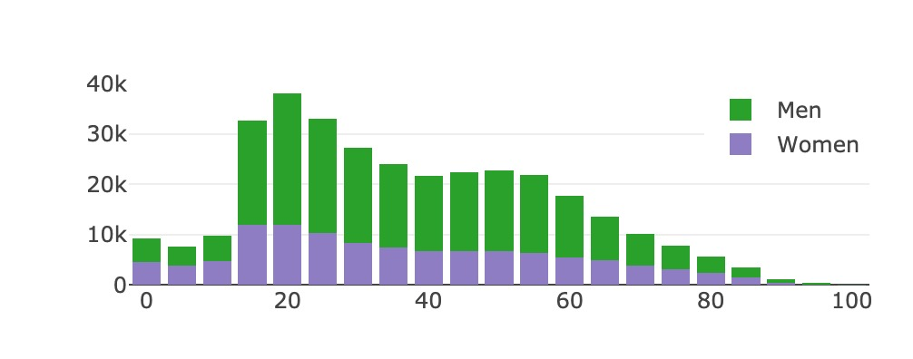
Age vs Gender

Slide 17
Development

Slide 18
Technologies
Backend - Django (Python)
Frontend - HTML, CSS + Bootstrap, JavaScript
Database - PostgreSQL
Plots - Plotly.js, AmCharts.js, Three.js
Data Reduction - OLAP

Slide 19
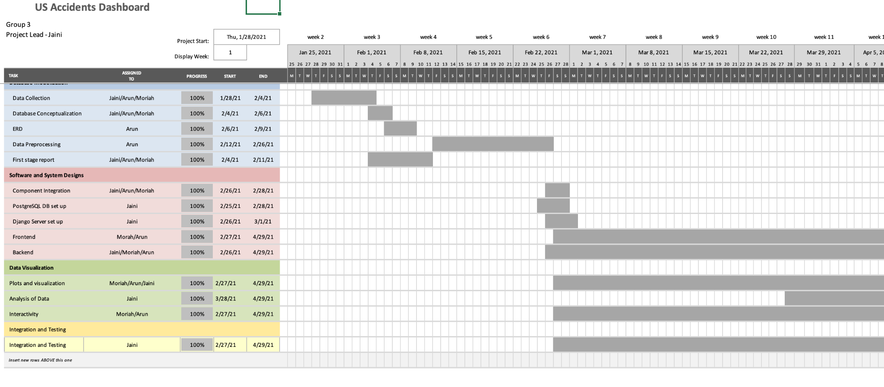
Gantt Chart

Slide 20
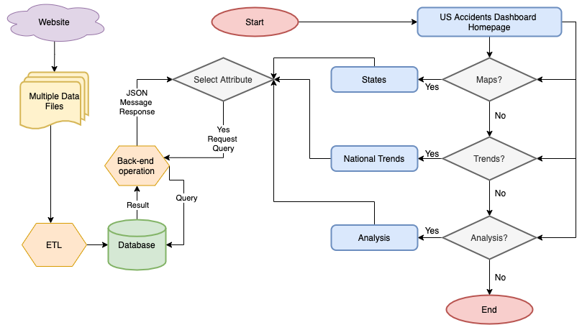
Conceptual Flow Chart

Slide 21
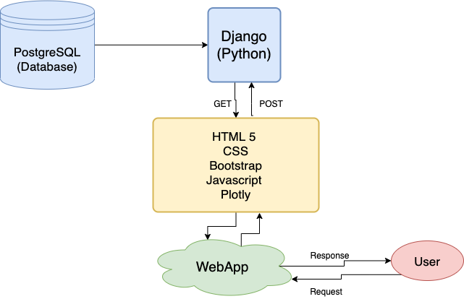
Interface/Component Integration

Slide 22
Interactivity
Expected Users
Mouse Hovering over charts
Selecting and clicking points on charts
Tooltip
Zooming and panning
Summary Tabs
Linking of different views (Brushing)
Range sliders
Checkboxes
Legends
Department of Transportation
Traffic Control Room
Stakeholders in National/State Transport System
Car Manufacturers

Slide 23
Outcome

Slide 24
Analytics & Evaluation
Some of the Interesting insights we found from our analysis: (interesting findings)
age group who need to be more cautious while driving,
unfavorable weather conditions for driving,
direction they are more likely to face the impact from,
at what age a car becomes more prone to accidents.

Slide 25
Dashboard Demo

Slide 26
Further work

Slide 27
Further Work
Include National Highway data to understand which highways are safer and which are not
Include junction / intersection data to identify junctions where most accidents happen
Integrate data from crash testing to help users choose the ‘safest’ cars
Include prediction models

Slide 28
References
[1] Fatality Analysis Reporting System (FARS) data published by National Highway Transport Safety Authority (NHTSA)
[2] Plotly.js Documentation - https://plotly.com/javascript/
[3] Amcharts.js Documentation - https://www.amcharts.com/docs/v4/
[4] Three.js Documentation - https://threejs.org/docs/index.html

Slide 29
Thank you.

