Slide 1
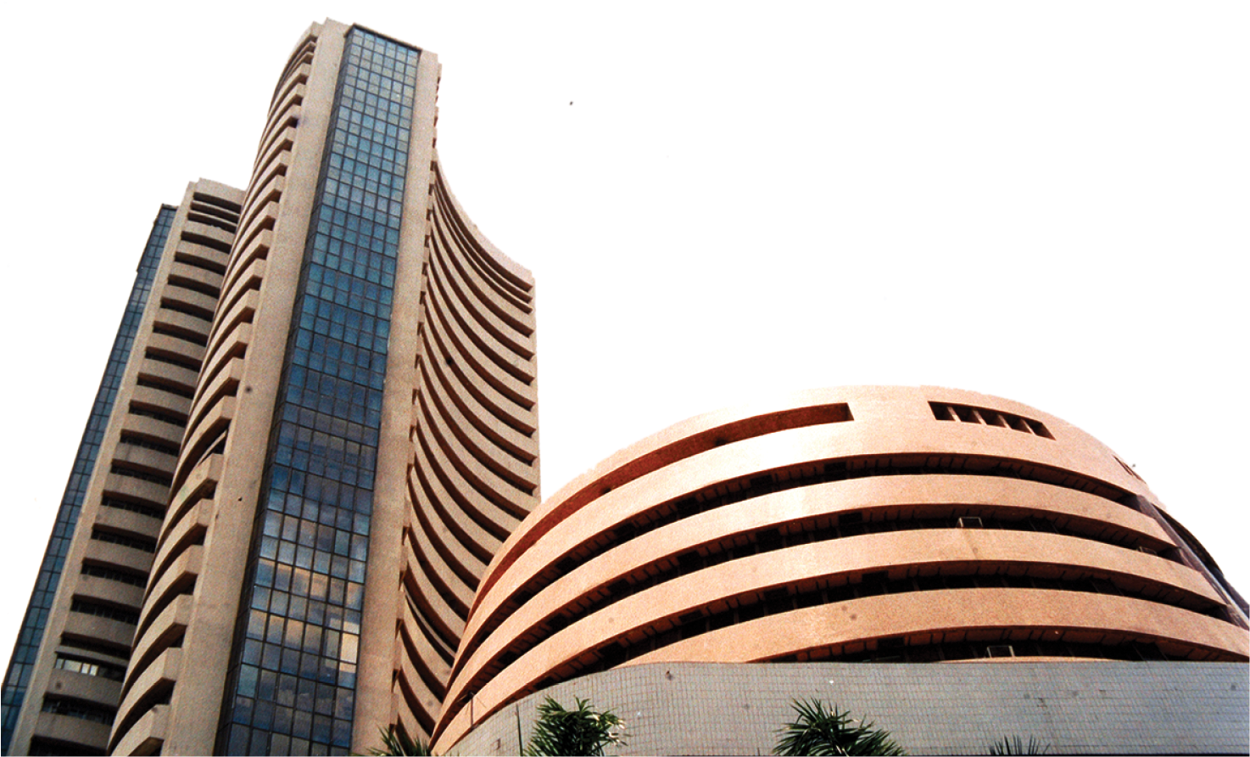
Stock Prediction using Sentiment & Historical Data
20MCED05
20MCED08

Slide 2
1. Introduction
20MCED05
20MCED08

Slide 3
Introduction
A stock market is a public market for the trading of company stock.
Stock market allows us to buy and sell units of stocks (ownership) of a company.
If the company’s profits go up then we own some of the profits and if they go down, then we lose profits with them.
If more sellers than buyers, stock prices tend to fall. Conversely, when more buyers than sellers, stock prices tend to rise.
Fountain Codes
20MCED05
20MCED08
20MCED08

Slide 4
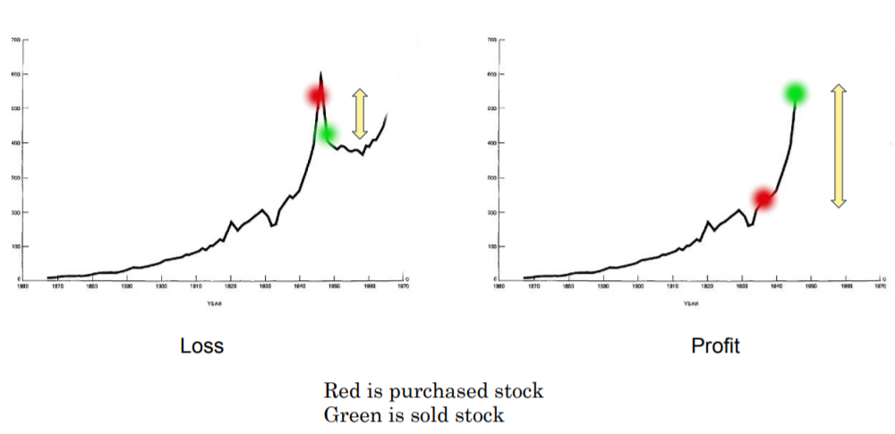
Introduction
Fountain Codes
20MCED05
20MCED08
20MCED08

Slide 5
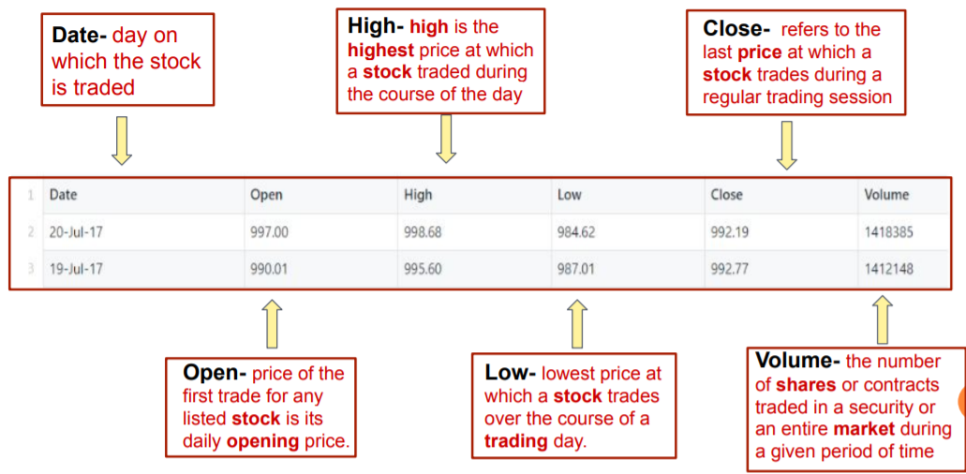
Introduction
Fountain Codes
20MCED05
20MCED08
20MCED08

Slide 6
2. Problem Definition
20MCED05
20MCED08

Slide 7
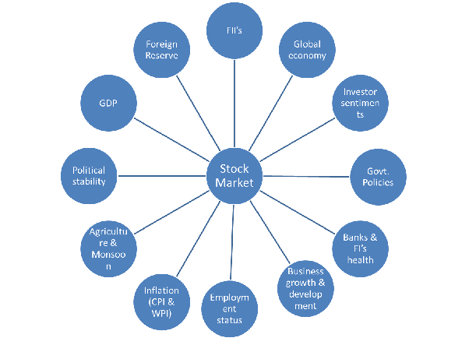
Factors Affecting Stock Price
Predicting how the stock market will perform is one of the most difficult things to do.
Finding the best time to buy or sell has remained a tough nut for investors because there are numerous factors that may influence stock price such as news, social media data, fundamentals and production of the company, government bonds, historical price and country’s economics.
All these aspects combine to make share prices volatile and very difficult to predict with a high degree of accuracy.
Fountain Codes
20MCED05
20MCED08
20MCED08

Slide 8
2. NEED AND SCOPE OF WORK
20MCED05
20MCED08

Slide 9
NEED AND SCOPE OF WORK
Broadly, stock market analysis is divided into two parts – Fundamental Analysis and Technical Analysis.
Fundamental Analysis involves analyzing the company’s future profitability on the basis of its current business environment and financial performance.
Technical Analysis, on the other hand, includes reading the charts and using statistical figures to identify the trends in the stock market.
Fountain Codes
20MCED05
20MCED08
20MCED08

Slide 10
NEED AND SCOPE OF WORK
As you might have guessed, our focus will be on the technical analysis part.
The study is primarily based on two components:
1. Sentiment analysis and
2. Historical data analysis.
Fountain Codes
20MCED05
20MCED08
20MCED08

Slide 11
2.1 Historical Data Analysis Component
20MCED05
20MCED08

Slide 12
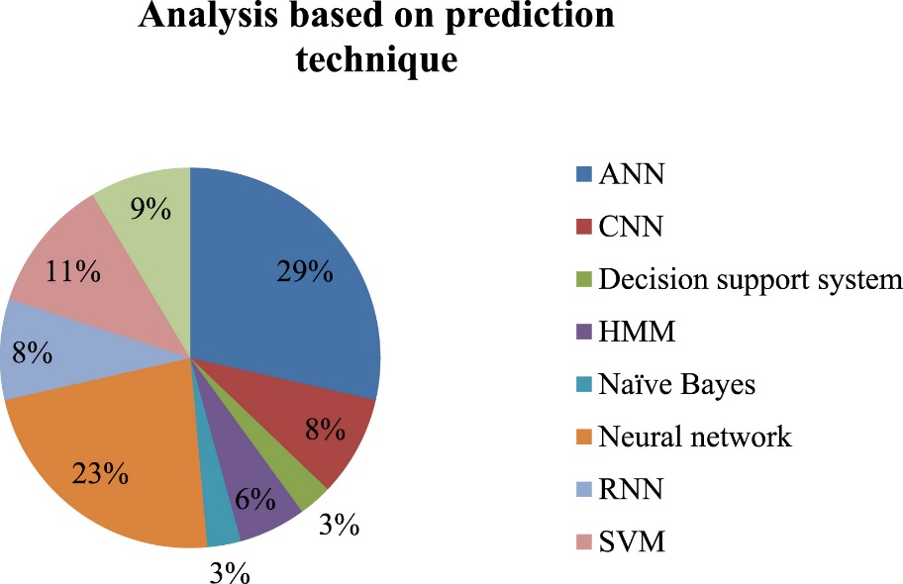
Historical Data Analysis Component
Several attempts have been made in the past to enhance accuracy in the prediction of stock prices as well as overall performance of stock exchanges.
Most of this prediction models aimed to predict future performance of stocks, on from the analysis of historic data.
None of these models succeeded in their prediction accuracy of at least 70–75%.
Fountain Codes
20MCED05
20MCED08
20MCED08

Slide 13
2.2 Sentiment Analysis Component
20MCED05
20MCED08

Slide 14
Sentiment Analysis Component
People use social networking sites, like Facebook, Twitter, etc. to express their comments and opinions about a particular topic such as news, movie, event and remarks related to product.
Sentiment classification could be done in word/phrase level, sentence level and document level.
Sentiment analysis is used to extract such opinion and remarks of users by classifying them as positive, negative and natural sentiment.
Here we shall be using this approach to predict whether the stock price will increase or decrease (1 or 0) based on the top news headlines collected form one such social media platform.
Fountain Codes
20MCED05
20MCED08
20MCED08

Slide 15
3.Understanding the Basic News-Market Relation
20MCED05
20MCED08

Slide 16
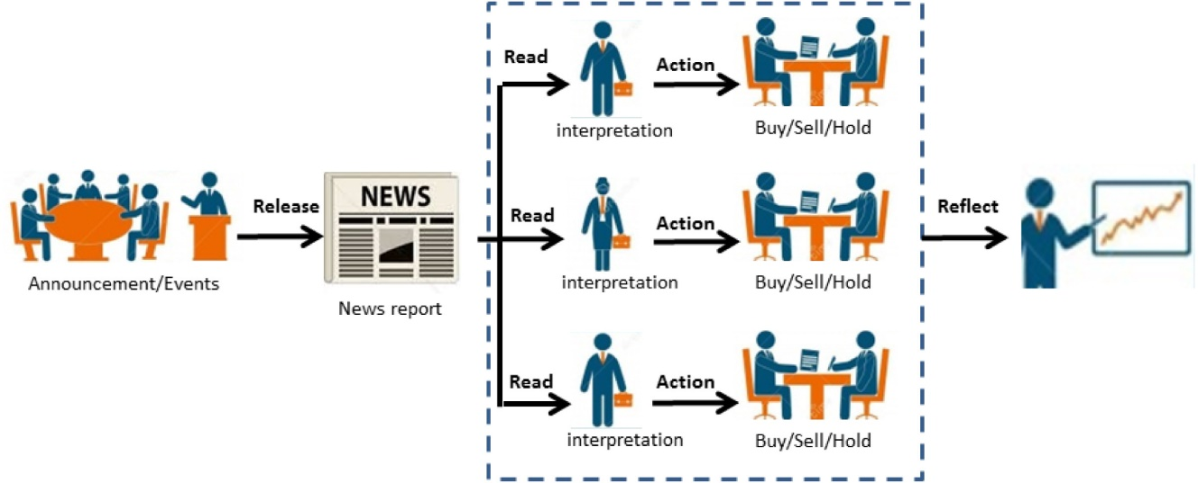
Understanding the Basic News-Market Relation
The figure here depicts how the stock market gets effected by daily news and how the prices of the stock are affected by constant buy and sell based on small events like appointment of new CEO, or Release of new product, etc.
Fountain Codes
20MCED05
20MCED08
20MCED08

Slide 17
4. THE GOAL OF THE STUDY
20MCED05
20MCED08

Slide 18
The Goal Of The Study
Our Goal here is to construct an effective and efficient model that can predict the future trends in the stock market as well as a stock sentiment based on top news headlines for a particular day.
We then compare the results of sentiment analysis as well as historical data analysis in order to see how closely they match, with the minimum error and maximum possible accuracy for the prediction.
Fountain Codes
20MCED05
20MCED08
20MCED08

Slide 19
5. DATASET DESCRIPTION
20MCED05
20MCED08

Slide 20
5.1. Historical Dataset
20MCED05
20MCED08

Slide 21
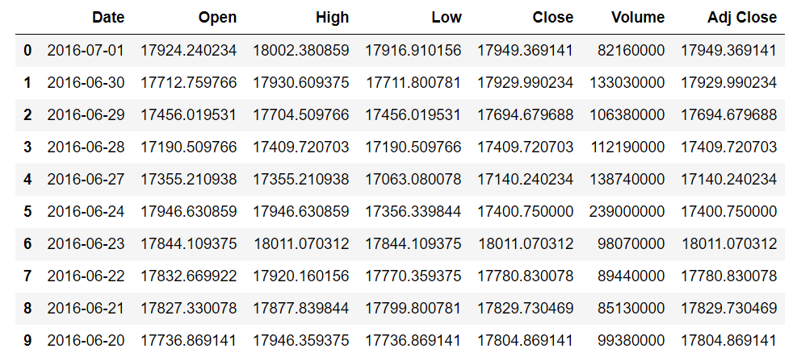
Historical Dataset
Fountain Codes
20MCED05
20MCED08
20MCED08

Slide 22
Historical Dataset
Dataset Name: DJIA Stock Data
Dataset Source: Yahoo Finance
Data Description: The dataset columns mean the following
Date – Date of the data generation
Open – The price of the stock when the market opened on that date
High – The highest price touched by the stock on that date
Low – The lowest price touched by the stock on that date
Close – The price of the stock when the market closed on that date
Volume - Number of shares of a stock traded between its daily open and close
Adj Close – Adjusted Close Value
Task Description: We are aiming to predict the close price of the given stock DJI, based on the other parameters like Open, High, Low and Volume
Fountain Codes
20MCED05
20MCED08
20MCED08

Slide 23
5.2. Sentiment Dataset
20MCED05
20MCED08

Slide 24
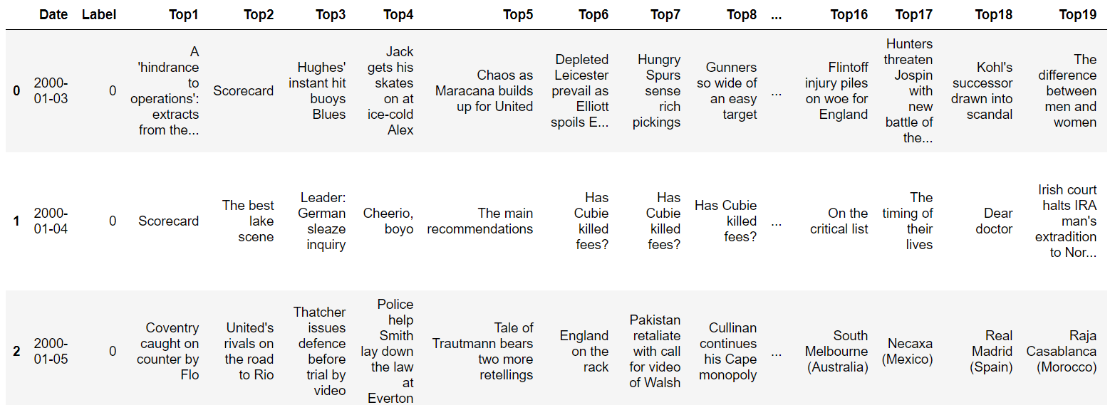
Sentiment Dataset
Fountain Codes
20MCED05
20MCED08
20MCED08

Slide 25
Sentiment Dataset
Dataset Name: DJIA News Dataset
Dataset Source: Reddit WorldNews Channel | Kaggle
Data Description: The dataset columns mean the following
Date – Date of the data generation
Label – Represents whether the Dow Jones Industrial Average (DJIA) rose or stayed as the same (1) or decreased (0) on that date
Rest of the columns are the top 25 news headlines as ranked on Reddit channel
Task Description: We are aiming to predict the Label value (0 or 1) from the sentiment of news headlines.
Fountain Codes
20MCED05
20MCED08
20MCED08

Slide 26
6. Models Used
20MCED05
20MCED08

Slide 27
6.1. Historical Data Analysis
20MCED05
20MCED08

Slide 28
Model-1: Linear Regression
Linear regression is a linear model, e.g. a model that assumes a linear relationship between the input variables (x) and the single output variable (y). More specifically, that y can be calculated from a linear combination of the input variables (x).
y = B0 + B1*x
When there is a single input variable (x), the method is referred to as simple linear regression. When there are multiple input variables, literature from statistics often refers to the method as multiple linear regression.
We are observing the r² value, and higher the value, better is the model fitted to the data.
Fountain Codes
20MCED05
20MCED08
20MCED08

Slide 29
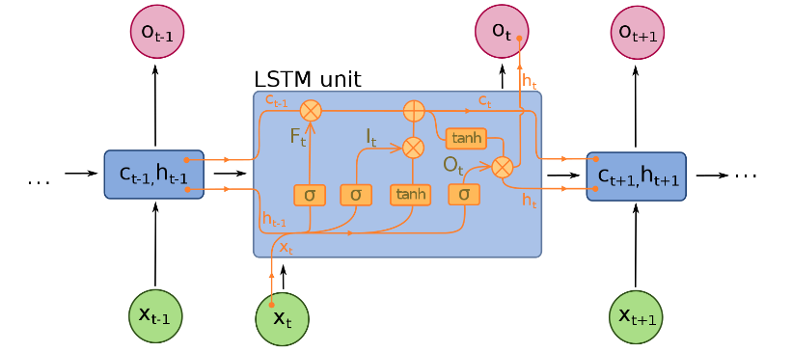
Model-2: LSTM (Experimental)
As we can see in figure, we are using LSTM for analyse Historical Data because LSTMs are widely used for sequence prediction problems and have proven to be extremely effective. The reason they work so well is because LSTM is able to store past information that is important, and forget the information that is not. LSTM has three gates:
The input gate: The input gate adds information to the cell state
The forget gate: It removes the information that is no longer required by the model
The output gate: Output Gate at LSTM selects the information to be shown as output
Fountain Codes
20MCED05
20MCED08
20MCED08

Slide 30
6.2. Sentiment Data Analysis
20MCED05
20MCED08

Slide 31
Model-1: Logistic Regression
The logistic function, also called the sigmoid function was developed by statisticians to describe properties of population growth in ecology, rising quickly and maxing out at the carrying capacity of the environment. It’s an S-shaped curve that can take any real-valued number and map it into a value between 0 and 1, but never exactly at those limits.
1 / (1 + e^{-value})
Where e is the base of the natural logarithms and value is the actual numerical value that you want to transform. Below is a plot of the numbers between -5 and 5 transformed into the range 0 and 1 using the logistic function.
Fountain Codes
20MCED05
20MCED08
20MCED08

Slide 32
Model-1: Logistic Regression
Logistic regression uses an equation as the representation, very much like linear regression.
Input values (x) are combined linearly using weights or coefficient values (referred to as the Greek capital letter Beta) to predict an output value (y). A key difference from linear regression is that the output value being modeled is a binary values (0 or 1) rather than a numeric value.
y = e^(b0 + b1*x) / (1 + e^(b0 + b1*x))
or
p(X) = e^(b0 + b1*X) / (1 + e^(b0 + b1*X))
Where y or p(x) is the predicted output, b0 is the bias or intercept term and b1 is the coefficient for the single input value (x). Each column in your input data has an associated b coefficient (a constant real value) that must be learned from your training data.
Logistic regression models the probability of the default class.
Fountain Codes
20MCED05
20MCED08
20MCED08

Slide 33
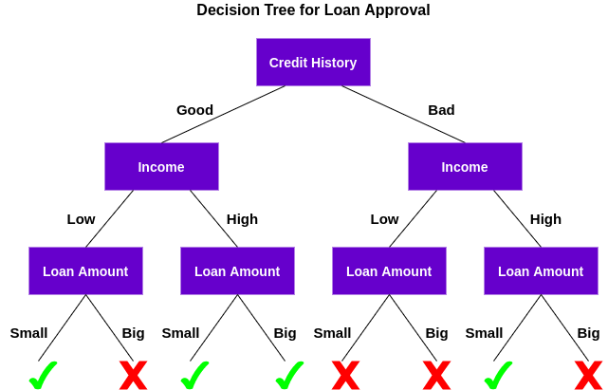
Model-2: Random Forest
Random Forest Model is an extension or advanced version of the Decision Tree Classifier.
A decision tree is a supervised machine learning algorithm that can be used for both classification and regression problems. A decision tree is simply a series of sequential decisions made to reach a specific result. Here’s an illustration of a decision tree in action:
Fountain Codes
20MCED05
20MCED08
20MCED08

Slide 34
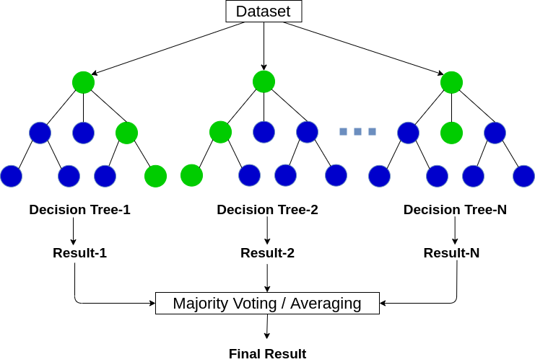
Model-2: Random Forest
The decision tree algorithm is quite easy to understand and interpret. But often, a single tree is not sufficient for producing effective results. This is where the Random Forest algorithm comes into the picture.
This process of combining the output of multiple individual models (also known as weak learners) is called Ensemble Learning. Random Forest is suitable for situations when we have a large dataset,
Fountain Codes
20MCED05
20MCED08
20MCED08

Slide 35
7. Result & Findings
20MCED05
20MCED08

Slide 36
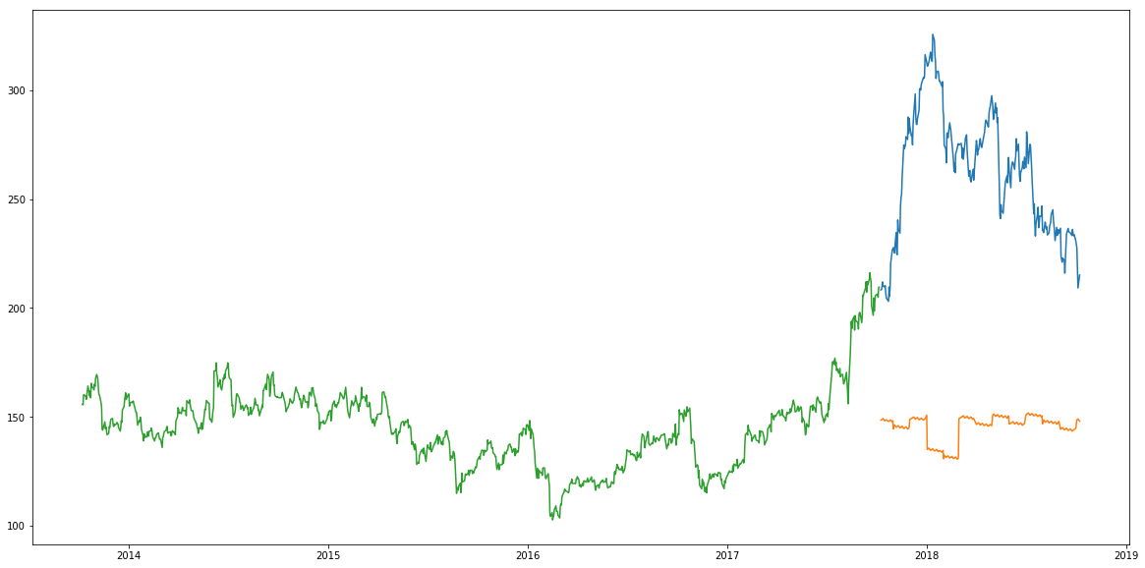
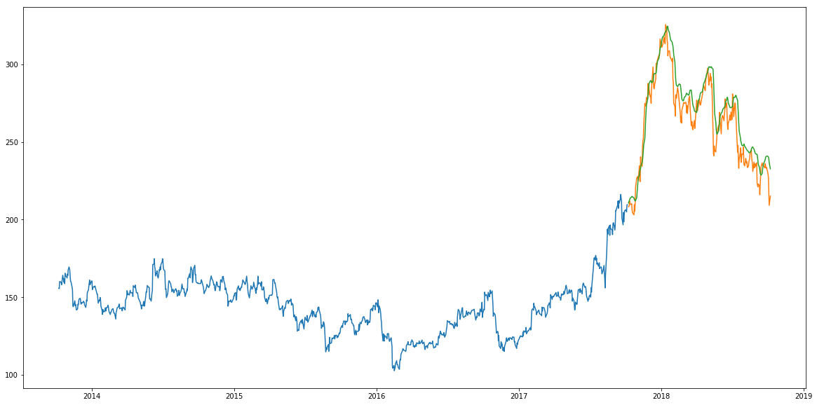
Historical Data Analysis
Linear Regression
LSTM
Data does not fit
Fountain Codes
20MCED05
20MCED08
20MCED08

Slide 37
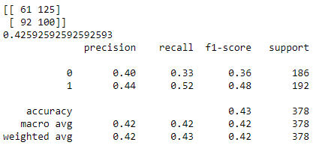
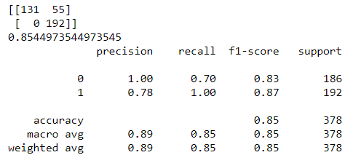
Sentiment Data Analysis
Logistic Regression
Random Forest
Fountain Codes
20MCED05
20MCED08
20MCED08

Slide 38
8. Conclusion
20MCED05
20MCED08

Slide 39
Conclusion
Since we know that market is volatile and keeps changing every minute, all these parameters are generated again and again. Thus, this prediction models can be used in building features like stop-loss or target threshold similar to those in famous trading apps like PayTM Money.
We also observed that our models are a little naïve and we need to implement more feature rich models to analyze stock market data like Support Vector Machine or Artificial Neural Network for more accurate predictions and sentiment classification.
Fountain Codes
20MCED05
20MCED08
20MCED08

Slide 40
Thank You!
Fountain Codes
20MCED05
20MCED08
20MCED08

