Slide 1
Capstone project
Presented by: Team Stallions.
Shrey Shah-202301165
Abhishek Kothari-202301128
Jainil Jagtap-202301032
Parv Khetawat-202301157

Slide 2
Problem Remainder and task scheduler
You are to build a Task scheduler with Remainder functionality, in which user are allowed to manage task based on deadline or importance level here we have used the file handling concept which is used to store tasks in a file, we also include different functionality like adding of a task, deletion of task marking task as completed,viewing completed task and displaying task in
order of priority and giving the remainder of task with highest priority.

Slide 3
DATA STRUCTURE USED:
Linked List :
● Used to implement the priority queue.
● Importance: The linked list is used to maintain the tasks in priority order based on their deadline and priority level. Each node contains information about the task such as description,
priority, and deadline.

Slide 4
Priority Queue :
● Implemented using a linked list.
● Importance: The priority queue is used to store tasks based on their priority and deadline. Tasks are added to the priority queue in such a way that the task with the nearest deadline is on the top if deadline is same then we check its importance level and sort it. This allows efficient retrieval and management of tasks based on their urgency.

Slide 5
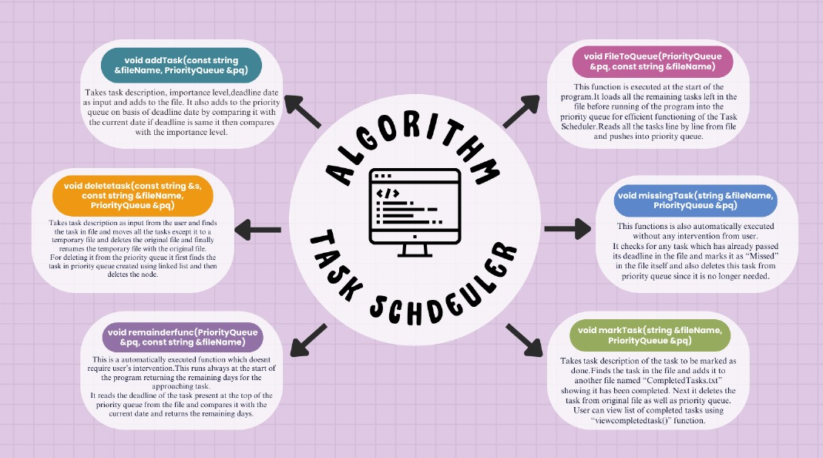

Slide 6
TIME AND SPACE COMPLEXITY
1>Push function in class priority queue
● Time complexity: O(n)
● Space complexity: O(1) (for creating temporary variables)
2>Peek Function
● Time complexity: O(1)
● Space complexity: O(1)

Slide 7
3>Pop function
● Time complexity: O(1)
● Space complexity: O(1)
4>Isempty function
● Time complexity: O(1)
● Space complexity: O(1)
5>Displaying the priority queue
● Time complexity: O(n)
● Space complexity: O(1) (excluding space for the output)
6>Function to add a task to the file and priority queue
● Time complexity: O(n)
● Space complexity: O(1) (excluding space for input variables)

Slide 8
7> Function to load any left tasks from the file to priority queue
● Time complexity: O(n^2)
● Space complexity: O(1) (excluding space for input variables)
8> Function which implements remainder functionality, it is called automatically everytime the program runs
● Time complexity: O(n^2)
● Space complexity: O(1) (excluding space for input variables)
9> Function to delete a given task from file and priority queue
● Time complexity: O(n^2)
● Space complexity: O(1) (excluding space for input variables)

Slide 9
10> Function to get deadline of a task inputted by user
● Time complexity: O(n^2)
● Space complexity: O(1) (excluding space for input variables)
11> Function to view all the completed tasks
● Time complexity: O(n)
● Space complexity: O(1) (excluding space for output variables)
12>Function to add missing tasks
● Time complexity: O(n^2)
● Space complexity: O(1) (excluding space for input variables)
13>Function to mark a task done
● Time complexity: O(n^2)
● Space complexity: O(1) (excluding space for input variables)

Slide 10
Click the Video link:

Slide 11
Thank you

