Slide 1
15 Puzzle using Reinforcement Learning
Presented by:
Jainisha Choksi
(202211019)
Guided by:
Prof. Aditya Tatu
Prof. Rachit Chhaya

Slide 2
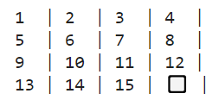
INTRODUCTION
15 Puzzle Game having a grid of 4 x 4 with 15 numbered blocks and 1 empty space.

Slide 3
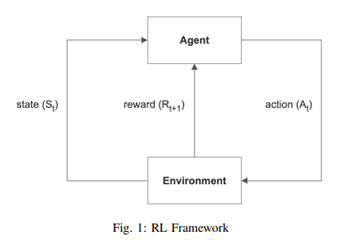
Reinforcement Learning
Agent | 1 Empty Space
Environment | 15 Numbered Blocks
Action | Up,Down, Left, Right
Reward | Goal State: 100
No.of States | 10^13

Slide 4
Approaches for Solving 15 Puzzle
Using Self-Supervised Training set.
Using Reinforcement Learning
Using Deep Q Network

Slide 5
Self-Supervision is All You Need to Solve the Puzzle
Training:
Unscrambling - the act of tracing a scramble path backward to the goal
Training DNN - Initializes the target problem with its goal state and applies random moves to scramble it.
DNN learns to predict the last move applied based on the current state’s pattern
Training Loss - Categorical Cross Entropy between actual and predicted probability distributions of the last move.
Training on 100 million solution - 100000 batches* 100 scrambles per batch
Scramble Length = 80(God’s Number)
Testing:
Search for solution path tracing back to goal state by sequentially reversing the DNN predicted moves.
Best-First Search Algorithm and prioritize the most promising candidate paths
Evaluate based on cumulative product of the probabilities of all their constituent moves.
Probability is the move is a reverse move toward the goal.

Slide 6
The cumulative probability of a random training scramble increases as the number of moves decreases: 1/|M|^N
M - Set of Moves
N - Path Length
This method leverages fundamental property of combinational search: the shorter a path, the more likely it is to occur randomly.

Slide 7
Reinforcement Learning
Reinforcement Learning using Dynamic Programming (Assume we have set of states)
But Total no. of States = 16!/2 which not possible to store in memory
Solution: We will try to solve 1st row at first then 2nd row and at last, last rows.
No.of States will be: 1st row = 16!/11!
2nd row = 12!/7!
Last 2 rows = 8!/2

Slide 8
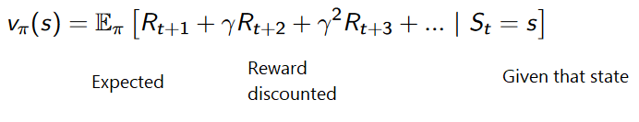
Approach: Firstly, we will solve for 1st row only as 1,2,3,4 and consider other numbers as 0 and have 1 empty cell as agent using Value Iteration algorithm.
Then for 2nd row we will not consider the 1st row and numbers other than 5,6,7,8, we will again consider them as 0 and solve the puzzle.

Slide 9
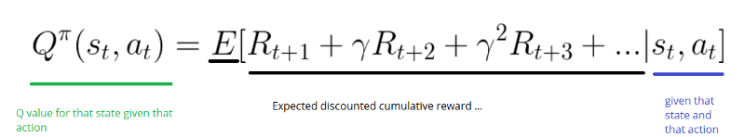
Deep Q Network
Deep Q Network - Defining Q function using Deep Neural Network.
DNN takes input as current state and output as all possible actions for that state.
Input layer is of 16 cells because of State Size
Output layer of 4 because we have 4 possible actions
When the agent is at a certain state, he forwards that state through the DNN and chooses the action with the highest Q-value.

Slide 10
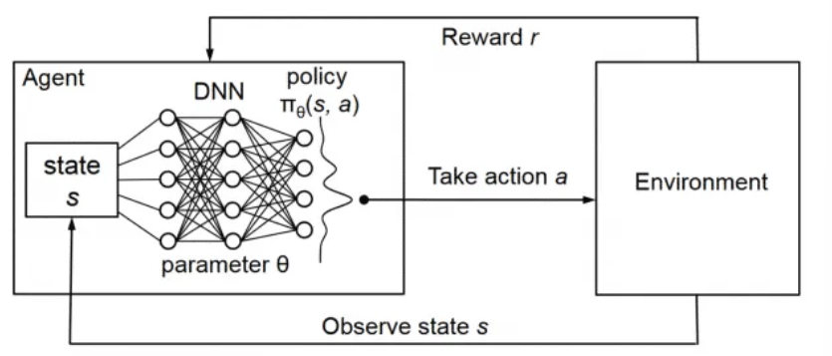
Deep Q Network

Slide 11
DQN Architecture
2 Neural Networks: Q-Network , Target Networks, and a component - Replayed Memory.
Q-Network is the agent that is trained to produce the Optimal State-Action Value.
Replayed Memory interacts with the environment to generate data to train the Q Network
Target Network is identical to the Q-Network.- predicts Target Q-Value.

Slide 12
Training Data Generating Phase:
Initialize Q Network with random weights
Q Network works as an agent to generate a training sample.
No DQN training happens during this phase.
Q-Network predicts the Q-values of all action for the current state.
Sample data is saved in Replayed Memory. - Current State, Action, Reward, Next State

Slide 13
Select Random Training Batch from the Replayed Memory.
Use the current state from the sample as input to predict Q-values for all actions
Select the Predicted Q-Value.
Use the next state from the sample as input to the Target Network. Target Network predicts Q-value for all actions from the next state and selects the maximum of those Q-value.
Target Q-value is the output of the Target Network + Reward from the sample.

Slide 14
Compute Loss -Loss Function- Temporal Difference error function - Qvalue(s,a) - Qtarget
BackPropagate Loss to Q-Network and Update weights of the Q Network using gradient descent.
Target network is not trained and remain fixed.

Slide 15
Comparison
Factors | Reinforcement Learning | Deep Q Network
Training Time | Less time to train | More time to train
No. of Steps in Testing | Large no. of steps | Comparatively less no. of steps
Algorithm used | Value Iteration algorithm | Q- Function using Deep Q Network
Exploration | No exploration | Exploration in Q-Network
Optimality | May be not Optimal | Optimal path only

Slide 16
Conclusion
From the experiments we can conclude that Deep Q Network method performs the best. However there is a trade off between the time complexity and optimality. The most effective method takes a longer training time.

Slide 17
Future Scope
The provided methods can be used for another game with more number of states such as Rubik’s cube(10^28).
⁠The provided methods can also be applied on other real applications that have more number of states like Healthcare.

Slide 18
References
Self-Supervision is All You Need for Solving Rubik’s Cube Kyo Takano - arXiv:2106.03157 [cs.LG]
Playing Atari with Deep Reinforcement Learning- arXiv:1312.5602 [cs.LG]
Solving the Rubik’s cube with deep reinforcement learning and search
Richard S. Sutton, and Andrew G. Barto, “Reinforcement Learning: An Introduction,” 2nd ed., MIT Press.
Sudharsan Ravichandiran, Hands-on Reinforcement Learning using GymAI and Universe, Packt Publishing.
Michael Mitzenmacher, and Eli Upfal, “Probability and Computing: Randomized Algorithms and Probabilistic Analysis,” Cambridge University Press.

Slide 19
Thank You

Slide 20
Appendix

Slide 21
Basic Terminologies
Input: Initial State as Scramble 15 Puzzle
Output: Goal State Unscramble 15 Puzzle
Agent: The entity or system that is responsible for making decisions. 1 Empty cell
Environment: The external system with which the agent interacts. 1 to 15 numbered tiles.
States(S): A representation of the current situation or configuration of the environment.(10^13)
Action(A): The set of possible moves or decisions that the agent can make.(Up, Down, Right, Left)

Slide 22

Policy(π):Determines what action to take at each state. Policy always output a probability distribution of action a.
Reward(R): A numerical signal provided by the environment to the agent as feedback for the action taken in a particular state.(Goal State-100)

Slide 23
Best First Search:
The idea of Best First Search is to use an evaluation function to decide which adjacent is most promising and then explore.
f(n) = g(n) +h(n)
f(n) - total cost function for node n
g(n) - cost of the path from start node to node n
h(n) - heuristic estimate of the cost from node n to the goal
Best First Search selects the node with the lowest f(n) value for expansion.

Slide 24
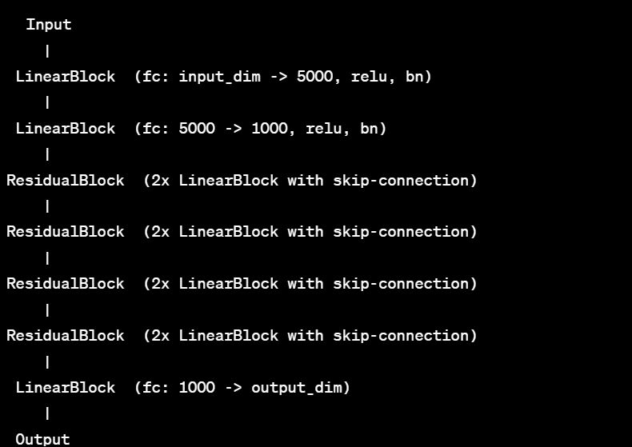

Slide 25

Dynamic Programming
DP refers to a collection of algorithms that can be used to compute optimal policies given a perfect model of the environment as a Markov Decision Process.
MDP - A state signal that succeeds in retaining all relevant information is said to be Markov property

Slide 26
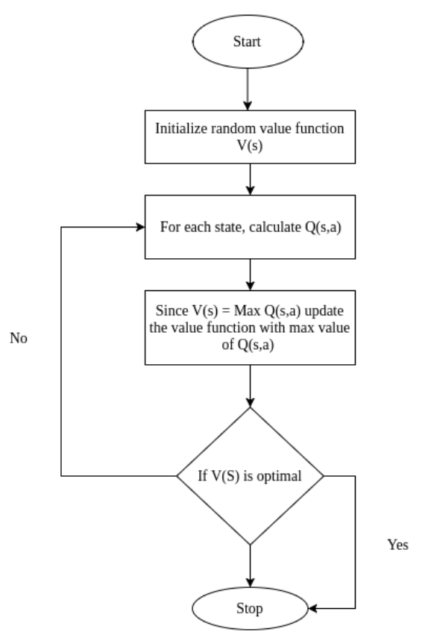
Value Iteration

Slide 27
Deep Q Network
Q-learning algorithm works well for finite states and actions spaces.
In some case where states, action, or both of them are continuous, it is just impossible to use the Q-learning algorithm. As a solution, we can compute Q-value function using Deep Neural Network for approximate functions.
Replayed Memory- The agent stores all its experiences in a memory buffer
Experience tuple- Current State, Chosen Action, Reward, Next State

Slide 28
Target Network takes the next state from each data sample and predicts the best Q value out of all action that can be taken from that state. Target Q Value
The Predicted Q Value, Target Q Value, and the observed reward from the data sample is used to compute the Loss to train Q Network. The Target Network is not trained.

Slide 29
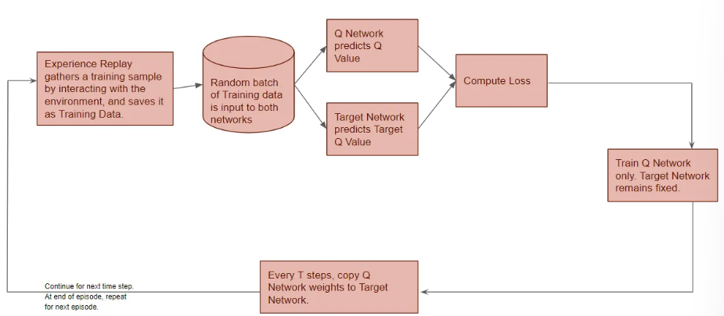

Slide 30
