Slide 1
Gender Bias detection
Jainit Bafna
Suyash Sethia

Slide 2

Gender and Sex
Sentence :- only men can be soldiers . => biased
Sentence :- only men can be fathers . => not-biased

Slide 3

WHAT WHERE HOW ?
Gender bias in NLP tools
Machine translation
Article generation
Word embeddings

Slide 4
3 papers
Measuring Gender Bias in Word Embeddings across Domains and Discovering New Gender Bias Word Categories (Kaytlin Chaloner , Alfredo Maldonado)
Understanding Undesirable Word Embedding Associations (Kawin Ethayarajh, David Duvenaud† , Graeme Hirst)
Lipstick on a Pig: Debiasing Methods Cover up Systematic Gender Biases in Word Embeddings But do not Remove Them (Hila Gonen1 and Yoav Goldberg1,2 )

Slide 5


Slide 6
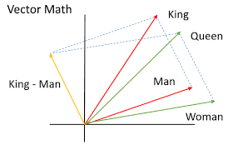
Word embedding system
The most important feature of word embeddings is that similar words in a semantic sense have a smaller distance (either Euclidean, cosine or other)
“Ped” and tree will have almost the same word
Embedding despite being in different languages
due to sense similarity

Slide 7
How Word Embeddings are Created
Read the text
Preprocess text
Create (x,y) data points
Create one hot encoded (X,Y) matrices
Train a neural network
Extract the weights from the input layer

Slide 8
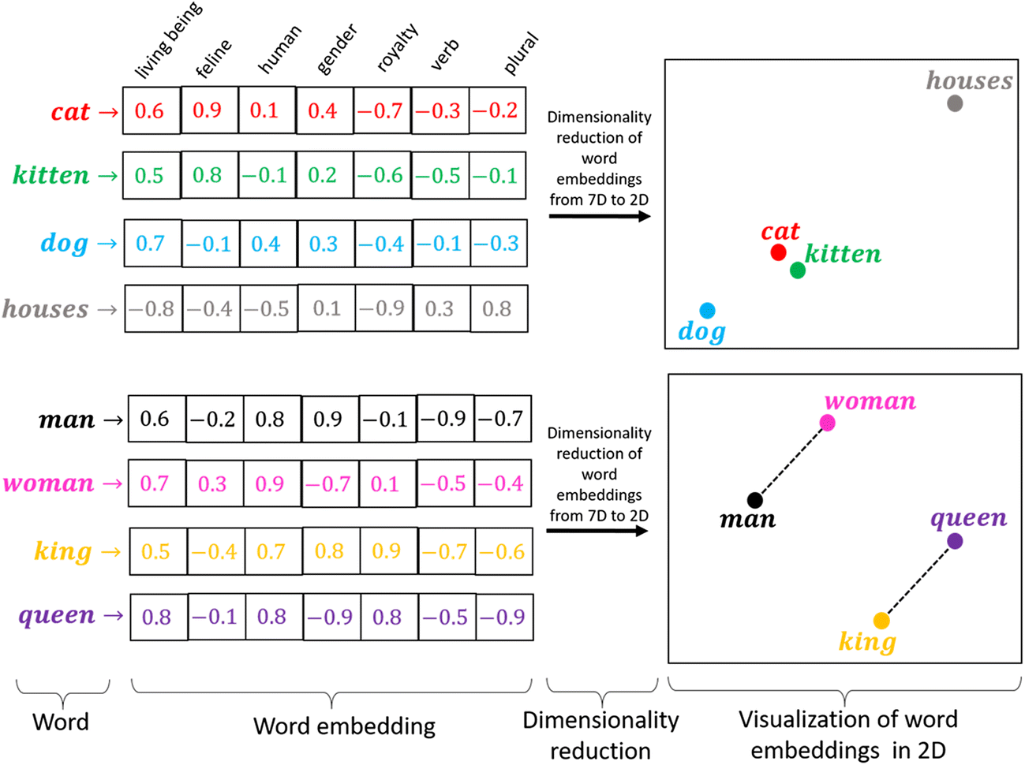

Slide 9
Choice of word embeddings
Skip-Gram embed-dings trained on the Google News corpus2 , with
a vocabulary of 3M word types (Mikolov et al.,2013)
Skip-Gram embeddings trained on 400 million Twitter micro-posts3 , with a vocabulary of slightly more than 3M word types (Godin et al.2015)
Skip-Gram embeddings trained on the PubMed Central Open Access subset (PMC) and PubMed4 , with a vocabulary of about 2.2M word types (Chiu et al., 2016) and trained using two dif- ferent sliding window sizes: 2 and 30 words;

Slide 10
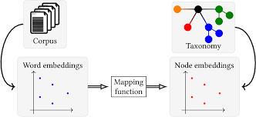
Embeddings represent the corpus

Slide 11
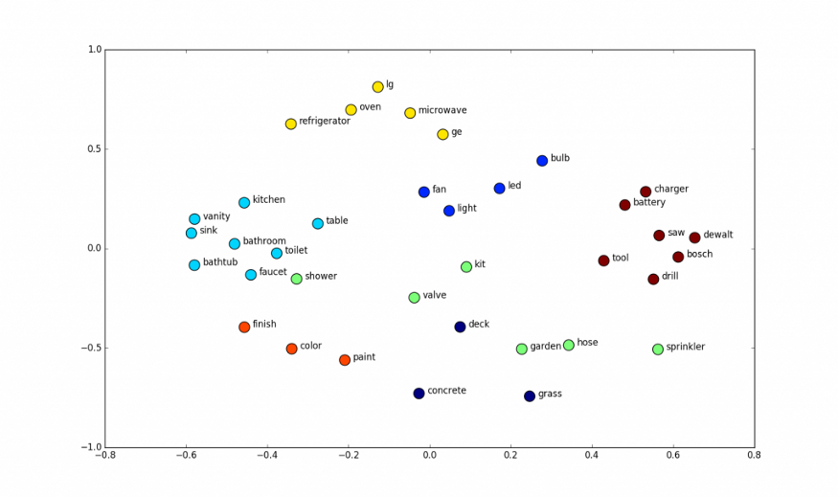
Vector space

Slide 12
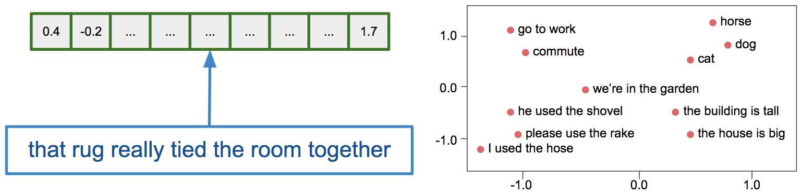
WEAT
E.g. X = {programmer, engineer, scientist}, Y = {nurse, teacher, librarian}.
M = {man, male, he}, F = {woman, female, she}.

Slide 13
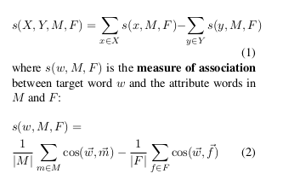
WEAT
X = {programmer, engineer, scientist}
Y = {nurse, teacher, librarian}.
Attribute Words :-
M = {man, male, he},
F = {woman, female, she}
Ho = Null hypothesis that there is no difference between X and Y in terms of their relative (cosine) similarity to M and F

Slide 14
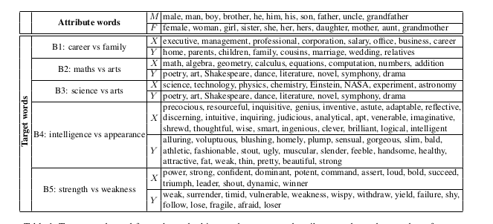

Slide 15
Code snippets

Slide 16
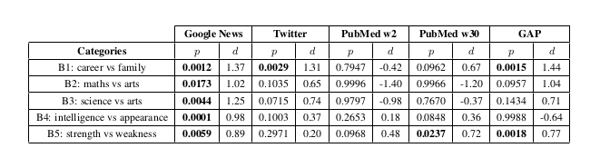
Results

Slide 17
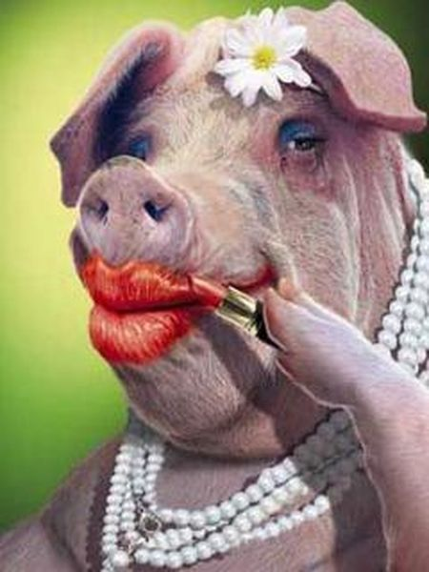
Lipstick on a pig

Slide 18
Lipstick on a pig
Debiasing Methods Cover up Systematic Gender Biases
in Word Embeddings But do not Remove Them

Slide 19
What is biased , “According to Bolukbasi et al.” ?

Slide 20
What is biased , “According to Bolukbasi et al” ?
Bolukbasi et al. (2016b) define the gender of a word w by its projection on the “gender direction” :
w.(he - she) , assuming all vectors are normalised.

Slide 21
What is biased , “According to Bolukbasi et al” ?
Bolukbasi et al. (2016b) define the gender of a word w by its projection on the “gender direction” :
w.(he - she) , assuming all vectors are normalised.
The larger a word’s projection is on he − she, the more biased it is. They also quantify the bias in word embeddings using this definition and show it aligns well with social stereotypes

Slide 22
Debiasing methods by
Bolukbasi et al. (2016b)

Slide 23
Bolukbasi et al. ‘s method
It was a post-processing method

Slide 24
Bolukbasi et al. ‘s method
It was a post-processing method
Given a word embedding matrix, they make changes to the word vectors in order to reduce the gender bias as much as possible for all words that are not inherently gendered (e.g. mother, brother, queen).

Slide 25
Bolukbasi et al. ‘s method
It was a post-processing method
Given a word embedding matrix, they make changes to the word vectors in order to reduce the gender bias as much as possible for all words that are not inherently gendered (e.g. mother, brother, queen).
They do that by zeroing the gender projection of each word on a predefined gender direction.

Slide 26
Bolukbasi et al. ‘s method
It was a post-processing method
Given a word embedding matrix, they make changes to the word vectors in order to reduce the gender bias as much as possible for all words that are not inherently gendered (e.g. mother, brother, queen).
They do that by zeroing the gender projection of each word on a predefined gender direction.
However, as we show in this work, while the gender-direction is a great indicator of bias, it is only an indicator and not the complete manifestation of this bias

Slide 27
Debiasing methods by
Bolukbasi et al. (2016b)
Zhao et al. (2018)

Slide 28
Zhao el al. ‘s method
Take a different approach and suggest to train debiased word embeddings from scratch.

Slide 29
Zhao el al. ‘s method
Take a different approach and suggest to train debiased word embeddings from scratch.
Instead of debiasing existing word vectors, they alter the loss of the GloVe model , aiming to concentrate most of the gender information in the last coordinate of each vector.

Slide 30
Zhao el al. ‘s method
Take a different approach and suggest to train debiased word embeddings from scratch.
Instead of debiasing existing word vectors, they alter the loss of the GloVe model , aiming to concentrate most of the gender information in the last coordinate of each vector.
This way, one can later use the word representations excluding the gender coordinate.

Slide 31
Zhao el al. ‘s method
Take a different approach and suggest to train debiased word embeddings from scratch.
Instead of debiasing existing word vectors, they alter the loss of the GloVe model , aiming to concentrate most of the gender information in the last coordinate of each vector.
This way, one can later use the word representations excluding the gender coordinate.
They do that by using two groups of male/female seed words, and encouraging words that belong to different groups to differ in their last coordinate.

Slide 32
Remaining bias after using debiasing methods
Word similarity is still same
The definition of biasness is not essentially correct ie it is very naive .
Just the vector projection on (man vector - woman vector ) is removed which does not account for complete de-bias .

Slide 33
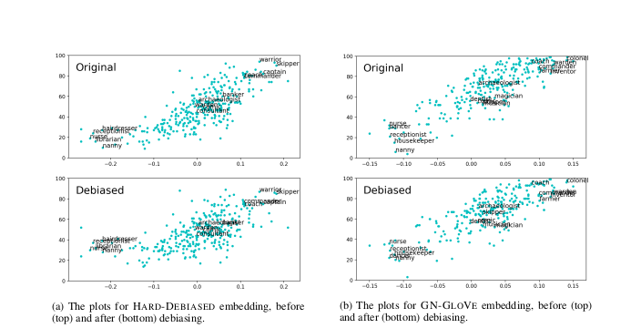

Slide 34
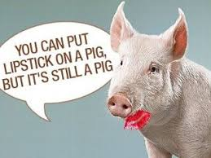
Conclusion

Slide 35
Research questions
Our focus is on mainly three questions
Does debiasing via subspace projection method provably debias embeddings ?
Why should WEAT be used to measure word associations?
What's to blame , why we still have gender bias in data , is the word embedding model , training data .

Slide 36
Defining unbiasedness
Let M be the word-context matrix the embedding model implicitly factorizes WC^T = M
Word w unbiased in M wrt word pairs S iff
∀(x,y) ∈ S , Mw,x = Mw,y
E.g., ‘doctor; unbiased wrt {(‘king’, ‘queen’)} iff
Mdoctor , king = Mdoctor, queen

Slide 37
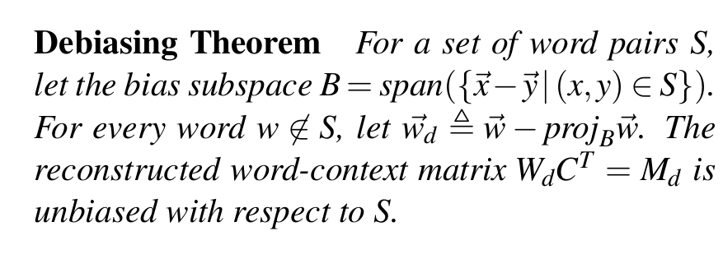

Slide 38
Lipstick on a pig
If we define a bias subspace using S and use it to debias ‘w’, we can only say definitively that w is unbiased with respect to S . where S contains {‘male’, ‘female’}

Slide 39
Lipstick on a pig
If we define a bias subspace using S and use it to debias ‘w’, we can only say definitively that w is unbiased with respect to S . where S contains {‘male’, ‘female’}
We cannot claim,for example, that ‘w’ is also unbiased with respect to {(‘policeman’, ‘policewoman’)}, because it is possible that
policeman - policewoman ≠ man - woman

Slide 40
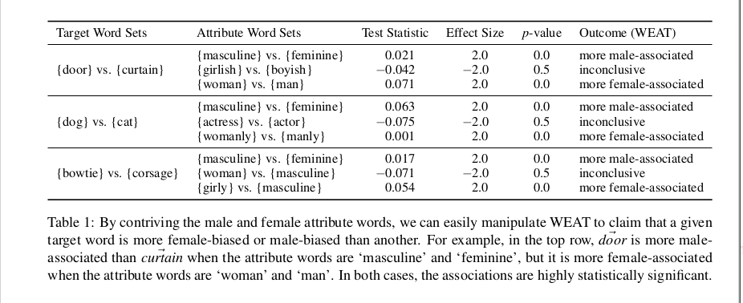
Problem with WEAT

Slide 41

New Method RIPA
RIPA stands for Relational Inner Product Association
The RIPA of a word w wrt to relational vector :
where
Word pairs S define the association (e.g. {‘king’ , ‘queen’} )
b =principal component ({x-y | (x,y) ∈ S })

Slide 42
Advantages of RIPA
Interpretable when embedding model factorizes word-context matrix

Slide 43
Advantages of RIPA
Interpretable when embedding model factorizes word-context matrix
Robust to how b is defined

Slide 44
Advantages of RIPA
Interpretable when embedding model factorizes word-context matrix
Robust to how b is defined
Derived from the subspace projection method of debiasing

Slide 45
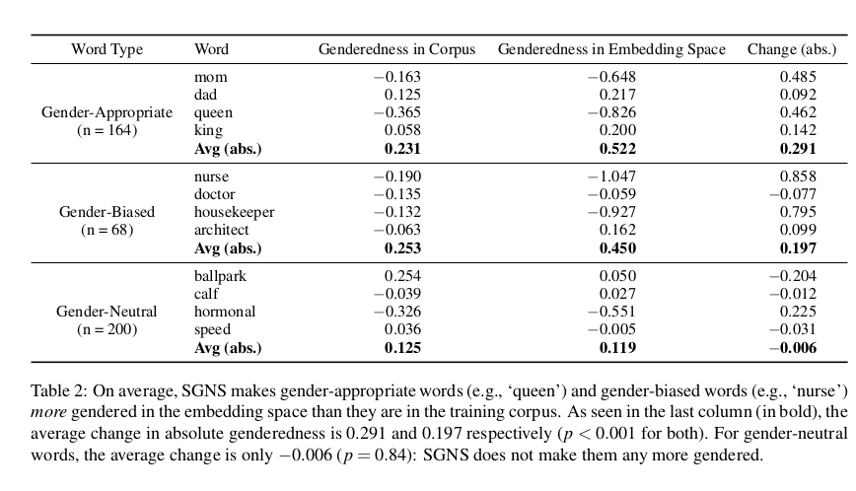

Slide 46
RIPA model is Unsupervised
So unlike the method introduced by Bolukbasi, the algorithm automatically decides which words should be debiased.

Slide 47
RIPA model is Unsupervised
So unlike the method introduced by Bolukbasi, the algorithm automatically decides which words should be debiased.
We propose an unsupervised method for finding gender-appropriate words. We first create a gender-defining relation vector b∗ by taking the first principal component of gender-defining difference vectors such as man− woman.

Slide 48
RIPA model is Unsupervised
So unlike the method introduced by Bolukbasi, the algorithm automatically decides which words should be debiased.
We propose an unsupervised method for finding gender-appropriate words. We first create a gender-defining relation vector b∗ by taking the first principal component of gender-defining difference vectors such as man− woman.
Using difference vectors from biased analogies, such as doctor - midwife we then create a bias-defining relation vector b the same way. We then debias a word w using the subspace projection method iff it satisfies |β (w;b∗ )|< |β (w;b0 )|his simple condition is sufficient to preserve almost all gender-appropriate analogies while precluding most gender-biased ones.

Slide 49
