Slide 1
Support vector machines
Lujain Alghamdi

Slide 2
AGENDA
What is a Support Vector Machine
Breakdown of the terminology
Types of boundaries
The Kernel trick
When to use SVM
How to use SVM
Implementation in VS code

Slide 3
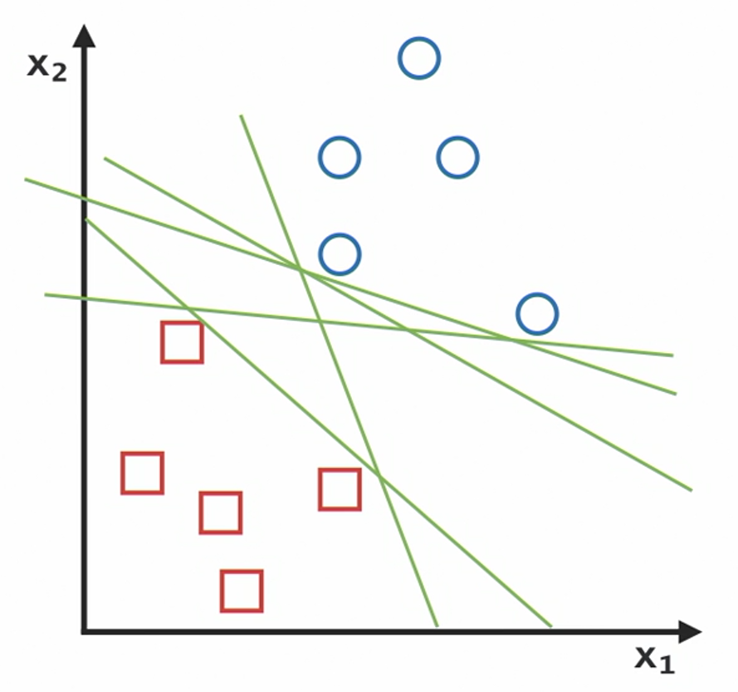
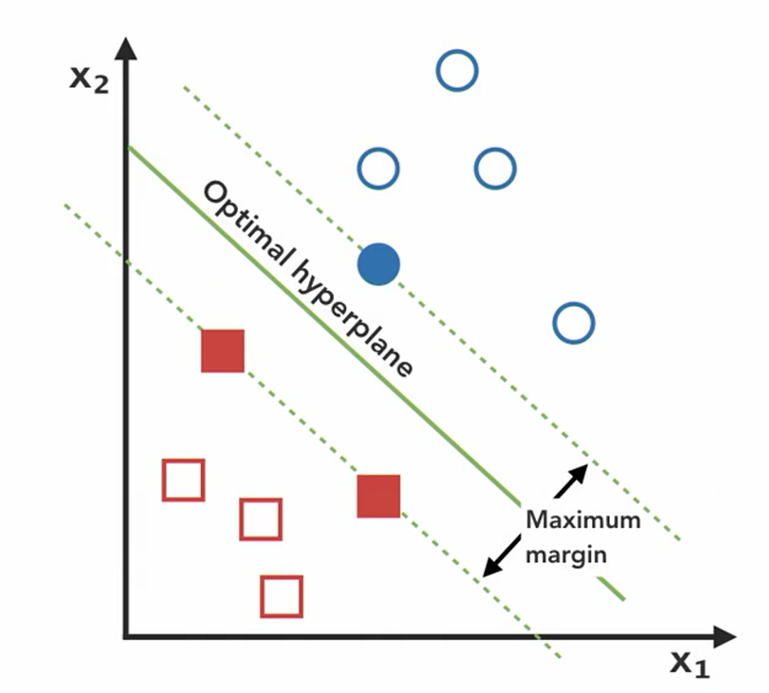
What is a support vector machine?
It’s a supervised machine learning algorithm used for classification.
The goal → is to maximize the support vector.
Notes:
SVM can be used for regression, but we’re only going to focus on classification for today

Slide 4
Break down of the terminology
Support Vector
Decision Boundary
the perpendicular line from the decision boundary to the closest point in both classes
The line that separates the two classes
Best boundary: the boundary with maximum distance between its points and the points in the two sets.
The Margin
The distance between two sets

Slide 5
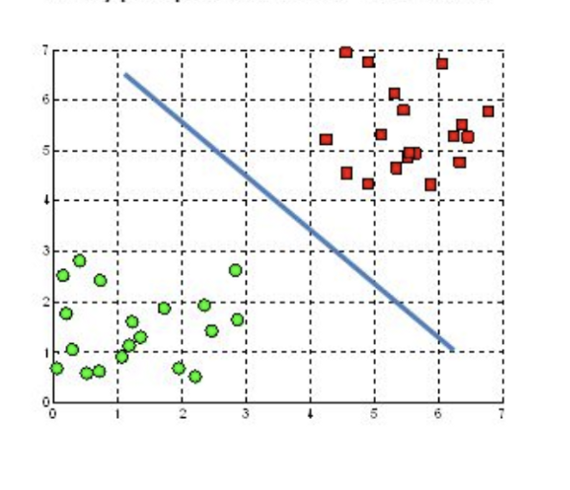
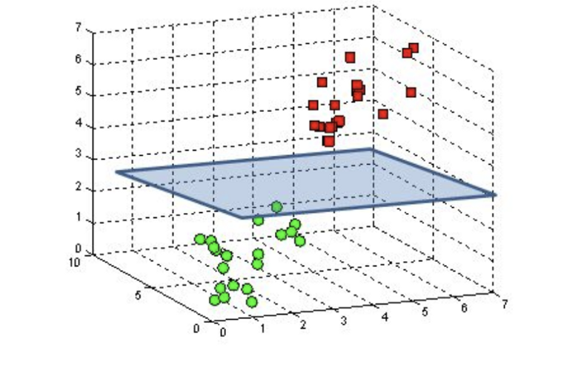
Types of boundaries
Line
Plane
Vector points are 2D
Vector points are 3D

Slide 6
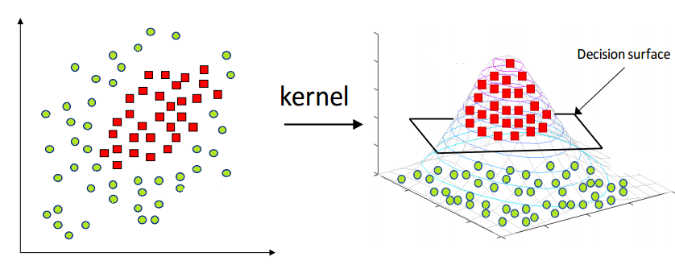
The kernel Trick
What if we have data that can’t be separated by a straight line or a hyperplane?
This 2D data can’t be separated by a line.
What if we transform it into a higher dimension?

Slide 7
When to Use SVM?
When to Use It?
Problems with binary target variable
When Not to Use It?
If time and compute power is a significant constraint
Feature-to-row ratio is high
Very complex relationships
Lots of outliers
Use Cases
Face detection
Handwriting recognition
Bioinformatics
Notes:
When to Use It?
Problems with a binary target variable
Feature-to-row ratio is very high
Most algorithms prefer lots of observations to be able to classify a new observation. Whereas SVM prefers to have MANY features a little rows to be able to classify a new observation
Very complex relationships
Lots of outliers
Because if we refer back to figure 2 it only looks at the points closest to the line, so the outliers are kind of ignored. Which is not true for other algorithms
When Not to Use It?
If time and compute power is a significant constraint
Because SVM takes a long time to train and takes longer than other algorithms to make predictions as well.
Use Cases:
Face detection – SVMs classify parts of the image as a face and non-face and create a square boundary around the face.
Bioinformatics – It includes protein classification and cancer classification. We use SVM for identifying the classification of genes, patients on the basis of genes and other biological problems.
Handwriting recognition – We use SVMs to recognize handwritten characters used widely.

Slide 8
How to use svm

Slide 9
Implementation steps
Load the data
Split the data into train and test samples
Initialize the SVM
Tune the hyperparameters
5. Fit the training data
6. Predict the classes for the test set
Notes:
Library:
To use this algorithm with python we will use the scikit-learn (sklearn) library which provides many classification, regression and clustering algorithms including SVM.
Platform:
VS code
Load the data
Split the data into train and test samples
Classify the predictor features and target feature
Initialize the SVM and fit the training data
Predict the classes for the test set
Compare the actual data predictions

Slide 10
Parameters VS Hyperparameters
Parameters
Are configuration variables that are internal to the model and whose values can be estimated from the training data
Hyper parameters
Are configurations that are external to the model and whose values guide how the algorithm learns parameter values.
Differs based on the dataset
Differs based on the algorithm
Notes:
Hyperparameters:
Parameters: are configuration variables that are internal to the model and whose values can be estimated from the training data.
is found after you train the model on the data
titanic dataset example: titanic dataset → fare = $20 or ticket class = third
differs depending on the dataset
Hyperparameters: are configurations that are external to the model, whose values cannot be estimated from the data, and whose values guide how the algorithm learns parameter values from the data
should be set before you fit the model on the training data
titanic dataset example: which features to consider from the dataset
differs depending of the algorithm
can lead overfitting or underfitting
We shouldn’t try to change all the hyperparameters, only change the ones that are most impactful.

Slide 11
Hyperparameters
C
Controls how willing the algorithm is to misclassify training examples
Kernel
Takes the type of transformation that is applied to the input data in order to make it linearly separable
Large C ➔ large penalty
Linear kernel ➔ 2D data
Small C ➔ small penalty
RBF kernel ➔ 3D data
Default (1)
Default (RBF)
Notes:
If C is large ⇒ there’s a large penalty for misclassification in training
If C is small ⇒ there’s a small penalty for misclassification in training
Why would we want to misclassify points in training? To be able to capture the general pattern of the data more freely. Summary: It will control the trade off between overfitting or underfitting the training data
Therefor,
if C is large ⇒ small margin and a potential of overfit if C is small ⇒ large margin

Slide 12
Implementation in VS code

Slide 13
THANK YOU
Lujain Alghamdi

