Slide 1
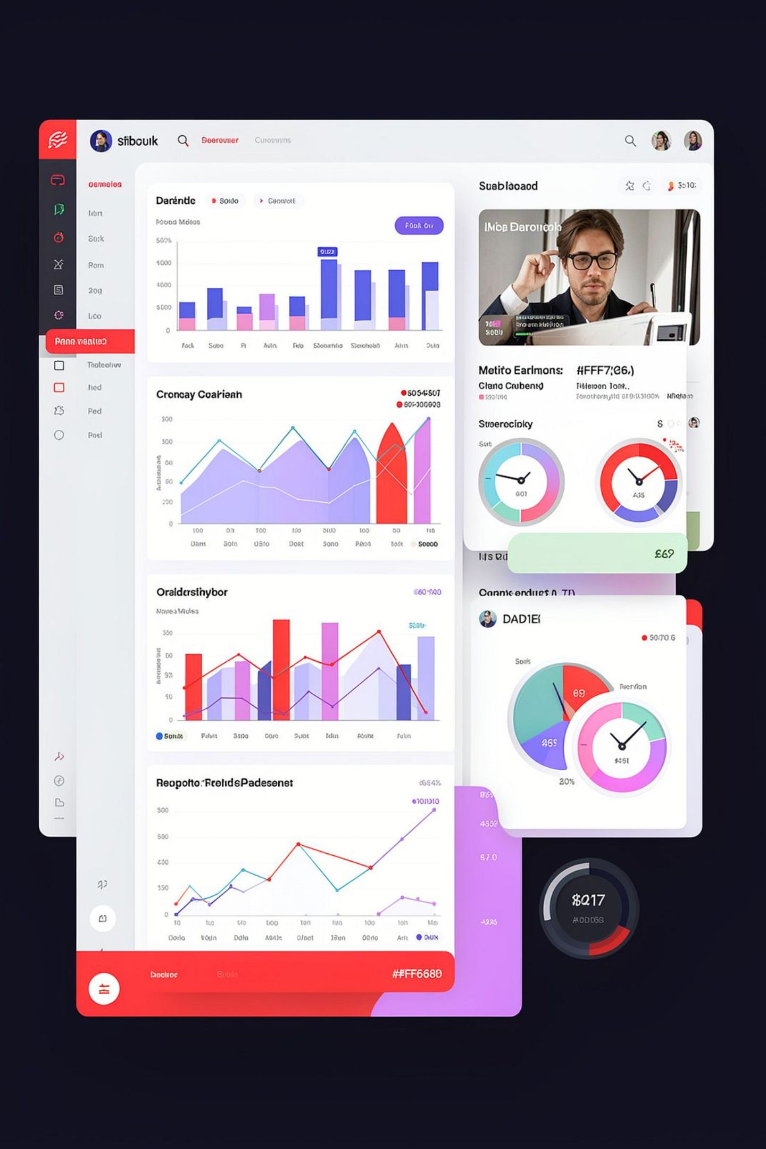
Quality & Performance Executive Summary
High-level snapshot: sample_total = 44K; quality_score = 73.38%; defects_% = 18.88%; error_% = 7.75%. These KPIs frame the report and drive the improvement agenda for operations, audits, and managers across locations.

Slide 2
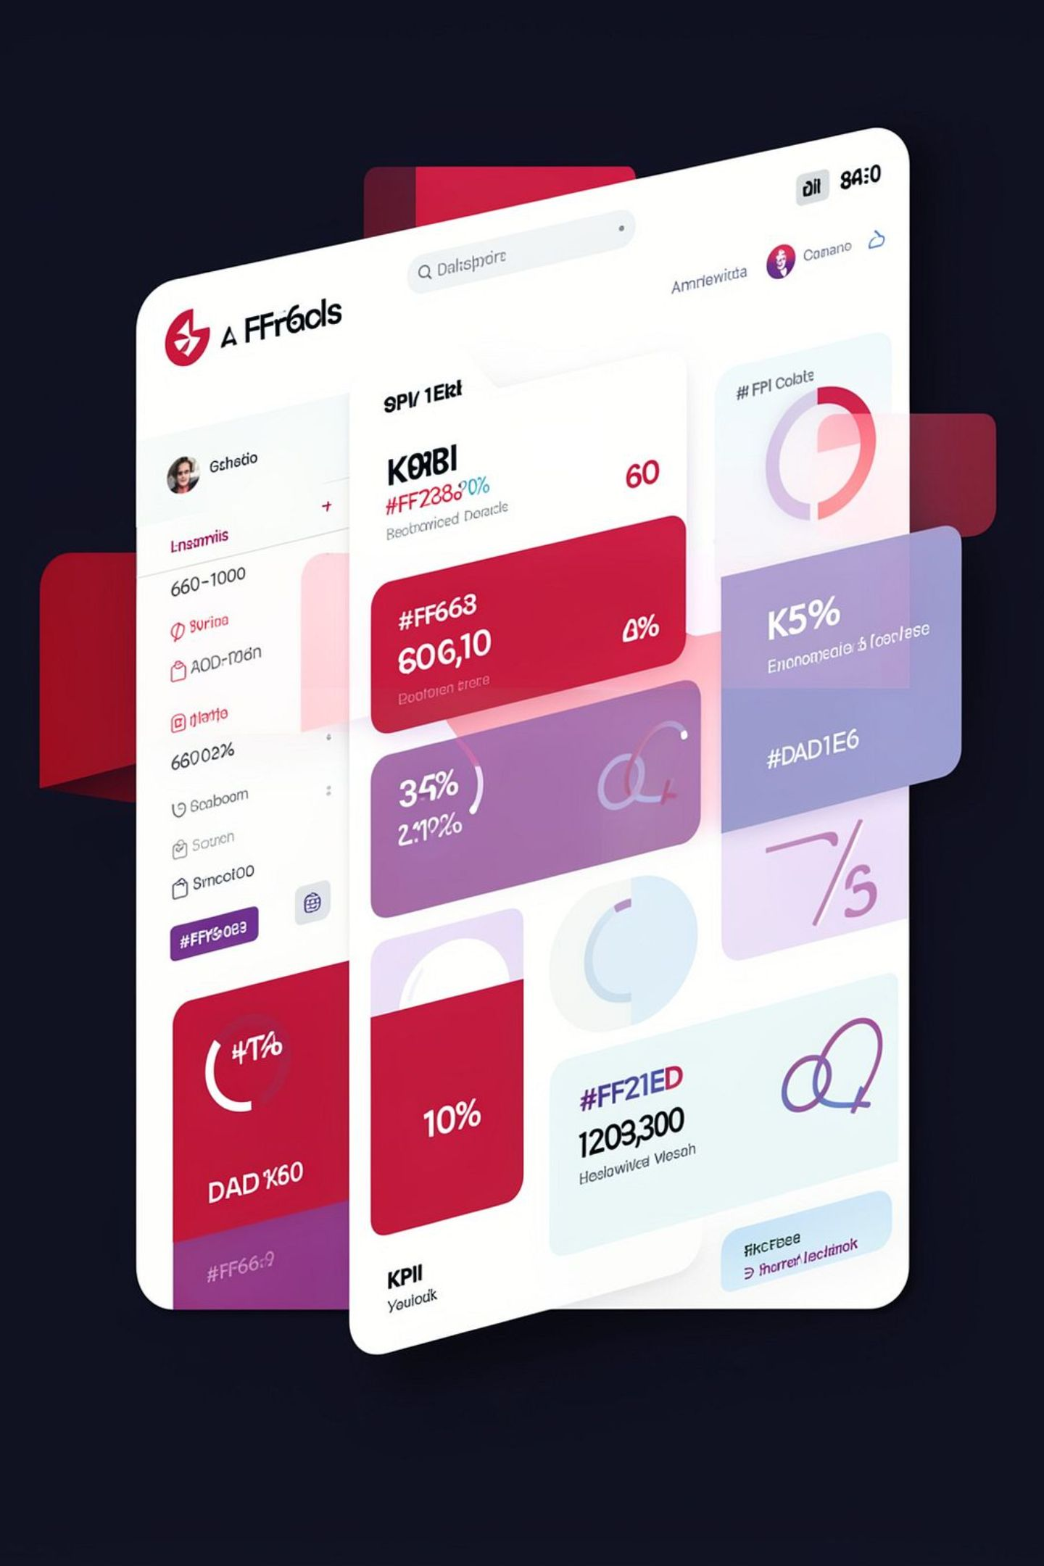
Key Metrics at a Glance
Samples
44K total samples processed — the volume underpinning all rate calculations.
Quality Score
Overall quality score: 73.38% — primary performance indicator for the program.
Defects %
Defects rate: 18.88% — largest contributor to quality loss and priority for reduction.
Error %
Error rate: 7.75% — actionable metric for training and process controls.

Slide 3
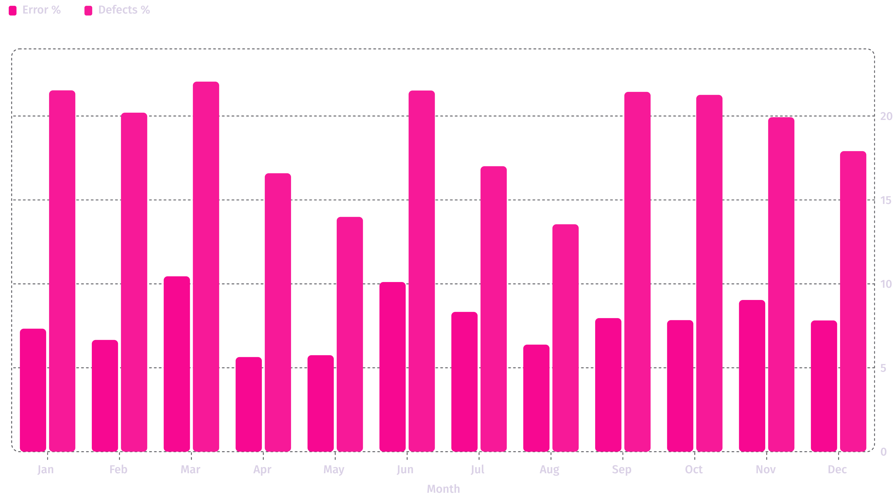
Monthly Trend — Errors vs Defects
Monthly comparison of Error % (dark series) and Defects % (light series). Defects consistently exceed errors; peaks occur in March, June, and October–November. Use monthly pattern to prioritize deep-dive root-cause analysis.

Slide 4
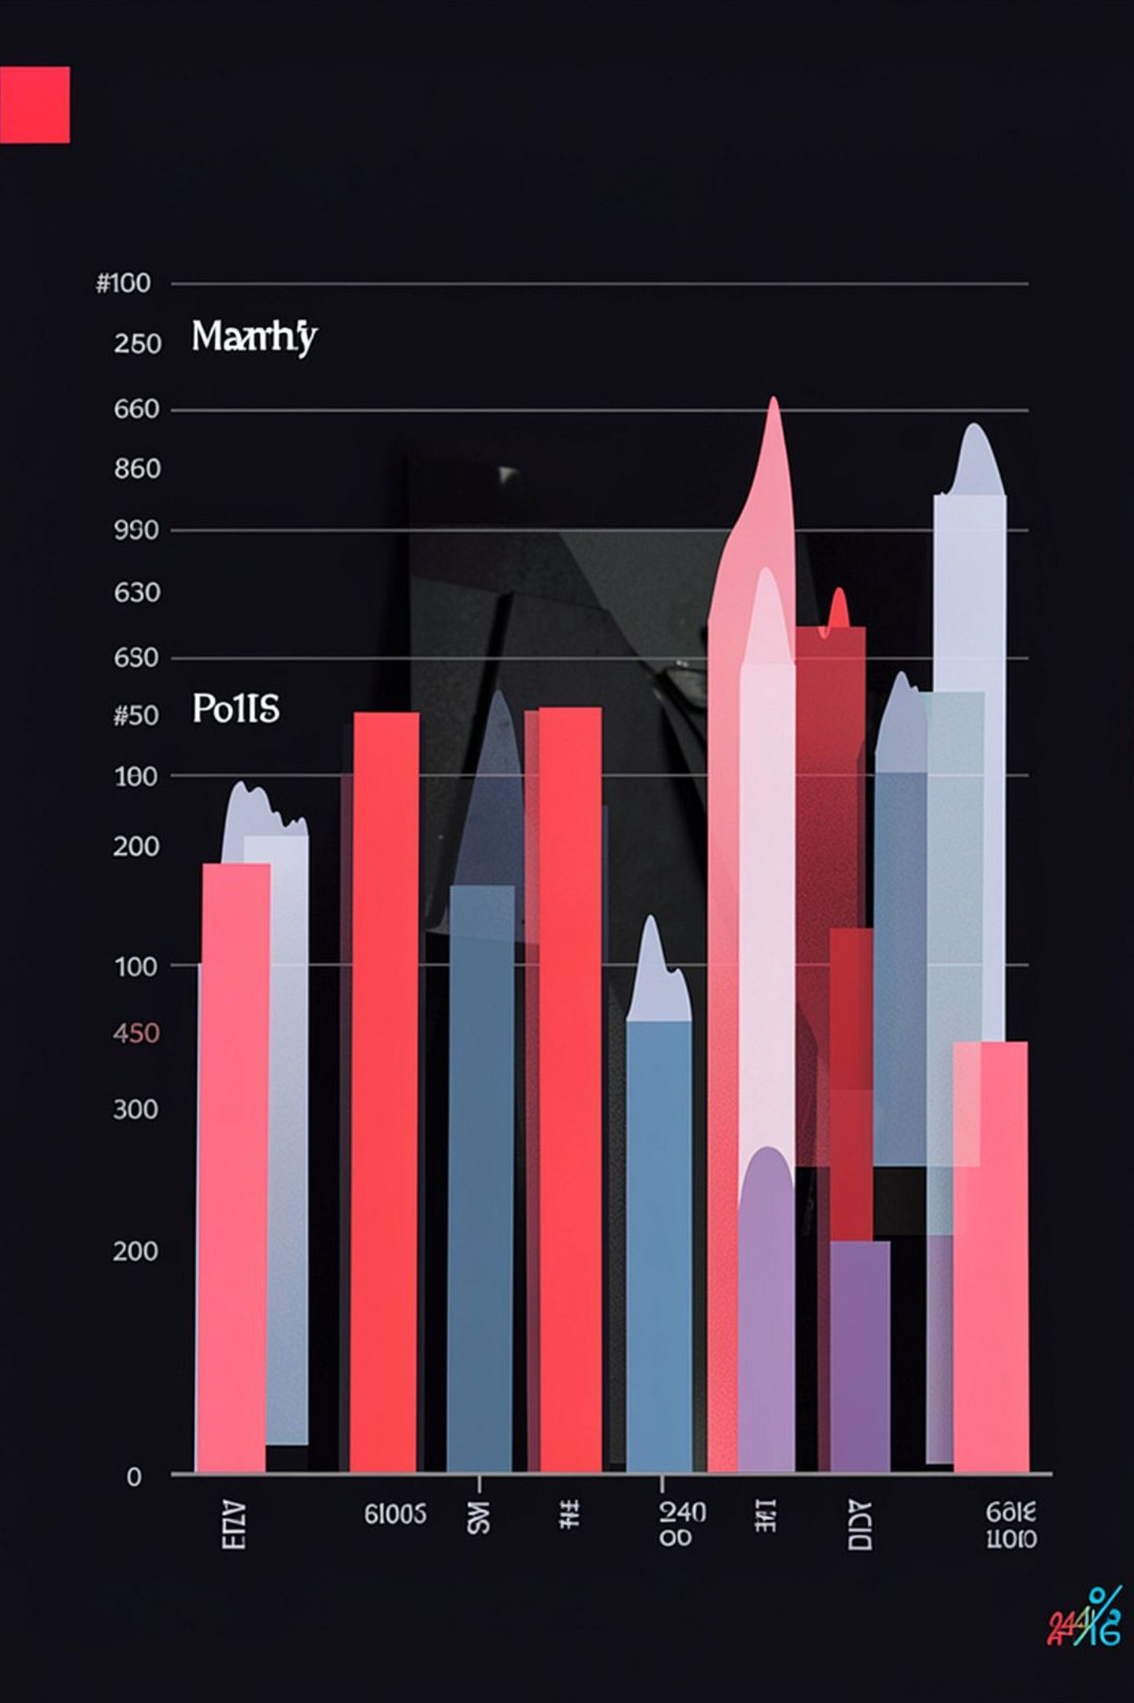
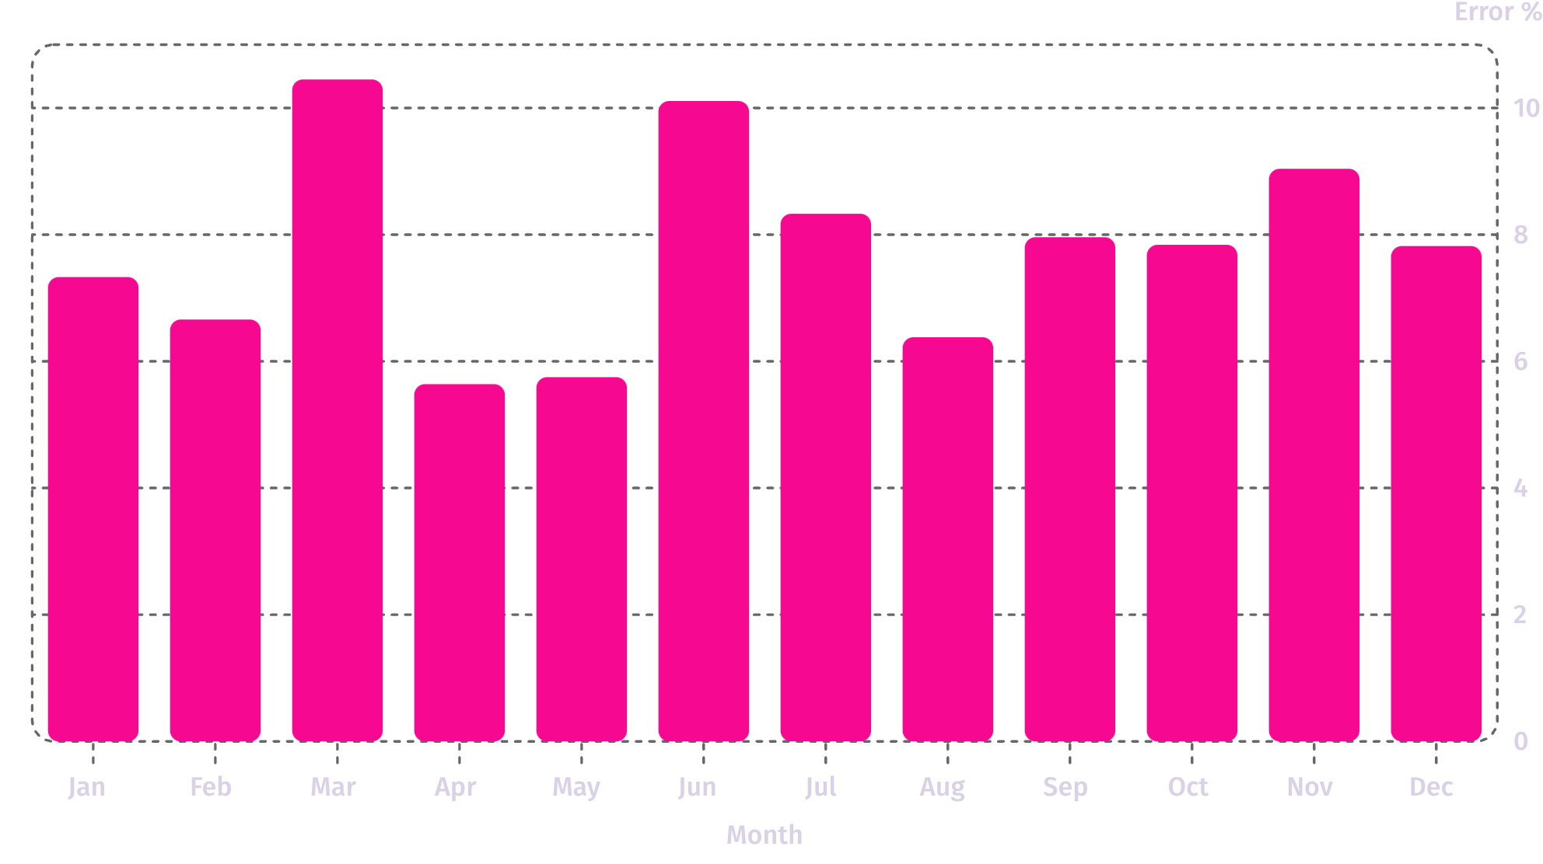
Error Rate — Monthly Profile
Single-series view highlights error spikes in March and June (≈10.4% and 10.11%). Targeted interventions (training, process checks) should focus around these months and any recurring contributors.

Slide 5



Geography & Location Summary
Locations
Australia, China, United Kingdom, United States — each location shares the same aggregate metrics in this dataset: sample_% 24.21%, defects_% 18.88%, error_% 7.75%, quality_score 73.38%.
Interpretation
Identical aggregates suggest either normalized reporting or consolidated roll-up — investigate local variance and data normalization rules to reveal hidden hotspots.

Slide 6

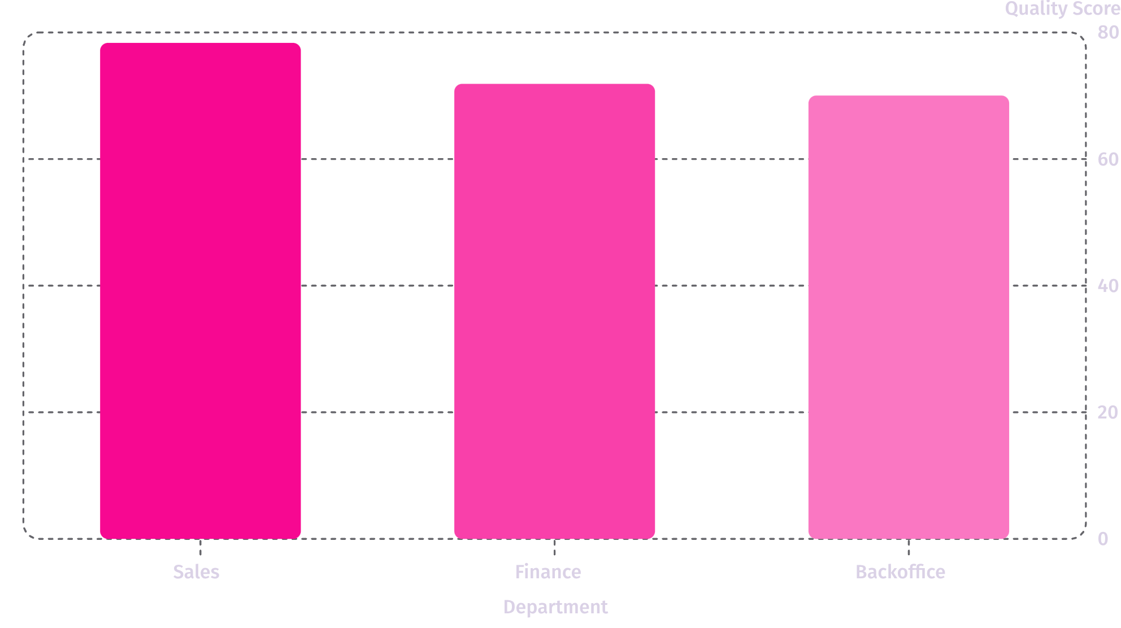
Department Performance Snapshot
Sales leads in quality (78.35%), followed by Finance (71.88%) and Backoffice (70.03%). These gaps indicate opportunities to transfer best practices from Sales to other departments to lift overall quality.

Slide 7
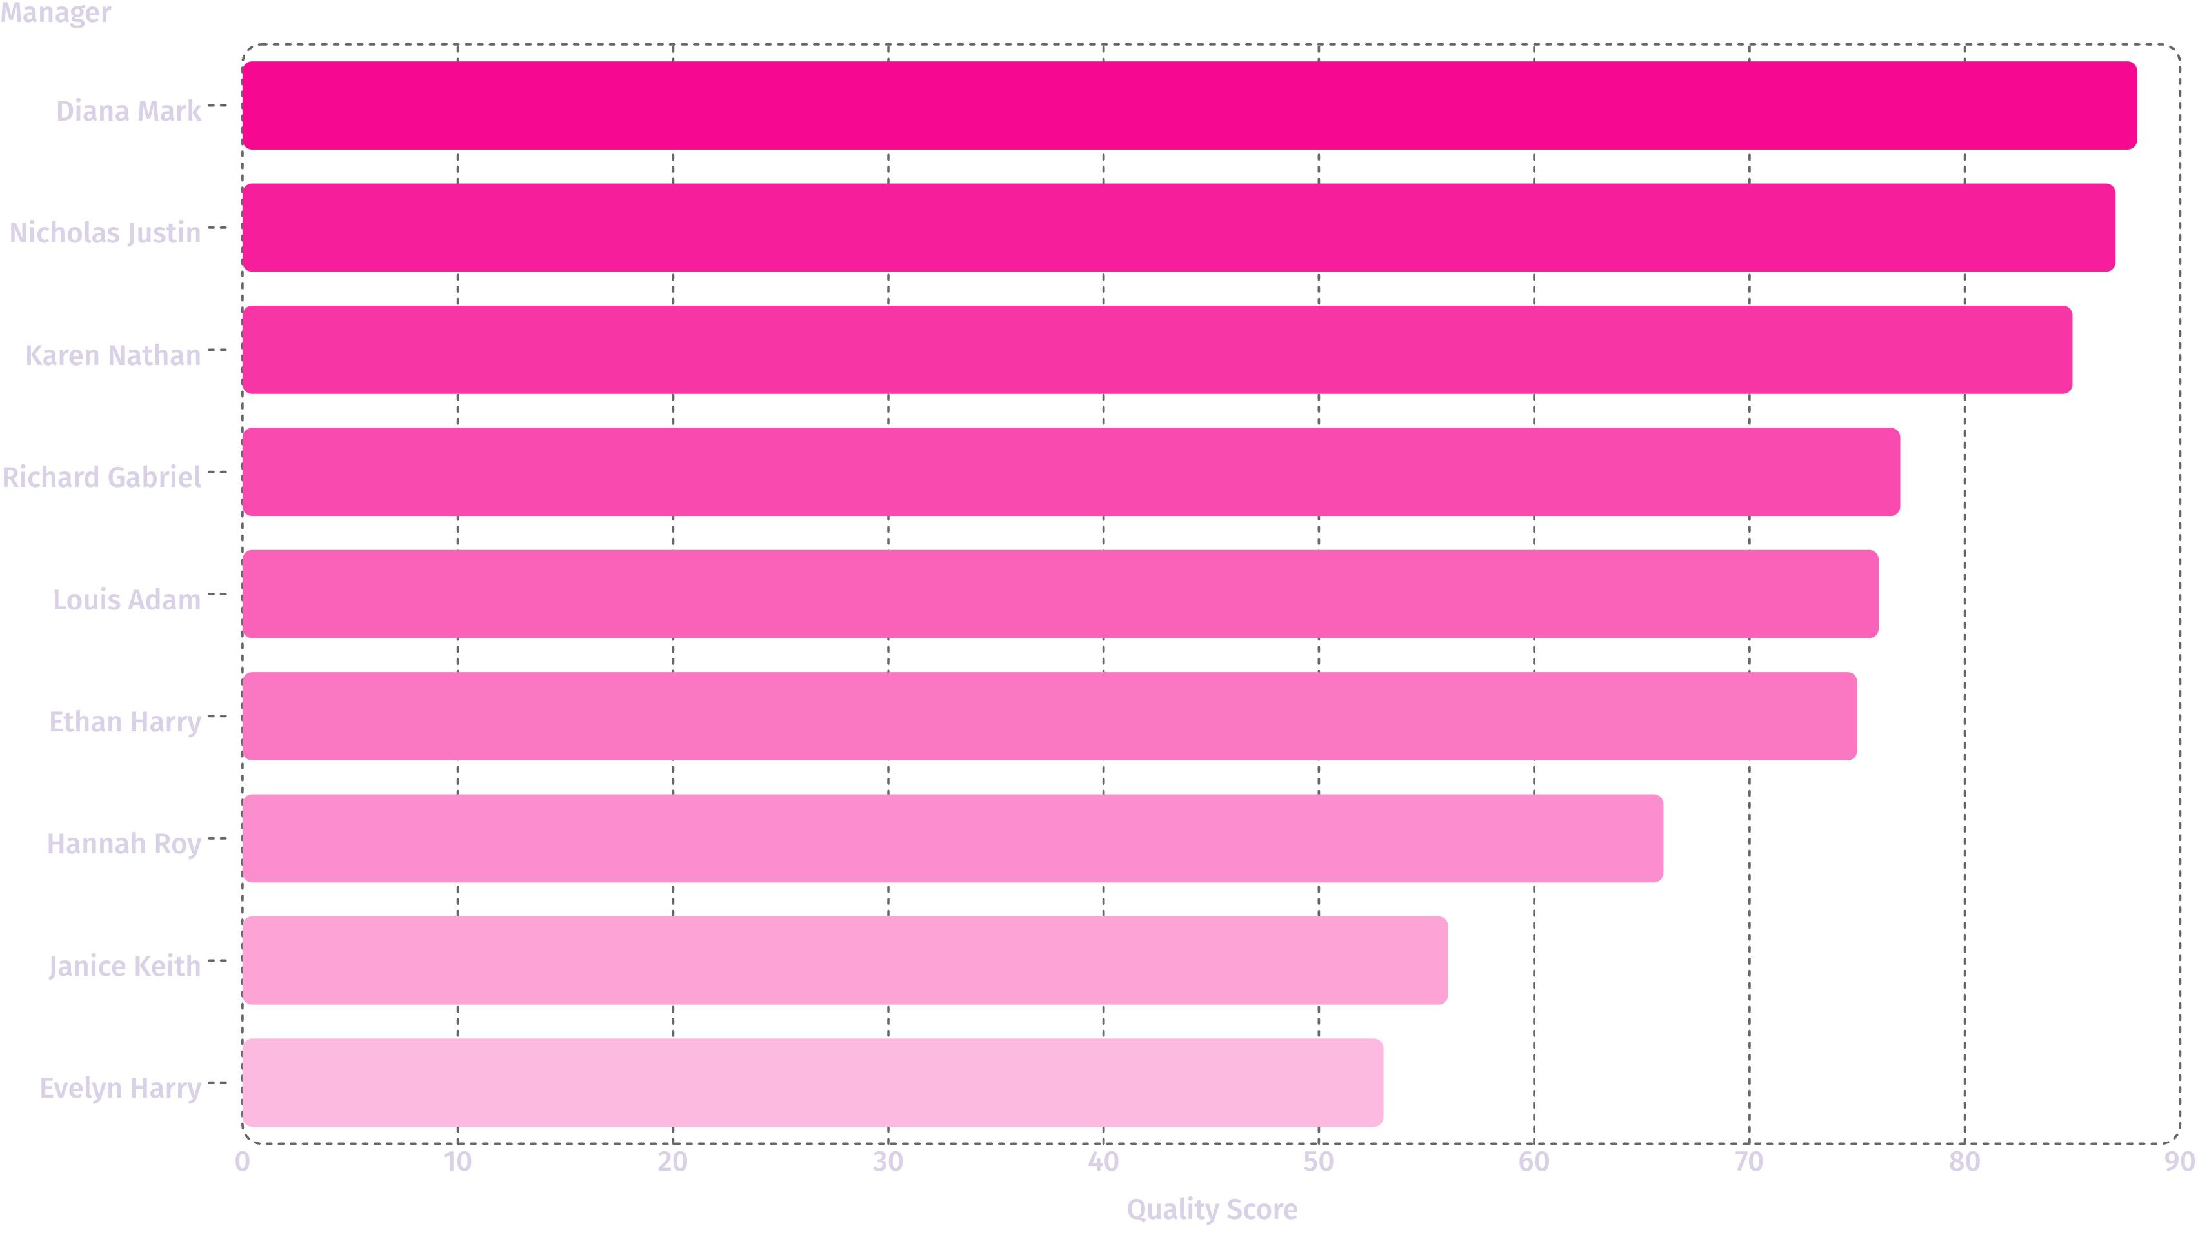
Manager-Level Quality Distribution
Manager scores range ~53%–88%. Spotlight top performers (Diana Mark, Nicholas Justin, Karen Nathan) for cross-training; address managers below 65% with coaching and targeted action plans.

Slide 8



Employee-Level Uniformity
The employee list in the dataset shows numerous individuals (e.g., Aaron Philip through Jonathan Willie) each attributed an aggregate quality score of 73.38%. This uniformity suggests consolidated averaging or a default assignment — verify raw records to confirm individual variation and avoid masking outliers.

Slide 9


Detailed Visuals — Distribution & Samples
Error Count Bubbles
Sample vs Defects
Clusters 0–30
Defects 0–8
The bubble visualization maps sum of errors by sample and defects. Use this to identify clusters of high-defect samples and prioritize sampling strategy or process audits where bubbles concentrate densely.

Slide 10


Conclusions & Next Steps
1. Validate Data
Confirm whether identical location and employee scores reflect true parity or data-normalization artifacts; audit raw records.
2. Targeted Root-Cause
Investigate March and June error/defect spikes and top defect contributors; run focused RCA sessions.
3. Best-Practice Transfer
Leverage top managers' approaches (e.g., Diana Mark) to coach lower-performing teams and reduce defects.
4. Monitoring & Controls
Implement targeted quality controls and monthly KPI reviews; aim to reduce defects_% from 18.88% and error_% from 7.75% while improving quality_score above 73.38%.
Theme accent: #f94cafff used for emphasis in layout. Prioritize data validation before large-scale process changes.

