Slide 1
Outline
ABSTRACT
PROBLEMS IN EXISTING SYSTEM
PURPOSE OF THE PROJECT
FUNCTION REQUIREMENTS
SYSTEM MODULES
SYSTEM REQUIREMENTS
FRONT END AND BACK END OF SYSTEM
SCREENSHOTS OF PROJECT
FUTURE ENHANCEMENT
CONCLUSION

Slide 2
1. ABSTRACT
-> This data science project presents a movie recommender system powered by natural language processing.
-> By analyzing user ratings and movie attributes, our system generates personalized recommendations, enabling users to discover films aligned with their tastes and preferences .
-> Through rigorous experimentation and evaluation, we showcase the effectiveness of our approach in enhancing the user experience by providing relevant and engaging movie suggestions in an ever-expanding content landscape.

Slide 3
2. PROBLEMS IN EXISTING SYSTEM
-> Cold Start Problem: When new users register or new movies are added to the system, there is insufficient data available to make accurate recommendations. This leads to poor initial recommendations until enough data is collected.
-> Popularity Bias: Many recommender systems tend to recommend popular movies to users, neglecting to offer diverse recommendations that cater to individual tastes and preferences. This bias can result in users missing out on lesser-known but potentially enjoyable films.
-> Scalability: As the size of the user and movie databases grows, computational complexity increases, leading to slower response times and resource-intensive operations.

Slide 4
3. PURPOSE OF THE PROJECT
The Movie Recommender system is a tool that suggests movies to users based on their personal preferences.
It uses natural language processing and machine learning to analyze data points, such as a user's previous movie choices, to generate personalized recommendations.
In essence, the purpose of a movie recommender system in data science is to leverage algorithms and data analysis techniques to deliver personalized movie recommendations that enhance user satisfaction, engagement, and content discovery while driving business growth and success.

Slide 5
4. FUNCTION REQUIREMENTS / Functionalities
-> Data Collection and Preprocessing
-> Recommendation Algorithm Implementation (Natural Language Processing)
-> Evaluation and Performance Metrics
-> User Interface Development
-> Security and privacy

Slide 6
5. SYSTEM MODULES
-> Data Collection and Preprocessing Module
-> Recommendation Algorithm Module (Natural Language Processing)
-> Evaluation and Testing Module
-> User Interface Module
-> Deployment and Integration Module
-> Security and Privacy Module

Slide 7
6. SYSTEM REQUIREMENTS
-> Data Collection and Preprocessing
-> Recommendation Algorithm Implementation (Natural Language Processing)
-> User Interface
-> Evaluation and Metrics
-> Deployment and Integration

Slide 8
7. FRONT END AND BACK END OF SYSTEM
Streamlit
HTML
CSS
Machine learning
Deep learning
SQL
Natural Language Processing

Slide 9
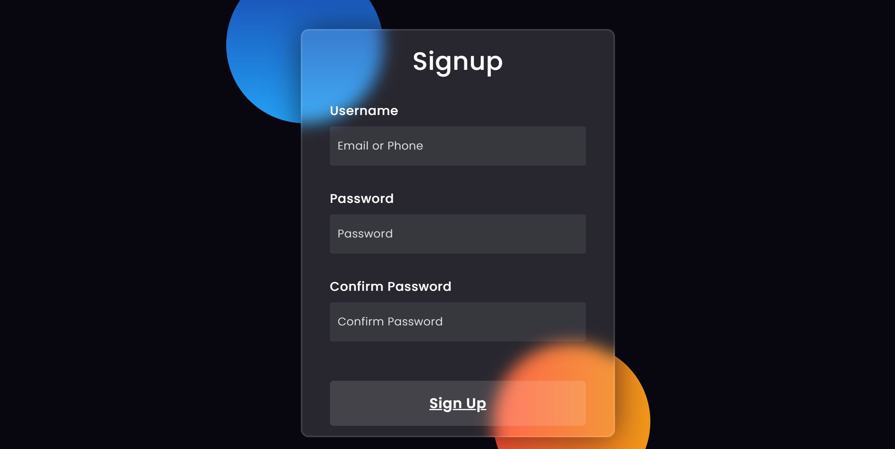
8. SCREENSHOTS OF PROJECT

Slide 10
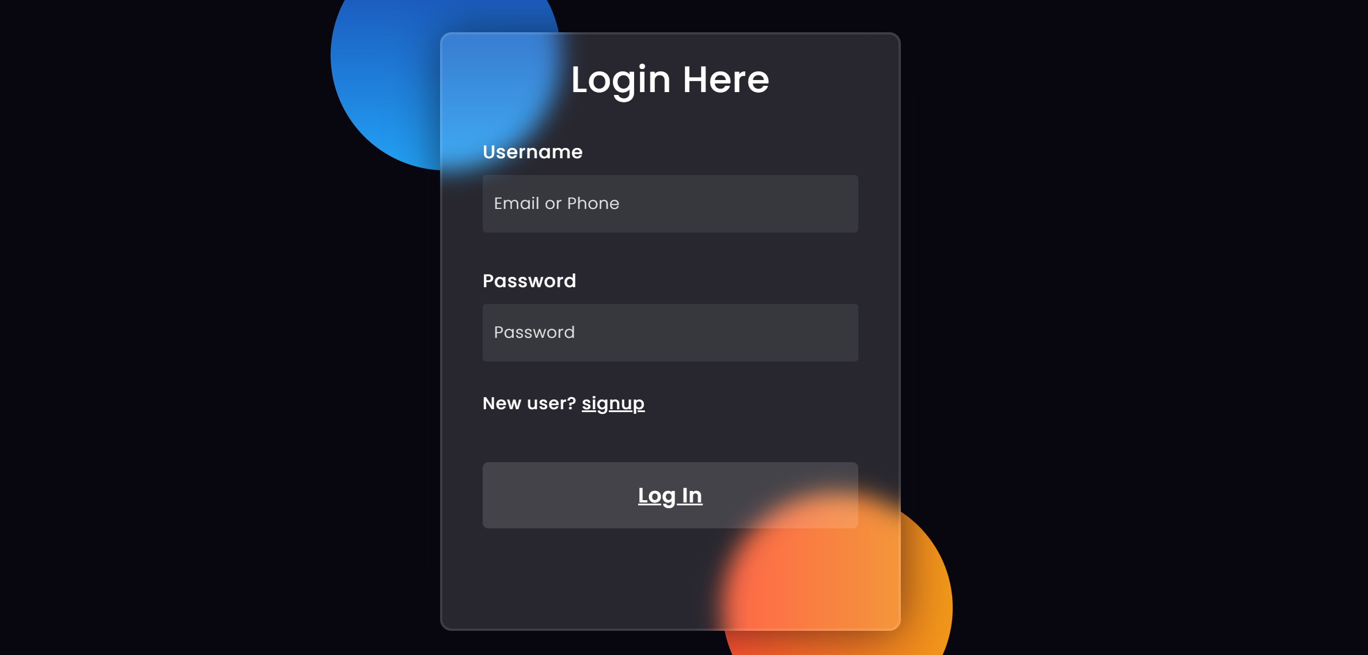

Slide 11
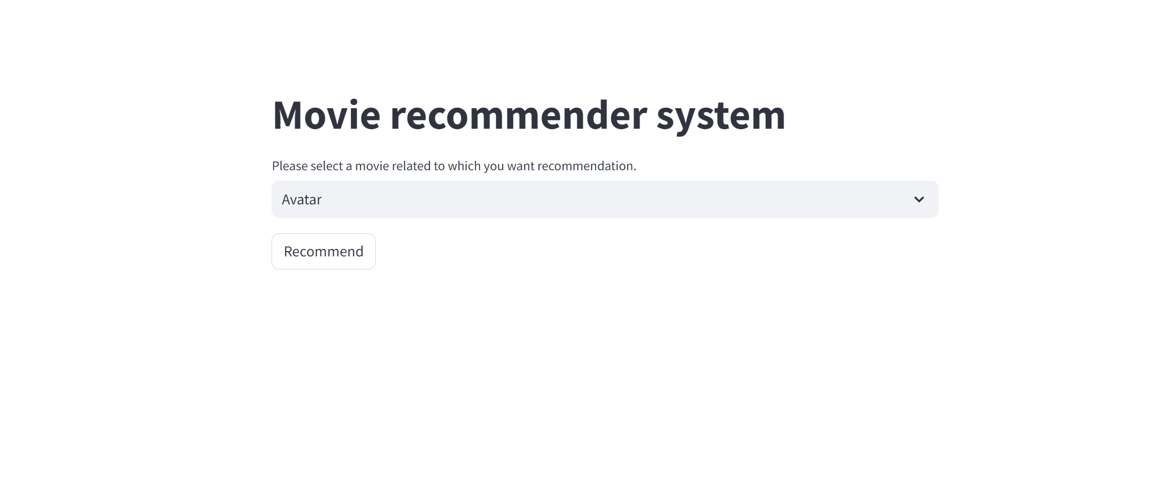

Slide 12
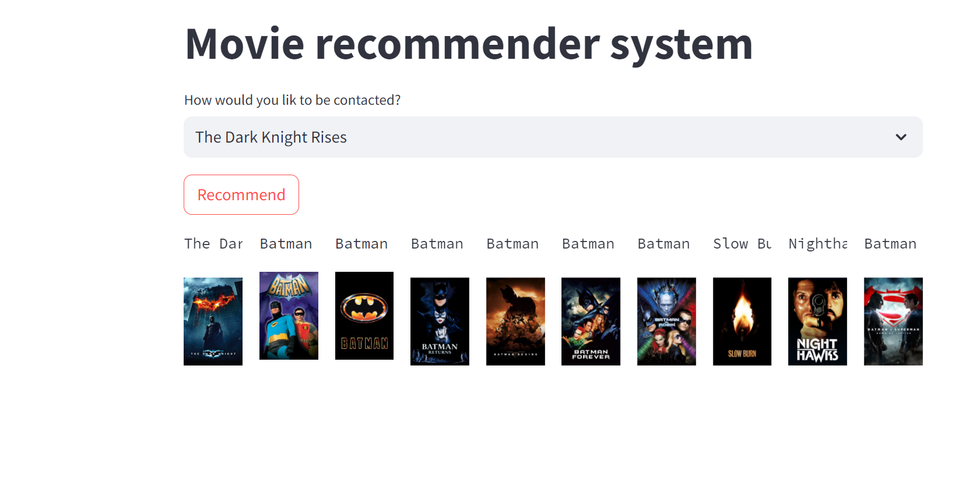

Slide 13
9. FUTURE ENHANCEMENT
Context-Aware Recommendations
Multi-Modal Recommendations
Deep Learning Techniques
Explainable AI
Federated Learning
Hybrid Recommendation Models
Dynamic Adaptation
Fairness and Bias Mitigation
Interactive Recommendation Interfaces

Slide 14
10. CONCLUSION
→ In conclusion, the Movie Recommender System developed using Streamlit leverages data science techniques to provide personalized movie recommendations to users.
→ Through filtering algorithms and user input, it effectively suggests movies tailored to individual preferences, enhancing the movie-watching experience.
→ With its intuitive interface and accurate suggestions, the system offers a seamless and enjoyable way for users to discover new films.

Slide 15


