Slide 1

How to create AWS free tier account

Slide 2
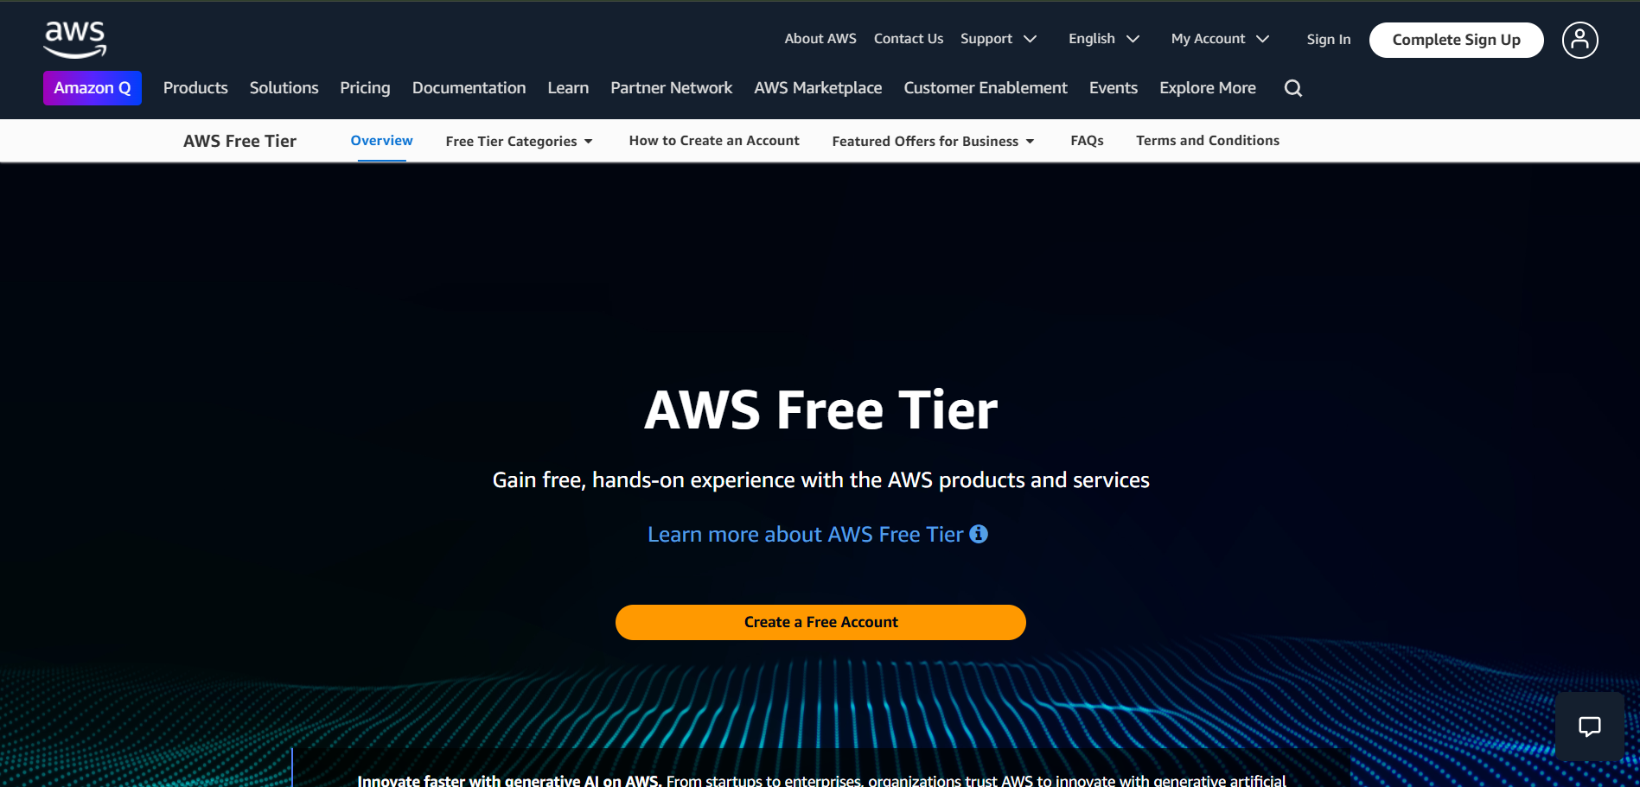
STEPS
Search “AWS FREE TIER ACCOUNT” in GOOGLE
Click the first link that redirect to the AWS official Website
3.Once you land in the above page click ”create free account”

Slide 3
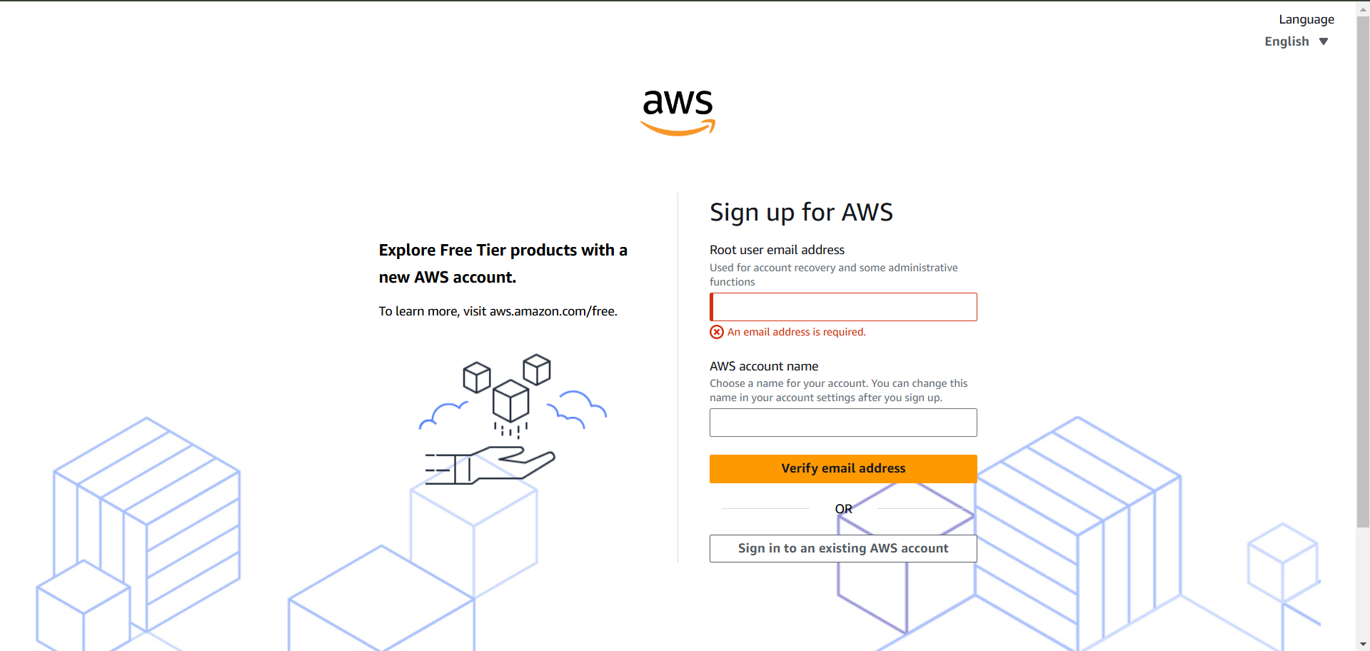
4.You will land in above page
5.After that give ROOT EMAIL ADDRESS and AWS ACCOUNT NAME
6.Click “VERIFY EMAIL”
7. You will receive the verification email from aws and put the verification code
8.Click “verify”

Slide 4
9.You will be asked to enter ROOT PASSWORD
10.After that you will asked to fill contact information. Once completed click continue
IMPORTANT POINT TO BE CONSIDER BEFORE NEXT STEP
checkout their free tier billing policy and more about how AWS BILLING WORKS
11.The billing information will land in your screen, Give details about card and click continue
12.You will get the SMS code in your registered mobile number.
13.Enter and click continue.
14.You will redirect to SELECT A SUPPORT PLAN page
15.Select “BASIC SUPPORT- FREE” and click complete signup.
16. Now you will receiver the AWS READY TO USE email once you have received , yeah Done .
AWS FREE TIER ACCOUNT is created successfully

