Slide 1
CUSTOMER CONVERSION PREDICTION - Application to predict whether a customer will opt for an insurance policy or not
SQUAD-A05 MEMEBER
JAI PRAKASH
BALAMURGAN
THANUJA
BIJU K M
VISHAL
DATATHAON 1.0
Real world Data science problem
(30 hours live hackathon event), an initiative by GUVI

Slide 2
UNDERSTANDING THE PROBLEM STATEMENT:
Analyzing the historic data of customer conversion to Insurance plans.
Gather insights from the data
Our task to suggest on business decision/technique to be followed to increase the conversion rate.
ML Supervised Learning
Classification problem
ML USED
NO
DISCRETE DATA
JOB
MARITAL
EDUCATION
CALL TYPE
MONTH
PREVIOUS OUTCOME
DATA SET
RandomForestClassifier
LogisticRegression
AdaBoostClassifier
KNeighborsClassifier
GaussianNB
AGE
DAY
DURATION
NO OF CALL
CONTINOUS DATA
YES

Slide 3
WORK FLOW:
DATA CLEANING
EDA
ENCODING
SPLITING
SCALING
MODEL FITTING
EVALUATION
HYDER PARAMETER TUNING
CONCLUSION

Slide 4
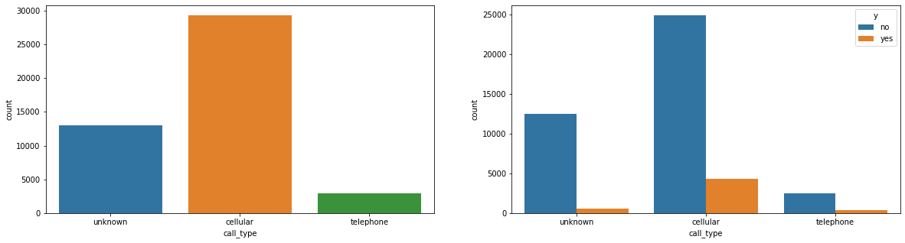
CATEGORICAL ANALYSIS:
CALL TYPE -VS- TARGET
INTREPRETATION:
The cellular type conversation is contributing a lot towards customers opting for insurance plan.

Slide 5
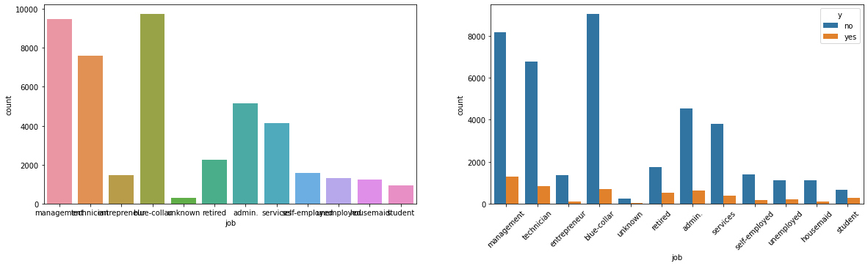
CATEGORICAL ANALYSIS:
JOB -VS- TARGET
INTREPRETATION:
The most targeted customers: Blue-collar job, but comparing with conversion rate, we end up in losing lot of money.
(Better to avoid targeting Blue-collar customers a lot)
Conversion rate is maximum: Management.
Based on Power law distribution, ~80% of people option for insurance is from (Management and Technician)

Slide 6
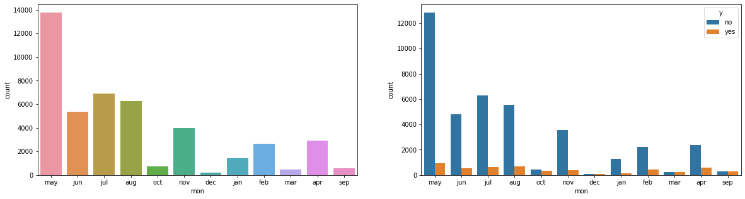
CATEGORICAL ANALYSIS:
MONTH -VS- TARGET
INTREPRETATION:
People opt for Insurance plans when targeted during start of new financial year/When they get their appraisal cycle result.

Slide 7
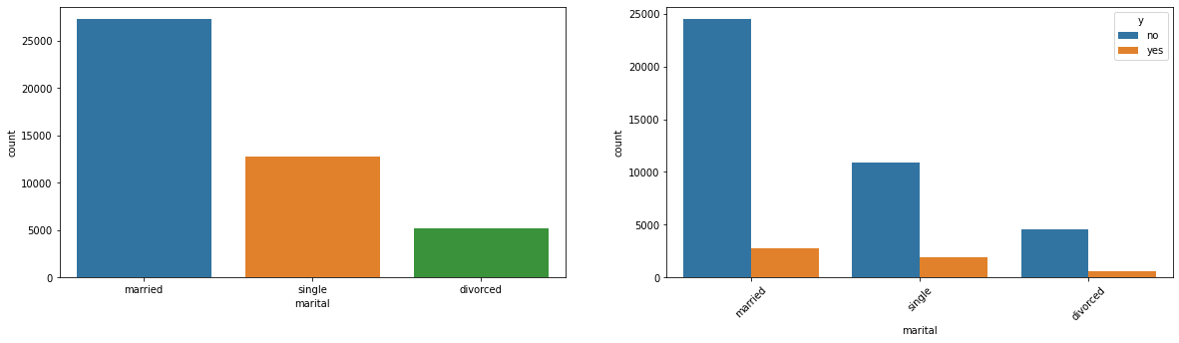
CATEGORICAL ANALYSIS:
MARITAL STATUS-VS- TARGET
INTREPRETATION:
Divorced people are not opting for insurance mostly.

Slide 8
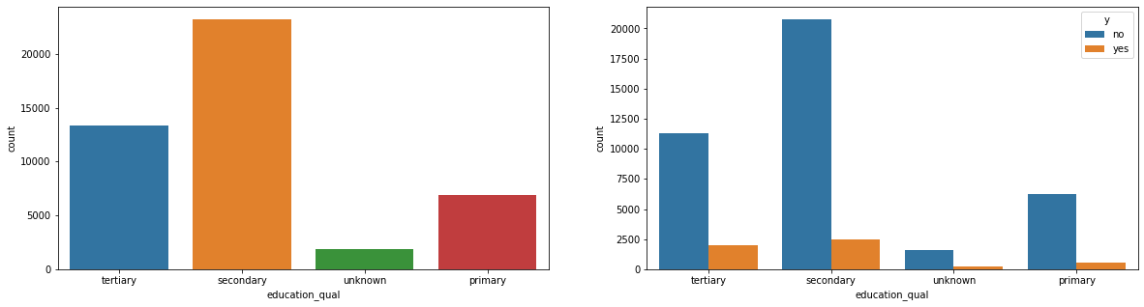
CATEGORICAL ANALYSIS:
EDUCATION QUALIFICATION-VS-TARGET
INTREPRETATION:
People with higher education(Secondary/Tertiary -->Bachelors/Masters) are option for insurance plans.

Slide 9
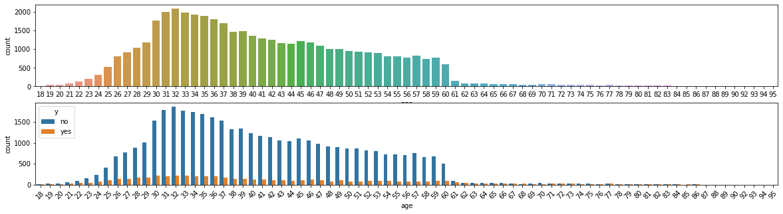
NUMERICAL ANALYSIS:
AGE-VS-TARGET
INTREPRETATION:
People between 25 and 60 age are opting for insurance.
Senior citizens are not opting for insurance.
Also people below 18 years are not opting for insurance(Please keep age > 18 filter)

Slide 10
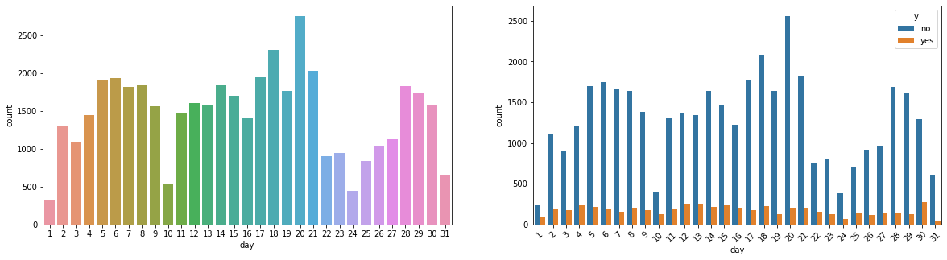
NUMERICAL ANALYSIS:
DAY-VS-TARGET
INTREPRETATION:
As data is uniformly distributed across dates, we don't infer any insight from above.

Slide 11
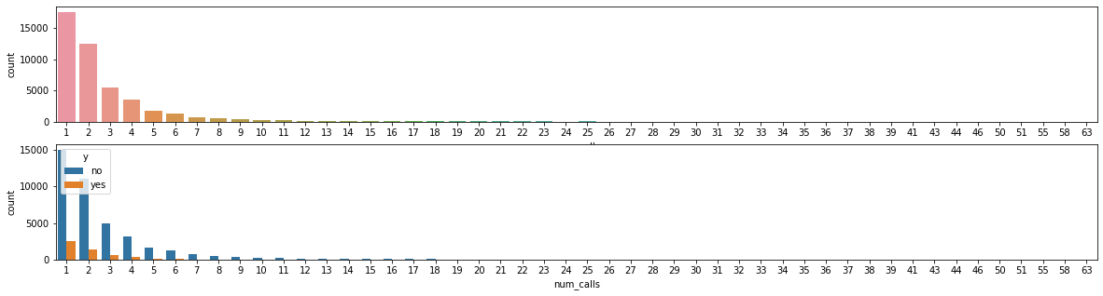
NUMERICAL ANALYSIS:
NO OF CALL -VS-TARGET
INTREPRETATION:
When contacted over phone, mostly customers opt for insurance in max 3 attempts.
As s cost effective approach, avoid reaching customer over phone after 3 attempts.

Slide 12
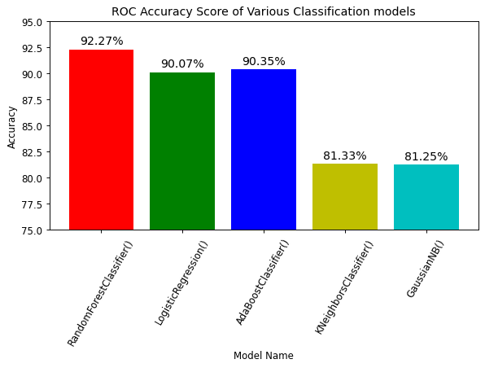
MODEL OUTPUT:

Slide 13
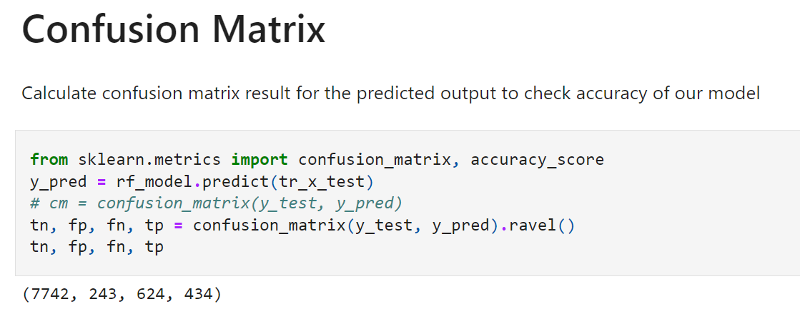

Slide 14
CONCLUSION :
Performed Hyper parameter Tuning
RF classifier is the best model.
Performed hyper parameter tuning for the Random Forest Classifier.
Below are few observation:
Random Forest ROC Classifier accuracy: 92.45 %
After hyper parameter tuning: : 92.60%

