Slide 1
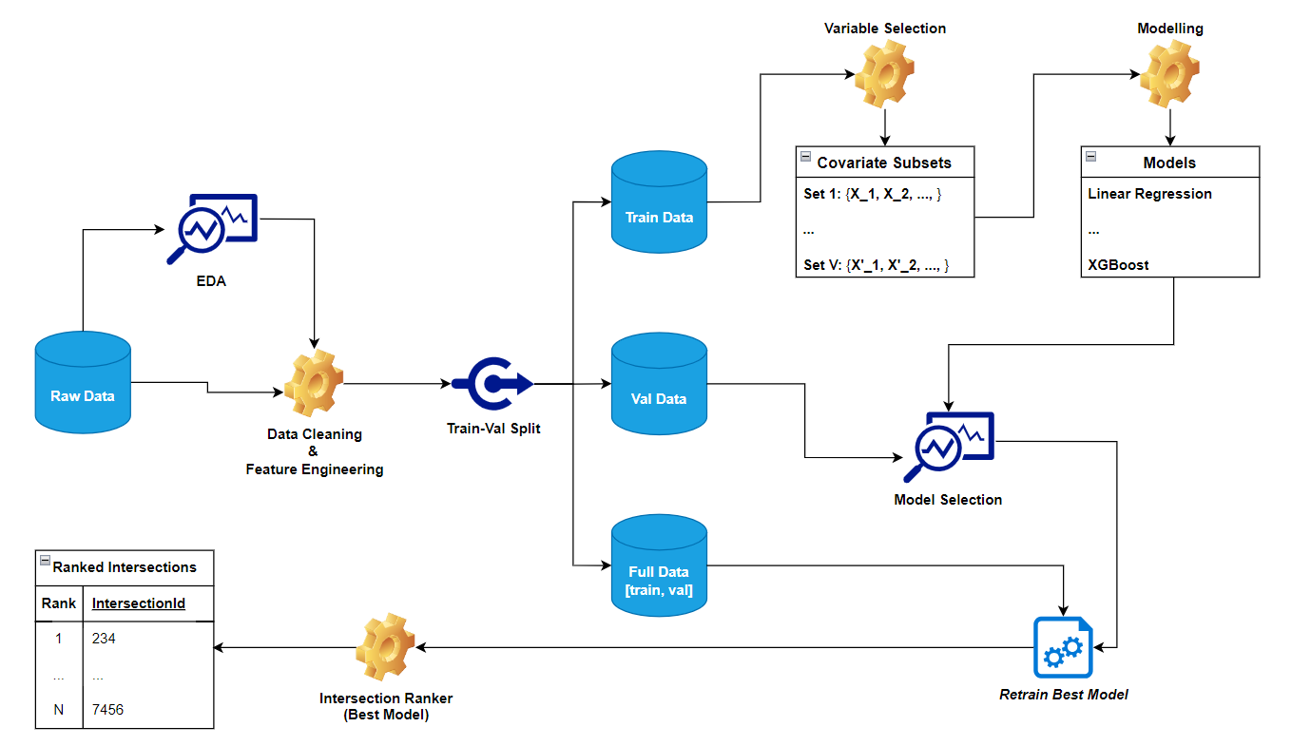
Road Safety Pilot Project: Intersection Ranking
By Hair Albeiro Parra Barrera and Charles Julien
Objective of Study
Methodology Architecture Diagram:
Assessment and ranking of street intersections to prioritize the riskiest ones for infrastructure improvements.
Data used
Collection of accident data, traffic data, and road geometry data for 1864 signalized intersections.
Methodology
Use of statistical learning tools to model safety of intersection based on accidents counts over the past 10 years.

Slide 2
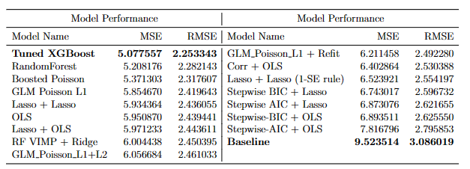
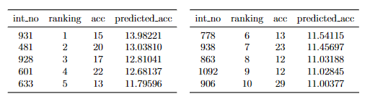
The Results
The models performance
The Rankings
Using that model and each intersection attributes, we have been able to rank them in order of safety. A csv file with the intersections’ numbers and their ranking has been provided.
It shows that we have succeeded to model the safety of intersections based on their attributes.
Conclusion
How much do these rankings differ from simple ordering using the observed accidents count?
Our predicted rankings show spearman correlation of 0.682, meaning that they show much similarity in their general order, proof that the model is capturing the structure without overfitting the sample data.
This study has succeeded in providing a data driven approach to rank intersection’s safety based on attributes like traffic, geometry, signalized intersection, etc. Hence, it provides an alternative to ranking them purely based on their observed accidents count.

