Slide 1


Ethereum & Smart Contracts --Enabling a Decentralized Future
LING Zong, Ph. D.
Senior Software Engineer / Scientist
IBM Almaden Research Center
San Jose, California, U.S.A.
Notes:
# It's important to cover the history of Bitcoin so that you can understand the backgrounds and motivations of the people running the industry today.
# First, we'll cover the most basic concepts relating to Bitcoin - you'll hear these over and over again, and then I'll outline the history covered in this lecture before we dive in.
# Note that this lecture is not very representative - the rest of the course is going to be a lot more technical.

Slide 2
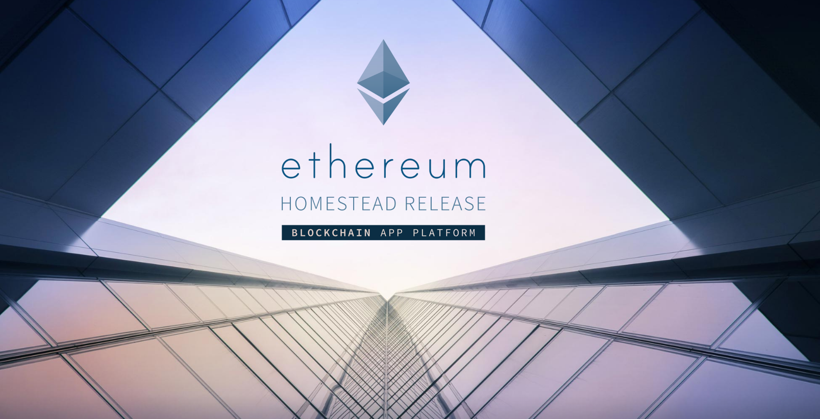

Slide 3
Ethereum
BLOCKCHAIN
TRUSTLESS
DECENTRALIZED APPS
SMART CONTRACTS
buzzwords
overview

Slide 4
Overview
Decentralized: no single point of control/failure; censorship resistant
Blockchain: state is built from a series of blocks, composed of transactions, created by accounts, + network consensus
Smart Contracts: more sophisticated scripting that allows for (nearly) arbitrary computation
Transaction-based: state transitions occur on new transactions, which transfer value and information between accounts
Account-based: state is made up of accounts, with each account having an address, some balance of ether, and optionally some contract code and storage
What is Ethereum?
Ethereum is a decentralized platform that runs smart contracts.
Ethereum is an account-based blockchain.
Ethereum is a distributed state machine that relies on transactions to move between states.

Slide 5
Some Differences from Bitcoin
Though Ethereum and Bitcoin have similar features, both are billed quite differently:
Ethereum: Smart Contract Platform
Bitcoin: Decentralized Asset
Account-based instead of UTXO-based
Ethereum has a Turing complete scripting language that is significantly more powerful than Bitcoin Script. Enables smart contracts.
The Ether asset is, in some ways, a side effect of having an incentive-aligned smart contract platform.
Ethereum plans to move to Proof-of-stake in the near future.
Misc. Implementation details:
Block creation time: (~12 sec vs ~10 min)
Proof-of-work: (Ethash vs Sha256)
Ethash is (currently) ASIC resistant
Exchange Rate: (2016-10-19 00:37 PST)
ETH ⇒ USD : $12.45
BTC ⇒ USD : $635.38
In computability theory, a system of data-manipulation rules (such as a computer's instruction set, a programming language, or a cellular automaton) is said to be Turing complete or computationally universal if it can be used to simulate any Turing machine.
Notes:
https://en.wikipedia.org/wiki/Turing_completeness
In computability theory, a system of data-manipulation rules (such as a computer's instruction set, a programming language, or a cellular automaton) is said to be Turing complete or computationally universal if it can be used to simulate any Turing machine.

Slide 6
Accounts vs. UTXOs
Externally Owned Accounts (EOAs):
Generally owned by some external entity
Identified by an address
Holds some balance of ether (unit of Ethereum currency)
Can send transactions (transfer ether to other accounts, trigger contract code)
Contract Accounts (Contracts):
Identified by an address
Has some ether balance
Has associated contract code
Code execution is triggered by transactions or messages (function calls) received from other contracts
Contracts have persistent storage
Recall: A Bitcoin user’s available balance is the sum of unspent transaction outputs for which they own the private keys to the output addresses.
Instead Ethereum uses a different concept, called Accounts.
Bitcoin:
Ethereum:
Bob owns private keys to set of UTXOs
Evan owns private keys to an account
address: “123abc…”
balance: 10 ETH
code: c := a + b
5 BTC -> Alice
3 BTC -> Alice
2 BTC -> Alice

Slide 7
All Accounts == Network State
The state of all accounts is the state of the Ethereum network, i.e., the entire Ethereum network agrees on the current balance, storage state, contract code, etc... of every single account.
The network state is updated with every block.
You can think of the block as the state transition function; it takes the previous state and produces a new network state, which every node has to agree upon.
Accounts interact with the network, other accounts, other contracts, and contract state through transactions.

Slide 8
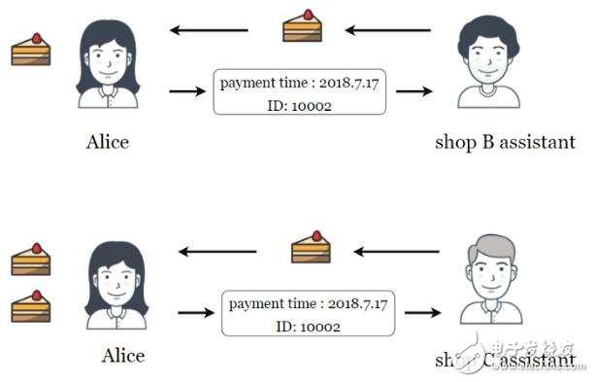
Accounts Rationale
Every account has a nonce attached that increments every time it sends a new transaction. A transaction is valid if its nonce value is 1 + account’s nonce.
This means that even no-longer-used accounts can never be pruned from the account state!
Example of a replay attack:
Bob receives 5 ETH from Alice.
Bob broadcasts the same exact txn…
Without a nonce, network sees another totally valid txn! With nonce, Bob can’t modify new txn’s nonce since he doesn’t have access to Alice’s private keys.
Space Savings: only need to update each account’s balance instead of storing every UTXO
Most importantly, smart contracts are more intuitive to program when transferring between accounts with a balance vs. constantly updating a UTXO set to compute user’s available balance.
One weakness of the account model is that in order to prevent replay attacks, every transaction must have a "nonce".
Notes:
现在Alice拿着付款信息给蛋糕店B的服务员后，蛋糕店C的服务员用电脑确认信息后将蛋糕给Alice。拿到之后Alice又拿相同付款信息给蛋糕店C的服务员后，蛋糕店C的服务员用电脑确认信息后又将蛋糕给Alice，因此Alice得到两个蛋糕，如果蛋糕店B和蛋糕店C能够有确认付款信息，就不会发生重放漏洞，没有漏洞就没有被攻击的可能，也就不会损失蛋糕了。
http://www.elecfans.com/blockchain/888196.html

Slide 9
Smart Contracts - Introduction
con·tract
(noun) /ˈkäntrakt/
a written or spoken agreement, especially one concerning employment, sales, or tenancy, that is intended to be enforceable by law.
smart con·tract
(noun) /smärt ˈkäntrakt/
code that facilitates, verifies, or enforces the negotiation or execution of a digital contract.
In the case of Ethereum, a smart contract is just an account with code.
Contracts in Ethereum are like autonomous agents that live inside of the Ethereum execution environment, always executing a specific piece of code when “poked” by a transaction or message, and having direct control over their own ether balance and their own permanent state.

Slide 10
Smart Contracts in Ethereum
Ethereum Contracts generally serve four purposes:
Store and maintain data, representing something useful to users or other contracts, e.g., a token currency or organization’s membership.
Manage contract or relationship between multiple, usually untrusting users, e.g., financial contracts, escrow, insurance.
Provide functions to other contracts, serving as a software library.
Serve as an externally owned account with a more complicated access policy, a.k.a. “forwarding contract”. Usually the contract receives incoming messages and forwards them to a certain destination if certain conditions are met, e.g., a multisignature contract that only forwards the message if M-of-N of the key holders approve.
Or some combination of the above!

Slide 11
Ethereum Virtual Machine
EVM Design Goals:
Simplicity: op-codes should be as low-level as possible. The number of op-codes should be minimized.
Determinism: The execution of EVM code should be deterministic; the same input state should always yield the same output state.
Space Efficiency: EVM assembly should be as compact as possible
Specialization: easily handle 20-byte addresses and custom cryptography with 32-byte values, modular arithmetic used in custom cryptography, read block and transaction data, interact with state, etc
Security: it should be easy to come up with a gas cost model for operations that makes the VM non-exploitable
The Ethereum contract code that actually gets executed on every node is so-called EVM code, a low-level, stack-based byte-code language.
Every Ethereum node runs the EVM as part of its block verification procedure.
EVM as a state transition mechanism:
(block_state, gas, memory, transaction, message, code, stack, pc)
(block_state’, gas’)
where block_state is the global state containing all accounts and includes balances and long-term storage

Slide 12
EVM Code Compilation
Solidity Contract
contract PhilipToken { /* ... */ }
solc
(Solidity Compiler)
EVM Code
PUSH1 0x60
PUSH1 0x40
. . .
POP
JUMP
Serpent Contract
def register(key, value):
/* … */
serpent compiler
Notes:
Solidity是一种语法类似JavaScript的高级语言。被设计成以编译的方式生成以太坊虚拟机代码。 Serpent是一种用来编写以太坊合约(Ethereum Contract)的高级编程语言。Serpent翻译成中文意思是"大蛇"，如这个名字所示，这是一种与Python类似的编程语言。

Slide 13
EVM Gas and Fees
Immediate Issue:
What if our contract has an infinite loop?
function foo() { while (true) { /* Loop forever! */ } }
Every node on the network will get stuck executing the loop forever! By the halting problem, it is impossible to determine ahead of time whether the contract will ever terminate ⇒ Denial of Service Attack!
Ethereum’s Solution:
Every contract requires “gas”, which “fuels” contract execution.
Specifically, every EVM op code requires a certain amount of gas in order to execute.
Every transaction specifies the startgas, or maximum quantity of gas it is willing to consume, and the gasprice, or the fee in ether it is willing to pay per unit gas.

Slide 14
EVM Gas and Fees
At the start of the transaction, startgas * gasprice ether are subtracted from the sender’s account.
If the contract successfully executes and uses less than the prespecified amount of gas, the remaining gas is refunded to the sender.
If the contract execution runs out of gas before it finishes, then execution reverts and startgas * gasprice are not refunded.
What about the infinite loop?
Ethereum still allows the infinite loop; however, whoever is attempting to DoS the network has to pay enough ether to fund the DoS.
Think of purchasing gas as purchasing distributed computational power.

Slide 15
Ethereum Smart Contracts
Ethereum is not about optimising efficiency of computation
Its parallel processing is redundantly parallel to offer an efficient way to reach consensus on the system state without needing trusted third parties.
Since contract executions are redundantly replicated across nodes, they are expensive, which generally creates an incentive not to use the blockchain for computation that can be done off chain.

Slide 16
Smart Contracts
TOKENs
PUBLIC DATABASES
CROWDFUNDING
FILE STORAGE
MARKETs
BLOCKCHAIN IOT
AUTOMATED SHARING ECONOMY
DAOs
Use Cases and Analysis

Slide 17
Basic Use Cases

Slide 18
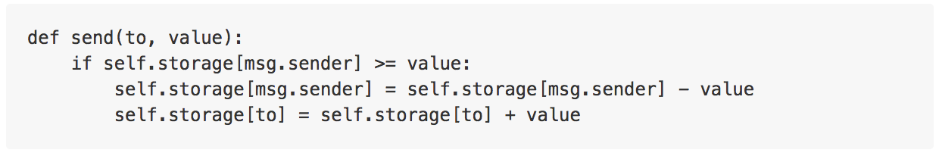
Token Systems
Very easy to implement in Ethereum
Database with one operation
Ensure Alice has enough money and that she initiated the transaction
Subtract X from Alice, give X to Bob
Example (from Ethereum white paper):

Slide 19
Minimum Viable Token
PhilipToken is a stripped down version of a digital token contract, written in Solidity.
You can instantiate it with some initial supply of tokens which can be transferred between different accounts.
Remember, the contract is an account! It has its own ether balance, address, storage, etc...
Token
contract PhilipToken { /* Maps account addresses to token balances */ mapping (address => uint256) public balanceOf; /* Initializes contract with initial supply tokens to the creator of the contract */ function PhilipToken(uint256 initialSupply) { // Give the creator all initial tokens balanceOf[msg.sender] = initialSupply; } /* Send tokens to a recipient address */ function transfer(address to, uint256 value) { if (balanceOf[msg.sender] < value) throw; // Check if the sender has enough if (balanceOf[to] + value < balanceOf[to]) throw; // Check for overflows balanceOf[msg.sender] -= value; // Subtract from the sender balanceOf[to] += value; // Add the same to the recipient } }
Notes:
Solidity is an object-oriented, high-level language for implementing smart contracts. Smart contracts are programs which govern the behavior of accounts within the Ethereum state.

Slide 20
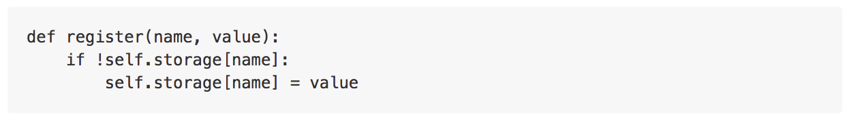
Public Registry / Public database
Example: Namecoin
DNS system
Maps domain name to IP address
"maxfa.ng" => "69.69.69.69"
Immutable
Easy implementation in Ethereum
Example (from Ethereum white paper):

Slide 21
Crowdfunding and Incentivization
Simple Example: "Ether-on-a-stick"
Allows you to put a bounty on the completion of arbitrary tasks
Contributors pool money into a smart contract that pays out to a specified recipient iff contributors vote that the task was indeed complete
Example use case
A company is polluting a local river and nearby residents bear a negative externality
Local gov't slow/unresponsive but residents are willing to pay
Residents pool money together to incentivize the company to clean it up
Implements a Dominant Assurance Contract: solves the free rider problem
https://en.bitcoin.it/wiki/Dominant_Assurance_Contracts
Notes:
Externality n. 外形; 外在性; 外部事物; （经济学名词） 外部效应
bounty n. （由政府提供的） 奖金，赏金; 慷慨，大方; 赠物，赠金;
https://baike.baidu.com/item/%E6%90%AD%E4%BE%BF%E8%BD%A6%E9%97%AE%E9%A2%98/8047102?fromtitle=Free%20rider%20problem&fromid=11190426&fr=aladdin

Slide 22
Advanced Use Cases

Slide 23

Decentralized File Storage
"Decentralized Dropbox Contract": Pay individuals small amounts of Ether to rent out extra hard drive space
Example contract specification:
Split cat picture into blocks, encrypt each block for privacy
Create Merkle tree from blocks, save Merkle root in contract
Every N blocks, the contract will:
Using previous block header (source of randomness), pick a random block in Merkle tree
First entity to provide proof of storage of block (Merkle branch) receives small ETH reward
Recovering the file:
Query node storing file and pay a small fee (via micropayment channels) to retrieve it
>Decrypt data, obtain furry kitten
>Profit

Slide 24


Decentralized Prediction Markets
Prediction markets draws on the wisdom of the crowd to forecast the future
Market makers create event
Ex: "Who will win the 2020 US Presidential election?"
Events must be public and easily verifiable, with set due date.
Participants buy shares of Trump or Biden and pay a small fee
On election day, random oracles on the network vote on who won.
Oracles who voted with the majority collect a fee, they are otherwise penalized
Shareholders who voted correctly cash out on their bet
The share price for each market accurately represents the best predicted probability of event occurring
Someone has extra information => arbitrage opportunity
Notes:
In cryptography, a random oracle is an oracle (a theoretical black box) that responds to every unique query with a (truly) random response chosen uniformly from its output domain. If a query is repeated it responds the same way every time that query is submitted. https://en.wikipedia.org/wiki/Random_oracle
Arbitrage n.仲裁; 套汇，套利;

Slide 25
Decentralized Prediction Markets
Use cases
Cost efficient way to buy information on a future event
Instead of hiring pundits and experts, create a market for your event
"Will this movie be a flop?"
Bet for and against your event to incentivize people who have information about this event (in this case, Hollywood insiders)
Hedging and insurance
Fire insurance is a bet that your house will burn down
Create market "Will my house burn down?" and vote yes
=> receive compensation if your house burns down
Possible to implement an entire insurance liquidity pool
Potential for extremely thin margins since no central intermediary is required
Notes:
https://baike.baidu.com/item/FLOP/3412284
Pundits n.行家; 权威; 专家; flop v. (因疲惫而) 猛然坐下，沉重地躺下; (沉重、笨拙或不自主地) 落下，移动，悬挂; 砸锅; 完全失败;
n. (电影、戏剧、聚会等) 失败，不成功;

Slide 26
Decentralized Prediction Markets
Use cases
Set up a security bug bounty
"Will my company be hacked?" Bet heavily against it to create a financial incentive
Someone who finds vulnerability will buy affirmative shares, then perform their hack
> Profit
Augur secures their own code this way
"Will someone be able to steal the money in this prediction market?"
Signaling: "Put your money where your mouth is"
Demonstrate your commitment to something by showing you will take a large financial loss if you miss your commitment
Ex. Kickstarter campaign; investors are worried you will delay launch date
"Will my Kickstarter campaign launch on time?"
Bet heavily that you WILL launch your produce on time.
Notes:
Bounty n.（由政府提供的） 奖金，赏金; 慷慨，大方; 赠物，赠金;

Slide 27
Decentralized Prediction Markets
Benefits to being decentralized
No restrictions on market creation
But raises ethical questions
Shared liquidity pool
No reason why the same market should exist in multiple countries
Allows for more advanced markets; e.g. combinatorial prediction markets
Censorship-resistant
Automatic, trustless payments

Slide 28
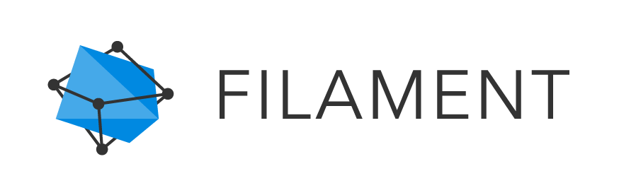
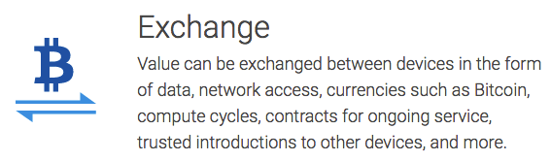
Decentralized IoT
Filament
"Blockchain-based decentralized Internet of Things"
"Ad hoc mesh networks of smart sensors"
Intended for industrial IoT applications
Product
Sensors with 10 mile range
battery lasts years
no internet connection needed - uses mesh networking
Technologies used:
Telehash - end-to-end message encryption
TMesh - self-forming radio mesh networks
Blockname - private device discovery
Uses Bitcoin blockchain + public notaries to verify authenticity of name/address bindings
Blocklet - smart contracts and microtransactions
Filament is a great application of decentralized tech especially because of its emphasis on resilience and dependability.

Slide 29
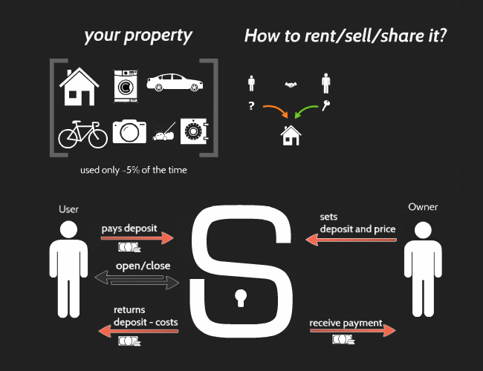
Decentralized Sharing Economy
Slock.it: A lock that can be directly opened by paying it
Owner sets a deposit + price
Renter pays deposit + price into lock connected to Ethereum node
Lock detects payment and unlocks itself
Use Cases (Slock.it):
Fully automated Airbnb apartments
no need to meet with owner for key
Wifi routers rented on demand
Fully automated shop
Purchase goods by sending the price of the good to the lock that holds it
Automated bike rentals

Slide 30

Decentralized Sharing Economy
Benefits of being decentralized (Slock.it):
...Trustless?
Decentralized reputation is very hard to implement
Centralized solutions probably better
Programmable money
Centralized solutions still programmable
Public blockchains (Bitcoin/Ethereum etc) have easier technological integration
No personal information needed to conduct transactions
IoT: Device autonomy
Devices can act independently of a central management system
Modular
???
from slock.it

Slide 31


Decentralized Autonomous Organizations
A Decentralized Autonomous Organization, or DAO, is an organization governed entirely by code (smart contracts)
Create and vote on proposals
Businesses can theoretically exist entirely on a blockchain
Uncertain legal status
"Code is law"
Issues:
Hard to edit the governing laws (the code) once deployed
Possible solution: Child DAO
Inactive participants: not enough people vote on proposals
DASH
Privacy-centric cryptocurrency
% of mining reward
TheDAO
Crowd venture fund
Largest crowdfunded project in history
Raised >$150 million in Ether
Hacked in June 2016, >$60 million worth of Ether stolen (10% of Ethereum market cap)
Other DAOs on Ethereum:
Slock.it
Digix.io
Store gold on the Ethereum blockchain

Slide 32
Generalizations

Slide 33
Limitations of Smart Contracts and Blockchain tech
No trustless way to access outside data
Must rely on oracles to provide information from outside the blockchain
Problem… Oracles must be trusted
Potential Solution: Proven execution (untrusted oracles)
Oraclize.it has a shoddy implementation
TLSnotary - modification of TLS protocol to provide cryptographic proof of receiving https page
Potential Solution: Oracle network votes on information
Drawback: Consensus protocol on top of a consensus protocol
Hard to align incentives/reputation
No way to enforce on-chain payments
Cannot implement financial products like loans and bonds
Money must be held on blockchain to ensure payment
Intuition: We pay interest on loans partially because of risk of default
Contracts cannot manipulate confidential data
Confidential data cannot be assembled on someone else's computer
Very limited access control capabilities
Can only store encrypted data and decrypt it locally
Potential solution: Homomorphic encryption

Slide 34
Essential Properties of Blockchain Killer Apps
Dapps can be thought of as client-side software - no central manager
Trustless environments that need consensus or coordination (ex. Smart grids, energy markets)
Privacy-centric systems (ex. social networks?)
Although data shouldn't be stored on the blockchain itself
Programmable money with open integration
IoT, M2M payments, (e.x. IBM ADEPT)
Easy to send and receive money - no personal information required
Micropayments possible (ex. Brave)
Fault-tolerant, resilient systems (ex. Filament)
Autonomous networks and devices
News ways to creating incentives (ex. Gnosis)
New governance models (ex. DAOs, futarchy)
Disintermediation, censorship-resistance
Trust in math and code, not institutions
Contrast with centralization: Deep integration, cohesive user experience
Efficiency - blockchains are slow in general
Full control over data and read/write permissions
ALWAYS ASK: Why is using a blockchain better than a central database?
Notes:
This is the most important slide in this lecture

Slide 35
Community, Regulation, and Controversy
Readings
(Wiki) Know Your Customer
https://www.wikiwand.com/en/Know_your_customer
(Wiki) BitLicense
https://www.wikiwand.com/en/BitLicense
(Article) BitLicense 2.0
http://www.coindesk.com/bitlicense-2-0-latest-revisions-mean-bitcoin-businesses/
(Article) Overview of the Blocksize Debate:
http://www.coindesk.com/making-sense-block-size-debate-bitcoin/
Optional reading:
A current list of use cases for Ethereum (medium article)
https://medium.com/@AroundTheBlock_/a-current-list-of-use-cases-for-ethereum-b8caa5807553#.2epaf2jud
Demystifying Incentives in the Consensus Computer: Investigates game-theoretic incentive problem in Ethereum similar to our last lecture
https://eprint.iacr.org/2015/702.pdf

Slide 36








END !
Hindi
Traditional Chinese
Thai
Gracias
Thank You
Russian
Spanish
Obrigado
English
Brazilian Portuguese
Arabic
Danke
Grazie
Italian
German
Merci
Simplified Chinese
French
Tamil
Japanese
Korean
Notes:
36

Slide 37
References (incomplete)
Ethereum White Paper
Ether-on-a-stick
https://github.com/phlip9/ether-on-a-stick
Gnosis Use Cases presentation by Martin Koppelmann
http://www.slideshare.net/MartinKppelmann/gnosis-vision-and-crowdsale

Slide 38
Lemmas 1 & 2
Computational power requires electricity, requires $$, reaches equilibrium if miners are breaking even or profitable
Lemma 1: Mining Reward = Mining Cost
If you are roughly breaking even with the capital you invest, there is little to no marginal cost to getting more hashrate. You simply need more capital to attain 51%
Lemma 2: Cost of acquiring 51% < Mining cost

Slide 39
Lemma 3
What profits can you get from owning >51% of the hashrate
Crash the currency? No problem. Regain value (and then some) by shorting Bitcoin on an exchange
You can effectively get 100% of the mining reward
Only mine on your own blocks
Can prevent anyone else from mining - you always produce longest PoW chain
How this would affect the price depends on threshold
q = 51% => 49% of blocks are orphaned
q = 80% => 20% of blocks are orphaned
Average Bitcoin user not really affected, still able to make transactions
Lemma 3: Value of 51% attack > Mining Reward

Slide 40
Combining Lemmas
Lemmas:
Lemma 1: Mining Reward = Mining Cost
Lemma 2: Cost of acquiring 51% < Mining Cost
Lemma 3: Value of 51% attack > Mining Reward
Therefore, Value of 51% attack > Cost of acquiring 51%
If math is correct, Game Theory says that 51% attacking Bitcoin is profitable
(Originally presented by Martin Koppelmann at SF Bitcoin Devs Seminar)

Slide 41
Additional Ideas
Insurance Contracts
A way to offset costs incurred by mining pools
More orphaned blocks are a sign of pool wars
Insurance contracts for bitcoin stakeholders based on number of orphaned blocks

Slide 42
Generalization of Vulnerabilities
Bitcoin mining is zero sum
In general, to increase earnings, someone else needs to be excluded
Members-only Mining
Let hashrate join a collusion until 80% of the network is in, then exclude the rest
No incentive not to join
Attack succeeds, get increased reward
Attack wouldn't fail: conduct attack in such a way that it wouldn't start until the threshold is reached
Naive Example
3 pools collude, own more than 51%
Ignore every 10th block of another pool
Undetectable
More profitable than honest strategy

Slide 43
Post-block Reward Bitcoin
Assumption: average Bitcoin user holds $100,000 in Bitcoin, willing to pay $1000 in fees
(This is when Bitcoin is near 0 block reward)
Is mining based off transaction fees sustainable?
Money must move, must be paid in transaction fees so that miners can collect it as mining reward
Amount of hashpower going into Bitcoin dependent on mining reward
Therefore
(average fees paid) / (avg holdings) = (cost of attacking) / (market cap)
In our example, attacker only needs to pay 1% of the market cap of Bitcoin to attack
Post reward Bitcoin must have a high velocity of money to be secure

