Slide 1


BlockChain for Developers
LING Zong, Ph. D.
Senior Software Engineer / Scientist
IBM Almaden Research Center
San Jose, California, U.S.A.
Notes:
https://developer.ibm.com/technologies/blockchain/

Slide 2
IBM Blockchain 101: Quick-start guide for developers
An overview of the capabilities of the IBM Blockchain Platform, followed by a demonstration of the process of deploying the IBM Blockchain Platform console in IBM Cloud.
Build a kick-starter blockchain network and start coding with IBM's next-generation Blockchain platform
This guide shows you how to spin up a blockchain network based on the latest open source Hyperledger Fabric framework using the next generation platform, or building it manually component by component.
Let’s first review key concepts around developing a business blockchain network.
Notes:
https://developer.ibm.com/technologies/blockchain/tutorials/cl-ibm-blockchain-101-quick-start-guide-for-developers-bluemix-trs

Slide 3
Key Concepts
Developing an Application
©2017 IBM Corporation

Slide 4
Key Concepts
Introduction
Hyperledger Fabric Functionalities
Hyperledger Fabric Model
Blockchain network
Identity
Membership
Peers
Smart Contracts and Chaincode
Ledger
The Ordering Service
Private data
Channel capabilities
Use Cases
Notes:
https://hyperledger-fabric.readthedocs.io/en/release-1.4/blockchain.html

Slide 5
Introduction
Hyperledger Fabric is a platform for distributed ledger solutions underpinned by a modular architecture delivering high degrees of confidentiality, resiliency, flexibility, and scalability.
It is designed to support pluggable implementations of different components and accommodate the complexity and intricacies that exist across the economic ecosystem.

Slide 6
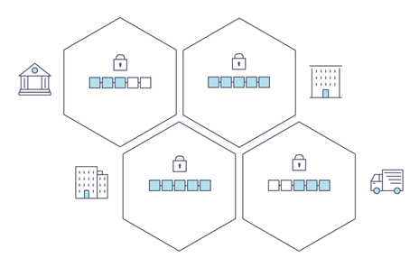
A Distributed Ledger
At the heart of a blockchain network is a distributed ledger that records all the transactions that take place on the network.
A blockchain ledger is often described as decentralized because it is replicated across many network participants, each of whom collaborate in its maintenance.
We’ll see that decentralization and collaboration are powerful attributes that mirror the way businesses exchange goods and services in the real world.
In addition to being decentralized and collaborative, the information recorded to a blockchain is append-only, using cryptographic techniques that guarantee that once a transaction has been added to the ledger it cannot be modified.
This property of “immutability” makes it simple to determine the provenance of information because participants can be sure information has not been changed after the fact.
It’s why blockchains are sometimes described as systems of proof.

Slide 7
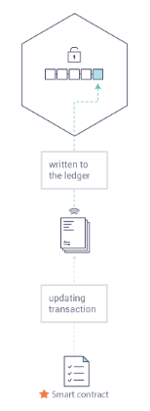
Smart Contracts
To support the consistent update of information — and to enable a whole host of ledger functions (transacting, querying, etc) — a blockchain network uses smart contracts to provide controlled access to the ledger.
Smart contracts are not only a key mechanism for encapsulating information and keeping it simple across the network, they can also be written to allow participants to execute certain aspects of transactions automatically.
  A smart contract can, for example, be written to stipulate the cost of shipping an item where the shipping charge changes depending on how quickly the item arrives.
  With the terms agreed to by both parties and written to the ledger, the appropriate funds change hands automatically when the item is received.

Slide 8
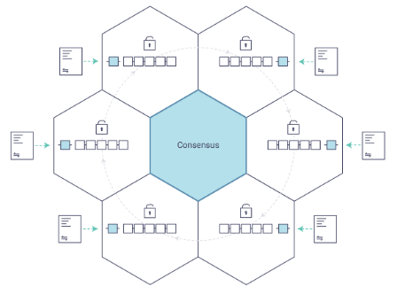
Consensus
The process of keeping the ledger transactions synchronized across the network — to ensure that ledgers update only when transactions are approved by the appropriate participants, and that when ledgers do update, they update with the same transactions in the same order — is called consensus.

Slide 9
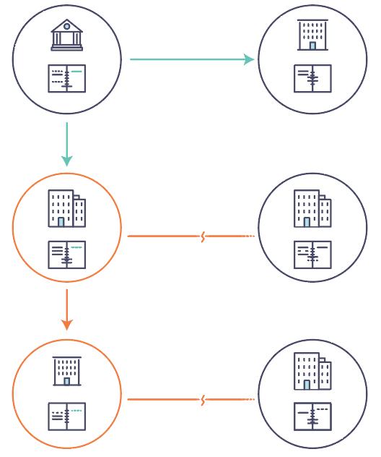
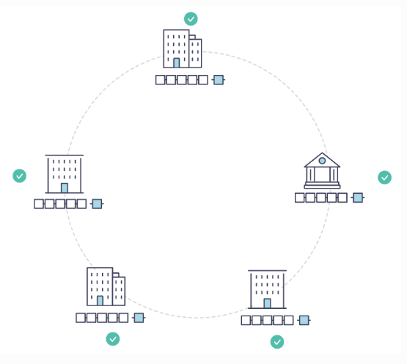
Why is a Blockchain useful?
Today’s Systems of Record
The Blockchain Difference
sharing of information and processes

Slide 10
What is Hyperledger Fabric?
Hyperledger Fabric is one of the blockchain projects within Hyperledger. Like other blockchain technologies, it has a ledger, uses smart contracts, and is a system by which participants manage their transactions.
Where Hyperledger Fabric breaks from some other blockchain systems is that it is private and permissioned.
  Rather than an open permissionless system that allows unknown identities to participate in the network (requiring protocols like “proof of work” to validate transactions and secure the network), the members of a Hyperledger Fabric network enroll through a trusted Membership Service Provider (MSP).
Hyperledger Fabric also offers several pluggable options.
  Ledger data can be stored in multiple formats, consensus mechanisms can be swapped in and out, and different MSPs are supported.
Hyperledger Fabric also offers the ability to create channels, allowing a group of participants to create a separate ledger of transactions.
  This is an especially important option for networks where some participants might be competitors and not want every transaction they make — a special price they’re offering to some participants and not others, for example — known to every participant.
  If two participants form a channel, then those participants — and no others — have copies of the ledger for that channel.

Slide 11
Shared Ledger
Hyperledger Fabric has a ledger subsystem comprising two components: the world state and the transaction log. Each participant has a copy of the ledger to every Hyperledger Fabric network they belong to.
The world state component describes the state of the ledger at a given point in time. It’s the database of the ledger. The transaction log component records all transactions which have resulted in the current value of the world state; it’s the update history for the world state.
The ledger, then, is a combination of the world state database and the transaction log history.
The ledger has a replaceable data store for the world state. By default, this is a LevelDB key-value store database. The transaction log does not need to be pluggable. It simply records the before and after values of the ledger database being used by the blockchain network.

Slide 12
Smart Contracts
Hyperledger Fabric smart contracts are written in chaincode and are invoked by an application external to the blockchain when that application needs to interact with the ledger.
In most cases, chaincode interacts only with the database component of the ledger, the world state (querying it, for example), and not the transaction log.
Chaincode can be implemented in several programming languages. Currently, Go and Node are supported.

Slide 13
Consensus
Transactions must be written to the ledger in the order in which they occur, even though they might be between different sets of participants within the network. For this to happen, the order of transactions must be established and a method for rejecting bad transactions that have been inserted into the ledger in error (or maliciously) must be put into place.
This is a thoroughly researched area of computer science, and there are many ways to achieve it, each with different trade-offs.
  For example, PBFT (Practical Byzantine Fault Tolerance) can provide a mechanism for file replicas to communicate with each other to keep each copy consistent, even in the event of corruption.
  Alternatively, in Bitcoin, ordering happens through a process called mining where competing computers race to solve a cryptographic puzzle which defines the order that all processes subsequently build upon.
Hyperledger Fabric has been designed to allow network starters to choose a consensus mechanism that best represents the relationships that exist between participants. As with privacy, there is a spectrum of needs; from networks that are highly structured in their relationships to those that are more peer-to-peer.
Hyperledger Fabric consensus mechanisms currently include SOLO, Kafka, and Raft.

Slide 14
Privacy
Depending on the needs of a network, participants in a Business-to-Business (B2B) network might be extremely sensitive about how much information they share. For other networks, privacy will not be a top concern.
Hyperledger Fabric supports networks where privacy (using channels) is a key operational requirement as well as networks that are comparatively open.

Slide 15
More
Identity (conceptual documentation)
A conceptual doc that will take you through the critical role identities play in a Fabric network (using an established PKI structure and x.509 certificates).
Membership (conceptual documentation)
Talks through the role of a Membership Service Provider (MSP), which converts identities into roles in a Fabric network.
Peers (conceptual documentation)
Peers — owned by organizations — host the ledger and smart contracts and make up the physical structure of a Fabric network.
Building Your First Network (tutorial)
Learn how to download Fabric binaries and bootstrap your own sample network with a sample script. Then tear down the network and learn how it was constructed one step at a time.
Writing Your First Application (tutorial)
Deploys a very simple network — even simpler than Build Your First Network — to use with a simple smart contract and application.
Transaction Flow
A high level look at a sample transaction flow.
Hyperledger Fabric Model
A high level look at some of components and concepts brought up in this introduction as well as a few others and describes how they work together in a sample transaction flow.

Slide 16
Key Concepts
Introduction
Hyperledger Fabric Functionalities
Hyperledger Fabric Model
Blockchain network
Identity
Membership
Peers
Smart Contracts and Chaincode
Ledger
The Ordering Service
Private data
Channel capabilities
Use Cases
Notes:
https://hyperledger-fabric.readthedocs.io/en/release-1.4/blockchain.html

Slide 17
Hyperledger Fabric Functionalities
Hyperledger Fabric is an implementation of distributed ledger technology (DLT) that delivers enterprise-ready network security, scalability, confidentiality and performance, in a modular blockchain architecture. Hyperledger Fabric delivers following blockchain network functionalities:
Identity management
To enable permissioned networks, Hyperledger Fabric provides a membership identity service that manages user IDs and authenticates all participants on the network. Access control lists can be used to provide additional layers of permission through authorization of specific network operations. For example, a specific user ID could be permitted to invoke a chaincode application, but be blocked from deploying new chaincode.
Privacy and confidentiality
Hyperledger Fabric enables competing business interests, and any groups that require private, confidential transactions, to coexist on the same permissioned network. Private channels are restricted messaging paths that can be used to provide transaction privacy and confidentiality for specific subsets of network members. All data, including transaction, member and channel information, on a channel are invisible and inaccessible to any network members not explicitly granted access to that channel
.
Efficient processing
Hyperledger Fabric assigns network roles by node type. To provide concurrency and parallelism to the network, transaction execution is separated from transaction ordering and commitment. Executing transactions prior to ordering them enables each peer node to process multiple transactions simultaneously. This concurrent execution increases processing efficiency on each peer and accelerates delivery of transactions to the ordering service.
In addition to enabling parallel processing, the division of labor unburdens ordering nodes from the demands of transaction execution and ledger maintenance, while peer nodes are freed from ordering (consensus) workloads. This bifurcation of roles also limits the processing required for authorization and authentication; all peer nodes do not have to trust all ordering nodes, and vice versa, so processes on one can run independently of verification by the other.
Chaincode functionality
Chaincode applications encode logic that is invoked by specific types of transactions on the channel. Chaincode that defines parameters for a change of asset ownership, for example, ensures that all transactions that transfer ownership are subject to the same rules and requirements. System chaincode is distinguished as chaincode that defines operating parameters for the entire channel. Lifecycle and configuration system chaincode defines the rules for the channel; endorsement and validation system chaincode defines the requirements for endorsing and validating transactions.
Modular design
Hyperledger Fabric implements a modular architecture to provide functional choice to network designers. Specific algorithms for identity, ordering (consensus) and encryption, for example, can be plugged in to any Hyperledger Fabric network. The result is a universal blockchain architecture that any industry or public domain can adopt, with the assurance that its networks will be interoperable across market, regulatory and geographic boundaries.

Slide 18
Key Concepts
Introduction
Hyperledger Fabric Functionalities
Hyperledger Fabric Model
Blockchain network
Identity
Membership
Peers
Smart Contracts and Chaincode
Ledger
The Ordering Service
Private data
Channel capabilities
Use Cases
Notes:
https://hyperledger-fabric.readthedocs.io/en/release-1.4/blockchain.html

Slide 19
Hyperledger Fabric Model
This section outlines the key design features woven into Hyperledger Fabric that fulfill its promise of a comprehensive, yet customizable, enterprise blockchain solution:
Assets — Asset definitions enable the exchange of almost anything with monetary value over the network, from whole foods to antique cars to currency futures.
Chaincode — Chaincode execution is partitioned from transaction ordering, limiting the required levels of trust and verification across node types, and optimizing network scalability and performance.
Ledger Features — The immutable, shared ledger encodes the entire transaction history for each channel, and includes SQL-like query capability for efficient auditing and dispute resolution.
Privacy — Channels and private data collections enable private and confidential multi-lateral transactions that are usually required by competing businesses and regulated industries that exchange assets on a common network.
Security & Membership Services — Permissioned membership provides a trusted blockchain network, where participants know that all transactions can be detected and traced by authorized regulators and auditors.
Consensus — A unique approach to consensus enables the flexibility and scalability needed for the enterprise.

Slide 20
Assets
Assets can range from the tangible (real estate and hardware) to the intangible (contracts and intellectual property).
Hyperledger Fabric provides the ability to modify assets using chaincode transactions.
Assets are represented in Hyperledger Fabric as a collection of key-value pairs, with state changes recorded as transactions on a Channel ledger. Assets can be represented in binary and/or JSON form.
Notes:
https://jsonforms.io/docs/what-is-jsonforms

Slide 21
Chaincode
Chaincode is software defining an asset or assets, and the transaction instructions for modifying the asset(s); in other words, it’s the business logic.
Chaincode enforces the rules for reading or altering key-value pairs or other state database information.
Chaincode functions execute against the ledger’s current state database and are initiated through a transaction proposal.
Chaincode execution results in a set of key-value writes (write set) that can be submitted to the network and applied to the ledger on all peers.

Slide 22
Ledger Features
The ledger is the sequenced, tamper-resistant record of all state transitions in the fabric.
State transitions are a result of chaincode invocations (‘transactions’) submitted by participating parties.
Each transaction results in a set of asset key-value pairs that are committed to the ledger as creates, updates, or deletes.
The ledger is comprised of a blockchain (‘chain’) to store the immutable, sequenced record in blocks, as well as a state database to maintain current fabric state. There is one ledger per channel. Each peer maintains a copy of the ledger for each channel of which they are a member. Some features of a Fabric ledger:
Query and update ledger using key-based lookups, range queries, and composite key queries
Read-only queries using a rich query language (if using CouchDB as state database)
Read-only history queries — Query ledger history for a key, enabling data provenance scenarios
Transactions consist of the versions of keys/values that were read in chaincode (read set) and keys/values that were written in chaincode (write set)
Transactions contain signatures of every endorsing peer and are submitted to ordering service
Transactions are ordered into blocks and are “delivered” from an ordering service to peers on a channel
Peers validate transactions against endorsement policies and enforce the policies
Prior to appending a block, a versioning check is performed to ensure that states for assets that were read have not changed since chaincode execution time
There is immutability once a transaction is validated and committed
A channel’s ledger contains a configuration block defining policies, access control lists, and other pertinent information
Channels contain Membership Service Provider instances allowing for crypto materials to be derived from different certificate authorities

Slide 23
Privacy
Hyperledger Fabric employs an immutable ledger on a per-channel basis, as well as chaincode that can manipulate and modify the current state of assets (i.e. update key-value pairs). A ledger exists in the scope of a channel — it can be shared across the entire network (assuming every participant is operating on one common channel) — or it can be privatized to include only a specific set of participants.
In order to solve scenarios that want to bridge the gap between total transparency and privacy, chaincode can be installed only on peers that need to access the asset states to perform reads and writes (in other words, if a chaincode is not installed on a peer, it will not be able to properly interface with the ledger).
When a subset of organizations on that channel need to keep their transaction data confidential, a private data collection (collection) is used to segregate this data in a private database, logically separate from the channel ledger, accessible only to the authorized subset of organizations. Thus, channels keep transactions private from the broader network whereas collections keep data private between subsets of organizations on the channel.
To further obfuscate the data, values within chaincode can be encrypted (in part or in total) using common cryptographic algorithms such as AES before sending transactions to the ordering service and appending blocks to the ledger. Once encrypted data has been written to the ledger, it can be decrypted only by a user in possession of the corresponding key that was used to generate the cipher text.

Slide 24
Security & Membership Services
Hyperledger Fabric underpins a transactional network where all participants have known identities.
Public Key Infrastructure is used to generate cryptographic certificates which are tied to organizations, network components, and end users or client applications. As a result, data access control can be manipulated and governed on the broader network and on channel levels.
This “permissioned” notion of Hyperledger Fabric, coupled with the existence and capabilities of channels, helps address scenarios where privacy and confidentiality are paramount concerns.
See the Membership Service Providers (MSP) topic to better understand cryptographic implementations, and the sign, verify, authenticate approach used in Hyperledger Fabric.

Slide 25
Consensus
In distributed ledger technology, consensus has recently become synonymous with a specific algorithm, within a single function.
However, consensus encompasses more than simply agreeing upon the order of transactions, and this differentiation is highlighted in Hyperledger Fabric through its fundamental role in the entire transaction flow, from proposal and endorsement, to ordering, validation and commitment.
In a nutshell, consensus is defined as full-circle verification of the correctness of a set of transactions comprising a block.
Consensus is achieved ultimately when the order and results of a block’s transactions have met the explicit policy criteria checks.
These checks and balances take place during the lifecycle of a transaction, and include the usage of endorsement policies to dictate which specific members must endorse a certain transaction class, as well as system chaincodes to ensure that these policies are enforced and upheld.
Prior to commitment, the peers will employ these system chaincodes to make sure that enough endorsements are present, and that they were derived from the appropriate entities.
Moreover, a versioning check will take place during which the current state of the ledger is agreed or consented upon, before any blocks containing transactions are appended to the ledger.
This final check provides protection against double spend operations and other threats that might compromise data integrity, and allows for functions to be executed against non-static variables.
In addition to the multitude of endorsement, validity and versioning checks that take place, there are also ongoing identity verifications happening in all directions of the transaction flow.
Access control lists are implemented on hierarchical layers of the network (ordering service down to channels), and payloads are repeatedly signed, verified and authenticated as a transaction proposal passes through the different architectural components.
To conclude, consensus is not merely limited to the agreed upon order of a batch of transactions; rather, it is an overarching characterization that is achieved as a byproduct of the ongoing verifications that take place during a transaction’s journey from proposal to commitment.

Slide 26
Key Concepts
Introduction
Hyperledger Fabric Functionalities
Hyperledger Fabric Model
Blockchain network
Identity
Membership
Peers
Smart Contracts and Chaincode
Ledger
The Ordering Service
Private data
Channel capabilities
Use Cases
Notes:
https://hyperledger-fabric.readthedocs.io/en/release-1.4/blockchain.html

Slide 27
Blockchain network
A blockchain network is a technical infrastructure that provides ledger and smart contract (chaincode) services to applications.
Primarily, smart contracts are used to generate transactions which are subsequently distributed to every peer node in the network where they are immutably recorded on their copy of the ledger. The users of applications might be end users using client applications or blockchain network administrators.
In most cases, multiple organizations come together as a consortium to form the network and their permissions are determined by a set of policies that are agreed by the consortium when the network is originally configured.
Ledger. One per channel. Comprised of the Blockchain and the World state
Smart contract (aka chaincode)
Peer nodes
Ordering service
Channel
Certificate Authority
Moreover, network policies can change over time subject to the agreement of the organizations in the consortium, as we’ll discover when we discuss the concept of modification policy.
See details in: https://hyperledger-fabric.readthedocs.io/en/release-1.4/network/network.html
Notes:
This topic will describe, at a conceptual level, how Hyperledger Fabric allows organizations to collaborate in the formation of blockchain networks. If you’re an architect, administrator or developer, you can use this topic to get a solid understanding of the major structure and process components in a Hyperledger
Fabric blockchain network.
This topic will use a manageable worked example that introduces all of the major components in a blockchain network. After understanding this example you can read more detailed information about these components elsewhere in the documentation, or try building a sample network.
After reading this topic and understanding the concept of policies, you will have a solid understanding of the decisions that organizations need to make to establish the policies that control a deployed Hyperledger Fabric network. You’ll also understand how organizations manage network evolution using declarative policies – a key feature of Hyperledger Fabric.
In a nutshell, you’ll understand the major technical components of Hyperledger Fabric and the decisions organizations need to make about them.

Slide 28
Key Concepts
Introduction
Hyperledger Fabric Functionalities
Hyperledger Fabric Model
Blockchain network
Identity
Membership
Peers
Smart Contracts and Chaincode
Ledger
The Ordering Service
Private data
Channel capabilities
Use Cases
Notes:
https://hyperledger-fabric.readthedocs.io/en/release-1.4/blockchain.html

Slide 29
Identity
The different actors in a blockchain network include peers, orderers, client applications, administrators and more.
Each of these actors — active elements inside or outside a network able to consume services — has a digital identity encapsulated in an X.509 digital certificate.
These identities really matter because they determine the exact permissions over resources and access to information that actors have in a blockchain network.
A digital identity furthermore has some additional attributes that Fabric uses to determine permissions, and it gives the union of an identity and the associated attributes a special name — principal.
Principals are just like userIDs or groupIDs, but a little more flexible because they can include a wide range of properties of an actor’s identity, such as the actor’s organization, organizational unit, role or even the actor’s specific identity.
When we talk about principals, they are the properties which determine their permissions.
For an identity to be verifiable, it must come from a trusted authority.
A membership service provider (MSP) is how this is achieved in Fabric.
More specifically, an MSP is a component that defines the rules that govern the valid identities for this organization.
The default MSP implementation in Fabric uses X.509 certificates as identities, adopting a traditional Public Key Infrastructure (PKI) hierarchical model (more on PKI later).
See details in: https://hyperledger-fabric.readthedocs.io/en/release-1.4/identity/identity.html

Slide 30
Key Concepts
Introduction
Hyperledger Fabric Functionalities
Hyperledger Fabric Model
Blockchain network
Identity
Membership
Peers
Smart Contracts and Chaincode
Ledger
The Ordering Service
Private data
Channel capabilities
Use Cases
Notes:
https://hyperledger-fabric.readthedocs.io/en/release-1.4/blockchain.html

Slide 31
Membership
Membership Service Provider (MSP) — it identifies which Root CAs and Intermediate CAs are trusted to define the members of a trust domain, e.g., an organization, either by listing the identities of their members, or by identifying which CAs are authorized to issue valid identities for their members, or — as will usually be the case — through a combination of both.
The power of an MSP goes beyond simply listing who is a network participant or member of a channel. An MSP can identify specific roles an actor might play either within the scope of the organization the MSP represents (e.g., admins, or as members of a sub-organization group), and sets the basis for defining access privileges in the context of a network and channel (e.g., channel admins, readers, writers).
The configuration of an MSP is advertised to all the channels where members of the corresponding organization participate (in the form of a channel MSP).
In addition to the channel MSP, peers, orderers, and clients also maintain a local MSP to authenticate member messages outside the context of a channel and to define the permissions over a particular component (who has the ability to install chaincode on a peer, for example).
In addition, an MSP can allow for the identification of a list of identities that have been revoked.
See details in: https://hyperledger-fabric.readthedocs.io/en/release-1.4/membership/membership.html

Slide 32
Key Concepts
Introduction
Hyperledger Fabric Functionalities
Hyperledger Fabric Model
Blockchain network
Identity
Membership
Peers
Smart Contracts and Chaincode
Ledger
The Ordering Service
Private data
Channel capabilities
Use Cases
Notes:
https://hyperledger-fabric.readthedocs.io/en/release-1.4/blockchain.html

Slide 33
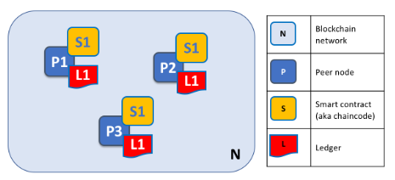
Peers
A blockchain network is comprised primarily of a set of peer nodes (or, simply, peers). Peers are a fundamental element of the network because they host ledgers and smart contracts.
Recall that a ledger immutably records all the transactions generated by smart contracts (which in Hyperledger Fabric are contained in a chaincode, more on this later). Smart contracts and ledgers are used to encapsulate the shared processes and shared information in a network, respectively.
These aspects of a peer make them a good starting point to understand a Fabric network.
Other elements of the blockchain network are of course important: ledgers and smart contracts, orderers, policies, channels, applications, organizations, identities, and membership, and you can read more about them in their own dedicated sections.
See details in: https://hyperledger-fabric.readthedocs.io/en/release-1.4/peers/peers.html

Slide 34
Key Concepts
Introduction
Hyperledger Fabric Functionalities
Hyperledger Fabric Model
Blockchain network
Identity
Membership
Peers
Smart Contracts and Chaincode
Ledger
The Ordering Service
Private data
Channel capabilities
Use Cases
Notes:
https://hyperledger-fabric.readthedocs.io/en/release-1.4/blockchain.html

Slide 35
Smart Contracts and Chaincode
From an application developer’s perspective, a smart contract, together with the ledger, form the heart of a Hyperledger Fabric blockchain system.
Whereas a ledger holds facts about the current and historical state of a set of business objects, a smart contract defines the executable logic that generates new facts that are added to the ledger.
A chaincode is typically used by administrators to group related smart contracts for deployment, but can also be used for low level system programming of Fabric.
See details in: https://hyperledger-fabric.readthedocs.io/en/release-1.4/smartcontract/smartcontract.html

Slide 36
Key Concepts
Introduction
Hyperledger Fabric Functionalities
Hyperledger Fabric Model
Blockchain network
Identity
Membership
Peers
Smart Contracts and Chaincode
Ledger
The Ordering Service
Private data
Channel capabilities
Use Cases
Notes:
https://hyperledger-fabric.readthedocs.io/en/release-1.4/blockchain.html

Slide 37
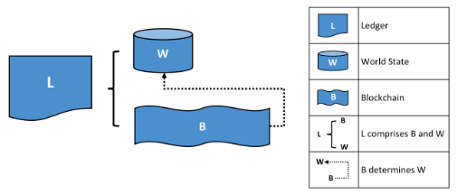
Ledger
A ledger is a key concept in Hyperledger Fabric; it stores important factual information about business objects; both the current value of the attributes of the objects, and the history of transactions that resulted in these current values.
See details in: https://hyperledger-fabric.readthedocs.io/en/release-1.4/ledger/ledger.html

Slide 38
Key Concepts
Introduction
Hyperledger Fabric Functionalities
Hyperledger Fabric Model
Blockchain network
Identity
Membership
Peers
Smart Contracts and Chaincode
Ledger
The Ordering Service
Private data
Channel capabilities
Use Cases
Notes:
https://hyperledger-fabric.readthedocs.io/en/release-1.4/blockchain.html

Slide 39
The Ordering Service
Many distributed blockchains, such as Ethereum and Bitcoin, are not permissioned, which means that any node can participate in the consensus process, wherein transactions are ordered and bundled into blocks.
  Because of this fact, these systems rely on probabilistic consensus algorithms which eventually guarantee ledger consistency to a high degree of probability,
  but which are still vulnerable to divergent ledgers (also known as a ledger “fork”), where different participants in the network have a different view of the accepted order of transactions.
Hyperledger Fabric works differently. It features a kind of a node called an orderer (it’s also known as an “ordering node”) that does this transaction ordering, which along with other nodes forms an ordering service.
  Because Fabric’s design relies on deterministic consensus algorithms, any block a peer validates as generated by the ordering service is guaranteed to be final and correct.
  Ledgers cannot fork the way they do in many other distributed blockchains.
In addition to promoting finality, separating the endorsement of chaincode execution (which happens at the peers) from ordering gives Fabric advantages in performance and scalability, eliminating bottlenecks which can occur when execution and ordering are performed by the same nodes.
See details in: https://hyperledger-fabric.readthedocs.io/en/release-1.4/orderer/ordering_service.html

Slide 40
Ordering service implementations
While every ordering service currently available handles transactions and configuration updates the same way, there are nevertheless several different implementations for achieving consensus on the strict ordering of transactions between ordering service nodes.
Solo
The Solo implementation of the ordering service is aptly named: it features only a single ordering node. As a result, it is not, and never will be, fault tolerant. For that reason, Solo implementations cannot be considered for production, but they are a good choice for testing applications and smart contracts, or for creating proofs of concept. However, if you ever want to extend this PoC network into production, you might want to start with a single node Raft cluster, as it may be reconfigured to add additional nodes.
Raft
New as of v1.4.1, Raft is a crash fault tolerant (CFT) ordering service based on an implementation of Raft protocol in etcd. Raft follows a “leader and follower” model, where a leader node is elected (per channel) and its decisions are replicated by the followers. Raft ordering services should be easier to set up and manage than Kafka-based ordering services, and their design allows different organizations to contribute nodes to a distributed ordering service.
Kafka
Similar to Raft-based ordering, Apache Kafka is a CFT implementation that uses a “leader and follower” node configuration. Kafka utilizes a ZooKeeper ensemble for management purposes. The Kafka based ordering service has been available since Fabric v1.0, but many users may find the additional administrative overhead of managing a Kafka cluster intimidating or undesirable.
See details in: https://hyperledger-fabric.readthedocs.io/en/release-1.4/orderer/ordering_service.html

Slide 41
Key Concepts
Introduction
Hyperledger Fabric Functionalities
Hyperledger Fabric Model
Blockchain network
Identity
Membership
Peers
Smart Contracts and Chaincode
Ledger
The Ordering Service
Private data
Channel capabilities
Use Cases
Notes:
https://hyperledger-fabric.readthedocs.io/en/release-1.4/blockchain.html

Slide 42
Private data
In cases where a group of organizations on a channel need to keep data private from other organizations on that channel, they have the option to create a new channel comprising just the organizations who need access to the data.
  However, creating separate channels in each of these cases creates additional administrative overhead (maintaining chaincode versions, policies, MSPs, etc), and doesn’t allow for use cases in which you want all channel participants to see a transaction while keeping a portion of the data private.
  That’s why, starting in v1.2, Fabric offers the ability to create private data collections, which allow a defined subset of organizations on a channel the ability to endorse, commit, or query private data without having to create a separate channel.
A collection is the combination of two elements:
Actual private data, sent peer-to-peer via gossip protocol to only the organization(s) authorized to see it.
  This data is stored in a private state database on the peers of authorized organizations (sometimes called a “side” database, or “SideDB”), which can be accessed from chaincode on these authorized peers. The ordering service is not involved here and does not see the private data.
  Note that because gossip distributes the private data peer-to-peer across authorized organizations, it is required to set up anchor peers on the channel, and configure CORE_PEER_GOSSIP_EXTERNALENDPOINT on each peer, in order to bootstrap cross-organization communication.
A hash of that data, which is endorsed, ordered, and written to the ledgers of every peer on the channel.
  The hash serves as evidence of the transaction and is used for state validation and can be used for audit purposes.
See details in: https://hyperledger-fabric.readthedocs.io/en/release-1.4/private-data/private-data.html

Slide 43
Key Concepts
Introduction
Hyperledger Fabric Functionalities
Hyperledger Fabric Model
Blockchain network
Identity
Membership
Peers
Smart Contracts and Chaincode
Ledger
The Ordering Service
Private data
Channel capabilities
Use Cases
Notes:
https://hyperledger-fabric.readthedocs.io/en/release-1.4/blockchain.html

Slide 44
Channel capabilities
Fabric is a distributed system that will usually involve multiple organizations, it is possible (and typical) that different versions of Fabric code will exist on different nodes within the network as well as on the channels in that network.
  Fabric allows this — it is not necessary for every peer and ordering node to be at the same version level.
  In fact, supporting different version levels is what enables rolling upgrades of Fabric nodes. What is important is that networks and channels process things in the same way, creating deterministic results for things like channel configuration updates and chaincode invocations.
  Without deterministic results, one peer on a channel might invalidate a transaction while another peer may validate it.
Fabric defines levels of what are called “capabilities”. These capabilities, which are defined in the configuration of each channel, ensure determinism by defining a level at which behaviors produce consistent results.
  These capabilities have versions which are closely related to node binary versions.
  Capabilities enable nodes running at different version levels to behave in a compatible and consistent way given the channel configuration at a specific block height.
  Capabilities exist in many parts of the configuration tree, defined along the lines of administration for particular tasks.
See details in: https://hyperledger-fabric.readthedocs.io/en/release-1.4/capabilities_concept.html

Slide 45
Key Concepts
Introduction
Hyperledger Fabric Functionalities
Hyperledger Fabric Model
Blockchain network
Identity
Membership
Peers
Smart Contracts and Chaincode
Ledger
The Ordering Service
Private data
Channel capabilities
Use Cases
Notes:
https://hyperledger-fabric.readthedocs.io/en/release-1.4/blockchain.html

Slide 46
Use Cases
Use case Categories
Aerospace | Financial Services /Trade Finance | Land and Property Management
Cross Border Payments | Government /Public Sector | Letters Of Credit
Cross Border Payments | Green Assets Management | Real Estate Transactions
Digital Assets/ Identity Management | Healthcare | Smart Contracts
Education | Internet Of Things | Supply Chain Management
Energy | Information Technology | Ticketing /Entertainment
Food /Food Delivery | KYC | Voting
See details in: https://wiki.hyperledger.org/display/LMDWG/Use+Cases

Slide 47
Key Concepts
Developing an Application
©2017 IBM Corporation

Slide 48
Getting Started
Before we begin, if you haven’t already done so, you may wish to check that you have all the Prerequisites installed on the platform(s) on which you’ll be developing blockchain applications and/or operating Hyperledger Fabric.
Once you have the prerequisites installed, you are ready to download and install HyperLedger Fabric.
While we work on developing real installers for the Fabric binaries, we provide a script that will Install Samples, Binaries and Docker Images to your system. The script also will download the Docker images to your local registry.

Slide 49
Contents
Prerequisites
Installations
Developing Applications
The scenario
Tutorials
Operations Guides
Commands Reference
Architecture Reference
Frequently Asked Questions

Slide 50
Prerequisites (1/3)
Install cURL
Download the latest version of the cURL tool if it is not already installed or if you get errors running the curl commands from the documentation.
      https://curl.haxx.se/download.html
Docker and Docker Compose
You will need the following installed on the platform on which you will be operating, or developing on (or for), Hyperledger Fabric:
  MacOSX, *nix, or Windows 10: Docker Docker version 17.06.2-ce or greater is required.
  Older versions of Windows: Docker Toolbox - again, Docker version Docker 17.06.2-ce or greater is required.
You can check the version of Docker you have installed with the following command from a terminal prompt:
docker --version
See details in: https://hyperledger-fabric.readthedocs.io/en/release-1.4/prereqs.html

Slide 51
Prerequisites (2/3)
Go Programming Language
Hyperledger Fabric uses the Go Programming Language for many of its components.
    Go version 1.12.x is required.
Given that we will be writing chaincode programs in Go, there are two environment variables you will need to set properly; you can make these settings permanent by placing them in the appropriate startup file, such as your personal ~/.bashrc file if you are using the bash shell under Linux.
First, you must set the environment variable GOPATH to point at the Go workspace containing the downloaded Fabric code base, with something like:
    export GOPATH=$HOME/go
Second, you should (again, in the appropriate startup file) extend your command search path to include the Go bin directory, such as the following example for bash under Linux:
    export PATH=$PATH:$GOPATH/bin
While this directory may not exist in a new Go workspace installation, it is populated later by the Fabric build system with a small number of Go executables used by other parts of the build system. So even if you currently have no such directory yet, extend your shell search path as above.
See details in: https://hyperledger-fabric.readthedocs.io/en/release-1.4/prereqs.html

Slide 52
Prerequisites (3/3)
Node.js Runtime and NPM
If you will be developing applications for Hyperledger Fabric leveraging the Hyperledger Fabric SDK for Node.js, version 8 is supported from 8.9.4 and higher. Node.js version 10 is supported from 10.15.3 and higher.
Node.js download
Python (The following applies to Ubuntu 16.04 users only.)
By default Ubuntu 16.04 comes with Python 3.5.1 installed as the python3 binary. The Fabric Node.js SDK requires an iteration of Python 2.7 in order for npm install operations to complete successfully. Retrieve the 2.7 version with the following command:
sudo apt-get install python
Check your version(s):
python --version
See details in: https://hyperledger-fabric.readthedocs.io/en/release-1.4/prereqs.html

Slide 53
Contents
Prerequisites
Installations
Developing Applications
The scenario
Tutorials
Operations Guides
Commands Reference
Architecture Reference
Frequently Asked Questions

Slide 54
Install Samples, Binaries and Docker Images
Determine a location on your machine where you want to place the fabric-samples repository and enter that directory in a terminal window. The command that follows will perform the following steps:
If needed, clone the hyperledger/fabric-samples repository
Checkout the appropriate version tag
Install the Hyperledger Fabric platform-specific binaries and config files for the version specified into the /bin and /config directories of fabric-samples
Download the Hyperledger Fabric docker images for the version specified
Once you are ready, and in the directory into which you will install the Fabric Samples and binaries, go ahead and execute the command to pull down the binaries and images.
curl -sSL http://bit.ly/2ysbOFE | bash -s
The command above downloads and executes a bash script that will download and extract all of the platform-specific binaries you will need to set up your network and place them into the cloned repo you created above. It retrieves the following platform-specific binaries:
  configtxgen,
  configtxlator,
  cryptogen,
  discover,
  idemixgen
  orderer,
  peer, and
  fabric-ca-client
and places them in the bin sub-directory of the current working directory.
You may want to add that to your PATH environment variable so that these can be picked up without fully qualifying the path to each binary. e.g.:
export PATH=<path to download location>/bin:$PATH
Finally, the script will download the Hyperledger Fabric docker images from Docker Hub into your local Docker registry and tag them as ‘latest’.
The script lists out the Docker images installed upon conclusion.
Look at the names for each image; these are the components that will ultimately comprise our Hyperledger Fabric network. You will also notice that you have two instances of the same image ID - one tagged as “amd64-1.x.x” and one tagged as “latest”. Prior to 1.2.0, the image being downloaded was determined by uname -m and showed as “x86_64-1.x.x”.
See details in: https://hyperledger-fabric.readthedocs.io/en/release-1.4/install.html

Slide 55
Contents
Prerequisites
Installations
Developing Applications
The scenario
Tutorials
Operations Guides
Commands Reference
Architecture Reference
Frequently Asked Questions

Slide 56
Developing Applications
This topic covers how to develop a client application and smart contract to solve a business problem using Hyperledger Fabric. In a real world Commercial Paper scenario, involving multiple organizations, you’ll learn about all the concepts and tasks required to accomplish this goal. We assume that the blockchain network is already available.
The topic is designed for multiple audiences:
  Solution and application architect
  Client application developer
  Smart contract developer
  Business professional
You can chose to read the topic in order, or you can select individual sections as appropriate. Individual topic sections are marked according to reader relevance, so whether you’re looking for business or technical information it’ll be clear when a topic is for you.
The topic follows a typical software development lifecycle. It starts with business requirements, and then covers all the major technical activities required to develop an application and smart contract to meet these requirements.
See details in: https://hyperledger-fabric.readthedocs.io/en/release-1.4/developapps/developing_applications.html

Slide 57
Contents
Prerequisites
Installations
Developing Applications
The scenario
Tutorials
Operations Guides
Commands Reference
Architecture Reference
Frequently Asked Questions

Slide 58
The scenario
In this topic, we’re going to describe a business scenario involving six organizations who use PaperNet, a commercial paper network built on Hyperledger Fabric, to issue, buy and redeem commercial paper. We’re going to use the scenario to outline requirements for the development of commercial paper applications and smart contracts used by the participant organizations.
PaperNet network
Introducing the actors
Analysis
Process and Data Design
Smart Contract Processing
Application
Application design elements
See details in: https://hyperledger-fabric.readthedocs.io/en/release-1.4/developapps/scenario.html

Slide 59
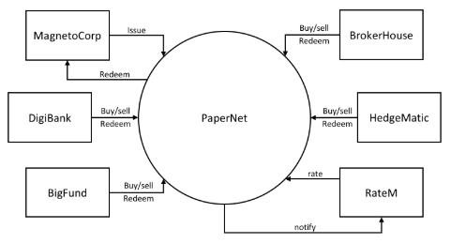
PaperNet network
PaperNet is a commercial paper network that allows suitably authorized participants to issue, trade, redeem and rate commercial paper.
The PaperNet commercial paper network. Six organizations currently use PaperNet network to issue, buy, sell, redeem and rate commercial paper. MagentoCorp issues and redeems commercial paper. DigiBank, BigFund, BrokerHouse and HedgeMatic all trade commercial paper with each other. RateM provides various measures of risk for commercial paper.

Slide 60
Introducing the actors
MagnetoCorp is a well-respected company that makes self-driving electric vehicles. In early April 2020, MagnetoCorp won a large order to manufacture 10,000 Model D cars for
Daintree, a new entrant in the personal transport market. Although the order represents a significant win for MagnetoCorp, Daintree will not have to pay for the vehicles until they start to be delivered on November 1, six months after the deal was formally agreed between MagnetoCorp and Daintree.
To manufacture the vehicles, MagnetoCorp will need to hire 1000 workers for at least 6 months. This puts a short term strain on its finances – it will require an extra 5M USD each month to pay these new employees.
Commercial paper is designed to help MagnetoCorp overcome its short term financing needs – to meet payroll every month based on the expectation that it will be cash rich when Daintree starts to pay for its new Model D cars.
At the end of May, MagnetoCorp needs 5M USD to meet payroll for the extra workers it hired on May 1. To do this, it issues a commercial paper with a face value of 5M USD with a maturity date 6 months in the future – when it expects to see cash flow from Daintree.
DigiBank thinks that MagnetoCorp is creditworthy, and therefore doesn’t require much of a premium above the central bank base rate of 2%, which would value 4.95M USD today at 5M USD in 6 months time. It therefore purchases the MagnetoCorp 6 month commercial paper for 4.94M USD – a slight discount compared to the 4.95M USD it is worth. DigiBank fully expects that it will be able to redeem 5M USD from MagnetoCorp in 6 months time, making it a profit of 10K USD for bearing the increased risk associated with this commercial paper. This extra 10K means it receives a 2.4% return on investment – significantly better than the risk free return of 2%.
At the end of June, when MagnetoCorp issues a new commercial paper for 5M USD to meet June’s payroll, it is purchased by BigFund for 4.94M USD. That’s because the commercial conditions are roughly the same in June as they are in May, resulting in BigFund valuing MagnetoCorp commercial paper at the same price that DigiBank did in May. Each subsequent month, MagnetoCorp can issue new commercial paper to meet its payroll obligations, and these may be purchased by DigiBank, or any other participant in the PaperNet commercial paper network –
BigFund, HedgeMatic or BrokerHouse. These organizations may pay more or less for the commercial paper depending on two factors – the central bank base rate, and the risk associated with MagnetoCorp. This latter figure depends on a variety of factors such as the production of Model D cars, and the creditworthiness of MagnetoCorp as assessed by
RateM, a ratings agency.
The organizations in PaperNet have different roles, MagnetoCorp issues paper, DigiBank, BigFund, HedgeMatic and BrokerHouse trade paper and RateM rates paper. Organizations of the same role, such as DigiBank, Bigfund, HedgeMatic and BrokerHouse are competitors. Organizations of different roles are not necessarily competitors, yet might still have opposing business interest, for example MagentoCorp will desire a high rating for its papers to sell them at a high price, while DigiBank would benefit from a low rating, such that it can buy them at a low price. As can be seen, even a seemingly simple network such as PaperNet can have complex trust relationships. A blockchain can help establish trust among organizations that are competitors or have opposing business interests that might lead to disputes. Fabric in particular has the means to capture even fine-grained trust relationships.
Let’s pause the MagnetoCorp story for a moment, and develop the client applications and smart contracts that PaperNet uses to issue, buy, sell and redeem commercial paper as well as capture the trust relationships between the organizations. We’ll come back to the role of the rating agency, RateM, a little later.
See details in: https://hyperledger-fabric.readthedocs.io/en/release-1.4/developapps/scenario.html or Introducing the actors.doc

Slide 61
Analysis (1/6)
Let’s analyze commercial paper in a little more detail. PaperNet participants such as MagnetoCorp and DigiBank use commercial paper transactions to achieve their business objectives – let’s examine the structure of a commercial paper and the transactions that affect it over time. We will also consider which organizations in PaperNet need to sign off on a transaction based on the trust relationships among the organizations in the network. Later we’ll focus on how money flows between buyers and sellers; for now, let’s focus on the first paper issued by MagnetoCorp.
Commercial paper lifecycle
A paper 00001 is issued by MagnetoCorp on May 31. Spend a few moments looking at the first state of this paper, with its different properties and values:
        Issuer = MagnetoCorp
        Paper = 00001
        Owner = MagnetoCorp
        Issue date = 31 May 2020
        Maturity = 30 November 2020
        Face value = 5M USD
        Current state = issued
This paper state is a result of the issue transaction and it brings MagnetoCorp’s first commercial paper into existence! Notice how this paper has a 5M USD face value for redemption later in the year. See how the Issuer and Owner are the same when paper 00001 is issued. Notice that this paper could be uniquely identified as MagnetoCorp00001 – a composition of the Issuer and Paper properties. Finally, see how the property Current state = issued quickly identifies the stage of MagnetoCorp paper 00001 in its lifecycle.
Shortly after issuance, the paper is bought by DigiBank. Spend a few moments looking at how the same commercial paper has changed as a result of this buy transaction:
    Issuer = MagnetoCorp
    Paper = 00001
    Owner = MagnetoCorp
    Issue date = 31 May 2020
    Maturity date = 30 November 2020
    Face value = 5M USD
    Current state = redeemed
The most significant change is that of Owner – see how the paper initially owned by MagnetoCorp is now owned by DigiBank. We could imagine how the paper might be subsequently sold to BrokerHouse or HedgeMatic, and the corresponding change to Owner. Note how Current state allow us to easily identify that the paper is now trading.
See details in: https://hyperledger-fabric.readthedocs.io/en/release-1.4/developapps/analysis.html or Analysis.doc

Slide 62
Analysis (2/6)
After 6 months, if DigiBank still holds the the commercial paper, it can redeem it with MagnetoCorp:
    Issuer = MagnetoCorp
    Paper = 00001
    Owner = MagnetoCorp
    Issue date = 31 May 2020
    Maturity date = 30 November 2020
    Face value = 5M USD
    Current state = redeemed
This final redeem transaction has ended the commercial paper’s lifecycle – it can be considered closed. It is often mandatory to keep a record of redeemed commercial papers, and the redeemed state allows us to quickly identify these. The value of Owner of a paper can be used to perform access control on the redeem transaction, by comparing the Owner against the identity of the transaction creator. Fabric supports this through the getCreator() chaincode API. If golang is used as a chaincode language, the client identity chaincode library can be used to retrieve additional attributes of the transaction creator.
Transactions
We’ve seen that paper 00001’s lifecycle is relatively straightforward – it moves between issued, trading and redeemed as a result of an issue, buy, or redeem transaction.
These three transactions are initiated by MagnetoCorp and DigiBank (twice), and drive the state changes of paper 00001.
Let’s have a look at the transactions that affect this paper in a little more detail:
See details in: https://hyperledger-fabric.readthedocs.io/en/release-1.4/developapps/analysis.html or Analysis.doc

Slide 63
Analysis (3/6)
Issue
Examine the first transaction initiated by MagnetoCorp:
    Txn = issue
    Issuer = MagnetoCorp
    Paper = 00001
    Issue time = 31 May 2020 09:00:00 EST
    Maturity date = 30 November 2020
    Face value = 5M USD
See how the issue transaction has a structure with properties and values. This transaction structure is different to, but closely matches, the structure of paper 00001. That’s because they are different things – paper 00001 reflects a state of PaperNet that is a result of the issue transaction. It’s the logic behind the issue transaction (which we cannot see) that takes these properties and creates this paper. Because the transaction creates the paper, it means there’s a very close relationship between these structures.
The only organization that is involved in the issue transaction is MagnetoCorp. Naturally, MagnetoCorp needs to sign off on the transaction. In general, the issuer of a paper is required to sign off on a transaction that issues a new paper.
See details in: https://hyperledger-fabric.readthedocs.io/en/release-1.4/developapps/analysis.html or Analysis.doc

Slide 64
Analysis (4/6)
Buy
Next, examine the buy transaction which transfers ownership of paper 00001 from MagnetoCorp to DigiBank:
    Txn = buy
    Issuer = MagnetoCorp
    Paper = 00001
    Current owner = MagnetoCorp
    New owner = DigiBank
    Purchase time = 31 May 2020 10:00:00 EST
    Price = 4.94M USD
See how the buy transaction has fewer properties that end up in this paper. That’s because this transaction only modifies this paper. It’s only New owner = DigiBank that changes as a result of this transaction; everything else is the same. That’s OK – the most important thing about the buy transaction is the change of ownership, and indeed in this transaction, there’s an acknowledgement of the current owner of the paper, MagnetoCorp.
You might ask why the Purchase time and Price properties are not captured in paper 00001? This comes back to the difference between the transaction and the paper. The 4.94 M USD price tag is actually a property of the transaction, rather than a property of this paper. Spend a little time thinking about this difference; it is not as obvious as it seems.
We’re going to see later that the ledger will record both pieces of information – the history of all transactions that affect this paper, as well its latest state. Being clear on this separation of information is really important. parties that are part of the deal.
See details in: https://hyperledger-fabric.readthedocs.io/en/release-1.4/developapps/analysis.html or Analysis.doc

Slide 65
Analysis (5/6)
It’s also worth remembering that paper 00001 may be bought and sold many times. Although we’re skipping ahead a little in our scenario, let’s examine what transactions we might see if paper 00001 changes ownership.
If we have a purchase by BigFund:
    Txn = buy
    Issuer = MagnetoCorp
    Paper = 00001
    Current owner = DigiBank
    New owner = BigFund
    Purchase time = 2 June 2020 12:20:00 EST
    Price = 4.93M USD
Followed by a subsequent purchase by HedgeMatic:
    Txn = buy
    Issuer = MagnetoCorp
    Paper = 00001
    Current owner = BigFund
    New owner = HedgeMatic
    Purchase time = 3 June 2020 15:59:00 EST
    Price = 4.90M USD
See how the paper owners changes, and how in out example, the price changes. Can you think of a reason why the price of MagnetoCorp commercial paper might be falling?
Intuitively, a buy transaction demands that both the selling as well as the buying organization need to sign off on such a transaction such that there is proof of the mutual agreement among the two parties that are part of the deal.
See details in: https://hyperledger-fabric.readthedocs.io/en/release-1.4/developapps/analysis.html or Analysis.doc

Slide 66
Analysis (6/6)
Redeem
The redeem transaction for paper 00001 represents the end of its lifecycle. In our relatively simple example, HedgeMatic initiates the transaction which transfers the commercial paper back to MagnetoCorp:
    Txn = redeem
    Issuer = MagnetoCorp
    Paper = 00001
    Current owner = HedgeMatic
    Redeem time = 30 Nov 2020 12:00:00 EST
Again, notice how the redeem transaction has very few properties; all of the changes to paper 00001 can be calculated data by the redeem transaction logic: the Issuer will become the new owner, and the Current state will change to redeemed. The Current owner property is specified in our example, so that it can be checked against the current holder of the paper.
From a trust perspective, the same reasoning of the buy transaction also applies to the redeem instruction: both organizations involved in the transaction are required to sign off on it.
The Ledger
In this topic, we’ve seen how transactions and the resultant paper states are the two most important concepts in PaperNet. Indeed, we’ll see these two fundamental elements in any Hyperledger Fabric distributed ledger – a world state, that contains the current value of all objects, and a blockchain that records the history of all transactions that resulted in the current world state.
The required sign-offs on transactions are enforced through rules, which are evaluated before appending a transaction to the ledger. Only if the required signatures are present, Fabric will accept a transaction as valid.
You’re now in a great place translate these ideas into a smart contract. Don’t worry if your programming is a little rusty, we’ll provide tips and pointers to understand the program code. Mastering the commercial paper smart contract is the first big step towards designing your own application. Or, if you’re a business analyst who’s comfortable with a little programming, don’t be afraid to keep dig a little deeper!
See details in: https://hyperledger-fabric.readthedocs.io/en/release-1.4/developapps/analysis.html or Analysis.doc

Slide 67
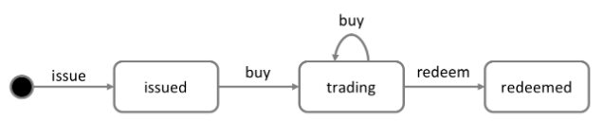
Process and Data Design (1/7)
Lifecycle
As we’ve seen, there are two important concepts that concern us when dealing with commercial paper; states and transactions. Indeed, this is true for all blockchain use cases; there are conceptual objects of value, modeled as states, whose lifecycle transitions are described by transactions. An effective analysis of states and transactions is an essential starting point for a successful implementation.
We can represent the life cycle of a commercial paper using a state transition diagram:
The state transition diagram for commercial paper. Commercial papers transition between issued, trading and redeemed states by means of the issue, buy and redeem transactions.
See how the state diagram describes how commercial papers change over time, and how specific transactions govern the life cycle transitions. In Hyperledger Fabric, smart contracts implement transaction logic that transition commercial papers between their different states. Commercial paper states are actually held in the ledger world state; so let’s take a closer look at them.
See details in: https://hyperledger-fabric.readthedocs.io/en/release-1.4/developapps/architecture.html or Process and Data Design.doc

Slide 68

Process and Data Design (2/7)
Recall the structure of a commercial paper:
A commercial paper can be represented as a set of properties, each with a value. Typically, some combination of these properties will provide a unique key for each paper.
See how a commercial paper Paper property has value 00001, and the Face value property has value 5M USD. Most importantly, the Current state property indicates whether the commercial paper is issued, trading or redeemed. In combination, the full set of properties make up the state of a commercial paper. Moreover, the entire collection of these individual commercial paper states constitutes the ledger world state.
See details in: https://hyperledger-fabric.readthedocs.io/en/release-1.4/developapps/architecture.html or Process and Data Design.doc

Slide 69
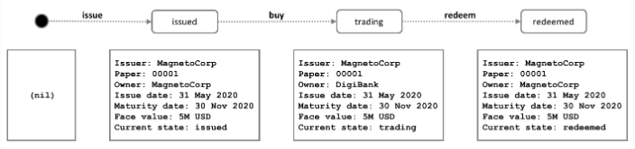
Process and Data Design (3/7)
All ledger state share this form; each has a set of properties, each with a different value. This multi-property aspect of states is a powerful feature – it allows us to think of a Fabric state as a vector rather than a simple scalar. We then represent facts about whole objects as individual states, which subsequently undergo transitions controlled by transaction logic. A Fabric state is implemented as a key/value pair, in which the value encodes the object properties in a format that captures the object’s multiple properties, typically JSON. The ledger database can support advanced query operations against these properties, which is very helpful for sophisticated object retrieval.
See how MagnetoCorp’s paper 00001 is represented as a state vector that transitions according to different transaction stimuli:
A commercial paper state is brought into existence and transitions as a result of different transactions. Hyperledger Fabric states have multiple properties, making them vectors rather than scalars.
Notice how each individual paper starts with the empty state, which is technically a nil state for the paper, as it doesn’t exist! See how paper 00001 is brought into existence by the issue transaction, and how it is subsequently updated as a result of the buy and redeem transactions.
Notice how each state is self-describing; each property has a name and a value. Although all our commercial papers currently have the same properties, this need not be the case for all time, as Hyperledger Fabric supports different states having different properties. This allows the same ledger world state to contain different forms of the same asset as well as different types of asset. It also makes it possible to update a state’s structure; imagine a new regulation that requires an additional data field. Flexible state properties support the fundamental requirement of data evolution over time.
See details in: https://hyperledger-fabric.readthedocs.io/en/release-1.4/developapps/architecture.html or Process and Data Design.doc

Slide 70
Process and Data Design (4/7)
State keys
In most practical applications, a state will have a combination of properties that uniquely identify it in a given context – it’s key. The key for a PaperNet commercial paper is formed by a concatenation of the Issuer and paper properties; so for MagnetoCorp’s first paper, it’s MagnetoCorp00001.
A state key allows us to uniquely identify a paper; it is created as a result of the issue transaction and subsequently updated by buy and redeem. Hyperledger Fabric requires each state in a ledger to have a unique key.
When a unique key is not available from the available set of properties, an application-determined unique key is specified as an input to the transaction that creates the state. This unique key is usually with some form of UUID, which although less readable, is a standard practice. What’s important is that every individual state object in a ledger must have a unique key. Note: You should avoid using U+0000 (nil byte) in keys.
Multiple states
As we’ve seen, commercial papers in PaperNet are stored as state vectors in a ledger. It’s a reasonable requirement to be able to query different commercial papers from the ledger; for example: find all the papers issued by MagnetoCorp, or: find all the papers issued by MagnetoCorp in the redeemed state.
To make these kinds of search tasks possible, it’s helpful to group all related papers together in a logical list. The PaperNet design incorporates the idea of a commercial paper list – a logical container which is updated whenever commercial papers are issued or otherwise changed.
See details in: https://hyperledger-fabric.readthedocs.io/en/release-1.4/developapps/architecture.html or Process and Data Design.doc

Slide 71
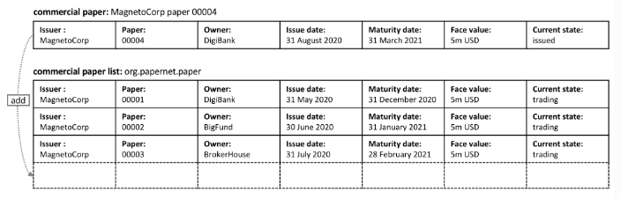
Process and Data Design (5/7)
Logical representation
It’s helpful to think of all PaperNet commercial papers being in a single list of commercial papers:
MagnetoCorp’s newly created commercial paper 00004 is added to the list of existing commercial papers.
New papers can be added to the list as a result of an issue transaction, and papers already in the list can be updated with buy or redeem transactions. See how the list has a descriptive name: org.papernet.papers; it’s a really good idea to use this kind of DNS name because well-chosen names will make your blockchain designs intuitive to other people. This idea applies equally well to smart contract names.
See details in: https://hyperledger-fabric.readthedocs.io/en/release-1.4/developapps/architecture.html or Process and Data Design.doc

Slide 72
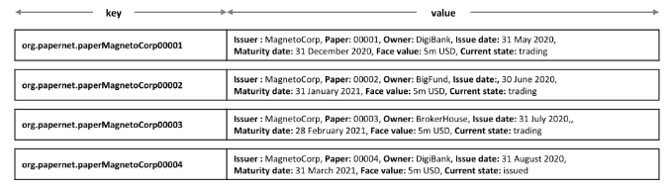
Process and Data Design (6/7)
Physical representation
While it’s correct to think of a single list of papers in PaperNet – org.papernet.papers – lists are best implemented as a set of individual Fabric states, whose composite key associates the state with its list. In this way, each state’s composite key is both unique and supports effective list query.
Representing a list of PaperNet commercial papers as a set of distinct Hyperledger Fabric states
Notice how each paper in the list is represented by a vector state, with a unique composite key formed by the concatenation of org.papernet.paper, Issuer and Paper properties. This structure is helpful for two reasons:
It allows us to examine any state vector in the ledger to determine which list it’s in, without reference to a separate list. It’s analogous to looking at set of sports fans, and identifying which team they support by the colour of the shirt they are wearing. The sports fans self-declare their allegiance; we don’t need a list of fans.
Hyperlegder Fabric internally uses a concurrency control mechanism to update a ledger, such that keeping papers in separate state vectors vastly reduces the opportunity for shared-state collisions. Such collisions require transaction re-submission, complicate application design, and decrease performance.
This second point is actually a key take-away for Hyperledger Fabric; the physical design of state vectors is very important to optimum performance and behavior. Keep your states separate!
See details in: https://hyperledger-fabric.readthedocs.io/en/release-1.4/developapps/architecture.html or Process and Data Design.doc

Slide 73
Process and Data Design (7/7)
Trust relationships
We have discussed how the different roles in a network, such as issuer, trader or rating agencies as well as different business interests determine who needs to sign off on a transaction.
In Fabric, these rules are captured by so-called endorsement policies. The rules can be set on a chaincode granularity, as well as for individual state keys.
This means that in PaperNet, we can set one rule for the whole namespace that determines which organizations can issue new papers.
Later, rules can be set and updated for individual papers to capture the trust relationships of buy and redeem transactions.
In the next topic, we will show you how to combine these design concepts to implement the PaperNet commercial paper smart contract, and then an application in exploits it!
See details in: https://hyperledger-fabric.readthedocs.io/en/release-1.4/developapps/architecture.html or Process and Data Design.doc

Slide 74
Smart Contract Processing
At the heart of a blockchain network is a smart contract.
In PaperNet, the code in the commercial paper smart contract defines the valid states for commercial paper, and the transaction logic that transition a paper from one state to another. In this topic, we’re going to show you how to implement a real world smart contract that governs the process of issuing, buying and redeeming commercial paper. We’re going to cover:
    What is a smart contract and why it’s important
    How to define a smart contract
    How to define a transaction
    How to implement a transaction
    How to represent a business object in a smart contract
    How to store and retrieve an object in the ledger
If you’d like, you can download the sample and even run it locally. It is written in JavaScript and Java, but the logic is quite language independent, so you’ll be easily able to see what’s going on! (The sample will become available for Go as well.)
See details in: https://hyperledger-fabric.readthedocs.io/en/release-1.4/developapps/smartcontract.html or Smart Contract Processing.doc

Slide 75
Application
An application can interact with a blockchain network by submitting transactions to a ledger or querying ledger content. This topic covers the mechanics of how an application does this; in our scenario, organizations access PaperNet using applications which invoke issue, buy and redeem transactions defined in a commercial paper smart contract. Even though MagnetoCorp’s application to issue a commercial paper is basic, it covers all the major points of understanding.
In this topic, we’re going to cover:
    The application flow to invoke a smart contract
    How an application uses a wallet and identity
    How an application connects using a gateway
    How to access a particular network
    How to construct a transaction request
    How to submit a transaction
    How to process a transaction response
To help your understanding, we’ll make reference to the commercial paper sample application provided with Hyperledger Fabric. You can download it and run it locally.
It is written in both JavaScript and Java, but the logic is quite language independent, so you’ll be easily able to see what’s going on! (The sample will become available for Go as well.)
See details in: https://hyperledger-fabric.readthedocs.io/en/release-1.4/developapps/application.html or Application.doc

Slide 76
Application design elements
This section elaborates the key features for client application and smart contract development found in Hyperledger Fabric.
A solid understanding of the features will help you design and implement efficient and effective solutions.
    Contract names
    Chaincode namespace
    Transaction context
    Transaction handlers
    Endorsement policies
    Connection Profile
    Connection Options
    Wallet
    Gateway
See details in: https://hyperledger-fabric.readthedocs.io/en/release-1.4/developapps/designelements.html or Application design elements.doc

Slide 77
Contents
Prerequisites
Installations
Developing Applications
The scenario
Tutorials
Operations Guides
Commands Reference
Architecture Reference
Frequently Asked Questions

Slide 78
Tutorials
We offer tutorials to get you started with Hyperledger Fabric.
The first is oriented to the Hyperledger Fabric application developer, Writing Your First Application. It takes you through the process of writing your first blockchain application for Hyperledger Fabric using the Hyperledger Fabric Node SDK.
The second tutorial is oriented towards the Hyperledger Fabric network operators, Building Your First Network. This one walks you through the process of establishing a blockchain network using Hyperledger Fabric and provides a basic sample application to test it out.
There are also tutorials for updating your channel, Adding an Org to a Channel, and upgrading your network to a later version of Hyperledger Fabric, Upgrading Your Network Components.
Finally, we offer two chaincode tutorials. One oriented to developers, Chaincode for Developers, and the other oriented to operators, Chaincode for Operators.
  Writing Your First Application
  Building Your First Network
  Commercial paper tutorial
  Updating a channel configuration
  Adding an Org to a Channel
  Upgrading Your Network Components
  Using Private Data in Fabric
  Chaincode Tutorials
    Chaincode for Developers
    Chaincode for Operators
  Writing Your First Chaincode
  Deploying a production network
  Using CouchDB
  Videos

Slide 79
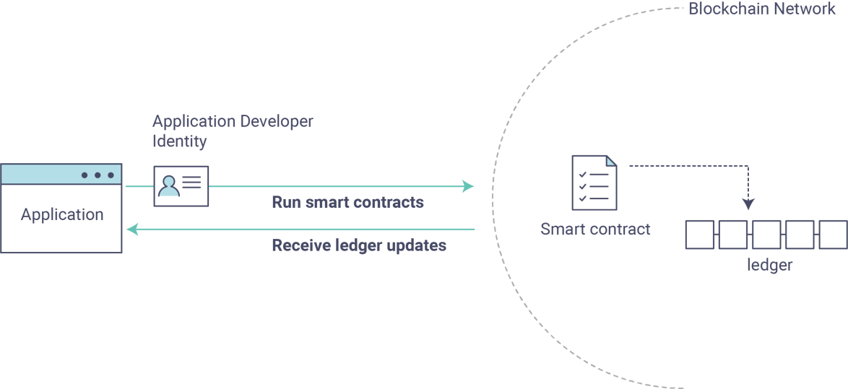
Writing Your First Application
We’ll be looking at a handful of sample programs to see how Fabric apps work.
These applications and the smart contracts they use are collectively known as FabCar. They provide a great starting point to understand a Hyperledger Fabric blockchain.
You’ll learn how to write an application and smart contract to query and update a ledger, and how to use a Certificate Authority to generate the X.509 certificates used by applications which interact with a permissioned blockchain.
We will use the application SDK — described in detail in the Application topic – to invoke a smart contract which queries and updates the ledger using the smart contract SDK — described in detail in section Smart Contract Processing.
We’ll go through three principle steps:
Setting up a development environment.
Learning about a sample smart contract, FabCar.
Develop a sample application which uses FabCar.
See details in： https://hyperledger-fabric.readthedocs.io/en/latest/write_first_app.html or Writing Your First Application.DOC
Notes:
https://hyperledger-fabric.readthedocs.io/en/release-1.4/write_first_app.html

Slide 80
Building Your First Network
The build your first network (BYFN) scenario provisions a sample Hyperledger Fabric network consisting of two organizations, each maintaining two peer nodes.
It also will deploy a “Solo” ordering service by default, though other ordering service implementations are available.
If you are getting started with Hyperledger Fabric and would like to deploy a basic network, see Using the Fabric test network.
If you are deploying Fabric in production, see the guide for Deploying a production network.
See details in： https://hyperledger-fabric.readthedocs.io/en/latest/build_network.html or Building Your First Network.DOC
Notes:
https://hyperledger-fabric.readthedocs.io/en/release-1.4/build_network.html

Slide 81
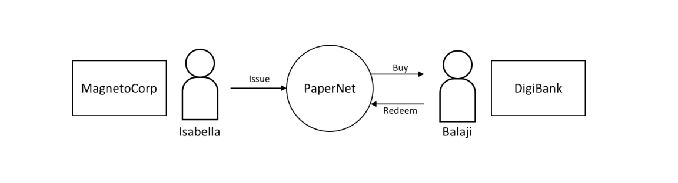
Commercial paper tutorial
You’ll act as an developer, end user, and administrator, each in different organizations, performing the following steps designed to help you understand what it’s like to collaborate as two different organizations working independently, but according to mutually agreed rules in a Hyperledger Fabric network.
Set up machine and download samples
Create a network
Understand the structure of a smart contract
Work as an organization, MagnetoCorp, to install and instantiate smart contract
Understand the structure of a MagnetoCorp application, including its dependencies
Configure and use a wallet and identities
Run a MagnetoCorp application to issue a commercial paper
Understand how a second organization, Digibank, uses the smart contract in their applications
As Digibank, run applications that buy and redeem commercial paper
See details in： https://hyperledger-fabric.readthedocs.io/en/latest/tutorial/commercial_paper.html or Commercial paper tutorial.DOC
Notes:
https://hyperledger-fabric.readthedocs.io/en/release-1.4/tutorial/commercial_paper.html

Slide 82
Updating a channel configuration
In this topic, we’ll:
Show a full sample configuration of an application channel.
Discuss many of the channel parameters that can be edited.
Show the process for updating a channel configuration, including the commands necessary to pull, translate, and scope a configuration into something that humans can read.
Discuss the methods that can be used to edit a channel configuration.
Show the process used to reformat a configuration and get the signatures necessary for it to be approved.
See details in： https://hyperledger-fabric.readthedocs.io/en/latest/config_update.html or Updating a channel configuration.DOC
Notes:
https://hyperledger-fabric.readthedocs.io/en/release-1.4/channel_update_tutorial.html

Slide 83
Adding an Org to a Channel
This tutorial serves as an extension to the Building Your First Network (BYFN) tutorial, and will demonstrate the addition of a new organization – Org3 – to the application channel (mychannel) autogenerated by BYFN.
It assumes a strong understanding of BYFN, including the usage and functionality of the aforementioned utilities.
See details in： https://hyperledger-fabric.readthedocs.io/en/latest/channel_update_tutorial.html or Adding an Org to a Channel.DOC
Notes:
https://hyperledger-fabric.readthedocs.io/en/release-1.4/channel_update_tutorial.html

Slide 84
Upgrading Your Network Components
This tutorial will perform the following steps:
  Backup the ledger and MSPs.
  Upgrade the orderer binaries to Fabric v1.4.x.
  Upgrade the peer binaries to Fabric v1.4.x.
  Update channel capabilities to v1.4.2 and 1.4.3 (optional).
This tutorial will demonstrate how to perform each of these steps individually with CLI commands. Instructions for both scripted execution and manual execution are included.
See details in： https://hyperledger-fabric.readthedocs.io/en/release-1.4/upgrading_your_network_tutorial.html or Upgrading Your Network Components.DOC
Notes:
https://hyperledger-fabric.readthedocs.io/en/release-1.4/channel_update_tutorial.html

Slide 85
Using Private Data in Fabric
The tutorial will take you through the following steps to practice defining, configuring and using private data with Fabric:
  Build a collection definition JSON file
  Read and Write private data using chaincode APIs
  Install and instantiate chaincode with a collection
  Store private data
  Query the private data as an authorized peer
  Query the private data as an unauthorized peer
  Purge Private Data
  Using indexes with private data
  Additional resources
See details in： https://hyperledger-fabric.readthedocs.io/en/latest/private_data_tutorial.html or Using Private Data in Fabric.DOC
Notes:
https://hyperledger-fabric.readthedocs.io/en/release-1.4/private_data_tutorial.html

Slide 86
Chaincode Tutorials
Chaincode is a program, written in Go, node.js, or Java that implements a prescribed interface.
Chaincode runs in a secured Docker container isolated from the endorsing peer process.
Chaincode initializes and manages ledger state through transactions submitted by applications.
A chaincode typically handles business logic agreed to by members of the network, so it may be considered as a “smart contract”.
State created by a chaincode is scoped exclusively to that chaincode and can’t be accessed directly by another chaincode.
However, within the same network, given the appropriate permission a chaincode may invoke another chaincode to access its state.
We offer two different perspectives on chaincode：
One, from the perspective of an application developer developing a blockchain application/solution entitled Chaincode for Developers, and
the other, Chaincode for Operators oriented to the blockchain network operator who is responsible for managing a blockchain network, and who would leverage the Hyperledger Fabric API to install, instantiate, and upgrade chaincode, but would likely not be involved in the development of a chaincode application.
See details in： https://hyperledger-fabric.readthedocs.io/en/release/chaincode.html or Chaincode Tutorials.DOC
Notes:
https://hyperledger-fabric.readthedocs.io/en/release/chaincode.html

Slide 87
Chaincode for Developers
Chaincode API
Simple Asset Chaincode
  Choosing a Location for the Code
  Housekeeping
  Initializing the Chaincode
  Invoking the Chaincode
  Implementing the Chaincode Application
  Pulling it All Together
Chaincode access control
Managing external dependencies for chaincode written in Go
See details in： https://hyperledger-fabric.readthedocs.io/en/latest/chaincode4ade.html or Chaincode for Developers.DOC
Notes:
https://hyperledger-fabric.readthedocs.io/en/release-1.4/chaincode.html

Slide 88
Chaincode for Operators
Chaincode lifecycle
Packaging
Creating the package
Package signing
Installing chaincode
Instantiate
Upgrade
Stop and Start
System chaincode
See ： https://hyperledger-fabric.readthedocs.io/en/release-1.4/chaincode4noah.html or Chaincode for Operators.DOC
Notes:
https://hyperledger-fabric.readthedocs.io/en/release-1.4/chaincode.html

Slide 89
Writing Your First Chaincode
We will explore chaincode through the eyes of an application developer. We’ll present a asset-transfer chaincode sample walkthrough, and the purpose of each method in the Fabric Contract API.
If you are a network operator who is deploying a chaincode to running network, visit the Deploying a smart contract to a channel tutorial and the Fabric chaincode lifecycle concept topic.
This tutorial provides an overview of the high level APIs provided by the Fabric Contract API.
To learn more about developing smart contracts using the Fabric contract API, visit the Smart Contract Processing topic.
See details in： https://hyperledger-fabric.readthedocs.io/en/latest/chaincode4ade.html or Writing Your First Chaincode.DOC

Slide 90
Deploying a production network
The process for deploying a Fabric network is complex and presumes an understanding of Public Key Infrastructure and managing distributed systems. If you are a smart contract or application developer, you should not need this level of expertise in deploying a production level Fabric network. However, you might need to be aware of how networks are deployed in order to develop effective smart contracts and applications.
The guide will give you an overview of the steps of setting up production components and a production network:
Step one: Decide on your network configuration
Step two: Set up a cluster for your resources
Step three: Set up your CAs
Step four: Use the CA to create identities and MSPs
Step five: Deploy nodes
  Create a peer
  Create an ordering node
See details in： https://hyperledger-fabric.readthedocs.io/en/latest/deployment_guide_overview.html or Deploying a production network.DOC

Slide 91
Using CouchDB
This tutorial will describe the steps required to use the CouchDB as the state database with Hyperledger Fabric.
By now, you should be familiar with Fabric concepts and have explored some of the samples and tutorials.
The tutorial will take you through the following steps:
  Enable CouchDB in Hyperledger Fabric
  Create an index
  Add the index to your chaincode folder
  Install and instantiate the Chaincode
  Query the CouchDB State Database
  Use best practices for queries and indexes
  Query the CouchDB State Database With Pagination
  Update an Index
  Delete an Index
See details in： https://hyperledger-fabric.readthedocs.io/en/latest/couchdb_tutorial.html or Using CouchDB.DOC

Slide 92

Videos
This collection（ledger-sprint3.MP4）contains developers demonstrating various v1 features and components such as: ledger, channels, gossip, SDK, chaincode, MSP, and more…
See details in： https://hyperledger-fabric.readthedocs.io/en/latest/videos.html
Notes:
https://hyperledger-fabric.readthedocs.io/en/release-1.4/videos.html

Slide 93
Contents
Prerequisites
Installations
Developing Applications
The scenario
Tutorials
Operations Guides
Commands Reference
Architecture Reference
Frequently Asked Questions

Slide 94
Operations Guides
Upgrading to the Newest Version of Fabric
Setting up an ordering node
Updating a Channel Configuration
Membership Service Providers (MSP)
Channel Configuration (configtx)
Defining capability requirements
Endorsement policies
Pluggable transaction endorsement and validation
Access Control Lists (ACL)
MSP Implementation with Identity Mixer
Identity Mixer MSP configuration generator (idemixgen)
The Operations Service
Metrics Reference
Error handling
Logging Control
Securing Communication With Transport Layer Security (TLS)
Configuring and operating a Raft ordering service
Migrating from Kafka to Raft
Bringing up a Kafka-based Ordering Service
See details in： https://hyperledger-fabric.readthedocs.io/en/latest/ops_guide.html or Operations Guides.DOC
Notes:
https://hyperledger-fabric.readthedocs.io/en/release-1.4/ops_guide.html

Slide 95
Upgrading to the latest release
If you’re familiar with previous releases of Hyperledger Fabric, you’re aware that upgrading the nodes and channels to the latest version of Fabric is, at a high level, a four step process.
Backup the ledger and MSPs.
Upgrade the orderer binaries in a rolling fashion to the latest Fabric version.
Upgrade the peer binaries in a rolling fashion to the latest Fabric version.
Update the orderer system channel and any application channels to the latest capability levels, where available.
Note that some releases will have capabilities in all groups while other releases may have few or even no new capabilities at all.
For more information about capabilities, check out Channel capabilities.
For a look at how these upgrade processes are accomplished, please consult these tutorials:
Upgrading your components. Components should be upgraded to the latest version before updating any capabilities.
Updating the capability level of a channel. Completed after updating the versions of all nodes.
Enabling the new chaincode lifecycle. Necessary to add organization specific endorsement policies central to the new chaincode lifecycle for Fabric v2.0.
As the upgrading of nodes and increasing the capability levels of channels is by now considered a standard Fabric process, we will not show the specific commands for upgrading to the newest release. Similarly, there is no script in the fabric-samples repo that will upgrade a sample network from the previous release to this one, as there has been for previous releases.
See details in： https://hyperledger-fabric.readthedocs.io/en/latest/upgrade.html or Upgrading to the latest release.DOC
Notes:
https://hyperledger-fabric.readthedocs.io/en/release-1.4/ops_guide.html

Slide 96
Contents
Prerequisites
Installations
Developing Applications
The scenario
Tutorials
Operations Guides
Commands Reference
Architecture Reference
Frequently Asked Questions

Slide 97
Commands Reference
peer
peer chaincode
peer channel
peer version
peer logging
peer node
configtxgen
configtxlator
cryptogen
Service Discovery CLI
Fabric-CA Commands
See details in： https://hyperledger-fabric.readthedocs.io/en/release-1.4/command_ref.html or Commands Reference.doc

Slide 98
Contents
Prerequisites
Installations
Developing Applications
The scenario
Tutorials
Operations Guides
Commands Reference
Architecture Reference
Frequently Asked Questions

Slide 99
Architecture Reference
Architecture Origins
Transaction Flow
Hyperledger Fabric CA's User Guide
Hyperledger Fabric SDKs
Service Discovery
Channels
CouchDB as the State Database
Peer channel-based event services
Private Data
Read-Write set semantics
Gossip data dissemination protocol
See details in： https://hyperledger-fabric.readthedocs.io/en/release-1.4/architecture.html or Architecture Reference.doc

Slide 100
Contents
Prerequisites
Installations
Developing Applications
The scenario
Tutorials
Operations Guides
Commands Reference
Architecture Reference
Frequently Asked Questions

Slide 101
Frequently Asked Questions
Endorsement
Endorsement architecture:
Security & Access Control
Application-side Programming Model
Chaincode (Smart Contracts and Digital Assets)
Differences in Most Recent Releases
Ordering Service
BFT
See details in： https://hyperledger-fabric.readthedocs.io/en/latest/Fabric-FAQ.html or Frequently Asked Questions.doc

Slide 102
Contents
Prerequisites
Installations
Developing Applications
The scenario
Tutorials
Operations Guides
Commands Reference
Architecture Reference
Frequently Asked Questions

Slide 103
Key Concepts
Developing an Application
©2017 IBM Corporation

Slide 104









END !
Hindi
Traditional Chinese
Thai
Gracias
Russian
Thank You
Spanish
Obrigado
English
Brazilian Portuguese
Arabic
Danke
Grazie
German
Merci
Italian
Simplified Chinese
French
Japanese
Korean

