Slide 1


Zero-Knowledge Proof -- A Method in Blockchain
LING Zong, Ph. D.
Senior Software Engineer / Scientist
IBM Almaden Research Center
San Jose, California, U.S.A.

Slide 2
Lecture Outline
Definition
Abstract examples
Practical examples
Applications
History
References
Notes:
https://en.wikipedia.org/wiki/Zero-knowledge_proof

Slide 3
Definition

Slide 4
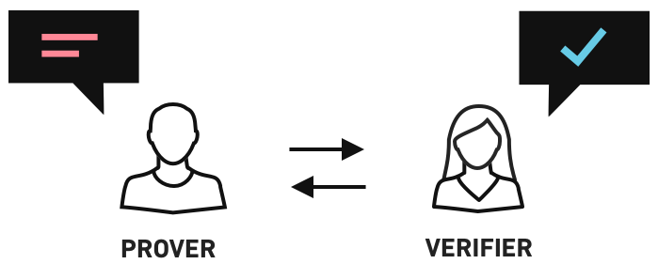
The Method（1/3）
In cryptography, a zero-knowledge proof or zero-knowledge protocol is a method by which one party (the prover Peggy) can prove to another party (the verifier Victor) that she knows a value x, without conveying any information apart from the fact that she knows the value x.
Another way of understanding this would be: Interactive zero-knowledge proofs require interaction between the individual (or computer system) proving their knowledge and the individual validating the proof.
Notes:
https://en.wikipedia.org/wiki/Zero-knowledge_proof

Slide 5
The Method（2/3）
If proving the statement requires knowledge of some secret information on the part of the prover, the definition implies that the verifier will not be able to prove the statement in turn to anyone else, since the verifier does not possess the secret information.
Notice that the statement being proved must include the assertion that the prover has such knowledge (otherwise, the statement would not be proved in zero-knowledge, since at the end of the protocol the verifier would gain the additional information that the prover has knowledge of the required secret information).
If the statement consists only of the fact that prover possesses the secret information, it is a special case known as zero-knowledge proof of knowledge, and it nicely illustrates the essence of the notion of zero-knowledge proofs: proving that one has knowledge of certain information is trivial if one is allowed to simply reveal that information; the challenge is proving that one has such knowledge without revealing the secret information or anything else.
Notes:
https://en.wikipedia.org/wiki/Zero-knowledge_proof

Slide 6
The Method（3/3）
For zero-knowledge proofs of knowledge, the protocol must necessarily require interactive input from the verifier, usually in the form of a challenge or challenges such that the responses from the prover will convince the verifier if and only if the statement is true (i.e., if the prover does have the claimed knowledge).
This is clearly the case, since otherwise the verifier could record the execution of the protocol and replay it to someone else: if this were accepted by the new party as proof that the replaying party knows the secret information, then the new party's acceptance is either justified—the replayer does know the secret information—which means that the protocol leaks knowledge and is not zero-knowledge, or it is spurious—i.e. leads to a party accepting someone's proof of knowledge who does not actually possess it.
Notes:
https://en.wikipedia.org/wiki/Zero-knowledge_proof

Slide 7
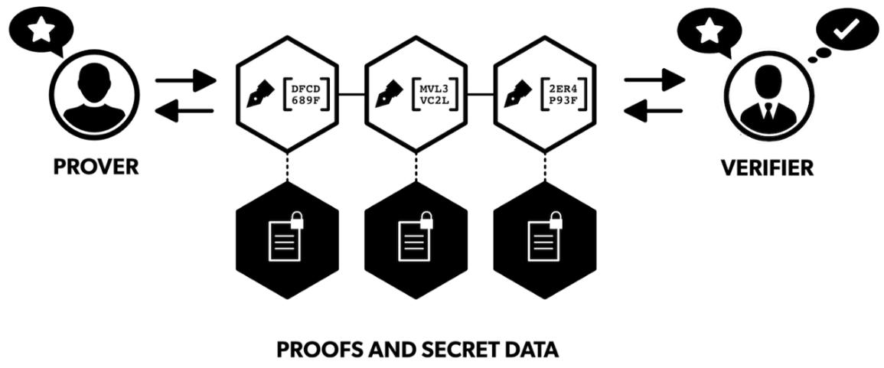
Definition (1/2)
A zero-knowledge proof must satisfy three properties:
Completeness: if the statement is true, the honest verifier (that is, one following the protocol properly) will be convinced of this fact by an honest prover.
Soundness: if the statement is false, no cheating prover can convince the honest verifier that it is true, except with some small probability.
Zero-knowledge: if the statement is true, no verifier learns anything other than the fact that the statement is true. In other words, just knowing the statement (not the secret) is sufficient to imagine a scenario showing that the prover knows the secret.
This is formalized by showing that every verifier has some simulator that, given only the statement to be proved (and no access to the prover), can produce a transcript that "looks like" an interaction between the honest prover and the verifier in question.
The first two of these are properties of more general interactive proof systems. The third is what makes the proof zero-knowledge.
Zero-knowledge proofs are not proofs in the mathematical sense of the term because there is some small probability, the soundness error, that a cheating prover will be able to convince the verifier of a false statement.
In other words, zero-knowledge proofs are probabilistic "proofs" rather than deterministic proofs. However, there are techniques to decrease the soundness error to negligibly small values.

Slide 8

Definition (2/2)
A formal definition of zero-knowledge has to use some computational model, the most common one being that of a Turing machine. Let P，V， and S be
Turing machines. An interactive proof system with （P，V）for a language L is zero-knowledge if for any probabilistic polynomial time (PPT) verifier V there exists a PPT simulator S such that
Where is a record of the interactions between and . The prover P is modeled as having unlimited computation power (in practice, P usually is a probabilistic Turing machine). Intuitively, the definition states that an interactive proof system （P，V） is zero-knowledge if for any verifier there exists an efficient simulator S (depending on ) that can reproduce the conversation between P and on any given input. The auxiliary string z in the definition plays the role of "prior knowledge" (including the random coins of ). The definition implies that cannot use any prior knowledge string z to mine information out of its conversation with P, because if S is also given this prior knowledge then it can reproduce the conversation between and P just as before.
The definition given is that of perfect zero-knowledge. Computational zero-knowledge is obtained by requiring that the views of the verifier and the simulator are only computationally indistinguishable, given the auxiliary string.
Notes:
https://en.wikipedia.org/wiki/Zero-knowledge_proof

Slide 9
Abstract examples

Slide 10
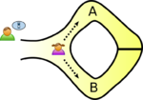
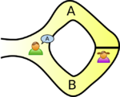
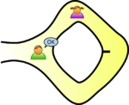
The Ali Baba cave
There is a well-known story presenting the fundamental ideas of zero-knowledge proofs, first published by Jean-Jacques Quisquater and others in their paper "How to Explain Zero-Knowledge Protocols to Your Children". It is common practice to label the two parties in a zero-knowledge proof as Peggy (the prover of the statement) and Victor (the verifier of the statement).
In this story, Peggy has uncovered the secret word used to open a magic door in a cave.
The cave is shaped like a ring, with the entrance on one side and the magic door blocking the opposite side.
Victor wants to know whether Peggy knows the secret word;
but Peggy, being a very private person, does not want to reveal her knowledge (the secret word) to Victor or to reveal the fact of her knowledge to the world in general.
They label the left and right paths from the entrance A and B. First, Victor waits outside the cave as Peggy goes in. Peggy takes either path A or B; Victor is not allowed to see which path she takes.
Then, Victor enters the cave and shouts the name of the path he wants her to use to return, either A or B, chosen at random.
Providing she really does know the magic word, this is easy: she opens the door, if necessary, and returns along the desired path.
However, suppose she did not know the word. Then, she would only be able to return by the named path if Victor were to give the name of the same path by which she had entered.
Since Victor would choose A or B at random, she would have a 50% chance of guessing correctly.
If they were to repeat this trick many times, say 20 times in a row, her chance of successfully anticipating all of Victor's requests would become vanishingly small (about one in a million).
Thus, if Peggy repeatedly appears at the exit Victor names, he can conclude that it is very probable—astronomically probable—that Peggy does in fact know the secret word.
Notes:
In this story, Peggy has uncovered the secret word used to open a magic door in a cave. The cave is shaped like a ring, with the entrance on one side and the magic door blocking the opposite side. Victor wants to know whether Peggy knows the secret word; but Peggy, being a very private person, does not want to reveal her knowledge (the secret word) to Victor or to reveal the fact of her knowledge to the world in general.
They label the left and right paths from the entrance A and B. First, Victor waits outside the cave as Peggy goes in. Peggy takes either path A or B; Victor is not allowed to see which path she takes. Then, Victor enters the cave and shouts the name of the path he wants her to use to return, either A or B, chosen at random. Providing she really does know the magic word, this is easy: she opens the door, if necessary, and returns along the desired path.
However, suppose she did not know the word. Then, she would only be able to return by the named path if Victor were to give the name of the same path by which she had entered. Since Victor would choose A or B at random, she would have a 50% chance of guessing correctly. If they were to repeat this trick many times, say 20 times in a row, her chance of successfully anticipating all of Victor's requests would become vanishingly small (about one in a million).
Thus, if Peggy repeatedly appears at the exit Victor names, he can conclude that it is very probable—astronomically probable—that Peggy does in fact know the secret word.
One side note with respect to third-party observers: even if Victor is wearing a hidden camera that records the whole transaction, the only thing the camera will record is in one case Victor shouting "A!" and Peggy appearing at A or in the other case Victor shouting "B!" and Peggy appearing at B. A recording of this type would be trivial for any two people to fake (requiring only that Peggy and Victor agree beforehand on the sequence of A's and B's that Victor will shout). Such a recording will certainly never be convincing to anyone but the original participants. In fact, even a person who was present as an observer at the original experiment would be unconvinced, since Victor and Peggy might have orchestrated the whole "experiment" from start to finish.
Further notice that if Victor chooses his A's and B's by flipping a coin on-camera, this protocol loses its zero-knowledge property; the on-camera coin flip would probably be convincing to any person watching the recording later. Thus, although this does not reveal the secret word to Victor, it does make it possible for Victor to convince the world in general that Peggy has that knowledge—counter to Peggy's stated wishes. However, digital cryptography generally "flips coins" by relying on a pseudo-random number generator, which is akin to a coin with a fixed pattern of heads and tails known only to the coin's owner. If Victor's coin behaved this way, then again it would be possible for Victor and Peggy to have faked the "experiment", so using a pseudo-random number generator would not reveal Peggy's knowledge to the world in the same way using a flipped coin would.
Notice that Peggy could prove to Victor that she knows the magic word, without revealing it to him, in a single trial. If both Victor and Peggy go together to the mouth of the cave, Victor can watch Peggy go in through A and come out through B. This would prove with certainty that Peggy knows the magic word, without revealing the magic word to Victor. However, such a proof could be observed by a third party, or recorded by Victor and such a proof would be convincing to anybody. In other words, Peggy could not refute such proof by claiming she colluded with Victor, and she is therefore no longer in control of who is aware of her knowledge.

Slide 11
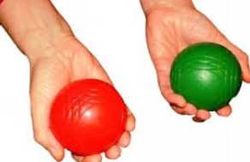
Two balls and the color-blind friend
This example requires two identical objects with different colors, such as two colored balls, and it is considered one of the easiest explanations of how interactive zero-knowledge proofs work. It was first demonstrated live by software engineers Konstantinos Chalkias and Mike Hearn at a blockchain related conference in September 2017 and is inspired by the work of Prof. Oded Goldreich, who used two differently coloured cards.
Imagine your friend is color-blind and you have two balls: one red and one green, but otherwise identical. To your friend they seem completely identical and he is skeptical that they are actually distinguishable. You want to prove to him they are in fact differently-colored, but nothing else, thus you do not reveal which one is the red and which is the green.
Here is the proof system. You give the two balls to your friend and he puts them behind his back. Next, he takes one of the balls and brings it out from behind his back and displays it. This ball is then placed behind his back again and then he chooses to reveal just one of the two balls, switching to the other ball with probability 50%. He will ask you, "Did I switch the ball?" This whole procedure is then repeated as often as necessary.
By looking at their colors, you can of course say with certainty whether or not he switched them. On the other hand, if they were the same color and hence indistinguishable, there is no way you could guess correctly with probability higher than 50%.
If you and your friend repeat this "proof" multiple times (e.g. 128), your friend should become convinced ("completeness") that the balls are indeed differently colored; otherwise, the probability that you would have randomly succeeded at identifying all the switch/non-switches is close to zero ("soundness").
The above proof is zero-knowledge because your friend never learns which ball is green and which is red; indeed, he gains no knowledge about how to distinguish the balls.
Notes:
https://en.wikipedia.org/wiki/Zero-knowledge_proof

Slide 12

Where's Wally?
Where's Wally? (or Where's Waldo?) is a picture book where the reader is challenged to find a small character called Wally hidden somewhere on a double-spread page that is filled with many other characters. The pictures are designed so that it is hard to find Wally.
Imagine that you are a professional Where's Wally? solver. A company comes to you with a Where's Wally? book that they need solved. The company wants you to prove that you are actually a professional Where's Wally? solver and thus asks you to find Wally in a picture from their book. The problem is that you don't want to do work for them without being paid.
Both you and the company want to cooperate, but you don't trust each other. It doesn't seem like it's possible to satisfy the company's demand without doing free work for them, but in fact there is a zero-knowledge proof which allows you to prove to the company that you know where Wally is in the picture without revealing to them how you found him, or where he is.
The proof goes as follows:
You ask the company representative to turn around, and then you place a very large piece of cardboard over the picture such that the center of the cardboard is positioned over Wally.
You cut out a small window in the center of the cardboard such that Wally is visible.
You can now ask the company representative to turn around and view the large piece of cardboard with the hole in the middle, and observe that Wally is visible through the hole.
The cardboard is large enough that they cannot determine the position of the book under the cardboard. You then ask the representative to turn back around so that you can remove the cardboard and give back the book.
As described, this proof is an illustration only, and not completely rigorous. The company representative would need to be sure that you didn't smuggle a picture of Wally into the room. Something like a tamper-proof glovebox might be used in a more rigorous proof. The above proof also results in the body position of Wally being leaked to the company representative, which may help them find Wally if his body position changes in each Where's Wally? puzzle.
Notes:
https://en.wikipedia.org/wiki/Zero-knowledge_proof

Slide 13
Practical examples

Slide 14
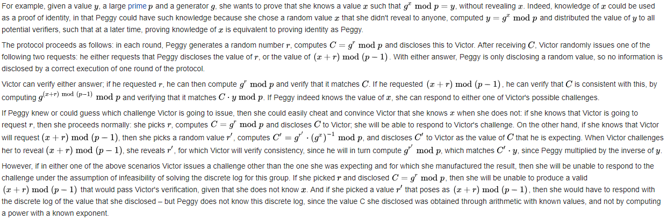
Discrete log of a given value (1/2)
We can apply these ideas to a more realistic cryptography application.
Peggy wants to prove to Victor that she knows the discrete log of a given value in a given group.
Thus, a cheating prover has a 0.5 probability of successfully cheating in one round. By executing a large enough number of rounds, the probability of a cheating prover succeeding can be made arbitrarily low.
Notes:
https://en.wikipedia.org/wiki/Discrete_logarithm

Slide 15
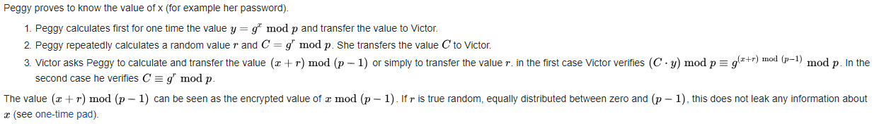
Discrete log of a given value (2/2)
Short summary

Slide 16
Hamiltonian cycle for a large graph (1/2)
In this scenario, Peggy knows a Hamiltonian cycle for a large graph G. Victor knows G but not the cycle (e.g., Peggy has generated G and revealed it to him.) Finding a Hamiltonian cycle given a large graph is believed to be computationally infeasible, since its corresponding decision version is known to be NP-complete. Peggy will prove that she knows the cycle without simply revealing it (perhaps Victor is interested in buying it but wants verification first, or maybe Peggy is the only one who knows this information and is proving her identity to Victor).
To show that Peggy knows this Hamiltonian cycle, she and Victor play several rounds of a game.
At the beginning of each round, Peggy creates H, a graph which is isomorphic to G (i.e. H is just like G except that all the vertices have different names). Since it is trivial to translate a Hamiltonian cycle between isomorphic graphs with known isomorphism, if Peggy knows a Hamiltonian cycle for G she also must know one for H.
Peggy commits to H. She could do so by using a cryptographic commitment scheme. Alternatively, she could number the vertices of H, then for each edge of H write on a small piece of paper containing the two vertices of the edge and then put these pieces of paper face down on a table. The purpose of this commitment is that Peggy is not able to change H while at the same time Victor has no information about H.
Victor then randomly chooses one of two questions to ask Peggy. He can either ask her to show the isomorphism between H and G (see graph isomorphism problem), or he can ask her to show a Hamiltonian cycle in H.
If Peggy is asked to show that the two graphs are isomorphic, she first uncovers all of H (e.g. by turning over all pieces of papers that she put on the table) and then provides the vertex translations that map G to H. Victor can verify that they are indeed isomorphic.
If Peggy is asked to prove that she knows a Hamiltonian cycle in H, she translates her Hamiltonian cycle in G onto H and only uncovers the edges on the Hamiltonian cycle. This is enough for Victor to check that H does indeed contain a Hamiltonian cycle.

Slide 17
Hamiltonian cycle for a large graph (2/2)
Completeness
If Peggy does know a Hamiltonian cycle in G, she can easily satisfy Victor's demand for either the graph isomorphism producing H from G (which she had committed to in the first step) or a Hamiltonian cycle in H (which she can construct by applying the isomorphism to the cycle in G).
Zero-knowledge
Peggy's answers do not reveal the original Hamiltonian cycle in G. Each round, Victor will learn only H's isomorphism to G or a Hamiltonian cycle in H. He would need both answers for a single H to discover the cycle in G, so the information remains unknown as long as Peggy can generate a distinct H every round. If Peggy does not know of a Hamiltonian Cycle in G, but somehow knew in advance what Victor would ask to see each round then she could cheat. For example, if Peggy knew ahead of time that Victor would ask to see the Hamiltonian Cycle in H then she could generate a Hamiltonian cycle for an unrelated graph. Similarly, if Peggy knew in advance that Victor would ask to see the isomorphism then she could simply generate an isomorphic graph H (in which she also does not know a Hamiltonian Cycle). Victor could simulate the protocol by himself (without Peggy) because he knows what he will ask to see. Therefore, Victor gains no information about the Hamiltonian cycle in G from the information revealed in each round.
Soundness
If Peggy does not know the information, she can guess which question Victor will ask and generate either a graph isomorphic to G or a Hamiltonian cycle for an unrelated graph, but since she does not know a Hamiltonian cycle for G she cannot do both. With this guesswork, her chance of fooling Victor is 2^{−n}, where n is the number of rounds. For all realistic purposes, it is infeasibly difficult to defeat a zero knowledge proof with a reasonable number of rounds in this way.

Slide 18
Applications

Slide 19
Authentication systems
Research in zero-knowledge proofs (ZKP) has been motivated by authentication systems where one party wants to prove its identity to a second party via some secret information (such as a password) but doesn't want the second party to learn anything about this secret.
This is called a "zero-knowledge proof of knowledge". However, a password is typically too small or insufficiently random to be used in many schemes for zero-knowledge proofs of knowledge.
A zero-knowledge password proof is a special kind of zero-knowledge proof of knowledge that addresses the limited size of passwords.

Slide 20
Ethical behavior
One of the uses of zero-knowledge proofs within cryptographic protocols is to enforce honest behavior while maintaining privacy.
Roughly, the idea is to force a user to prove, using a zero-knowledge proof, that its behavior is correct according to the protocol.
Because of soundness, we know that the user must really act honestly in order to be able to provide a valid proof.
Because of zero knowledge, we know that the user does not compromise the privacy of its secrets in the process of providing the proof.

Slide 21
Nuclear disarmament
In 2016, the Princeton Plasma Physics Laboratory and Princeton University demonstrated a novel technique that may have applicability to future nuclear disarmament talks.
It would allow inspectors to confirm whether or not an object is indeed a nuclear weapon without recording, sharing or revealing the internal workings which might be secret.

Slide 22
Blockchains
ZKPs can be used to guarantee that transactions are valid despite the fact that information about the sender, the recipient and other transaction details remain hidden.
Zero-knowledge protocols enable the transfer of assets across a distributed, peer-to-peer blockchain network with complete privacy. In regular blockchain transactions, when an asset is sent from one party to another, the details of that transaction are visible to every other party in the network. By contrast, in a zero knowledge transaction, the others only know that a valid transaction has taken place, but nothing about the sender, recipient, asset class and quantity. The identity and amount being spent can remain hidden, and problems such as “front-running” can be avoided.
The most prominent blockchain-based system using zero-knowledge proofs is ZCash, which was also the first cryptocurrency to implement zk-SNARKs. Other blockchain-based systems have since also incorporate zero-knowledge proofs into their solutions to allow for transactions to be verified while protecting user/transaction privacy. Probably the best known of which is Ethereum, which implemented zk-SNARKS as part of the Byzantium upgrade.
Notes:
https://medium.com/@argongroup/on-zero-knowledge-proofs-in-blockchains-14c48cfd1dd1

Slide 23
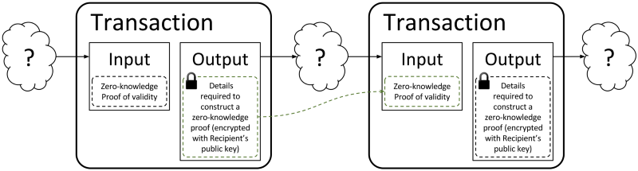
What are zk-Snarks?
You might already have stumbled upon the term ‘zk-Snarks’. The term was introduced in 2012 by Nir Bitansky, Ran Canetti, Alessandro Chiesa & Eran Tromer and describes a special variation of the zero-knowledge technique.
zk-SNARKs introduce a number of innovations that render them usable in blockchains. Most importantly, zk-SNARKs reduce the size of the proofs and the computational effort required to verify them.
https://z.cash/zh/technology/zksnarks/
Notes:
https://medium.com/@argongroup/on-zero-knowledge-proofs-in-blockchains-14c48cfd1dd1

Slide 24
Variants of zero-knowledge
Different variants of zero-knowledge can be defined by formalizing the intuitive concept of what is meant by the output of the simulator "looking like" the execution of the real proof protocol in the following ways:
We speak of perfect zero-knowledge if the distributions produced by the simulator and the proof protocol are distributed exactly the same. This is for instance the case in the first example above.
Statistical zero-knowledge means that the distributions are not necessarily exactly the same, but they are statistically close, meaning that their statistical difference is a negligible function.
We speak of computational zero-knowledge if no efficient algorithm can distinguish the two distributions.

Slide 25
Zero knowledge types
Proof of knowledge: the knowledge is hidden in the exponent like in the example shown above.
Pairing based cryptography: given f(x) and f(y), without knowing x and y, it is possible to compute f(x×y).
Witness indistinguishable proof: verifiers cannot know which witness is used for producing the proof.
Multi-party computation: while each party can keep their respective secret, they together produce a result.
Ring signature: outsiders have no idea which key is used for signing.

Slide 26
History

Slide 27
History (1/2)
Zero-knowledge proofs were first conceived in 1985 by Shafi Goldwasser, Silvio Micali, and Charles Rackoff in their paper "The Knowledge Complexity of Interactive Proof-Systems".
This paper introduced the IP hierarchy of interactive proof systems (see interactive proof system) and conceived the concept of knowledge complexity, a measurement of the amount of knowledge about the proof transferred from the prover to the verifier.
The quadratic nonresidue problem has both an NP and a co-NP algorithm, and so lies in the intersection of NP and co-NP. This was also true of several other problems for which zero-knowledge proofs were subsequently discovered, such as an unpublished proof system by Oded Goldreich verifying that a two-prime modulus is not a Blum integer.
Notes:
In their own words, Goldwasser, Micali, and Rackoff say:
Of particular interest is the case where this additional knowledge is essentially 0 and we show that [it] is possible to interactively prove that a number is quadratic non residue mod m releasing 0 additional knowledge. This is surprising as no efficient algorithm for deciding quadratic residuosity mod m is known when m’s factorization is not given. Moreover, all known NP proofs for this problem exhibit the prime factorization of m. This indicates that adding interaction to the proving process, may decrease the amount of knowledge that must be communicated in order to prove a theorem.

Slide 28
History (2/2)
Oded Goldreich, Silvio Micali, and Avi Wigderson took this one step further, showing that, assuming the existence of unbreakable encryption, one can create a zero-knowledge proof system for the NP-complete graph coloring problem with three colors. Since every problem in NP can be efficiently reduced to this problem, this means that, under this assumption, all problems in NP have zero-knowledge proofs. The reason for the assumption is that, as in the above example, their protocols require encryption. A commonly cited sufficient condition for the existence of unbreakable encryption is the existence of one-way functions, but it is conceivable that some physical means might also achieve it.
On top of this, they also showed that the graph nonisomorphism problem, the complement of the graph isomorphism problem, has a zero-knowledge proof. This problem is in co-NP, but is not currently known to be in either NP or any practical class. More generally, Russell Impagliazzo and Moti Yung as well as Ben-Or et al. would go on to show that, also assuming one-way functions or unbreakable encryption, that there are zero-knowledge proofs for all problems in IP = PSPACE, or in other words, anything that can be proved by an interactive proof system can be proved with zero knowledge.
In September 2017, the first ZKP was conducted on the Byzantium fork of Ethereum.
Notes:
Not liking to make unnecessary assumptions, many theorists sought a way to eliminate the necessity of one way functions. One way this was done was with multi-prover interactive proof systems (see interactive proof system), which have multiple independent provers instead of only one, allowing the verifier to "cross-examine" the provers in isolation to avoid being misled. It can be shown that, without any intractability assumptions, all languages in NP have zero-knowledge proofs in such a system.
It turns out that in an Internet-like setting, where multiple protocols may be executed concurrently, building zero-knowledge proofs is more challenging. The line of research investigating concurrent zero-knowledge proofs was initiated by the work of Dwork, Naor, and Sahai. One particular development along these lines has been the development of witness-indistinguishable proof protocols. The property of witness-indistinguishability is related to that of zero-knowledge, yet witness-indistinguishable protocols do not suffer from the same problems of concurrent execution.
Another variant of zero-knowledge proofs are non-interactive zero-knowledge proofs. Blum, Feldman, and Micali showed that a common random string shared between the prover and the verifier is enough to achieve computational zero-knowledge without requiring interaction.

Slide 29
References

Slide 30
External links
"What is a zero-knowledge proof and why is it useful?". 16 November 2017.
"Ethereum Upgrade Byzantium Is Live, Verifies First ZK-Snark Proof". Cointelegraph. Retrieved 2017-12-18.
A tutorial by Oded Goldreich on zero knowledge proofs
Demonstrate how Zero-Knowledge Proofs work without using maths
The Bitcoin's Zero knowledge proof to binding
https://en.wikipedia.org/wiki/Zero-knowledge_proof

Slide 31
Lecture Outline
Definition
Abstract examples
Practical examples
Applications
History
References
Notes:
https://en.wikipedia.org/wiki/Zero-knowledge_proof

Slide 32









完
Hindi
Traditional Chinese
Thai
Gracias
Russian
Thank You
Spanish
Obrigado
English
Brazilian Portuguese
Arabic
Danke
Grazie
German
Italian
Simplified Chinese
Merci
French
Japanese
Korean
Notes:
32

