Slide 1
电路与模拟电子技术
Circuits and Analog Electronics
软件学院 任江涛
Email: issrjt@mail.sysu.edu.cn

Slide 2
电路与模拟电子技术
主要参考书：
电路与模拟电子技术 高玉良 高教出版社

Slide 3
Circuits and Analog Electronics
Circuits The basic principles of circuit analysis, introduction to the current, voltage, power, circuit elements, Ohm's law, Kirchhoff's current and voltage laws, Node-voltage, Mesh-current methods, Superposition, and Equivalence theorems, Transient analysis, AC steady-state analysis.
Analog Electronics the physical operation principles of electronic components, in other words, to what is "inside" the transistor or the diode. And terminal current-voltage characteristics of the components, analysis and design of electronic circuits using discrete components such as diodes and transistors, in particular to linear amplifiers come into play.

Slide 4
Circuits and Analog Electronics
Ch1 Basic Concepts and Laws of Electric Circuits
1.1 Basic Concepts and Electric Circuits
1.2 Basic Quantities
1.3 Circuit Elements
1.4 Kirchhoff's Current and Voltage Laws
Readings: Gao-Ch1; Hayt-Ch1, 2, 5

Slide 5
Ch1 Basic Concepts and Laws of Electric Circuits
1.1 Basic Concepts and Electric Circuits
Key Words:
Lumped Circuit Abstraction
Circuits System

Slide 6
Ch1 Basic Concepts and Laws of Electric Circuits
1.1 Basic Concepts and Electric Circuits
Signal processing and transmission
transmitter
Amplifiers
Speaker
Circuits
Kinescope
Antenna
Electrical power conversion and transmission
Power Supplies
Transmission
Loads

Slide 7
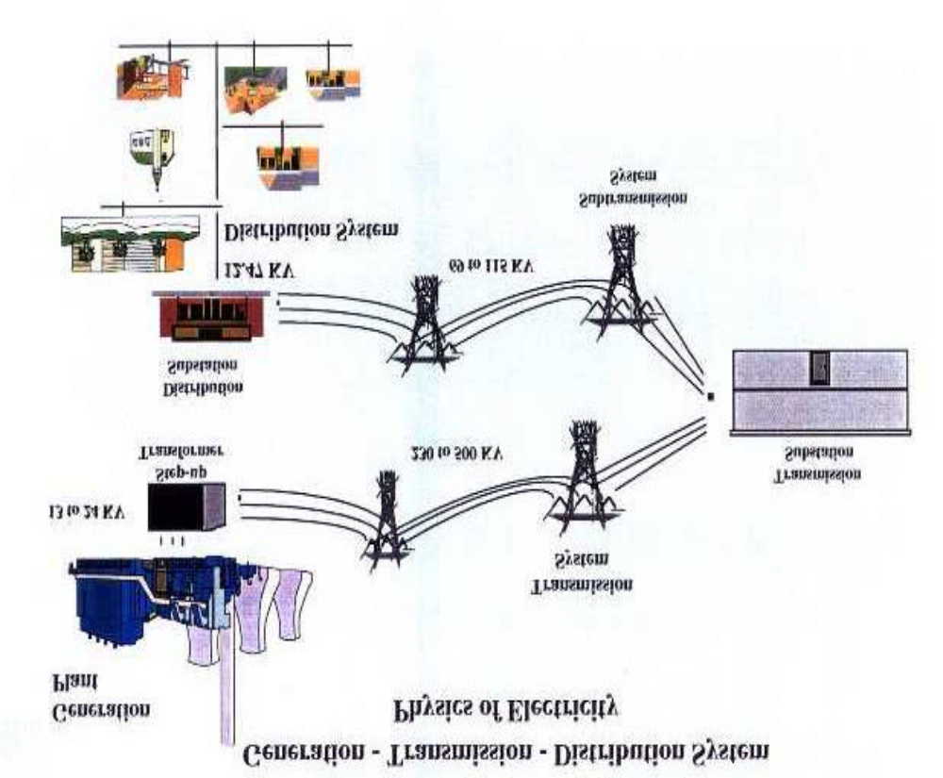
Ch1 Basic Concepts and Laws of Electric Circuits
1.1 Basic Concepts and Electric Circuits

Slide 8
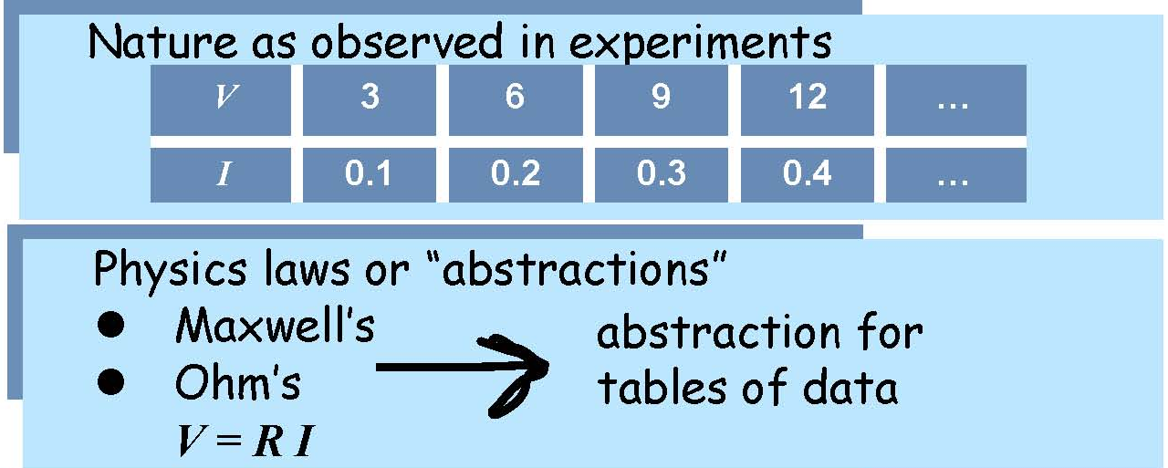
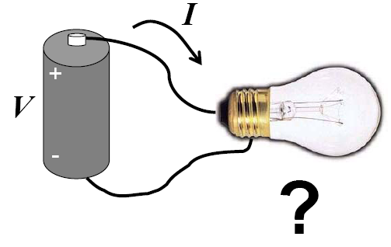
Ch1 Basic Concepts and Laws of Electric Circuits
1.1 Basic Concepts and Electric Circuits
Suppose we wish to answer this question: What is the current through the bulb?

Slide 9
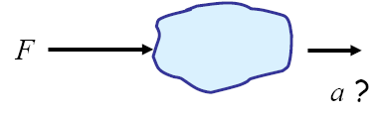


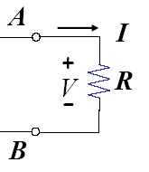
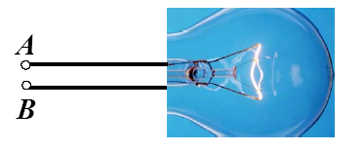

Ch1 Basic Concepts and Laws of Electric Circuits
1.1 Basic Concepts and Electric Circuits
In doing so, you ignored the object’s shape，its temperature，its color，point of force .
Then, we can replace the bulb with a resistor for the purpose of calculating the current.
R represents the only property of interest!
R is a lumped element abstraction for the bulb.

Slide 10
Ch1 Basic Concepts and Laws of Electric Circuits
1.1 Basic Concepts and Electric Circuits
called element v-i relationship
1Ω=1V/A
G = 1/R is the conductance in Siemens (S)
i(t) = G × v(t)
1S = 1 A/V
A resistor is a circuit element that dissipates electrical energy (usually as heat).
Real-world devices that are modeled by resistors: incandescent light bulb, heating elements (stoves, heaters, etc.), long wires
A circuit is composed of elements (sources, resistors, capacitors, inductors) and conductors (wires).
Elements are lumped.
Conductors are perfect.
Lumped circuit abstraction!
Notes:
Incandescent 白帜 dissipate 消散

Slide 11
Ch1 Basic Concepts and Laws of Electric Circuits
1.1 Basic Concepts and Electric Circuits
The AM Radio “System”
Understanding the AM radio requires knowledge of several EE subdisciplines:
  --Communications/signal processing (frequency domain analysis)
  --Electromagnetics (antennas, high-frequency circuits)
  --Power (batteries, power supplies)
  --Solid state (miniaturization, low-power electronics)

Slide 12
Ch1 Basic Concepts and Laws of Electric Circuits
1.1 Basic Concepts and Electric Circuits
The AM Radio “System”
Transmitter
Receiver

Slide 13
Ch1 Basic Concepts and Laws of Electric Circuits
1.1 Basic Concepts and Electric Circuits
The AM Radio “System”
A signal is a quantity that may vary with time.
  --Voltage or current in a circuit
  --Sound (pressure wave traveling through air)
  --Light or radio waves (electromagnetic energy traveling through free space)
The analysis and design of AM radios (and communication systems in general) is usually conducted in the frequency domain using Fourier analysis.
Fourier analysis allows us to represent signals as combinations of sinusoids (sines and cosines).

Slide 14
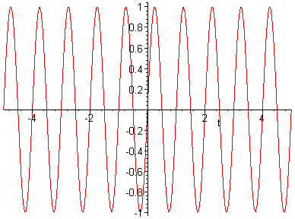
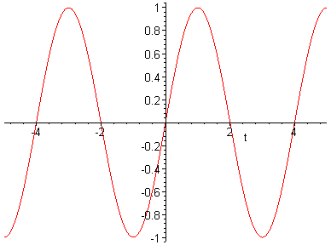
Ch1 Basic Concepts and Laws of Electric Circuits
1.1 Basic Concepts and Electric Circuits
The AM Radio “System”
Frequency is the rate at which a signal oscillates.
High Frequency
Low Frequency

Slide 15
Ch1 Basic Concepts and Laws of Electric Circuits
1.1 Basic Concepts and Electric Circuits
The AM Radio “System”
Visible light is electromagnetic energy with frequency between 380THz (Terahertz) and 860THz.
  Our visual system perceives the frequency of the electromagnetic energy as color.
  Red is 460THz, green is 570THz, and blue is 630THz.
An AM radio signal has a frequency of between 500kHz and 1.8MHz.
FM radio and TV uses different frequencies.
Mathematical analysis of signals in terms of frequency
Most commonly encountered signals can be represented as a Fourier series or a Fourier transform.
A Fourier series is a weighted sum of cosines and sines.

Slide 16
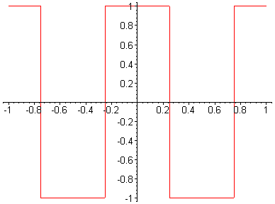
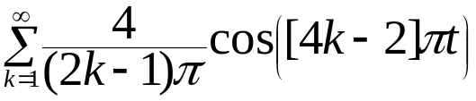
Ch1 Basic Concepts and Laws of Electric Circuits
1.1 Basic Concepts and Electric Circuits
The AM Radio “System”
Example-Fourier Series
Square wave
Fourier Series representation of the square wave

Slide 17
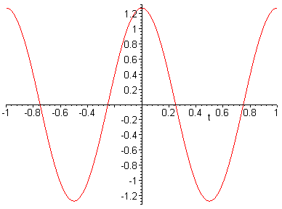
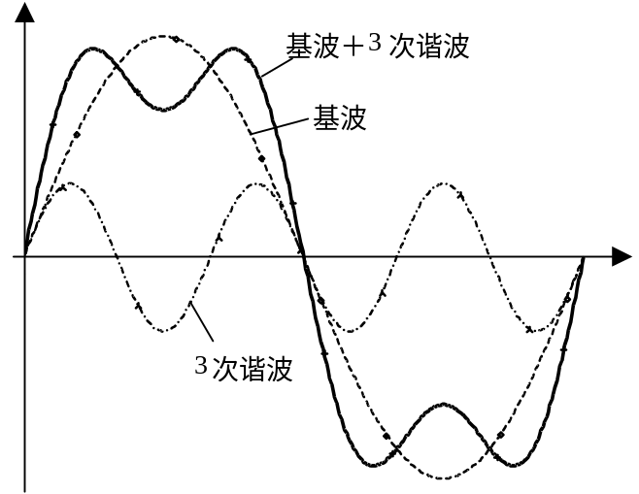
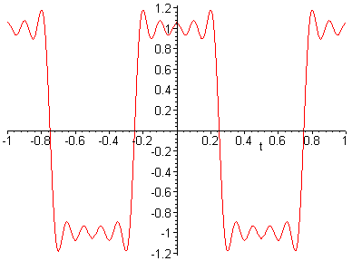
Ch1 Basic Concepts and Laws of Electric Circuits
1.1 Basic Concepts and Electric Circuits
The AM Radio “System”
Example-Fourier Series

Slide 18
Ch1 Basic Concepts and Laws of Electric Circuits
1.1 Basic Concepts and Electric Circuits
The AM Radio “System”
Signals can be represented in terms of their frequency components.
The AM transmitter and receiver are analyzed in terms of their effects on the frequency components signals.
Transmitter Block Diagram
Signal
Source
Power
Amplifier
Modulator
Antenna

Slide 19
Ch1 Basic Concepts and Laws of Electric Circuits
1.1 Basic Concepts and Electric Circuits
The AM Radio “System”
Modulator
The modulator converts the frequency of the input signal from the audio range (0-5kHz) to the carrier frequency of the station (i.e.. 605kHz-615kHz)
5kHz
frequency
610kHz
frequency
Frequency domain representation of input
Frequency domain representation of output

Slide 20
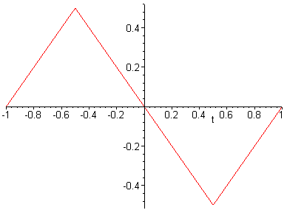
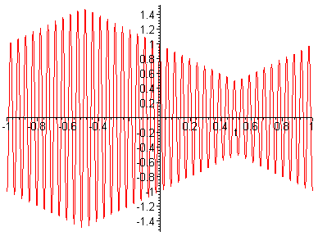
Ch1 Basic Concepts and Laws of Electric Circuits
1.1 Basic Concepts and Electric Circuits
The AM Radio “System”
Modulator-Time Domain
Input Signal
Output Signal

Slide 21
Ch1 Basic Concepts and Laws of Electric Circuits
1.1 Basic Concepts and Electric Circuits
The AM Radio “System”
Power Amplifier
A typical AM station broadcasts several kW
  Up to 50kW-Class I or class II stations
  Up to 5kW-Class III station
  Up to 1kW-Class IV station
Typical modulator circuit can provide at most a few mW
Power amplifier takes modulator output and increases its magnitude
Antenna
The antenna converts a current or a voltage signal to an electromagnetic signal which is radiated throughout space.

Slide 22
Ch1 Basic Concepts and Laws of Electric Circuits
1.1 Basic Concepts and Electric Circuits
The AM Radio “System”
Receiver Block Diagram
RF
IF
IF
Amplifier
Mixer
Amplifier
Antenna
Audio
Envelope
Amplifier
Detector
Speaker

Slide 23
Ch1 Basic Concepts and Laws of Electric Circuits
1.1 Basic Concepts and Electric Circuits
The AM Radio “System”
The antenna captures electromagnetic energy-its output is a small voltage or current.
In the frequency domain, the antenna output is
Antenna
Desired Signal
Undesired Signals
0
frequency
Carrier Frequency
of desired station

Slide 24
Ch1 Basic Concepts and Laws of Electric Circuits
1.1 Basic Concepts and Electric Circuits
The AM Radio “System”
RF Amplifier
RF stands for radio frequency.
RF Amplifier amplifies small signals from the antenna to voltage levels appropriate for transistor circuits.
RF Amplifier also performs a bandpass filter operation on the signal
  Bandpass filter attenuates the frequency components outside the frequency band containing the desired station
Frequencies outside the desired frequency band are attenuated
Frequency domain representation of the output:
RF Amplifier-Frequency Domain
Undesired Signals
Desired Signal
0
Carrier Frequency of desired station
frequency

Slide 25
Ch1 Basic Concepts and Laws of Electric Circuits
1.1 Basic Concepts and Electric Circuits
The AM Radio “System”
IF Mixer
The IF Mixer shifts its input in the frequency domain from the carrier frequency to an intermediate frequency of 455kHz
Desired Signal
Undesired Signals
0
frequency
455 kHz

Slide 26
Ch1 Basic Concepts and Laws of Electric Circuits
1.1 Basic Concepts and Electric Circuits
The AM Radio “System”
IF Amplifier
The IF amplifier bandpass filters the output of the IF Mixer, eliminating essentially all of the undesired signals.
Desired Signal
0
frequency
455 kHz

Slide 27
Ch1 Basic Concepts and Laws of Electric Circuits
1.1 Basic Concepts and Electric Circuits
The AM Radio “System”
Envelope Detector
Computes the envelope of its input signal
Input Signal
Output Signal

Slide 28
Ch1 Basic Concepts and Laws of Electric Circuits
1.1 Basic Concepts and Electric Circuits
The AM Radio “System”
Audio Amplifier
Amplifies signal from envelope detector
Provides power to drive the speaker

Slide 29
Ch1 Basic Concepts and Laws of Electric Circuits
1.1 Basic Concepts and Electric Circuits
The AM Radio “System”
Hierarchical System Models
Hierarchical modeling is modeling at different levels of abstraction
Higher levels of the model describe overall function of the system
Lower levels of the model describe detail necessary to implement the system
In the AM receiver, the input is the antenna voltage and the output is the sound energy produced by the speaker.
In EE, a system is an electrical and/or mechanical device, a process, or a mathematical model that relates one or more inputs to one or more outputs.
Inputs
System
Outputs

Slide 30
Ch1 Basic Concepts and Laws of Electric Circuits
1.1 Basic Concepts and Electric Circuits
The AM Radio “System”
Top Level Model
Input Signal
AM Receiver
Sound

Slide 31
Ch1 Basic Concepts and Laws of Electric Circuits
1.1 Basic Concepts and Electric Circuits
The AM Radio “System”
Second Level Model
RF
IF
IF
Antenna
Amplifier
Mixer
Amplifier
Power Supply
Audio
Envelope
Amplifier
Detector
Speaker

Slide 32
Ch1 Basic Concepts and Laws of Electric Circuits
1.1 Basic Concepts and Electric Circuits
The AM Radio “System”
Low Level Model Envelope Detector.
Half-wave
Low-pass
Rectifier
Filter
Circuit Level Model Envelope Detector
+
+
V_{in}
R
C
V_{out}
-
-

Slide 33
Ch1 Basic Concepts and Laws of Electric Circuits
1.1 Basic Concepts and Electric Circuits
The Telephone System
The modern telephone system draws from these Electrical Engineering subdisciplines:
Signal processing: Speech compression, noise reduction, A/D and D/A conversion..
Communications and networking: transmission technologies, network architectures and protocols.
Digital and computer: configurable switching hardware.
Electromagnetics: microwave transmission hardware.
Solid state: miniaturization, integration of complex systems onto a single chip.
Power Electronics: extremely reliable power supplies.

Slide 34
Ch1 Basic Concepts and Laws of Electric Circuits
1.1 Basic Concepts and Electric Circuits
The Telephone System
An Early Phone System
Speaker
Mic.
Speaker
Switchboard
Telephone
Mic.
Power Supply
Telephone
Speaker
Mic.
Central Office
Telephone
Notes:
Switchboard接线总机

Slide 35
Ch1 Basic Concepts and Laws of Electric Circuits
1.1 Basic Concepts and Electric Circuits
The Telephone System
An Early Phone System
The major components of a telephone were a carbon microphone and a speaker made from an electromagnet and a paramagnetic diaphragm.
Telephones were connected to the central office by twisted-pair wires.
At the central office, calls were completed by a human operator at a switchboard-a physical connection between two telephones was made.
Notes:
Paramagnetic顺磁性的 electromagnet电磁石

Slide 36
Ch1 Basic Concepts and Laws of Electric Circuits
1.1 Basic Concepts and Electric Circuits
The Telephone System
An Early Phone Circuit
Earphone
Earphone
Carbon Microphone
Battery
Carbon Microphone
Telephone Handset
Central Office
Telephone Handset
Electrical current flows in this circuit in a loop from the battery at the central office, through the components of the two telephones (the speaker and the microphone), and back into the battery.
This circuit is a series connection of the components in the two telephones and the battery.
All of the current that flows through the battery also flows through the components in the two telephones.

Slide 37

Ch1 Basic Concepts and Laws of Electric Circuits
1.1 Basic Concepts and Electric Circuits
The Telephone System
The Modern Telephone System
PCM Encoder
PCM Decoder
Switching Network
PCM Decoder
PCM Encoder
Analog
Digital
Analog
Fundamentally, the modern telephone systems appears much the same as the early system to handset users.
There are very significant differences:
  Digital data, video, and other signals are transmitted along with speech.
  Calls are routed automatically under software control.
  Most transmission is digital.

Slide 38
Ch1 Basic Concepts and Laws of Electric Circuits
1.1 Basic Concepts and Electric Circuits
The Telephone System
Analog Vs. Digital
An analog signal is a continuous-time signal:
time
A digital signal is a sequence of 1’s and 0’s:
1101001010011100100110001001110

Slide 39
Ch1 Basic Concepts and Laws of Electric Circuits
1.1 Basic Concepts and Electric Circuits
The Telephone System
Why Digital?
Transmission over long distances degrades both analog and digital signals can be “cleaned up”, allowing repeaters to be used without any signal distortion.
Can mix many types of information (phone, video, data, etc.)
Digital hardware is less expensive.
Digital data can be encrypted.
Notes:
Encrypted 加密

Slide 40
Ch1 Basic Concepts and Laws of Electric Circuits
1.1 Basic Concepts and Electric Circuits
The Telephone System
PCM-Pulse Code Modulation
A PCM encoder converts an analog signal into a digital signal with a particular format.
A PCM decoder converts a digital signal into an analog signal.
PCM is one form of quantization.
PCM is one form of analog-to-digital (A/D) conversion.

Slide 41
Ch1 Basic Concepts and Laws of Electric Circuits
1.1 Basic Concepts and Electric Circuits
The Telephone System
PCM-Pulse Code Modulation
PCM Encoder
A continuous signal is converted into a bit stream:
0000010100000000111111
Involves three operations:
Sampling, Quantization, and Encoding

Slide 42
Ch1 Basic Concepts and Laws of Electric Circuits
1.1 Basic Concepts and Electric Circuits
The Telephone System
PCM-Pulse Code Modulation
PCM Encoder
Value of the signal is obtained at equally spaced points in time:
Sampling
time

Slide 43
Ch1 Basic Concepts and Laws of Electric Circuits
1.1 Basic Concepts and Electric Circuits
The Telephone System
PCM-Pulse Code Modulation
PCM Encoder
Each sample is quantized to one of a finite number of values.
Quantizer input/output relationship:
output voltage
Quantizer
input voltage

Slide 44
Ch1 Basic Concepts and Laws of Electric Circuits
1.1 Basic Concepts and Electric Circuits
The Telephone System
PCM-Pulse Code Modulation
PCM Encoder
Encoding
A pattern of bits is assigned to each possible output level of the quantizer.
n bits can represent 2^{n} quantizer output levels.
PCM decoder is one type of digital-to-analog (D/A) converter.
0000010100000000111111

Slide 45
Ch1 Basic Concepts and Laws of Electric Circuits
1.1 Basic Concepts and Electric Circuits
The Telephone System
Telephone Network
A house or business is called a subscriber.
Typically, phone lines to houses or small businesses are analog twisted-pair wire connections.
Subscribers’ analog lines are connected to a Regional Terminal (RT) or to a Central Office (CO).
At the RT or CO, the analog signal is converted to a digital signal.
Subscriber
RT
Subscriber
Long-distance
Network
CO
Subscriber
RT
Subscriber

Slide 46
Ch1 Basic Concepts and Laws of Electric Circuits
1.2 Basic Quantities
Key Words:
current, voltage, power and energy

Slide 47
Ch1 Basic Concepts and Laws of Electric Circuits
1.2 Basic Quantities
Units
Standard SI Prefixes
  10⁻¹² pico (p)
  10⁻⁹ nano (n)
  10⁻⁶ micro (μ)
  10⁻³ milli (m)
  10³ kilo (k)
  10⁶ mega (M)
  10⁹ giga (G)
  10¹² tera (T)
Electric charge (q)
  in Coulombs (C)
Current (I)
  in Amperes (A)
Voltage (V)
  in Volts (V)
Energy (W)
  in Joules (J)
Power (P)
  in Watts (W)

Slide 48
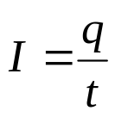

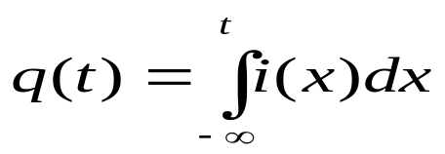



Ch1 Basic Concepts and Laws of Electric Circuits
1.2 Basic Quantities
Current
Time rate of change of charge
Constant current
Time varying current
Unit
(1 A = 1 C/s)
Notation: Current flow represents the flow of positive charge
Alternating versus direct current (AC vs DC)
i(t)
i(t)
t
t
AC
DC

Slide 49


Ch1 Basic Concepts and Laws of Electric Circuits
1.2 Basic Quantities
Current
Positive versus negative current
2 A
-2 A
P1.1, In the wire electrons moving left to right to create a current of 1 mA. Determine I₁ and I₂.
Ans: I₁ = -1 mA; I₂ = +1 mA.

Slide 50
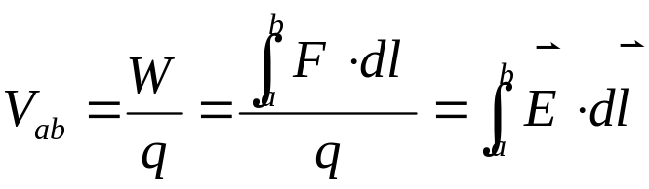

Ch1 Basic Concepts and Laws of Electric Circuits
1.2 Basic Quantities
Voltage(Potential)
Voltage
Units: 1 V = 1 J/C
Positive versus negative voltage
+
–
2 V
-2 V
–
+

Slide 51



Ch1 Basic Concepts and Laws of Electric Circuits
1.2 Basic Quantities
Voltage(Potential)
a
P1.2,
Ο
a、b, which point’s potential is higher？
b
Ο
a
Ο
V_{ab}=?
b
Ο
a
b
+Q from point b to point a get energy ，Point a is Positive? or negative ?
Ο
Ο

Slide 52
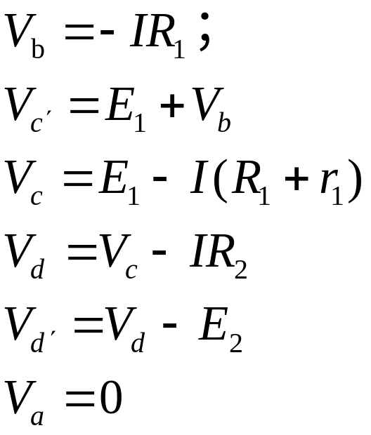
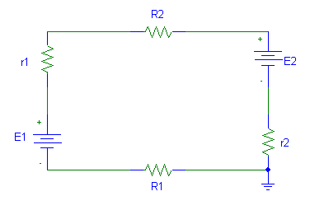
Ch1 Basic Concepts and Laws of Electric Circuits
1.2 Basic Quantities
Voltage(Potential)
P1.3,
V_{ab}=V_{a}-V_{b}=-V_{b}
c
d
c´
d´
I
b
a

Slide 53
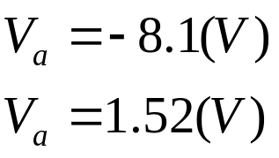
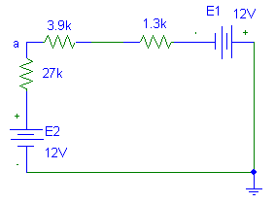
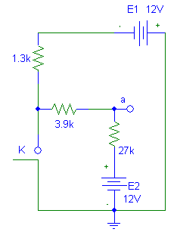
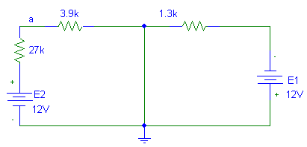
Ch1 Basic Concepts and Laws of Electric Circuits
1.2 Basic Quantities
Voltage(Potential)
P1.4,
V_{a}=?
K Open
I
K Close
I

Slide 54
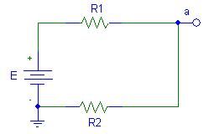
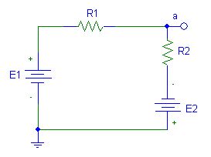
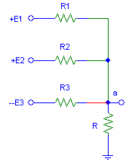
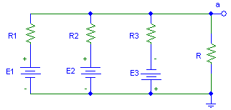
Ch1 Basic Concepts and Laws of Electric Circuits
1.2 Basic Quantities

Slide 55
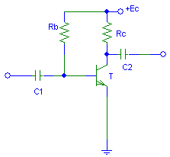
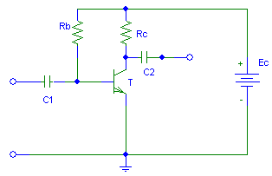
Ch1 Basic Concepts and Laws of Electric Circuits
1.2 Basic Quantities

Slide 56
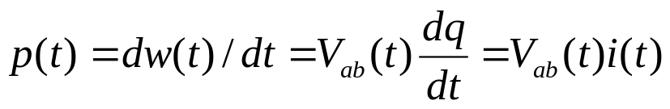
Ch1 Basic Concepts and Laws of Electric Circuits
1.2 Basic Quantities
Power
Rate of change of energy
P = W/t
i(t)
+
p(t) = v(t) i(t)
v(t)
v(t) is defined as the voltage with
positive reference at the same
terminal that the current i(t) is entering.
–
Used to determine the electrical power is being absorbed or supplied
  if P is positive (+), power is absorbed
  if P is negative(–), power is supplied

Slide 57





Ch1 Basic Concepts and Laws of Electric Circuits
1.2 Basic Quantities
Power
Power absorbed by a resistor:

Slide 58








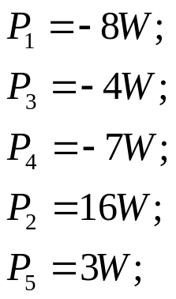
Ch1 Basic Concepts and Laws of Electric Circuits
1.2 Basic Quantities
Power
P1.5 Find the power absorbed by each element in the circuit.
+
-
5
I₁
I₂
-
+
I₃
-
+
+
-
+
1
3
4
+
-
-
-
+
+
2
-

Slide 59
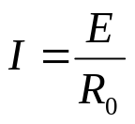


Ch1 Basic Concepts and Laws of Electric Circuits
1.2 Basic Quantities
Open Circuit
R=∞
R₀
I=0, V=E , P=0
E
Short Circuit
R=0
R₀
R＝0
E

Slide 60
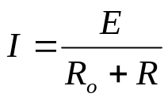



Ch1 Basic Concepts and Laws of Electric Circuits
1.2 Basic Quantities
Loaded Circuit
I
R₀
R
E

Slide 61
Ch1 Basic Concepts and Laws of Electric Circuits
1.3 Circuit Elements
Key Words:
Resistors, Capacitors, Inductors
voltage source, current source

Slide 62
Ch1 Basic Concepts and Laws of Electric Circuits
1.3 Circuit Elements
Passive elements (cannot generate energy)
  e.g., resistors, capacitors, inductors, etc.
Active elements (capable of generating energy)
  batteries, generators, etc.
Important active elements
  Independent voltage source
  Independent current source
  Dependent voltage source
    voltage dependent and current dependent
  Dependent current source
    voltage dependent and current dependent

Slide 63
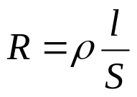
Ch1 Basic Concepts and Laws of Electric Circuits
1.3 Circuit Elements
Resistors
Dissipation Elements
v=iR
P=vi=Ri²=v²/R >0 ，
v-i relationship
i
v
Resistors connected in series:
  Equivalent Resistance is found by R_{eq}= R₁ + R₂ + R₃ + …
Resistors connected in parallel 1/R_{eq}=1/R₁ + 1/R₂ + 1/R₃ + …

Slide 64
Ch1 Basic Concepts and Laws of Electric Circuits
1.3 Circuit Elements
Capacitors
Capacitance occurs when two conductors (plates) are separated by a dielectric (insulator).
Charge on the two conductors creates an electric field that stores energy.
The voltage difference between the two conductors is proportional to the charge: q = C v
The proportionality constant C is called capacitance.
Units of Farads (F) - C/V
1F=10⁶μF, 1μF=10⁶PF

Slide 65
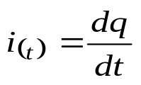
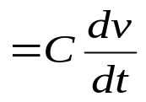
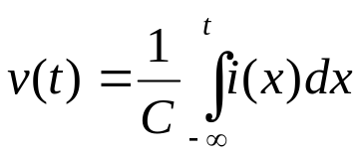

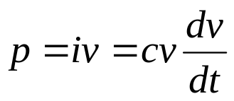
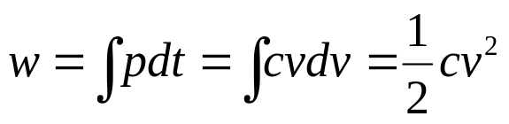
Ch1 Basic Concepts and Laws of Electric Circuits
1.3 Circuit Elements
Capacitors
store energy in an electric field
i(t)
v-i relationship
The
rest
of
the
circuit
+
v(t)
-
Energy stored
Capacitors connected in series:
  Equivalent capacitance is found by 1/C_{eq}=1/C₁ + 1/C₂ + 1/C₃ + …
Capacitors connected in parallel C_{eq}= C₁ + C₂ + C₃ + …

Slide 66
Ch1 Basic Concepts and Laws of Electric Circuits
1.3 Circuit Elements
i(t)
The
rest
of
the
circuit
Capacitors
+
P1.7
0.2F
v(t)
-
i(t)
1A
2s
-1A
t
1s
w (t)
v(t)
2.5J
5V
t
1s
2s
t
2s
t
1s

Slide 67
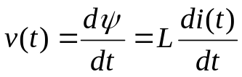
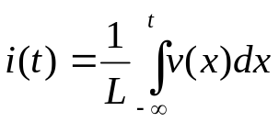

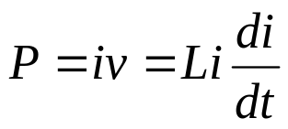
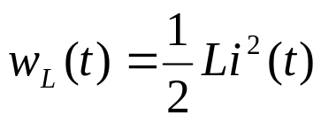
Ch1 Basic Concepts and Laws of Electric Circuits
1.3 Circuit Elements
Inductors
store energy in a magnetic field
v-i relationship
i(t)
+
The
rest
of
the
circuit
L
v(t)
-
Energy stored:
Inductors connected in series: L_{eq}= L₁ + L₂ + L₃ + …
Inductors connected in parallel: 1/L_{eq}=1/L₁ + 1/L₂ + 1/L₃ + …

Slide 68

Ch1 Basic Concepts and Laws of Electric Circuits
1.3 Circuit Elements
Independent voltage source
Ideal
R_{S}＝0
v
V_{S}
V_{S}
+
i
practical

Slide 69

Ch1 Basic Concepts and Laws of Electric Circuits
1.3 Circuit Elements
Independent current source
Ideal
v
R_{S}＝∞
I
I_{S}
i
practical

Slide 70
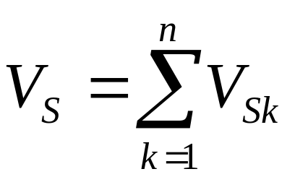
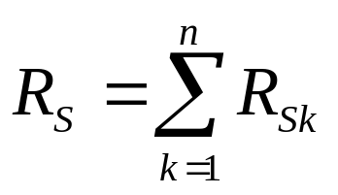
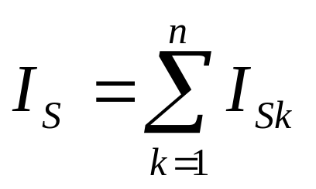

Ch1 Basic Concepts and Laws of Electric Circuits
1.3 Circuit Elements
Voltage source connected in series:
Current source connected in parallel:

Slide 71




Ch1 Basic Concepts and Laws of Electric Circuits
1.3 Circuit Elements
Voltage controlled (dependent) voltage source (VCVS)
+
+
_
_
Current controlled (dependent) voltage source (CCVS)
+
_
Q: What are the units for μ and r?

Slide 72


Ch1 Basic Concepts and Laws of Electric Circuits
1.3 Circuit Elements
Voltage controlled (dependent) current source (VCCS)
+
_
Current controlled (dependent) current source (CCCS)
Q: What are the units for β and g?

Slide 73
Ch1 Basic Concepts and Laws of Electric Circuits
1.3 Circuit Elements
Independent source
Can provide power to the circuit;
Excitation to circuit ;
Output is not controled by external.
dependent source
Can provide power to the circuit;
No excitation to circuit;
Output is controled by external.

Slide 74
Ch1 Basic Concepts and Laws of Electric Circuits
1.3 Circuit Elements
Review
So far, we have talked about two kinds of circuit elements:
  Sources (independent and dependent)
    active, can provide power to the circuit.
  Resistors
    passive, can only dissipate power.
  The energy supplied by the active elements is equivalent to the energy absorbed by the passive elements!

Slide 75
Ch1 Basic Concepts and Laws of Electric Circuits
1.4 Kirchhoff's Current and Voltage Laws
Key Words:
Nodes, Branches, Loops
KCL, KVL

Slide 76
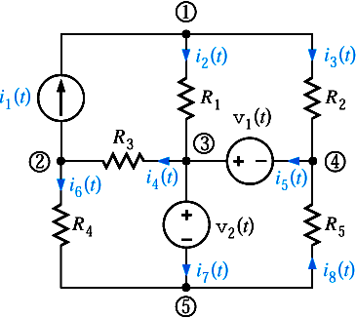
Ch1 Basic Concepts and Laws of Electric Circuits
1.4 Kirchhoff's Current and Voltage Laws
Nodes, Branches, Loops, mesh
Node: point where two, or more, elements are joined (e.g., big node 1)
Branch: Component connected between two nodes (e.g., component R4)
Loop: A closed path that never goes twice over a node (e.g., the blue line)
The red path is NOT a loop
Mesh: A loop that does not contain any other loops in it.

Slide 77
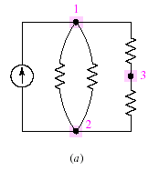
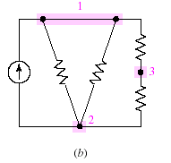
Ch1 Basic Concepts and Laws of Electric Circuits
1.4 Kirchhoff's Current and Voltage Laws
Nodes, Branches, Loops, mesh
P1.8
A circuit containing three nodes and five branches.
Node 1 is redrawn to look like two nodes; it is still one nodes.

Slide 78


Ch1 Basic Concepts and Laws of Electric Circuits
1.4 Kirchhoff's Current and Voltage Laws
KCL
sum of all currents entering a node is zero
sum of currents entering node is equal to sum of currents leaving node
KCL Mathematically
i₁(t)
i₅(t)
i₂(t)
i₄(t)
i₃(t)

Slide 79


Ch1 Basic Concepts and Laws of Electric Circuits
1.4 Kirchhoff's Current and Voltage Laws
KCL
sum of all currents entering a node is zero
sum of currents entering node is equal to sum of currents leaving node
P1.9

Slide 80
Ch1 Basic Concepts and Laws of Electric Circuits
1.4 Kirchhoff's Current and Voltage Laws
KCL
P1.10
KCL-Christmas Lights
I_{s}
+
120V
-
Find currents through each light bulb:
I_{B} = 1W/120V = 8.3mA
Apply KCL to the top node:
I_{S} - 50I_{B} = 0
Solve for I_{S}: I_{S} = 50 I_{B} = 417mA
50* 1W Bulbs

Slide 81

Ch1 Basic Concepts and Laws of Electric Circuits
1.4 Kirchhoff's Current and Voltage Laws
KCL
P1.11
We can make supernodes by aggregting node.

Slide 82








Ch1 Basic Concepts and Laws of Electric Circuits
1.4 Kirchhoff's Current and Voltage Laws
KCL
P1.12
Find i_{x}

Slide 83





Ch1 Basic Concepts and Laws of Electric Circuits
1.4 Kirchhoff's Current and Voltage Laws
KCL
Current divider
I
ο
+
I₁
I₂
N
V
G₁
G₂
-
ο

Slide 84


Ch1 Basic Concepts and Laws of Electric Circuits
1.4 Kirchhoff's Current and Voltage Laws
KVL
  sum of voltages around any loop in a circuit is zero.
KVL Mathematically
A voltage encountered + to - is positive.
A voltage encountered - to + is negative.

Slide 85




Ch1 Basic Concepts and Laws of Electric Circuits
1.4 Kirchhoff's Current and Voltage Laws
KVL
  KVL is a conservation of energy principle
A positive charge gains electrical energy as it moves to a point with higher voltage and releases electrical energy if it moves to a point with lower voltage
If the charge comes back to the same Initial point the net energy gain Must be zero.

Slide 86





Ch1 Basic Concepts and Laws of Electric Circuits
1.4 Kirchhoff's Current and Voltage Laws
KVL
P1.13

Slide 87



Ch1 Basic Concepts and Laws of Electric Circuits
1.4 Kirchhoff's Current and Voltage Laws
KVL
Voltage divider
+
+
R₁
V₁
N
V
-
+
R₂
V₂
-
-
Important voltage Divider quations

Slide 88




Ch1 Basic Concepts and Laws of Electric Circuits
1.4 Kirchhoff's Current and Voltage Laws
KVL
Voltage divider
P1.14
Volume control?

