Slide 1
Circuits and Analog Electronics
Ch2 Basic Analysis Methods to Circuits
2.1 Equivalent Circuits
2.2 Basic Nodal and Mesh Analysis
2.3 Useful Circuit Analysis Techniques
Readings: Gao-Ch2; Hayt-Ch3, 4

Slide 2
Ch2 Basic Analysis Methods to Circuits
2.1 Equivalent Circuits
Key Words:
Equivalent Circuits Network
Equivalent Resistance,
Equivalent Independent Sources

Slide 3
Ch2 Basic Analysis Methods to Circuits
2.1 Equivalent Circuits
Equivalent Circuits Network
о
о
Two-terminal Circuits Network
c
d
о
о
о
о
a
о
5Ω
6Ω
о
15Ω
5Ω
b
о
о
I
a
I
a
о
N₁
о
N₂
+
+
V
V
-
-
о
о
b
b

Slide 4
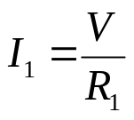
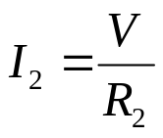
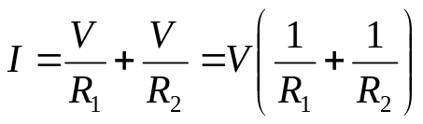
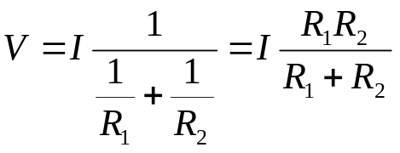
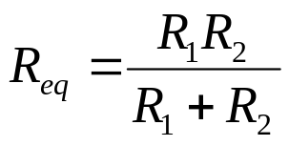
Ch2 Basic Analysis Methods to Circuits
2.1 Equivalent Circuits
Equivalent Resistance
How do we find I₁ and I₂?
I₁ + I₂ = I
+
I₁
I₂
I
R₁
R₂
V
-

Slide 5
Ch2 Basic Analysis Methods to Circuits
2.1 Equivalent Circuits
Equivalent Resistance
i(t)
i(t)
+
+
v(t)
v(t)
R_{eq}
-
-
R_{eq} is equivalent to the resistor network on the left in the sense that they have the same i-v characteristics.

Slide 6
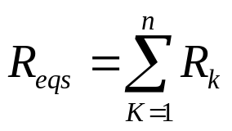
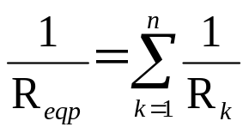
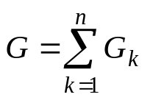
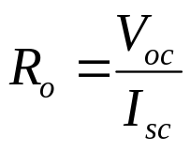
Ch2 Basic Analysis Methods to Circuits
2.1 Equivalent Circuits
Equivalent Resistance
Method 1
Series and parallel Resistance
(source-free)
Method 2
a
I
source
-free
ο
=
=
V
V
R
o
R
ab
I
ο
b
Method 3
ο
ο
source
V_{oc}
source
I_{SC}
ο
ο

Slide 7

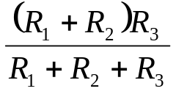
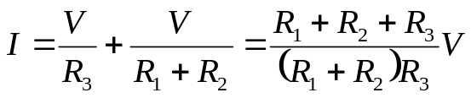
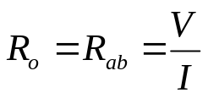
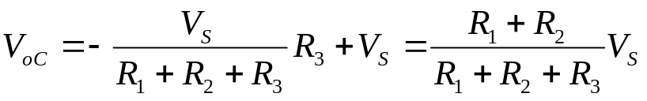
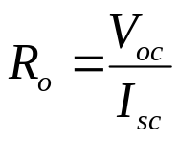
Ch2 Basic Analysis Methods to Circuits
2.1 Equivalent Circuits
Equivalent Resistance
P2.1
How do we find R_{ab}?
a
ο
R₂
R₃
R₁
+
V_{S}
-
b
ο
Method 1
Method 2
I
a
ο
R₂
R₃
R₁
V
ο
b
Method 3
I_{SC}=V_{S}/R₃

Slide 8
Ch2 Basic Analysis Methods to Circuits
2.1 Equivalent Circuits
Source Transformation
Ideally:
  An ideal current source has the voltage necessary to provide its rated current
  An ideal voltage source supplies the current necessary to provide its rated voltage
Practice:
  A real voltage source cannot supply arbitrarily large amounts of current
  A real current source cannot have an arbitrarily large terminal voltage

Slide 9
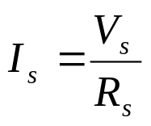

Ch2 Basic Analysis Methods to Circuits
2.1 Equivalent Circuits
Source Transformation
R_{s}
+
V_{s}
I_{s}
R_{s}
-
Note: Consistency between the current source ref. direction and the voltage Source ref. terminals.

Slide 10
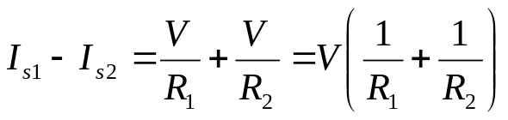
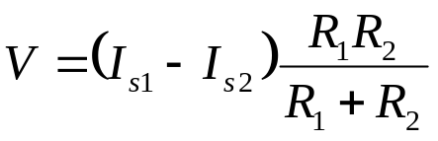
Ch2 Basic Analysis Methods to Circuits
2.1 Equivalent Circuits
Equivalent Source
I₁
I₂
+
I_{s1}
How do we find I₁ and I₂?
I_{s2}
R₁
R₂
V
-
I₁ + I₂ = I_{s1} - I_{s2}
I_{eq}

Slide 11
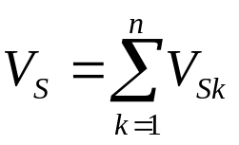
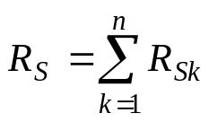
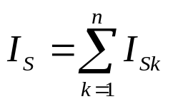
Ch2 Basic Analysis Methods to Circuits
2.1 Equivalent Circuits
Equivalent Source
Series Voltage Source
V_{S1}
-
V_{S2}
-
+
+
V_{Sn}
-
+
+
-
V_{S}
ο
ο
ο
ο
parallel Current Source
ο
I
R_{S}=R_{S1}// R_{S2}//…// R_{Sn}
ο
I_{S1}
I_{S2}
I_{Sn}
I_{S}
ο
ο

Slide 12
Ch2 Basic Analysis Methods to Circuits
2.2 Basic Nodal and Mesh Analysis
Key Words:
Branche Analysis, Nodal Analysis,
Mesh(Loop) Analysis
Why?
  The analysis techniques previously (voltage divider, equivalent resistance, etc.) provide an intuitive approach to analyzing circuits
  They are not systematic and cannot be easily automated by a computer
Comments:
  Analysis of circuits using node or loop analysis requires solutions of systems of linear equations.
  These equations can usually be written by inspection of the circuit.

Slide 13
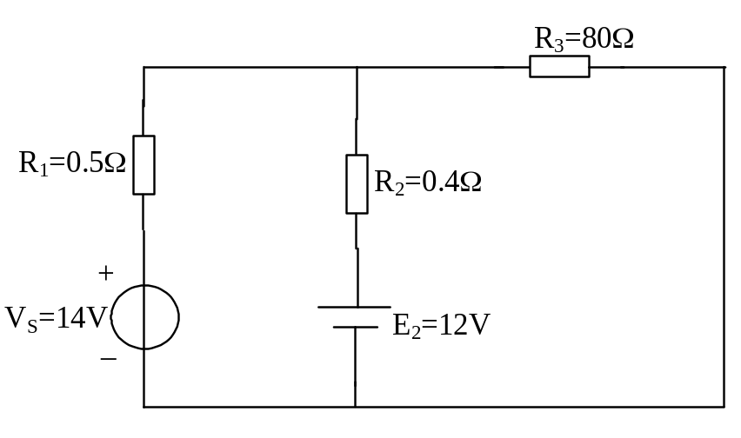
Ch2 Basic Analysis Methods to Circuits
2.2 Basic Nodal and Mesh Analysis
Branche Analysis
P2.2
How do we find I₁ and I_{2,} I₃,?
I₃
I₂
I₁

Slide 14
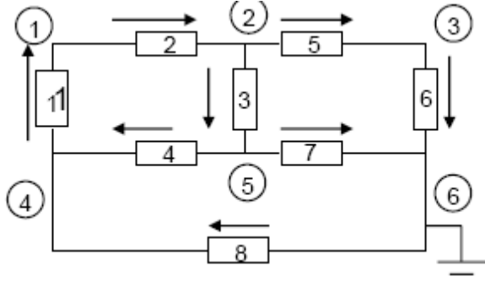
Ch2 Basic Analysis Methods to Circuits
2.2 Basic Nodal and Mesh Analysis
Branche Analysis
Suppose m branches, n nodals
write KCL equation for each independent node.
——(n-1) KCL equations
write KVL equation for each independent mesh/loop
——m-(n-1) KVL equations

Slide 15
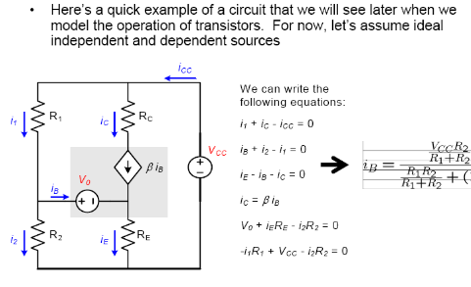
Ch2 Basic Analysis Methods to Circuits
2.2 Basic Nodal and Mesh Analysis
Branche Analysis
i_{B}

Slide 16
Ch2 Basic Analysis Methods to Circuits
2.2 Basic Nodal and Mesh Analysis
Nodal Analysis
1)Choose a reference node
500Ω
500Ω
+
I₁
V
1kΩ
500Ω
I₂
500Ω
-
The reference node is called the ground node.

Slide 17
Ch2 Basic Analysis Methods to Circuits
2.2 Basic Nodal and Mesh Analysis
Nodal Analysis
1)Choose a reference node
500Ω
500Ω
I₄
I₇
I₅
+
I₆
I₈
I₁
V
1kΩ
500Ω
I₂
500Ω
-
0

Slide 18
Ch2 Basic Analysis Methods to Circuits
2.2 Basic Nodal and Mesh Analysis
Nodal Analysis
2)Assign node voltages to the other nodes
V₁
500Ω
V₂
500Ω
V₃
I₄
I₇
1
I₅
2
I₆
I₈
3
I₁
1kΩ
500Ω
I₂
500Ω
0
V₁, V₂, and V₃ are unknowns for which we solve using KCL.

Slide 19

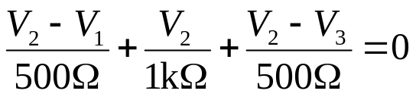
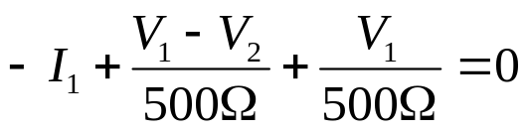
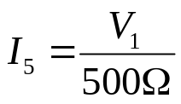
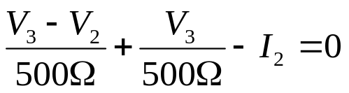
Ch2 Basic Analysis Methods to Circuits
2.2 Basic Nodal and Mesh Analysis
Nodal Analysis
3)Apply KCL to each node other than the reference-express currents in terms of node voltages.
V₁
500Ω
V₂
500Ω
V₃
I₄
I₇
1
I₅
2
I₆
I₈
3
I₁
1kΩ
500Ω
I₂
500Ω
0

Slide 20
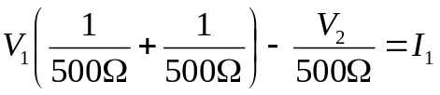
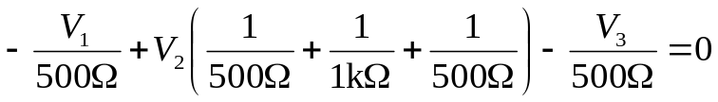
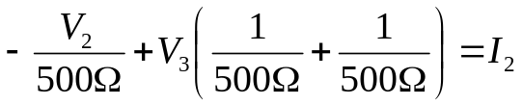
Ch2 Basic Analysis Methods to Circuits
2.2 Basic Nodal and Mesh Analysis
Nodal Analysis
4)Solve the resulting system of linear equations.
Node 1:
Node 2:
Node 3:
V₁
500Ω
V₂
500Ω
V₃
I₁
1
2
3
500Ω
1kΩ
500Ω
I₂
0
These equations can be written by inspection-the left side:
  The node voltage is multiplied by the sum of conductances of all resistors connected to the node.
  Other node voltages are multiplied by the conductance of the resistor(s) connecting to the node and subtracted.
The right side of the equation:
  The right side of the equation is the sum of currents from sources entering the node.

Slide 21
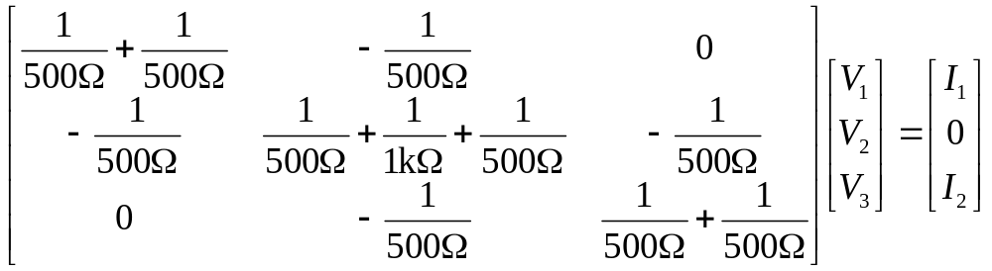
Ch2 Basic Analysis Methods to Circuits
2.2 Basic Nodal and Mesh Analysis
Nodal Analysis
4)Solve the resulting system of linear equations.
Node 1:
Node 2:
Node 3:
V₁
500Ω
V₂
500Ω
V₃
I₁
1
2
3
500Ω
1kΩ
500Ω
I₂
Matrix Notation(Symmetric)

Slide 22
Ch2 Basic Analysis Methods to Circuits
2.2 Basic Nodal and Mesh Analysis
Nodal Analysis
4)Solve the resulting system of linear equations.
Node 1:
Node 2:
Node 3:
V₁
500Ω
V₂
500Ω
V₃
I₁
1
2
3
500Ω
1kΩ
500Ω
I₂
G₁₁V₁+G₁₂V₂ +G₁₃V₃ =I₁₁
G₂₁V₂+G₂₂V₂ +G₂₃V₃ =I₂₂
G₃₁V₁+G₃₂V₂+G₃₃V₃=I₃₃

Slide 23
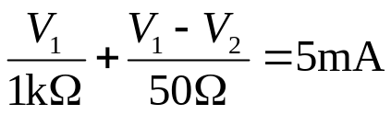
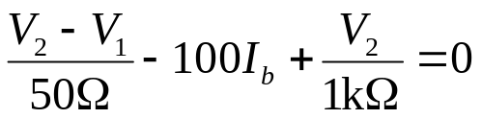
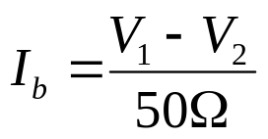
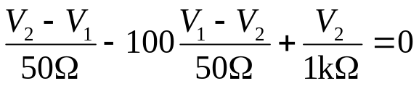
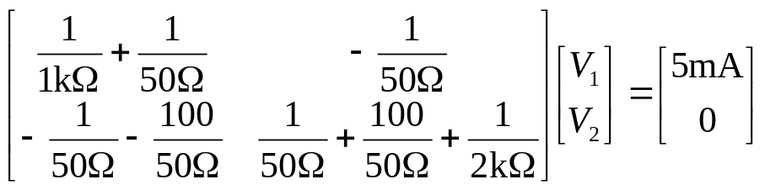
Ch2 Basic Analysis Methods to Circuits
2.2 Basic Nodal and Mesh Analysis
Nodal Analysis
What if there are dependent sources?
V₁
I_{b}
V₂
Example:
1
2
+
50Ω
2kΩ
5mA
1kΩ
100I_{b}
V_{o}
-
Matrix is not symmetric due to the dependent source.

Slide 24
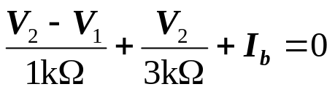
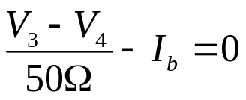
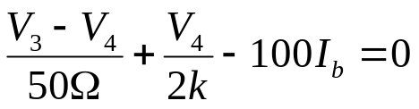
Ch2 Basic Analysis Methods to Circuits
2.2 Basic Nodal and Mesh Analysis
Nodal Analysis
What if there are voltage sources?
0.7V
R₁
V₂
V₃
R₃
V₄
I_{b}
+
-
1
+
1kΩ
2
3
50Ω
4
+
V_{o}
3kΩ
100I_{b}
R₄
V₁
-
R₂
2kΩ
-
Node 2:
Difficulty: We do not know I_{b} the current through the voltage source?
Node 3:
Node 4:
Independent Voltage Source:
V₂-V₃=0.7V
Equations: KCL at node 2, node 3, node 4, and V₂-V₃=0.7V
Unknowns: I_{b}, V₂, V_{3,}V₄

Slide 25
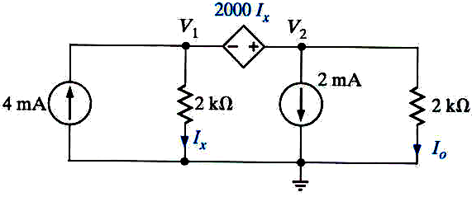

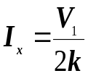

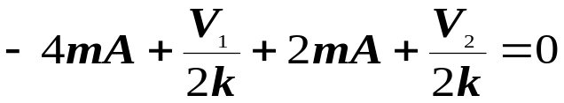


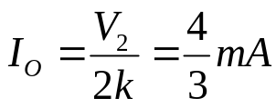
Ch2 Basic Analysis Methods to Circuits
2.2 Basic Nodal and Mesh Analysis
Nodal Analysis
What if there are voltage sources?
CURRENT CONTROLLED VOLTAGE SOURCE
I_{o}=?
KCL AT SUPERNODE

Slide 26
Ch2 Basic Analysis Methods to Circuits
2.2 Basic Nodal and Mesh Analysis
Nodal Analysis
Advantages of Nodal Analysis
Solves directly for node voltages.
Current sources are easy.
Voltage sources are either very easy or somewhat difficult.
Works best for circuits with few nodes.
Works for any circuit.

Slide 27
Ch2 Basic Analysis Methods to Circuits
2.2 Basic Nodal and Mesh Analysis
Mesh(Loop) Analysis
1)Identifying the Meshes
1kΩ
1kΩ
+
Mesh 1
Mesh 2
+
V₁
V₂
-
-
1kΩ
Mesh: A special kind of loop that doesn’t contain any loops within it.

Slide 28
Ch2 Basic Analysis Methods to Circuits
2.2 Basic Nodal and Mesh Analysis
Mesh(Loop) Analysis
2)Assigning Mesh Currents
1kΩ
1kΩ
+
1kΩ
+
V₁
V₂
I₁
I₂
-
-
3)Apply KVL around each loop to get an equation in terms of the loop currents.
-V₁ + I₁ 1kΩ + (I₁ - I₂) 1kΩ = 0
I₁ ( 1kΩ + 1kΩ) - I₂ 1kΩ = V₁
(I₂ - I₁) 1kΩ + I₂ 1kΩ + V₂ = 0
- I₁ 1kΩ + I₂ ( 1kΩ + 1kΩ) = -V₂

Slide 29
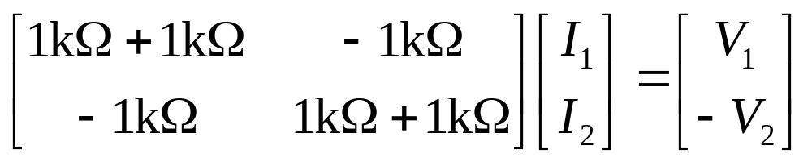
Ch2 Basic Analysis Methods to Circuits
2.2 Basic Nodal and Mesh Analysis
Mesh(Loop) Analysis
3)Apply KVL around each loop to get an equation in terms of the loop currents.
1kΩ
1kΩ
I₁ ( 1kΩ + 1kΩ) - I₂ 1kΩ = V₁
+
1kΩ
+
V₁
V₂
- I₁ 1kΩ + I₂ ( 1kΩ + 1kΩ) = -V₂
-
I₁
I₂
-
4)Solve the resulting system of linear equations.

Slide 30
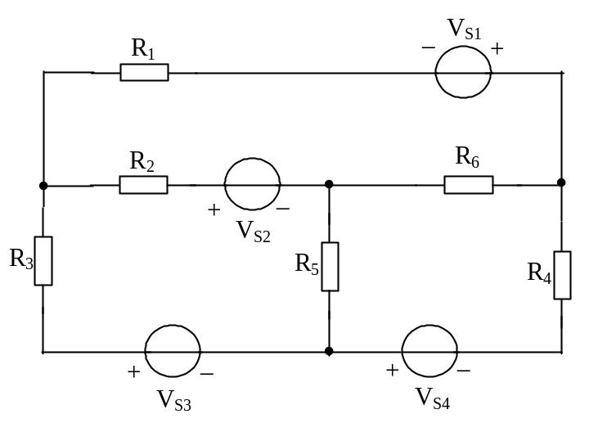
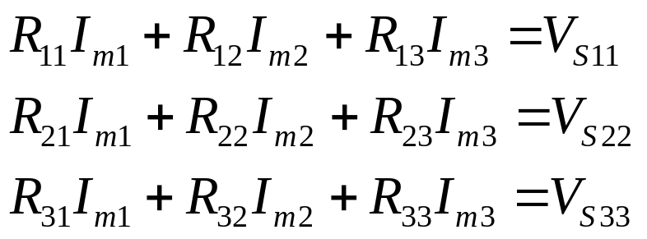
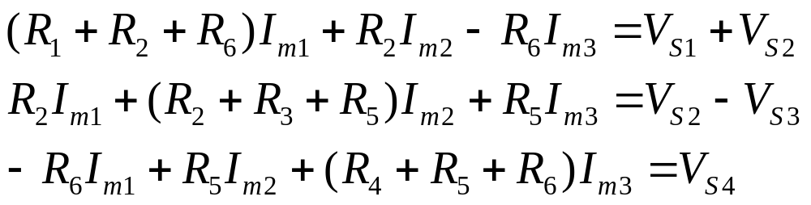
Ch2 Basic Analysis Methods to Circuits
2.2 Basic Nodal and Mesh Analysis
Mesh(Loop) Analysis
I₁
I_{m1}
I₂
I₆
I₃
I₄
I₅
I_{m2}
I_{m3}

Slide 31

Ch2 Basic Analysis Methods to Circuits
2.2 Basic Nodal and Mesh Analysis
Mesh(Loop) Analysis
P2.4(P2.2)
I_{m1}
I_{m2}

Slide 32
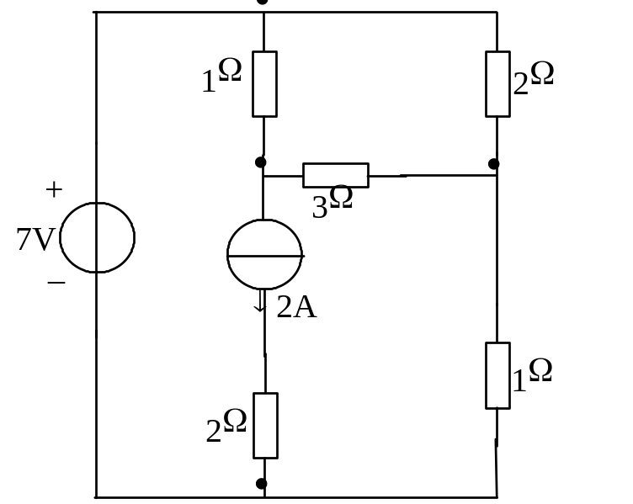
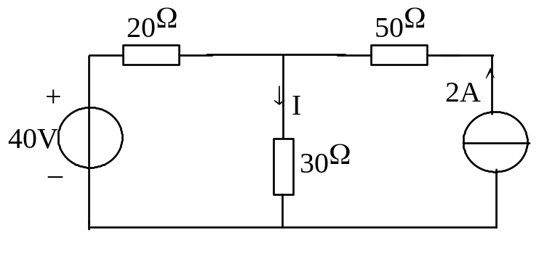
Ch2 Basic Analysis Methods to Circuits
2.2 Basic Nodal and Mesh Analysis
Mesh(Loop) Analysis
What if there are current sources?
The current sources in this circuit will have whatever voltage is necessary to make the current correct.
We can’t use KVL around the loop because we don’t know the voltage.
P2.5 I=?
P2.6
I_{m2}
+
I_{m1}
V
I_{m2}
I_{m1}
-
I_{m3}

Slide 33
Ch2 Basic Analysis Methods to Circuits
2.2 Basic Nodal and Mesh Analysis
Mesh(Loop) Analysis
What if there are current sources?
The Supermesh does not include this source!
2kΩ
The Supermesh surrounds this source!
2mA
I₃
1kΩ
+
2kΩ
12V
I₁
I₂
4mA
-
I₀

Slide 34
Ch2 Basic Analysis Methods to Circuits
2.2 Basic Nodal and Mesh Analysis
Mesh(Loop) Analysis
What if there are current sources?
2kΩ
The 4mA current source sets I₂:
I₂ = -4mA
The 2mA current source sets a constraint on I₁ and I₃:
I₁ - I₃ = 2mA
We have two equations and three unknowns. Where is the third equation?
2mA
I₃
1kΩ
+
2kΩ
12V
I₁
I₂
4mA
-
I₀
I₁ 2kΩ - I₂ (1kΩ + 2kΩ) +I₃ (1kΩ + 2kΩ) = 12V

Slide 35
Ch2 Basic Analysis Methods to Circuits
2.2 Basic Nodal and Mesh Analysis
Mesh(Loop) Analysis
What if there are current sources?
P2.6
I_{m2}
+
V
-
I_{m1}
I_{m3}

Slide 36
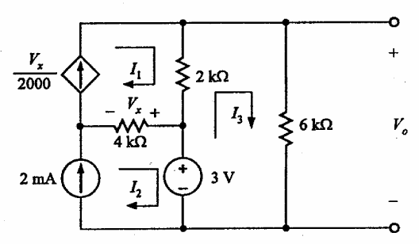







Ch2 Basic Analysis Methods to Circuits
DEPENDENT CURRENT SOURCE. CURRENT SOURCES NOT SHARED BY MESHES
2.2 Useful Circuit Analysis Techniques
WE ARE ASKED FOR Vo. WE ONLY NEED
TO SOLVE FOR I3
Mesh(Loop) Analysis
REPLACE AND REARRANGE
We treat the dependent source as a
conventional source
Equations for meshes with current sources
Then KVL on the remaining loop(s)
And express the controlling variable,
Vx, in terms of loop currents

Slide 37
Ch2 Basic Analysis Methods to Circuits
2.2 Basic Nodal and Mesh Analysis
Mesh(Loop) Analysis
Advantages of Loop Analysis
Solves directly for some currents.
Voltage sources are easy.
Current sources are either very easy or somewhat difficult.
Works best for circuits with few loops.
Disadvantages of Loop Analysis
Some currents must be computed from loop currents.
Choosing the supermesh may be difficult.

Slide 38
Ch2 Basic Analysis Methods to Circuits
2.3 Useful Circuit Analysis Techniques
Key Words:
Linearity
Superposition
Thevenin’s and Norton’s theorems

Slide 39
Ch2 Basic Analysis Methods to Circuits
2.3 Useful Circuit Analysis Techniques
Linearity
Linearity is a mathematical property of circuits that makes very powerful analysis techniques possible.
Linearity leads to many useful properties of circuits:
  Superposition: the effect of each source can be considered separately.
  Equivalent circuits: Any linear network can be represented by an equivalent source and resistance (Thevenin’s and Norton’s theorems)

Slide 40

Ch2 Basic Analysis Methods to Circuits
2.3 Useful Circuit Analysis Techniques
Linearity
Linearity leads to simple solutions:
  Nodal analysis for linear circuits results in systems of linear equations that can be solved by matrices
V₁
500Ω
V₂
500Ω
V₃
1
2
3
I₁
1kΩ
500Ω
I₂
500Ω

Slide 41
Ch2 Basic Analysis Methods to Circuits
2.3 Useful Circuit Analysis Techniques
Linearity
The relationship between current and voltage for a linear elements satisfies two properties:
  Homogeneity
  Additivity
*Real circuit elements are not linear, but can be approximated as linear

Slide 42
Ch2 Basic Analysis Methods to Circuits
2.3 Useful Circuit Analysis Techniques
Linearity
Homogeneity:
  Let v(t) be the voltage across an element with current i(t) flowing through it.
  In an element satisfying homogeneity, if the current is increased by a factor of K, the voltage increases by a factor of K.
Additivity
  Let v₁(t) be the voltage across an element with current i₁(t) flowing through it, and let v₂(t) be the voltage across an element with current i₂ (t) flowing through it
  In an element satisfying additivity, if the current is the sum of i₁ (t) and i₂ (t), then the voltage is the sum of v₁ (t) and v₂ (t).
Example: Resistor: V = R I
  If current is KI, then voltage is R KI = KV
  If current is I₁ + I₂, then voltage is R(I₁ + I₂) = RI₁ + RI₂ = V₁ + V₂

Slide 43

Ch2 Basic Analysis Methods to Circuits
2.3 Useful Circuit Analysis Techniques
Superposition
I₂
I
Superposition is a direct consequence of linearity
It states that “in any linear circuit containing multiple independent sources, the current or voltage at any point in the circuit may be calculated as the algebraic sum of the individual contributions of each source acting alone.”

Slide 44
Ch2 Basic Analysis Methods to Circuits
2.3 Useful Circuit Analysis Techniques
Superposition
How to Apply Superposition?
To find the contribution due to an individual independent source, zero out the other independent sources in the circuit.
  Voltage source ⇒ short circuit.
  Current source ⇒ open circuit.
Solve the resulting circuit using your favorite techniques.
  Nodal analysis
  Loop analysis

Slide 45
Ch2 Basic Analysis Methods to Circuits
2.3 Useful Circuit Analysis Techniques
Superposition
P2.7
12V
2kΩ
4mA
-
+
2mA
1kΩ
2kΩ
I₀

Slide 46
Ch2 Basic Analysis Methods to Circuits
2.3 Useful Circuit Analysis Techniques
Superposition
P2.7
2kΩ
2mA
1kΩ
2kΩ
I’_{o}
I’₀ = -4/3 mA

Slide 47
Ch2 Basic Analysis Methods to Circuits
2.3 Useful Circuit Analysis Techniques
Superposition
P2.7
2kΩ
4mA
1kΩ
2kΩ
I’’₀
I’’₀ = 0

Slide 48
Ch2 Basic Analysis Methods to Circuits
2.3 Useful Circuit Analysis Techniques
Superposition
P2.7
12V
2kΩ
-
+
1kΩ
2kΩ
I’’’₀
I’’’₀ = -4 mA

Slide 49
Ch2 Basic Analysis Methods to Circuits
2.3 Useful Circuit Analysis Techniques
Superposition
P2.7
12V
12V
4mA
2kΩ
4mA
2kΩ
-
-
+
+
2mA
2mA
1kΩ
1kΩ
2kΩ
2kΩ
I₀
I₀
I₀ = I’₀ +I’’₀+ I’’’₀ = -16/3 mA
I₀ = I’₀ +I’’₀+ I’’’₀ = -16/3 mA

Slide 50

Ch2 Basic Analysis Methods to Circuits
2.3 Useful Circuit Analysis Techniques
Superposition
P2.8
V_{R4}=?

Slide 51
Ch2 Basic Analysis Methods to Circuits
2.3 Useful Circuit Analysis Techniques
Superposition
P2.9
（D/A）Decode circuit。
0000
0
0110
6
0001
1
0111
7
0010
2
1000
8
0011
3
1001
9
0100
4
1010
10
0101
5
R/8
R/4
•
•
ο
R/2
•
+
R
2³
2²
2¹
2⁰
V_{o}
ο
ο
ο
ο
ο
ο
ο
ο
ο
ο
ο
ο
E
E
E
E
_
•
ο

Slide 52
Ch2 Basic Analysis Methods to Circuits
2.3 Useful Circuit Analysis Techniques
Thevenin’s theorem
Any circuit with sources (dependent and/or independent) and resistors can be replaced by an equivalent circuit containing a single voltage source and a single resistor
Thevenin’s theorem implies that we can replace arbitrarily complicated networks with simple networks for purposes of analysis

Slide 53
Ch2 Basic Analysis Methods to Circuits
2.3 Useful Circuit Analysis Techniques
Thevenin’s theorem
Independent Sources
R_{Th}
+
V_{oc}
-
Circuit with independent sources
Thevenin equivalent circuit

Slide 54
Ch2 Basic Analysis Methods to Circuits
2.3 Useful Circuit Analysis Techniques
Thevenin’s theorem
No Independent Sources
R_{Th}
Circuit without independent sources
Thevenin equivalent circuit

Slide 55














Ch2 Basic Analysis Methods to Circuits
Outline of proof
2.3 Useful Circuit Analysis Techniques
Thevenin’s theorem
No Independent Sources
If Circuit A is unchanged then the current should be the same
Use source superposition
All independent
sources set to
zero in A
How do we interpret this result?

Slide 56



Thevenin approach
For ANY circuit in Part B
This is the Thevenin equivalent
circuit for the circuit in Part A
The voltage source is called the
THEVENIN EQUIVALENT SOURCE
The resistance is called the
THEVENIN EQUIVALENT RESISTANCE
Part a must behave like
This circuit

Slide 57

Ch2 Basic Analysis Methods to Circuits
2.3 Useful Circuit Analysis Techniques
resistance of network seen from port
Thevenin’s theorem
independent sources
i
R_{Th}
+
v_{o}
-
V_{oc}(V_{TH})
open circuit voltage
at terminal pair
Circuit without independent sources
R_{TH}
For ANY circuit in Part B

Slide 58
Ch2 Basic Analysis Methods to Circuits
2.3 Useful Circuit Analysis Techniques
Thevenin’s theorem
Circuits with independent sources
  Compute the open circuit voltage, this is Voc
  Compute the Thevenin resistance (set the sources to zero – short circuit the voltage sources, open circuit the current sources), and find the equivalent resistance, this is R_{Th}
Circuits with independent and dependent sources:
  Compute the open circuit voltage
  Compute the short circuit current
  The ratio of the two is R_{Th}
Circuits with dependent sources only
  V_{oc} is simply 0
  R_{Th} is found by applying an independent voltage source (V volts) to the terminals and finding voltage/current ratio

Slide 59

Ch2 Basic Analysis Methods to Circuits
2.3 Useful Circuit Analysis Techniques
Thevenin’s theorem
Valid partitions keep the dependent sources and their controlling
variable in the same partition.

Slide 60

Ch2 Basic Analysis Methods to Circuits
2.3 Useful Circuit Analysis Techniques
Thevenin’s theorem
P2.10 I_{ac}=?

Slide 61
Independent. Sources Dependent. Sources | With Independent sources | Without Independent sources
With dependent sources | Compute the open circuit voltage V_{oc} Compute the short circuit current I_{sc} The ratio of the two is R_{Th}, i.e. R_{Th}= V_{oc}/ I_{sc} | V_{oc} is simply 0. R_{Th} is found by applying an independent voltage source (V volts) to the terminals and finding voltage/current ratio.
Without dependent sources | Compute the open circuit voltage, V_{oc} Compute the Thevenin resistance by setting the sources to zero Short circuit the voltage sources, Open circuit the current sources Find the equivalent resistance, R_{Th} | A circuit only containing resistors V_{oc} is simply 0 Find the equivalent resistance, R_{Th}

Slide 62


Ch2 Basic Analysis Methods to Circuits
2.3 Useful Circuit Analysis Techniques
Thevenin’s theorem
P2.11

Slide 63







Ch2 Basic Analysis Methods to Circuits
2.3 Useful Circuit Analysis Techniques
Maximum power transfer
For every choice of R_{L} we have a different power.
How do we find the maximum value?
Consider P_{L} as a function of R_{L} and find the
maximum of such function
3
The maximum power transfer theorem
The load that maximizes the power transfer for a circuit is equal to the Thevenin equivalent resistance of the circuit.
The value of the maximum power that can be transferred is

Slide 64
Ch2 Basic Analysis Methods to Circuits
2.3 Useful Circuit Analysis Techniques
Norton’s theorem
Very similar to Thevenin’s theorem
It simply states that any circuit with sources (dependent and/or independent) and resistors can be replaced by an equivalent circuit containing a single current source and a single resistor

Slide 65




Ch2 Basic Analysis Methods to Circuits
2.3 Useful Circuit Analysis Techniques
Norton’s theorem
Norton Approach
Norton

Slide 66
Ch2 Basic Analysis Methods to Circuits
2.3 Useful Circuit Analysis Techniques
Norton’s theorem
Norton Equivalent: Independent Sources
I_{sc}
R_{Th}
Circuit with one or more independent sources
Norton equivalent circuit

Slide 67
Ch2 Basic Analysis Methods to Circuits
2.3 Useful Circuit Analysis Techniques
Norton’s theorem
Norton Equivalent: No Independent Sources
R_{Th}
Circuit without independent sources
Norton equivalent circuit

Slide 68
Ch2 Basic Analysis Methods to Circuits
2.3 Useful Circuit Analysis Techniques
Norton’s theorem
Finding the Norton Equivalent
Circuits with independent sources, w/o dependent sources
  Compute the short circuit current, this is I_{sc}
  Compute the Thevenin resistance (set the sources to zero – short circuit the voltage sources, open circuit the current sources), and find the equivalent resistance, this is R_{Th}
Circuits with both independent and dependent sources
  Find V_{oc} and I_{sc}
  Compute R_{Th}= V_{oc}/ I_{sc}
Circuits w/o independent sources
  Apply a test voltage (current) source
  Find resulting current (voltage)
  Compute R_{Th}

Slide 69

Ch2 Basic Analysis Methods to Circuits
2.3 Useful Circuit Analysis Techniques
Norton’s theorem
I=?

Slide 70


Ch2 Basic Analysis Methods to Circuits
Analysis methods Review
KVL, KCL, I — V
Combination rules
Node method
Mesh method
Superposition
Thévenin
Norton
Any circuits
linear circuits

