Slide 1
Circuits and Analog Electronics
Ch3 Basic RL and RC Circuits
3.1 First-Order RC Circuits
3.2 First-Order RL Circuits
3.3 Examples

Slide 2
Ch3 Basic RL and RC Circuits
3.1 First-Order RC Circuits
Key Words:
Transient Response of RC Circuits
Time constant

Slide 3
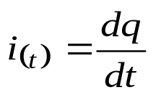
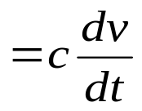

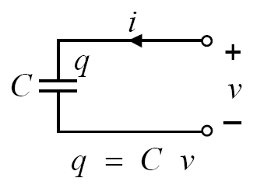
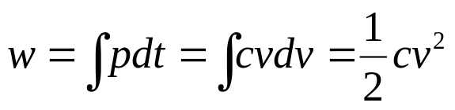
Ch3 Basic RL and RC Circuits
3.1 First-Order RC Circuits
Any circuit with a single energy storage element, an arbitrary number of sources, and an arbitrary number of resistors is a circuit of order 1.
Any voltage or current in such a circuit is the solution to a 1st order differential equation.
Ideal Linear Capacitor
Energy stored
A capacitor is an energy storage device → memory device.

Slide 4
Ch3 Basic RL and RC Circuits
3.1 First-Order RC Circuits
v_{r}(t)
+
-
R
+
+
v_{s}(t)
C
v_{c}(t)
-
-
One capacitor and one resistor
The source and resistor may be equivalent to a circuit with many resistors and sources.

Slide 5
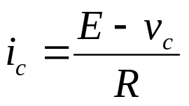
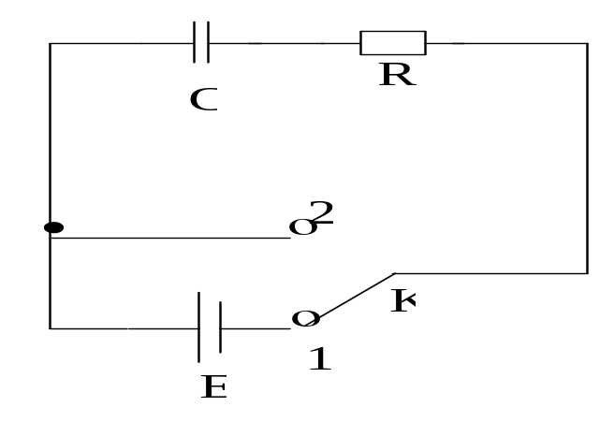

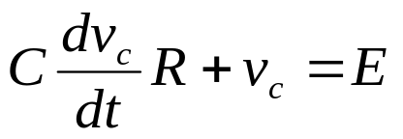
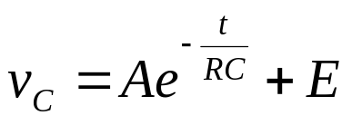

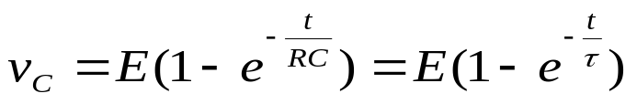

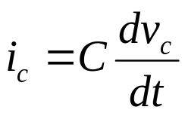
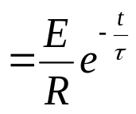
Ch3 Basic RL and RC Circuits
3.1 First-Order RC Circuits
Transient Response of RC Circuits
Switch is thrown to 1
KVL around the loop:
Initial condition
Called time constant

Slide 6

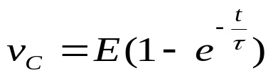
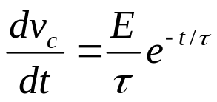
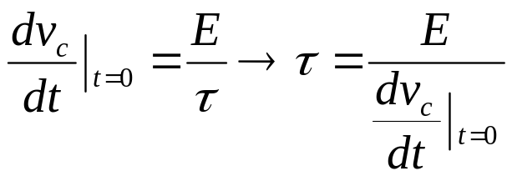
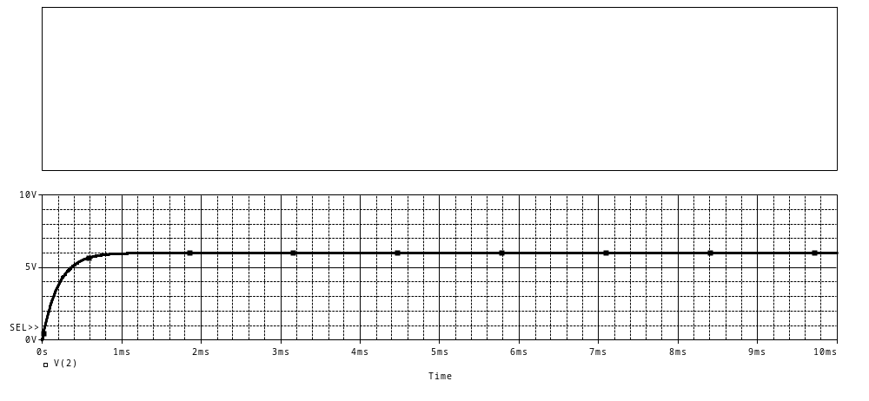
Ch3 Basic RL and RC Circuits
3.1 First-Order RC Circuits
Time Constant
R=2k
C=0.1μF
RC

Slide 7

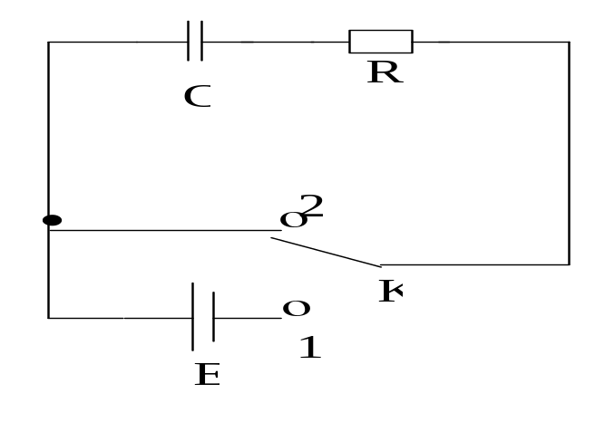
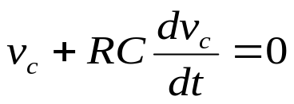
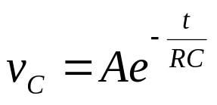


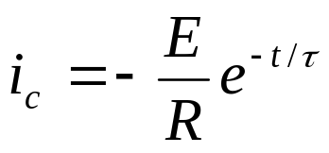
Ch3 Basic RL and RC Circuits
3.1 First-Order RC Circuits
Transient Response of RC Circuits
Switch is thrown to 2
Initial condition

Slide 8
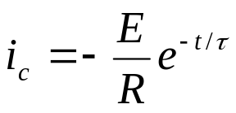
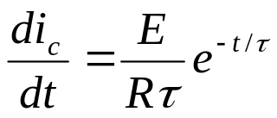
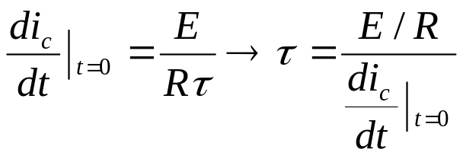
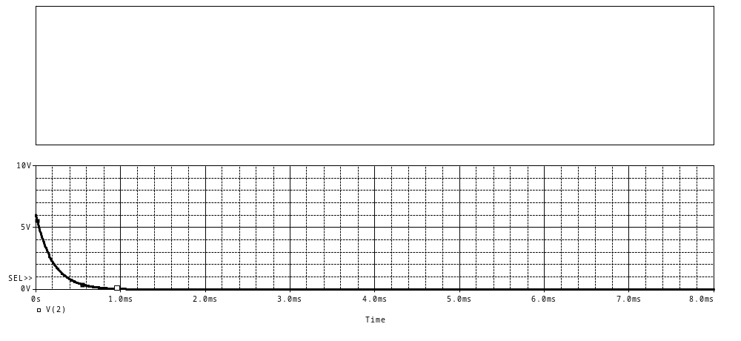
Ch3 Basic RL and RC Circuits
3.1 First-Order RC Circuits
Time Constant
R=2k
C=0.1μF

Slide 9
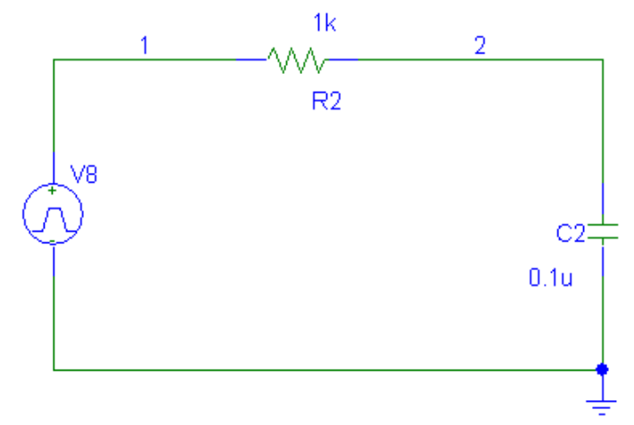
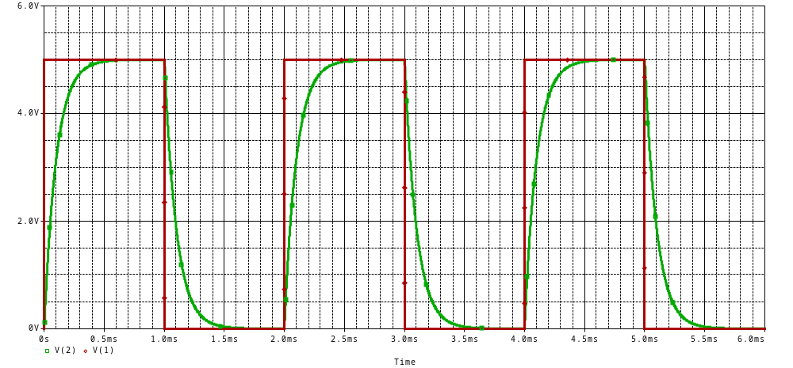
Ch3 Basic RL and RC Circuits
3.1 First-Order RC Circuits

Slide 10
Ch3 Basic RL and RC Circuits
3.2 First-Order RL Circuits
Key Words:
Transient Response of RL Circuits
Time constant

Slide 11
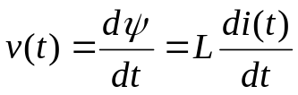
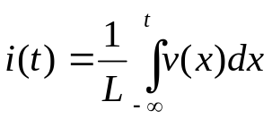
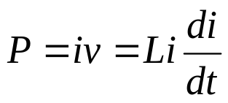

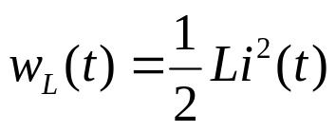
Ch3 Basic RL and RC Circuits
3.2 First-Order RL Circuits
Ideal Linear Inductor
i(t)
+
The
rest
of
the
circuit
L
v(t)
-
Energy stored:
One inductor and one resistor
The source and resistor may be equivalent to a circuit with many resistors and sources.

Slide 12
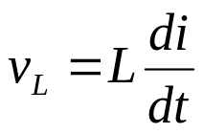
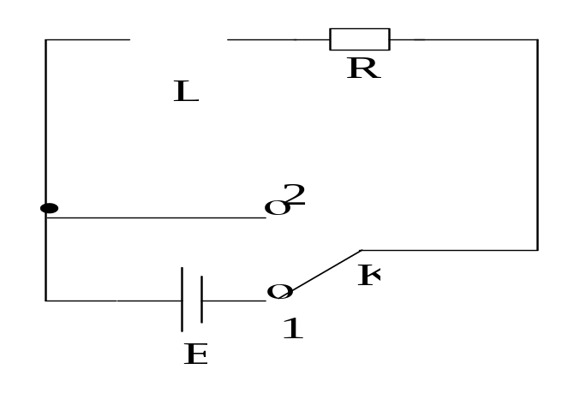

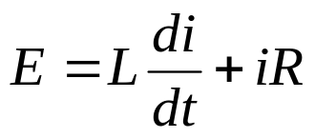

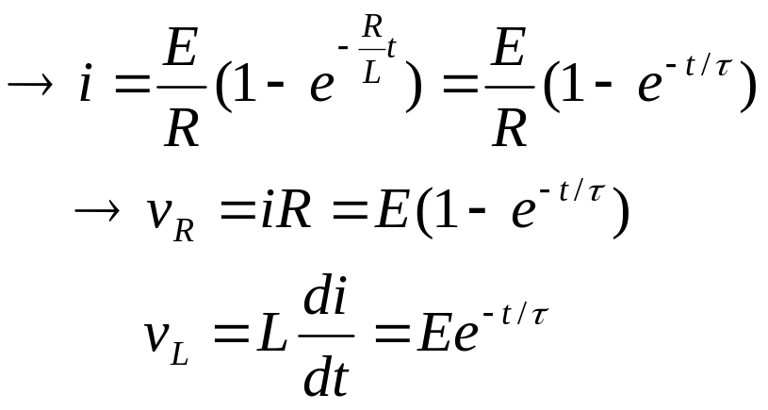

Ch3 Basic RL and RC Circuits
3.2 First-Order RL Circuits
Transient Response of RL Circuits
Switch is thrown to 1
KVL around the loop:
Initial condition
Called time constant

Slide 13
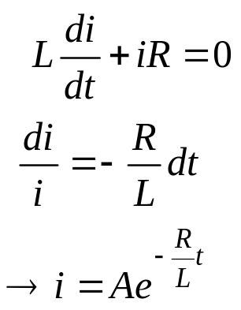
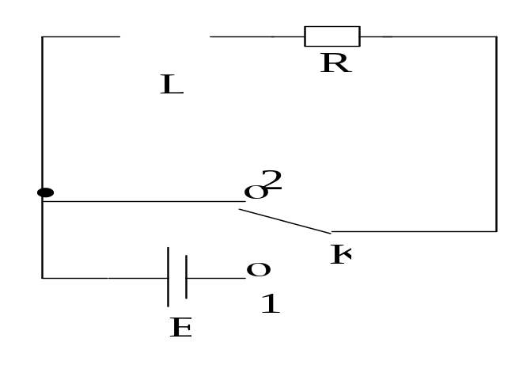
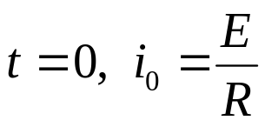
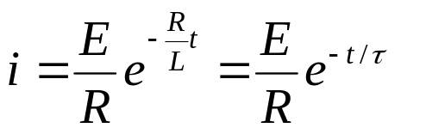
Ch3 Basic RL and RC Circuits
3.2 First-Order RL Circuits
Transient Response of RL Circuits
Switch is thrown to 2
Initial condition

Slide 14
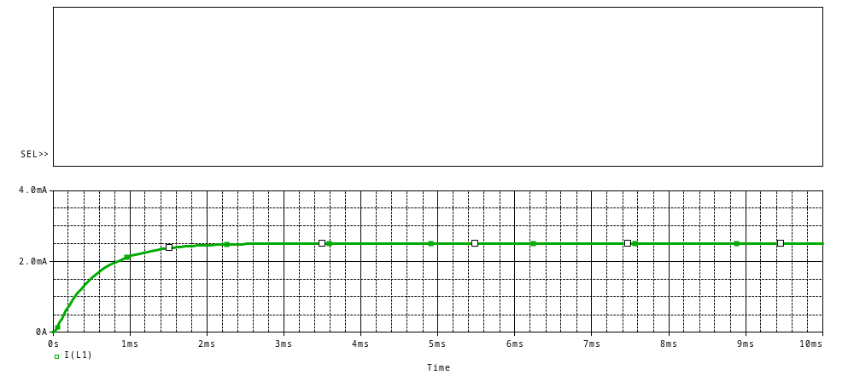
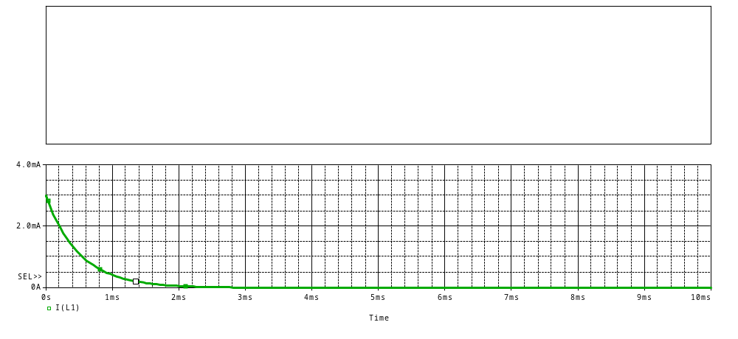
Ch3 Basic RL and RC Circuits
3.2 First-Order RL Circuits
Transient Response of RL Circuits

Slide 15

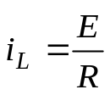

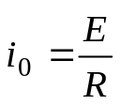






Ch3 Basic RL and RC Circuits
Summary
Initial Value （t=0）
Steady Value （t→∞）
time constant
τ
RL Circuits
Source
(0 state)
Source-free
(0 input)
RC
Circuits
Source
(0 state)
Source-free
(0 input)

Slide 16
Ch3 Basic RL and RC Circuits
Summary
The Time Constant
For an RC circuit, τ = RC
For an RL circuit, τ = L/R
-1/τ is the initial slope of an exponential with an initial value of 1
Also, τ is the amount of time necessary for an exponential to decay to 36.7% of its initial value

Slide 17
Ch3 Basic RL and RC Circuits
Summary
How to determine initial conditions for a transient circuit. When a sudden change occurs, only two types quantities will definitely remain the same before and after the change.
  I_{L}(t), inductor current
  Vc(t), capacitor voltage
Find these two types of the values before the change and use them as initial conditions of the circuit after change.

Slide 18
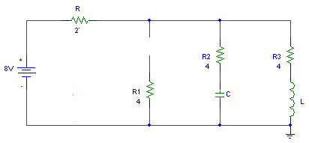


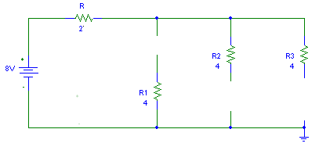
Ch3 Basic RL and RC Circuits
3.3 Examples
About Calculation for The Initial Value
→i
↓i_{C}
↓i_{L}
t=0
i₍₀₊₎
i_{C(0+)}
i_{L(0+)}
+
v_{C(0+)}=4V
+
v_{L(0+)}
_
-
∨
1A

Slide 19
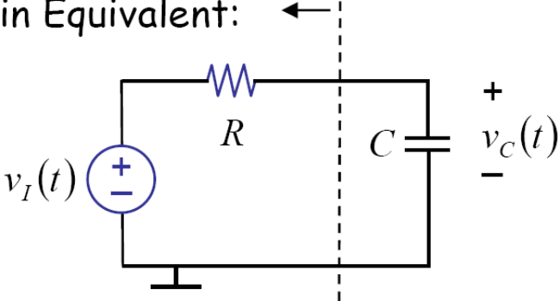
Ch3 Basic RL and RC Circuits
3.3 Examples
(Analyzing an RC circuit or RL circuit)
Method 1
1) Thévenin Equivalent.(Draw out C or L)
Simplify the circuit
V_{eq} , R_{eq}
2) Find L_{eq}(C_{eq}), and τ =L_{eq}/R_{eq} (τ =C_{eq}R_{eq})
3) Substituting Leq(Ceq), and τ to previous solution of differential equation for RC (RL)circuit .

Slide 20
Ch3 Basic RL and RC Circuits
3.3 Examples
(Analyzing an RC circuit or RL circuit)
Method 2
1) KVL around the loop, → the differential equation
2) Find the homogeneous solution.
3) Find the particular solution.
4) The total solution is the sum of the particular and homogeneous solutions.

Slide 21
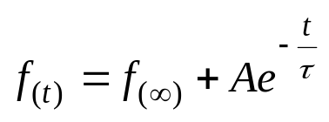

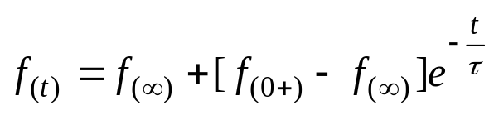

Ch3 Basic RL and RC Circuits
3.3 Examples
(Analyzing an RC circuit or RL circuit)
Method 3 (step-by-step)
In general,
Given f_{（0＋），}thus
Initial
Steady
1) Draw the circuit for t=0₋ and find v(0₋), or i(0₋)
2) Use the continuity of the capacitor voltage, or inductor current, draw the circuit for t=0₊ to find v(0₊), or i(0₊)
3) Find v( ∞ ), or i(∞) at steady state
4) Find the time constant τ
  For an RC circuit, τ = RC
  For an RL circuit, τ = L/R
5) The solution is:

Slide 22
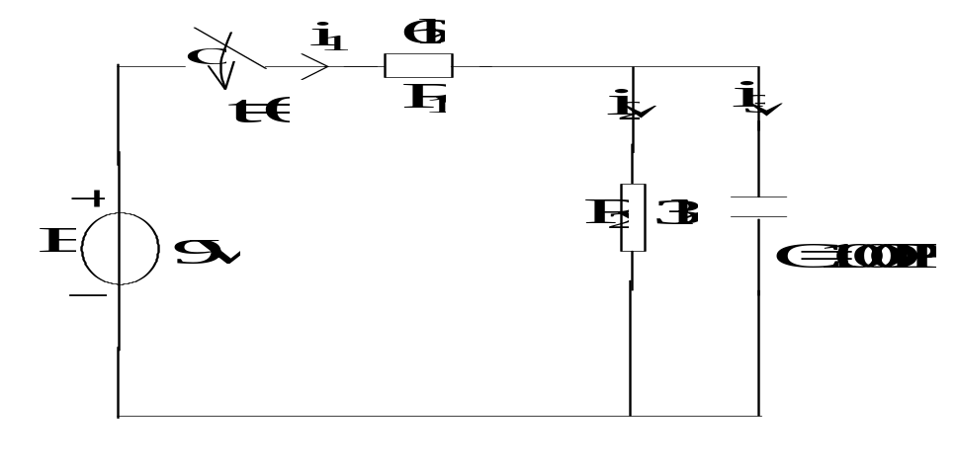
Ch3 Basic RL and RC Circuits
3.3 Examples
v_{C(0)}=0, Find v_{C(t)} for t≥0.

