Slide 1
Circuits and Analog Electronics
Ch4 Sinusoidal Steady State Analysis
4.1 Characteristics of Sinusoidal
4.2 Phasors
4.3 Phasor Relationships for R, L and C
4.4 Impedance
4.5 Parallel and Series Resonance
4.6 Examples for Sinusoidal Circuits Analysis
4.7 Magnetically Coupled Circuits

Slide 2
Ch4 Sinusoidal Steady State Analysis
Any steady state voltage or current in a linear circuit with a sinusoidal source is a sinusoid
  All steady state voltages and currents have the same frequency as the source
In order to find a steady state voltage or current, all we need to know is its magnitude and its phase relative to the source (we already know its frequency)
We do not have to find this differential equation from the circuit, nor do we have to solve it
Instead, we use the concepts of phasors and complex impedances
Phasors and complex impedances convert problems involving differential equations into circuit analysis problems
❖ Focus on steady state; 􀂄 Focus on sinusoids.

Slide 3
Ch4 Sinusoidal Steady State Analysis
4.1 Characteristics of Sinusoidal
Key Words:
Period: T ,
Frequency: f , Radian frequency ω
Phase angle
Amplitude: V_{m} I_{m}

Slide 4
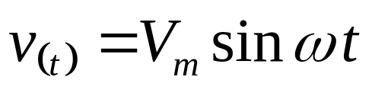
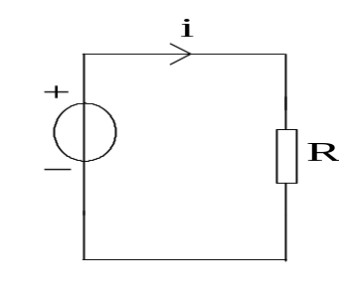
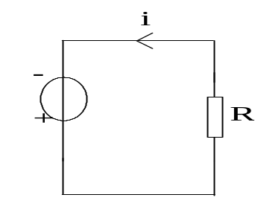
Ch4 Sinusoidal Steady State Analysis
4.1 Characteristics of Sinusoidal
v、i
0
t₁
t₂
t

Slide 5
Ch4 Sinusoidal Steady State Analysis
4.1 Characteristics of Sinusoidal
Period: T ——Time necessary to go through one cycle. (S)
Frequency: f ——Cycles per second. (Hz)
f = 1/T
Radian frequency(Angular frequency): ω=2πf =2π /T (rad/s）
Amplitude: V_{m} I_{m}
i=I_{m}sinωt ， v=V_{m}sinωt
v、i
V_{m}、I_{m}
0
π
2π
ωt

Slide 6
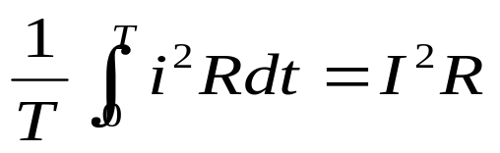
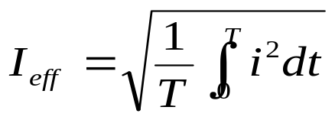
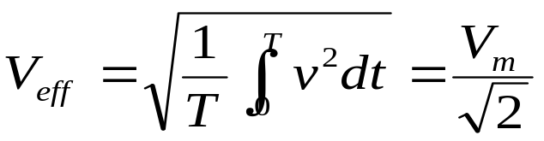
Ch4 Sinusoidal Steady State Analysis
4.1 Characteristics of Sinusoidal
Effective(RMS) Value of a Periodic Waveform——is equal to the value of the direct current which, flowing through an R-ohm resistor, delivers the same average power to the resistor as does the periodic current.
Effective Value of a Periodic Waveform

Slide 7

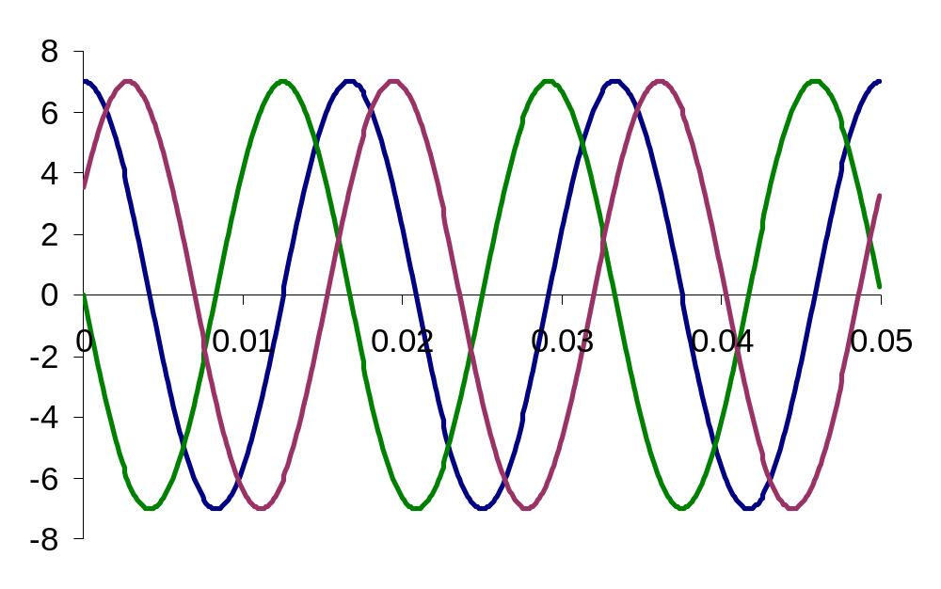

Ch4 Sinusoidal Steady State Analysis
4.1 Characteristics of Sinusoidal
Phase(angle)
Phase angle
ϕ>0
ϕ<0
Notes:
①如果正弦波的起始最小值发生在时间起点之前，则ϕ为正值。
②如果正弦波的起始最小值发生在时间起点之后，则ϕ为负值。

Slide 8





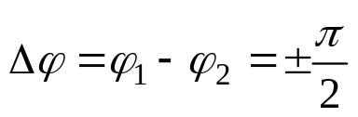

Ch4 Sinusoidal Steady State Analysis
4.1 Characteristics of Sinusoidal
Phase difference
——v(t) leads i(t) by (ϕ₁- ϕ₂), or i(t) lags v(t) by (ϕ₁- ϕ₂)
——v(t) lags i(t) by (ϕ₂- ϕ₁), or i(t) leads v(t) by (ϕ₂- ϕ₁)
In phase.
Out of phase。
v、i
v、i
v、i
v
v
v
i
i
i
ωt
ωt
ωt

Slide 9











Ch4 Sinusoidal Steady State Analysis
4.1 Characteristics of Sinusoidal
Phase difference
P4.1,
Find

Slide 10
Ch4 Sinusoidal Steady State Analysis
4.1 Characteristics of Sinusoidal
Phase difference
P4.2,
v、i
v
i
•
•
•
-π/3
π/3
π
ωt
Notes:
P4.2, v、i波形如图，问，v、i初相各为多少？若将时间起点右移π/3，则v、i初相有何改变？Δϕ改变否？若时间起点右移π，则v、i初相有何改变？ Δϕ改变否？若将时间起点左移π/3 ，则v、i初相有何改变？ Δϕ改变否？

Slide 11
Ch4 Sinusoidal Steady State Analysis
4.2 Phasors
Key Words:
Complex Numbers,
Rotating Vector
Phasors

Slide 12



Ch4 Sinusoidal Steady State Analysis
4.2 Phasors
Rotating Vector
y
i
I_{m}
i
I_{m}
ωt
ϕ
ωt₁
i_{(t1)}
x
ϕ
ωt
Notes:
P4.2, v、i波形如图，问，v、i初相各为多少？若将时间起点右移π/3，则v、i初相有何改变？Δϕ改变否？若时间起点右移π，则v、i初相有何改变？ Δϕ改变否？若将时间起点左移π/3 ，则v、i初相有何改变？ Δϕ改变否？

Slide 13

Ch4 Sinusoidal Steady State Analysis
4.2 Phasors
Rotating Vector
y
ω
V_{m}
ϕ
0
x
Notes:
P4.2, v、i波形如图，问，v、i初相各为多少？若将时间起点右移π/3，则v、i初相有何改变？Δϕ改变否？若时间起点右移π，则v、i初相有何改变？ Δϕ改变否？若将时间起点左移π/3 ，则v、i初相有何改变？ Δϕ改变否？

Slide 14


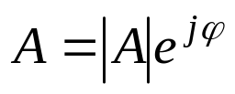


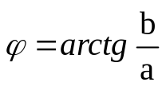




Ch4 Sinusoidal Steady State Analysis
4.2 Phasors
Complex Numbers
——Rectangular Coordinates
imaginary axis
b
|A|
——Polar Coordinates
ϕ
real axis
a
conversion：
Notes:
P4.2, v、i波形如图，问，v、i初相各为多少？若将时间起点右移π/3，则v、i初相有何改变？Δϕ改变否？若时间起点右移π，则v、i初相有何改变？ Δϕ改变否？若将时间起点左移π/3 ，则v、i初相有何改变？ Δϕ改变否？
j——旋转90°的算子

Slide 15
Ch4 Sinusoidal Steady State Analysis
4.2 Phasors
Complex Numbers
Arithmetic With Complex Numbers
Addition: A = a + jb, B = c + jd, A + B = (a + c) + j(b + d)
Imaginary Axis
A + B
B
A
Real Axis
Notes:
P4.2, v、i波形如图，问，v、i初相各为多少？若将时间起点右移π/3，则v、i初相有何改变？Δϕ改变否？若时间起点右移π，则v、i初相有何改变？ Δϕ改变否？若将时间起点左移π/3 ，则v、i初相有何改变？ Δϕ改变否？

Slide 16
Ch4 Sinusoidal Steady State Analysis
4.2 Phasors
Complex Numbers
Arithmetic With Complex Numbers
Subtraction : A = a + jb, B = c + jd, A - B = (a - c) + j(b - d)
Imaginary Axis
B
A
Real Axis
A - B
Notes:
P4.2, v、i波形如图，问，v、i初相各为多少？若将时间起点右移π/3，则v、i初相有何改变？Δϕ改变否？若时间起点右移π，则v、i初相有何改变？ Δϕ改变否？若将时间起点左移π/3 ，则v、i初相有何改变？ Δϕ改变否？

Slide 17



Ch4 Sinusoidal Steady State Analysis
4.2 Phasors
Complex Numbers
Arithmetic With Complex Numbers
Multiplication : A = A_{m} ∠ ϕ_{Α}, B = B_{m} ∠ ϕ_{Β}
A *B = (A_{m} × B_{m}) ∠ (ϕ_{Α} + ϕ_{Β})
Division: A = A_{m} ∠ ϕ_{Α} , B = B_{m} ∠ ϕ_{Β}
A / B = (A_{m} / B_{m}) ∠ (ϕ_{Α} − ϕ_{Β})
P4.3,
Find：
Notes:
P4.2, v、i波形如图，问，v、i初相各为多少？若将时间起点右移π/3，则v、i初相有何改变？Δϕ改变否？若时间起点右移π，则v、i初相有何改变？ Δϕ改变否？若将时间起点左移π/3 ，则v、i初相有何改变？ Δϕ改变否？

Slide 18
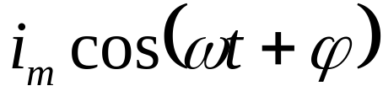
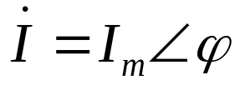
Ch4 Sinusoidal Steady State Analysis
4.2 Phasors
Phasors
A phasor is a complex number that represents the magnitude and phase of a sinusoid:
Phasor Diagrams
A phasor diagram is just a graph of several phasors on the complex plane (using real and imaginary axes).
A phasor diagram helps to visualize the relationships between currents and voltages.
Notes:
P4.2, v、i波形如图，问，v、i初相各为多少？若将时间起点右移π/3，则v、i初相有何改变？Δϕ改变否？若时间起点右移π，则v、i初相有何改变？ Δϕ改变否？若将时间起点左移π/3 ，则v、i初相有何改变？ Δϕ改变否？

Slide 19

Ch4 Sinusoidal Steady State Analysis
4.2 Phasors
Complex Exponentials
A real-valued sinusoid is the real part of a complex exponential.
Complex exponentials make solving for AC steady state an algebraic problem.
Notes:
P4.2, v、i波形如图，问，v、i初相各为多少？若将时间起点右移π/3，则v、i初相有何改变？Δϕ改变否？若时间起点右移π，则v、i初相有何改变？ Δϕ改变否？若将时间起点左移π/3 ，则v、i初相有何改变？ Δϕ改变否？

Slide 20
Ch3正弦交流电路 > 3.2正弦量的相量表示法
1.正弦量的相量表示法
3）相量
——表示正弦量的复数
相量在复平面上的几何表示称为相量图．
讨论：
①只有正弦周期量才能用相量表示，相量不能表示非正弦周期量．
②只有同频率的正弦量才能画在同一相量图上，不同频率的正弦量不能画在一个相量图上。
③相量只能代表正弦信号，不能将其与正弦信号画等号．
④正弦量用相量表示后，它们运算就变换为复数的运算．
⑤表示正弦量的相量有两种形式：相量图、复数式

Slide 21

Ch3正弦交流电路 > 3.2正弦量的相量表示法
1.正弦量的相量表示法
正弦量的四种表示方法：
三角函数式
波形图
旋转矢量
相量（复数）
例3：已知，
求：

Slide 22
Ch4 Sinusoidal Steady State Analysis
4.3 Phasor Relationships for R, L and C
Key Words:
I-V Relationship for R, L and C,
Power conversion

Slide 23
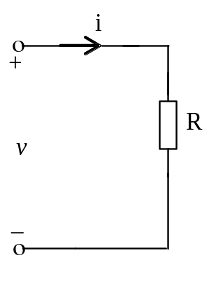
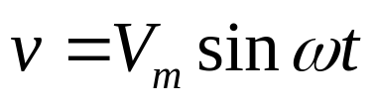
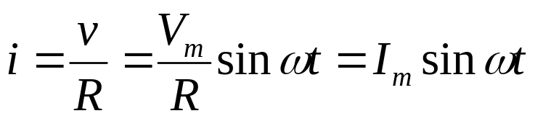
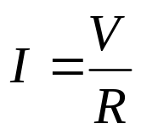


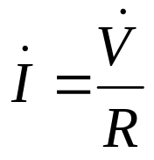
Ch4 Sinusoidal Steady State Analysis
4.3 Phasor Relationships for R, L and C
Resistor
v~i relationship for a resistor
Suppose
v、i
Relationship between RMS:
v
Wave and Phasor diagrams：
i
ωt

Slide 24

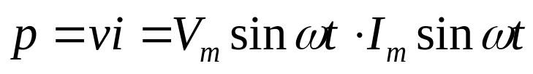

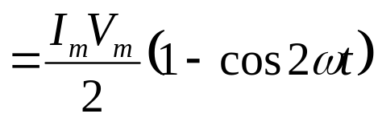

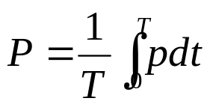
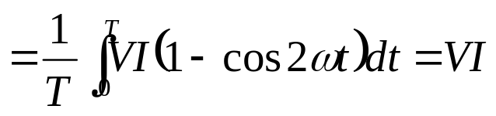
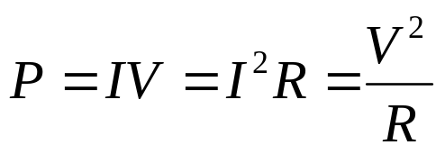
Ch4 Sinusoidal Steady State Analysis
4.3 Phasor Relationships for R, L and C
Resistor
Power
Transient Power
p>0
v、i
Average Power
v
P=IV
i
ωt

Slide 25

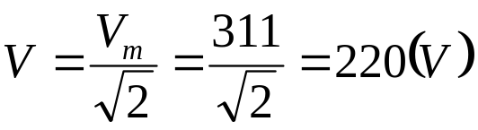
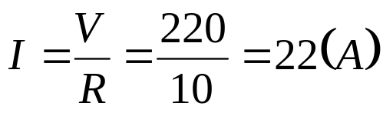

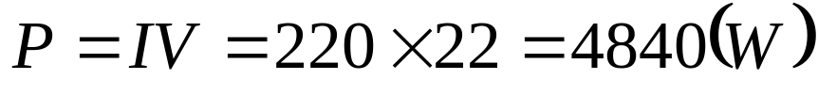
Ch4 Sinusoidal Steady State Analysis
4.3 Phasor Relationships for R, L and C
Resistor
P4.4 ， , R=10Ω，Find i and P。

Slide 26
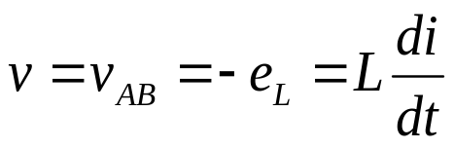
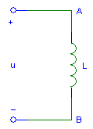

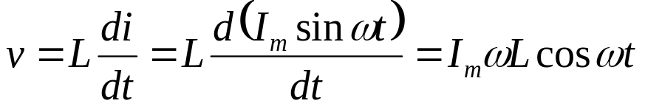


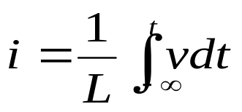
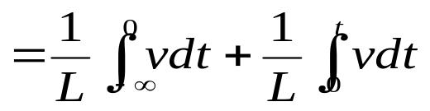
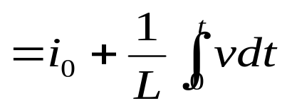
Ch4 Sinusoidal Steady State Analysis
4.3 Phasor Relationships for R, L and C
Inductor
v~i relationship
Suppose

Slide 27
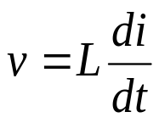




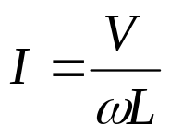



Ch4 Sinusoidal Steady State Analysis
4.3 Phasor Relationships for R, L and C
Inductor
v~i relationship
Relationship between RMS:
For DC，f=0，→X_{L}=0。
v(t) leads i(t) by 90º, or i(t) lags v(t) by 90º

Slide 28
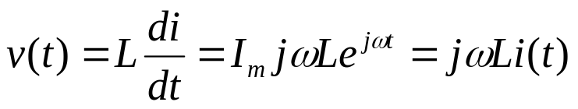

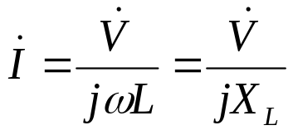
Ch4 Sinusoidal Steady State Analysis
4.3 Phasor Relationships for R, L and C
Inductor
v~i relationship
i(t) = I_{m} e^{jωt}
Represent v(t) and i(t) as phasors:
The derivative in the relationship between v(t) and i(t) becomes a multiplication by jω in the relationship between V and I.
The time-domain diffierential equation has become the algebraic equation in the frequency-domain.
Phasors allow us to express current-voltage relationships for inductors and capacitors much like we express the current-voltage relationship for a resistor.

Slide 29



Ch4 Sinusoidal Steady State Analysis
4.3 Phasor Relationships for R, L and C
Inductor
v~i relationship
Wave and Phasor diagrams：
v、i
v
e_{L}
i
ωt

Slide 30



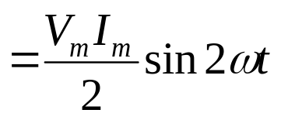

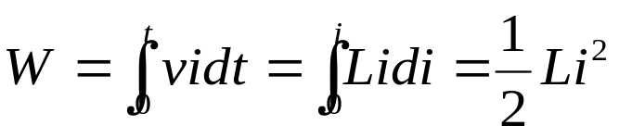
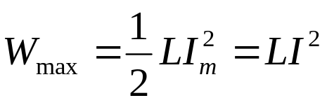
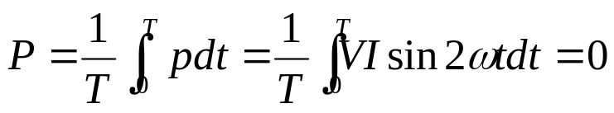
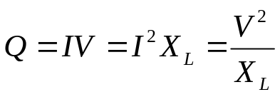
Ch4 Sinusoidal Steady State Analysis
4.3 Phasor Relationships for R, L and C
Inductor
Power
P
Energy stored:
+
+
ωt
-
-
v、i
Average Power
v
i
Reactive Power
（Var）
ωt

Slide 31
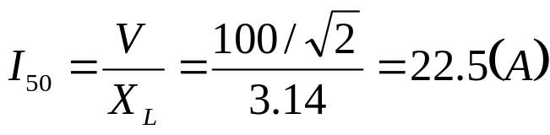
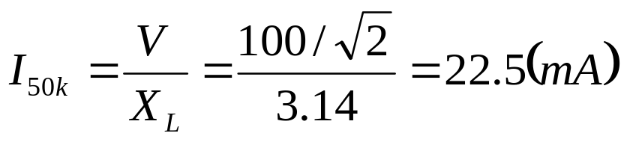
Ch4 Sinusoidal Steady State Analysis
4.3 Phasor Relationships for R, L and C
Inductor
P4.5，L=10mH，v=100sinωt，Find i_{L} when f=50Hz and 50kHz.

Slide 32
Ch4 Sinusoidal Steady State Analysis
4.3 Phasor Relationships for R, L and C
Inductor
P4.6，L=0.5H，i_{L} is shown in fig。Find e_{L}and v
i (mA)
-
4
2
-
0
I
I
I
t (ms)
2
4
6
e_{L}、v (V)
e_{L}
0.4
-
0.2
-
v
0
I
I
I
t (ms)
2
4
6
-0.2
-
-0.4
-

Slide 33
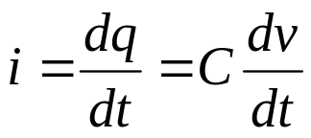
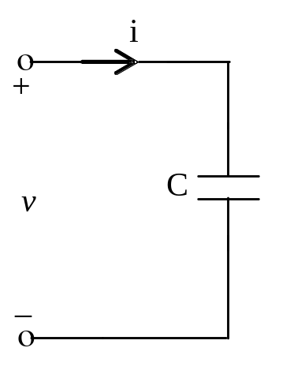




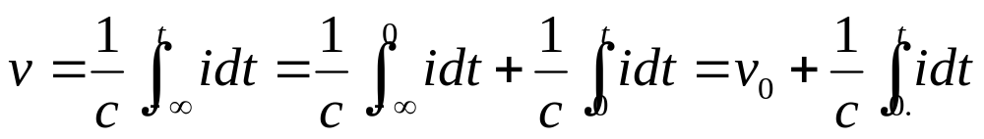
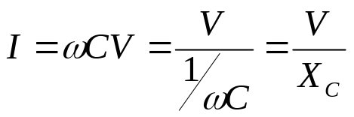
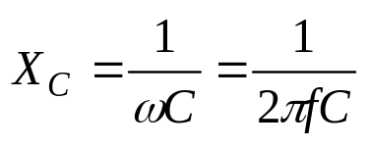
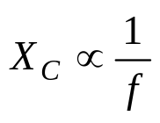
Ch4 Sinusoidal Steady State Analysis
4.3 Phasor Relationships for R, L and C
Capacitor
v~i relationship
Suppose:
Relationship between RMS:
For DC，f=0，→ X_{C}→∞
i(t) leads v(t) by 90º, or v(t) lags i(t) by 90º

Slide 34
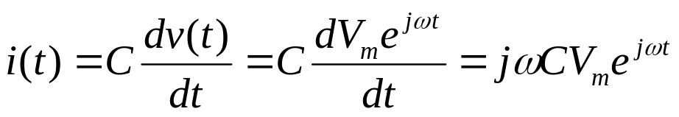
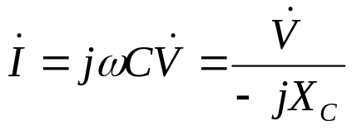
Ch4 Sinusoidal Steady State Analysis
4.3 Phasor Relationships for R, L and C
Capacitor
v~i relationship
v(t) = V_{m} e^{jωt}
Represent v(t) and i(t) as phasors:
The derivative in the relationship between v(t) and i(t) becomes a multiplication by jω in the relationship between V and I.
The time-domain diffierential equation has become the algebraic equation in the frequency-domain.
Phasors allow us to express current-voltage relationships for inductors and capacitors much like we express the current-voltage relationship for a resistor.

Slide 35



Ch4 Sinusoidal Steady State Analysis
4.3 Phasor Relationships for R, L and C
Capacitor
v~i relationship
Wave and Phasor diagrams：
v、i
i
v
ωt

Slide 36





Ch4 Sinusoidal Steady State Analysis
4.3 Phasor Relationships for R, L and C
Capacitor
Power
P
Energy stored:
+
+
ωt
-
-
Average Power: P=0
v、i
i
Reactive Power
（Var）
v
ωt

Slide 37




Ch4 Sinusoidal Steady State Analysis
4.3 Phasor Relationships for R, L and C
Capacitor
P4.7，Suppose C=20μF，AC source v=100sinωt，Find X_{C} and I for f=50Hz, 50kHz。

Slide 38







Ch4 Sinusoidal Steady State Analysis
4.3 Phasor Relationships for R, L and C
Summary
R：
L：
C：
Frequency characteristics of an Ideal Inducter and Capacitor:
A capacitor is an open circuit to DC currents;
A Inducter is a short circuit to DC currents.

Slide 39
Ch4 Sinusoidal Steady State Analysis
4.4 Impedance
Key Words:
complex currents and voltages.
Impedance
Phasor Diagrams

Slide 40




Ch4 Sinusoidal Steady State Analysis
4.4 Impedance
Complex voltage， Complex current， Complex Impedance
AC steady-state analysis using phasors allows us to express the relationship between current and voltage using a formula that looks likes Ohm’s law:
Z is called impedance.
measured in ohms (Ω)

Slide 41
Ch4 Sinusoidal Steady State Analysis
4.4 Impedance
Complex Impedance
Complex impedance describes the relationship between the voltage across an element (expressed as a phasor) and the current through the element (expressed as a phasor)
Impedance is a complex number and is not a phasor (why?).
Impedance depends on frequency

Slide 42






Ch4 Sinusoidal Steady State Analysis
4.4 Impedance
Complex Impedance
Resistor——The impedance is R
Z_{R}=R ϕ=0 （Δϕ＝0); or Z_{R}=R∠0
Capacitor——The impedance is 1/jωC
or
ϕ=-π/2
Inductor——The impedance is jωL
or
ϕ=π/2

Slide 43






Ch4 Sinusoidal Steady State Analysis
4.4 Impedance
Complex Impedance
Impedance in series/parallel can be combined as resistors.
Voltage divider:
Current divider:

Slide 44

Ch4 Sinusoidal Steady State Analysis
4.4 Impedance
Complex Impedance
P4.8,

Slide 45
Ch4 Sinusoidal Steady State Analysis
4.4 Impedance
Complex Impedance
Phasors and complex impedance allow us to use Ohm’s law with complex numbers to compute current from voltage and voltage from current
P4.9
20kΩ
+
+
ω = 377
Find V_{C}
10V ∠ 0°
1μF
V_{C}
-
-
How do we find V_{C}?
First compute impedances for resistor and capacitor:
Z_{R} = 20kΩ= 20kΩ ∠ 0°
Z_{C} = 1/j (377 *1μF) = 2.65kΩ ∠ -90°

Slide 46


Ch4 Sinusoidal Steady State Analysis
4.4 Impedance
Complex Impedance
P4.9
20kΩ
+
+
ω = 377
Find V_{C}
10V ∠ 0°
1μF
V_{C}
-
-
20kΩ ∠ 0°
Now use the voltage divider to find V_{C}:
+
+
10V ∠ 0°
V_{C}
2.65kΩ ∠ -90°
-
-

Slide 47
Ch4 Sinusoidal Steady State Analysis
4.4 Impedance
Complex Impedance
Impedance allows us to use the same solution techniques for AC steady state as we use for DC steady state.
All the analysis techniques we have learned for the linear circuits are applicable to compute phasors
  KCL&KVL
  node analysis/loop analysis
  superposition
  Thevenin equivalents/Notron equivalents
  source exchange
The only difference is that now complex numbers are used.

Slide 48




Ch4 Sinusoidal Steady State Analysis
4.4 Impedance
Kirchhoff’s Laws
KCL and KVL hold as well in phasor domain.
KCL:
i_{k}- Transient current of the #k branche
KVL：
v_{k}- Transient voltage of the #k branche

Slide 49
Ch4 Sinusoidal Steady State Analysis
4.4 Impedance
Admittance
I = YV, Y is called admittance, the reciprocal of impedance, measured in siemens (S)
Resistor:
  The admittance is 1/R
Inductor:
  The admittance is 1/jωL
Capacitor:
  The admittance is j ω C

Slide 50
Ch4 Sinusoidal Steady State Analysis
4.4 Impedance
Phasor Diagrams
A phasor diagram is just a graph of several phasors on the complex plane (using real and imaginary axes).
A phasor diagram helps to visualize the relationships between currents and voltages.
I = 2mA ∠ 40°, V_{R} = 2V ∠ 40°
V_{C} = 5.31V ∠ -50°, V = 5.67V ∠ -29.37°
2mA ∠ 40°
+
+
Imaginary Axis
1μF
V_{C}
–
V
V_{R}
Real Axis
+
1kΩ
V_{R}
–
V
–
V_{C}

Slide 51
Ch4 Sinusoidal Steady State Analysis
4.5 Parallel and Series Resonance
Key Words:
RLC Circuit,
Series Resonance
Parallel Resonance

Slide 52












Ch4 Sinusoidal Steady State Analysis
4.5 Parallel and Series Resonance
Series RLC Circuit
(2nd Order RLC Circuit )
↓v_{R}
v
Phasor
↓v_{L}
↓v_{C}
Δϕ

Slide 53






Ch4 Sinusoidal Steady State Analysis
4.5 Parallel and Series Resonance
Series RLC Circuit
(2nd Order RLC Circuit )
Z
X=X_{L}-X_{C}
Phase difference:
ϕ
R
ϕ
X_{L}>X_{C}，→ϕ >0，v leads i by ϕ——Inductance Circuit
X_{L}<X_{C}，→ϕ <0，v lags i by ϕ——Capacitance Circuit
X_{L}=X_{C}，→ϕ =0，v and i in phase——Resistors Circuit

Slide 54








Ch4 Sinusoidal Steady State Analysis
4.5 Parallel and Series Resonance
Series RLC Circuit
(2nd Order RLC Circuit )
↓v_{R}
v
↓v_{L}
↓v_{C}

Slide 55

Ch4 Sinusoidal Steady State Analysis
4.5 Parallel and Series Resonance
Series RLC Circuit
(2nd Order RLC Circuit )
P4.9, R. L. C Series Circuit，R=30Ω，L=127mH，C=40μF，Source
, Find 1）X_{L}、X_{C}、Z；2）I and i；3）V_{R} and v_{R}； V_{L} and v_{L}； V_{C} and v_{C}； 4） Phasor Diagrams
I=6.22 ∠ 73°
V_{R}=I.R=186.6 ∠ 73°
V_{L}=I.X_{L} ∠ 90° =248 ∠ 163°
V_{C}=I.X_{C} ∠- 90° =495 ∠ -17 °
X_{L=}39.88 Ω
X_{C=}79.62 Ω
Z=30-j39.74
=50 ∠ -53°
↓v_{R}
v
↓v_{L}
↓v_{C}
P4.10，Computing by (complex numbers) Phasors

Slide 56











Ch4 Sinusoidal Steady State Analysis
4.5 Parallel and Series Resonance
Series Resonance
(2nd Order RLC Circuit )
Resonance condition
Resonance frequency
and
——Series Resonance
X
f₀
f

Slide 57






Ch4 Sinusoidal Steady State Analysis
4.5 Parallel and Series Resonance
Series Resonance
(2nd Order RLC Circuit )
Resonance condition:
Z_{min}；when V=constant, I=I_{max}=I₀。
When ，→
Quality Factor Q,

Slide 58


Ch4 Sinusoidal Steady State Analysis
4.5 Parallel and Series Resonance
Series Resonance
(2nd Order RLC Circuit )

Slide 59

Ch4 Sinusoidal Steady State Analysis
4.5 Parallel and Series Resonance
Series Resonance
(2nd Order RLC Circuit )

Slide 60

Ch4 Sinusoidal Steady State Analysis
4.5 Parallel and Series Resonance
Series Resonance
(2nd Order RLC Circuit )

Slide 61

Ch4 Sinusoidal Steady State Analysis
4.5 Parallel and Series Resonance
Series Resonance
(2nd Order RLC Circuit )

Slide 62

Ch4 Sinusoidal Steady State Analysis
4.5 Parallel and Series Resonance
Series Resonance
(2nd Order RLC Circuit )

Slide 63

Ch4 Sinusoidal Steady State Analysis
4.5 Parallel and Series Resonance
Series Resonance
(2nd Order RLC Circuit )

Slide 64















Ch4 Sinusoidal Steady State Analysis
4.5 Parallel and Series Resonance
Parallel RLC Circuit
→
当
时
↓
↓
In phase with the
Parallel Resonance
Parallel Resonance frequency
In generally
Z_{max} I_{min}:

Slide 65







Ch4 Sinusoidal Steady State Analysis
4.5 Parallel and Series Resonance
Parallel RLC Circuit
→
↓
↓
Z→∞。
Quality Factor Q,

Slide 66


Ch4 Sinusoidal Steady State Analysis
4.5 Parallel and Series Resonance
Parallel RLC Circuit
P4.10,
Find i_{1、} i_{2、} i
→ i
→ i₂
i₁ ↓
v

Slide 67




Ch4 Sinusoidal Steady State Analysis
4.5 Parallel and Series Resonance
Parallel RLC Circuit
Review
For sinusoidal circuit， Series ：
？
Parallel :
Two Simple Methods:
Phasor Diagrams and Complex Numbers

Slide 68
Ch4 Sinusoidal Steady State Analysis
4.6 Examples for Sinusoidal Circuits Analysis
Key Words:
Bypass Capacitor ,
RC Phase Difference
Low-Pass and High-Pass Filter

Slide 69




Ch4 Sinusoidal Steady State Analysis
4.6 Examples for Sinusoidal Circuits Analysis
Bypass Capacitor
P4.11, Let
f＝500Hz，Determine V_{AB} before the C have been not connected . And V_{AB}=? after parallel C= 30μF
Before C connected
→i
After C connected
v

Slide 70

Ch4 Sinusoidal Steady State Analysis
4.6 Examples for Sinusoidal Circuits Analysis
RC Phase Difference
P4.12,
f=300Hz, R=100Ω。 If ϕ_{vo}-ϕ_{vi}=π/4，C=？

Slide 71







Ch4 Sinusoidal Steady State Analysis
4.6 Examples for Sinusoidal Circuits Analysis
Low-Pass and High-Pass Filter
R↔C---- High-Pass Filter
P4.13, The voltage sources are v_{i}=240+100sin2π100t(V), R＝200Ω，
C＝50μF， Determine V_{AC} and V_{DC} in output voltage v_{o}.
V_{DC}=240V

Slide 72

Ch4 Sinusoidal Steady State Analysis
4.6 Examples for Sinusoidal Circuits Analysis
Low-Pass and High-Pass Filter

Slide 73

Ch4 Sinusoidal Steady State Analysis
4.6 Examples for Sinusoidal Circuits Analysis
Low-Pass and High-Pass Filter

Slide 74



Ch4 Sinusoidal Steady State Analysis
4.6 Examples for Sinusoidal Circuits Analysis

Slide 75

Ch4 Sinusoidal Steady State Analysis
4.6 Examples for Sinusoidal Circuits Analysis
Low-Pass and High-Pass Filter

Slide 76


Ch4 Sinusoidal Steady State Analysis
4.6 Examples for Sinusoidal Circuits Analysis

Slide 77

Ch4 Sinusoidal Steady State Analysis
4.6 Examples for Sinusoidal Circuits Analysis

Slide 78





Ch4 Sinusoidal Steady State Analysis
4.6 Examples for Sinusoidal Circuits Analysis
Complex Numbers Analysis
P4.14, Find
in the circuit of the following fig.
i₃
→
↓ i₁
↓ i₂
v₁=120sinωt
v₂

Slide 79
Ch4 Sinusoidal Steady State Analysis
4.7 Magnetically Coupled Circuits
Key Words:
Self- inductance and Mutual inductance
Magnetically Coupled Circuits and v~i relationship
Dot convention
Ideal transformer

Slide 80


Ch4 Sinusoidal Steady State Analysis
4.7 Magnetically Coupled Circuits
Coupled Circuits and v~i relationship
Magnetic flux: ψ₁＝f(i₁) (ψ₁=N₁ϕ₁)
The flux is proportional to the current in linear inductor: ψ_{1(t)}＝L₁i_{1(t)}
L is a lumped element abstraction for the coil.
i₁
i₁
→
ο
→
+
v₁
v₁
-
ο

Slide 81






Ch4 Sinusoidal Steady State Analysis
4.7 Magnetically Coupled Circuits
Coupled Circuits and v~i relationship
i₂
i₁
←
ο
+
ο
→
+
v₁
v₂
ο
-
-
ο
——Ideal Coupled Circuits’s v~i relationship
L1、L2、M represent Ideal Coupled Inductor
Mutual- inductance voltage
Self- inductance voltage

Slide 82








Ch4 Sinusoidal Steady State Analysis
4.7 Magnetically Coupled Circuits
Coupled Circuits and v~i relationship
i₂
i₂
i₁
←
ο
i₁
ο
+
ο
→
+
ο
→
←
+
+
v₁
v₂
v₁
v₂
ο
-
ο
ο
-
-
ο
-

Slide 83





Ch4 Sinusoidal Steady State Analysis
i₁
i₂
→
←
4.7 Magnetically Coupled Circuits
•
v₁
v₂
•
Dot convention
i₁
i₂
i₁
i₂
+
ο
→
←
ο
+
ο
→
←
ο
+
+
v₁
v₂
v₁
v₂
ο
-
ο
-
ο
-
-
ο
i₁
i₂
→
←
•
•
v₁
v₂
A current entering the dotted terminal of one coil produces an open circuit voltage with a positive voltage reference at the dotted terminal of the second coil.

Slide 84

Ch4 Sinusoidal Steady State Analysis
4.7 Magnetically Coupled Circuits
Question：The terminal is dotted，how can we get v~i equations to coupled inducter？
i₁
i₂
i₁
i₂
→
←
→
←
•
•
•
v₁
v₂
v₁
v₂
u₂
Suppose direction of the i and is consistent with Dot convention!
•
P4.16，For the circuit shown in following figures, determine v₁and v₂.
i₁
i₂
i₁
i₂
i₁
i₂
←
M
←
←
M
←
←
M
←
－
•
•
•
L₂
L₁
•
v₁
v₂
v₁
v₂
v₁
L₂
v₂
L₁
L₂
u₂
L₁
•
u₂
•
u₂
＋

Slide 85

Ch4 Sinusoidal Steady State Analysis
4.7 Magnetically Coupled Circuits
Coupled Circuits and v~i relationship
i₂
i₁
←
ο
+
ο
→
+
v₁
v₂
ο
-
-
ο
——Ideal Coupled Circuits’s v~i relationship
For sinusoidal circuit,

Slide 86







Ch4 Sinusoidal Steady State Analysis
4.7 Magnetically Coupled Circuits
Coupled Inductor
Series
jωL₁
jωL₂
jωM
The same direction:
•
•
+
-
+
-
↑
jωL₁
jωL₂
jωM
•
•
The reverse direction:
+
-
+
-
↑

Slide 87









Ch4 Sinusoidal Steady State Analysis
4.7 Magnetically Coupled Circuits
Coupled Inductor
jωM
Parallel
→
↓
↓
+
+
•
+
•
jωL₂
jωL₁
-
-
jωM
jωM
→
→
↓
↓
↓
↓
+
+
•
+
jω(L₁-M)
jω(L₂-M)
jωL₁
•
-
-
Z

Slide 88




Ch4 Sinusoidal Steady State Analysis
4.7 Magnetically Coupled Circuits
Ideal transformer
(k=1, L=∞ M=∞)
n=N₁/N₂
i₁
i₂
→
←
•
•
v₁
v₂
N₁
N₂
u₂
Z_{L}
For ideal transformer, p=0
Z₁
Impedance Transformation

