Slide 1
Circuits and Analog Electronics
Ch5 Diodes and Diodes Circuits
5.1 The Physical Principles of Semiconductor
5.2 Diodes
5.3 Diode Circuits
5.4 Zener Diode

Slide 2
Ch5 Diodes and Diodes Circuits
5.1 The Physical Principles of Semiconductor
Key Words:
Intrinsic(pure) Semiconductors
Electrons, Holes, Carriers,
Phosphorus Doping (N-type)
Boron Doping (P-type)
PN Junction

Slide 3
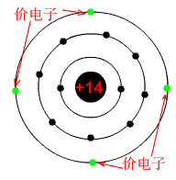
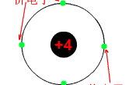
Ch5 Diodes and Diodes Circuits
5.1 The Physical Principles of Semiconductor
Intrinsic(pure) Semiconductors
Different types of solids:
Conductor ρ <10⁻⁴Ω ·cm
Insulator ρ >10¹⁰Ω · cm
Semiconductor ρ
ρ_{Si} > ρ_{Cu}*10¹¹Ω · cm , ρ_{Ge} > ρ_{Cu}*10⁷Ω · cm
The atomic structure of a neutral silicon atom
Valence electrons
Valence electrons

Slide 4
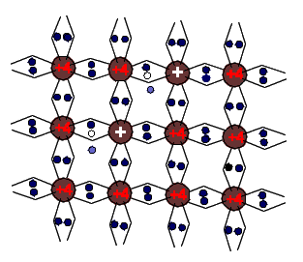
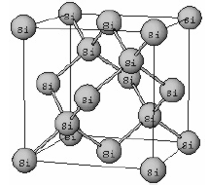
Ch5 Diodes and Diodes Circuits
5.1 The Physical Principles of Semiconductor
Intrinsic(pure) Semiconductors
A hole
Intrinsic(pure) silicon
A free electron
An electron-hole pair is created when an electron get excited by thermal or light energy;
Recombination occurs when an electron loses energy and falls back into a hole.

Slide 5

Ch5 Diodes and Diodes Circuits
5.1 The Physical Principles of Semiconductor
Intrinsic(pure) Semiconductors
Holes also conduct current. In reality, it’s the movement of all the other electrons. The hole allows this motion.
Holes have positive charge.
• Current flows in the same direction as the holes move.
Both electrons and holes carry current-- carriers.
In intrinsic semiconductors the electron and hole concentrations are equal because carriers are created in pairs
The intrinsic concentration depends exponentially on temperature.
At room temp (300K), the intrinsic carrier concentration of silicon is:

Slide 6
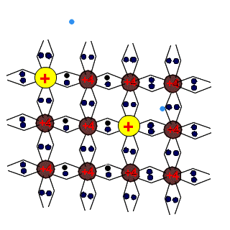
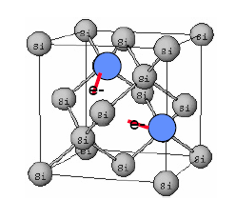
Ch5 Diodes and Diodes Circuits
5.1 The Physical Principles of Semiconductor
Phosphorus Doping (N-type)
Phosphorus has 5 valence electrons.
• P atoms will sit in the location of a Si atom in the lattice, to avoid breaking symmetry, but each will have an extra electron that does not bond in the same way. And these extra electrons are easier to excite (and can move around more easily)
• These electrons depends on the amounts of the two materials.

Slide 7



Ch5 Diodes and Diodes Circuits
5.1 The Physical Principles of Semiconductor
Phosphorus Doping (N-type)
Electrons---Majority carrier.
Holes---Minority carrier
Phosphorus---Donor materials.
In equilibrium,
At room temp (300K), if 1/10¹⁰ donors are added to the intrinsic silicon,
then the electron carrier concentration is about 10¹³cm^{－3}; the hole carrier concentration is about 10⁶cm^{－3}.
Phosphorus Intrinsic silicon

Slide 8
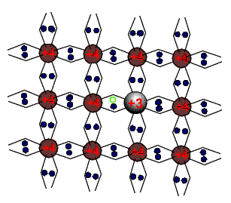
Ch5 Diodes and Diodes Circuits
5.1 The Physical Principles of Semiconductor
Boron Doping (P-type)
Holes---Majority carrier; Electrons---Minority carrier
Boron---acceptor materials.
Boron has 3 valence electrons.
• B will sit at a lattice site, but the adjacent Si atoms lack an electron to fill its shell. This creates a hole.

Slide 9
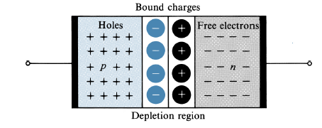
Ch5 Diodes and Diodes Circuits
5.1 The Physical Principles of Semiconductor
PN Junction
N-type materials: Doping Si with a Group V element, providing extra electrons (n for negative) .
P-type materials: Doping Si with a Group III element, providing extra holes (p for positive).
What happens when P-type meets N-type?

Slide 10
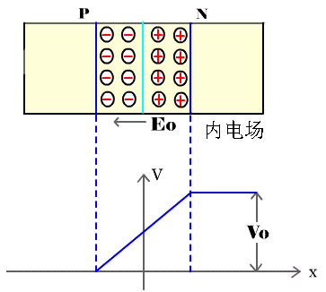
Ch5 Diodes and Diodes Circuits
5.1 The Physical Principles of Semiconductor
PN Junction
What happens when P-type meets N-type?
Holes diffuse from the p-type into the n-type, electrons diffuse from the n-type
into the p-type, creating a diffusion current.
• Once the holes [electrons] cross into the n-type [p-type] region, they recombine
with the electrons [holes].
• This recombination “strips” the n-type [p-type] of its electrons near the
boundary, creating an electric field due to the positive and negative bound
charges.
• The region “stripped” of carriers is called the space-charge region, or depletion
region.
• V₀ is the contact potential that exists due to the electric field. Typically, at room
temp, V₀ is 0.5~0.8V.
• Some carriers are generated (thermally) and make their way into the depletion region where they are whisked away by the electric field, creating a drift current.

Slide 11
Ch5 Diodes and Diodes Circuits
5.1 The Physical Principles of Semiconductor
PN Junction
What happens when P-type meets N-type?
There are two mechanisms by which mobile carriers move in
semiconductors – resulting in current flow
– Diffusion
• Majority carriers move (diffuse) from a place of higher
concentration to a place of lower concentration
– Drift
• Minority carrier movement is induced by the electric field.
In equilibrium, diffusion current (I_{D}) is balanced by drift current (I_{S}).
So, there is no net current flow.

Slide 12
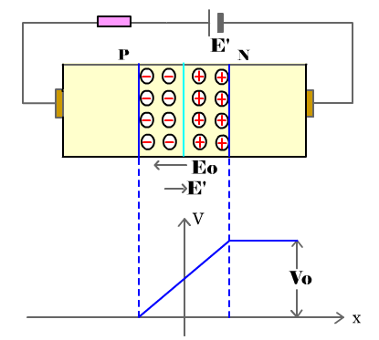
Ch5 Diodes and Diodes Circuits
5.1 The Physical Principles of Semiconductor
PN Junction
Forward bias: apply a positive voltage to the p-type, negative to n-type.
Add more majority carriers to both sides
→shrink the depletion region→ lower V₀ →diffusion current increases.
Decrease the built-in potential, lower
the barrier height.
• Increase the number of carriers able to
diffuse across the barrier
• Diffusion current increases
• Drift current remains the same. The
drift current is essentially constant, as
it is dependent on temperature.
• Current flows from p to n

Slide 13
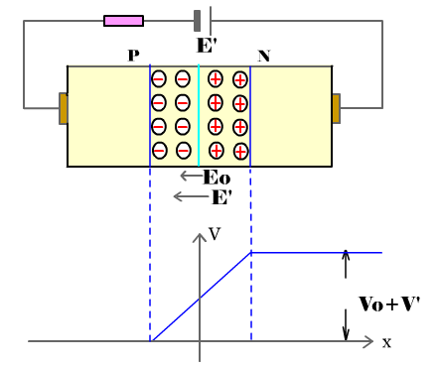
Ch5 Diodes and Diodes Circuits
5.1 The Physical Principles of Semiconductor
PN Junction
Reverse bias: apply a negative voltage to the p-type, positive to n-type.
Increase the built-in potential, increase the barrier height.
• Decrease the number of carriers able to diffuse across the barrier.
• Diffusion current decreases.
• Drift current remains the same
• Almost no current flows. Reverse leakage current, I_{S}, is the drift current, flowing from n to p.

Slide 14
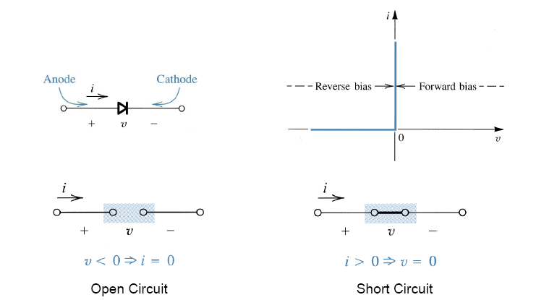
Ch5 Diodes and Diodes Circuits
5.2 Diodes
Key Words:
Diode I-V Characteristic
Diode Parameters,
Diode Models

Slide 15
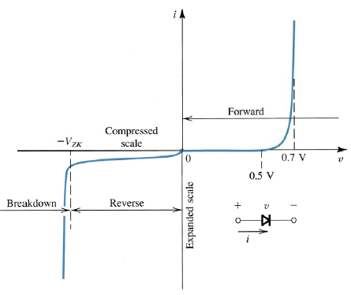
Ch5 Diodes and Diodes Circuits
5.2 Diodes and Diode Circuits
PN Junction Diode V-A Characteristic
Typical PN junction diode volt-ampere characteristic is shown on the left.
– In forward bias, the PN junction has
a “turn on” voltage based on the
“built-in” potential of the PN The
junction. turn on voltage is typically
in the range of 0.5V to 0.8V
– In reverse bias, the PN junction
conducts essentially no current until
a critical breakdown voltage is
reached. The breakdown voltage can
range from 1V to 100V. Breakdown
mechanisms include avalanche and
zener tunneling.

Slide 16
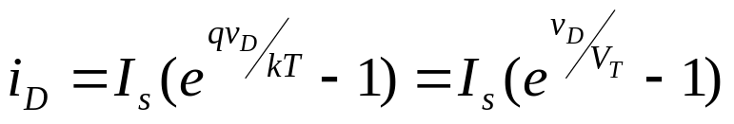
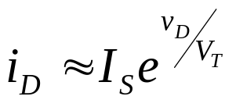
Ch5 Diodes and Diodes Circuits
5.2 Diodes and Diode Circuits
PN Junction Diode V-A Characteristic
Current Equations
• The forward bias current is closely approximated by
where V_{T} =kT/q is the thermal voltage (~25.8mV at room temp T= 300K or 27C )
k = Boltzman’s constant = 1.38 x 10-23 joules/kelvin
T = absolute temperature
q = electron charge = 1.602 x 10-19 coulombs
n = constant dependent on structure, between 1 and 2 (we will assume n = 1)
I_{S} = scaled current for saturation current that is set by diode size
– Notice there is a strong dependence on temperature
– We can approximate the diode equation for v_{D} >> V_{T} ,

Slide 17
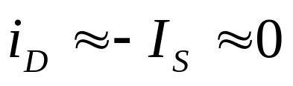


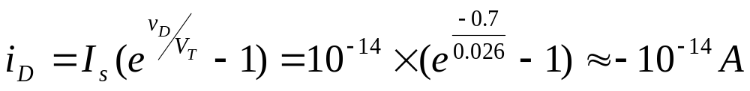
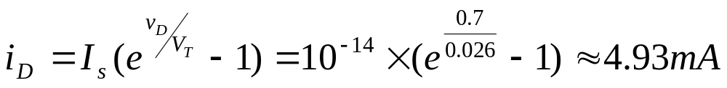
Ch5 Diodes and Diodes Circuits
5.2 Diodes and Diode Circuits
PN Junction Diode V-A Characteristic
Current Equations
• In reverse bias (when v_{D} << 0 by at least V_{T} ), then
• In breakdown, reverse current increases rapidly… a vertical line
P5.1, PN Junction when T=300K， Find i_{D} when

Slide 18
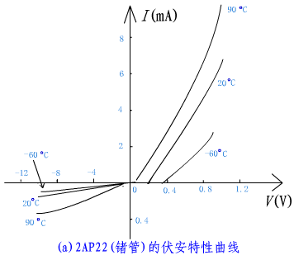
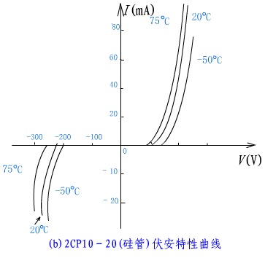
Ch5 Diodes and Diodes Circuits
5.2 Diodes and Diode Circuits
PN Junction Diode V-A Characteristic

Slide 19
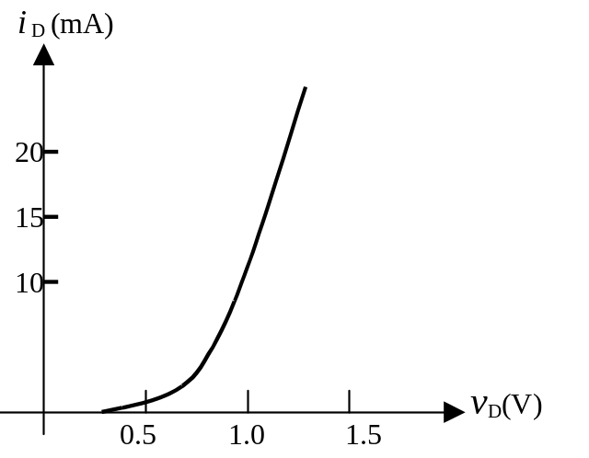
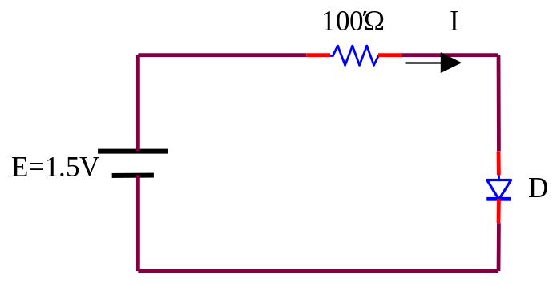
Ch5 Diodes and Diodes Circuits
5.2 Diodes and Diode Circuits
PN Junction Diode V-A Characteristic
P5.2, Look at the simple diode circuit below.
operating point
Q
Load line
I_{D}=7(mA), V_{D}=0.8(V)

Slide 20
Ch5 Diodes and Diodes Circuits
5.2 Diodes and Diode Circuits
Diode Parameters
V_{R} | The maximum reverse DC voltage that can be applied across the diode.
I_{R} | The maximum current when the diode is reverse-biased with a DC voltage.
I_{F} | The maximum average value of a rectified forward current.
f_{M} | The maximum operation frequency of the diode.

Slide 21
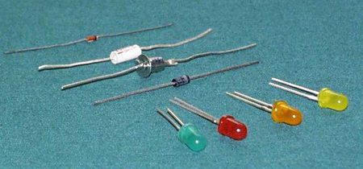
Ch5 Diodes and Diodes Circuits
5.2 Diodes and Diode Circuits
Diodes

Slide 22
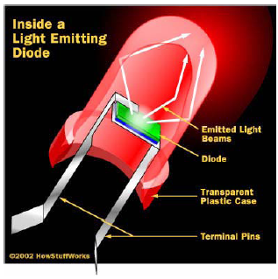
Ch5 Diodes and Diodes Circuits
5.2 Diodes and Diode Circuits
Light Emitting Diodes
When electrons and holes
combine, they release energy.
• This energy is often released as heat into the lattice, but in some materials, they release light.
• This illustration describes the importance of the plastic bubble in directing the light so that it is more effectively seen.

Slide 23
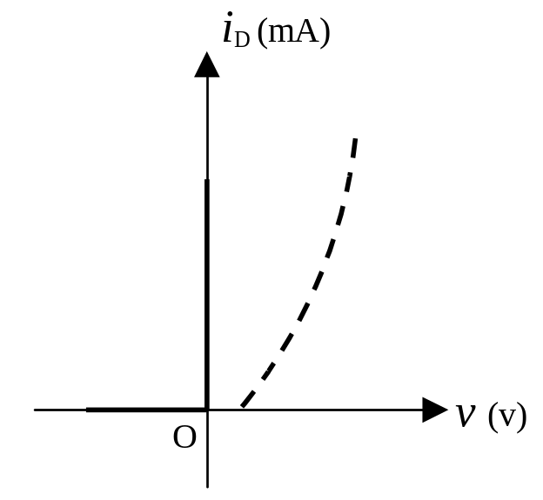
Ch5 Diodes and Diodes Circuits
5.2 Diodes and Diode Circuits
Diode Models-- The Ideal Switch Model
When forward-biased, the diode ideally acts as a closed(on) switch.
When reverse-biased, the diode acts as an open(off) switch.

Slide 24
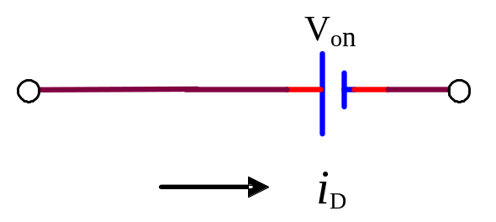
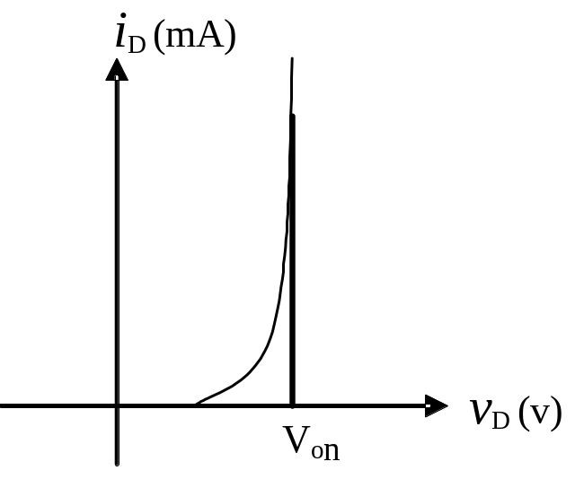
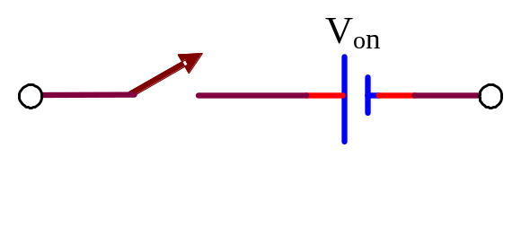
Ch5 Diodes and Diodes Circuits
5.2 Diodes and Diode Circuits
Diode Models-- The Offset Model
V> V_{on}，closed switch
V< V_{on}， open switch
Si diode：V_{on}≈0.7(V)（0.6～0.8）
Ge diode：V_{on}≈0.2（V）

Slide 25
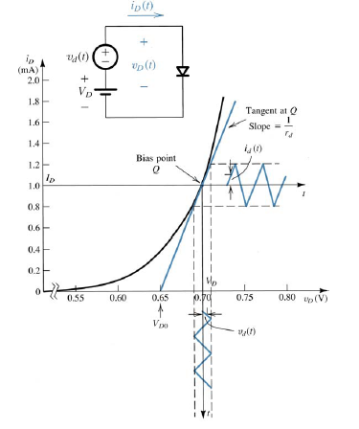
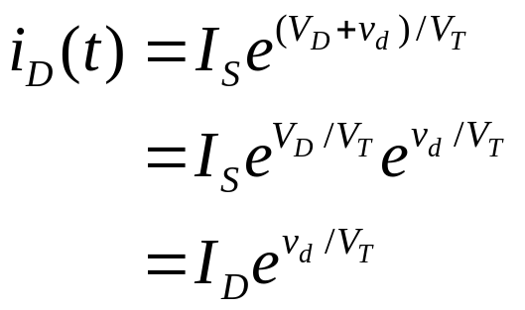
Ch5 Diodes and Diodes Circuits
5.2 Diodes and Diode Circuits
Diode Models--The Small-Signal Model
Some circuit applications bias the diode at a DC point (V_{D}) and superimpose a small signal (v_{d}(t))on top of it. Together,the signal is v_{D}(t), consisting of both DC and AC components
– Graphically, can show that there is a
translation of voltage to current (i_{d}(t))
– Can model the diode at this bias
point as a resistor with resistance as
the inverse of the tangent of the i-v
curve at that point

Slide 26
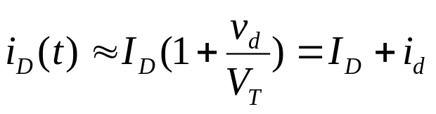
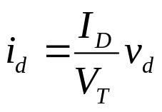
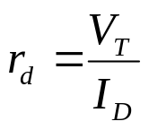
Ch5 Diodes and Diodes Circuits
5.2 Diodes and Diode Circuits
Diode Models--The Small-Signal Model
– And if v_{d}(t) is sufficiently small then we
can expand the exponential and get an
approximate expression called the small-
signal approximation (valid for v_{d} <10mV)
– So, the diode small-signal resistance is…

Slide 27


Ch5 Diodes and Diodes Circuits
5.2 Diodes and Diode Circuits
Diode Models--The Small-Signal Model
Frequency is not high.

Slide 28
Ch5 Diodes and Diodes Circuits
5.3 Diode Circuits
Key Words:
Diode Limiter
multi diode Circuits
Rectifier Circuits

Slide 29
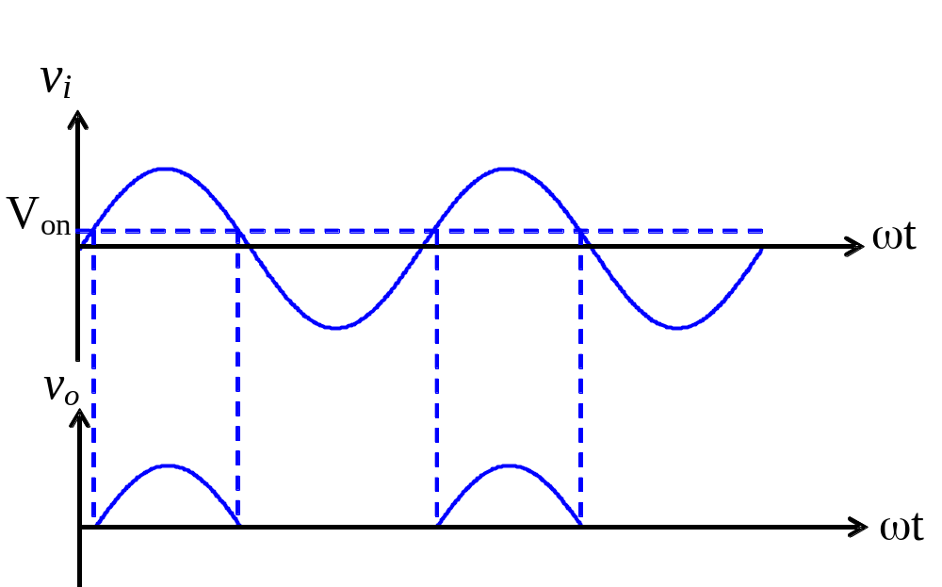
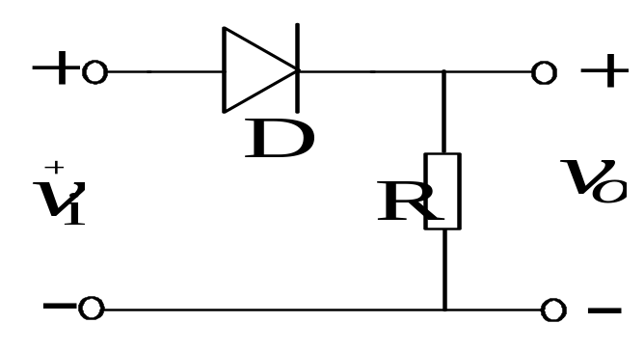
Ch5 Diodes and Diodes Circuits
5.3 Diode Circuits
Diode Limiter
When v_{i}>V_{on} , D on →v_{o}≈ v_{i}；
v_{i}<V_{on}， D off → v_{o}=0。

Slide 30
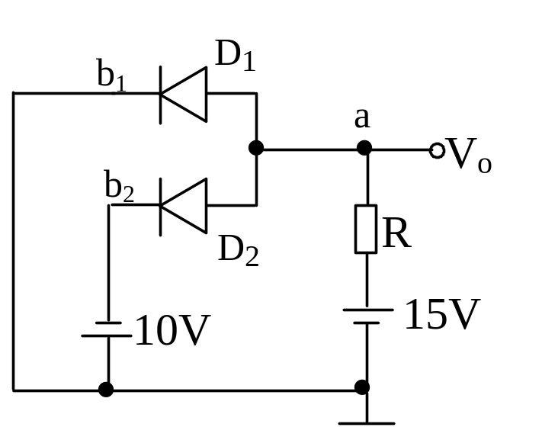
Ch5 Diodes and Diodes Circuits
5.3 Diode Circuits
multiple diodes Circuits
Let V_{on}=0.7V, V_{o}=?

Slide 31
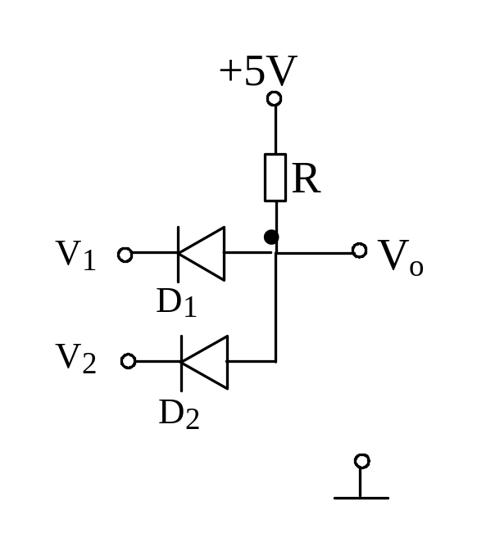
Ch5 Diodes and Diodes Circuits
5.3 Diode Circuits
multiple diodes Circuits
V₁(V)
V₂(V)
V_{o}(V)
Logic output
0
0
0.7
0
5
0
0.7
0
0
5
0.7
0
5
5
5
1

Slide 32
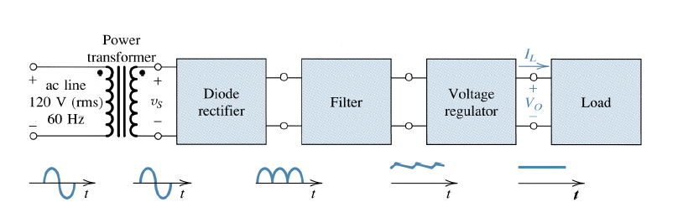
Ch5 Diodes and Diodes Circuits
5.3 Diode Circuits
Rectifier Circuits
One of the most important applications of diodes is in the design of rectifier circuits. Used to convert an AC signal into a DC voltage used by most electronics.

Slide 33
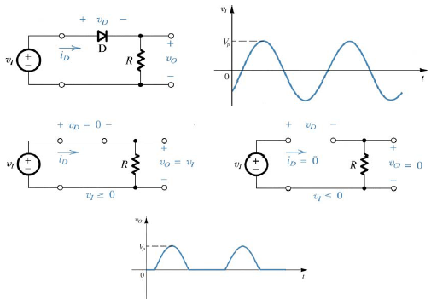
Ch5 Diodes and Diodes Circuits
5.3 Diode Circuits
Rectifier Circuits
Simple Half-Wave Rectifier
What would the waveform
look like if not an ideal diode?

Slide 34
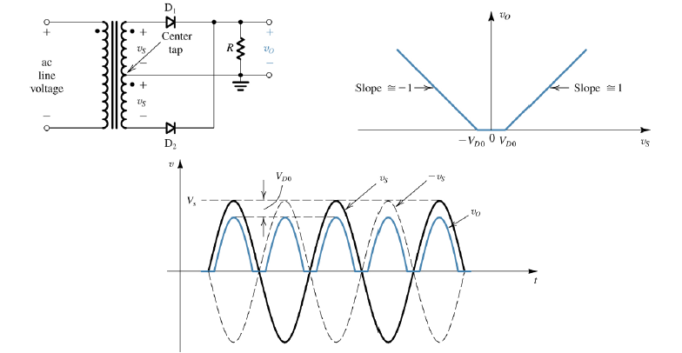
Ch5 Diodes and Diodes Circuits
5.3 Diode Circuits
Rectifier Circuits
To utilize both halves of the input sinusoid use a center-tapped transformer…
Full-Wave Rectifier

Slide 35
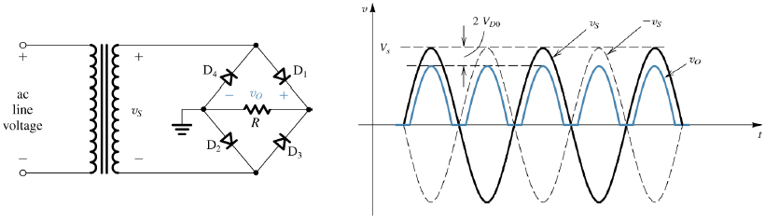
Ch5 Diodes and Diodes Circuits
5.3 Diode Circuits
Rectifier Circuits
Bridge Rectifier
Looks like a Wheatstone bridge. Does not require a enter tapped transformer.
Requires 2 additional diodes and voltage drop is double.

Slide 36
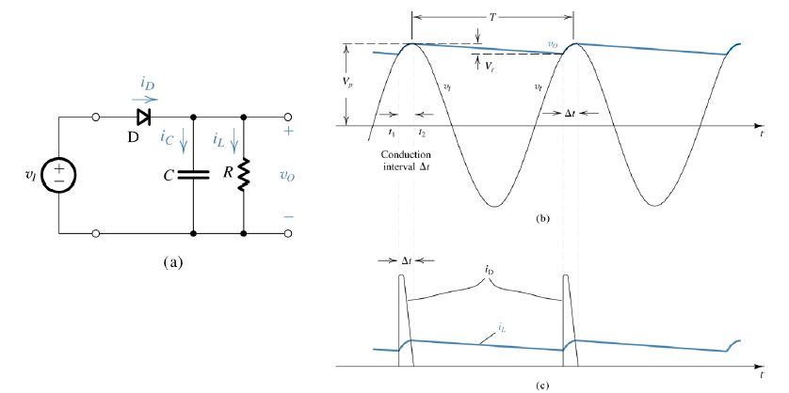
Ch5 Diodes and Diodes Circuits
5.3 Diode Circuits
Rectifier Circuits
Peak Rectifier
To smooth out the peaks and obtain a DC voltage, add a capacitor across the output.

Slide 37
Ch5 Diodes and Diodes Circuits
5.4 Zener Diode
Key Words:
Reverse Bias Piecewise Linear Model
Zener diode Application

Slide 38
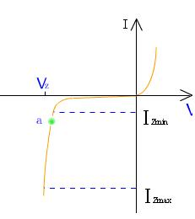

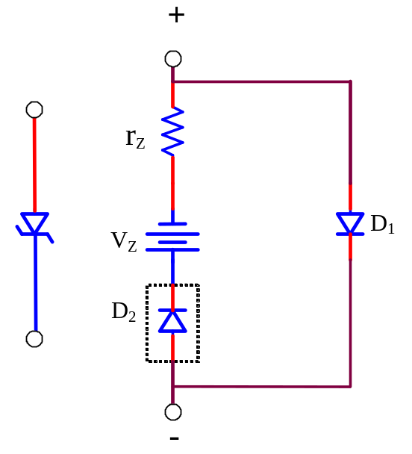
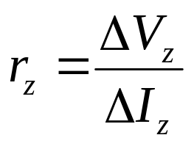
Ch5 Diodes and Diodes Circuits
5.4 Zener Diode
Reverse Bias Piecewise Linear Model
Zener symbol
(V_{BR})
perfect

Slide 39
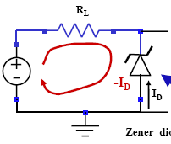
Ch5 Diodes and Diodes Circuits
5.4 Zener Diode
Zener diode Application
Assume I_{min}=4mA, I_{max}=40mA, r_{z}=0,
What are the minimum and maximum input voltages for these currents?
1.0k
+
10V
-
Solution: For the minimum zener current, the voltage across the 1.0k resistor is
V_{R}=I_{min}R=4(V)
Since V_{R}=V_{in}-V_{z}, V_{in}=V_{R}+V_{z}=14(V)
For the maximum zener current, the voltage across the 1.0k resistor is
V_{R}=I_{max}R=40(V)
Therefore, Vin=V_{R}+V_{z}=50(V)

Slide 40
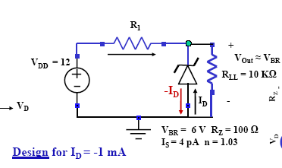
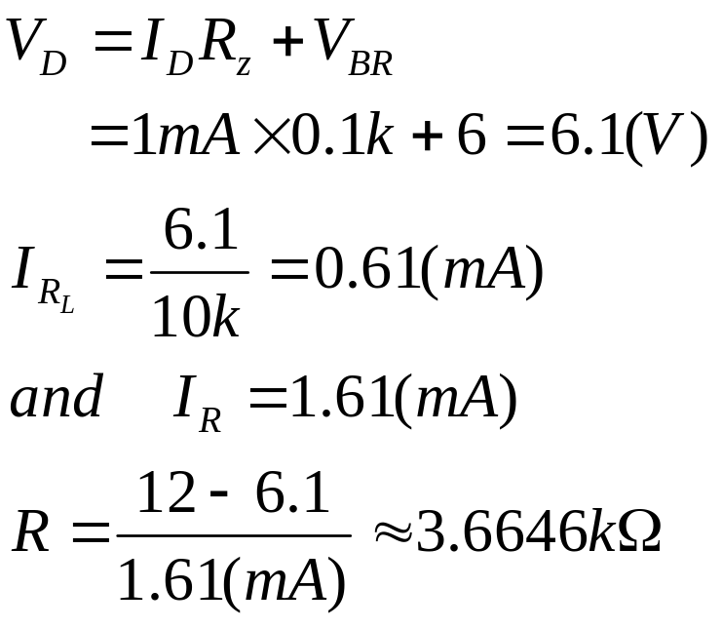
Ch5 Diodes and Diodes Circuits
5.4 Zener Diode
Zener diode Application

Slide 41
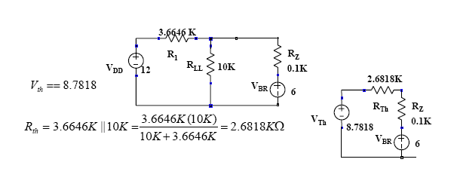


Ch5 Diodes and Diodes Circuits
5.4 Zener Diode
Zener diode Application
Design Verification: Apply Thevinen’s Equivalent to simplify

Slide 42
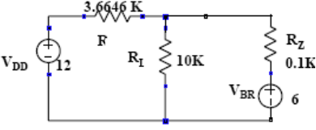

Ch5 Diodes and Diodes Circuits
5.4 Zener Diode
Zener diode Application
If V_{DD} = 15 V instead of 12 what is Vout?

Slide 43





Ch5 Diodes and Diodes Circuits
5.4 Zener Diode
Zener diode Application
If R_{L} = 8 KΩ instead of 10 KΩ; what is Vout?

Slide 44

Ch5 Diodes and Diodes Circuits
5.4 Zener Diode
Zener diode Application
R_{L} have no changed:
V_{I}↑→ I_{R}↑→V_{O}↑→I_{z}↑↑→I_{L}↓→ I_{L}R_{L}↓
V_{O}↓
V_{I} have no changed: V_{O}↓→I_{Z}↓↓→I_{L}↑
V_{O}↑

Slide 45




Ch5 Diodes and Diodes Circuits
5.4 Zener Diode
Zener diode Application
P_{Z}＝I_{Z}V_{Z}

