Slide 1
Circuits and Analog Electronics
Ch6 Basic BJT Amplifiers Circuits
6.1 Bipolar junction transistors (BJTs)
6.2 Single-Stage BJT Amplifiers
6.3 Power Amplifiers

Slide 2
Ch6 Basic BJT Amplifiers Circuits
6.1 Bipolar junction transistors (BJTs)
Key Words:
Construction of BJT
BJT in Active Mode
BJT DC Model and DC Analysis
C-E Circuits I-V Characteristics
DC Load Line and Quiescent Operation Point
BJT AC Small-Signal Model

Slide 3
Ch6 Basic BJT Amplifiers Circuits
6.1 Bipolar junction transistors (BJTs)
This lecture will spend some time understanding how the bipolar junction transistor (BJT) works based on what we know about PN junctions. One way to look at a BJT transistor is two back-to-back diodes, but it has very different characteristics.
Once we understand how the BJT device operates, we will take a look at the different circuits (amplifiers) we can build with them.

Slide 4
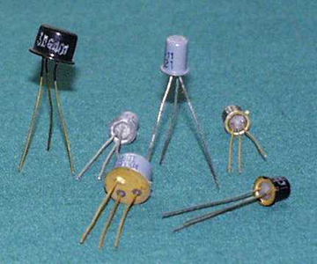
Ch6 Basic BJT Amplifiers Circuits
6.1 Bipolar junction transistors (BJTs)

Slide 5
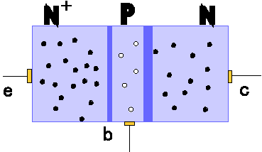
Ch6 Basic BJT Amplifiers Circuits
6.1 Bipolar junction transistors (BJTs)
Construction of Bipolar junction transistors
Emitter-base junction
Base region
(very narrow)
Emitter region
Collector
Collector region
Emitter
Base
Collector-base junction

Slide 6
Ch6 Basic BJT Amplifiers Circuits
6.1 Bipolar junction transistors (BJTs)
Construction of Bipolar junction transistors
NPN BJT shown
• 3 terminals: emitter, base, and collector
• 2 junctions: emitter-base junction (EBJ) and collector-base junction (CBJ)
– These junctions have capacitance (high-frequency model)
BJTs are not symmetric devices
– doping and physical dimensions are different for emitter
and collector

Slide 7
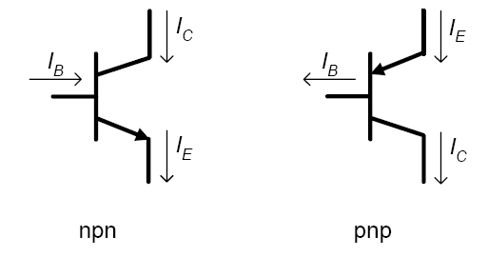
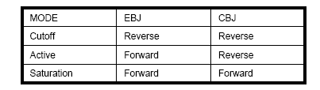
Ch6 Basic BJT Amplifiers Circuits
6.1 Bipolar junction transistors (BJTs)
Standard bipolar junction transistor symbols
Depending on the biasing across each of the junctions, different modes of operation are obtained – cutoff, active, and saturation

Slide 8
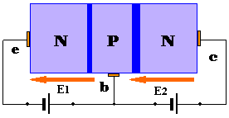
Ch6 Basic BJT Amplifiers Circuits
6.1 Bipolar junction transistors (BJTs)
BJT in Active Mode
Two external voltage sources set the bias conditions for active mode
– EBJ is forward biased and CBJ is reverse biased

Slide 9
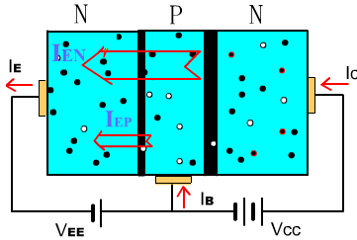
Ch6 Basic BJT Amplifiers Circuits
6.1 Bipolar junction transistors (BJTs)
BJT in Active Mode
I_{E}＝I_{EN}＋I_{EP}≈ I_{EN}
Forward bias of EBJ injects electrons from emitter into base (small number of holes injected from base into emitter)

Slide 10
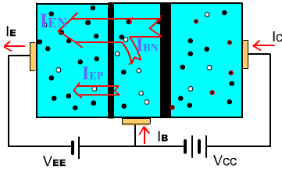
Ch6 Basic BJT Amplifiers Circuits
6.1 Bipolar junction transistors (BJTs)
BJT in Active Mode
I_{B}＝I_{BN}＋I_{EP} -I_{CBO}
Most electrons shoot through the base into the collector
across the reverse bias junction
Some electrons recombine with majority carrier in (P-type)
base region

Slide 11
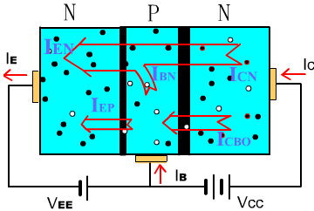
Ch6 Basic BJT Amplifiers Circuits
6.1 Bipolar junction transistors (BJTs)
BJT in Active Mode
I_{C}=I_{CN}+I_{CBO}
Electrons that diffuse across the base to the CBJ junction are swept across the CBJ depletion region to the collector.

Slide 12
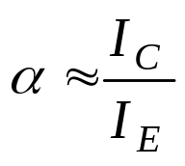
Ch6 Basic BJT Amplifiers Circuits
6.1 Bipolar junction transistors (BJTs)
BJT in Active Mode
I_{E}＝I_{EN}＋I_{EP}≈ I_{EN}
I_{C}=I_{CN}+I_{CBO}
I_{E}=I_{B}+I_{C}
Let I_{CN}＝αI_{E}
I_{B}＝I_{BN}＋I_{EP}-I_{CBO}
I_{C} (1－α)= αI_{B}+I_{CBO}
---common-base current gain

Slide 13
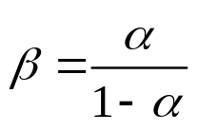

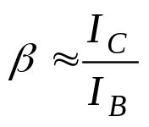
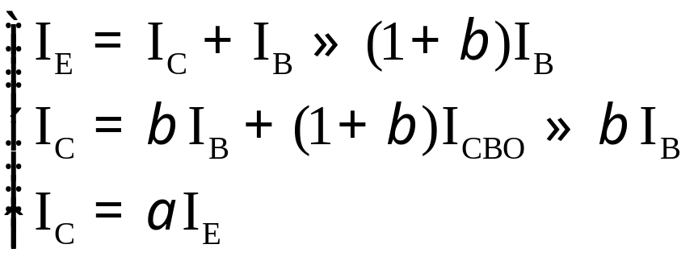
Ch6 Basic BJT Amplifiers Circuits
6.1 Bipolar junction transistors (BJTs)
BJT in Active Mode
I_{E}＝I_{EN}＋I_{EP}≈ I_{EN}
I_{B}＝I_{BN}＋I_{EP}-I_{CBO}
I_{C}=I_{CN}+I_{CBO}
I_{E}=I_{B}+I_{C}
I_{C} (1－α)= αI_{B}+I_{CBO}
Let
Beta:
---common-emitter current gain

Slide 14
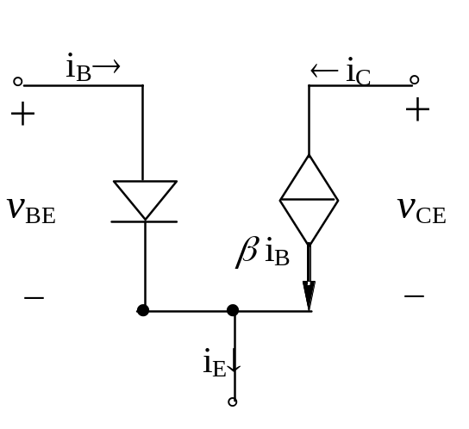
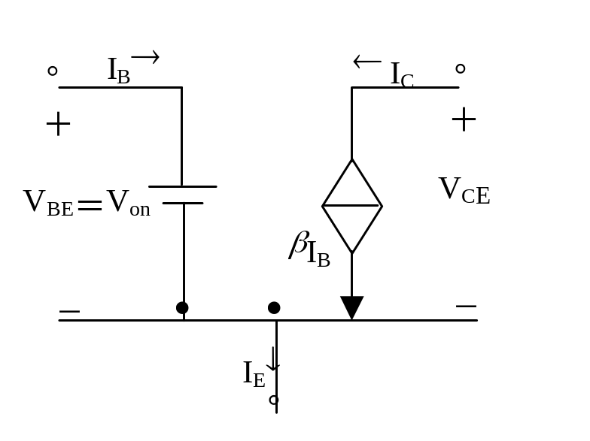
Ch6 Basic BJT Amplifiers Circuits
6.1 Bipolar junction transistors (BJTs)
BJT Equivalent Circuits
BJT DC model
Use a simple constant-V_{BE} model
– Assume V_{BE} = 0.7V

Slide 15

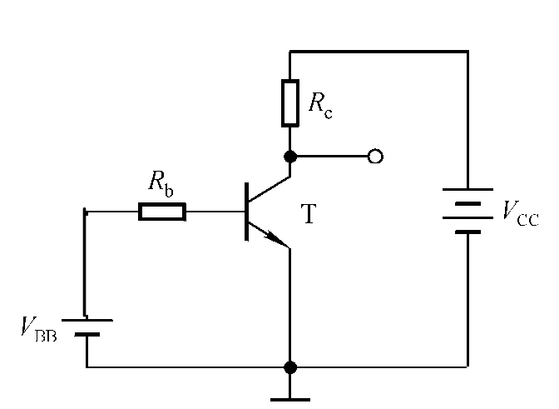
Ch6 Basic BJT Amplifiers Circuits
6.1 Bipolar junction transistors (BJTs)
BJT DC Analysis
• Make sure the BJT current equations and region of operation match
V_{BE} > 0,
V_{BC} < 0, →V_{E} < V_{B} <V_{C}
• Utilize the relationships ( βand α) between collector, base, and emitter currents to solve for all currents

Slide 16
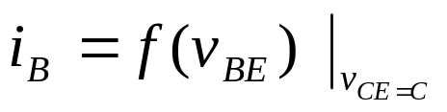
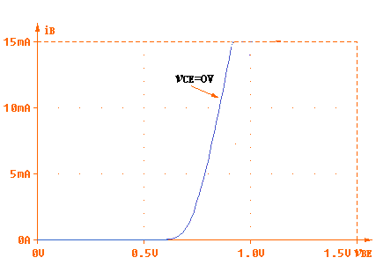
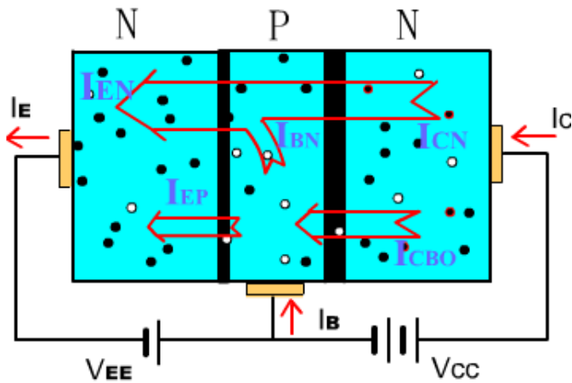
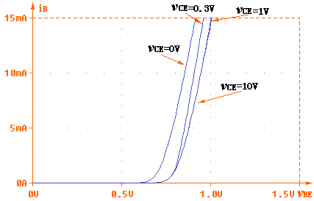
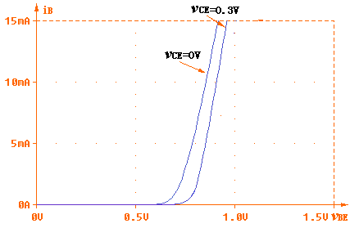
Ch6 Basic BJT Amplifiers Circuits
6.1 Bipolar junction transistors (BJTs)
C-E Circuits I-V Characteristics
Base-emitter Characteristic(Input characteristic)

Slide 17
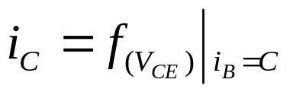

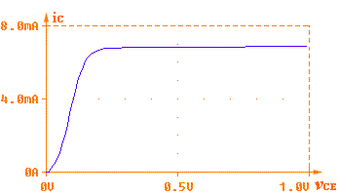
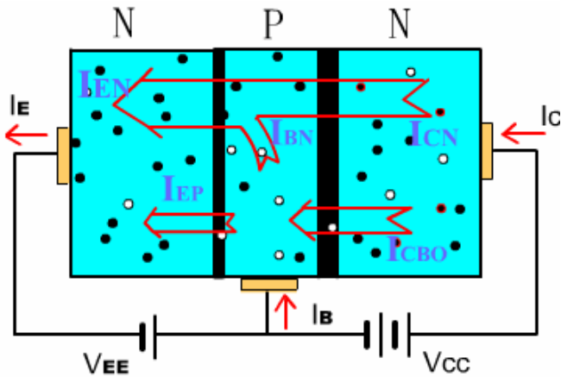
Ch6 Basic BJT Amplifiers Circuits
6.1 Bipolar junction transistors (BJTs)
C-E Circuits I-V Characteristics
Collector characteristic (output characteristic)

Slide 18
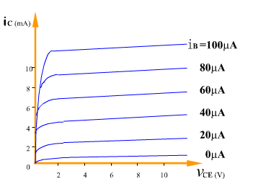
Ch6 Basic BJT Amplifiers Circuits
6.1 Bipolar junction transistors (BJTs)
C-E Circuits I-V Characteristics
Collector characteristic (output characteristic)

Slide 19
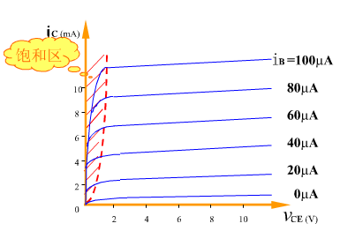
Ch6 Basic BJT Amplifiers Circuits
6.1 Bipolar junction transistors (BJTs)
C-E Circuits I-V Characteristics
Collector characteristic
Saturation
Saturation occurs when the supply voltage,V_{CC,} is across the total resistance of the collector circuit,R_{C}.
I_{C(sat)}=V_{CC}/R_{C}
V_{sat}
Once the base current is high enough to produce saturation, further increases in base current have no effect on the collector current and the relationship I_{C}=βI_{B} is no longer valid. When V_{CE} reaches its saturation value, V_{CE(sat)}, the base-collector junction becomes forward-biased.

Slide 20
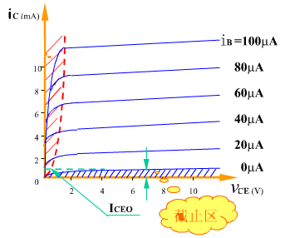
Ch6 Basic BJT Amplifiers Circuits
6.1 Bipolar junction transistors (BJTs)
C-E Circuits I-V Characteristics
Collector characteristic
When I_{B}=0, the transistor is in cutoff and there is essentially no collector current except for a very tiny amount of collector leakage current, I_{CEO}, which can usually be neglected. I_{C}≈0.
In cutoff both the base-emitter and the base-collector junctions are reverse-biased.
Cutoff

Slide 21
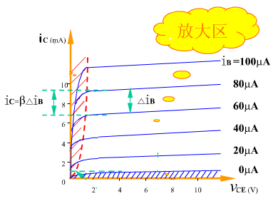
Ch6 Basic BJT Amplifiers Circuits
6.1 Bipolar junction transistors (BJTs)
C-E Circuits I-V Characteristics
Collector characteristic
linearity

Slide 22
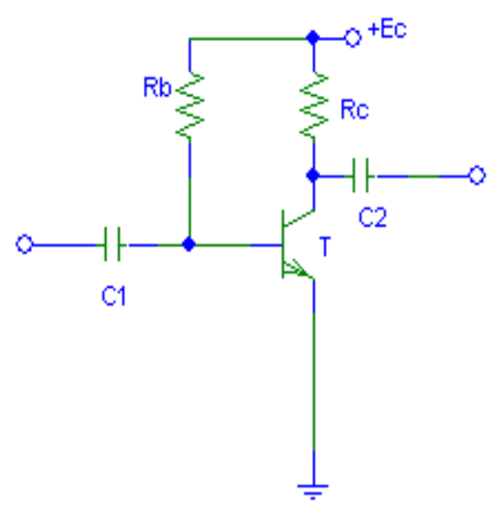
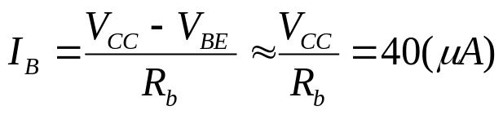

Ch6 Basic BJT Amplifiers Circuits
6.1 Bipolar junction transistors (BJTs)
DC Load Line and Quiescent Operation Point
Q-point
V_{CC}
.Q
I_{CQ}
V_{CEQ}
DC load line

Slide 23
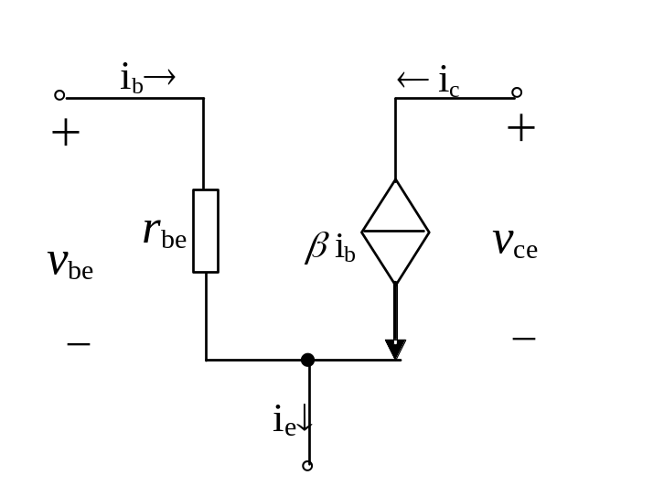
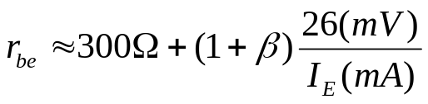

Ch6 Basic BJT Amplifiers Circuits
6.1 Bipolar junction transistors (BJTs)
BJT AC Small-Signal Model
We can create an equivalent circuit to model the transistor for small signals
– Note that this only applies for small signals (v_{be} < V_{T})
We can represent the small-signal model for the transistor as a voltage controlled
current source( )or a current-controlled current source(i_{c}=βi_{b}).
For small enough signals, approximate exponential curve with a linear line.

Slide 24
Ch6 Basic BJT Amplifiers Circuits
6.2 Single-Stage BJT Amplifiers
Key Words:
Common-Emitter Amplifier
Graphical Analysis
Small-Signal Models Analysis
Common-Collector Amplifier
Common-Base Amplifier

Slide 25
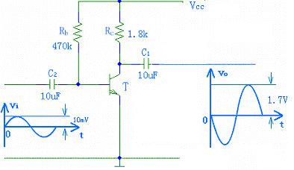



Ch6 Basic BJT Amplifiers Circuits
6.2 Single-Stage BJT Amplifiers
C-E Amplifiers
To operate as an amplifier, the BJT must be biased to operate in active mode and then superimpose a small voltage signal v_{be} to the base.
DC + small signal
coupling capacitor
(only passes ac signals)

Slide 26
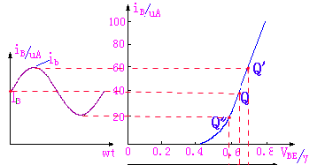
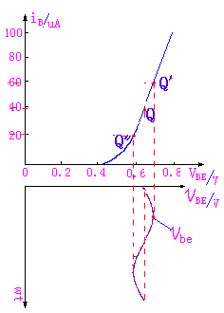
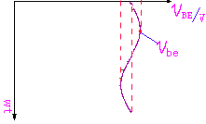
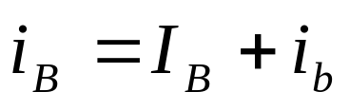
Ch6 Basic BJT Amplifiers Circuits
6.2 Single-Stage BJT Amplifiers
C-E Amplifiers
Apply a small signal input voltage and see i_{b}
v_{BE}=v_{i}+V_{BE}

Slide 27
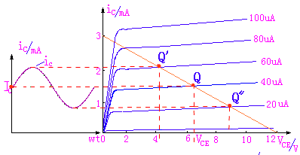
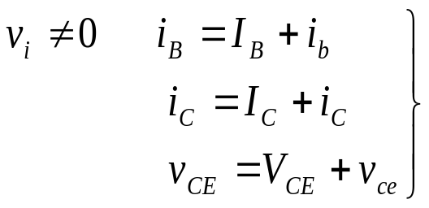
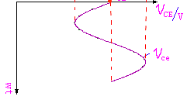

Ch6 Basic BJT Amplifiers Circuits
6.2 Single-Stage BJT Amplifiers
C-E Amplifiers
See how i_{b} translates into v_{ce.}
v_{i}=0， →I_{B}、I_{C}、V_{CE}
i_{C}=i_{c}+I_{C}
v_{o} out of phase with v_{i}
v_{CE}=v_{ce}+V_{CE}

Slide 28
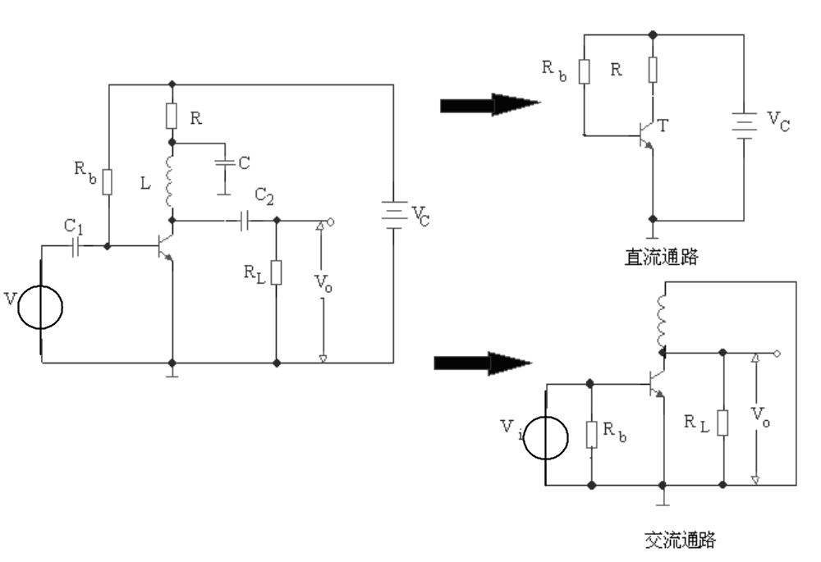
Ch6 Basic BJT Amplifiers Circuits
6.2 Single-Stage BJT Amplifiers
C-E Amplifiers

Slide 29
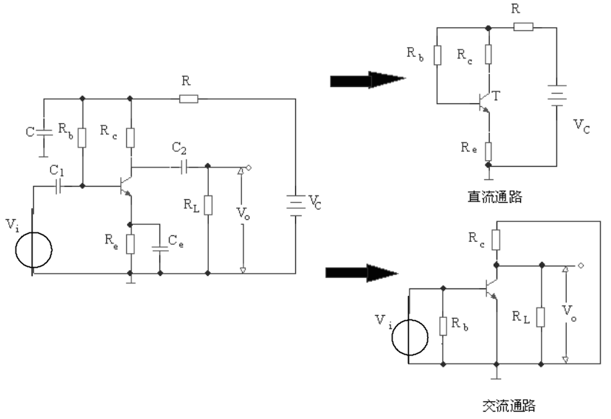
Ch6 Basic BJT Amplifiers Circuits
6.2 Single-Stage BJT Amplifiers
C-E Amplifiers

Slide 30
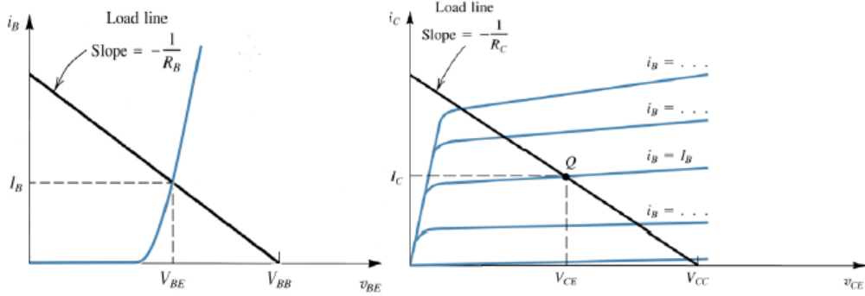
Ch6 Basic BJT Amplifiers Circuits
6.2 Single-Stage BJT Amplifiers
Graphical Analysis
Can be useful to understand the operation of BJT
circuits.
• First, establish DC conditions by finding I_{B} (or V_{BE})
• Second, figure out the DC operating point for I_{C}
V_{CC}
Can get a feel for whether the BJT will stay in active region of operation
– What happens if R_{C} is larger or smaller?

Slide 31
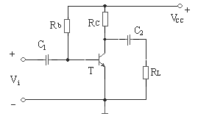
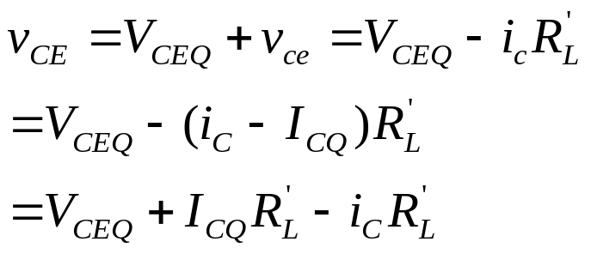
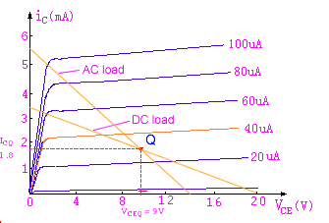


Ch6 Basic BJT Amplifiers Circuits
6.2 Single-Stage BJT Amplifiers
Graphical Analysis
V′_{CC}

Slide 32
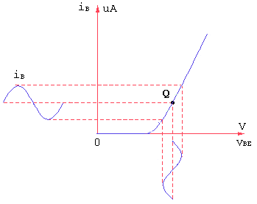
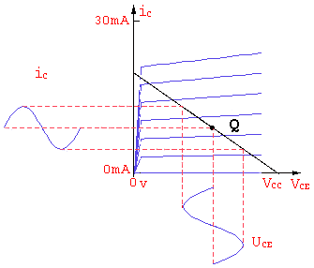
Ch6 Basic BJT Amplifiers Circuits
6.2 Single-Stage BJT Amplifiers
Graphical Analysis
Q-point is centered on the ac load line:
V′_{CC}

Slide 33
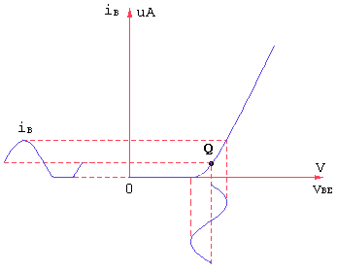
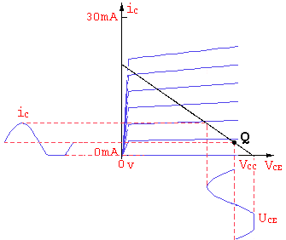
Ch6 Basic BJT Amplifiers Circuits
6.2 Single-Stage BJT Amplifiers
Graphical Analysis
Q-point closer to cutoff:
V′_{CC}
Clipped at cutoff
(cutoff distortion)

Slide 34
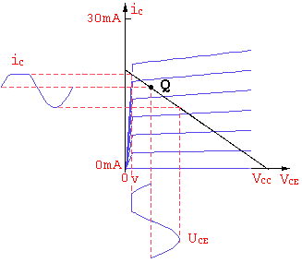

Ch6 Basic BJT Amplifiers Circuits
6.2 Single-Stage BJT Amplifiers
Graphical Analysis
Q-point closer to saturation:
V′_{CC}
Clipped at cutoff
(saturation distortion)

Slide 35


Ch6 Basic BJT Amplifiers Circuits
6.2 Single-Stage BJT Amplifiers
Graphical Analysis

Slide 36
Ch6 Basic BJT Amplifiers Circuits
6.2 Single-Stage BJT Amplifiers
Small-Signal Models Analysis
Steps for using small-signal models
1. Determine the DC operating point of the BJT
－ in particular, the collector current
2. Calculate small-signal model parameters: r_{be}
3. Eliminate DC sources
– replace voltage sources with shorts and current
sources with open circuits
4. Replace BJT with equivalent small-signal models
5.Analyze

Slide 37



Ch6 Basic BJT Amplifiers Circuits
6.2 Single-Stage BJT Amplifiers
Small-Signal Models Analysis
Example 1,
I_{C}≈βI_{B},
I_{E}=I_{C}+I_{B}=(1+β)I_{B}

Slide 38

Ch6 Basic BJT Amplifiers Circuits
6.2 Single-Stage BJT Amplifiers
Small-Signal Models Analysis
Example 1,

Slide 39





Ch6 Basic BJT Amplifiers Circuits
6.2 Single-Stage BJT Amplifiers
Small-Signal Models Analysis
Example 2, Find R_{i}、R_{o}；A_{v}、 A_{vs} 、v_{o}

Slide 40
Ch6 Basic BJT Amplifiers Circuits
6.2 Single-Stage BJT Amplifiers
Small-Signal Models Analysis
There are three basic configurations for single-stage BJT amplifiers:
– Common-Emitter
– Common-Base
– Common-Collector

Slide 41





Ch6 Basic BJT Amplifiers Circuits
6.2 Single-Stage BJT Amplifiers
Common-Emitter Amplifier

Slide 42

Ch6 Basic BJT Amplifiers Circuits
6.2 Single-Stage BJT Amplifiers
Common-Emitter Amplifier

Slide 43

Ch6 Basic BJT Amplifiers Circuits
6.2 Single-Stage BJT Amplifiers
Common-Emitter Amplifier

Slide 44










Ch6 Basic BJT Amplifiers Circuits
6.2 Single-Stage BJT Amplifiers
Common-Emitter Amplifier

Slide 45






Ch6 Basic BJT Amplifiers Circuits
6.2 Single-Stage BJT Amplifiers
Common-Collector Amplifier

Slide 46

Ch6 Basic BJT Amplifiers Circuits
6.2 Single-Stage BJT Amplifiers
Common-Collector Amplifier
The last basic configuration is to tie the collector to a fixed voltage, drive an input signal into the base and observe the output at the emitter.

Slide 47









Ch6 Basic BJT Amplifiers Circuits
6.2 Single-Stage BJT Amplifiers
Common-Collector Amplifier
Let’s find A_{v，} A_{i}：
<< R_{b}
>>1

Slide 48



Ch6 Basic BJT Amplifiers Circuits
6.2 Single-Stage BJT Amplifiers
Common-Collector Amplifier
Let’s find R_{i}：

Slide 49



Ch6 Basic BJT Amplifiers Circuits
6.2 Single-Stage BJT Amplifiers
Common-Collector Amplifier
Let’s find R_{o}：

Slide 50



Ch6 Basic BJT Amplifiers Circuits
6.2 Single-Stage BJT Amplifiers
Common-Collector Amplifier

Slide 51

Ch6 Basic BJT Amplifiers Circuits
6.2 Single-Stage BJT Amplifiers
Common-Collector Amplifier
>>1
C-C amp characteristics:
Gain is less than unity, but close (to unity) since βis large and r_{be} is small.
Also called an emitter follower since the emitter follows the input signal.
Input resistance is higher, output resistance is lower.
- Used for connecting a source with a large R_{s} to a load with low
resistance.

Slide 52






Ch6 Basic BJT Amplifiers Circuits
6.2 Single-Stage BJT Amplifiers
Common-Base Amplifier
Ground the base and drive the input signal into the emitter

Slide 53






Ch6 Basic BJT Amplifiers Circuits
6.2 Single-Stage BJT Amplifiers
Common-Base Amplifier
R_{i}=
For R_{L}<<R_{C},
R_{o}≈R_{C}

Slide 54




Ch6 Basic BJT Amplifiers Circuits
6.2 Single-Stage BJT Amplifiers
Common-Base Amplifier
For R_{L}<<R_{C},
R_{i}=
R_{o}≈R_{C}
CB amp characteristics:
current gain has little dependence on β
is non-inverting
most commonly used as a unity-gain current amplifier or current buffer and not
as a voltage amplifier: accepts an input signal current with low input resistance
and delivers a nearly equal current with high output impedance
most significant advantage is its excellent frequency response

Slide 55
Ch6 Basic BJT Amplifiers Circuits
6.3 Power Amplifiers
Key Words:
Power Calculation
Class-A, B, AB Amplifiers
Complementary Symmetry(Push-Pull) Amplifier
Biasing the Push-Pull Amplifier (OCL)
Single-Supply Push-Pull Amplifier (OTL)

Slide 56
Ch6 Basic BJT Amplifiers Circuits
6.3 Power Amplifiers
An Analog Electronics System Block
Sensor
Voltage Amplifiers
Power Amplifiers
Load
Energy conversion
Signal Amplifiers
Energy conversion

Slide 57



Ch6 Basic BJT Amplifiers Circuits
6.3 Power Amplifiers
The output power delivered to the load R_{L}:
The average power delivered by the supply:
The efficiency in converting supply power to useful output power is defined as

Slide 58


Ch6 Basic BJT Amplifiers Circuits
6.3 Power Amplifiers
Power Calculation
The DC power by the supply
The DC power delivered to BJT by the supply

Slide 59

Ch6 Basic BJT Amplifiers Circuits
6.3 Power Amplifiers
Power Calculation
The average power dissipated as heat in the BJT:

Slide 60


Ch6 Basic BJT Amplifiers Circuits
6.3 Power Amplifiers
Class-A Amplifiers
Class-B Amplifiers

Slide 61

Ch6 Basic BJT Amplifiers Circuits
6.3 Power Amplifiers
Class-AB Amplifiers

Slide 62

Ch6 Basic BJT Amplifiers Circuits
6.3 Power Amplifiers
Complementary Symmetry Power Amplifier (Class-B)

Slide 63

Ch6 Basic BJT Amplifiers Circuits
6.3 Power Amplifiers
Complementary Symmetry Power Amplifier (Class-B)

Slide 64










Ch6 Basic BJT Amplifiers Circuits
6.3 Power Amplifiers
Complementary Symmetry Power Amplifier (Class-B)
Assuming
→
for

Slide 65


Ch6 Basic BJT Amplifiers Circuits
6.3 Power Amplifiers
Complementary Symmetry Power Amplifier (Class-B)
=78.5%

Slide 66



Ch6 Basic BJT Amplifiers Circuits
6.3 Power Amplifiers
Complementary Symmetry Power Amplifier (Class-B)
Crossover distortion

Slide 67




Ch6 Basic BJT Amplifiers Circuits
6.3 Power Amplifiers
Biasing the Push-Pull Amplifier (Class-AB)(OCL)
To overcome crossover distortion, the biasing is adjusted to just overcome the V_{BE} of the transistors; this results in a modified form of operation called class AB. In class AB operation, the push-pull stages are biased into slight conduction, even when no input signal is present.
}V_{CC}
}V_{CC}
Power Calculation is the same as class-B

Slide 68

Ch6 Basic BJT Amplifiers Circuits
6.3 Power Amplifiers
Single-Supply Push-Pull Amplifier (OTL)
The circuit operation is the same as that described previously, except the bias is set to force the output emitter voltage to be V_{CC}/2 instead of zero volts used with two supplies. Because the output is not biased at zero volts, capacitive coupling for the input and output is necessary to block the bias voltage from the source and the load resistor.

