Slide 1
Circuits and Analog Electronics
Ch7 Operational Amplifiers and Op Amp Circuits
7.1 Operational Amplifiers
7.2 Op Amp Circuits
7.3 Active Filter
7.4 Op Amp Positive Feedback
Readings: Gao-Ch7, Ch9; Floyd-Ch6

Slide 2
Ch7 Operational Amplifiers and Op Amp Circuits
7.1 Operational Amplifiers
Key Words:
Op Amp Model
Ideal Op Amp
Op Amp transfer characteristic
Feedback
Virtual short

Slide 3
Ch7 Operational Amplifiers and Op Amp Circuits
7.1 Operational Amplifiers (Op Amp )
Symbol
Positive voltage supply
Non-inverting input
+
Output
Inverting input
-
Negative voltage supply
At a minimum, op amps have 3 terminals: 2 input and 1 output.
An op amp also requires dc power to operate. Often, the op amp requires both positive and negative voltage supplies (V+ and V-).

Slide 4
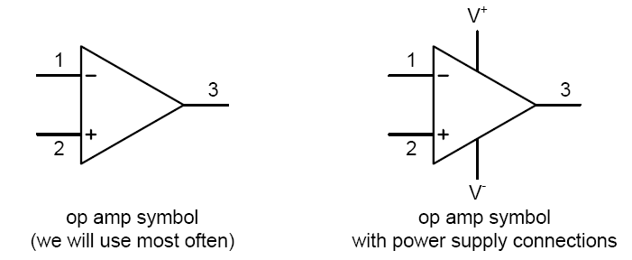
Ch7 Operational Amplifiers and Op Amp Circuits
7.1 Operational Amplifiers
Symbol
One of the input terminals (1) is called an inverting input
terminal denoted by ‘-’
The other input terminal (2) is called a non-inverting input
terminal denoted by ‘+’

Slide 5
Ch7 Operational Amplifiers and Op Amp Circuits
7.1 Operational Amplifiers
The Op Amp Model
v₊
Non-inverting input
+
R_{o}
v_{o}
R_{in}
+
v₋
-
Inverting input
-
A(v₊ -v₋ )
The op amp is designed to sense the difference between the voltage
signals applied to the two input terminals and then multiply it by some
gain factor A such that the voltage at the output terminal is A(v₊-v₋).
The voltage gain A is very large (practically infinite). The gain A is
often referred to as the differential gain or open-loop gain.
The input resistance R_{in} is very large (practically infinite). The output
resistance Ro is very small (practically zero).

Slide 6
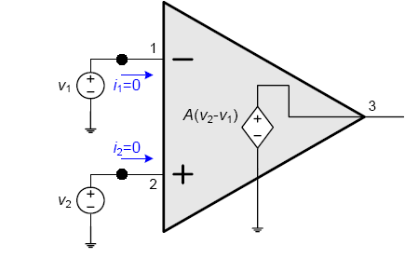
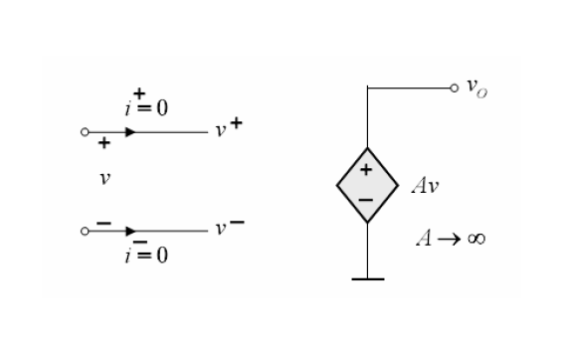


Ch7 Operational Amplifiers and Op Amp Circuits
7.1 Operational Amplifiers
Ideal Op Amp
Circuit model (ideal)
We can model an ideal amplifier as a voltage-controlled voltage
source (VCVS)
The input resistance is infinite.
The output resistance is zero.
The gain A is infinite.

Slide 7
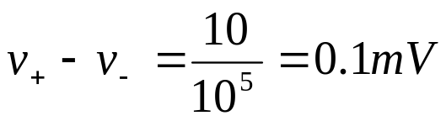
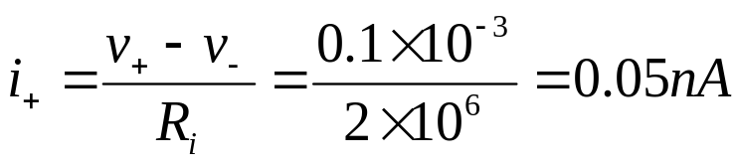
Ch7 Operational Amplifiers and Op Amp Circuits
7.1 Operational Amplifiers
v₊
Non-inverting input
+
R_{o}
v_{o}
R_{in}
+
v₋
-
Inverting input
-
A(v₊ -v₋ )
For μA741, A=100dB=10⁵， if v_{o}=10V，
Then

Slide 8
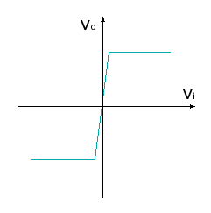
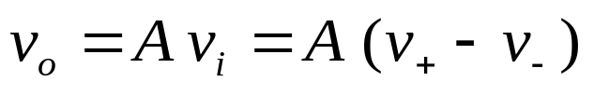
Ch7 Operational Amplifiers and Op Amp Circuits
7.1 Operational Amplifiers
Op Amp transfer characteristic curve
saturation
active region

Slide 9
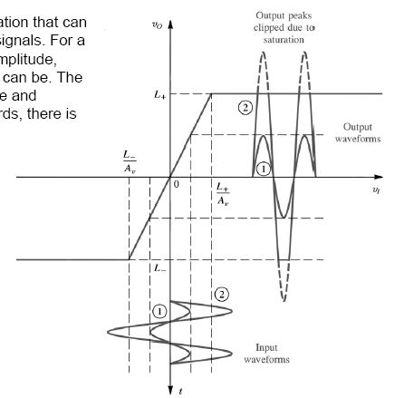
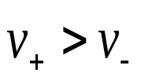
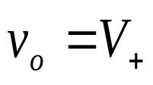
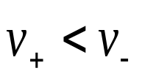
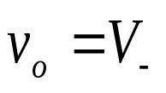
Ch7 Operational Amplifiers and Op Amp Circuits
7.1 Operational Amplifiers
Op Amp transfer characteristic curve
So far, we have been looking at the amplification that can be achieved for relatively small (amplitude) signals.
For a fixed gain, as we increase the input signal amplitude, there is a limit to how large the output signal can be. The output saturates as it approaches the positive and
negative power supply voltages.
In other words, there is limited range across which the gain is linear.

Slide 10
Ch7 Operational Amplifiers and Op Amp Circuits
7.1 Operational Amplifiers
Review
Ideal op amp characteristics:
Does not draw input current so that the input impedance
is infinite (i.e., i₁=0 and i₂=0)
The output terminal can supply an arbitrary amount of
current (ideal VCVS) and the output impedance is zero
The op amp only responds to the voltage difference
between the signals at the two input terminals and ignores
any voltages common to both inputs. In other words, an
ideal op amp has infinite common-mode rejection.
A is or can be treated as being infinite.

Slide 11
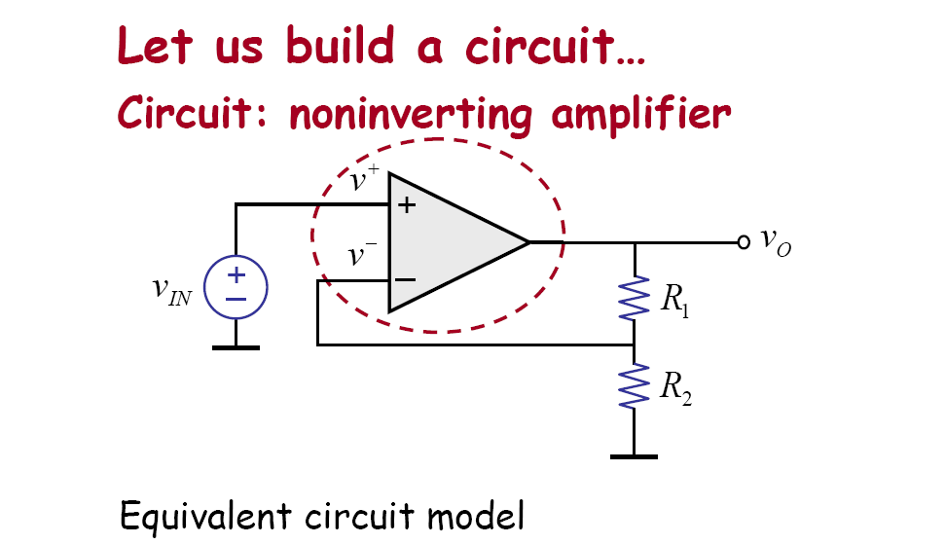
Ch7 Operational Amplifiers and Op Amp Circuits
7.1 Operational Amplifiers

Slide 12
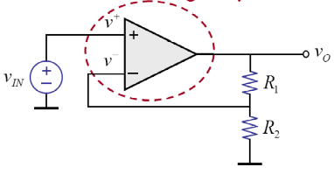
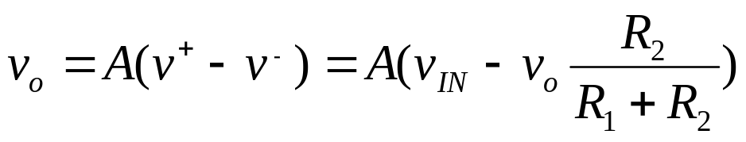
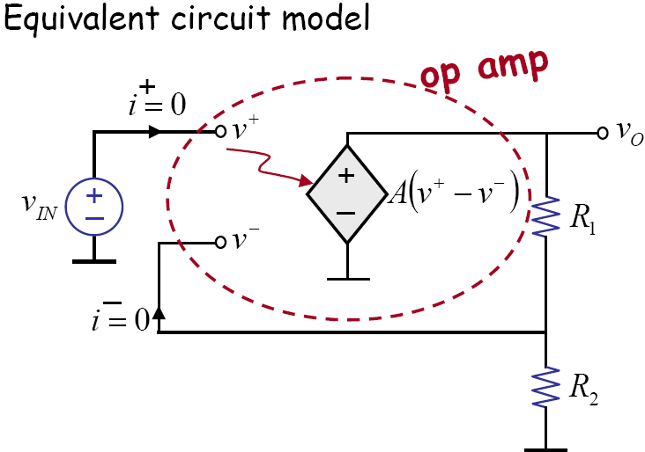
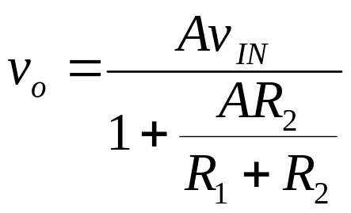
Ch7 Operational Amplifiers and Op Amp Circuits
7.1 Operational Amplifiers
What happens when “A” is very large?

Slide 13
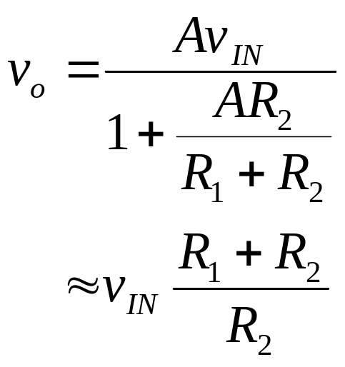
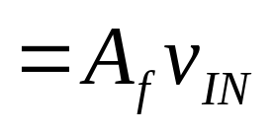
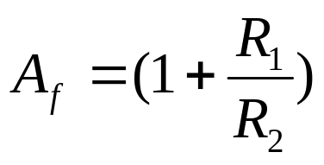
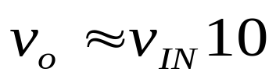
Ch7 Operational Amplifiers and Op Amp Circuits
7.1 Operational Amplifiers
Closed-loop gain
A_{f}=v_{o}/v_{in}
Gain
Suppose A=10⁶, R₁=9R, R₂=R,
Closed-loop gain: determined by resistor ratio
insensitive to A, temperature

Slide 14
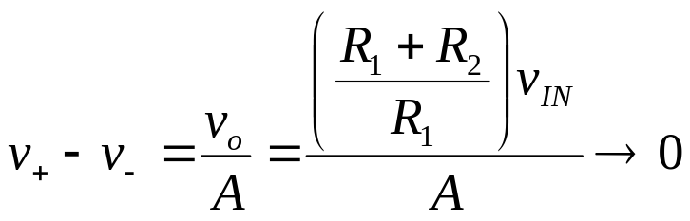
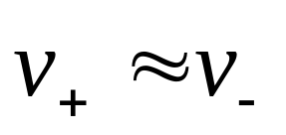
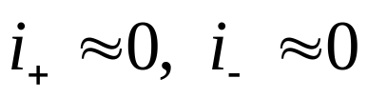
Ch7 Operational Amplifiers and Op Amp Circuits
7.1 Operational Amplifiers
Negative feedback 􀃆
Observe, under negative feedback,
analysis method under negative feedback!
– So, we say there is a virtual short between the two terminals (“+” and “-”) .

Slide 15
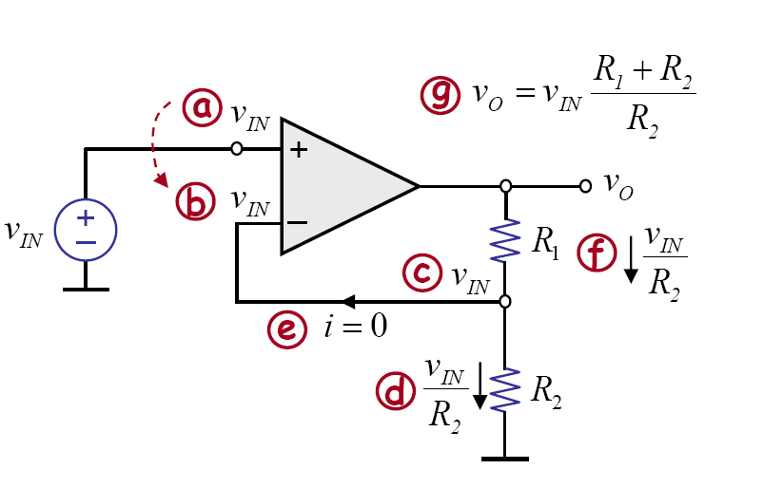
Ch7 Operational Amplifiers and Op Amp Circuits
7.1 Operational Amplifiers
Negative feedback 􀃆

Slide 16
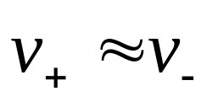
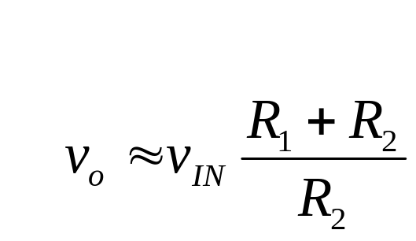
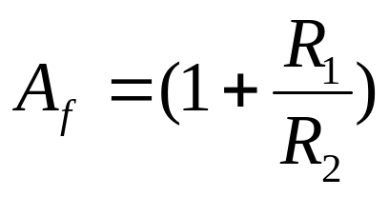
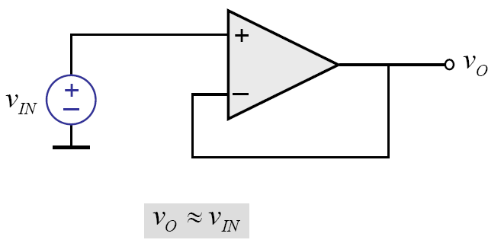
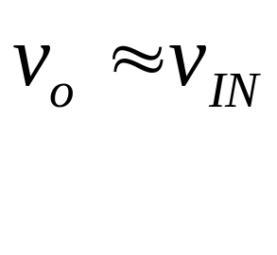
Ch7 Operational Amplifiers and Op Amp Circuits
7.1 Operational Amplifiers
Negative feedback 􀃆
When R₁=0, R₂=∞,
Buffer: voltage gain = 1
Voltage Follower

Slide 17
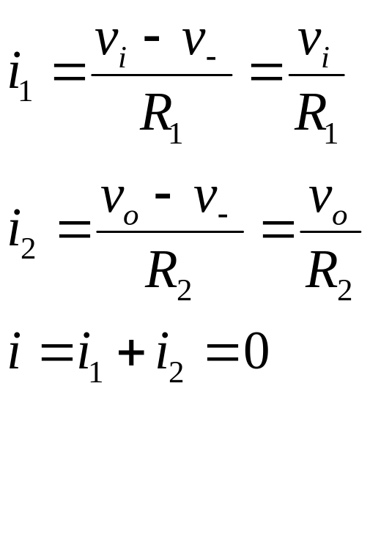
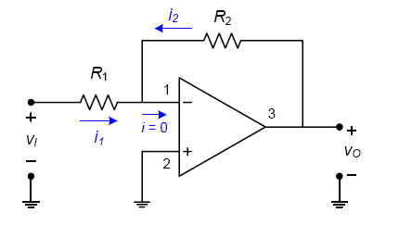
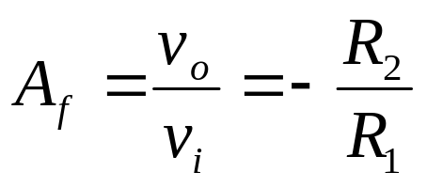
Ch7 Operational Amplifiers and Op Amp Circuits
7.1 Operational Amplifiers
Negative feedback 􀃆

Slide 18
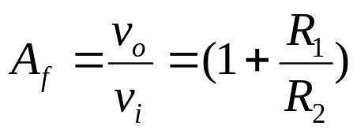
Ch7 Operational Amplifiers and Op Amp Circuits
7.1 Operational Amplifiers
Negative feedback 􀃆
We can adjust the closed-loop gain by changing the ratio of R₂ and R₁
• The closed-loop gain is (ideally) independent of op amp open-loop gain A (if A is large enough) and we can make it arbitrarily large or small and of desired accuracy depending on the accuracy of the resistors.

Slide 19
Ch7 Operational Amplifiers and Op Amp Circuits
7.1 Operational Amplifiers
Negative feedback 􀃆
The terminal 1 is a virtual ground since terminal 2 is grounded.
Inverting configuration,
This is a classic example of what negative feedback does. It takes an amplifier with very large gain and through negative feedback, obtain a gain that is smaller, stable, and predictable. In effect, we have traded gain for accuracy. This kind of trade off is common in electronic circuit design… as we will see more of later.

Slide 20
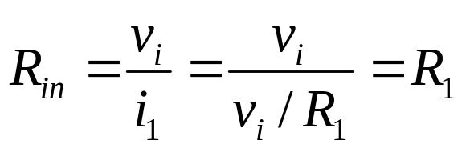
Ch7 Operational Amplifiers and Op Amp Circuits
7.1 Operational Amplifiers
Negative feedback 􀃆
Inverting configuration,
Input Resistance:
Assuming an ideal op amp (open-loop gain A = infinity), in the closed-loop inverting configuration, the input resistance is R₁.

Slide 21
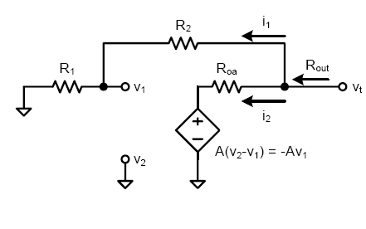
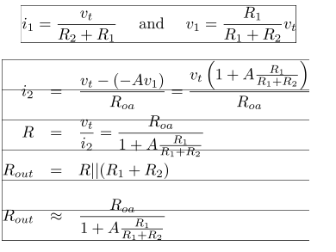
Ch7 Operational Amplifiers and Op Amp Circuits
7.1 Operational Amplifiers
Negative feedback 􀃆
Inverting configuration,
Output Resistance:
R_{oa} is usually small and so R_{out} is negligible when A is large

Slide 22
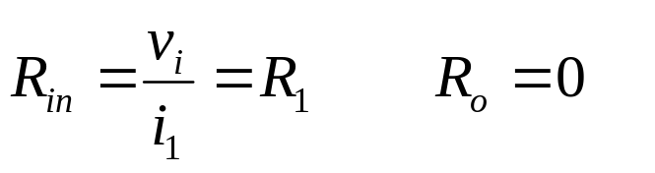
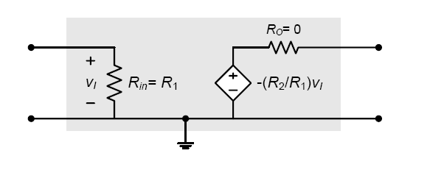
Ch7 Operational Amplifiers and Op Amp Circuits
7.1 Operational Amplifiers
Negative feedback 􀃆
Inverting configuration,
We can model the closed-loop inverting amplifier (with A = infinite) with the following equivalent circuit using a voltage-controlled voltage source…

Slide 23
Ch7 Operational Amplifiers and Op Amp Circuits
7.2 Op Amp Circuits
Key Words:
Subtracting Amplifiers
Summing Amplifiers
Intergrator
Differentiator

Slide 24
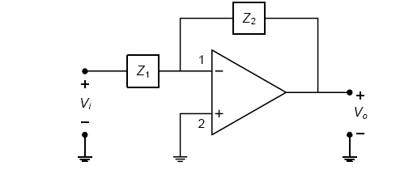

Ch7 Operational Amplifiers and Op Amp Circuits
7.2 Op Amp Circuits
Inverting Configuration with General Impedances
Let’s replace R₁ and R₂ in the inverting configuration with impedances Z₁(s) and Z₂(s).
• We can write the closed-loop transfer function as…
• By placing different circuit elements into Z₁ and Z₂, we can get interesting operations. Some examples…
– Integrator, – Differentiator, – Summer

Slide 25
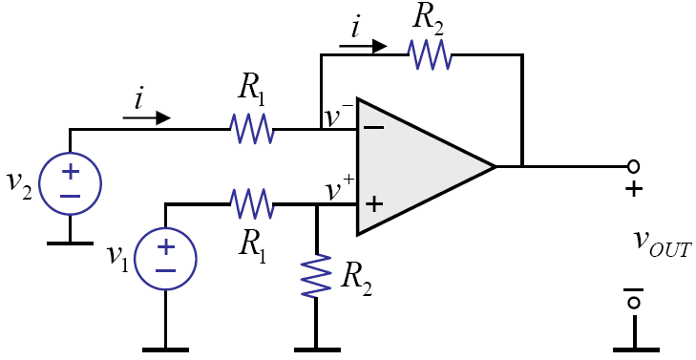


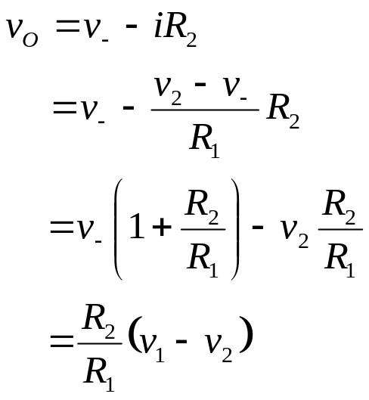
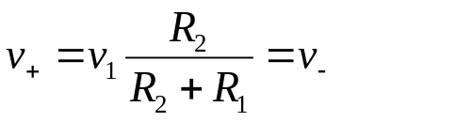
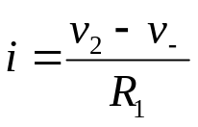


Ch7 Operational Amplifiers and Op Amp Circuits
7.2 Op Amp Circuits
Consider this circuit:
Subtraction!
Let →

Slide 26
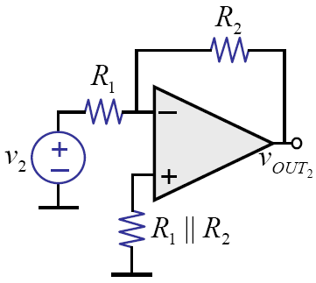
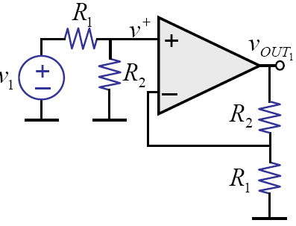
Ch7 Operational Amplifiers and Op Amp Circuits
7.2 Op Amp Circuits
Subtracting Amplifiers
Another way of solving —use superposition

Slide 27
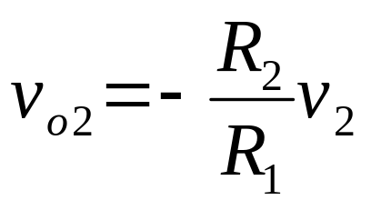
Ch7 Operational Amplifiers and Op Amp Circuits
7.2 Op Amp Circuits
Subtracting Amplifiers
Another way of solving —use superposition

Slide 28
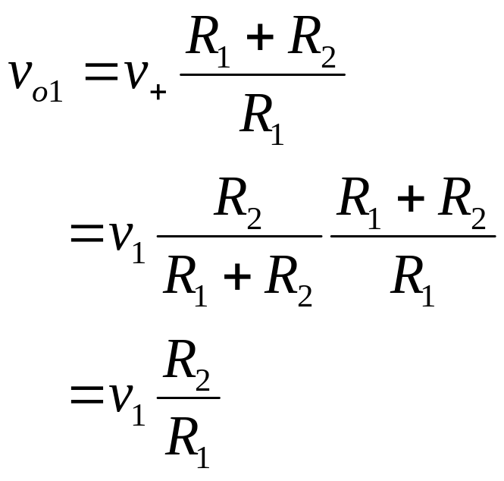
Ch7 Operational Amplifiers and Op Amp Circuits
7.2 Op Amp Circuits
Subtracting Amplifiers
Another way of solving —use superposition

Slide 29
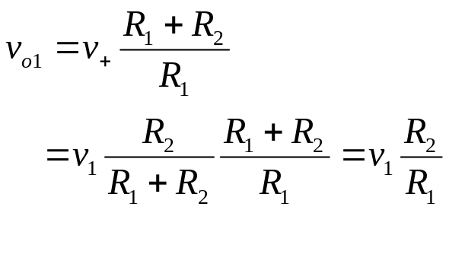
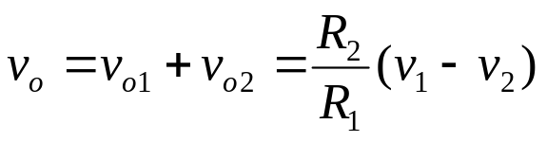
Ch7 Operational Amplifiers and Op Amp Circuits
7.2 Op Amp Circuits
Subtracting Amplifiers
Another way of solving —use superposition
Still subtracts!

Slide 30







Ch7 Operational Amplifiers and Op Amp Circuits
7.2 Op Amp Circuits
Subtracting Amplifiers
v_{o1}
Let
Let

Slide 31







Ch7 Operational Amplifiers and Op Amp Circuits
7.2 Op Amp Circuits
Summing Amplifiers
For node N，
Let

Slide 32


Ch7 Operational Amplifiers and Op Amp Circuits
7.2 Op Amp Circuits
Weighted Summer

Slide 33












Ch7 Operational Amplifiers and Op Amp Circuits
7.2 Op Amp Circuits
Example 1, Design an summer which has an output voltage given by v_{O}=1.5v_{s1}-5v_{s2}+0.1v_{s3}。
Solution 1:
R₄
R₃
R₂
we have，
Let ,→ , 。
Let ，→

Slide 34











Ch7 Operational Amplifiers and Op Amp Circuits
7.2 Op Amp Circuits
Example 1, Design an summer which has an output voltage given by v_{O}=1.5v_{s1}-5v_{s2}+0.1v_{s3}。
Solution 2:
Because
Let

Slide 35




Ch7 Operational Amplifiers and Op Amp Circuits
7.2 Op Amp Circuits
Let’s build an intergrator…
Let’s start with the following insight:
v_{I}
But we need to somehow convert voltage v_{I} to current.

Slide 36



Ch7 Operational Amplifiers and Op Amp Circuits
7.2 Op Amp Circuits
First try… use resistor
When is v_{O} small compared to v_{R}?
larger the RC,
smaller the v_{O}
When v_{R} >>v_{O} ,
for good integrator
ωRC >> 1

Slide 37


Ch7 Operational Amplifiers and Op Amp Circuits
7.2 Op Amp Circuits
There’s a better way…

Slide 38

Ch7 Operational Amplifiers and Op Amp Circuits
7.2 Op Amp Circuits
There’s a better way…
But, v_{O} must be very small compared to v_{R}, or else

Slide 39





Ch7 Operational Amplifiers and Op Amp Circuits
7.2 Op Amp Circuits
Intergrator
How about in the frequency domain?

Slide 40



Ch7 Operational Amplifiers and Op Amp Circuits
7.2 Op Amp Circuits
Intergrator

Slide 41




Ch7 Operational Amplifiers and Op Amp Circuits
7.2 Op Amp Circuits
Intergrator

Slide 42


Ch7 Operational Amplifiers and Op Amp Circuits
7.2 Op Amp Circuits
Intergrator
While the DC gain in the previous integrator circuit is infinite, the amplifier itself will saturate.
To limit the low-frequency gain to a known and reliable value, add a parallel resistor to the
capacitor.
What does the magnitude response look like?

Slide 43


Ch7 Operational Amplifiers and Op Amp Circuits
7.2 Op Amp Circuits
Now, let’s build a differentiator…
Let’s start with the following insights:
But we need to somehow convert current to voltage.

Slide 44



Ch7 Operational Amplifiers and Op Amp Circuits
7.2 Op Amp Circuits
Differentiator
v_{o}=-iR

Slide 45
Ch7 Operational Amplifiers and Op Amp Circuits
7.3 Active Filter
Key Words:
Basic Filter Responses
Low-Pass Filter
High-Pass Filter
Band-Pass Filter
Band-Stop Filter

Slide 46





Ch7 Operational Amplifiers and Op Amp Circuits
7.3 Active Filter
Basic Filter Responses
Filter
voltage gain
Basic Filter Responses
Low-Pass Filter
bandwidth
Transition region
stopband region
cutoff frequency

Slide 47




Ch7 Operational Amplifiers and Op Amp Circuits
7.3 Active Filter

Slide 48




Ch7 Operational Amplifiers and Op Amp Circuits
7.3 Active Filter
Low-Pass Filter

Slide 49


Ch7 Operational Amplifiers and Op Amp Circuits
7.3 Active Filter
High-Pass Filter

Slide 50







Ch7 Operational Amplifiers and Op Amp Circuits
7.3 Active Filter
Advantages of Filter
R_{L}
where

Slide 51



Ch7 Operational Amplifiers and Op Amp Circuits
7.3 Active Filter
Low-Pass Filter
-20dB/decade

Slide 52




Ch7 Operational Amplifiers and Op Amp Circuits
7.3 Active Filter
Low-Pass Filter
First-order(one-pole) Filter
Second-order(two-pole) Filter

Slide 53







Ch7 Operational Amplifiers and Op Amp Circuits
7.3 Active Filter
Low-Pass Filter
Voltage-controlled voltage source
(VCVS) filiter
A
For simplicity,

Slide 54


Ch7 Operational Amplifiers and Op Amp Circuits
7.3 Active Filter
High-Pass Filter
Transfer functions:
Circuit: R↔C
Frequency domain

Slide 55



Ch7 Operational Amplifiers and Op Amp Circuits
7.3 Active Filter
Band-Pass Filter
Low-Pass
High-Pass
Lower-frequency
Upper-frequency

Slide 56



Ch7 Operational Amplifiers and Op Amp Circuits
7.3 Active Filter
Band-Stop Filter
Low-Pass
High-Pass

Slide 57



Ch7 Operational Amplifiers and Op Amp Circuits
7.3 Active Filter
Exp.2, For the circuit shown, show that what it is filter?
(a)
The Inverting First-order Low-Pass Filter.

Slide 58



Ch7 Operational Amplifiers and Op Amp Circuits
7.3 Active Filter
Exp.2, For the circuit shown, show that what it is filter?
(b)
The Inverting First-order High-Pass Filter.

Slide 59

Ch7 Operational Amplifiers and Op Amp Circuits
7.3 Active Filter
Exp.2, For the circuit shown, show that what it is filter?
(c)
The Non-Inverting Band-Stop Filter(Second-order).

Slide 60
Ch7 Operational Amplifiers and Op Amp Circuits
7.4 Op Amp Positive Feedback
Key Words:
Positive Feedback
The Comparator
Oscillator

Slide 61


Ch7 Operational Amplifiers and Op Amp Circuits
7.4 Op Amp Positive Feedback
Positive Feedback
What’s the difference?
Positive feedback drives op amp into saturation: V_{out}→±V_{saturation}

Slide 62





Ch7 Operational Amplifiers and Op Amp Circuits
7.4 Op Amp Positive Feedback
The Comparator
The op amp is often used as a comparator.
The output voltage exhibits two stable states. The output state depends on the relative value of one input voltage compared to the other input voltage.
Threshold voltages

Slide 63

Ch7 Operational Amplifiers and Op Amp Circuits
7.4 Op Amp Positive Feedback
The Comparator

Slide 64


Ch7 Operational Amplifiers and Op Amp Circuits
7.4 Op Amp Positive Feedback
The Comparator

Slide 65






Ch7 Operational Amplifiers and Op Amp Circuits
7.4 Op Amp Positive Feedback
The Comparator

Slide 66




Ch7 Operational Amplifiers and Op Amp Circuits
7.4 Op Amp Positive Feedback
The Comparator

Slide 67

Ch7 Operational Amplifiers and Op Amp Circuits
7.4 Op Amp Positive Feedback
The Comparator

Slide 68

Ch7 Operational Amplifiers and Op Amp Circuits
7.4 Op Amp Positive Feedback
The Comparator with Positive Feedback
Positive feedback is often used with comparator circuits. The feedback is applied from the output to the non-inverting input of the op amp.

Slide 69


Ch7 Operational Amplifiers and Op Amp Circuits
7.4 Op Amp Positive Feedback
The Comparator with Positive Feedback

Slide 70
Ch7 Operational Amplifiers and Op Amp Circuits
7.4 Op Amp Positive Feedback
The Comparator (Schmidt trigger)
hysteresis

Slide 71





Ch7 Operational Amplifiers and Op Amp Circuits
7.4 Op Amp Positive Feedback
The Comparator (Schmidt trigger)
When v_{i}（<0）<V₊，→v_{O}=V_{O}⁺ >0，
When v_{i}>V_{TH1}，v_{O}→V_{O}⁻ <0，
V_{TH2}
V_{TH1}

Slide 72

Ch7 Operational Amplifiers and Op Amp Circuits
7.4 Op Amp Positive Feedback
The Comparator (Schmidt trigger)
Why is hysteresis useful?
e.g., analog to digital

Slide 73

Ch7 Operational Amplifiers and Op Amp Circuits
7.4 Op Amp Positive Feedback
The Comparator (Schmidt trigger)
Without hysteresis

Slide 74


Ch7 Operational Amplifiers and Op Amp Circuits
7.4 Op Amp Positive Feedback
The Comparator (Schmidt trigger)
Oscillator — can create a clock

Slide 75


Ch7 Operational Amplifiers and Op Amp Circuits
7.4 Op Amp Positive Feedback
The Comparator (Schmidt trigger)
There’s a better way…----triangular-wave generator

