Slide 1
Circuits and Analog Electronics
Ch8 Negative Feedback Amplifiers
8.1 Basic Description of Negative Feedback
8.2 The Four Types of Feedback
Readings: Gao-Ch8 ; Floyd-Ch6

Slide 2
Ch8 Negative Feedback Amplifiers
8.1 Basic Description of Negative Feedback
Negative feedback is one of the most useful concepts in electronic and is the process whereby a portion of the output voltage of an amplifier is returned to the input with a phase angle that opposes (or subtracts from) the input signal.
Key Words:
The basic block diagrams
Closed-loop gain
Loop-gain
Calculating closed-loop gain

Slide 3
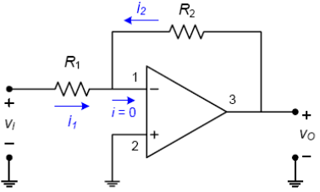
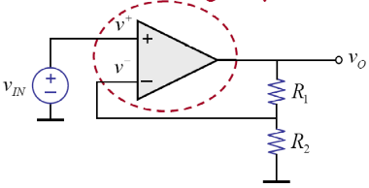
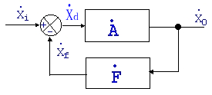
Ch8 Negative Feedback Amplifiers
8.1 Basic Description of Negative Feedback
The basic block diagrams of non-inverting and inverting negative feedback amplifiers are shown in following
The basic block diagram
the variables X are voltages or currents.

Slide 4
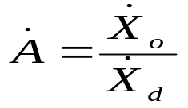
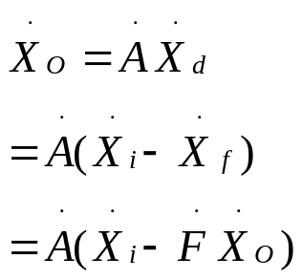
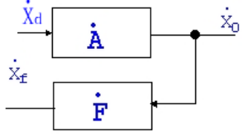

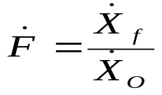
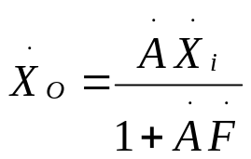
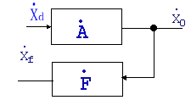
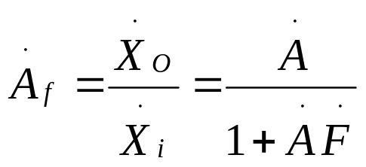
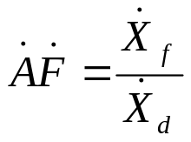
Ch8 Negative Feedback Amplifiers
8.1 Basic Description of Negative Feedback
Closed-loop gain
Open-loop gain
Feedback factor
Closed-loop gain
Loop-gain

Slide 5
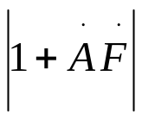
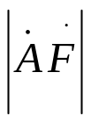
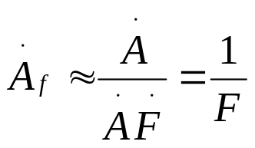
Ch8 Negative Feedback Amplifiers
8.1 Basic Description of Negative Feedback
Closed-loop gain
amount of feedback
If A is large enough so that >> 1( >> 1), the closed-loop gain can be approximated by
These are important results, for they show that the gain is set by the feedback network and not by the amplifier. In practice, this means that an amplifier without feedback can be designed without too much consideration of what its gain will be as long as the gain is high enough. When feedback is added, the gain can be reduced to any desired value by the feedback network.

Slide 6


Ch8 Negative Feedback Amplifiers
8.1 Basic Description of Negative Feedback
loop gain
Loop-gain
If the loop-gain is positive, the feedback is said to be negative. If the gain around the loop is negative, the amplifier is said to be positive feedback.
－A and F are positive real constants，
In general, the gains are phasor functions of frequency.
Suppose that AF = −1 at some frequency. A_{f} show that the gain becomes
infinite at that frequency. An amplifier with an infinite gain at any frequency can put out a signal at that frequency with no input signal. In this case, the amplifier is said to oscillate.

Slide 7
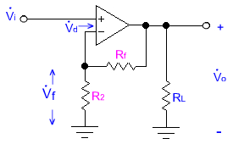


Ch8 Negative Feedback Amplifiers
8.1 Basic Description of Negative Feedback
Example 8-1,
--- Negative Feedback

Slide 8
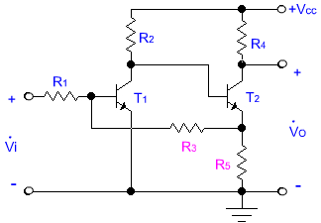
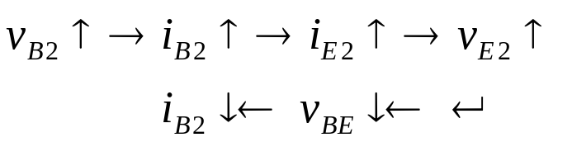
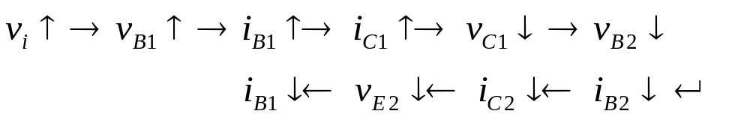
Ch8 Negative Feedback Amplifiers
8.1 Basic Description of Negative Feedback
Example 8-1,

Slide 9

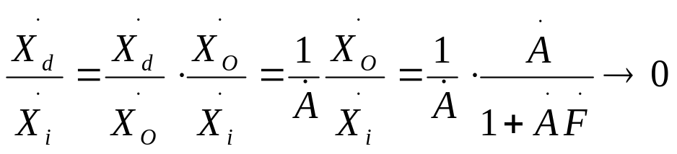
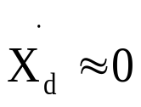
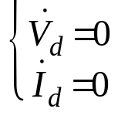
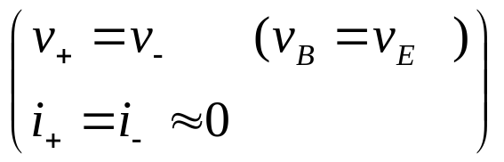
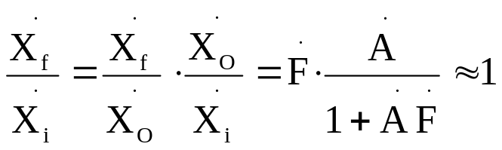
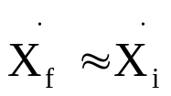
Ch8 Negative Feedback Amplifiers
8.1 Basic Description of Negative Feedback
Calculating closed-loop gain

Slide 10
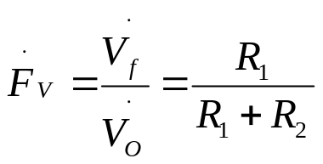
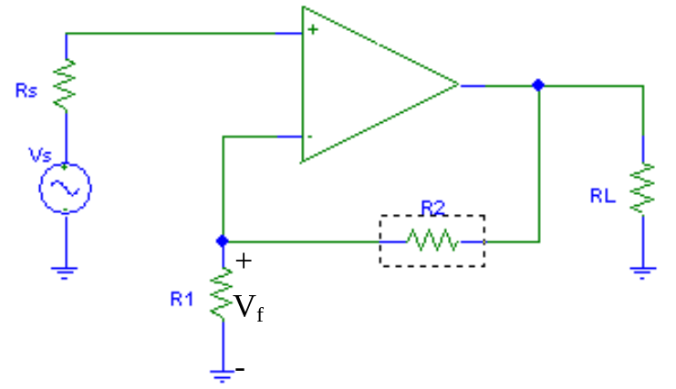
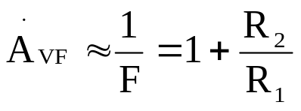
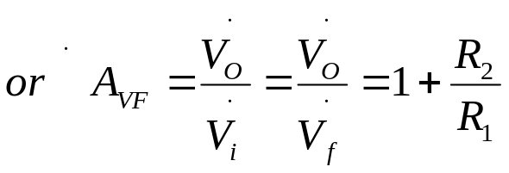
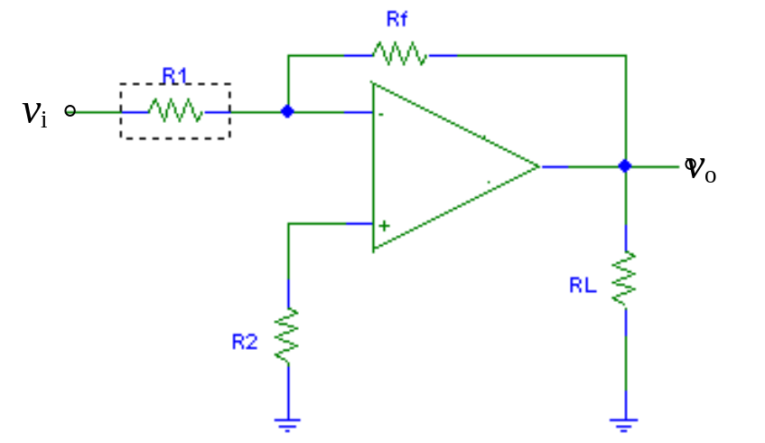
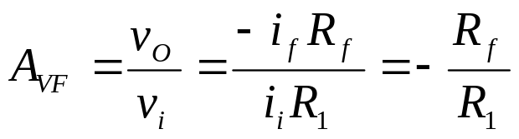
Ch8 Negative Feedback Amplifiers
8.1 Basic Description of Negative Feedback
Calculating closed-loop gain

Slide 11
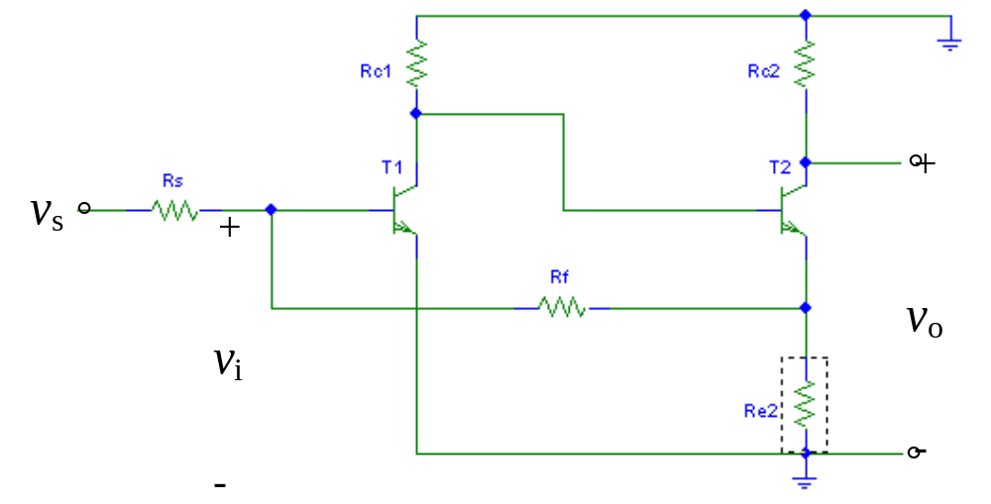
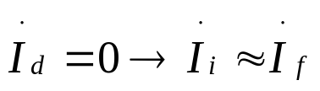
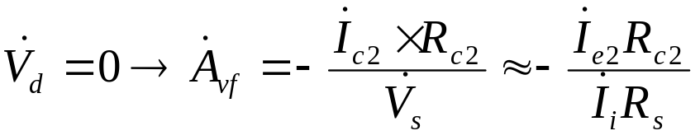
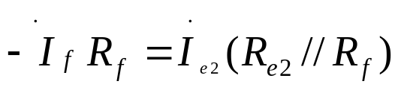
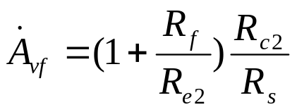
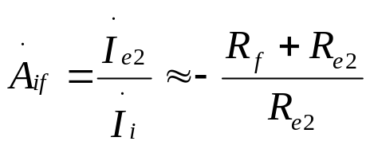
Ch8 Negative Feedback Amplifiers
8.1 Basic Description of Negative Feedback
Calculating closed-loop gain

Slide 12
Ch8 Negative Feedback Amplifiers
8.2 The Four Types of Feedback
Key Words:
The four types of feedback

Slide 13
Ch8 Negative Feedback Amplifiers
8.2 The Four Types of Feedback
The four types of feedback
In the block diagram, the input and output variables can be modeled as either a voltage or a current. It follows then that there are four types of feedback amplifiers.

Slide 14
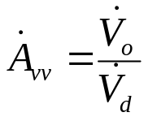
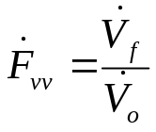
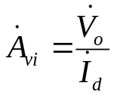
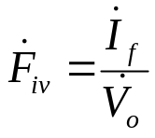
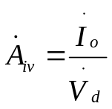
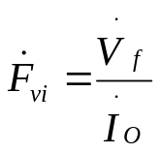
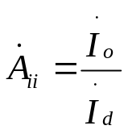
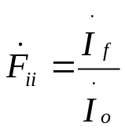
Ch8 Negative Feedback Amplifiers
8.2 The Four Types of Feedback
The four types of feedback
Name | Input Variable | Output Variable | Error Variable | A | F
Series-Voltage (Series-Shunt) | Voltage | Voltage | Voltage
Parallel-Voltage (Shunt-Shunt) | Current | Voltage | Current | Transresistance | Transconductance
Series- Current (Series-Series) | Voltage | Current | Voltage | Transconductance | Transresistance
Parallel-Current (Shunt-Series) | Current | Current | Current

Slide 15
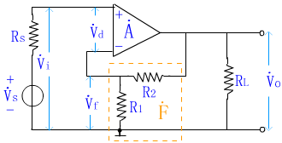
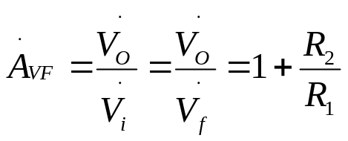
Ch8 Negative Feedback Amplifiers
8.2 The Four Types of Feedback
Series-Voltages Feedback Amplifiers
A series-shunt feedback amplifier is a non-inverting amplifier in which the input signal is a voltage and the output signal is a voltage.
The feedback network connects in shunt with the output node, thus the sampling is shunt.
Because the input is a voltage and the output is a voltage, the gain A_{vf} represents a dimensionless voltage gain. The feedback factor is also dimensionless.

Slide 16
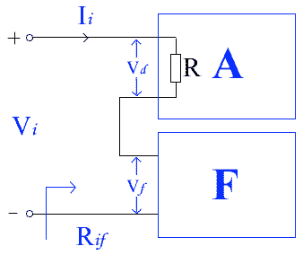
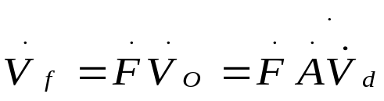
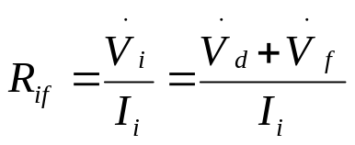
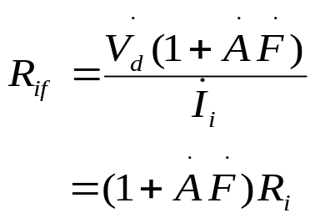
Ch8 Negative Feedback Amplifiers
8.2 The Four Types of Feedback
Series-Voltage Feedback Amplifiers
Note that the voltage gain and the output resistance are decreased by the feedback. The input resistance is increased by the feedback. These are properties of the series-shunt topology.

Slide 17

Ch8 Negative Feedback Amplifiers
8.2 The Four Types of Feedback
Series-Voltage Feedback Amplifiers
A_{O}——for R_{L} open。
Summary of the Effects of Series-Shunt Feedback
The voltage gain is divided by the factor (1 + AF).
The input resistance is multiplied by the factor (1 + AF).
The output resistance is divided by the factor (1 + A_{o}F).

Slide 18

Ch8 Negative Feedback Amplifiers
8.2 The Four Types of Feedback
Parallel-Voltage Feedback Amplifiers
A shunt-shunt feedback amplifier is an inverting amplifier in which the input signal is a current and the output signal is a voltage.
Because the feedback connects to the same terminal as the input signal, the summing is shunt. The feedback network connects in shunt with the output node, thus the sampling is shunt.
Because the input is a current and
the output is a voltage, the gain A represents a transresistance with the units Ω.

Slide 19





Ch8 Negative Feedback Amplifiers
8.2 The Four Types of Feedback
Parallel-Voltage Feedback Amplifiers

Slide 20

Ch8 Negative Feedback Amplifiers
8.2 The Four Types of Feedback
Parallel-Voltage Feedback Amplifiers
Summary of the Effects of Shunt-Shunt Feedback
The transresistance gain and the voltage gain are divided by the factor (1 +AF). The input resistance is divided by the factor (1 +AF).
The output resistance is divided by the factor (1 + AF).

Slide 21


Ch8 Negative Feedback Amplifiers
8.2 The Four Types of Feedback
Series-Current Feedback Amplifiers
A series-series feedback amplifier is a non-inverting amplifier in which the input signal is a voltage and the output signal is a current.
Because the feedback does not connect to the same op-amp input as the source, the circuit is said to have
series summing.
Because the input is a voltage and
the output is a current, the gain A represents a transconductance.

Slide 22
Ch8 Negative Feedback Amplifiers
8.2 The Four Types of Feedback
Series-Current Feedback Amplifiers
Note that the effect of the feedback is to reduce the gain, increase the input resistance and increase the output resistance.
In the case AF→∞, the output resistance becomes infinite and the
load resistor R_{L} is driven by an ideal current source.

Slide 23

Ch8 Negative Feedback Amplifiers
8.2 The Four Types of Feedback
Parallel-Current Feedback Amplifiers
A shunt-series feedback amplifier is an inverting amplifier in which the input signal is a voltage and the output signal is a current.
Because the feedback connects to the same op-amp input as the source, the circuit is said to have shunt summing at the input.
-
Because the input is a current and
the output is a current, the gain A represents a dimensionless current gain.
+
-
+

Slide 24

Ch8 Negative Feedback Amplifiers
8.2 The Four Types of Feedback
Parallel-Current Feedback Amplifiers
-
+
-
+
Note that the effect of the the feedback is to reduce the gain, decrease the input resistance and increase the output resistance.
In the case AF→∞, the output resistance becomes infinite and the load resistor R_{L} is driven by an ideal current source.

Slide 25

Ch8 Negative Feedback Amplifiers
8.2 The Four Types of Feedback
Example 8-2,
v_{i}
v_{f}

Slide 26

Ch8 Negative Feedback Amplifiers
8.2 The Four Types of Feedback
Example 8-2,
.

