Slide 1
Sequential Logic Circuits (FSM)
FSM: Finite State Machines
Analysis and Design

Slide 2
Combinational vs. Sequential
Combinational Logic Circuit
  Output is a function of the inputs.
  Does not have state information.
  Does not require memory.
Sequential Logic Circuit
  Output is a function of the present state (and of the inputs).
  Has state information
  Requires memory.
  Uses Flip-Flops to implement memory.

Slide 3
Synchronous vs. Asynchronous
Synchronous Sequential Logic Circuit
  Clocked
  All Flip-Flops use the same clock and change state on the same triggering edge.
Asynchronous Sequential Logic Circuit
  No clock
  Can change state at any instance in time.
  Faster but more complex than synchronous sequential circuits.

Slide 4
Finite State Machine: Models
Moore Machine
  Outputs are a function of the present state.
  Outputs are independent of the inputs.
  State diagram includes an output value for each state.
Mealy Machine
  Outputs are a function of the present state and the input.
  State diagram includes an input and output value for each transition (between states).
There is an equivalent Mealy machine for each Moore machine.

Slide 5
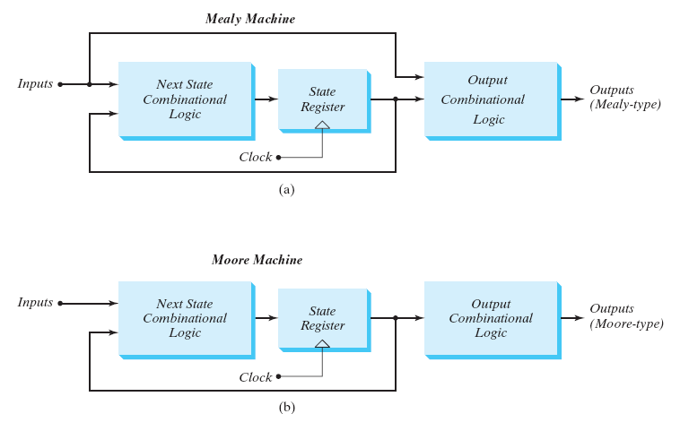
Finite State Machine: Models

Slide 6
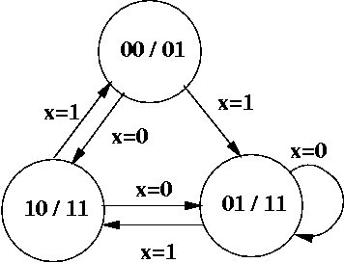
FSM: State Diagram (Moore)
Output
State
A
Input
C
B

Slide 7
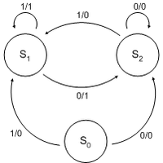
FSM: State Diagram (Mealy)
State
Output
Input

Slide 8
Finite State Machine Analysis

Slide 9
FSM Analysis: Procedure
Determine the Flip-Flop input equations
  In terms of the present state and input variables
Determine the FSM output equation(s)
Determine the next state values in the state table
  Assume binary encoding
  Use Flip-Flop Characteristic Equation
Construct the state table
  Assign a state to each binary state assignment
Draw the corresponding state diagram
Determine the behavior of the FSM

Slide 10
FSM Analysis
Example:
FSM using D Flip-Flops

Slide 11
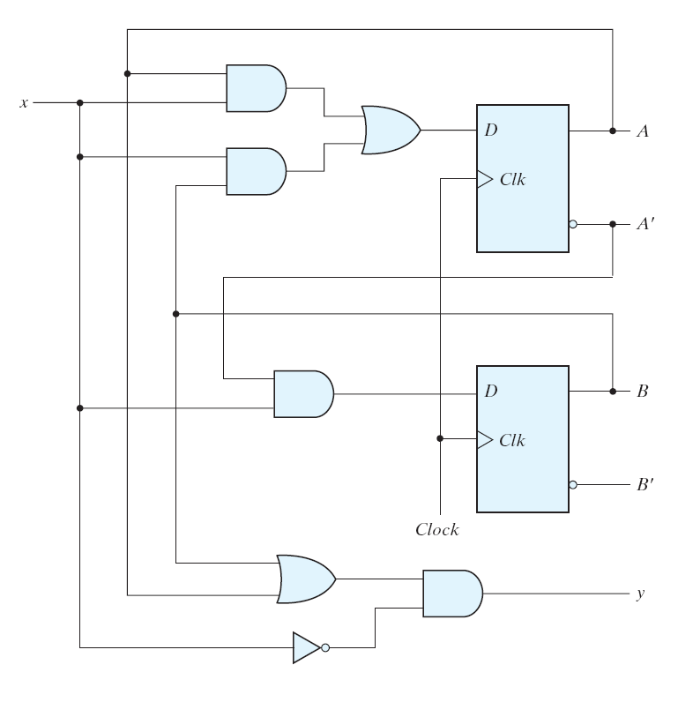
FSM Analysis: Example (D FF)
input
state
output
What type of
FSM is this?

Slide 12
FSM Analysis: Example (D FF)
Determine the FF input equations
and the FSM output equation(s)

Slide 13
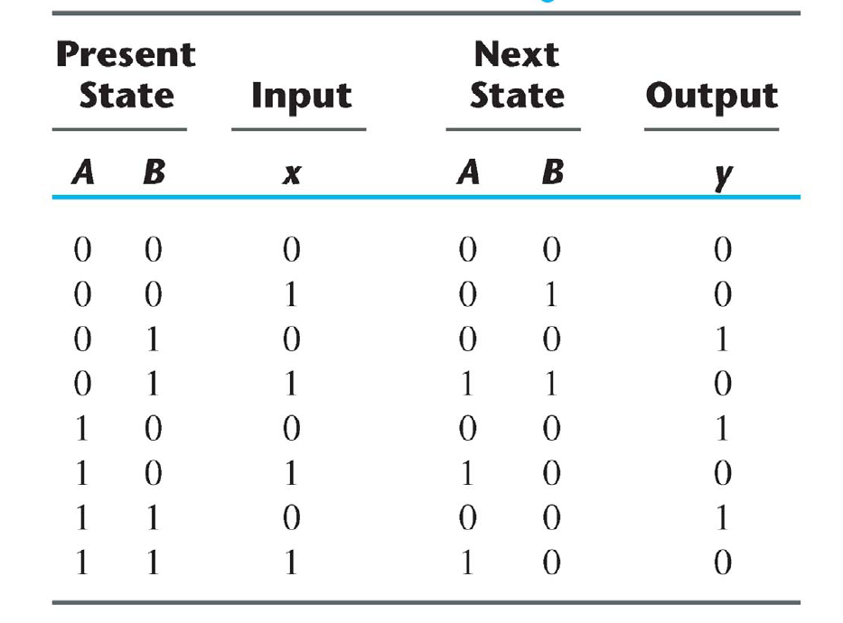
FSM Analysis: Example (D FF)

Slide 14
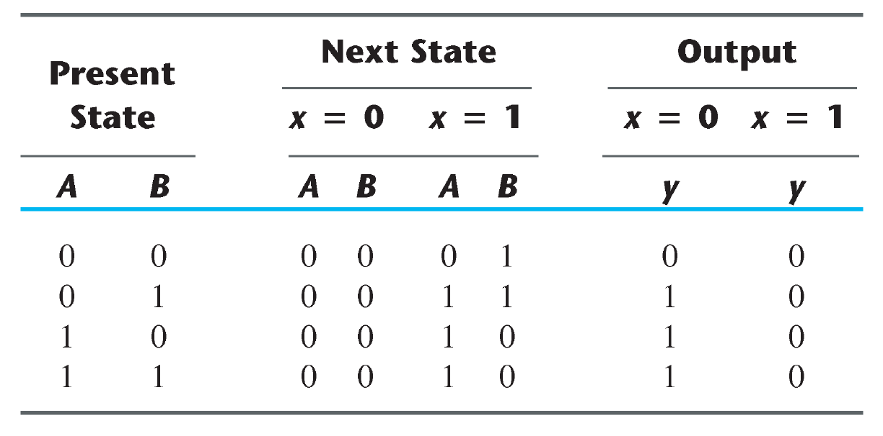
FSM Analysis: Example (D FF)

Slide 15
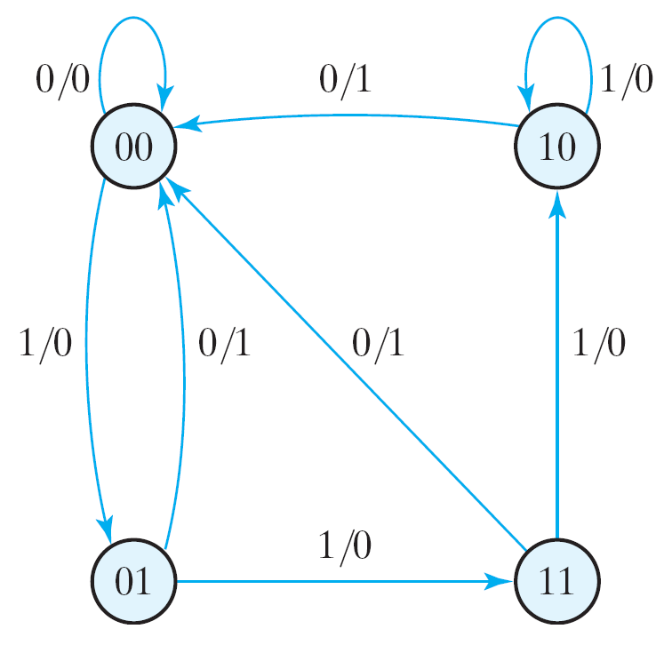
FSM Analysis: Example (D FF)

Slide 16
FSM Analysis
Example:
FSM using JK Flip-Flops

Slide 17
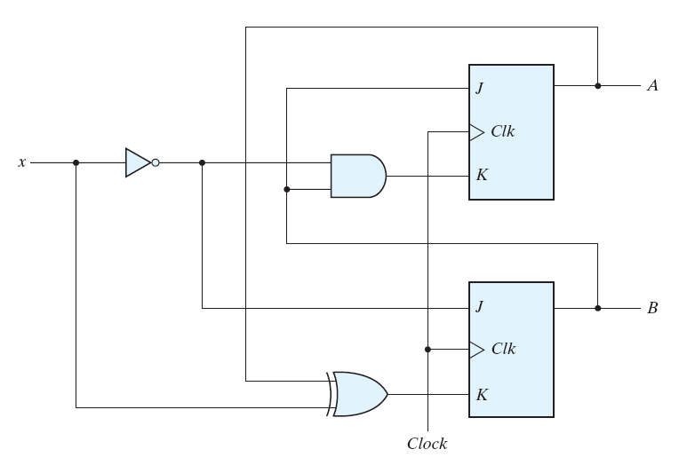
FSM Analysis: Example (JK FF)
state
input
What type of
FSM is this?

Slide 18
FSM Analysis: Example (JK FF)
Determine the FF input equations
and the FSM output equation(s)

Slide 19
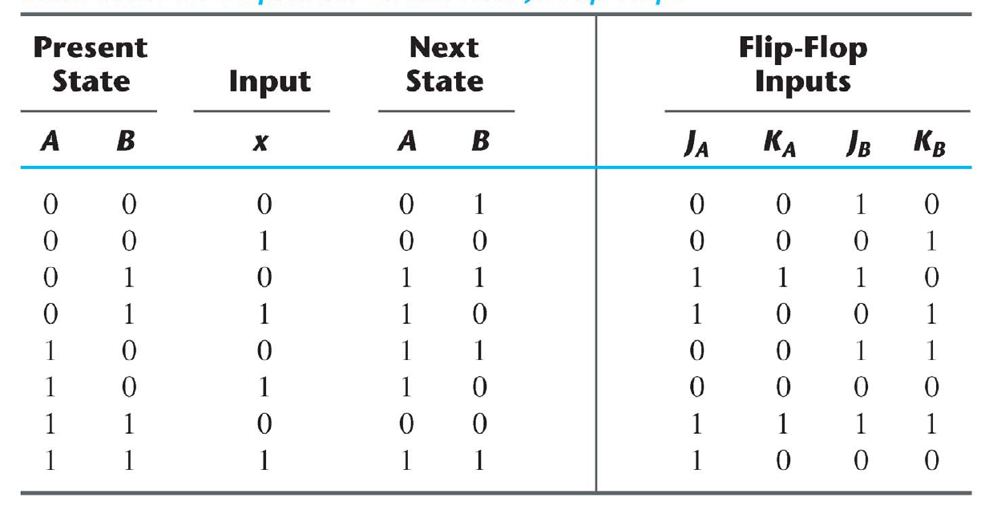
FSM Analysis: Example (JK FF)

Slide 20
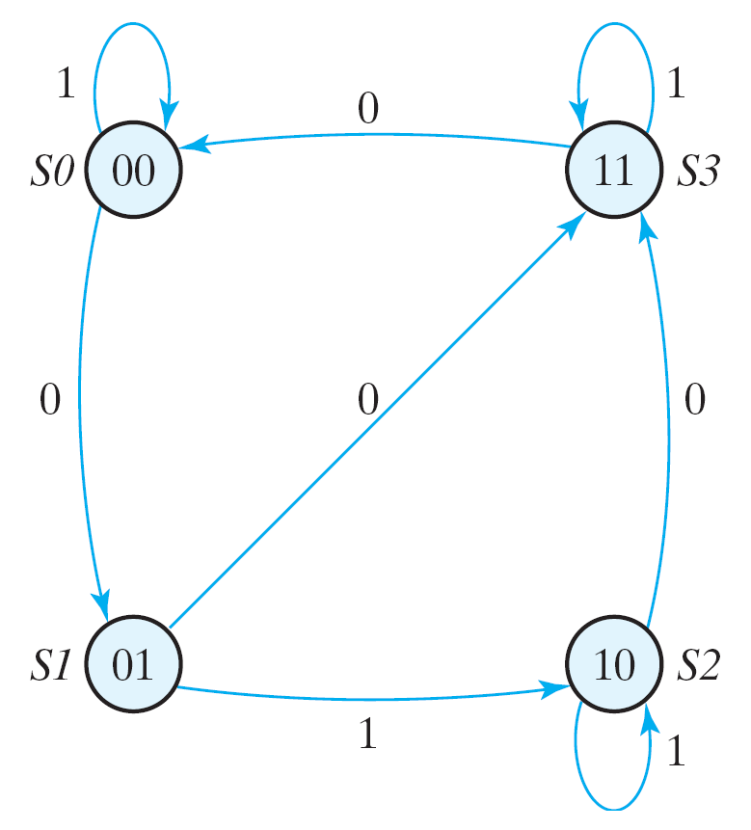
FSM Analysis: Example (JK FF)

Slide 21
Digital Systems Design
Sequential Logic Circuits:
FSM Design

Slide 22
FSM Design: Procedure
Understand specifications
Derive state diagram
Create state table
Perform state minimization (if necessary)
Encode states (state assignment)
Create state-assigned table
Select type of Flip-Flop to use
Determine Flip-Flop input equations and FSM output equation(s)
Draw logic diagram

Slide 23
FSM Design
Moore Machines

Slide 24
FSM Design (Moore)
Example:
Design a FSM that detects a sequence of three or more consecutive ones on an input bit stream.
The FSM should output a 1 when the sequence is detected, and a 0 otherwise.
A circuit that detects the occurrence of a particular pattern
on its input is referred to as a sequence detector.

Slide 25
FSM Design: Example (Moore)
Input: 0 1 1 1 0 1 0 1 1 0 1 1 1 0 1 …
Output: 0 0 0 1 0 0 0 0 0 0 0 0 1 0 0 …

Slide 26
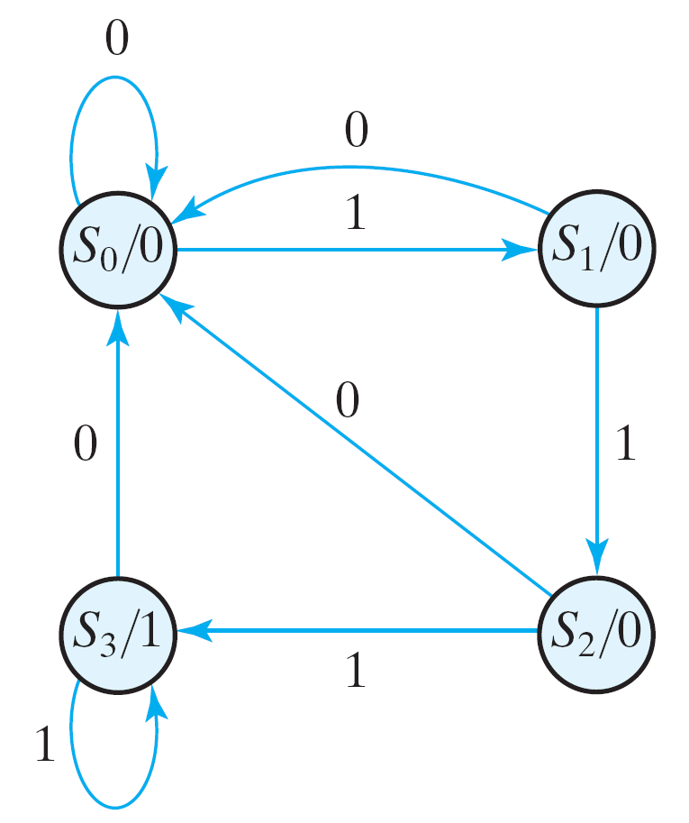
FSM Design: Example (Moore)
State
Diagram

Slide 27
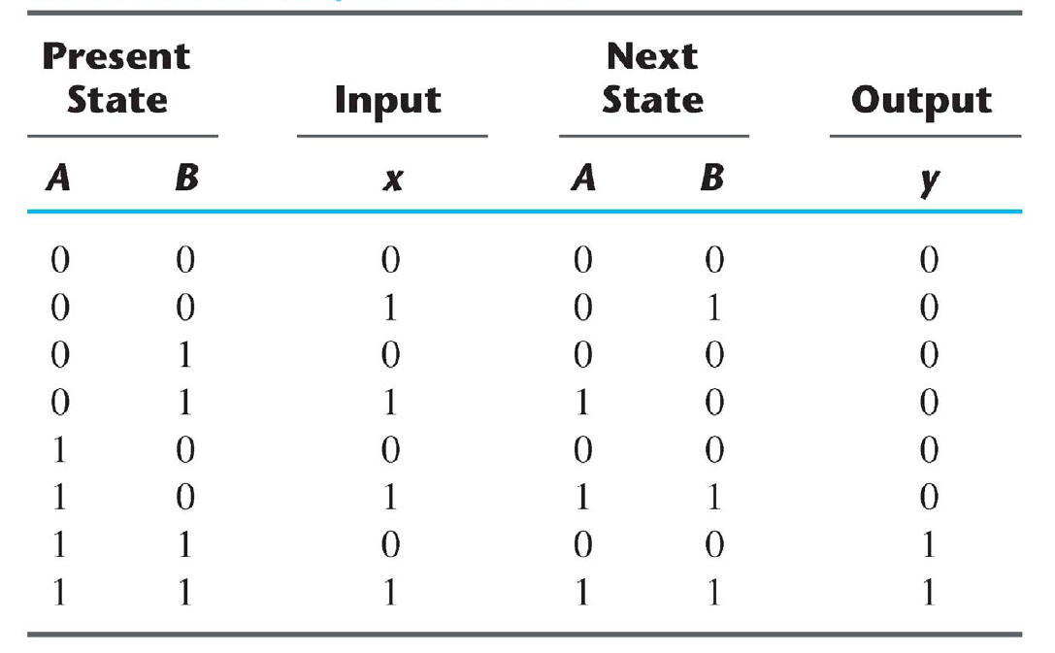
FSM Design: Example (Moore)
Q_{A}
Q_{B}
Q_{A}⁺
Q_{B}⁺
State Table

Slide 28
FSM Design: Example (Moore)
The choice of Flip-Flop determines the complexity of the combinational logic required in the design of the state machine.
Each type of Flip-Flop has a unique characteristic equation.
SR Flip-Flop
  Q⁺ = S + R'.Q
D Flip-Flop
  Q⁺ = D
JK Flip-Flop
  Q⁺ = J.Q' + K'.Q
T Flip-Flop (ignore)
  Q⁺ = T '.Q + T.Q'

Slide 29
FSM Design (Moore)
Synthesis using D Flip-Flops
(Q⁺ = D)

Slide 30
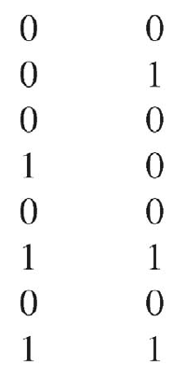
FSM Design: Example (Moore)
Flip-Flop
Input
Q_{A}
Q_{B}
Q_{A}⁺
Q_{B}⁺
D_{A} D_{B}
Q⁺ = D
next state
flip-flop input

Slide 31
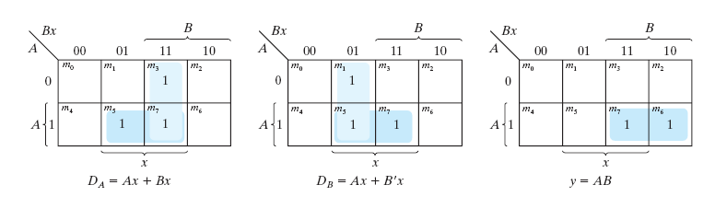
FSM Design: Example (Moore)

Slide 32
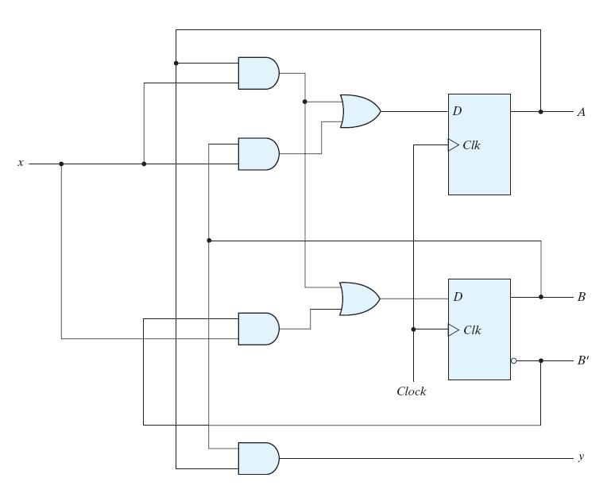
FSM Design: Example (Moore)
Q_{A}
Q_{B}
Q'_{B}

Slide 33
FSM Design (Moore)
Synthesis using JK Flip-Flops
(Q⁺ = J.Q' + K'.Q)

Slide 34
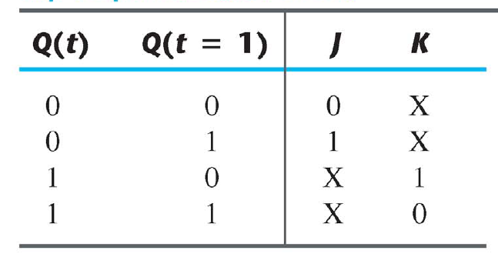
FSM Design: Example (Moore)
+
Excitation Table

Slide 35
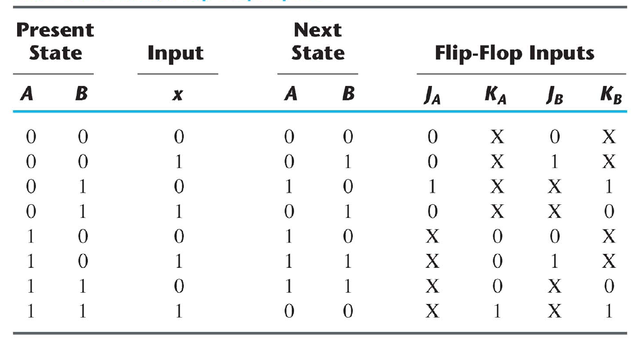
FSM Design: Example (Moore)
Q_{A}
Q_{B}
Q_{A}⁺
Q_{B}⁺
Q⁺ = J.Q' + K'.Q
next state
flip-flop inputs

Slide 36
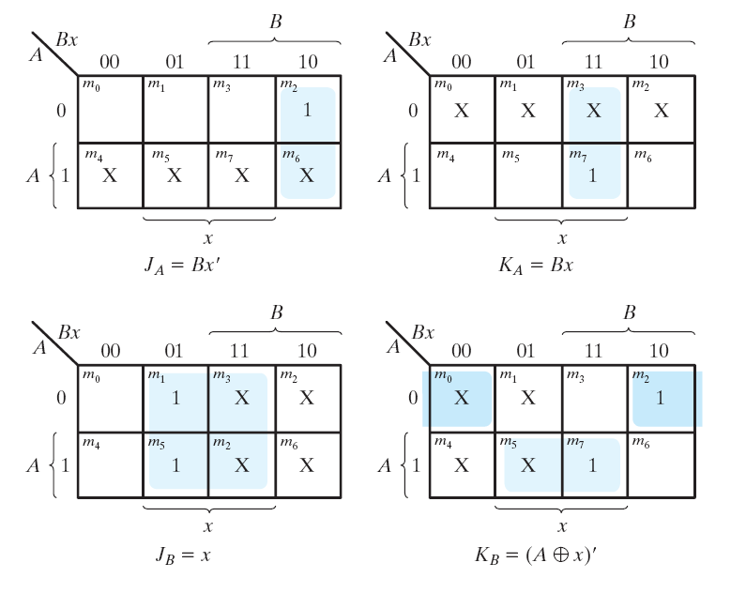
FSM Design: Example (Moore)

Slide 37
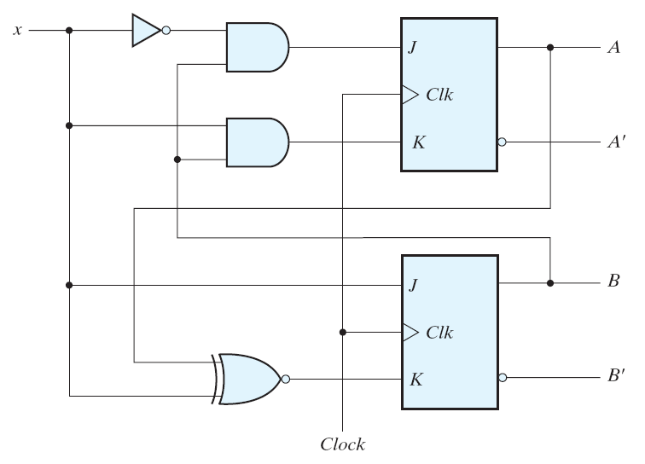
FSM Design: Example (Moore)
Q_{A}
Q'_{A}
Q_{B}
Q'_{B}

Slide 38
FSM Design (Moore)
Example:
Design a Finite State Machine (FSM) that meets the following specifications:
1. The circuit has one input, w, and one output, z.
2. All changes in the circuit occur on the positive edge of the clock.
3. The output z is equal to 1 if the pattern 101 is detected on the input w. Otherwise, the value of z is equal to 0. Overlapping sequences should not be detected.
This is another example of a sequence detector.

Slide 39
FSM Design: Example (Moore)
Input (w): 0 0 0 1 0 1 0 1 1 0 1 1 0 1 1 …
Output (z): 0 0 0 0 0 1 0 0 0 0 1 0 0 1 0 …

Slide 40
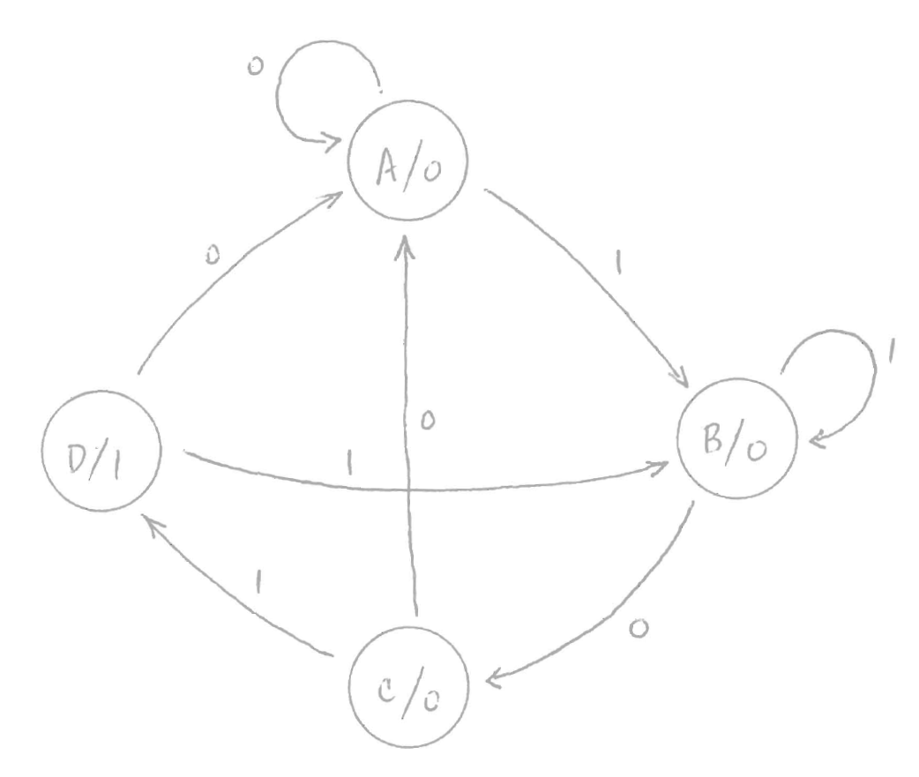
FSM Design: Example (Moore)
Start State
State
Diagram
End State

Slide 41
FSM Design (Moore)
Example:
Design a Finite State Machine (FSM) that meets the following specifications:
1. The circuit has one input, w, and one output, z.
2. All changes in the circuit occur on the positive edge of the clock.
3. The output z is equal to 1 if the pattern 101 is detected on the input w. Otherwise, the value of z is equal to 0. Overlapping sequences should be detected.
This is another example of a sequence detector.

Slide 42
FSM Design: Example (Moore)
Input (w): 0 0 0 1 0 1 0 1 1 0 1 1 0 1 1 …
Output (z): 0 0 0 0 0 1 0 1 0 0 1 0 0 1 0 …

Slide 43
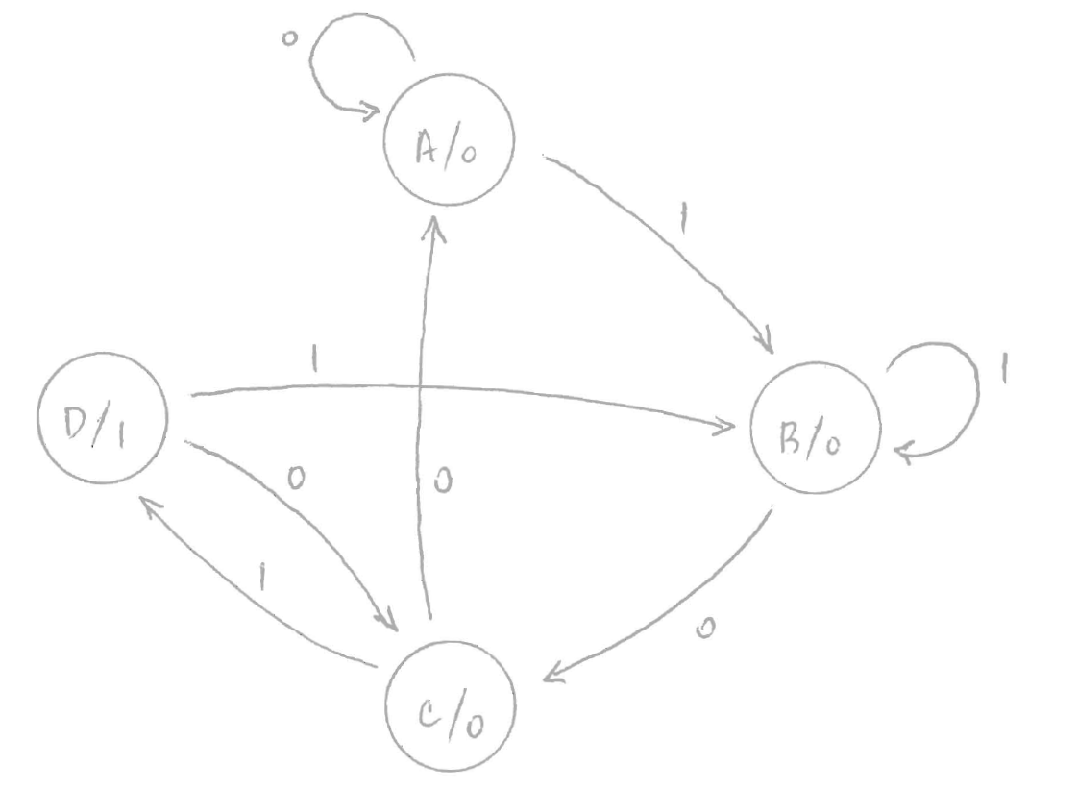
FSM Design: Example (Moore)
Start State
State
Diagram
End State

Slide 44
FSM Design (Moore)
Example:
Design a Finite State Machine (FSM) that meets the following specifications:
1. The circuit has one input, w, and one output, z.
2. All changes in the circuit occur on the positive edge of the clock.
3. The output z is equal to 1 if the pattern 110 or the pattern 010 is detected on the input w. Otherwise, the value of z is equal to 0. Overlapping sequences should be detected.
This is example of a sequence detector that can detect 2 sequences.

Slide 45
FSM Design: Example (Moore)
Input (w): 0 1 0 0 1 1 0 1 0 1 1 1 0 1 1 …
Output (z): 0 0 1 0 0 0 1 0 1 0 0 0 1 0 0 …

Slide 46
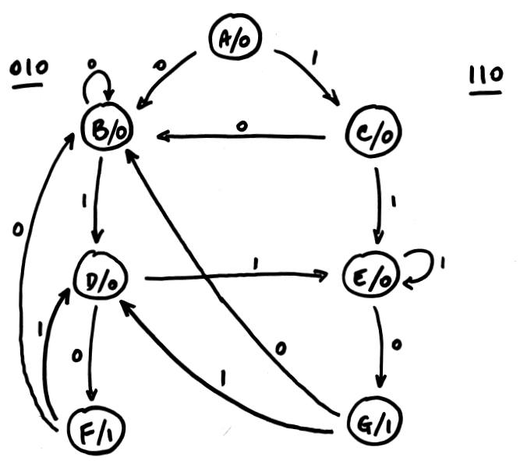
FSM Design: Example (Moore)
State
Diagram

Slide 47
Digital Systems Design
Sequential Logic Circuits:
FSM Design (Mealy)

Slide 48
FSM Design: Procedure
Understand specifications
Derive state diagram
Create state table
Perform state minimization (if necessary)
Encode states (state assignment)
Create state-assigned table
Select type of Flip-Flop to use
Determine Flip-Flop input equations and FSM output equation(s)
Draw circuit diagram

Slide 49
FSM Design
Mealy Machines

Slide 50
FSM Design (Mealy)
Example:
Design a FSM that detects a sequence of three or more consecutive ones on an input bit stream.
The FSM should output a 1 when the sequence is detected, and a 0 otherwise.
This is another example of a sequence detector.

Slide 51
FSM Design: Example (Mealy)
Input: 0 1 1 1 0 1 0 1 1 0 1 1 1 0 1 …
Output: 0 0 0 1 0 0 0 0 0 0 0 0 1 0 0 …

Slide 52
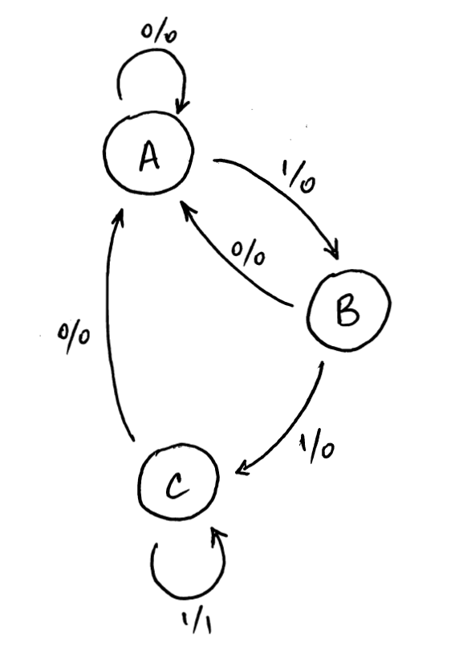
FSM Design: Example (Mealy)
State Diagram
ECE 331 - Digital Systems Design

Slide 53
FSM Design: Example (Moore)
State
Diagram

Slide 54
FSM Design: Example (Mealy)
State Table
Present State |  |  | Next State |  |  |  |  |  | Output
 |  |  | w = 0 |  |  | w = 1 |  |  | w = 0 | w = 1
 | Q_{A} | Q_{B} |  | Q_{A}⁺ | Q_{B}⁺ |  | Q_{A}⁺ | Q_{B}⁺ | z | z
A | 0 | 0 | A | 0 | 0 | B | 0 | 1 | 0 | 0
B | 0 | 1 | A | 0 | 0 | C | 1 | 0 | 0 | 0
C | 1 | 0 | A | 0 | 0 | C | 1 | 0 | 0 | 1
D | 1 | 1 |  | d | d |  | d | d | d | d
Output is a function
of the present state
and the input
(Mealy Machine)
Using Binary Encoding
for the State Assignment
Next state is a function
of the present state
and the input

Slide 55
FSM Design: Example (Mealy)
The choice of Flip-Flop determines the complexity of the combinational logic required in the design of the state machine.
Each type of Flip-Flop has a unique characteristic equation.
SR Flip-Flop
  Q⁺ = S + R'.Q
D Flip-Flop
  Q⁺ = D
JK Flip-Flop
  Q⁺ = J.Q' + K'.Q
T Flip-Flop
  Q⁺ = T '.Q + T.Q'

Slide 56
FSM Design (Mealy)
Synthesis using D Flip-Flops
(Q⁺ = D)

Slide 57
FSM Design: Example (Mealy)
Present State |  |  | Next State |  |  |  | FF Inputs
 |  |  | w = 0 |  | w = 1 |  | w = 0 |  | w = 1
 | Q_{A} | Q_{B} | Q_{A}⁺ | Q_{B}⁺ | Q_{A}⁺ | Q_{B}⁺ | D_{A} | D_{B} | D_{A} | D_{B}
A | 0 | 0 | 0 | 0 | 0 | 1 | 0 | 0 | 0 | 1
B | 0 | 1 | 0 | 0 | 1 | 0 | 0 | 0 | 1 | 0
C | 1 | 0 | 0 | 0 | 1 | 0 | 0 | 0 | 1 | 0
D | 1 | 1 | d | d | d | d | d | d | d | d

Slide 58
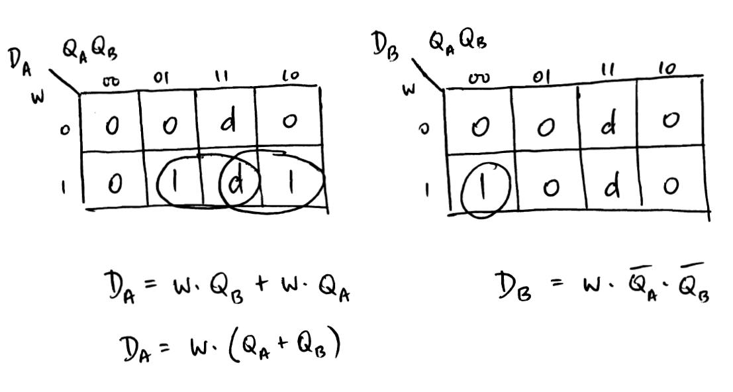
FSM Design: Example (Mealy)
Karnaugh Maps

Slide 59
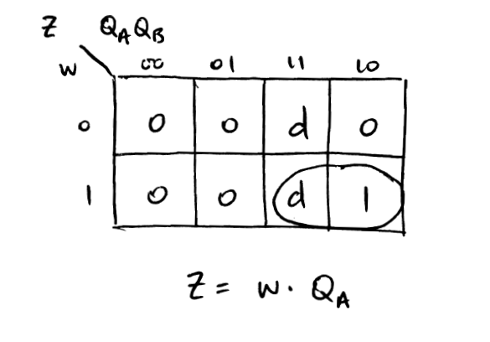
FSM Design: Example (Mealy)
Karnaugh Maps

Slide 60
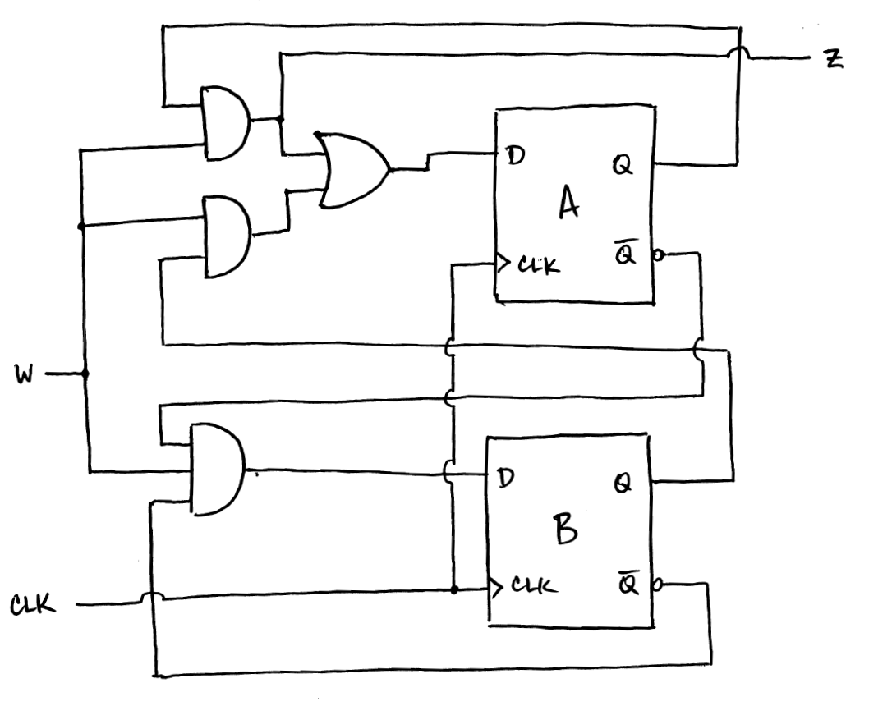
FSM Design: Example (Mealy)
Circuit Diagram

Slide 61
FSM Design (Mealy)
Synthesis using JK Flip-Flops
(Q⁺ = J.Q' + K'.Q)

Slide 62
FSM Design: Example (Mealy)
Q
Q⁺
+
Excitation Table

Slide 63
FSM Design: Example (Mealy)
Present State |  |  | Next State |  |  |  | FF Inputs
 |  |  | w = 0 |  | w = 1 |  | w = 0 |  |  |  | w = 1
 | Q_{A} | Q_{B} | Q_{A}⁺ | Q_{B}⁺ | Q_{A}⁺ | Q_{B}⁺ | J_{A} | K_{A} | J_{B} | K_{B} | J_{A} | K_{A} | J_{B} | K_{B}
A | 0 | 0 | 0 | 0 | 0 | 1 | 0 | d | 0 | d | 0 | d | 1 | d
B | 0 | 1 | 0 | 0 | 1 | 0 | 0 | d | d | 1 | 1 | d | d | 1
C | 1 | 0 | 0 | 0 | 1 | 0 | d | 1 | 0 | d | d | 0 | 0 | d
D | 1 | 1 | d | d | d | d | d | d | d | d | d | d | d | d

Slide 64
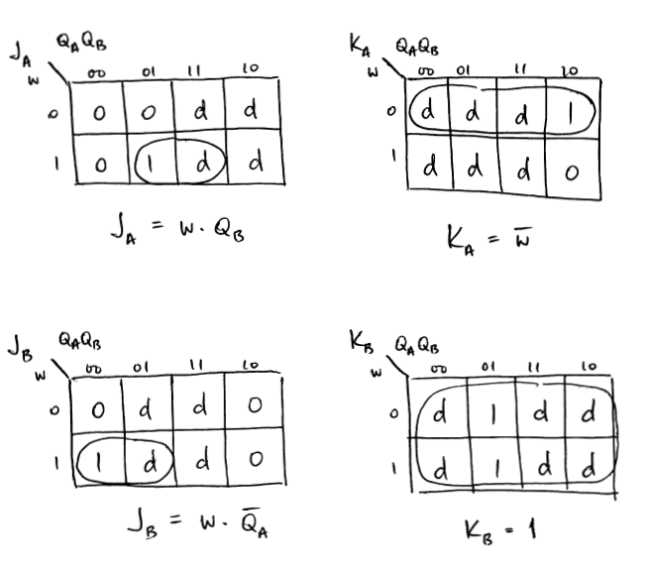
FSM Design: Example (Mealy)
Karnaugh Maps

Slide 65
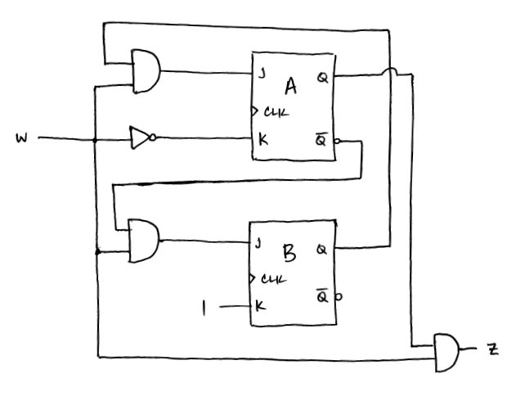
FSM Design: Example (Mealy)
Circuit Diagram

Slide 66
FSM Design (Mealy)
Example:
Design a Finite State Machine (FSM) that meets the following specifications:
1. The circuit has one input, w, and one output, z.
2. All changes in the circuit occur on the positive edge of the clock.
3. The output z is equal to 1 if the pattern 010 is detected on the input w. Otherwise, the value of z is equal to 0. Overlapping sequences should not be detected.
This is another example of a sequence detector.

Slide 67
FSM Design: Example (Mealy)
Input (w): 0 0 0 0 1 0 1 0 0 1 0 0 1 0 1 …
Output (z): 0 0 0 0 0 1 0 0 0 0 1 0 0 1 0 …

Slide 68
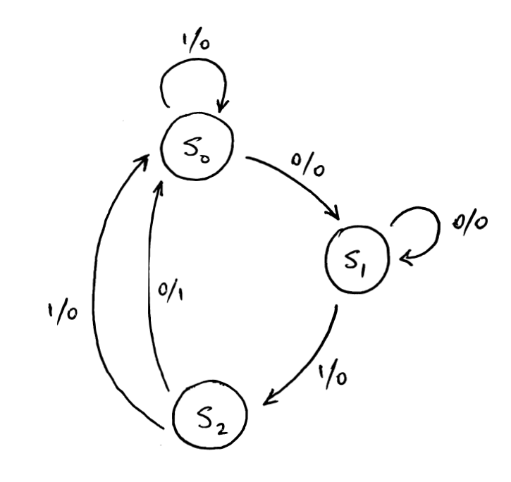
FSM Design: Example (Mealy)
State Diagram

Slide 69
FSM Design (Mealy)
Example:
Design a Finite State Machine (FSM) that meets the following specifications:
1. The circuit has one input, w, and one output, z.
2. All changes in the circuit occur on the positive edge of the clock.
3. The output z is equal to 1 if the pattern 010 is detected on the input w. Otherwise, the value of z is equal to 0. Overlapping sequences should be detected.
This is another example of a sequence detector.

Slide 70
FSM Design: Example (Mealy)
Input (w): 0 0 0 0 1 0 1 0 0 1 0 0 1 0 1 …
Output (z): 0 0 0 0 0 1 0 1 0 0 1 0 0 1 0 …

Slide 71
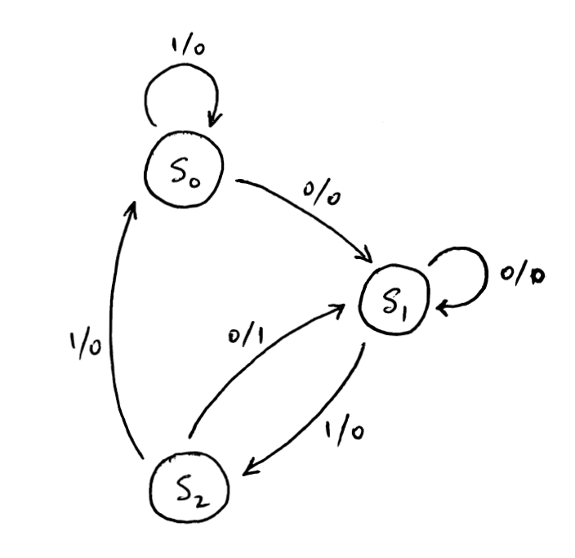
FSM Design: Example (Mealy)
State Diagram

Slide 72
FSM Design (Mealy)
Example:
Design a Finite State Machine (FSM) that meets the following specifications:
1. The circuit has one input, w, and one output, z.
2. All changes in the circuit occur on the positive edge of the clock.
3. The output z is equal to 1 if the pattern 010 or the pattern 110 is detected on the input w. Otherwise, the value of z is equal to 0. Overlapping sequences should be detected.
This is example of a sequence detector that can detect 2 sequences.

Slide 73
FSM Design: Example (Mealy)
Input (w): 0 1 0 0 1 1 0 1 0 1 1 1 0 1 1 …
Output (z): 0 0 1 0 0 0 1 0 1 0 0 0 1 0 0 …

Slide 74
Acknowledgments
The slides used in this lecture were taken, with permission, from those provided by Pearson Prentice Hall for
Digital Design (4th Edition).
They are the property of and are copyrighted by
Pearson Education.

