Slide 1
Digital Systems Design
Introduction to Sequential Logic Circuits
(aka. Finite State Machines)
and
FSM Analysis

Slide 2
Combinational vs. Sequential
Combinational Logic Circuit
  Output is a function of the inputs.
  Does not have state information.
  Does not require memory.
Sequential Logic Circuit
  Output is a function of the present state (and of the inputs).
  Has state information
  Requires memory.
  Uses Flip-Flops to implement memory.

Slide 3
Synchronous vs. Asynchronous
Synchronous Sequential Logic Circuit
  Clocked
  All Flip-Flops use the same clock and change state on the same triggering edge.
Asynchronous Sequential Logic Circuit
  No clock
  Can change state at any instance in time.
  Faster but more complex than synchronous sequential circuits.

Slide 4
Finite State Machine: Models
Moore Machine
  Outputs are a function of the present state.
  Outputs are independent of the inputs.
  State diagram includes an output value for each state.
Mealy Machine
  Outputs are a function of the present state and the input.
  State diagram includes an input and output value for each transition (between states).
There is an equivalent Mealy machine for each Moore machine.

Slide 5
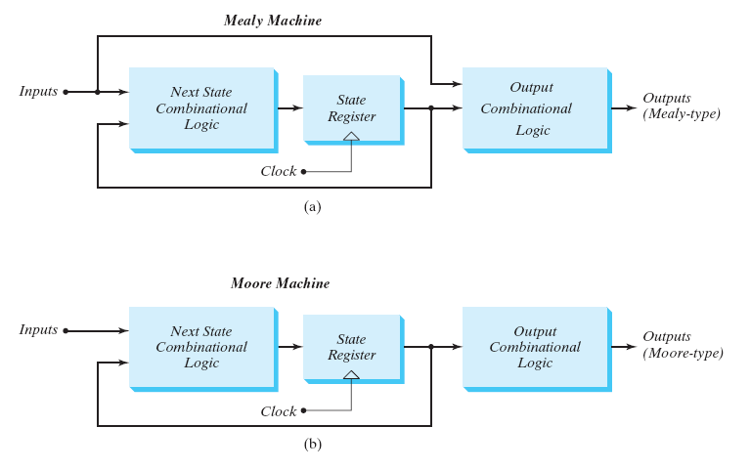
Finite State Machine: Models

Slide 6
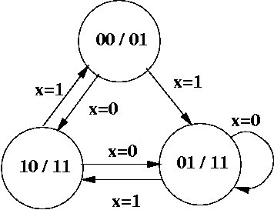
FSM: State Diagram (Moore)
Output
State
A
Input
C
B

Slide 7
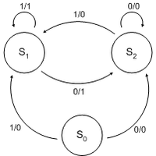
FSM: State Diagram (Mealy)
State
Output
Input

Slide 8
Finite State Machine Analysis

Slide 9
FSM Analysis: Procedure
Determine the Flip-Flop input equations
  In terms of the present state and input variables
Determine the FSM output equation(s)
Determine the next state values in the state table
  Assume binary encoding
  Use Flip-Flop Characteristic Equation
Construct the state table
  Assign a state to each binary state assignment
Draw the corresponding state diagram
Determine the behavior of the FSM

Slide 10
FSM Analysis
Example:
FSM using D Flip-Flops

Slide 11
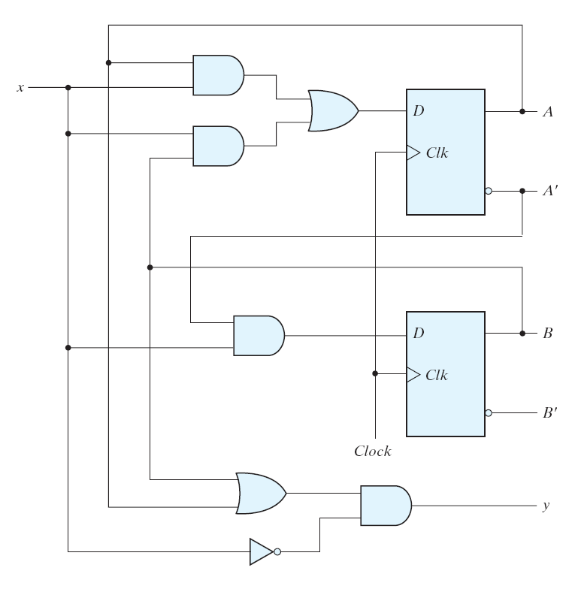
FSM Analysis: Example (D FF)
input
state
output
What type of
FSM is this?

Slide 12
FSM Analysis: Example (D FF)
Determine the FF input equations
and the FSM output equation(s)

Slide 13
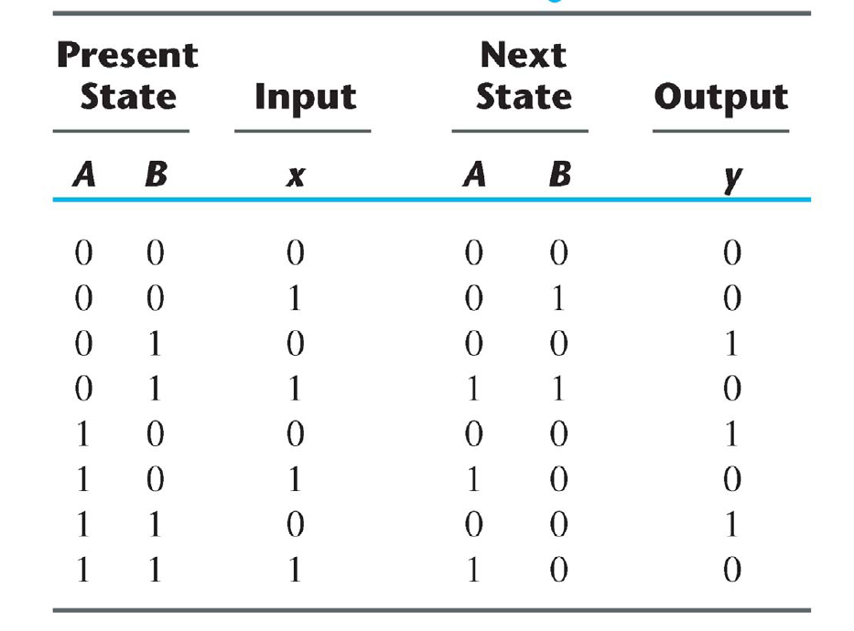
FSM Analysis: Example (D FF)

Slide 14
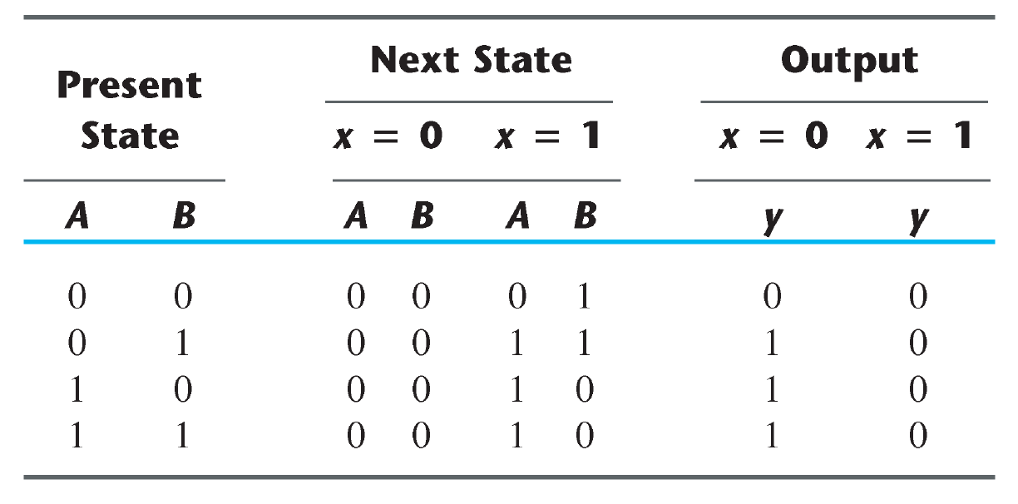
FSM Analysis: Example (D FF)

Slide 15
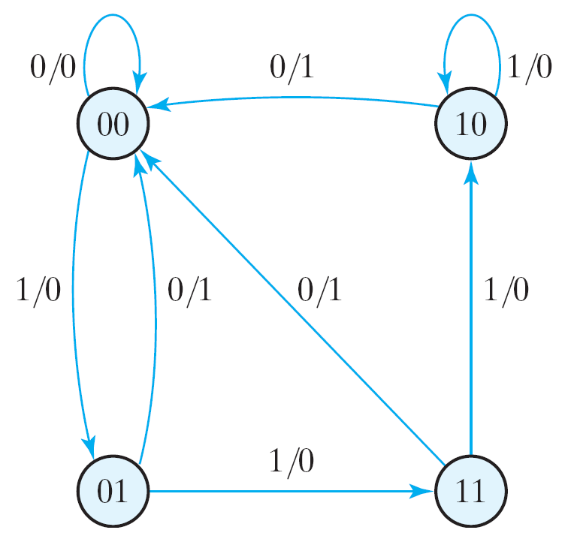
FSM Analysis: Example (D FF)

Slide 16
FSM Analysis
Example:
FSM using JK Flip-Flops

Slide 17
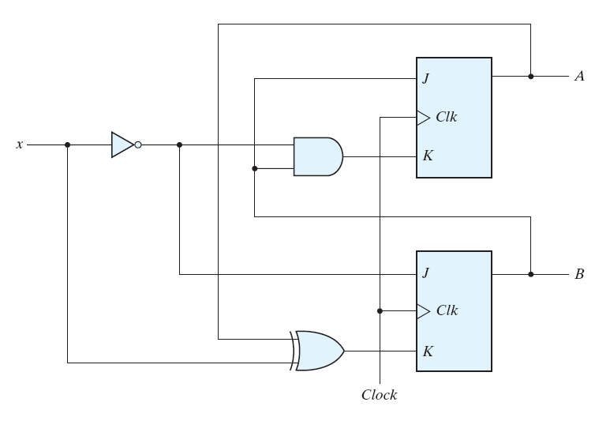
FSM Analysis: Example (JK FF)
state
input
What type of
FSM is this?

Slide 18
FSM Analysis: Example (JK FF)
Determine the FF input equations
and the FSM output equation(s)

Slide 19
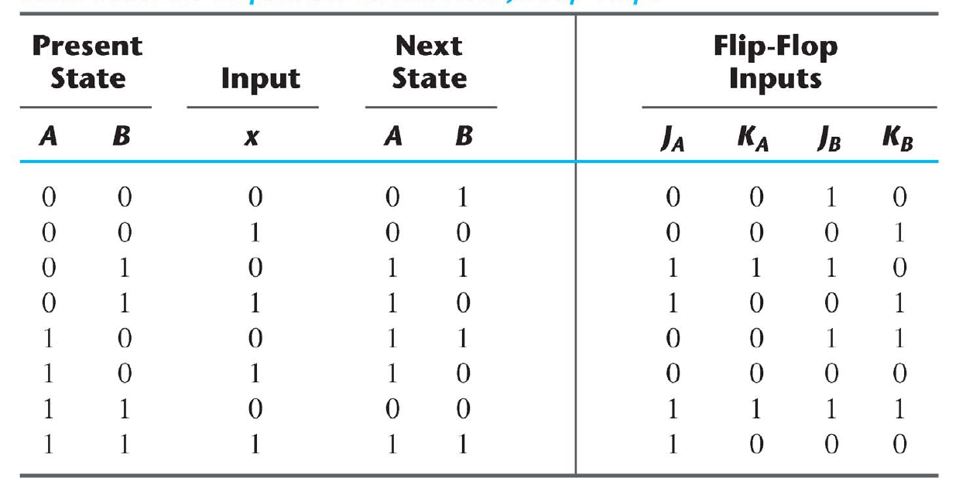
FSM Analysis: Example (JK FF)

Slide 20
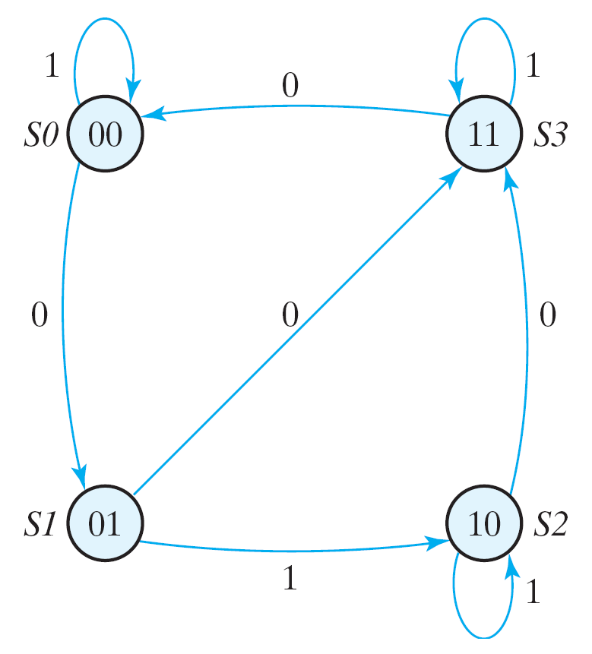
FSM Analysis: Example (JK FF)

Slide 21
FSM Analysis
Example:
FSM using T Flip-Flops

Slide 22
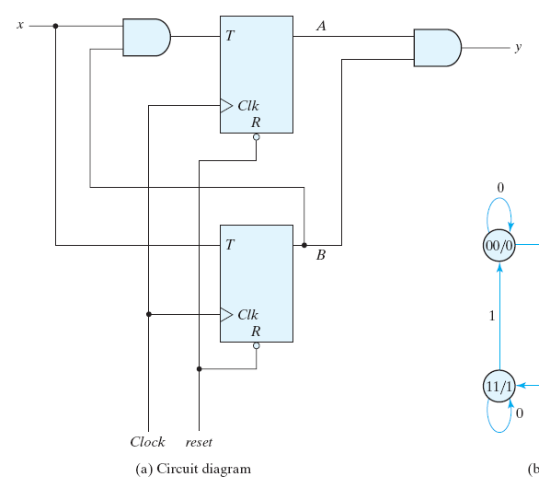
FSM Analysis: Example (T FF)
input
output
state
What type of
FSM is this?

Slide 23
FSM Analysis: Example (T FF)
Determine the FF input equations
and the FSM output equation(s)

Slide 24
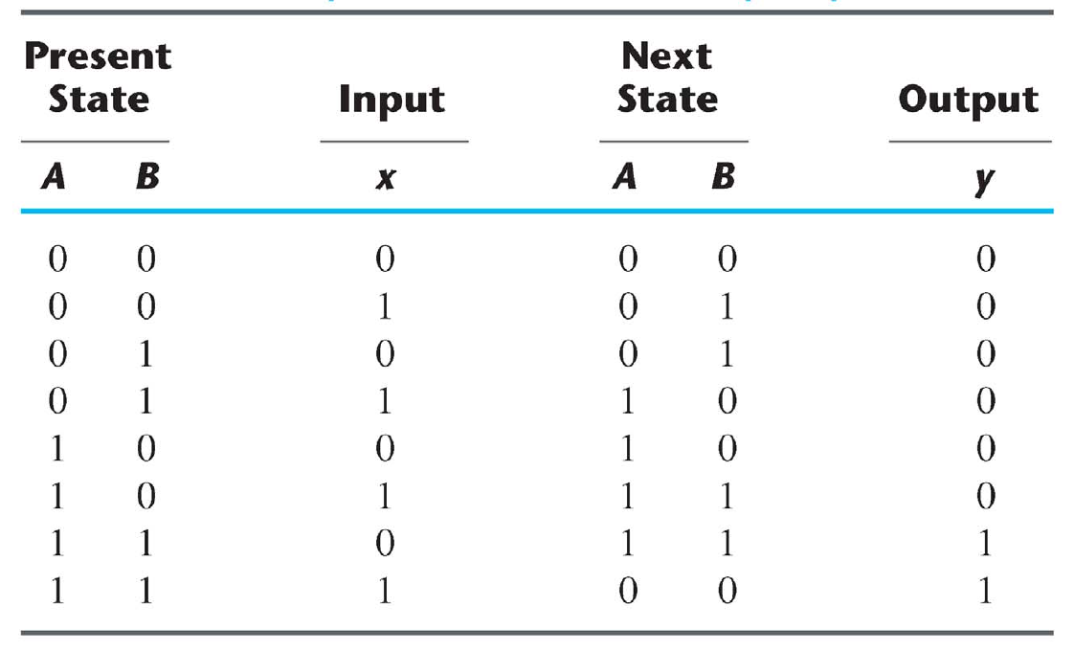
FSM Analysis: Example (T FF)

Slide 25
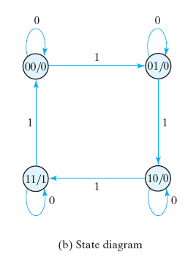
FSM Analysis: Example (T FF)

Slide 26
Acknowledgments
The slides used in this lecture were taken, with permission, from those provided by Pearson Prentice Hall for
Digital Design (4th Edition).
They are the property of and are copyrighted by
Pearson Education.

