Slide 1

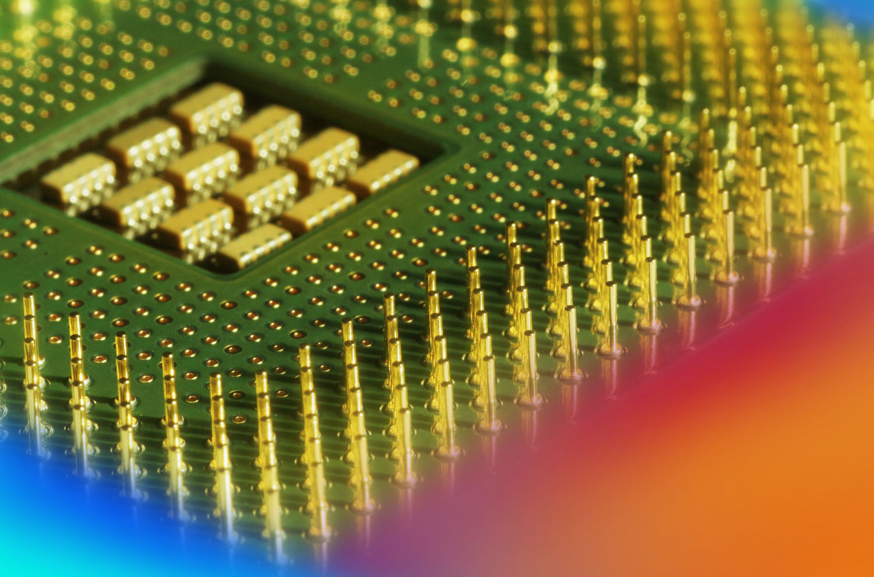
Digital Fundamentals
Tenth Edition
Floyd
Chapter 7
© 2008 Pearson Education

Slide 2
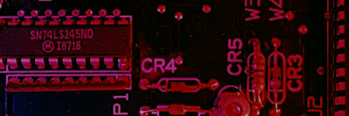
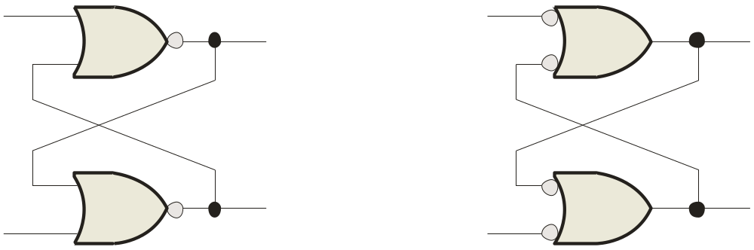
Summary
Latches
A latch is a temporary storage device that has two stable states (bistable). It is a basic form of memory.
The S-R (Set-Reset) latch is the most basic type. It can be constructed from NOR gates or NAND gates. With NOR gates, the latch responds to active-HIGH inputs; with NAND gates, it responds to active-LOW inputs.
R
S
Q
Q
Q
Q
S
R
NOR Active-HIGH Latch NAND Active-LOW Latch

Slide 3
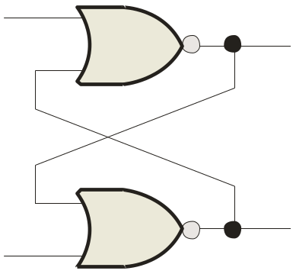
Summary
Latches
The active-HIGH S-R latch is in a stable (latched) condition when both inputs are LOW.
0
R
1
Assume the latch is initially RESET (Q = 0) and the inputs are at their inactive level (0). To SET the latch (Q = 1), a momentary HIGH signal is applied to the S input while the R remains LOW.
0
Q
Latch initially RESET
0
1
Q
0
S
0
R
0
To RESET the latch (Q = 0), a momentary HIGH signal is applied to the R input while the S remains LOW.
1
Q
Latch initially SET
1
0
Q
0
S

Slide 4
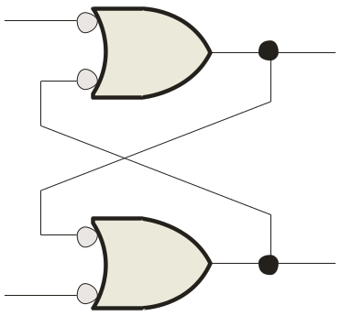
Summary
Latches
The active-LOW S-R latch is in a stable (latched) condition when both inputs are HIGH.
Assume the latch is initially RESET (Q = 0) and the inputs are at their inactive level (1). To SET the latch (Q = 1), a momentary LOW signal is applied to the S input while the R remains HIGH.
1
S
1
0
Q
Latch initially RESET
0
1
Q
1
R
To RESET the latch a momentary LOW is applied to the R input while S is HIGH.
1
S
0
1
Q
Latch initially SET
Never apply an active set and reset at the same time (invalid).
1
0
1
Q
R

Slide 5
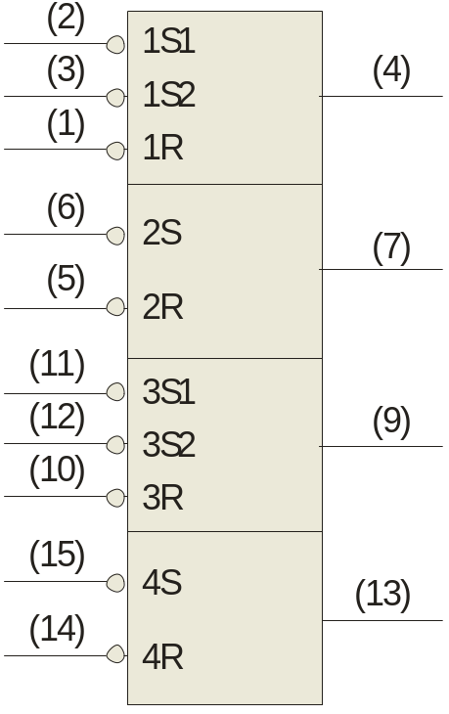
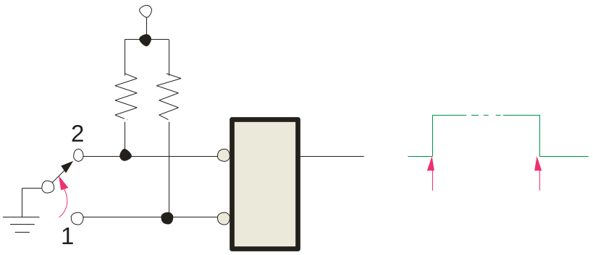
Summary
Latches
The active-LOW S-R latch is available as the 74LS279A IC.
It features four internal latches with two having two S inputs. To SET any of the latches, the S line is pulsed low. It is available in several packages.
1Q
S-R latches are frequently used for switch debounce circuits as shown:
2Q
V_{CC}
3Q
S
Q
4Q
S
R
R
Position 1 to 2
Position 2 to 1
74LS279A

Slide 6
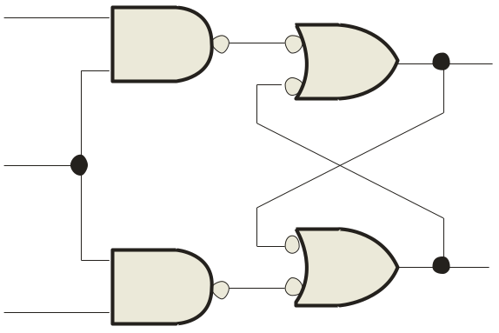
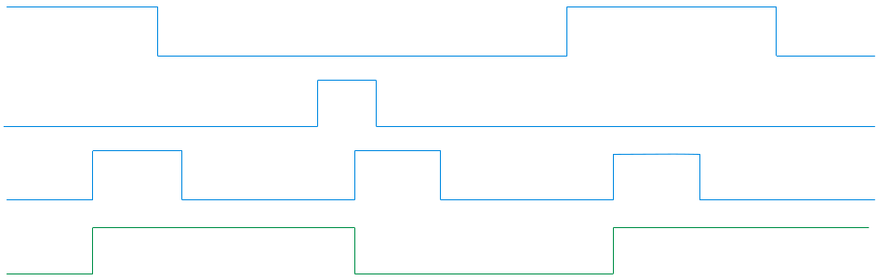

Summary
Latches
A gated latch is a variation on the basic latch.
The gated latch has an additional input, called enable (EN) that must be HIGH in order for the latch to respond to the S and R inputs.
S
Q
EN
Example
Show the Q output with relation to the input signals. Assume Q starts LOW.
Q
R
Solution
Keep in mind that S and R are only active when EN is HIGH.
S
R
EN
Q

Slide 7
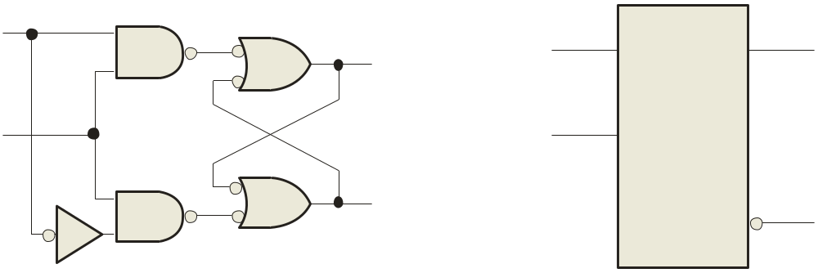
Summary
Latches
The D latch is an variation of the S-R latch but combines the S and R inputs into a single D input as shown:
D
D
Q
Q
EN
EN
Q
Q
A simple rule for the D latch is:
Q follows D when the Enable is active.

Slide 8
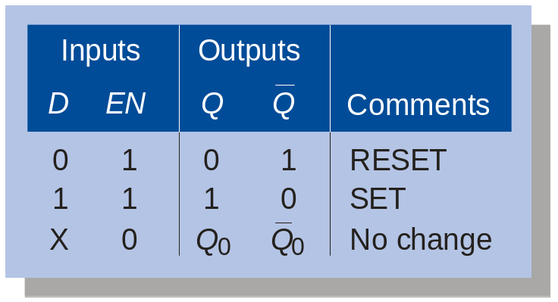
Summary
Latches
The truth table for the D latch summarizes its operation. If EN is LOW, then there is no change in the output and it is latched.

Slide 9
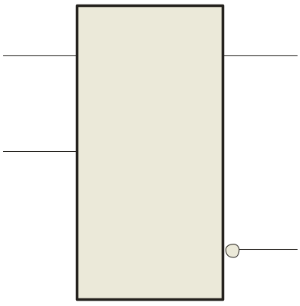

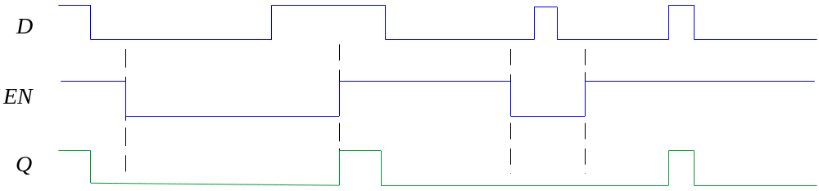
Summary
Latches
Q
D
Example
EN
Determine the Q output for the D latch, given the inputs shown.
Q
Notice that the Enable is not active during these times, so the output is latched.

Slide 10
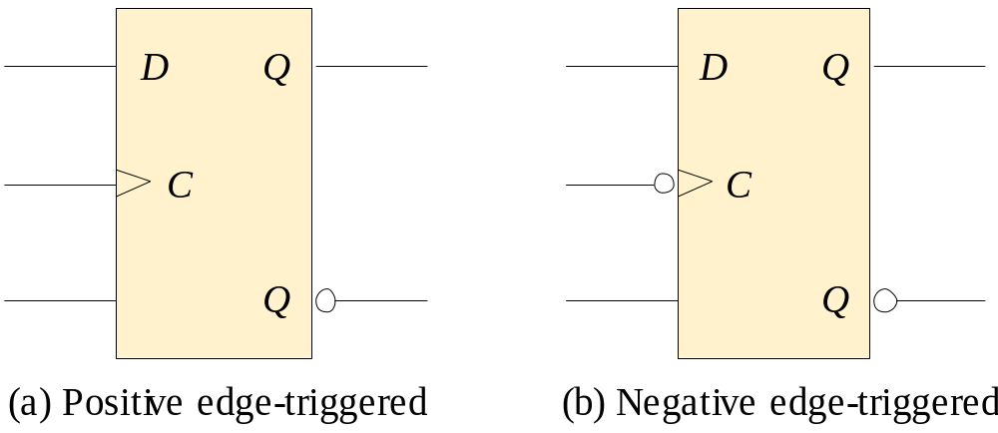
Summary
Flip-flops
A flip-flop differs from a latch in the manner it changes states. A flip-flop is a clocked device, in which only the clock edge determines when a new bit is entered.
The active edge can be positive or negative.
Dynamic input indicator

Slide 11
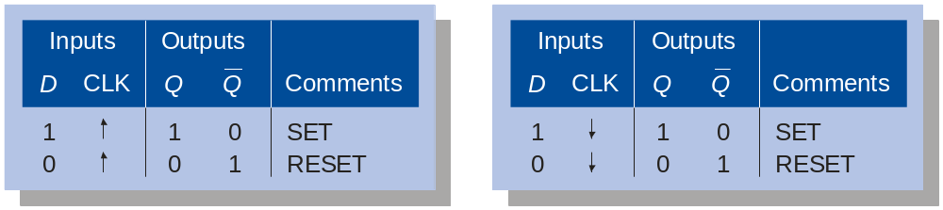
Summary
Flip-flops
The truth table for a positive-edge triggered D flip-flop shows an up arrow to remind you that it is sensitive to its D input only on the rising edge of the clock; otherwise it is latched. The truth table for a negative-edge triggered D flip-flop is identical except for the direction of the arrow.
(a) Positive-edge triggered (b) Negative-edge triggered

Slide 12
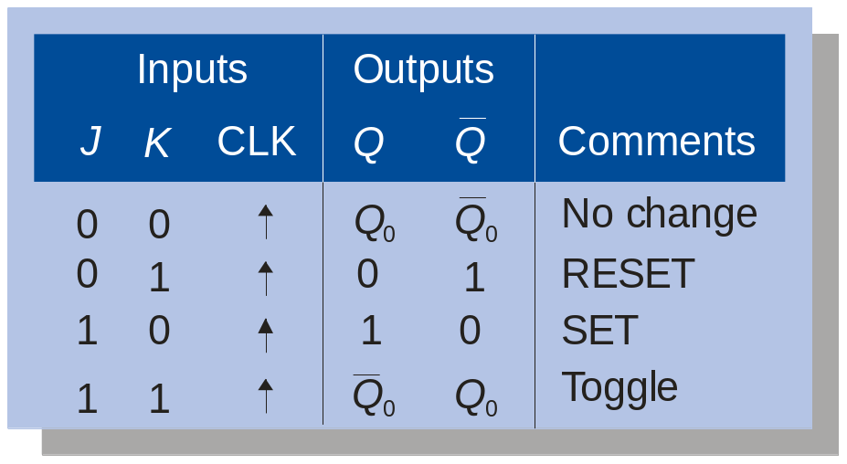
Summary
Flip-flops
The J-K flip-flop is more versatile than the D flip flop. In addition to the clock input, it has two inputs, labeled J and K. When both J and K = 1, the output changes states (toggles) on the active clock edge (in this case, the rising edge).

Slide 13
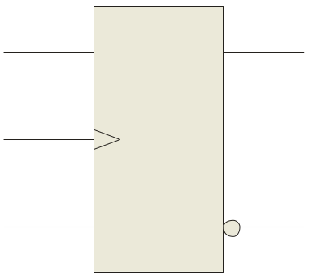
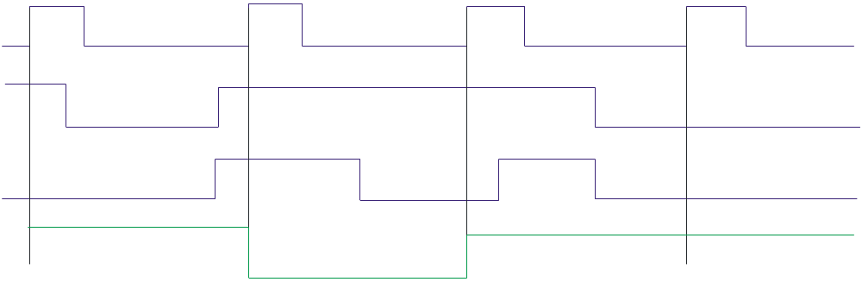
Summary
Flip-flops
Q
J
Example
Determine the Q output for the J-K flip-flop, given the inputs shown.
CLK
K
Q
Notice that the outputs change on the leading edge of the clock.
Solution
Set
Toggle
Set
Latch
CLK
J
K
Q

Slide 14
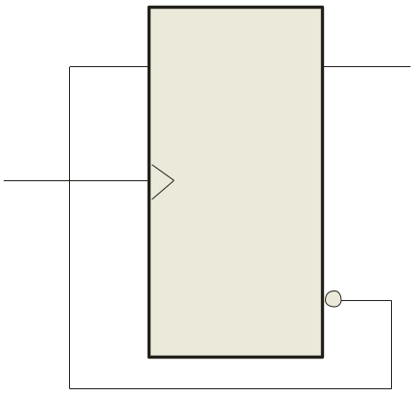
Summary
Flip-flops
A D-flip-flop does not have a toggle mode like the J-K flip-flop, but you can hardwire a toggle mode by connecting Q back to D as shown. This is useful in some counters as you will see in Chapter 8.
D
Q
For example, if Q is LOW, Q is HIGH and the flip-flop will toggle on the next clock edge. Because the flip-flop only changes on the active edge, the output will only change once for each clock pulse.
CLK
CLK
Q
D flip-flop hardwired for a toggle mode

Slide 15
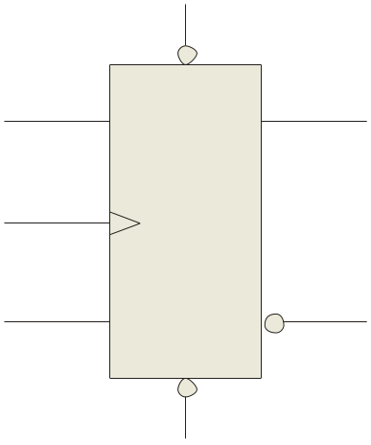
Summary
Flip-flops
Synchronous inputs are transferred in the triggering edge of the clock (for example the D or J-K inputs). Most flip-flops have other inputs that are asynchronous, meaning they affect the output independent of the clock.
PRE
Two such inputs are normally labeled preset (PRE) and clear (CLR). These inputs are usually active LOW. A J-K flip flop with active LOW preset and CLR is shown.
Q
J
CLK
K
Q
CLR

Slide 16
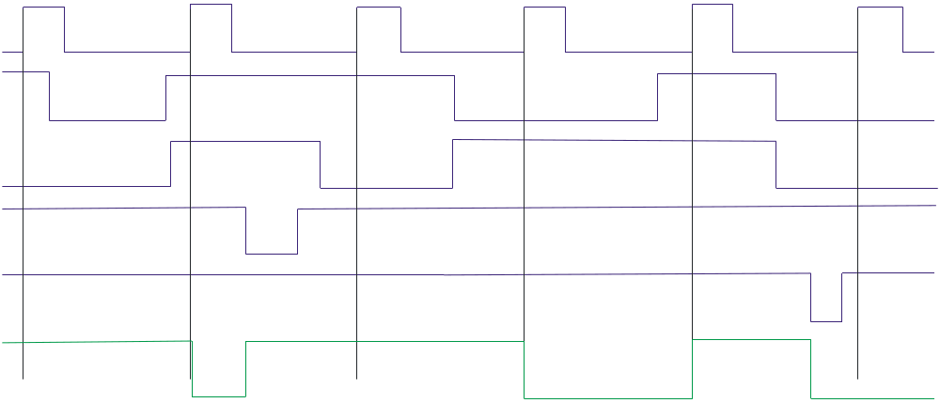
Summary
PRE
Flip-flops
Flip-flops
Q
J
Example
CLK
Determine the Q output for the J-K flip-flop, given the inputs shown.
K
Q
Solution
CLR
Set
Toggle
Set
Reset
Toggle
Latch
CLK
J
K
Set
PRE
Reset
CLR
Q

Slide 17
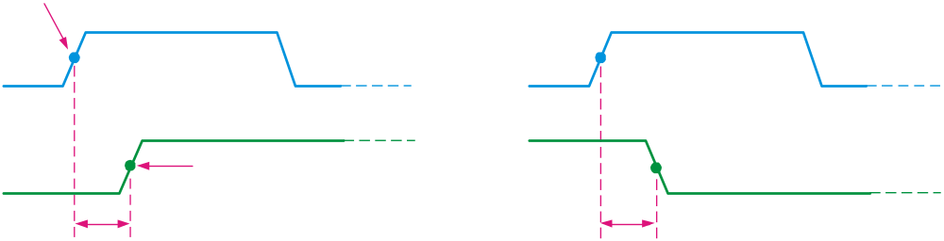
Summary
Flip-flop Characteristics
Propagation delay time is specified for the rising and falling outputs. It is measured between the 50% level of the clock to the 50% level of the output transition.
50% point on triggering edge
CLK
CLK
50% point
Q
50% point on LOW-to-HIGH transition of Q
Q
50% point on HIGH-to- LOW transition of Q
t_{PLH}
t_{PHL}
The typical propagation delay time for the 74AHC family (CMOS) is 4 ns. Even faster logic is available for specialized applications.

Slide 18
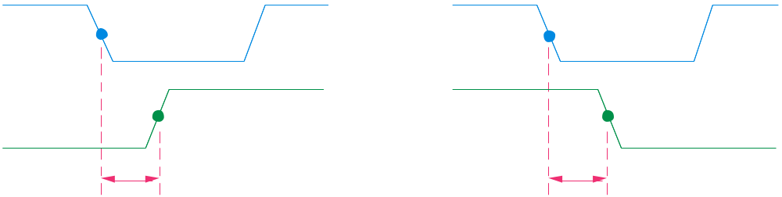
Summary
Flip-flop Characteristics
Another propagation delay time specification is the time required for an asynchronous input to cause a change in the output. Again it is measured from the 50% levels. The 74AHC family has specified delay times under 5 ns.
PRE
50% point
CLR
50% point
Q
50% point
Q
50% point
t_{PHL}
t_{PLH}

Slide 19
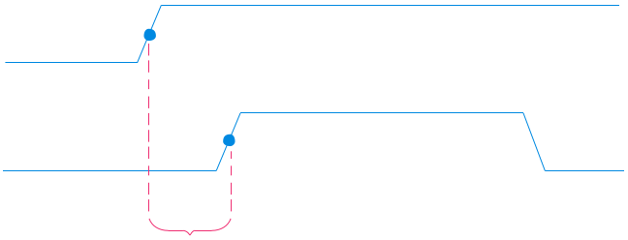
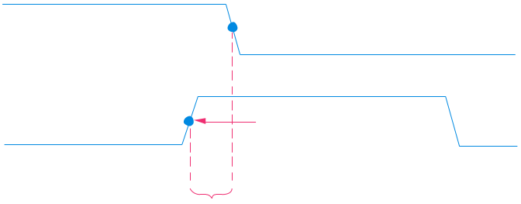
Summary
Flip-flop Characteristics
Set-up time and hold time are times required before and after the clock transition that data must be present to be reliably clocked into the flip-flop.
Setup time is the minimum time for the data to be present before the clock.
D
CLK
Set-up time, t_{s}
Hold time is the minimum time for the data to remain after the clock.
D
CLK
Hold time, t_{H}

Slide 20
Summary
Flip-flop Characteristics
Other specifications include maximum clock frequency, minimum pulse widths for various inputs, and power dissipation. The power dissipation is the product of the supply voltage and the average current required.
A useful comparison between logic families is the speed-power product which uses two of the specifications discussed: the average propagation delay and the average power dissipation. The unit is energy.
Example
What is the speed-power product for 74AHC74A? Use the data from Table 7-5 to determine the answer.
Solution
From Table 7-5, the average propagation delay is 4.6 ns. The quiescent power dissipated is 1.1 mW. Therefore, the speed-power product is
5 pJ

Slide 21
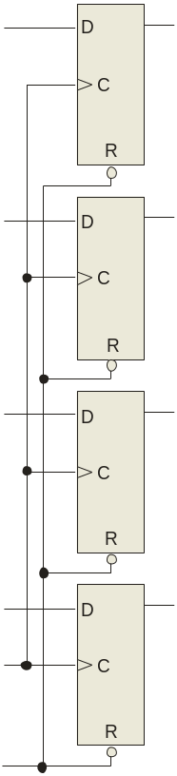
Summary
Flip-flop Applications
Output lines
Principal flip-flop applications are for temporary data storage, as frequency dividers, and in counters (which are covered in detail in Chapter 8).
Q₀
Q₁
Typically, for data storage applications, a group of flip-flops are connected to parallel data lines and clocked together. Data is stored until the next clock pulse.
Q₂
Parallel data input lines
Q₃
Clock
Clear

Slide 22
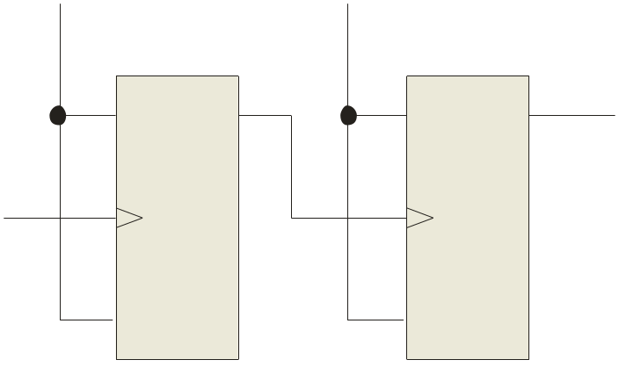
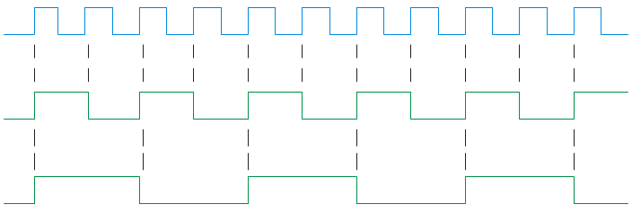
Summary
Flip-flop Applications
For frequency division, it is simple to use a flip-flop in the toggle mode or to chain a series of toggle flip flops to continue to divide by two.
HIGH
HIGH
One flip-flop will divide f_{in} by 2, two flip-flops will divide f_{in} by 4 (and so on). A side benefit of frequency division is that the output has an exact 50% duty cycle.
J
Q_{A}
J
Q_{B}
f_{out}
f_{in}
CLK
CLK
K
K
f_{in}
Waveforms:
f_{out}

Slide 23
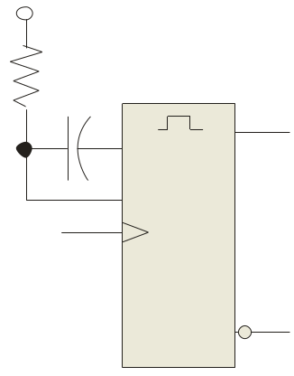
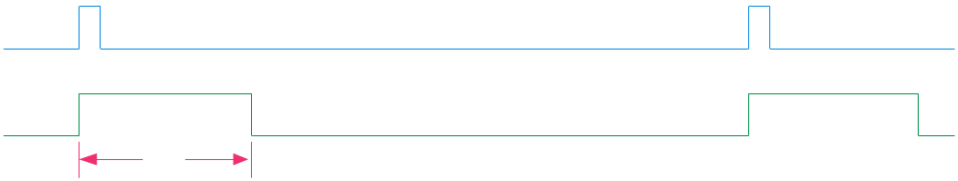
Summary
One-Shots
The one-shot or monostable multivibrator is a device with only one stable state. When triggered, it goes to its unstable state for a predetermined length of time, then returns to its stable state.
+V
R_{EXT}
C_{EXT}
For most one-shots, the length of time in the unstable state (t_{W}) is determined by an external RC circuit.
Q
CX
RX/CX
Trigger
Q
Trigger
Q
t_{W}

Slide 24
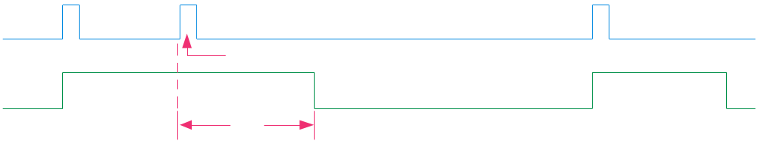
Summary
One-Shots
Nonretriggerable one-shots do not respond to any triggers that occur during the unstable state.
Retriggerable one-shots respond to any trigger, even if it occurs in the unstable state. If it occurs during the unstable state, the state is extended by an amount equal to the pulse width.
Retriggerable one-shot:
Trigger
Retriggers
Q
t_{W}

Slide 25
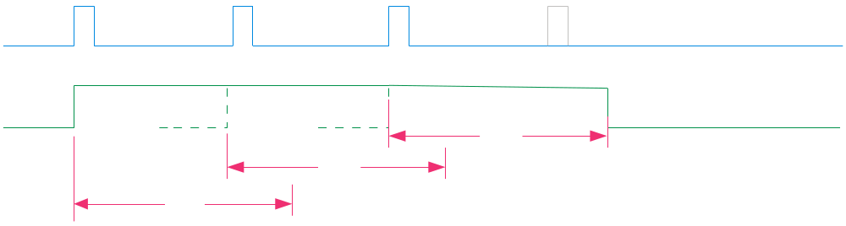
Summary
One-Shots
An application for a retriggerable one-shot is a power failure detection circuit. Triggers are derived from the ac power source, and continue to retrigger the one shot. In the event of a power failure, the one-shot is not triggered and an alarm can be initiated.
Triggers derived from ac
Missing trigger due to power failure
Q
Retriggers
Retriggers
Power failure indication
t_{W}
t_{W}
t_{W}

Slide 26
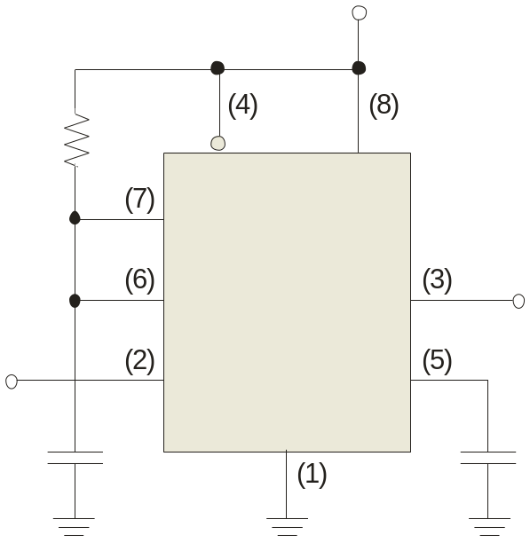
Summary
The 555 timer
The 555 timer can be configured in various ways, including as a one-shot. A basic one shot is shown. The pulse width is determined by R₁C₁ and is approximately t_{W} = 1.1R₁C₁.
+V_{CC}
R₁
RESET
V_{CC}
DISCH
The trigger is a negative-going pulse.
THRES
OUT
t_{W} = 1.1R₁C₁
TRIG
CONT
GND
C₁

Slide 27
Summary
The 555 timer
Example
Determine the pulse width for the circuit shown.
Solution
t_{W} = 1.1R₁C₁ = 1.1(10 kΩ)(2.2 μF) =
24.2 ms
+V_{CC}
+15 V
R₁
10 kΩ
RESET
V_{CC}
DISCH
THRES
OUT
t_{W} = 1.1R₁C₁
TRIG
CONT
C₁
GND
2.2 μF

Slide 28
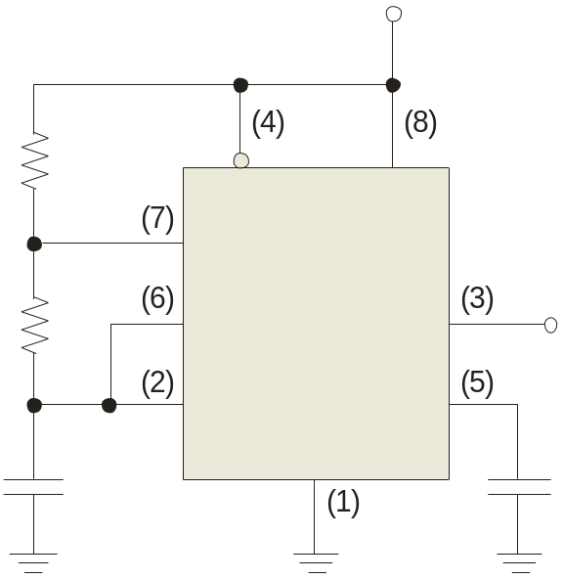
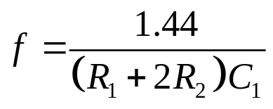
Summary
The 555 timer
The 555 can be configured as a basic astable multivibrator with the circuit shown. In this circuit C₁ charges through R₁ and R₂ and discharges through only R₂. The output frequency is given by:
+V_{CC}
R₁
RESET
V_{CC}
DISCH
The frequency and duty cycle are set by these components.
R₂
THRES
OUT
TRIG
CONT
C₁
GND

Slide 29
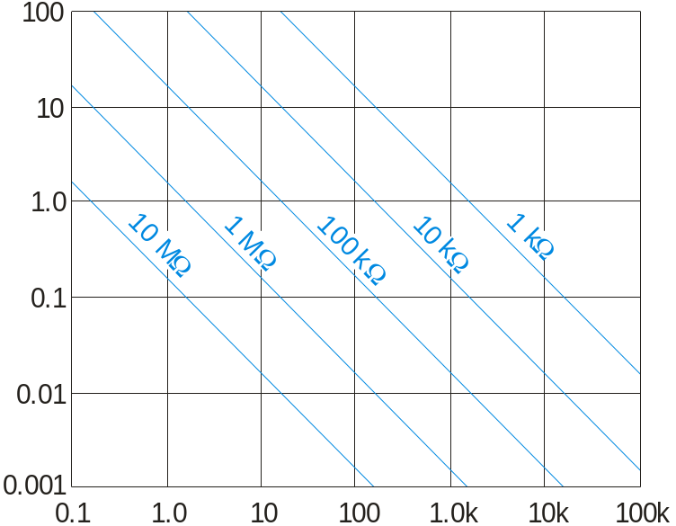
Summary
The 555 timer
Given the components, you can read the frequency from the chart. Alternatively, you can use the chart to pick components for a desired frequency.
+V_{CC}
R₁
RESET
V_{CC}
DISCH
C₁ (μF)
R₂
THRES
OUT
TRIG
CONT
C₁
GND
f (Hz)

Slide 30

Selected Key Terms
Latch
Bistable
Clock
D flip-flop
J-K flip-flop
A bistable digital circuit used for storing a bit.
Having two stable states. Latches and flip-flops are bistable multivibrators.
A triggering input of a flip-flop.
A type of bistable multivibrator in which the output assumes the state of the D input on the triggering edge of a clock pulse.
A type of flip-flop that can operate in the SET, RESET, no-change, and toggle modes.

Slide 31
Selected Key Terms
Propagation delay time
Set-up time
Hold time
Timer
The interval of time required after an input signal has been applied for the resulting output signal to change.
The time interval required for the input levels to be on a digital circuit.
The time interval required for the input levels to remain steady to a flip-flop after the triggering edge in order to reliably activate the device.
A circuit that can be used as a one-shot or as an oscillator.

Slide 32

Quiz
1. The output of a D latch will not change if
a. the output is LOW
b. Enable is not active
c. D is LOW
d. all of the above
© 2008 Pearson Education

Slide 33
Quiz
2. The D flip-flop shown will
a. set on the next clock pulse
b. reset on the next clock pulse
c. latch on the next clock pulse
d. toggle on the next clock pulse
D
Q
CLK
CLK
Q
© 2008 Pearson Education

Slide 34
Quiz
3. For the J-K flip-flop shown, the number of inputs that are asynchronous is
a. 1
b. 2
c. 3
d. 4
PRE
Q
J
CLK
K
Q
CLR
© 2008 Pearson Education

Slide 35
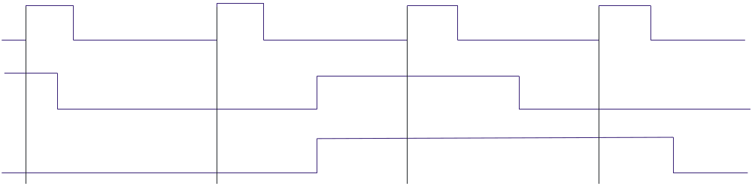
Quiz
4. Assume the output is initially HIGH on a leading edge triggered J-K flip flop. For the inputs shown, the output will go from HIGH to LOW on which clock pulse?
a. 1
b. 2
c. 3
d. 4
CLK
J
K
1 2 3 4
© 2008 Pearson Education

Slide 36
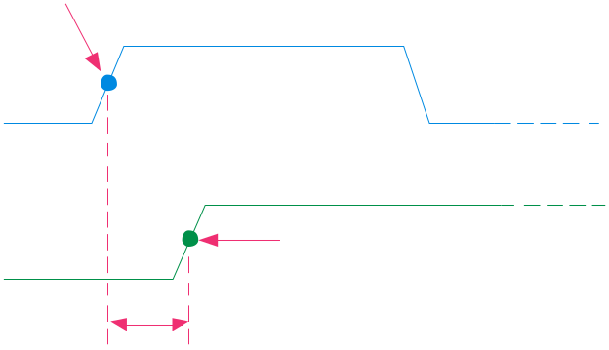
Quiz
5. The time interval illustrated is called
a. t_{PHL}
b. t_{PLH}
c. set-up time
d. hold time
50% point on triggering edge
CLK
Q
50% point on LOW-to-HIGH transition of Q
?
© 2008 Pearson Education

Slide 37
Quiz
6. The time interval illustrated is called
a. t_{PHL}
b. t_{PLH}
c. set-up time
d. hold time
D
CLK
?
© 2008 Pearson Education

Slide 38
Quiz
7. The application illustrated is a
a. astable multivibrator
b. data storage device
c. frequency multiplier
d. frequency divider
HIGH
HIGH
Q_{A}
Q_{B}
f_{out}
J
J
f_{in}
CLK
CLK
K
K
© 2008 Pearson Education

Slide 39
Quiz
Output lines
Q₀
8. The application illustrated is a
a. astable multivibrator
b. data storage device
c. frequency multiplier
d. frequency divider
Q₁
Q₂
Parallel data input lines
Q₃
Clock
Clear
© 2008 Pearson Education

Slide 40
Quiz
9. A retriggerable one-shot with an active HIGH output has a pulse width of 20 ms and is triggered from a 60 Hz line. The output will be a
a. series of 16.7 ms pulses
b. series of 20 ms pulses
c. constant LOW
d. constant HIGH
© 2008 Pearson Education

Slide 41
Quiz
10. The circuit illustrated is a
a. astable multivibrator
b. monostable multivibrator
c. frequency multiplier
d. frequency divider
+V_{CC}
R₁
RESET
V_{CC}
DISCH
R₂
THRES
OUT
TRIG
CONT
C₁
GND
© 2008 Pearson Education

Slide 42
Quiz
Answers:
1. b
2. d
3. b
4. c
5. b
6. d
7. d
8. b
9. d
10. a

