Slide 1


Digital Fundamentals
Tenth Edition
Floyd
Chapter 11

Slide 2
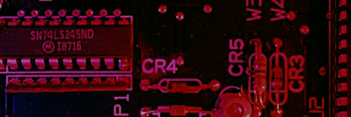

Summary
Programmable Logic
Programmable Logic Devices (PLDs) are ICs with a large number of gates and flip flops that can be configured with basic software to perform a specific logic function or perform the logic for a complex circuit. Major types of PLDs are:
SPLD: (Simple PLDs) are the earliest type of array logic used for fixed functions and smaller circuits with a limited number of gates. (The PAL and GAL are both SPLDs).
CPLD: (Complex PLDs) are multiple SPLDs arrays and inter-connection arrays on a single chip.
FPLD: (Field Programmable Gate Array) are a more flexible arrangement than CPLDs, with much larger capacity.

Slide 3
Summary
Programmable Logic
Advantages to PLDs include
Reduced complexity of circuit boards
  Lower power requirements
  Less board space
  Simpler testing procedures
Higher reliability
Design flexibility

Slide 4
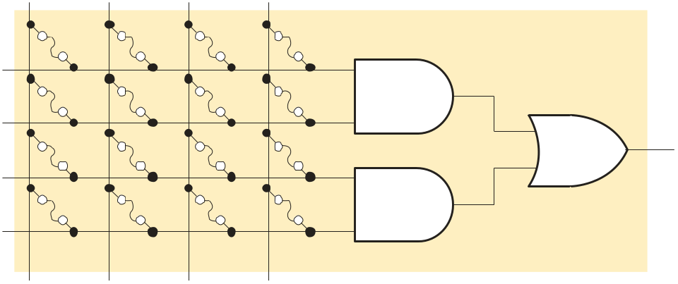
Summary
PALs and GALs
All PLDs contain arrays. Two important SPLDs are PALs (Programmable Array Logic) and GALs (Generic Array Logic). A typical array consists of a matrix of conductors connected in rows and columns to AND gates.
PALs have a one time programmable (OTP) array, in which fuses are permanently blown, creating the product terms in an AND array.
A A B B
X
Simplified AND-OR array

Slide 5
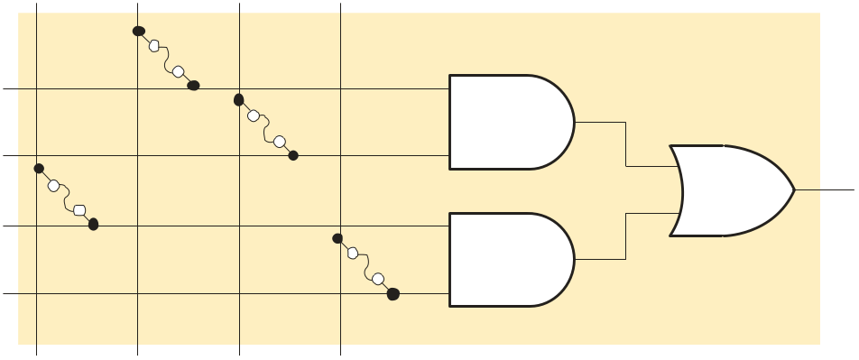

Summary
PALs and GALs
PALs are programmed with a specialized programmer that blows selected internal fuse links. After blowing the fuses, the array represents the Boolean logic expression for the desired circuit.
A A B B
Example
What function is represented by the array?
X
Solution
X = AB + AB
The function represents an XOR gate.

Slide 6
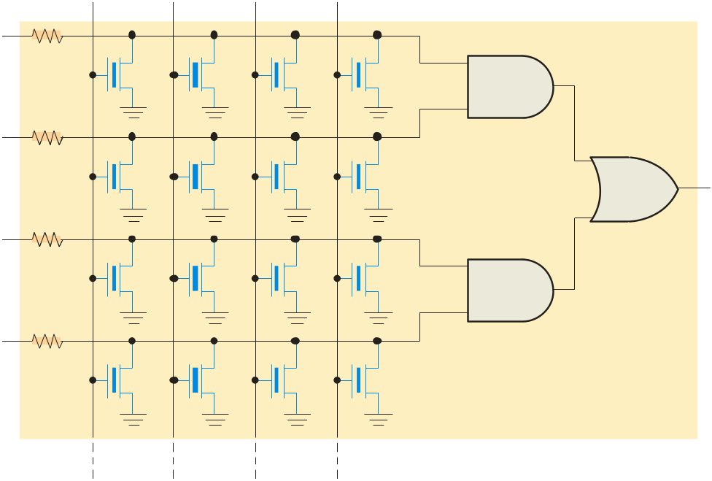
Summary
PALs and GALs
The GAL (Generic Array Logic) is similar to a PAL but can be reprogrammed. For this reason, they are useful for new product development (prototyping) and for training purposes.
A A B B
GALs were developed by Lattice Semiconductor. They are high speed, extremely fast devices and can interface with both 3.3 V or 5 V logic signals.
X

Slide 7
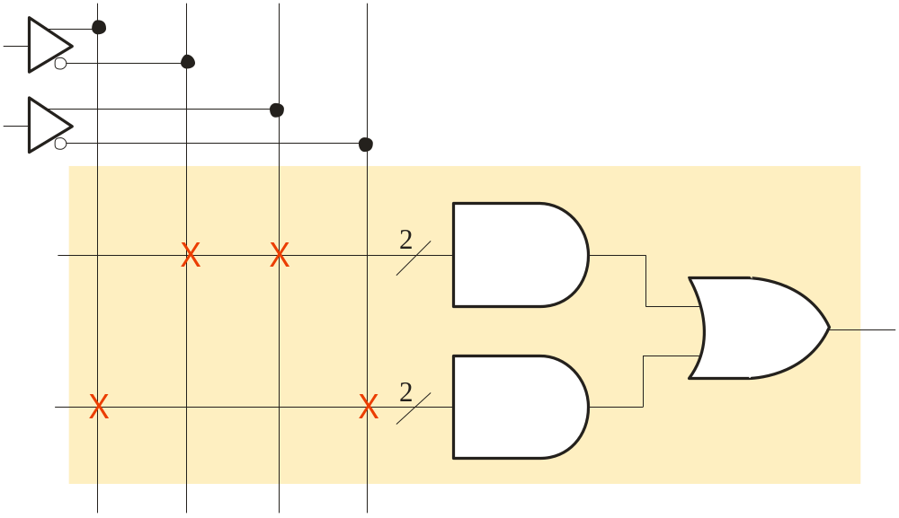
Summary
PALs and GALs
PALs and GALs can be represented with a simplified diagram. A single line can represent multiple gate inputs. The logic shown is for the XOR gate, given previously.
Input buffer
A A B B
Single line with slash indicating multiple AND gate inputs
Fuse blown
AB
Fuse intact
AB + AB
AB

Slide 8
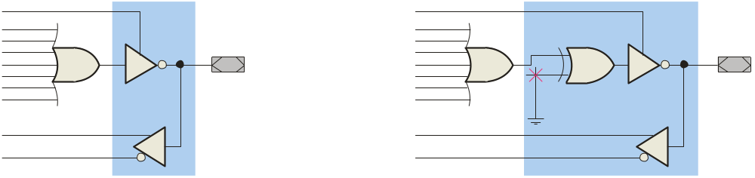
Summary
PALs and GALs
PALs and GALs have large array logic and include output logic that varies in complexity. The output logic is connected to each OR gate and together is referred to as a macrocell. Two types of PAL/GAL macrocells are shown. For these particular macrocells, the I/O pins can serve as an input or an output.
Tristate control
From AND array
From AND array
I/O
I/O
To AND array
To AND array
Programmable fuse link to control output polarity

Slide 9
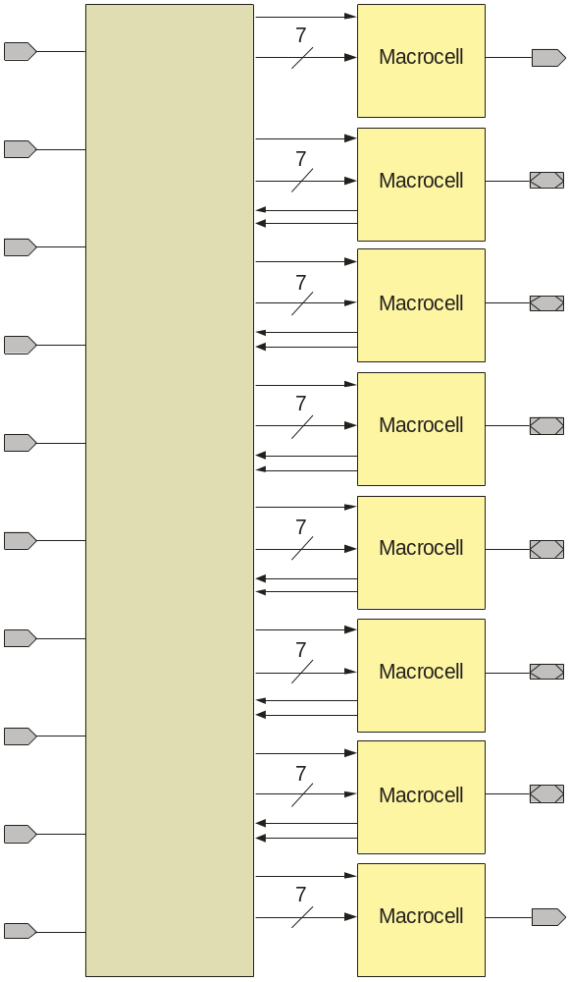
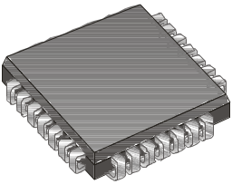
Summary
PALs and GALs
I1
O1
The PAL16V8 is a typical SPLD. There are 16 pins that can be used as inputs and 8 pins that can be used as outputs. I/O pins are counted as both inputs and outputs.
I2
I/O1
I3
I/O2
I4
I5
I/O3
Programmable AND array
I6
I/O4
I7
I/O5
I8
I/O6
I9
PLCC Package
O2
I/O10

Slide 10
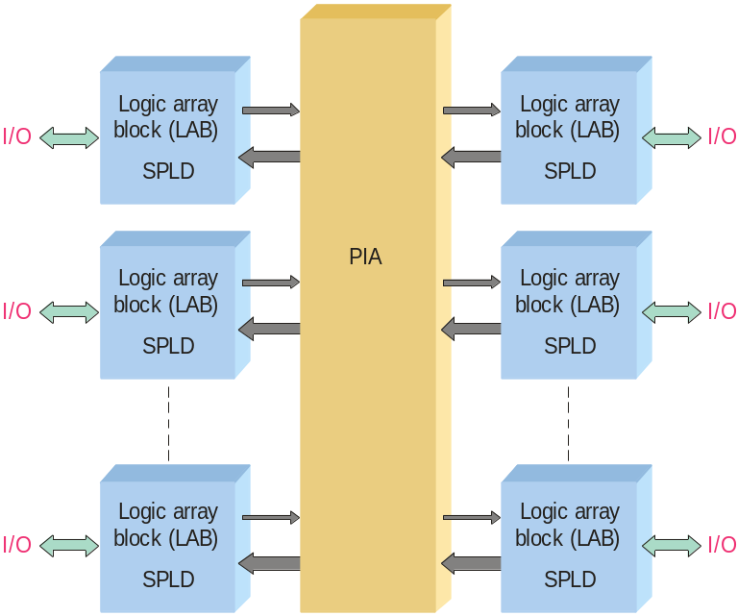
Summary
CPLDs
A complex programmable logic device (CPLD) has multiple logic array blocks (LABs) that are actually SPLDs on a single IC. LABs are connected via a programmable interconnect array (PIA). Various CPLDs have different structures for these elements.
The PIA is the interconnection between the LABs. Logic is fitted to the CPLD and routing is determined by a high-level programming language called a hardware description language (HDL).

Slide 11
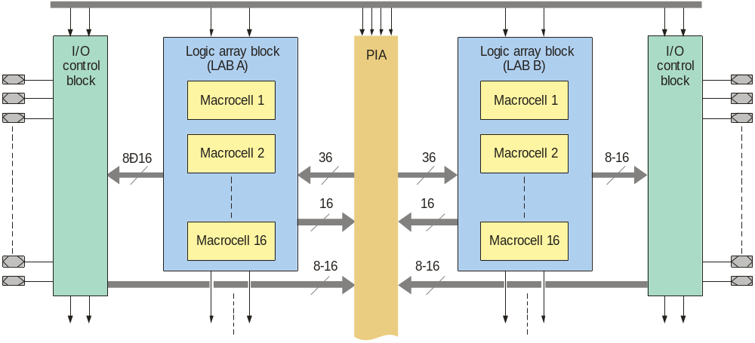
Summary
CPLDs
The architecture of a CPLD is the way in which the internal elements are configured. A portion of the Altera MAX 7000 series is shown. This structure is typical for CPLDs although densities, size, speed, and internal factors (macrocells, etc) will vary between manufacturers.
General-purpose inputs
I/O pins
I/O pins

Slide 12
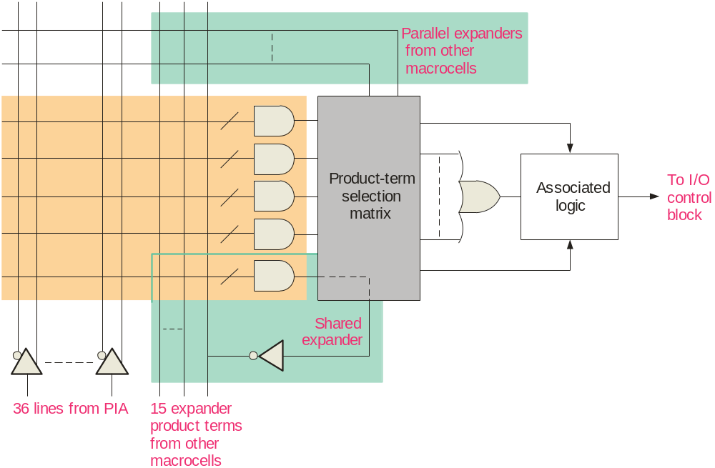
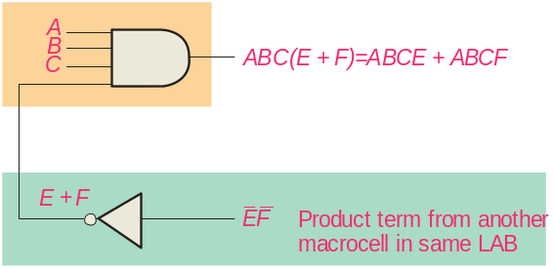
Summary
CPLDs
Macrocells in the Altera MAX 7000 series can generate up to five product terms. For expressions requiring more terms, the output can be expanded as described in the text.
Expander example

Slide 13
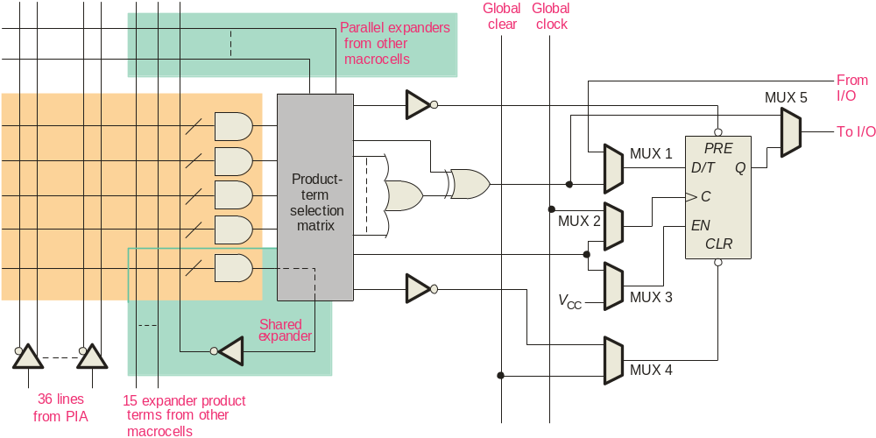
Summary
Macrocells
In addition to combination logic, some macrocells have registered outputs available (using programmable flip-flops). This allows the CPLD to perform sequential logic.

Slide 14
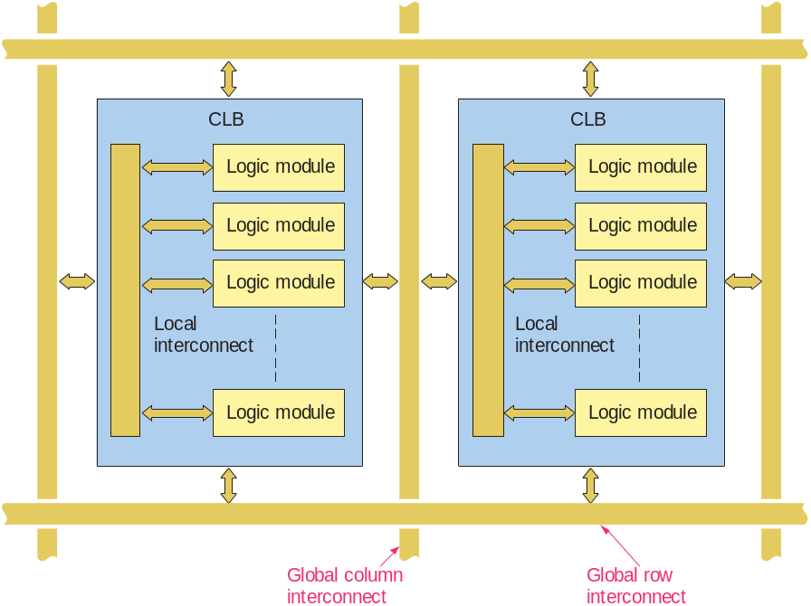
Summary
FPGAs
A field programmable gate array (FPGA) uses a different architecture than a CPLD. The configurable logic block (CLB) is the basic element which is replicated many times.
CLBs are arranged in a row and column structure. Within the CLBs are logic modules joined by local interconnects. Generally, the logic modules are composed of a look-up table (LUT), a flip-flop, and a MUX that can be used to bypass the flip-flop for strictly combinational logic.

Slide 15
Summary
FPGAs
Logic modules can be configured for combinational logic, registered logic, or a combination of both. The global interconnects distribute signals (including the clock) to various CLBs.
FPGAs may also have a hard core portion of logic that is put in by the manufacturer and cannot be reprogrammed by the user. These FPGAs are useful in commonly used functions such as I/O interfaces.

Slide 16
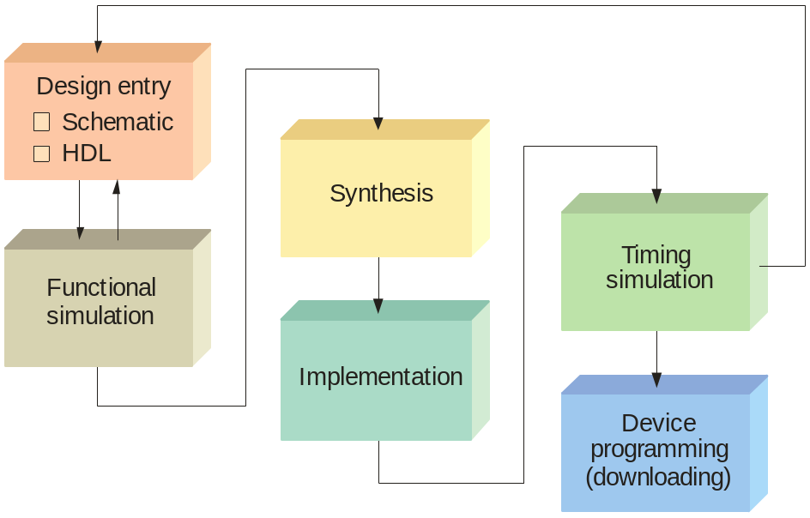
Summary
Programmable Logic Software
All manufacturers of programmable logic provide software to support their products. The process is illustrated in the flowchart.
The first step is to enter the logic design into a computer. It is done in one of two ways:
1) Schematic entry
2) Hardware description language (HDL).

Slide 17
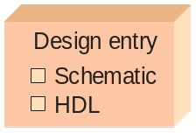
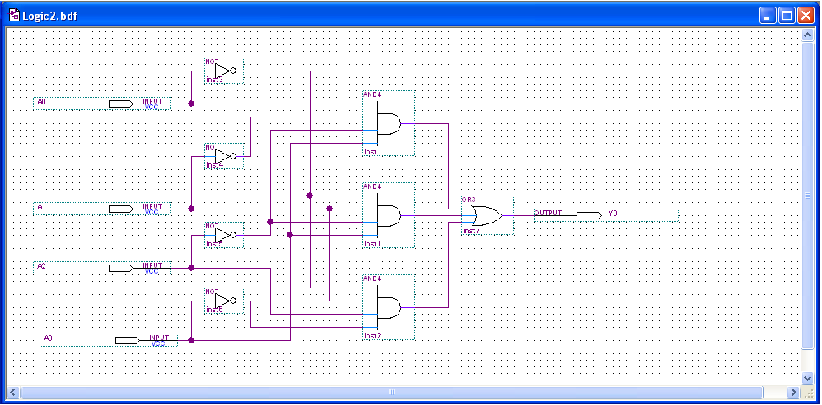
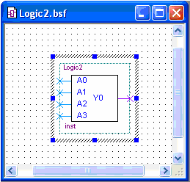
Summary
Programmable Logic Software
In schematic entry, the design is drawn on a computer screen by placing components and connecting then with simulated wires. You do not need to know the details of an HDL. After drawing the schematic, it can be reduced to a single block symbol:

Slide 18
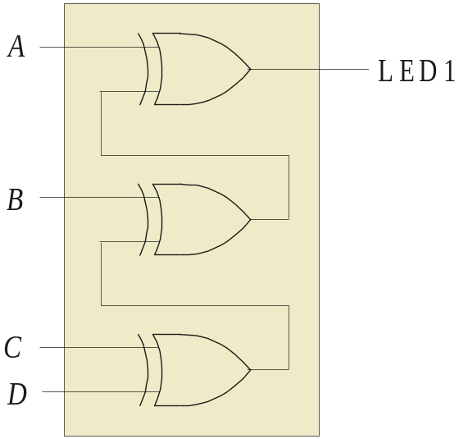
Summary
Programmable Logic Software
In text entry, the design is entered via a hardware description language such as VHDL or Verilog.
VHDL has two key parts: the entity and the architecture. The entity section describes the inputs, outputs, and variables. The architecture section describes the relationships between variables using Boolean equations. The VHDL equation can be understood, even if you do not know VHDL.
For example, the VHDL expression for LED1 is written as
LED1 <= ((D XOR C) XOR B) XOR A;

Slide 19
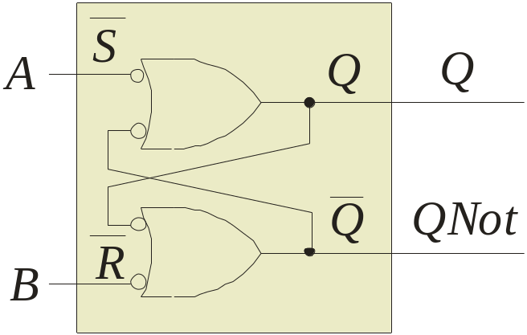
Summary
Programmable Logic Software
VHDL allows you to describe components in one program and then use them in another program.
For example, an active-LOW S-R latch can be drawn as
The complete VHDL program for this component is shown on the following slide…..

Slide 20
Summary
Programmable Logic Software
entity S_RLatch is
port (A, B: in bit; Q, QNot: inout bit);
end entity S_RLatch;
architecture Behavior of S_RLatch is
begin
Q <= not A or not QNot;
QNot <= not B or not Q;
end architecture Behavior;
Entity section
Input and output variable names and types
Architecture section
}
Boolean descriptions of circuit
Assigns expression on right to variable on left

Slide 21
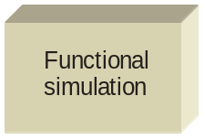
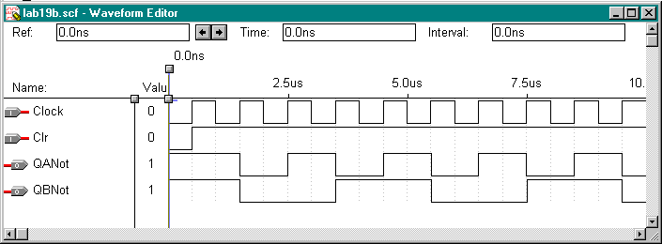
Summary
Functional Simulation
After entering the circuit into an HDL (such as VHDL), the circuit is tested in a functional simulation. The functional simulation is part of the HDL. You can test the circuit with waveforms to verify the operation.
Example
The following shows the functional test of a counter using a waveform editor:

Slide 22
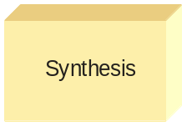
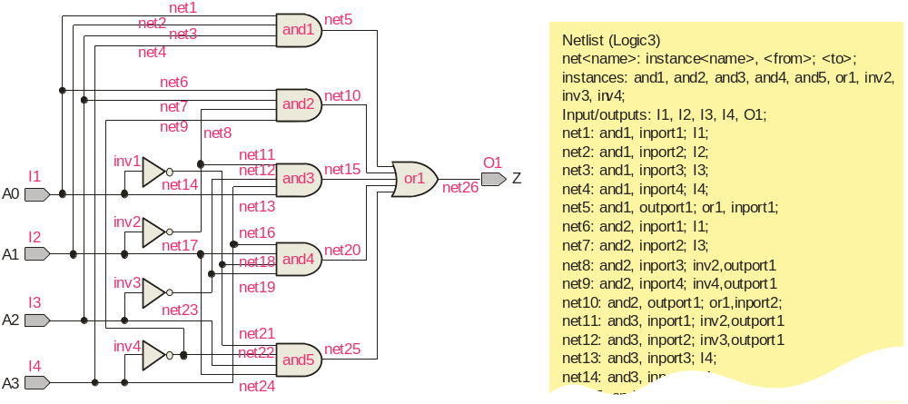
Summary
Synthesis
After the simulation, the computer program optimizes the logic by eliminating redundant terms and generating a netlist, (a connection list) that is a complete description of the circuit.
Netlist

Slide 23
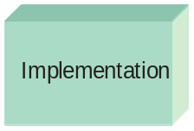

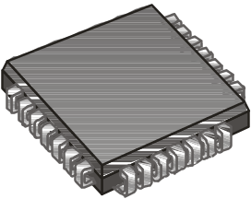
Summary
Implementation
The computer next “maps” the design from the netlist to fit it to a target device. Data for all potential target devices are in a software library. The computer must account for the I/O pins and fit the logic to the target device.

Slide 24
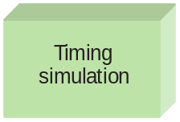
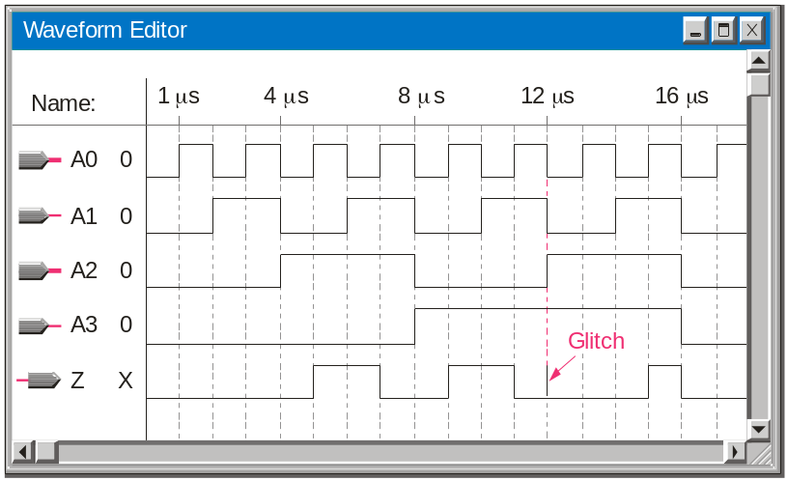
Summary
Timing Simulation
After implementation, a timing simulation is done that takes into account the specific delays in the target device and verifies that there no problems with the timing. As in the case of the functional simulation, the waveform editor can be used to review final timing.
If a problem is revealed, it is not too late to correct it before downloading the file.

Slide 25
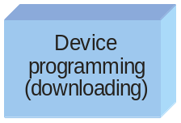
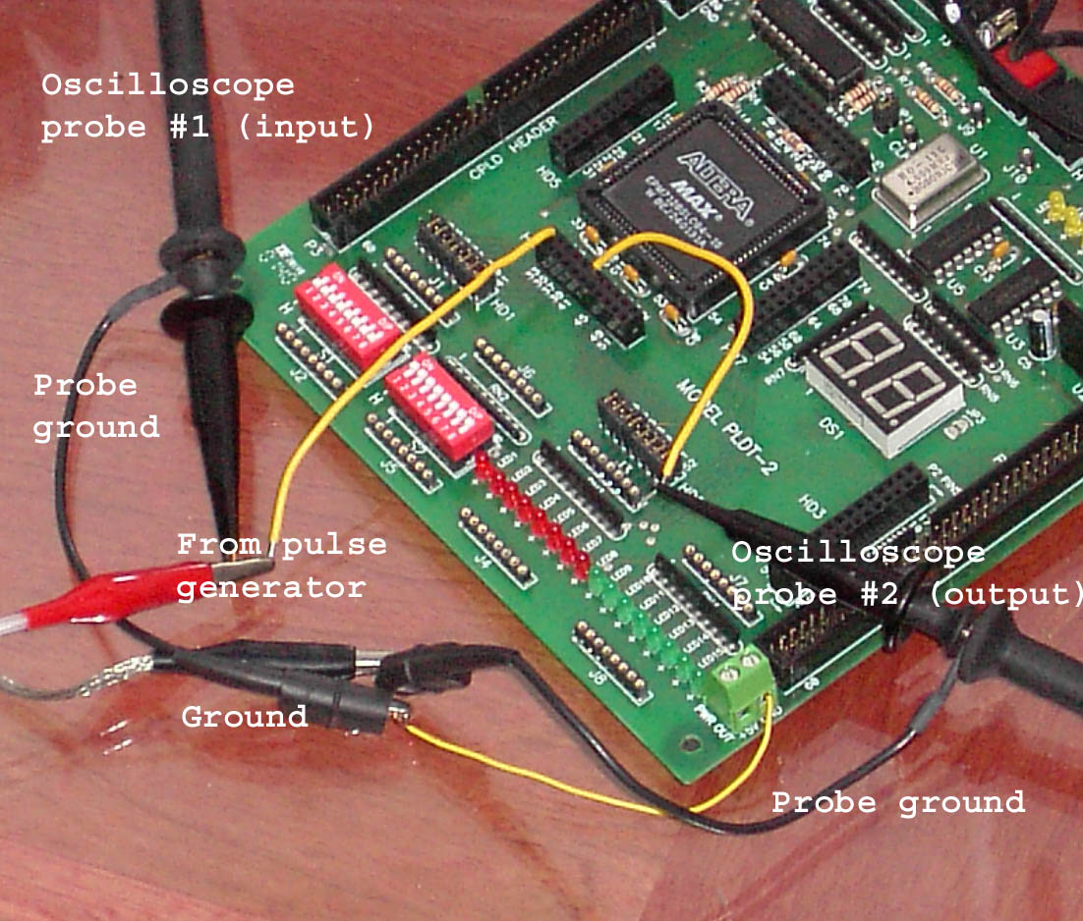
Summary
Device Programming
The final step is to send the programming file from the computer to the target device and test the implementation.
A PLDT-2 prototyping board that has an Altera PLD as the target device is shown. Connections are added to the board from a pulse generator and oscilloscope to test the actual circuit in a laboratory environment. The prototyping board has built-in power supplies, interfacing, I/O, and more.

Slide 26
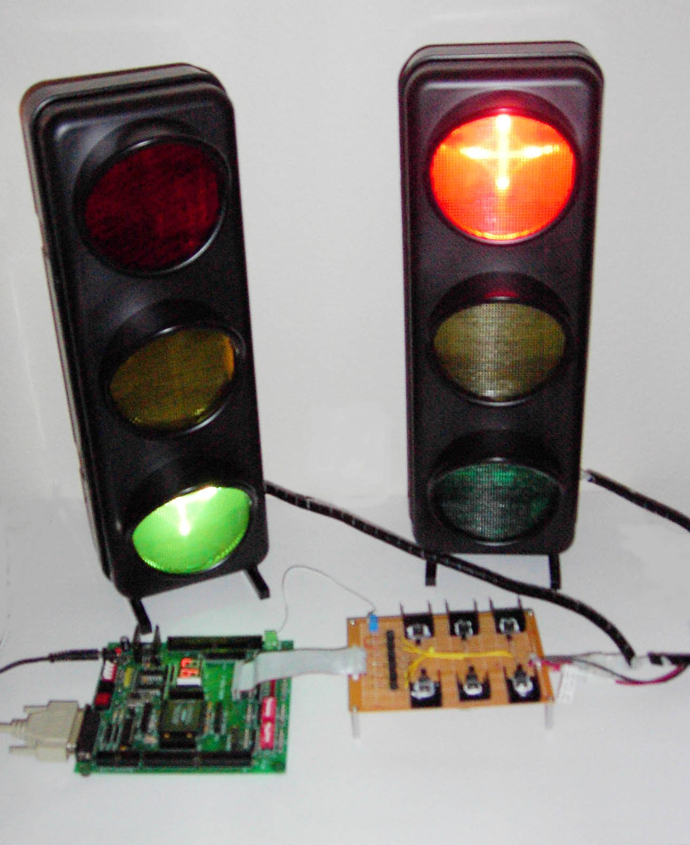
Summary
Testing
The traffic light system application was described in several System Application Activities in the text. The photograph is the traffic light logic downloaded to a PLDT-2 board and operating a simulated traffic light. An interface is added to allow for the voltage and current requirements of the bulbs.
PLDT-2 board
Interface board

Slide 27
Summary
Boundary Scan Logic
Boundary scan that is designed by the manufacturer of programmable devices to provide a means of testing and programming the device without requiring physical access to the internal logic. Programmable devices that are compliant with a certain standard have internal registers to allow testing of internal interconnections and logic. Test data is supplied and verified. When the circuit is operating, the boundary scan logic is “invisible”.
The following slide shows a boundary scan logic diagram…

Slide 28
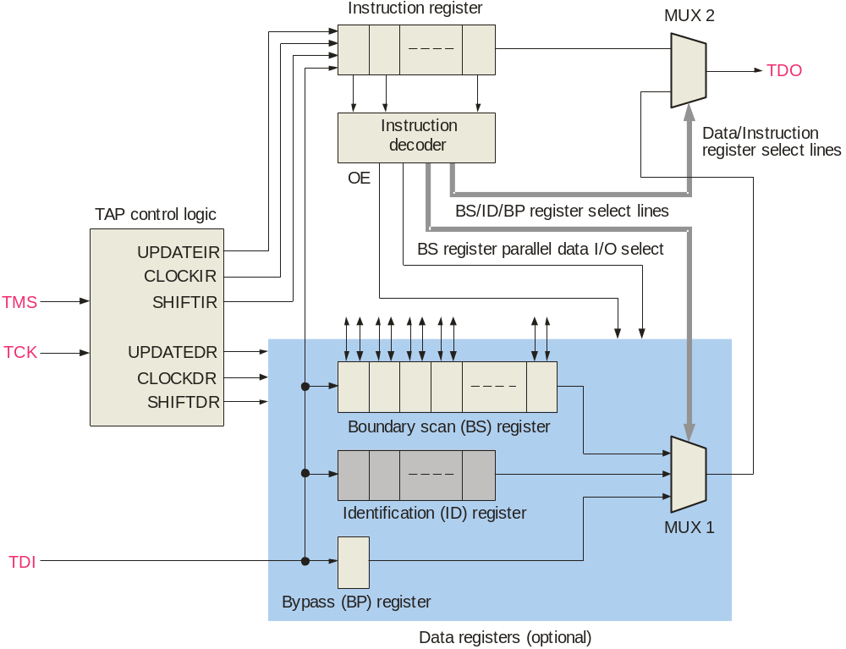
Summary
Boundary Scan Logic

Slide 29

Selected Key Terms
PAL
GAL
Macrocell
CPLD
A type of one-time programmable SPLD that consists of a programmable array of AND gates that connects to a fixed array of OR gates.
A reprogrammable type of SPLD that that is similar to a PAL except it uses a reprogrammable process technology, such as EEPROM instead of fuses.
Part of a PAL, GAL, or CPLD that generally consists of one OR gate and some associated output logic.
A complex reprogrammable logic device that consists basically of multiple SPLD arrays with programmable interconnections.

Slide 30
Selected Key Terms
FPGA
Design flow
Schematic entry
Text entry
Boundary scan
Field programmable gate array; a programmable logic device that uses the LUT as the basic logic element and generally employs either the antifuse or SRAM-based process technology
The process or sequence carried out to program a target device.
A method of placing a logic design into software using schematic symbols.
A method of placing a logic design into software using a hardware description language (HDL).
A method for internally testing a PLD based on the JTAG standard (IEEE Std. 1149.1).

Slide 31

Quiz
An advantage of PLDs over discrete circuits is
  a. lower power and space requirements
  b. higher reliability
c. design flexibility
d. all of the above
© 2008 Pearson Education

Slide 32
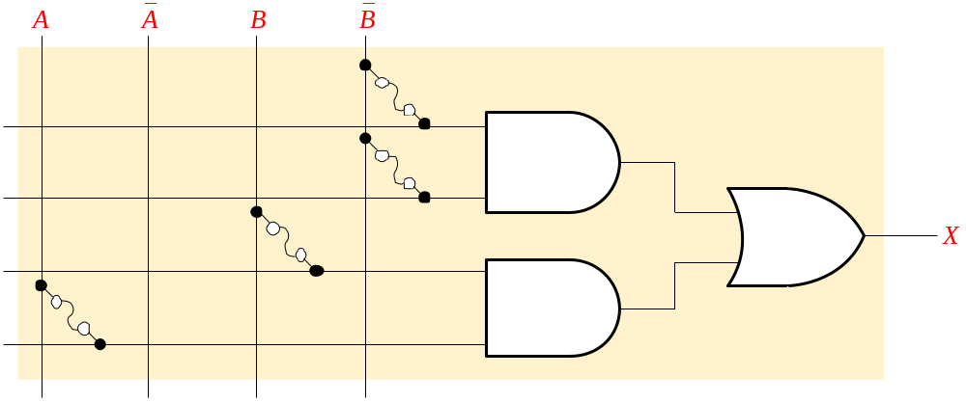
Quiz
2. The logic expression for X is
a. X = B(A + B)
b. X = B + AB
c. X = B + AB
d. X = B(A + B)
© 2008 Pearson Education

Slide 33
Quiz
3. Generic Array Logic (GAL)
a. is reprogrammable
b. uses look-up tables for combinational logic
c. uses SRAM technology
d. all of the above
© 2008 Pearson Education

Slide 34
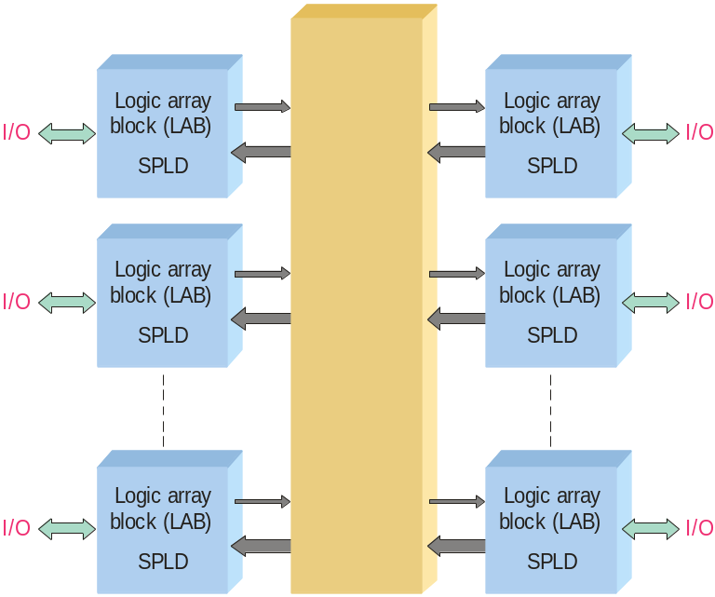
Quiz
4. A general block of a CPLD is shown. The center (unmarked) block represents a
a. configurable logic block (CLB)
b. programmable interconnect array (PIA)
c. comparator
d. look-up table (LUT)
© 2008 Pearson Education

Slide 35
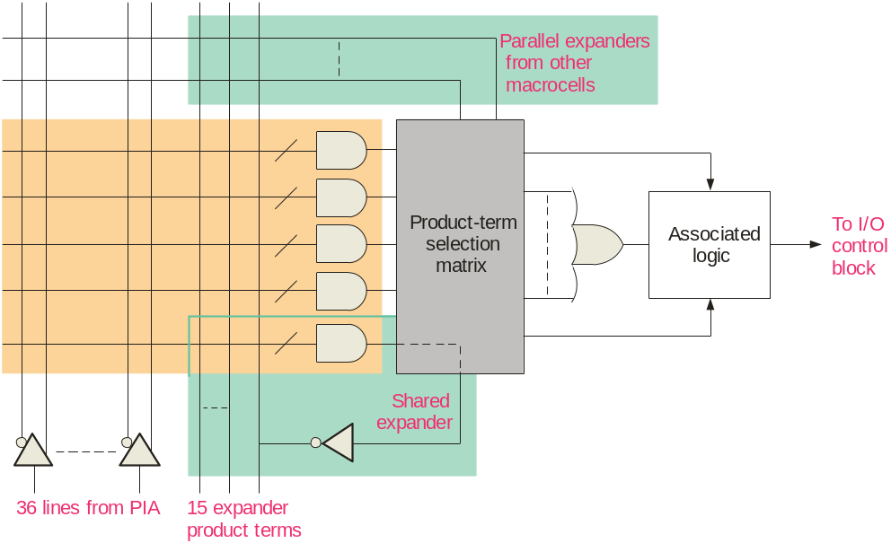
Quiz
5. The diagram represents
a. a PIA
b. an FPGA
c. a logic module
d. a macrocell
© 2008 Pearson Education

Slide 36
Quiz
6. A programmable device that uses a LUT to generate logic is
a. a PAL
b. a GAL
c. an FPGA
d. a CPLD
© 2008 Pearson Education

Slide 37
Quiz
7. The drawings represent two types of
a. expanders
b. macrocells
c. logic array blocks
d. sequential logic blocks
© 2008 Pearson Education

Slide 38
Quiz
8. VHDL is a
a. type of FPGA
b. system programming language
c. development software
d. hardware description language (HDL)
© 2008 Pearson Education

Slide 39
Quiz
9. A written description of all of the components and connections in a circuit is called a
a. netlist
b. look-up table
c. logic array list
d. simulation table
© 2008 Pearson Education

Slide 40
Quiz
10. An statement in VHDL is: QNot <= not B or not Q;. The <= characters cause
    variable on the left to be complemented
    expression on the right to be assigned to the variable on the left
    variable on the left to be assigned the smaller of two values
    constant on the left to be assigned to the expression on the right
© 2008 Pearson Education

Slide 41
Quiz
Answers:
1. a
2. c
3. a
4. b
5. d
6. c
7. b
8. d
9. a
10. b

