Slide 1


Digital Fundamentals
Tenth Edition
Floyd
Chapter 12

Slide 2
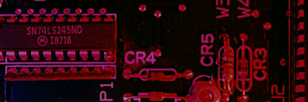
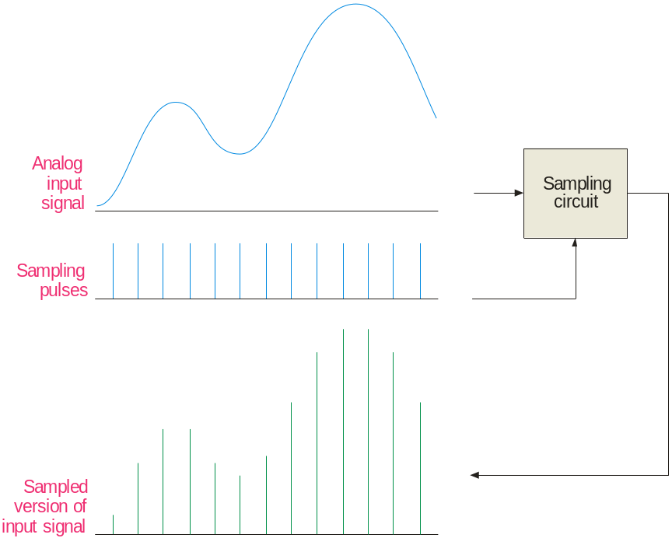
Summary
Sampling
Most input signals to an electronic system start out as analog signals. For processing, the signal is normally converted to a digital signal by sampling the input.
Before sampling, the analog input must be filtered with a low-pass anti-aliasing filter. The filter eliminates frequencies that exceed a certain limit that is determined by the sampling rate.

Slide 3
Summary
Anti-aliasing Filter
To understand the need for an anti-aliasing filter, you need to understand the sampling theorem which essentially states:
In order to recover a signal, the sampling rate must be greater than twice the highest frequency in the signal.
Stated as an equation, f_{sample} > 2f_{a(max)}
where f_{sample} = sampling frequency
f_{a(max)} = highest harmonic in the analog signal
If the signal is sampled less than this, the recovery process will produce frequencies that are entirely different than in the original signal. These “masquerading” signals are called aliases.

Slide 4
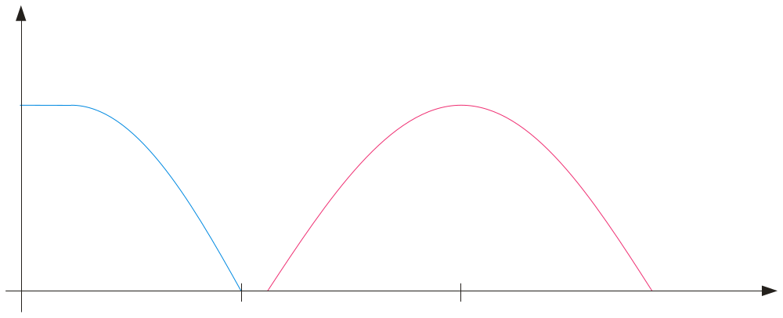
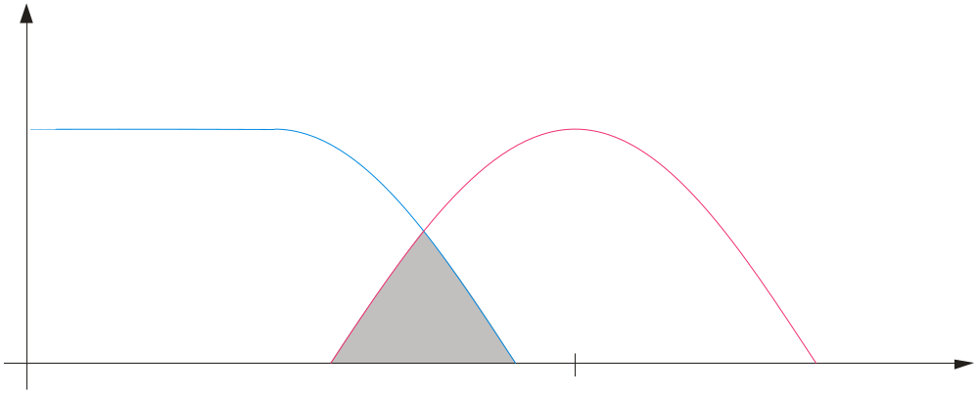
Summary
Anti-aliasing Filter
The anti-aliasing filter is a low-pass filter that limits high frequencies in the input signal to only those that meet the requirements of the sampling theorem.
Filtered analog frequency spectrum
Unfiltered analog frequency spectrum
Sampling frequency spectrum
f
f_{c}
f_{sample}
Overlap causes aliasing error
The filter’s cutoff frequency, f_{c}, should be less than ½ f_{sample}.

Slide 5
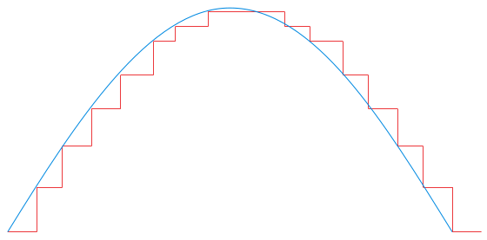
Summary
Analog-to-Digital Conversion
To process naturally occurring analog quantities with a digital system, the analog signal is converted to digital form after the anti-aliasing filter.
The first step in converting a signal to digital form is to use a sample-and-hold circuit. This circuit samples the input signal at a rate determined by a clock signal and holds the level on a capacitor until the next clock pulse.
A positive half-wave from 0-10 V is shown in blue. The sample-and-hold circuit produces the staircase representation shown in red.
10 V
0 V

Slide 6
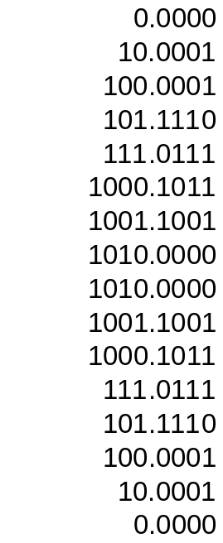

Summary
Analog-to-Digital Conversion
The second step is to quantize these staircase levels to binary coded form using an analog-to-digital converter (ADC). The digital values can then be processed by a digital signal processor or computer.
Example
What is the maximum unsigned binary value for the waveform?
Solution
10 V = 1010₂ V. The table lists the quantized binary values for all of the steps.
Peak = 10 V
10 V
0 V

Slide 7

Summary
Anti-aliasing Filter
Most signals have higher frequency harmonic and noise. For most ADCs, the sampling and filter cutoff frequencies are selected to be able to reconstruct the desired signal without including unnecessary harmonics and noise.
An example of a reasonable sampling rate is in a digital audio CD. For audio CDs, sampling is done at 44.1 kHz because audio frequencies above 20 kHz are not detectable by the ear.
Question
What cutoff frequency should an anti-aliasing filter have for a digital audio CD?
Answer
Less than 22.05 kHz.

Slide 8
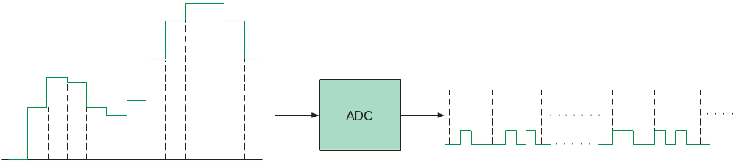
Summary
Sample-and-Hold and ADC
Following the anti-aliasing filter, is the sample-and-hold circuit and the analog-to-digital converter. At this point, the original analog signal has been converted to a digital signal.
Samples held for one clock pulse
0 1 0 0 0 1 0 1
1 1 0 0 1 0 1 0
Many ICs can perform both functions on a single chip and include two or more channels. For audio applications, the AD1871 is an example of a stereo audio ADC.

Slide 9
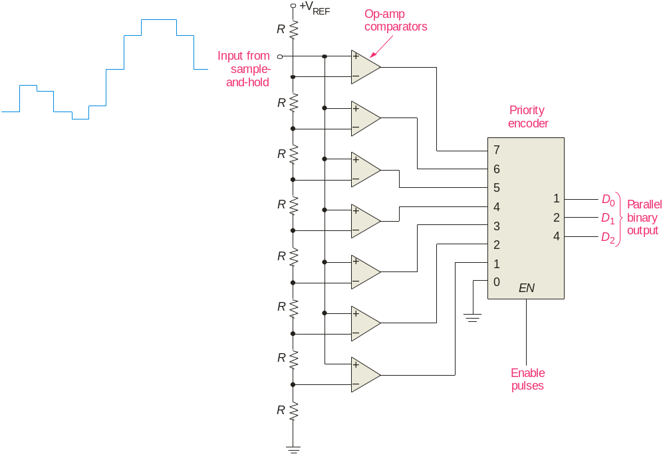
Summary
Analog-to-Digital Conversion Methods
The flash ADC:
The flash ADC uses a series high-speed comparators that compare the input with reference voltages. Flash ADCs are fast but require 2^{n} – 1 comparators to convert an analog input to an n-bit binary number.
Question
How many comparators are needed by a 10-bit flash ADC?
Answer
1023

Slide 10

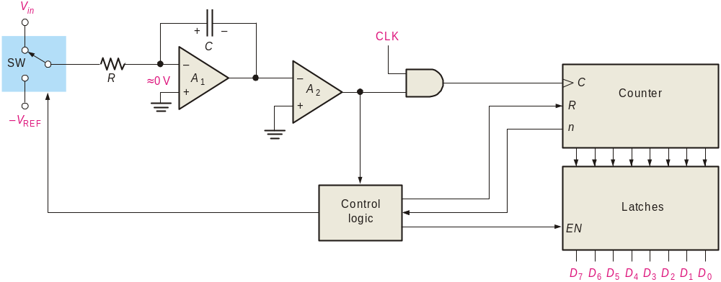

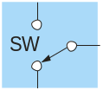
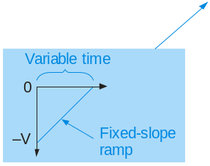
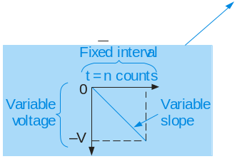
Summary
Analog-to-Digital Conversion Methods
The dual-slope ADC:
1. The dual-slope ADC integrates the input voltage for a fixed time while the counter counts to n.
2. Control logic switches to the V_{REF} input.
2. A fixed-slope ramp starts from –V as the counter counts. When it reaches 0 V, the counter output is latched.
-V
HIGH
HIGH

Slide 11
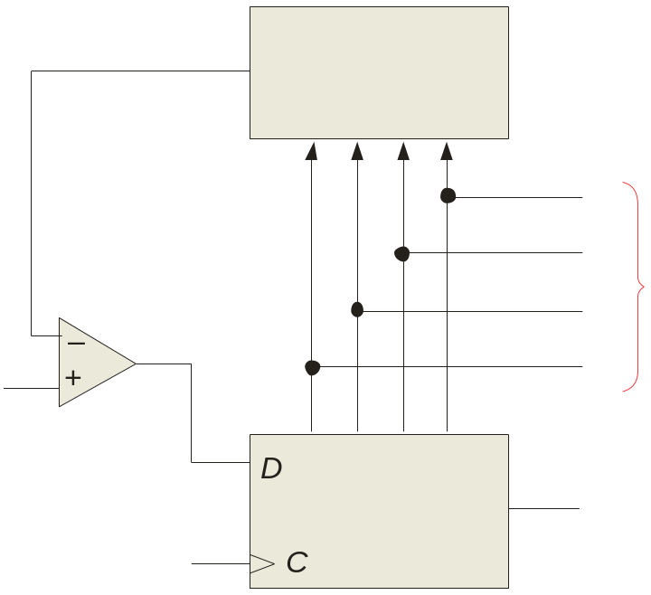

Summary
Analog-to-Digital Conversion Methods
The successive approximation ADC:
1. Starting with the MSB, each bit in the successive approximation register (SAR) is activated and tested by the digital-to-analog converter (DAC).
V_{out}
2. After each test, the DAC produces an output voltage that represents the bit.
DAC
D₀
D₁
Parallel binary output
3. The comparator compares this voltage with the input signal. If the input is larger, the bit is retained; otherwise it is reset (0).
Comparator
D₂
Input signal
D₃
(MSB)
(LSB)
SAR
Serialbinary output
CLK
The method is fast and has a fixed conversion time for all inputs.

Slide 12
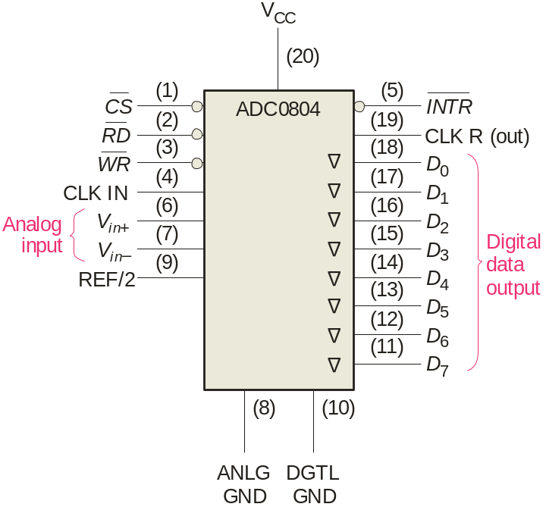
Summary
Analog-to-Digital Conversion Methods
An integrated circuit successive approximation ADC is the ADC804. This popular ADC is an 8-bit converter that completes a conversion in 64 clock periods (100 μs).
The completion is signaled by the INTR line going LOW.

Slide 13
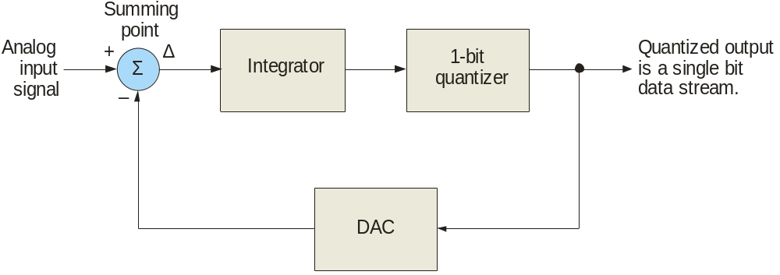
Summary
Analog-to-Digital Conversion Methods
The sigma-delta ADC:
With sigma-delta conversion, the difference between two samples of the analog input signal integrated and quantized. The density of 1s at the output is proportional to the input signal.

Slide 14
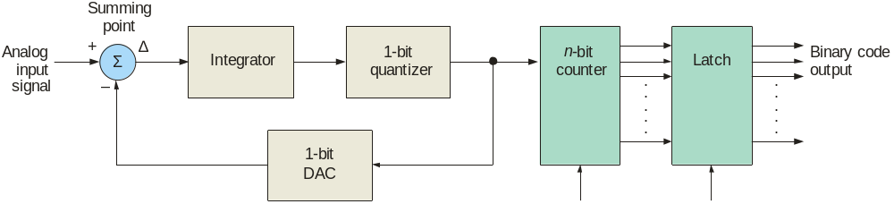
Summary
Analog-to-Digital Conversion Methods
One option for the sigma-delta method is to count the one-bit quantized output for a set interval. The output of the counter is latched with the parallel binary code.
Sigma-delta ADCs can have high resolution and have advantages for rejecting noise signals (such as 60 Hz power line interference). They are available in ICs with internal programmable amplifiers. For these reasons, they are widely used in instrumentation applications.

Slide 15
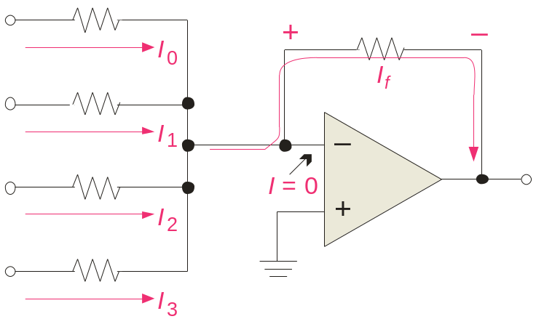
Summary
Digital-to-Analog Conversion Methods
Binary-weighted-input DAC:
The binary-weighted-input DAC is a basic DAC in which the input current in each resistor is proportional to the column weight in the binary numbering system. It requires very accurate resistors and identical HIGH level voltages for accuracy.
LSB
8R
D₀
R_{f}
The MSB is represented by the largest current, so it has the smallest resistor. To simplify analysis, assume all current goes through R_{f} and none into the op-amp.
4R
D₁
2R
V_{out}
D₂
Analog output
D₃
R
MSB

Slide 16
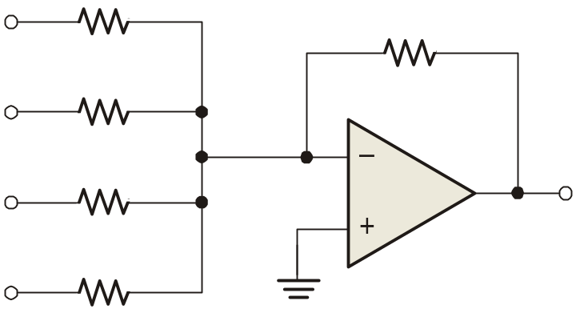
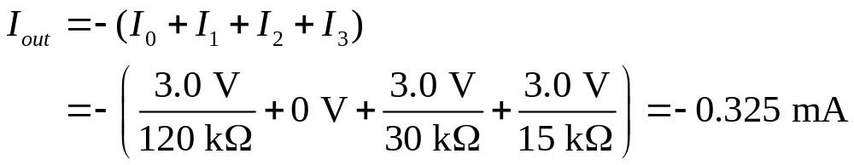
Summary
Digital-to-Analog Conversion Methods
Example
A certain binary-weighted-input DAC has a binary input of 1101. If a HIGH = +3.0 V and a LOW = 0 V, what is V_{out}?
120 kΩ
R_{f}
+3.0 V
60 kΩ
10 kΩ
0 V
30 kΩ
V_{out}
+3.0 V
15 kΩ
+3.0 V
Solution
V_{out} = I_{out} R_{f} = (−0.325 mA)(10 kΩ) =
−3.25 V

Slide 17
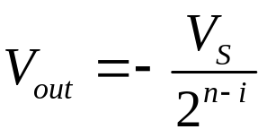
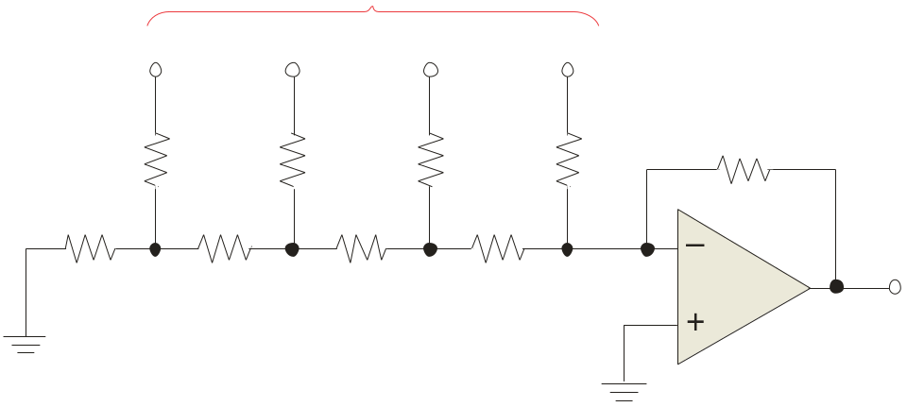
Summary
Digital-to-Analog Conversion Methods
R-2R ladder:
The R-2R ladder requires only two values of resistors. By calculating a Thevenin equivalent circuit for each input, you can show that the output is proportional to the binary weight of inputs that are HIGH.
Each input that is HIGH contributes to the output:
where V_{S} = input HIGH level voltage
n = number of bits
i = bit number
Inputs
D₀
D₁
D₂
D₃
For accuracy, the resistors must be precise ratios, which is easily done in integrated circuits.
R₁
R₃
R₅
R₇
R_{f} = 2R
2R
2R
2R
2R
R₂
R₄
R₆
R₈
2R
R
R
R
V_{out}

Slide 18
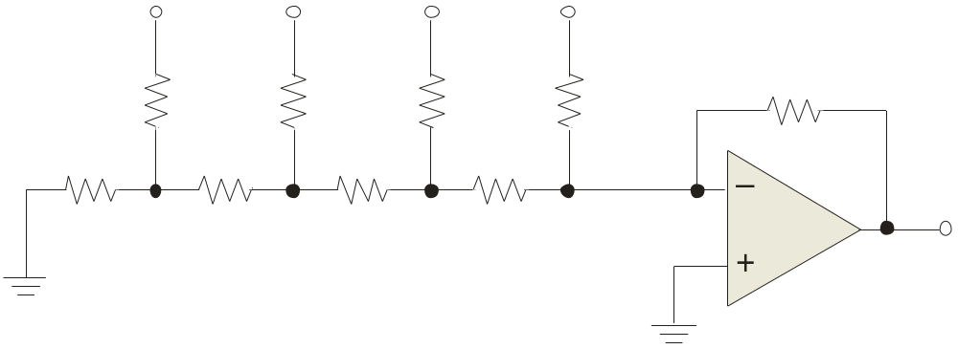

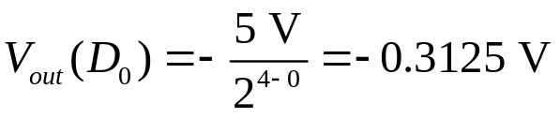
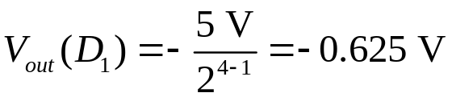
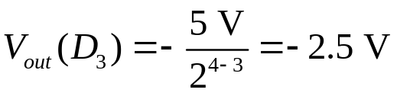
Summary
Digital-to-Analog Conversion Methods
Example
An R-2R ladder has a binary input of 1011. If a HIGH = +5.0 V and a LOW = 0 V, what is V_{out}?
D₀
D₁
D₂
D₃
+5.0 V
+5.0 V
0 V
+5.0 V
R₁
R₃
R₅
R₇
R_{f} = 50 kΩ
50 kΩ
50 kΩ
50 kΩ
50 kΩ
R₂
R₄
R₆
R₈
50 kΩ
25 kΩ
25 kΩ
25 kΩ
V_{out}
Solution
Apply to all inputs that are HIGH, then sum the results.
Applying superposition, V_{out} =
−3.43 V

Slide 19

Summary
Resolution and Accuracy of DACs
The R-2R ladder is relatively easy to manufacturer and is available in IC packages. DACs based on the R-2R network are available in 8, 10, and 12-bit versions. The resolution is an important specification, defined as the reciprocal of the number of steps in the output.
Question
What is the resolution of the BCN31 R-2R ladder network, which has 8-bits?
Answer
2⁸ – 1 = 255
1/255 = 0.39%
The accuracy is another important specification and is derived from a comparison of the actual output to the expected output. For the BCN31, the accuracy is specified as ±½ LSB = 0.2%.

Slide 20
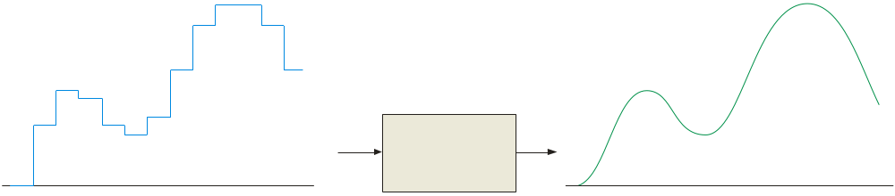
Summary
Reconstruction Filter
After converting a digital signal to analog, it is passed through a low-pass “reconstruction filter” to smooth the stair steps in the output. The cutoff frequency of the reconstruction filter is often set to the same limit as the anti-aliasing filter, to block higher harmonics due to the digitizing process.
Reconstruction Filter
Output of the DAC
Final analog output

Slide 21
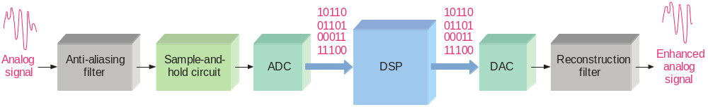
Summary
Digital Signal Processing
A digital signal processor (DSP) is optimized for speed and working in real time (as events happen). It is basically a specialized microprocessor with a reduced instruction set.
After filtering and converting the analog signal to digital, the DSP takes over. It may enhance the signal in some predetermined way (reducing noise or echoes, improving images, encrypting the signal, etc.). The signal can then be converted back to analog form if desired.

Slide 22
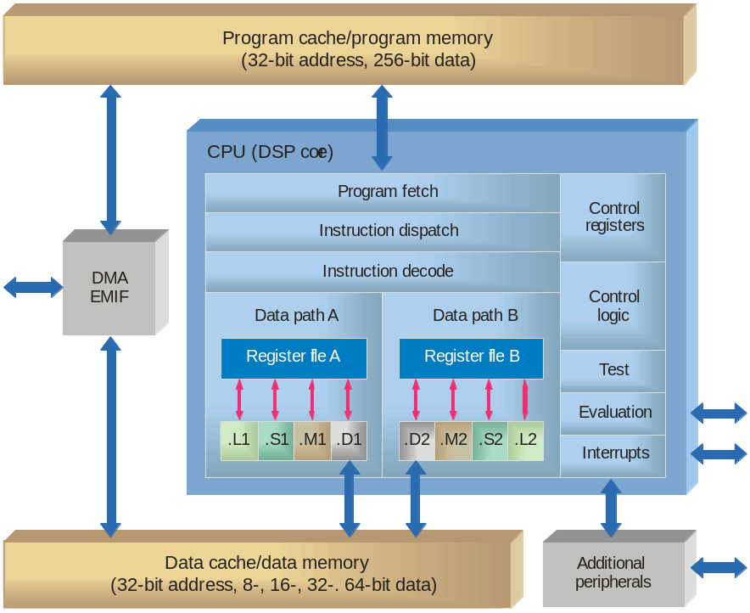
Summary
Digital Signal Processing
Because speed is important in DSP applications, assembly language is frequently used because in general it executes faster.
A general block diagram of the TMS320C6000 series DSP

Slide 23

Selected Key Terms
Nyquist frequency
Quantization
Analog-to-digital converter (ADC)
DSP
Digital-to-analog converter (DAC)
The highest signal frequency that can be sampled at a specified sampling frequency; a frequency equal or less than half the sampling frequency.
The process whereby a binary code is assigned to each sampled value during analog-to-digital conversion.
A circuit used to convert an analog signal to digital form.
Digital signal Processor; a special type of microprocessor that processes data in real time.
A circuit used to convert a digital signal to analog form.

Slide 24

Quiz
1. If an anti-aliasing filter is not used in digitizing a signal the recovery process
a. is slowed
b. may include alias signals
c. will have less noise
d. all of the above
© 2008 Pearson Education

Slide 25
Quiz
2. An anti-aliasing filter should have
a. f_{c} more than 2 times the Nyquist frequency
b. f_{c} equal to the Nyquist frequency
c. f_{c} more than ½ f_{sample}
d. f_{c} less than ½ f_{sample}
© 2008 Pearson Education

Slide 26
Quiz
3. The number of comparators required in a 10-bit flash ADC is
a. 255
b. 511
c. 1023
d. 4095
© 2008 Pearson Education

Slide 27
Quiz
4. The block diagram is for a successive-approximation ADC. The top block is
a. an SAR
b. a DAC
c. an ADC
d. a comparator
V_{out}
D₀
D₁
Parallel binary output
D₂
Input signal
D₃
(MSB)
(LSB)
Serialbinary output
CLK
© 2008 Pearson Education

Slide 28
Quiz
5. The ADC804 integrated circuit signals a completed conversion by
a. INTR goes LOW
b. CS goes LOW
c. RD goes LOW
d. CLK R goes HIGH
© 2008 Pearson Education

Slide 29
Quiz
6. A sigma-delta circuit is a form of
a. DSP
b. DAC
c. ADC
d. SAR
© 2008 Pearson Education

Slide 30
Quiz
7. The circuit shown is a
a. DSP
b. DAC
c. ADC
d. SAR
8R
R_{f}
4R
2R
V_{out}
R
© 2008 Pearson Education

Slide 31
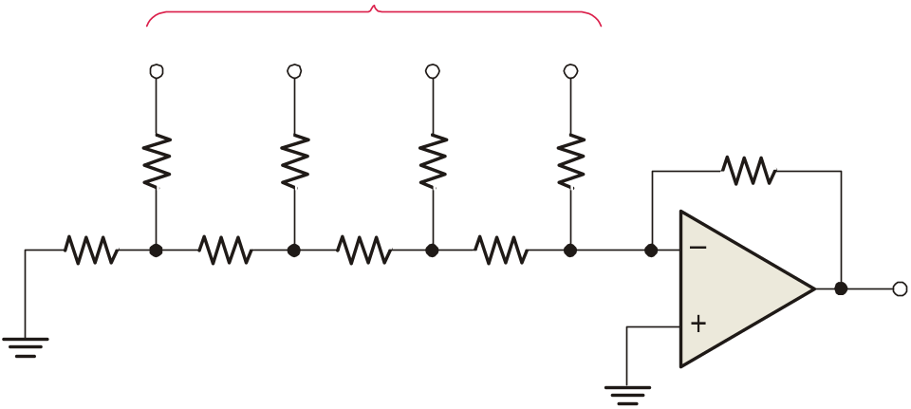
Quiz
8. For the circuit shown, the input on the far left is for the
a. analog input
b. clock
c. LSB
d. MSB
Inputs
R₁
R₃
R₅
R₇
R_{f} = 2R
2R
2R
2R
2R
R₂
R₄
R₆
R₈
2R
R
R
R
V_{out}
© 2008 Pearson Education

Slide 32
Quiz
9. A reconstruction filter
a. is a low-pass filter
b. can have the same response as an anti-aliasing filter
c. smoothes the output from a DAC
d. all of the above
© 2008 Pearson Education

Slide 33
Quiz
10. A DSP is a specialized microprocessor that
a. has a very large instruction set
b. is deigned to be very fast
c. has internal anti-aliasing and reconstruction filters
d. all of the above
© 2008 Pearson Education

Slide 34
Quiz
Answers:
1. b
2. d
3. c
4. b
5. a
6. c
7. b
8. c
9. d
10. b

