Slide 1

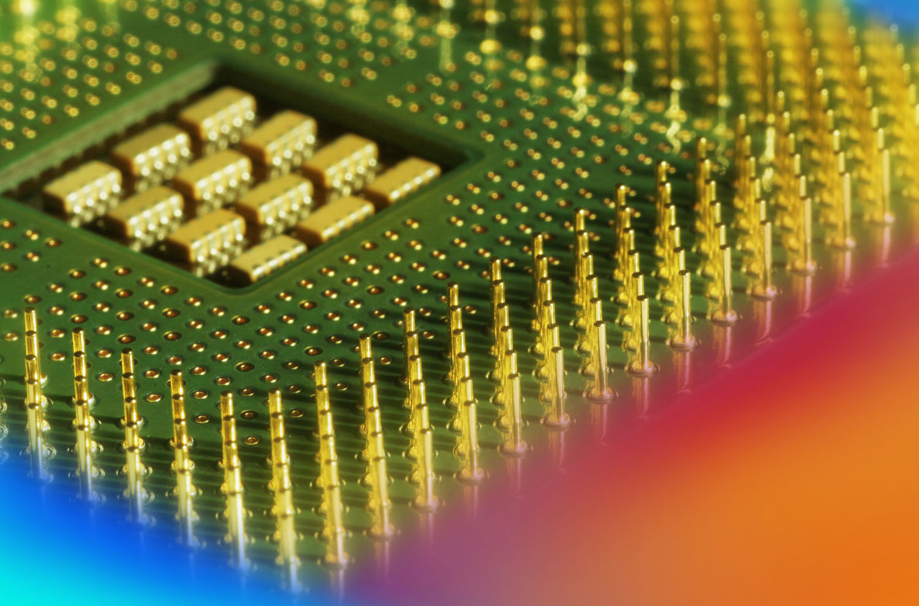
Digital Fundamentals
Tenth Edition
Floyd
Chapter 13
© 2008 Pearson Education

Slide 2
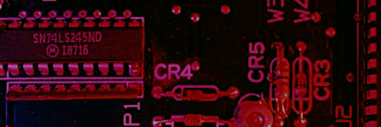
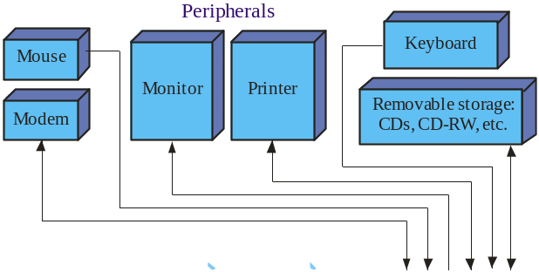
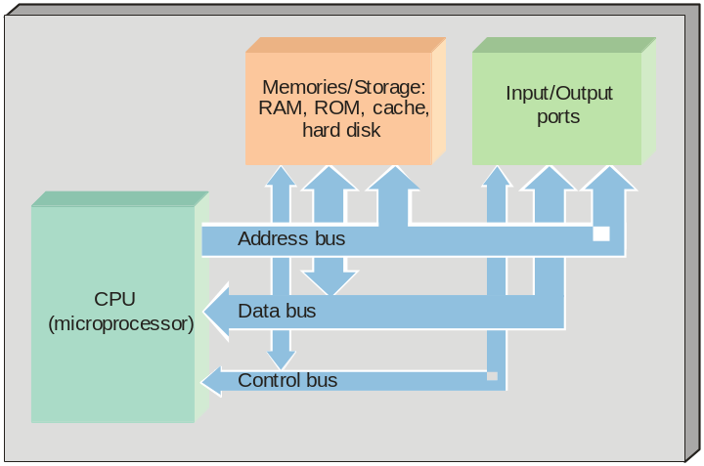
Summary
Computer Block Diagram
The central processing unit (CPU) controls the operations by issuing a fetch to memory for an instruction, then executes it.
Memory stores instructions and data until needed by the CPU.
The ports are the I/O connections to the peripherals.
The buses are groups of conductors with a common purpose.
Peripherals are devices for inputting or outputting information.

Slide 3
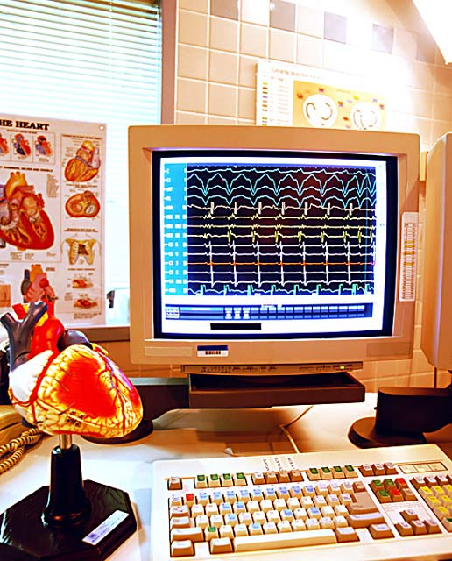
Summary
Software
Software is all of the instructions that determine what operations are performed.
System software is the operating system of the computer and acts as the system manager.
The BIOS is a portion of the operating system called “firmware” because it is a permanent part of the system software in ROM (read-only memory).
Application software includes the various programs used to accomplish a task.

Slide 4

Summary
Microprocessors
Four blocks are common to all microprocessors. These are:
ALU
  Performs arithmetic and logic operations
Instruction decoder
  Translates the programming instruction into an address where microcode resides for executing the instruction
Register array
  A group of temporary storage locations within the processor, each with special features
Control unit
  Synchronizes the processing of instructions
Microprocessor
Arithmetic logic unit (ALU)
Instruction decoder
Register array
Control unit

Slide 5
Summary
Microprocessor Buses
Three buses for microprocessors allow data, addresses and instructions to be moved.
The address bus is used by the microprocessor to specify a location in memory or external device. Some processors have 64 address lines and can access 1.8 x 10¹⁹ locations.
The data bus transfers data and instruction codes to and from memory and I/O ports.
The control bus coordinates operations and communicates with external devices.

Slide 6

Summary
Microprocessor Programming
Microprocessors work with an instruction set that allows it to function. Although the instruction set within the processor is binary, programmers work with English-like commands, which are divided into seven groups. These are:
Data transfer
Arithmetic and logic
Bit manipulation
Loops and jumps
Strings
Subroutines and interrupts
Control

Slide 7
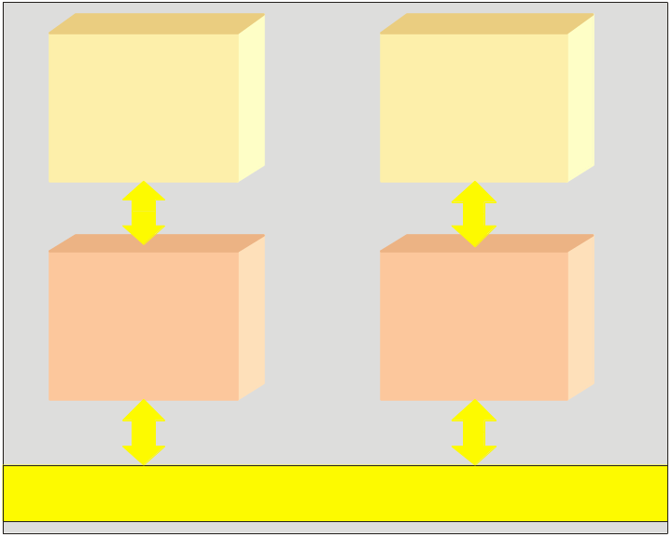

Summary
Multicore Processors
The Intel microprocessors up through the Pentium were all single core processors, meaning they had only one microprocessor in an IC.
Many newer processors have more than one core on a single IC. Multicore processors can execute more than one instruction at a time. This process is also called multiprocessing.
Cache
Cache
Processor core
Processor core
Example
System bus
An example of multiprocessing is when
two processors work on an image at the same time to adjust the contrast. The work is sectioned so that each processor works on only one part.

Slide 8

Summary
Multitasking
Multitasking is a technique that allows a computer to perform more than one task. Unlike multiprocessing, the work only appears to be simultaneous because of the speed of the processor.
One type of multitasking parcels time slices on the processor for each program – this is called preemptive multitasking. Another type of multitasking is done when the program controls the processor – this is called cooperative multitasking.
Multithreading is a variation on multitasking, where different parts of the same program are executed simultaneously.

Slide 9
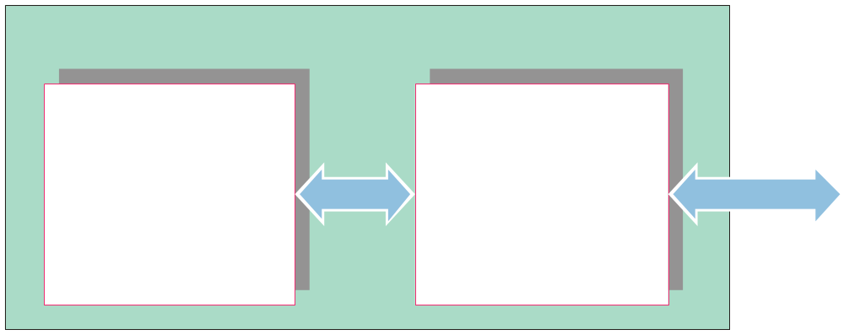
Summary
Operations
Microprocessors execute programs by repeatedly cycling through three basic steps:
Fetch
Decode
Execute
The processor has two internal units, the EU and the BIU, as shown in the figure:
8086/8088 Microprocessor
Execution unit
EU
Bus interface unit
BIU
Executes instructions
Fetches instructions
System buses
Reads operands
Writes results

Slide 10
Summary
Operations
While the EU is executing instructions, the BIU is fetching the next instruction from memory, and storing the next instruction in a high speed memory called the cache.
In the Pentium processors, two execution units (EUs) allow instructions that are independent of each other to execute at the same time.
8086/8088 Microprocessor
Execution unit
EU
Bus interface unit
BIU
Executes instructions
Fetches instructions
System buses
Reads operands
Writes results
The following slide shows the architecture of the 8088 processor …

Slide 11
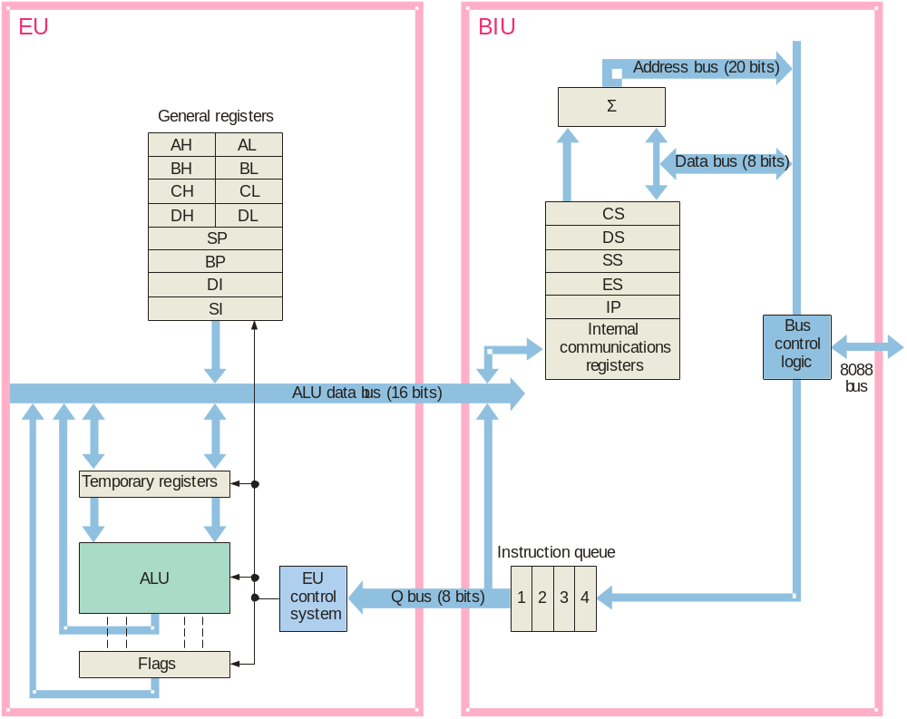
Summary

Slide 12
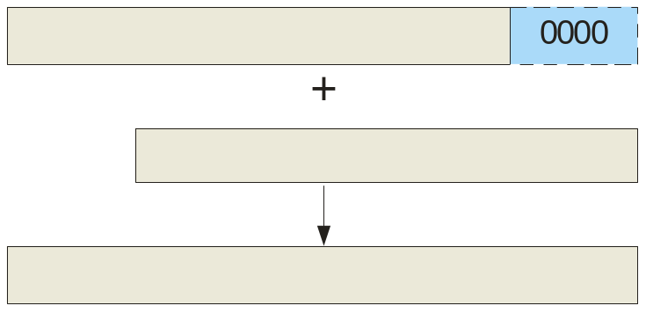
Summary
Addressing
Intel chose a innovative way of generating 20-bit physical addresses in the 8088 and subsequent processors.
The physical address is formed by combining a 16-bit address in a segment register with a 16-bit address in a general register. The addresses “overlap” as shown, with an implied 0000₂ on the right side of the segment register (shown in blue).
Segment register
16-bit segment base address
General register
16-bit offset address
20-bit physical address

Slide 13
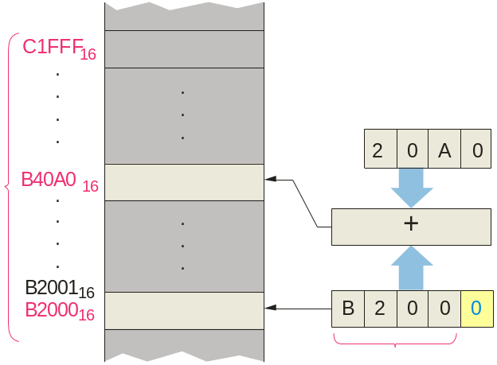
Summary
Addressing
Segment/offset addressing allows 64k blocks of code to be relocated in memory by changing only the segment address.
Example
Assume IP = 20A0₁₆ and CS=B200₁₆.
What is the location of the start and end of the block?
What physical address is formed?
Solution
The addressing is diagramed:
a) The start of the block is at B2000₁₆;
it ends at B2000₁₆ + FFFF₁₆ = C1FFF₁₆
b) The physical address is B2000₁₆ + 20A0₁₆ = B40A0₁₆
Contents of IP
64 kB block
implied
Contents of CS

Slide 14
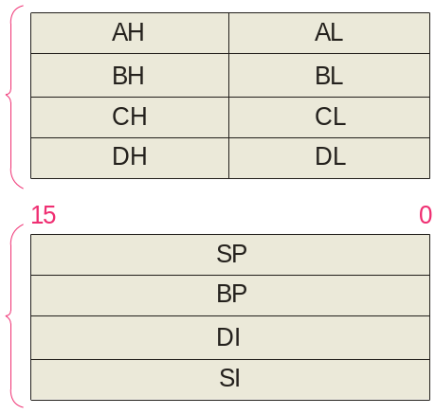
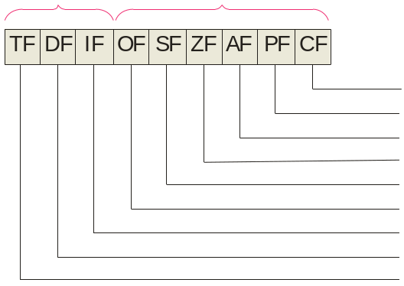
Summary
The Execution Unit
The EU decodes instructions, generates control signals, and executes instructions. The general registers and flags are key elements from an assembly language programming view.
15 8 7 0
Control flags
Status flags
Accumulator
Data set
Base index
Count
Data
Carry
Parity
Aux carry
Stack pointer
Zero
Pointer and index set
Base pointer
Sign
Overflow
Destination index
Interrupt enable
Source index
Direction
Trap
As processors have evolved, the register set has expanded, both in number size and number. The following slide shows part of that evolution…

Slide 15
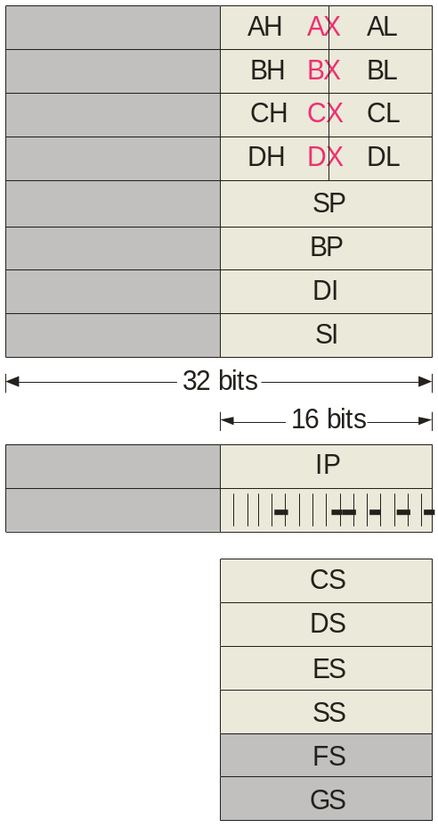
Summary
The Execution Unit
32-bit names
Name
EAX
Accumulator
The software model of later processors includes expanded registers, buses, math coprocessors and the ability to do “pipelining”. Pipelining is a technique where the processor begins executing the next instruction before the previous instruction has been completed.
EBX
Base index
ECX
Count
EDX
Data
ESP
Stack pointer
EBP
Base pointer
EDI
Destination index
ESI
Source index
EIP
Instruction pointer
EFlags
Code segment
Data segment
Extra segment
Stack segment

Slide 16
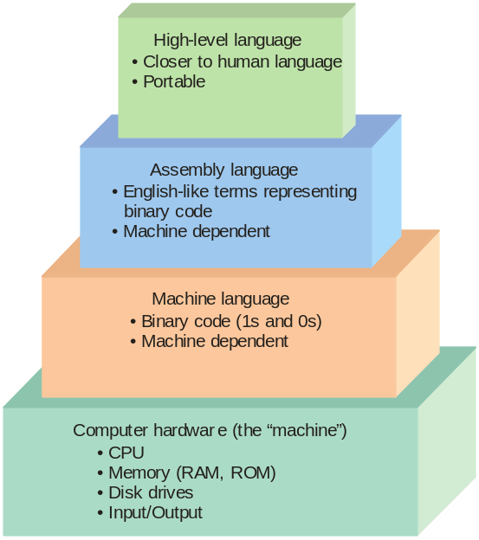
Summary
Computer Programming
Most programming today is done in a high-level language, which can run on various machines. It is easier to write and maintain high-level programs.
Assembly language was developed to make a simpler interface between the machine and the programmer. Assembly language is useful today for many operations because it executes fast and efficiently, but it must be written for a specific processor and takes more time to write programs.
Early computers were programmed in machine language, which was the only instructions the computer could execute. Machine language is tedious to write and prone to errors.

Slide 17


Summary
Computer Programming
High-level languages can run on any machine; the source code is converted to machine code by a compiler. (In some cases an interpreter is used; it converts source code line-by-line.)
High-level language program
(Source program)
Machine language program
(Object program)
Compiler
Assembly language must written for the specific processor it will be used on and the programmer must understand the register structure of the processor. An assembler converts the source code to the machine code.
Assembly language program
(Source program)
Machine language program
(Object program)
Assembler

Slide 18
Summary
Assembly Programming
Assembly language is suited to instrumentation and control applications such as found in a production facility. It is also used to write device drivers for peripheral devices because necessary instructions are not readily available in high-level languages.
In assembly language, there are two types of instructions – assembler directives and executable instructions. Assembler directives provide the assembler with various types of information such as space requirements, or where to begin executing instructions. Executable instructions can be directly translated to machine code and include arithmetic and other operations.
Example
dw 30 ;an assembler directive that reserves space for 30 as a word
sub ax,bx ;an executable instruction - subtract (bx) from (ax)
The following slide lists categories of executable instructions…

Slide 19
Summary
Instruction type Examples Syntax
Transfer Move (copy) MOV destination, source Input IN destination, port number
Arithmetic Add with Carry ADC destination, source
Subtract SUB destination, source
Bit Manipulation Invert bits NOT register
Shift left (logical) SHL register, quantity
Arithmetic Add with Carry ADC destination, source
Subtract SUB destination, source
Loops and Jumps Unconditional jump JMP destination
Jump if no carry JNC destination
Strings Input a string INS port number
Subroutines Call a procedure CALL label
and Interrupts Interrupt INT number
Processor Control Clear carry flag CLC

Slide 20
Summary
Interrupts
In microprocessor based systems, there are three ways to start a service routine for a peripheral device. These are:
Polled I/O – the CPU tests each device one at a time to check if it needs service. If it does, the service routine is invoked.
Interrupt driven I/O – the peripheral device requests service by sending an interrupt request signal. The CPU acknowledges the interrupt, fetches the service routine, and returns to its program when the routine is completed.
Software interrupts – a software interrupt is issued from software rather than external hardware. After the interrupt occurs, the steps are the same as with a hardware interrupt.

Slide 21
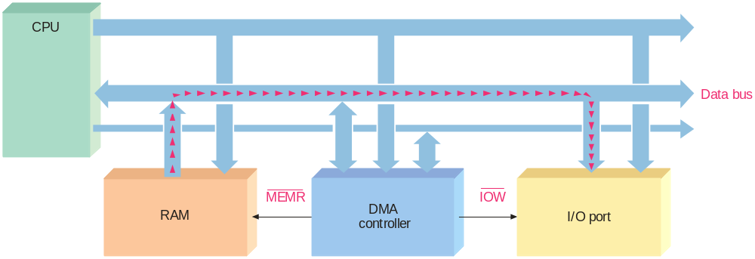
Summary
Direct Memory Access
Direct memory access (DMA) is a data transfer technique in which data is transferred to or from a peripheral device and memory without involving the CPU. A DMA controller handles the transfer. The transfer is faster using this method.

Slide 22
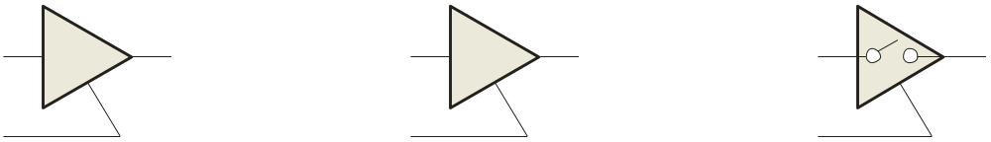
Summary
Internal Interfacing
It is often necessary to communicate with various devices in systems. Often, the devices are connected together with a bus and access to the bus is controlled by a bus controller or bus arbitrator to avoid conflicts.
To avoid having two or more devices “talking” on a common bus, tristate buffers are commonly used. These are buffers with three states: HIGH, LOW, and high impedance (disconnected). An enable line determines if the device is enabled or disconnected.
LOW or HIGH
HIGH
HIGH
Disconnected (high-Z)
HIGH
HIGH
HIGH
Active HIGH enable line

Slide 23
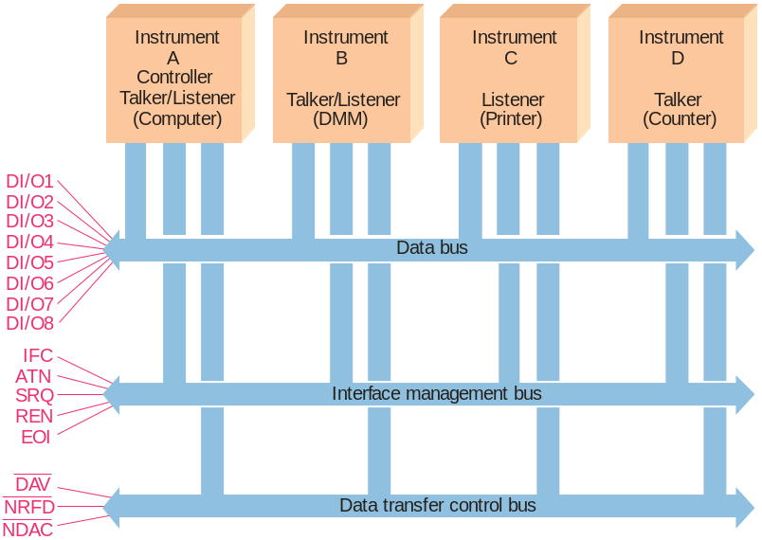
Summary
The IEEE 488 (GPIB) Bus
An example of a bus system is the IEEE 488 general-purpose interface bus (GPIB) that has evolved from a standard originally developed in 1965 by Hewlett-Packard. The standard is widely used to allow instruments to send data over a parallel data bus. There are three types of devices defined by the standard.
Listeners are devices that receive data such as monitors or printers.
Talkers are devices that send data such as DMMs or signal generators.
Data lines
Controllers are devices that determine who can talk and who should listen.
Management lines
Handshake lines

Slide 24

Selected Key Terms
Port
Interrupt
Assembly language
Tristate
A physical interface on a computer through which data are passed to or from a peripheral.
A computer signal or instruction that causes the current process to be temporarily stopped while a service routine is run.
A programming language that uses English like words and has a one-to-one correspondence to machine language.
A type of output on logic circuits that exhibits three states: HIGH, LOW, and high Z; used to interface the outputs of a source device to a bus.

Slide 25

Quiz
1. In a computer, the address bus is a
a. one way bus from the CPU
b. one way bus to the CPU
c. two way bus between the CPU and memory
d. two way bus between the CPU and ports
© 2008 Pearson Education

Slide 26
Quiz
2. A example of software that resides in ROM (firmware) is
a. assembly language
b. application software
c. the BIOS
d. all of the above
© 2008 Pearson Education

Slide 27
Quiz
3. The part of a microprocessor that translates the programming instruction into an address where microcode resides is the
a. ALU
b. instruction decoder
c. register array
d. control unit
© 2008 Pearson Education

Slide 28
Quiz
4. The part of a microprocessor that fetches the next instruction from memory is called the
a. ALU
b. BIU
c. EU
d. bus controller
© 2008 Pearson Education

Slide 29
Quiz
5. The figure illustrates the segment/offset method of addressing used in Intel processors. The advantage of this method is
a. code can be easily relocated
b. a smaller address bus can be used
c. addresses can be “pipelined”
d. the clock speed can be increased
16-bit segment base address
16-bit offset address
20-bit physical address
© 2008 Pearson Education

Slide 30
Quiz
6. An advantage to assembly language is that it is
a. fast and efficient
b. easier to write programs
c. can be used on any processor
d. all of the above
© 2008 Pearson Education

Slide 31
Quiz
7. Information given to an assembler such as where to begin executing instructions is provided by
a. the BIOS
b. system programs
c. executable instructions
d. assembler directives
© 2008 Pearson Education

Slide 32
Quiz
8. The CPU is not involved in
a. arithmetic instructions
b. loop instructions
c. software interrupts
d. direct memory access
© 2008 Pearson Education

Slide 33
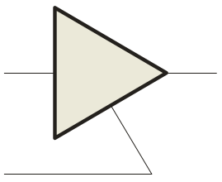
Quiz
9. For the circuit shown, the output will be
a. LOW
b. HIGH
c. high impedance
d. not enough information to tell
HIGH
?
LOW
© 2008 Pearson Education

Slide 34
Quiz
10. The IEEE 488 bus standard
a. is a serial bus with 2 types of devices
b. is a parallel bus with 2 types of devices
c. is a serial bus with 3 types of devices
d. is a parallel bus with 3 types of devices
© 2008 Pearson Education

Slide 35
Quiz
Answers:
1. a
2. c
3. b
4. b
5. a
6. a
7. d
8. d
9. c
10. d

