Slide 1

Digital Circuit and Logic Design

Slide 2
Feature of the Course
Major Basic Course
Preliminary knowledge
Electric Circuits
Analog Electronic Technology

Slide 3
What will we learn?
Numbers Systems and Codes
Logic Algebra
Logic Gates
Combinational Logic Analysis
Flip-flops
Sequential Logic Circuit
The Generation of Pulse
D/A and A/D
Memory and Storage

Slide 4
Textbook
Digital Fundamentals, Tenth Edition
[美] Thomas L. Floyd 著 余 璆 改编 电子工业出版社
References
1. 电子技术基础 数字部分（第五版）
康华光主编 高等教育出版社
2. 数字电子技术基础（第四版）
阎 石 主编 高等教育出版社

Slide 5
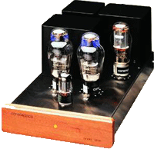
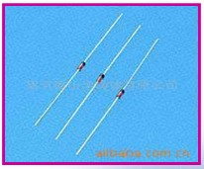
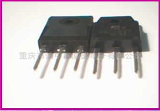
The Development of Digital Circuit
The development of digital circuit is depended on the
development of electric device.
Vacuum Tube Transistor Integrated Circuits

Slide 6
The Application of Digital Circuit
Computer
Broadcast
Television (VCD DVD)
Control ( traffic control )
Aerospace
Entertainment (Digital Camera)

Slide 7
The Classification of Digital Circuit
SSI Small scale integration (12 logic gates)
MSI medium scale integration (12~99 logic gates)
LSI large scale integration (100~9999)
VLSI very large scale integration (10000~99999)
ULSI ultra large scale integration (over 10⁶)
ASIC, Application Specific Integrated Circuit

Slide 8
The Feature of Digital Circuit
Processed and transmitted more efficiently and reliable
Easy to design
Can be produced in batches
Programmable
High speed
Low power
Storage

Slide 9
Chapter 1
Digital Concepts

Slide 10
Main Contents
Analog signal
Digital signal
Binary digital
Logic levels
Digital waveforms

Slide 11
Sec.1.1 Digital and Analog Quantities
An analog quantity is one having continuous values.
Most things that can be measured quantitatively occur in nature
in analog form. For example, the air temperature, press, speed etc.
A digital quantity is one having a discrete set of values.
CHAPTER 1

Slide 12
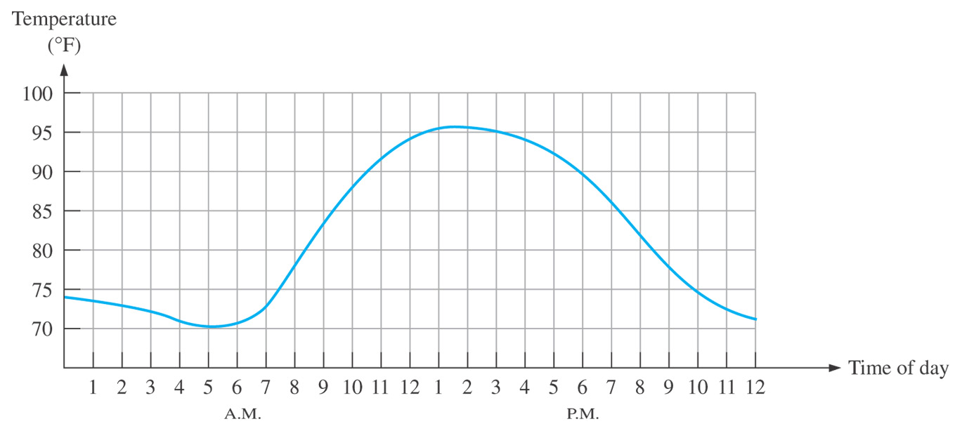
Sec.1.1 Digital and Analog Quantities
CHAPTER 1

Slide 13
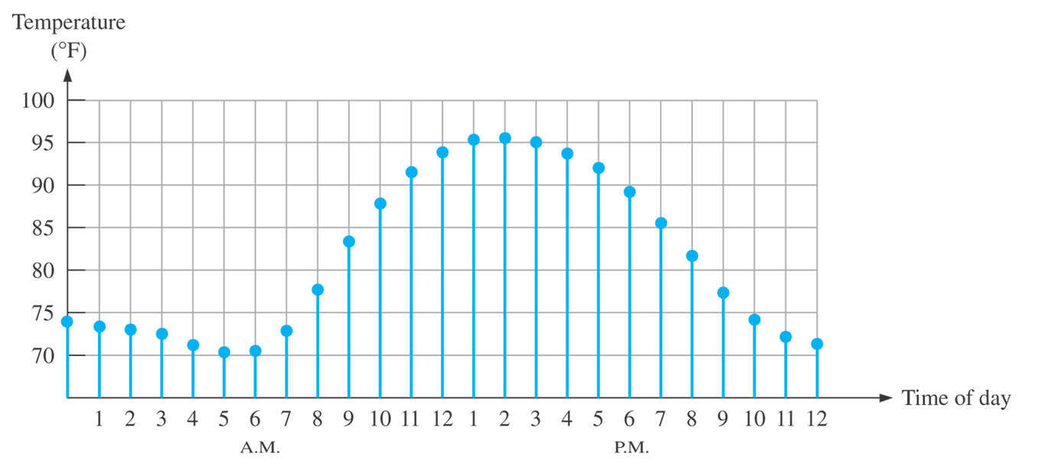
Sec.1.1 Digital and Analog Quantities
CHAPTER 1

Slide 14
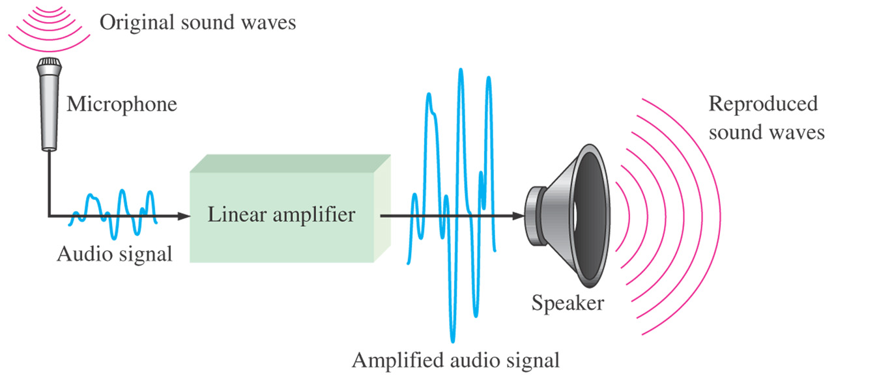
Sec.1.1 Digital and Analog Quantities
An analog electronic system
An analog electronic circuit involves quantities with continuous values.
CHAPTER 1

Slide 15
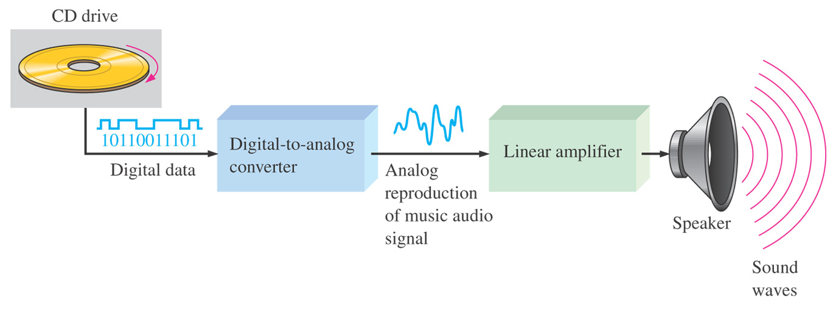
Sec.1.1 Digital and Analog Quantities
An system Using Digital and Analog Methods
The output is analog signals.
CHAPTER 1

Slide 16
Sec.1.2 Binary digital, logic levels, and digital waveforms
Digital electronics involves circuits and systems in which there are only two possible states. These states are represented by two different
voltage levels: a HIGH and a LOW.
The two-state number system is called binary, and its two digits are 0 and 1. A binary digit is called a bit.
CHAPTER 1

Slide 17
Sec.1.2 Binary digital, logic levels, and digital waveforms
Binary Digits
Each of the two digits in the binary system, 1 and 0, is called a bit.
Two different voltage levels are used to represent the two bits.
Positive logic
HIGH = 1, and LOW = 0
Negative logic
HIGH = 0, and LOW = 1
CHAPTER 1

Slide 18
Sec.1.2 Binary digital, logic levels, and digital waveforms
Logic Levels
The voltages used to represent a 1 and a 0 are called logic levels. Ideally, one voltage level represents a HIGH and another represents a LOW. The HIGH and LOW can be any voltage between a specified
minimum value and a specified maximum value.
CHAPTER 1

Slide 19
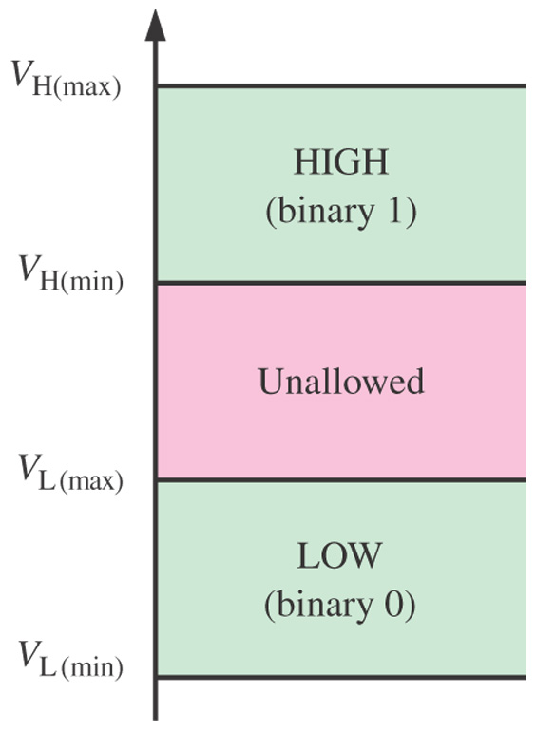
Sec.1.2 Binary digital, logic levels, and digital waveforms
Logic Levels
CHAPTER 1

Slide 20
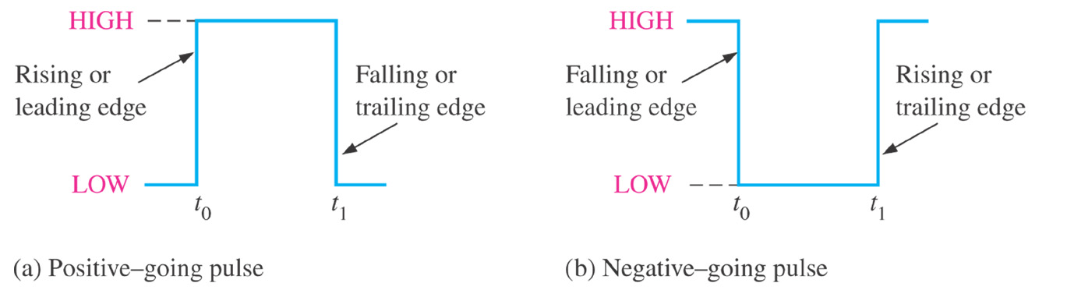
Sec.1.2 Binary digital, logic levels, and digital waveforms
Digital Waveforms
Digital waveforms consist of voltage levels that are changing back
and forth between the HIGH and LOW levels or states.
CHAPTER 1

Slide 21
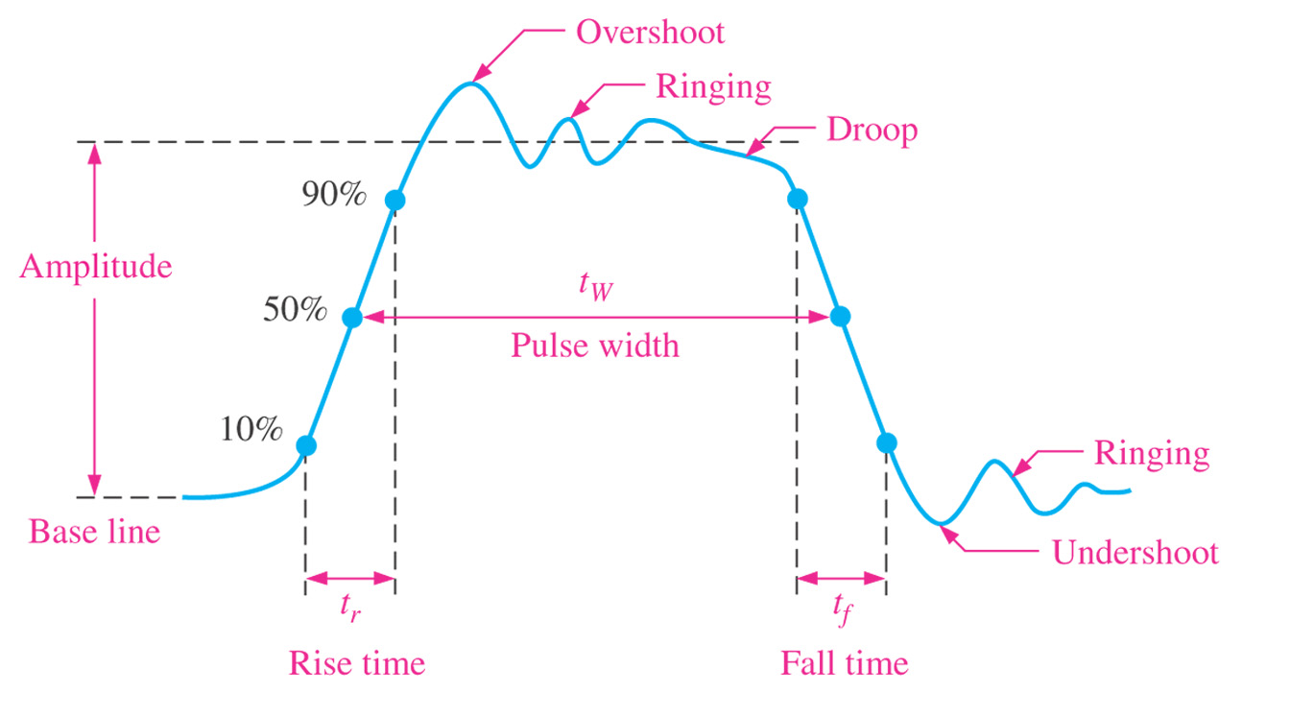
Sec.1.2 Binary digital, logic levels, and digital waveforms
Digital Waveforms
Figure 1-7 shows a nonideal pulse.
CHAPTER 1

Slide 22
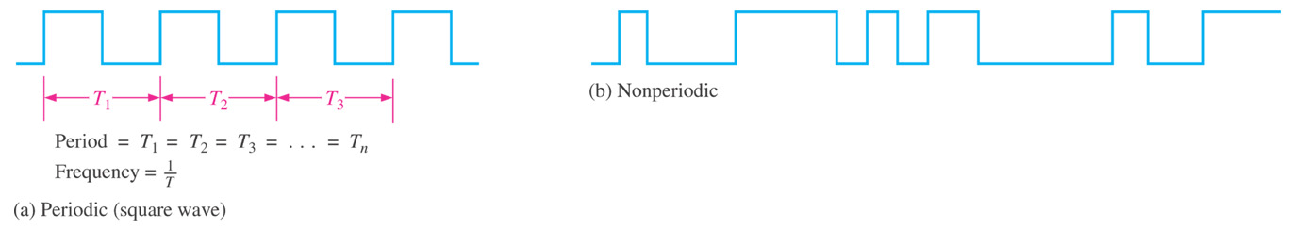
Sec.1.2 Binary digital, logic levels, and digital waveforms
Waveforms Characteristics
Most waveforms encountered in digital systems are composed of series of pulses, sometimes called pulse trains, can be either periodic or
nonperiodic.
CHAPTER 1

Slide 23
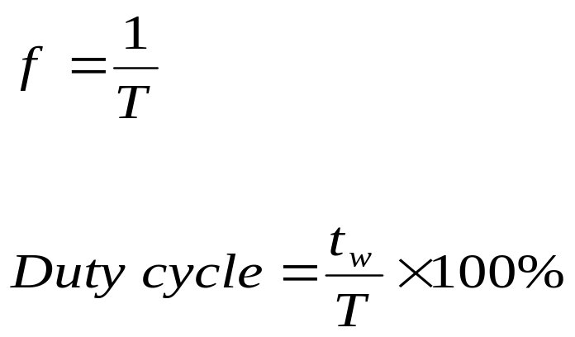
Sec.1.2 Binary digital, logic levels, and digital waveforms
Waveforms Characteristics
For a periodic signal, the frequency (f) of a pulse waveform is the reciprocal of the period.
Duty cycle is the ratio of the pulse width (T_{w}) to the period (T).
CHAPTER 1

Slide 24
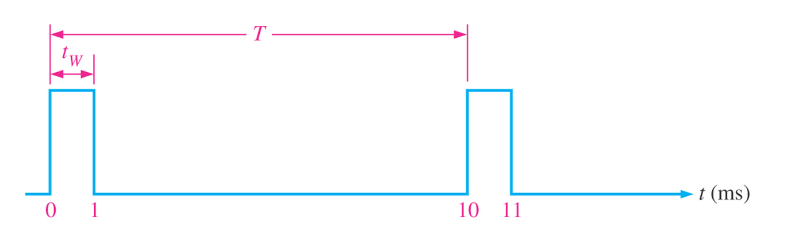
Sec.1.2 Binary digital, logic levels, and digital waveforms
Example 1-1
A portion of a periodic digital waveform is shown in Figure 1-9. The measurements are in milliseconds. Determine the following:
(a) period (b) frequency (c) duty cycle
CHAPTER 1

Slide 25
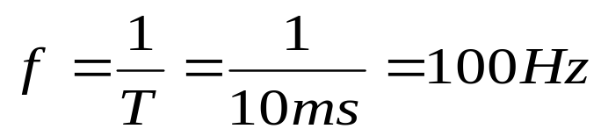
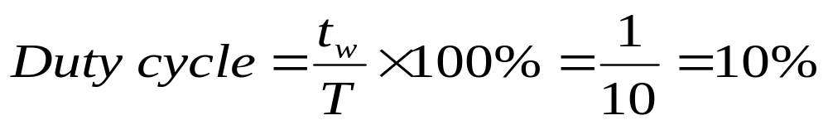
Sec.1.2 Binary digital, logic levels, and digital waveforms
Example 1-1
Solution:
(a) The period is 10ms.
(b) The frequency is
(c) duty cycle
CHAPTER 1

Slide 26
Sec.1.2 Binary digital, logic levels, and digital waveforms
A Digital Waveform Carries Binary Information
Binary information that is handled by digital systems appears as waveforms that represent sequences of bits. Each binary digital 1 or 0 has the same interval. Each bit in a sequence occupies a defined time
called a bit time.
CHAPTER 1

Slide 27
Sec.1.2 Binary digital, logic levels, and digital waveforms
A Digital Waveform Carries Binary Information
In digital systems, all waveforms are synchronized with a basic timing waveform called the clock. The clock is a period waveform in
which each interval between pulses equals the time for one bit.
CHAPTER 1

Slide 28
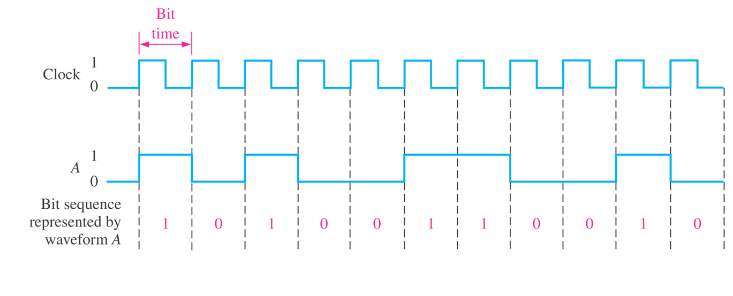
Sec.1.2 Binary digital, logic levels, and digital waveforms
A Digital Waveform Carries Binary Information
CHAPTER 1

Slide 29
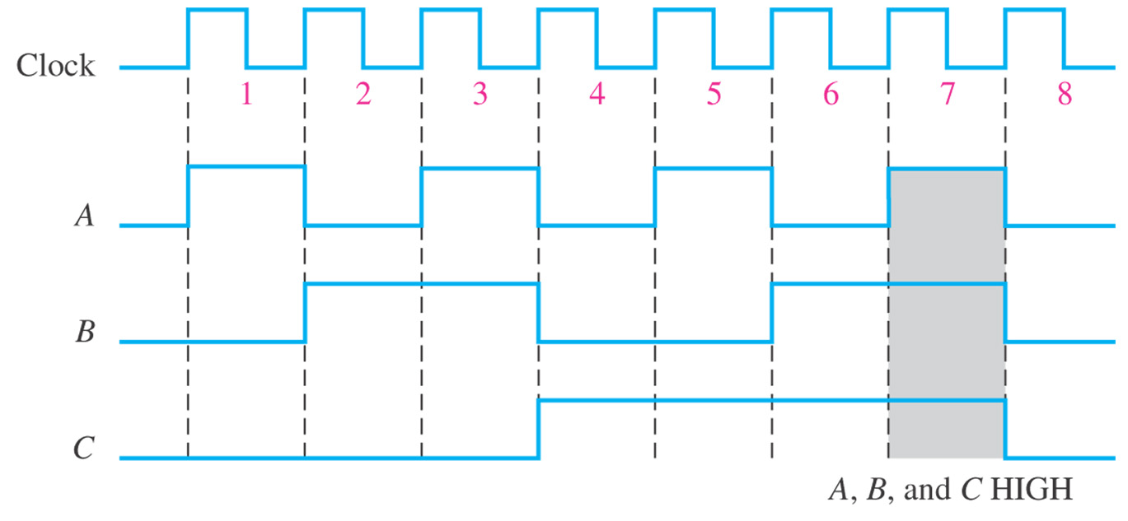
Sec.1.2 Binary digital, logic levels, and digital waveforms
A Digital Waveform Carries Binary Information
CHAPTER 1

Slide 30
Sec.1.2 Binary digital, logic levels, and digital waveforms
Data Transfer
Data refers to groups of bits that convey some type of information. Binary data, which are represented by digital waveforms, must be transferred from one circuit to another within a digital system or from
one system to another in order to accomplish a given purpose.
CHAPTER 1

Slide 31
Sec.1.2 Binary digital, logic levels, and digital waveforms
Data Transfer
There are two ways to transfer data: serial and parallel.
In serial mode, the data are transferred one bit by one bit; In parallel mode, several bits are transferred at the same time.
CHAPTER 1

Slide 32
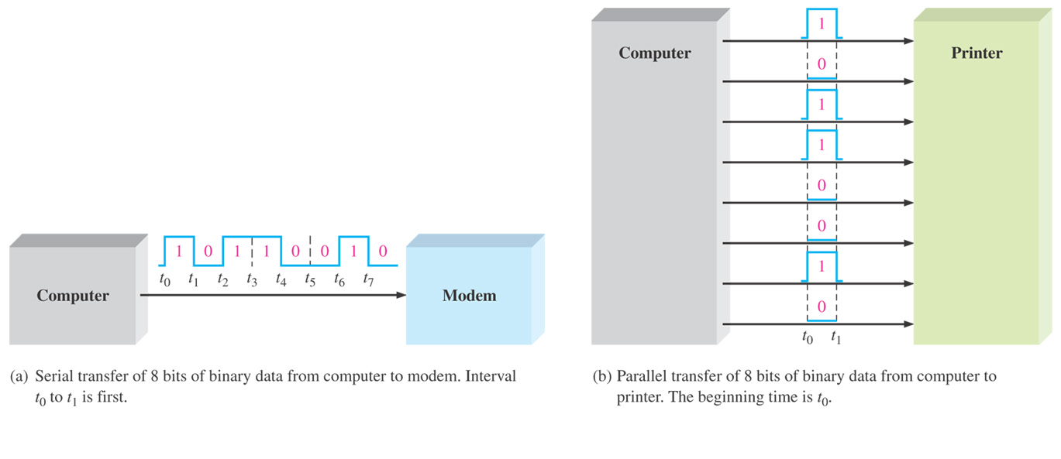
Sec.1.2 Binary digital, logic levels, and digital waveforms
Data Transfer
CHAPTER 1

Slide 33
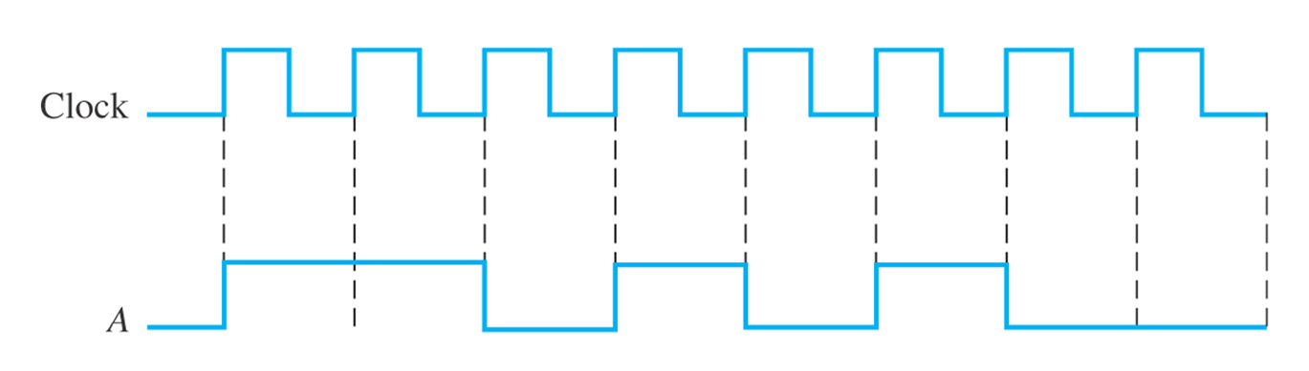
Sec.1.2 Binary digital, logic levels, and digital waveforms
Example 1-2
(a) Determine the total time required to serially transfer the eight bits contained in waveform A of Figure 1-13, and indicate the sequence of bits. The left-most bit is the
first to be transferred. The 100kHz clock is used as reference.
(b) What is the total time to transfer the same eight bits in parallel?
CHAPTER 1

Slide 34
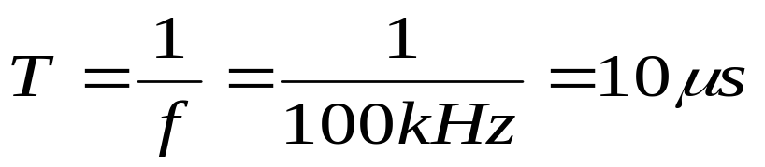


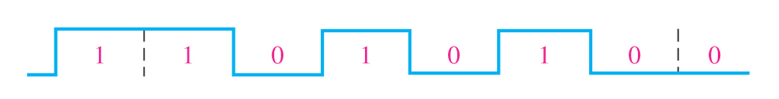
Sec.1.2 Binary digital, logic levels, and digital waveforms
Example 1-2
Solution:
(a) Since the frequency of the clock is 100kHz, the period is
It takes to transfer each bit in the waveform. The total transfer time for 8 bits is
(b) A parallel transfer would take for all eight bits.
CHAPTER 1

Slide 35
Chapter 2
Number Systems,
Operation, and Codes

Slide 36
Main Contents
Number systems
Code systems
Decimal, Binary, hexadecimal, octal

Slide 37
Sec.2.1 Decimal Numbers
In the decimal number system each of the ten digitals, 0 through 9, represents a certain quantity.
The decimal number system has a base of 10. The value of a digit is determined by its position in the number.
9+1=10
CHAPTER 2

Slide 38
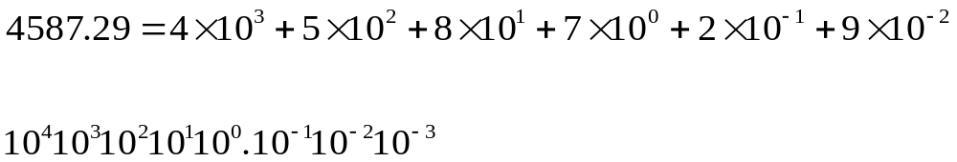
Sec.2.1 Decimal Numbers
The position of each digit in a decimal number indicates the
magnitude of quantity represented and can be assigned a weight.
CHAPTER 2

Slide 39
Sec.2.2 Binary Numbers
The binary number system is another way to represent quantities. It is less complicated than the decimal system because it has only two
digits.
The binary system is used in computer system.
CHAPTER 2

Slide 40
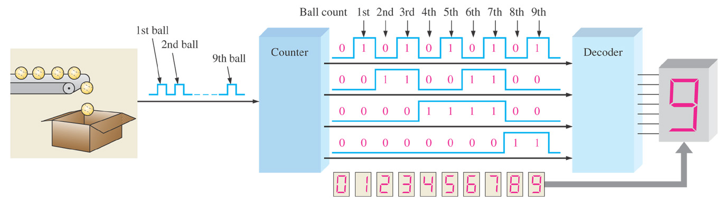
Sec.2.2 Binary Numbers
An Application
CHAPTER 2

Slide 41
Sec.2.2 Binary Numbers
The binary number system has two digits (bits). In general, with n bits you can count up to equal to 2^{n}-1.
The binary number system has a base of 2.
1+1=10
CHAPTER 2

Slide 42
Sec.2.2 Binary Numbers
Decimal | Binary
0 | 0000
1 | 0001
2 | 0010
3 | 0011
4 | 0100
5 | 0101
6 | 0110
7 | 0111
8 | 1000
9 | 1001
10 | 1010
11 | 1011
12 | 1100
13 | 1101
14 | 1110
15 | 1111
CHAPTER 2

Slide 43
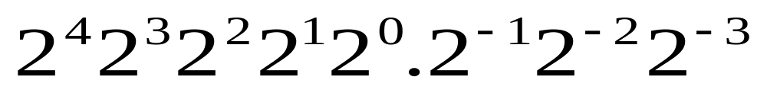
Sec.2.2 Binary Numbers
A binary number is a weighted number. The right-most bit is the LSB (least significant bit) in a binary whole number and has a weight of 2⁰=1. The weights increase from right to left by a power of two for each
bit.
CHAPTER 2

Slide 44
Sec.2.2 Binary Numbers
Binary-to-Decimal Conversion
The decimal value of any binary number can be found by adding the
weights of all bits that are discarding the weights of all bits that are 0.
Example 2-3 Convert the binary whole number 1101101 to decimal.
Solution: Determine the weight of each bit that is a 1, and then find the sum of the weights to get the decimal number.
Weight: 2⁶ 2⁵ 2⁴ 2³ 2² 2¹ 2⁰
Binary number: 1 1 0 1 1 0 1
1101101_{B}= 2⁶+ 2⁵+2³+2²+2⁰ = 109_{D}
CHAPTER 2

Slide 45
Sec.2.2 Binary Numbers
Binary-to-Decimal Conversion
Example 2-4 Convert the fractional binary number 0.1011 to decimal.
Solution: Determine the weight of each bit that is a 1, and then sum the weights to get the decimal fraction.
Weight: 2⁻¹ 2⁻² 2⁻³ 2⁻⁴
Binary number: 0.1 0 1 1
0.1011_{B}= 2⁻¹+ 2⁻³+2⁻⁴ =0.5+0.125+0.0625=0.6875_{D}
CHAPTER 2

Slide 46
Sec.2.3 Decimal-to-Binary Conversion
There are two ways to convert decimal to binary number. One is using the sum-of-weights method. The other is using the repeated
division-by-2 method.
CHAPTER 2

Slide 47
Sec.2.3 Decimal-to-Binary Conversion
Sum-of-Weights Method
One way to find the binary number that is equivalent to a given decimal number is to determine the set of binary weights whose sum is
equal to the decimal number.
9=8+1 or 9=2³+2⁰
2³ 2² 2¹ 2⁰
1 0 0 1
9_{D}=1001_{B}
CHAPTER 2

Slide 48
Sec.2.3 Decimal-to-Binary Conversion
Example 2-5
Use the concept of weight to convert 58₁₀ to binary.
Solution:
Weight: 32 16 8 4 2 1
Digits: 1 1 1 0 1 0
Sum: 32+ 16+ 8+ 0+ 2+ 0 =58
58_{D}=111010_{B}
CHAPTER 2

Slide 49
Sec.2.3 Decimal-to-Binary Conversion
Repeated Division-by-2 Method
To get the binary number for a given decimal number, divide the decimal number by 2 until the quotient is 0. remainders form the binary
number. Remainder
12/2=6 0
6/2=3 0
3/2=1 1
½=0 1
12_{D}=1100_{B}
CHAPTER 2

Slide 50
Sec.2.3 Decimal-to-Binary Conversion
Repeated Division-by-2 Method
Example 2-6
Convert 19₁₀ to binary.
Solution:
Quotient Remainder
19/2 = 9 1 LSB (Least significant bit)
9/2 = 4 1
4/2 = 2 0
2/2 = 1 0
1/2 = 0 1 MSB (most significant bit)
Therefore, 19₁₀ = 10011₂.
CHAPTER 2

Slide 51
Sec.2.3 Decimal-to-Binary Conversion
Converting Decimal Fractions to Binary
The sum-of-weights method can be applied to fractional decimal
numbers, as shown in the following example:
0.625_{D}=0.5+0.125=2⁻¹+2⁻³=0.101_{B}
CHAPTER 2

Slide 52
Sec.2.3 Decimal-to-Binary Conversion
Converting Decimal Fractions to Binary
Decimal fractions can be converted to binary by repeated multiplication by 2, until the fractional product is zero or until the
desired number of decimal places is reached.
0.3125 x 2=0.625 0 ( carry)
0.625 x 2=1.25 1
0.25 x 2=0.5 0
0.5 x 2=1 1
0.3125_{D}=0.0101_{B}
CHAPTER 2

Slide 53
Sec.2.4 Binary Arithmetic
Binary arithmetic is essential in all digital computers and in many other types of digital systems. The essential operation includes:
Add binary numbers
Subtract binary numbers
Multiply binary numbers
Divide binary numbers
CHAPTER 2

Slide 54
Sec.2.4 Binary Arithmetic
Binary Addition
The four basic rules for adding binary digits (bits) are as following:
0 + 0 = 0
0 + 1 = 1
1 + 0 = 1
1 + 1 = 10
In decimal addition 1+1=2
CHAPTER 2

Slide 55
Sec.2.4 Binary Arithmetic
Binary Addition
Example 2-7 Add the binary number 110 + 100
110 6
+ 100 + 4
1010 10
CHAPTER 2

Slide 56
Sec.2.4 Binary Arithmetic
Binary Subtraction
The four basic rules for adding binary digits (bits) are as following:
0 - 0 = 0
1 - 1 = 0
1 - 0 = 1
0 - 1 = 1 0 – 1 with a borrow of 1
CHAPTER 2

Slide 57
Sec.2.4 Binary Arithmetic
Binary Subtraction
Example 2-9 Subtract 011 from 101.
Solution:
101 5
- 011 - 3
010 2
the left column, 1 is borrowed, a 0 is left.
CHAPTER 2

Slide 58
Sec.2.4 Binary Arithmetic
Binary Multiplication
Binary multiplication of two bits is the same as multiplication of the decimal digits 0 and 1.
0 x 0 = 0
0 x 1 = 0
1 x 0 = 0
1 x 1 = 1
CHAPTER 2

Slide 59
Sec.2.4 Binary Arithmetic
Binary Multiplication
Example Multiply 1101 x 1010
1101
x 1010
0000
1101
+ 1101
10000010 13 x 10 =130
CHAPTER 2

Slide 60
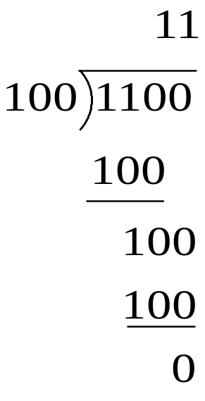
Sec.2.4 Binary Arithmetic
Binary Division
Example Perform the binary division 1100 ÷100
12 ÷ 4 =3
CHAPTER 2

Slide 61
Next Lesson
Number Systems, Operations, and Codes
2-5 ~ 2-11

