Slide 1

Review
Digital and analog quantities
Digital waveform
Decimal system
Binary system

Slide 2
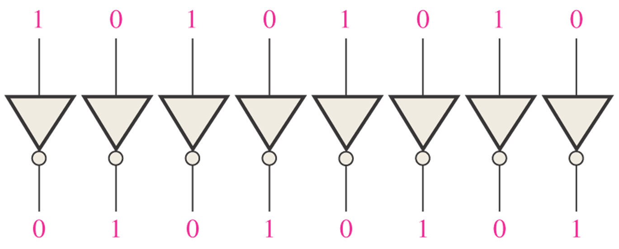
Sec.2.5 1’s and 2’s Complements of Binary Numbers
The 1’s complement of a binary number is found by changing all 1s
to 0s and all 0s to 1s.
CHAPTER 2

Slide 3
Sec.2.5 1’s and 2’s Complements of Binary Numbers
The 2’s complement of a binary number is found by adding 1 to the
LSB of the 1’s complement.
2’s complement = ( 1’s complement )+1
Example 2-12 Find the 2’s complement of 10110010
Solution 10110010 Binary number
01001101 1’s complement
+ 1 Add 1
01001110 2’s complement
CHAPTER 2

Slide 4
Sec.2.6 Signed Numbers
The most significant digit (MSB) denotes the sign, the other digits are aside for the magnitude of the number.
If the MSB=1, it denotes negative,
If the MSB=0, it denotes positive.
+81=01010001 -81=11010001
CHAPTER 2

Slide 5
Sec.2.6 Signed Numbers
For a positive, the 1’complent and 2’scomplent are same as the positive.
For a negative, the 1’complent and 2’scomplent can be gotten as following:
1’s complement
Changing all 1s and 0s to 0s and 1s.
2’s complement
Invert all the bits and then add 1 to the result.
CHAPTER 2

Slide 6
Sec.2.6 Signed Numbers
Example The true binary form, 1’s complement and 2’s
complement of +25 and -25 .
+25 00011001
-25 10011001
11100110 (1’s complement)
11100111 (2’s complement)
CHAPTER 2

Slide 7
Sec.2.6 Signed Numbers
The range of values for n-bit numbers is
-(2^{n-1}-1) ~ +(2^{n-1}-1) the true binary form
-(2^{n-1}-1) ~ +(2^{n-1}-1) 1’s complement
-(2^{n-1}) ~ +(2^{n-1}-1) 2’s complement
A 8 bits binary number ( 00000000~11111111) is one of the
numbers (0~255) for unsigned, (-128~127) for signed.
CHAPTER 2

Slide 8
Sec.2.6 Signed Numbers
The decimal Value of signed Numbers
Sign-magnitude Decimal values of positive and negative numbers in the sign-magnitude form are determined by summing the weights in all the magnitude bit positions where there are 1s and ignoring those positions where there are zeros. The sign determined by examination of
the sign bit.
Example 10010101 16+4+1=21
The decimal number is -21.
CHAPTER 2

Slide 9
Sec.2.6 Signed Numbers
The decimal Value of signed Numbers
1’s complement Decimal values of negative numbers are determined by assigning a negative value to weight of the sign bit,
summing all the weights where there are 1s, and add 1 to the result.
Example 1 1 1 0 1 0 0 0
-2⁷ 2⁶ 2⁵ 2⁴ 2³ 2² 2¹ 2⁰
-128 +64 +32 +8=-24
-24+1=-23
The final decimal number is -23.
CHAPTER 2

Slide 10
Sec.2.6 Signed Numbers
The decimal Value of signed Numbers
2’s complement Decimal values of negative numbers are determined by assigning a negative value to weight of the sign bit,
summing all the weights where there are 1s.
Example 1 0 1 0 1 0 1 0
-2⁷ 2⁶ 2⁵ 2⁴ 2³ 2² 2¹ 2⁰
-128 +32 +8 +2=-86
The final decimal number is -86.
CHAPTER 2

Slide 11
Sec.2.6 Signed Numbers
Floating-Point Numbers
A floating-point number (real number) consists of two parts plus a sign. For binary floating-point numbers, the format is defined by ANSI/IEEE Standard 754-1985 in three forms: single-precision, double-
precision, extended-precision.
CHAPTER 2

Slide 12
Sec.2.6 Signed Numbers
Floating-Point Numbers
single-precision has 32bits
double-precision has 64bits
extended-precision has 80bits
S(1bit) | Exponent(8bits) | Mantissa (23bits)
S(1bit) | Exponent(11bits) | Mantissa (52bits)
S(1bit) | Exponent(15bits) | Mantissa (64bits)
CHAPTER 2

Slide 13
Sec.2.6 Signed Numbers
Floating-Point Numbers
Example 1011010010001 expressed in single-precision form.
1011010010001= 1.011010010001 x 2¹²
The sign bit is 0. The exponent, 12, is expressed as a biased exponent by adding it to 127 (127+12=139) 10001011. The mantissa is
the fractional part. 011010010001.
0 | 10001011 | 01101001000100000000000
CHAPTER 2

Slide 14
Sec.2.6 Signed Numbers
Floating-Point Numbers (single-precision )
Exponent (E) | Mantissa (M) | Value (V)
E=0 | M=0 | V=0
E=0 | M≠0 | V=(-1)^{s}2⁻¹²⁶(0.M) Denormalnumber
1≤E≤254 |  | V=(-1)^{s}2^{E-127}(1.M) Normalnumber
E=255 | M=0 | V=(-1)^{s}∞
E=255 | M≠0 | V=NaN (Not a number)
CHAPTER 2

Slide 15
Sec.2.7 Arithmetic Operations with Signed Numbers
Addition
Overflow Condition When two numbers are added and the number of bits required to represent the sum exceeds the number of bits in the two
numbers, an overflow results as indicated by an incorrect sign bit.
+125 + 58 = 183
01111101
+ 00111010
10110111
The sign bit is not right. The magnitude is incorrect.
CHAPTER 2

Slide 16
Sec.2.7 Arithmetic Operations with Signed Numbers
Subtraction
Subtraction is a special case of addition.
15-6=(+15)+(-6)=+9
00001111
+11111010 2’scomplement
100001001 Discard the carry
CHAPTER 2

Slide 17
Sec.2.7 Arithmetic Operations with Signed Numbers
Multiplication
Multiplication is equivalent to adding a number to itself a number of times equal to the multiplier.
Direct addition and partial products are two basic methods for
performing multiplication.
CHAPTER 2

Slide 18
Sec.2.7 Arithmetic Operations with Signed Numbers
Multiplication
When two binary numbers are multiplied, both numbers must be in true (uncomplemented) form.
If the signs of multiplicand and multiplier are the same, the product is positive.
If the signs of multiplicand and multiplier are different, the product is negative.
CHAPTER 2

Slide 19
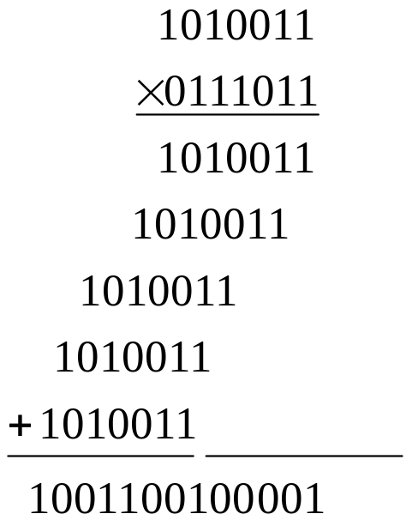
Sec.2.7 Arithmetic Operations with Signed Numbers
Multiplication
Example 2-22 Multiply the signed numbers: 01010011 and 11000101
Solution: the signs are different, the product is negative.
get the true form of multiplier 00111011
Get 2’s complement 0110011011111
Attach the sign bit 1 0110011011111
CHAPTER 2

Slide 20
Sec.2.7 Arithmetic Operations with Signed Numbers
Division
The division operation in computers is accomplished using subtraction. Since subtraction is done with an adder, division can also be
accomplished with an adder. 21÷7=3
21
- 7 First subtraction
14
-7 Second subtraction
7
- 7 Third subtraction
0
CHAPTER 2

Slide 21
Sec.2.7 Arithmetic Operations with Signed Numbers
Division
When two binary numbers are divided, both numbers must be in true (uncomplemented) form.
If the signs of dividend and divisor are the same, the product is
positive.
If the signs of dividend and divisor are different, the product is
negative.
CHAPTER 2

Slide 22
Sec.2.7 Arithmetic Operations with Signed Numbers
Division
Example 9÷ (-3)
Solution the true form of 9 is 00001001
2’s complement of 3 is 11111101.
the quotient is negative. Let quotient is 0, then
00001001
+11111101 quotient=quotient+1 =1
00000110
+11111101 quotient=quotient+1 =2
00000011
+11111101 quotient=quotient+1 =3
00000000
Get 2’s complement 1111101
Attach the sign bit 11111101
CHAPTER 2

Slide 23
Sec.2.8 Hexadecimal Numbers
The hexadecimal number system has sixteen characters; it is used primarily as a compact way of displaying or writing binary numbers
because it is very easy to convert between binary and hexadecimal.
The hexadecimal number system has a base of sixteen; that is, it is
composed of 16 numeric and alphabetic characters.
0, 1, 2, 3, 4, 5, 6, 7, 8, 9, A, B, C, D, E, F
CHAPTER 2

Slide 24
Sec.2.8 Hexadecimal Numbers
Decimal | Binary | Hexadecimal
0 | 0000 | 0
1 | 0001 | 1
2 | 0010 | 2
3 | 0011 | 3
4 | 0100 | 4
5 | 0101 | 5
6 | 0110 | 6
7 | 0111 | 7
8 | 1000 | 8
9 | 1001 | 9
10 | 1010 | A
11 | 1011 | B
12 | 1100 | C
13 | 1101 | D
14 | 1110 | E
15 | 1111 | F
CHAPTER 2

Slide 25
Sec.2.8 Hexadecimal Numbers
Counting in Hexadecimal
In hexadecimal system,
9+1=A
A+1= B
….
F+1=10
so we can count as this 10, 11, 12, 13, 14, 15, 16, 17, 18, 19, 1A, 1B, 1C, 1D, 1E, 1F, 20, 21….
Sometimes, we can write FF₁₆ or FFH, which is decimal 255.
CHAPTER 2

Slide 26
Sec.2.8 Hexadecimal Numbers
Binary-to-Hexadecimal Conversion
Converting a binary whole number to hexadecimal is a straightforward procedure. Simply break the number into 4-bit groups, starting at the right-most bit and replace each 4-bit group with the
equivalent hexadecimal symbol.
CHAPTER 2

Slide 27
Sec.2.8 Hexadecimal Numbers
Binary-to-Hexadecimal Conversion
Example Convert binary 10111001011.01001 and
1100101001010111 to hexadecimal
0101 1100 1011. 0100 1000
= 5CB.48₁₆
1100 1010 0101 0111
= CA57₁₆
CHAPTER 2

Slide 28
Sec.2.8 Hexadecimal Numbers
Hexadecimal-to-Binary Conversion
To convert from a hexadecimal number to a binary number, reverse the process and replace each hexadecimal symbol with the appropriate
four bits.
Example Determine the binary numbers for CF8E hexadecimal number.
CF8E₁₆ = 1100 1111 1000 1110₂
CHAPTER 2

Slide 29
Sec.2.8 Hexadecimal Numbers
Hexadecimal-to-Decimal Conversion
One way to find the decimal equivalent of a hexadecimal number is to first convert the hexadecimal number to binary and then convert from
binary to decimal.
Another way to convert a hexadecimal number to its decimal equivalent is to multiply the decimal value of each hexadecimal digit by
its weight and then take the sum of these products.
CHAPTER 2

Slide 30
Sec.2.8 Hexadecimal Numbers
Hexadecimal-to-Decimal Conversion
Example Convert hexadecimal number E5₁₆ to decimal number.
The hexadecimal symbol E is 14.
E5₁₆=14 x 16¹ + 5 x 16⁰ = 224 + 5 = 229₁₀
CHAPTER 2

Slide 31
Sec.2.8 Hexadecimal Numbers
Decimal-to-Hexadecimal Conversion
Repeated division of a decimal number by 16 will produce the equivalent hexadecimal number, formed by the remainders of the
divisions.
Example Convert the decimal number 650 to hexadecimal number.
650/16 =40 remainder is 10 A
40/16=2 remainder is 8 8
2/16=0 remainder is 2 2
650₁₀=28A₁₆
CHAPTER 2

Slide 32
Sec.2.8 Hexadecimal Numbers
Hexadecimal Addition
Addition can be done directly with hexadecimal numbers by remembering that the hexadecimal digits 0 through 9 are equivalent to decimal digits 0 through 9 and that hexadecimal digits A through F are
equivalent to decimal numbers 10 through 15.
CHAPTER 2

Slide 33
Sec.2.8 Hexadecimal Numbers
Hexadecimal Addition
Example
Perform hex addition: 23D9 + 94BE.
Solution:
23D9
+ 94BE
B897
LSD: 9 + 14 = 23 23 - 16 = 7 with a carry to next digit
1 + 13 + 11 = 25 25 – 16 = 9 with a carry to next digit
1 + 3 + 4 = 8
MSD: 2 + 9 = B
CHAPTER 2

Slide 34
Sec.2.8 Hexadecimal Numbers
Hexadecimal Subtraction
Since a hexadecimal number can be used to represent a binary number, it can also be used to represent the 2’s complement of a binary
number.
Subtraction is a special case of addition.
CHAPTER 2

Slide 35
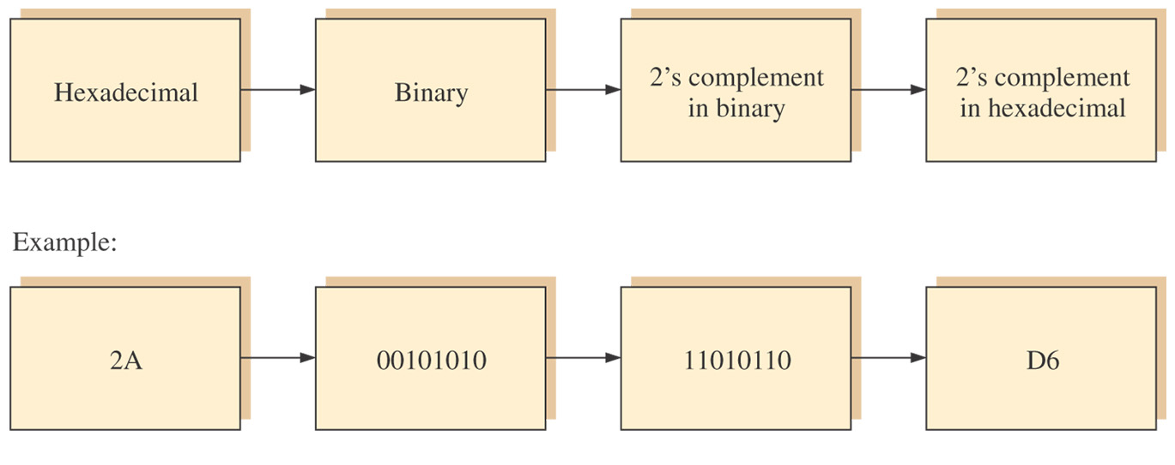
Sec.2.8 Hexadecimal Numbers
Hexadecimal Subtraction
CHAPTER 2

Slide 36
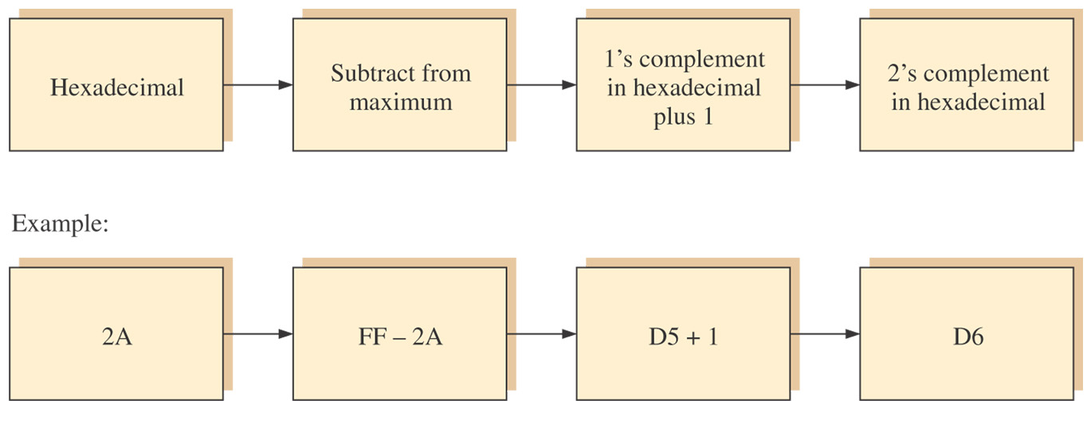
Sec.2.8 Hexadecimal Numbers
Hexadecimal Subtraction
CHAPTER 2

Slide 37
Sec.2.9 Octal Numbers
The octal number system is composed of eight digits, which are
0, 1, 2, 3, 4, 5, 6, 7
The octal number system has a base of 8.
7+ 1 = 10
001 011₂= 13₈ 7526₈=111 101 010 110₂
CHAPTER 2

Slide 38
Sec.2.10 Binary Coded Decimal (BCD)
Binary coded decimal (BCD) is a way to express each of the decimal digits with a binary code. There are only ten code groups in the BCD
system, so it is very easy to convert between decimal and BCD.
There are several BCD codes widely used, such as 8421, 5421, 2421
code.
CHAPTER 2

Slide 39
Sec.2.10 Binary Coded Decimal (BCD)
8421 Code
The 8421 code is a type of BCD code. Binary coded decimal means that each decimal digit, 0 through 9, is represented by a binary code of four bits. The designation 8421 indicates the binary weights of four bits
(2³, 2², 2¹, 2⁰).
0000, 0001, 0010, 0011, 0100, 0101, 0110, 0111, 1000, 1001
represent 0 through 9.
1010, 1011, 1100, 1101, 1110, 1111 are invalid.
CHAPTER 2

Slide 40
Sec.2.10 Binary Coded Decimal (BCD)
BCD Addition
Example Add the BCD numbers 1001 + 0100
Solution: The decimal number addition is shown for comparison
1001 9
+ 0100 + 4
1101 13
+ 0110 (add 6 0110)
0001 0011 (BCD 13)
CHAPTER 2

Slide 41
Sec.2.11 Digital Codes
Gray Code
The Gray Code is unweighted and is not an arithmetic code; that is, there are no specific weights assigned to the bit positions. The important feature of the Gray code is that it exhibits only a single bit change from
one code word to the next in sequence.
CHAPTER 2

Slide 42
Sec.2.11 Digital Codes
Gray Code
Decimal | Binary | Gray Code | Decimal | Binary | Gray Code
0 | 0000 | 0000 | 8 | 1000 | 1100
1 | 0001 | 0001 | 9 | 1001 | 1101
2 | 0010 | 0011 | 10 | 1010 | 1111
3 | 0011 | 0010 | 11 | 1011 | 1110
4 | 0100 | 0110 | 12 | 1100 | 1010
5 | 0101 | 0111 | 13 | 1101 | 1011
6 | 0110 | 0101 | 14 | 1110 | 1001
7 | 0111 | 0100 | 15 | 1111 | 1000
CHAPTER 2

Slide 43
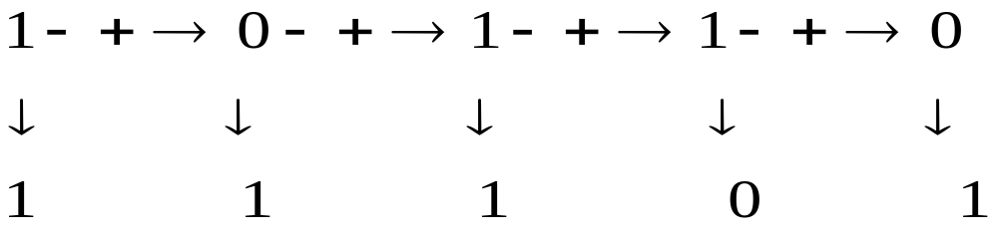
Sec.2.11 Digital Codes
Binary-to-Gray Code Conversion
The binary number is 10110, the Gray code is 11101.
CHAPTER 2

Slide 44
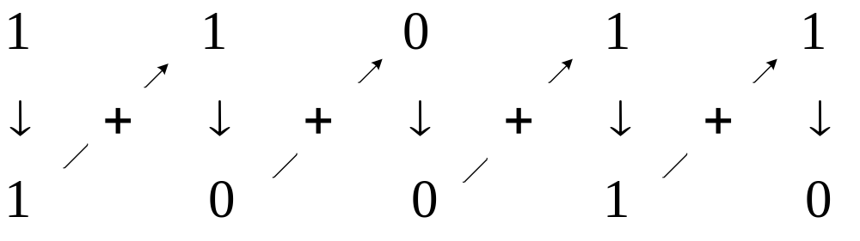
Sec.2.11 Digital Codes
Gray Code-to-Binary Conversion
The Gray code is 11011, the binary number is 10010.
CHAPTER 2

Slide 45
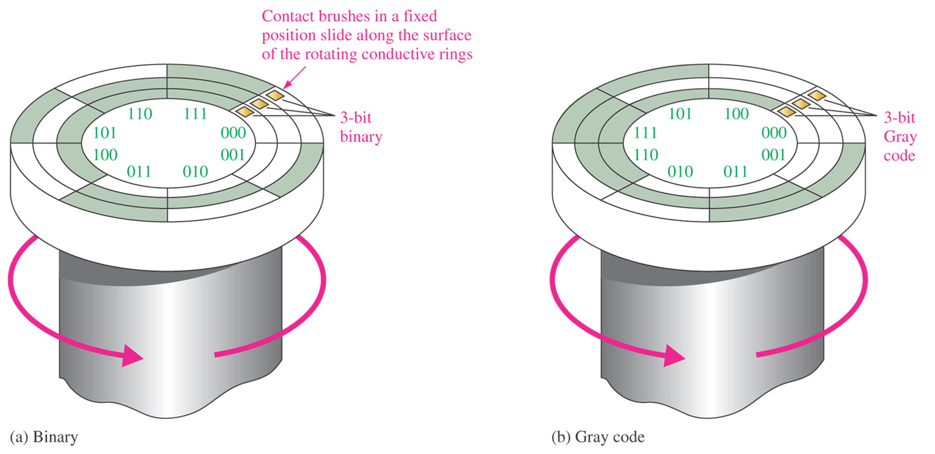
Sec.2.11 Digital Codes
Application of Gray Code
CHAPTER 2

Slide 46
Sec.2.12 Error Detection Codes
We often add some redundant bits in the codes, then we can detect the error, or correct the error. The parity and CRC method of error
detection is introduced.
CHAPTER 2

Slide 47
Sec.2.3 Decimal-to-Binary Conversion
Parity Method for Error Detection
Many systems use a parity bit as a means for bit error detection. A parity tells if the number of 1s is odd or even. Any group of bits contain either an even or odd number of 1s. A parity bit is attached to a group of bits to make the total number of 1s in a group always even or always
odd.
CHAPTER 2

Slide 48
Sec.2.3 Decimal-to-Binary Conversion
The BCD code with parity bits
Even Parity |  | Odd Parity
P | BCD | P | BCD
0 | 0000 | 1 | 0000
1 | 0001 | 0 | 0001
1 | 0010 | 0 | 0010
0 | 0011 | 1 | 0011
1 | 0100 | 0 | 0100
0 | 0101 | 1 | 0101
0 | 0110 | 1 | 0110
1 | 0111 | 0 | 0111
1 | 1000 | 0 | 1000
0 | 1001 | 1 | 1001
CHAPTER 2

Slide 49
Sec.2.3 Decimal-to-Binary Conversion
Parity Method for Error Detection
Example Add odd parity system received the code group,
00110111, 11110000, which one is incorrect?
00110111, has 5 1s, it is odd, this code is OK.
11110000, has 4 1s, it is even, it is incorrect.
CHAPTER 2

Slide 50
Sec.2.3 Decimal-to-Binary Conversion
Cyclic Redundancy Check ( CRC )
A single parity bit allows for the detection of single-bit errors in a code word. In order to correct a detected error, more information is required because the position of the bit in error must be identified before
it can be corrected.
CHAPTER 2

Slide 51
Sec.2.3 Decimal-to-Binary Conversion
Cyclic Redundancy Check ( CRC )
The CRC codes is well-suited for error detection, it is used for detecting one- and two- transmission errors. It can be designed to detect man combinations of likely errors. The implementation of both encoding
and error-detecting circuits is practical.
CHAPTER 2

Slide 52
Sec.2.3 Decimal-to-Binary Conversion
Cyclic Redundancy Check ( CRC )
In CRC, a certain number of check bits, called checksum, are
appended to the data bits ( added to end) that are being transmitted.
Consider an (n, k) CRC Code, in which k bits of the n code bits are always identical to the message sequence to be transmitted. The n-k bits in the remaining portion are computed from the message bits in
accordance with a prescribed encoding rule.
CHAPTER 2

Slide 53

Sec.2.3 Decimal-to-Binary Conversion
Cyclic Redundancy Check ( CRC )
CRC is often described mathematical as the division of two polynomials to generate a remainder.
For 4-bit binary number 1011, its univariate polynomial is
CHAPTER 2

Slide 54
Sec.2.3 Decimal-to-Binary Conversion
Cyclic Redundancy Check ( CRC )
Encoding procedure for an ( n, k ) CRC
Multiply the message polynomial m(X) by X^{n-k}
Divide X^{n-k}m(X) by the generator polynomial g(X), obtaining the remainder b(X).
Add b(X) to X^{n-k}m(X), obtaining the code polynomial c(X)
CHAPTER 2

Slide 55
Sec.2.3 Decimal-to-Binary Conversion
Cyclic Redundancy Check ( CRC )
A method called modulo-2 addition is used in the division.
Modulo-2 operation:
0+0=0
0+1=1
1+0=1
1+1=0
CHAPTER 2

Slide 56


Sec.2.3 Decimal-to-Binary Conversion
Cyclic Redundancy Check ( CRC )
Example: (7,4) CRC code, the generator code is 1011.
If the message is 1100, then
the generator polynomial is
CHAPTER 2

Slide 57
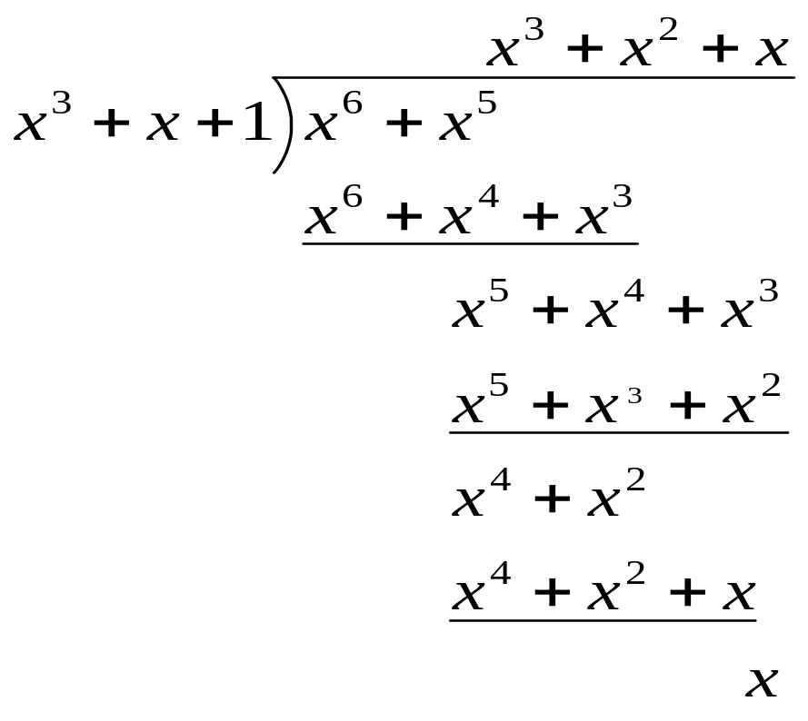
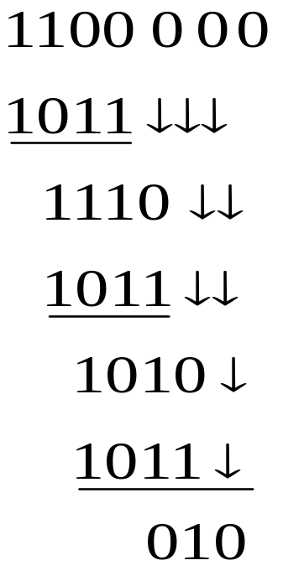
Sec.2.3 Decimal-to-Binary Conversion
Cyclic Redundancy Check ( CRC )
The remainder is x, the checksum code is 010.
CHAPTER 2

Slide 58
Sec.2.3 Decimal-to-Binary Conversion
Cyclic Redundancy Check ( CRC )
The g(x)=1011, ( 7,4 ) CRC code are
0000000 1111111
1100010 0011101
1000101 0111010
0001011 1110100
0010110 1101001
0101100 1010011
1011000 0100111
0110001 1001110
CHAPTER 2

Slide 59
Sec.2.3 Decimal-to-Binary Conversion
Cyclic Redundancy Check ( CRC )
A binary code is said to be a cyclic code if it exhibits two fundamental properties:
1. Linearity property: The sum of any two code words in the code is also a code word.
2. Cyclic property: Any cyclic shift of a code word in the code is also a code word.
CHAPTER 2

Slide 60
Sec.2.3 Decimal-to-Binary Conversion
Cyclic Redundancy Check ( CRC )
At the receiving end, the receiver divides the incoming appended data bit code by the same generator code as used by the sender.
If the remainder is 0, there is no error detected. If the remainder is not 0, an error has been detected in the transmission and a retransmission is requested by the receiver.
CHAPTER 2

Slide 61
Sec.2.3 Decimal-to-Binary Conversion
Cyclic Redundancy Check ( CRC )
For the same example, g(x) code is 1011.
CRC code | b₆ | b₅ | b₄ | b₃ | b₂ | b₁ | b₀ | remainder | Error bit
right | 1 | 1 | 0 | 0 | 0 | 1 | 0 | 000 | no
error | 1 | 1 | 0 | 0 | 0 | 1 | 1 | 001 | 0
 | 1 | 1 | 0 | 0 | 0 | 0 | 0 | 010 | 1
 | 1 | 1 | 0 | 0 | 1 | 1 | 0 | 100 | 2
 | 1 | 1 | 0 | 1 | 0 | 1 | 0 | 011 | 3
 | 1 | 1 | 1 | 0 | 0 | 1 | 0 | 110 | 4
 | 1 | 0 | 0 | 0 | 0 | 1 | 0 | 111 | 5
 | 0 | 1 | 0 | 0 | 0 | 1 | 0 | 101 | 6
CHAPTER 2

Slide 62
Homework
7. a b 13. g h 29 a 30 a 62

Slide 63
Next Lesson
Chapter 3
Boolean Algebra and Logic Simplification

