Slide 1

Review
The Inverter
The AND Gate
The OR Gate
The NAND Gate
The NOR Gate
The XOR and XNOR Gates

Slide 2
Chapter 4
Boolean Algebra and Logic Simplification

Slide 3
Main Contents
Boolean Operation and Expressions
Laws and Rules of Boolean Algebra
Simplification Using Boolean Algebra
Truth Tables
The Karnaugh Map
Simplification Using Karnaugh Map

Slide 4

Sec.4.1 Boolean Operations and Expressions
Boolean algebra is the mathematics of digital systems. A basic knowledge of Boolean algebra is indispensable to study and analysis of
logic circuits.
Any single variable A can have a 1 or 0 value. The variable and its complement can be expressed as A and .
CHAPTER 4

Slide 5
Sec.4.1 Boolean Operations and Expressions
Boolean Addition
The Boolean addition is equivalent to the OR operation.
A sum term is equal to 1 when one or more of the literals in term
are 1. A sum term is equal to 0 only if each of the literals is 0.
0 + 0 =0 0 + 1 = 1
1 + 0 = 1 1 + 1 = 1
CHAPTER 4

Slide 6

Sec.4.1 Boolean Operations and Expressions
Boolean Addition
Example Determine the values of A, B, that make the sum term
equal to 0.
Solution: For the sum to be 0, each of the literals in the term must be 0. Therefore A=1, B=0.
CHAPTER 4

Slide 7
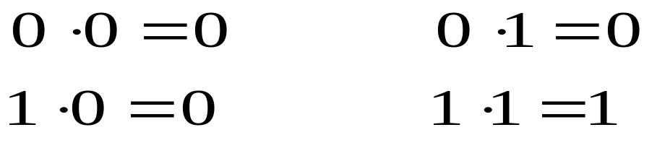
Sec.4.1 Boolean Operations and Expressions
Boolean Multiplication
Boolean multiplication is equivalent to the AND operation.
A product term is equal to 1 only if each of the literals in the term is 1. A product term is equal to 0 when one or more of the literals are 0.
CHAPTER 4

Slide 8

Sec.4.1 Boolean Operations and Expressions
Boolean Multiplication
Example Determine the values of A, B, that make the product term
equal to 1.
Solution: For the product to be 1, each of the literals in the term must be 1. Therefore A=0, B=0.
CHAPTER 4

Slide 9
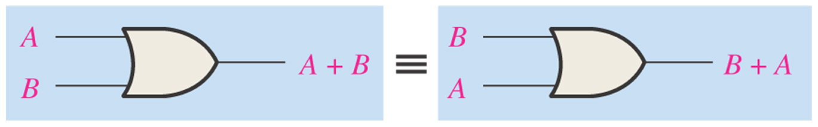
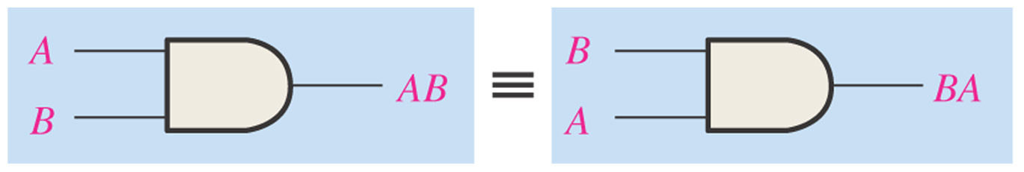
Sec.4.2 Laws and Rules of Boolean Algebra
Laws of Boolean Algebra
Commutative laws for addition and multiplication:
A + B = B + A
AB = BA
CHAPTER 4

Slide 10
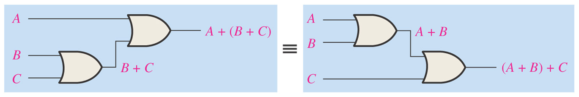
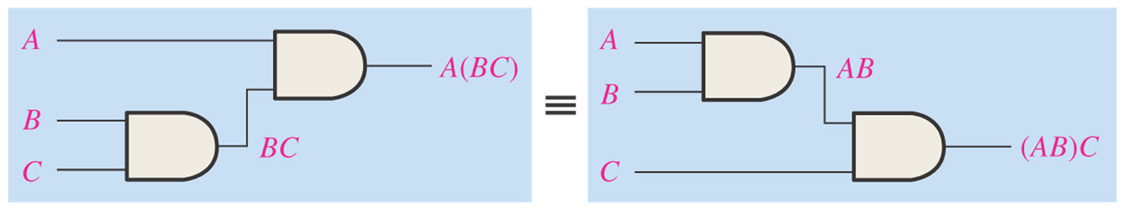
Sec.4.2 Laws and Rules of Boolean Algebra
Laws of Boolean Algebra
Associative laws for addition and multiplication:
A + (B+C) =(A+B) + C
A(BC) =(AB)C
CHAPTER 4

Slide 11
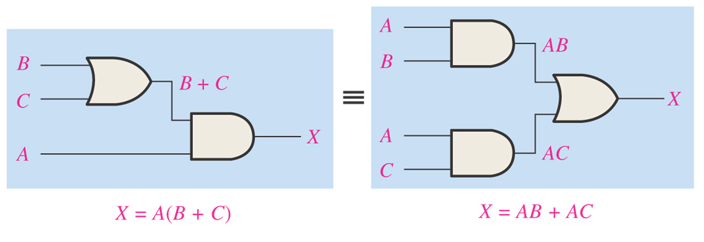
Sec.4.2 Laws and Rules of Boolean Algebra
Laws of Boolean Algebra
Distributive laws for three variables:
A(B+C) =AB +AC
CHAPTER 4

Slide 12

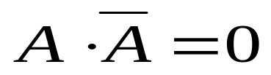
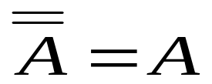
Sec.4.2 Laws and Rules of Boolean Algebra
Rules of Boolean Algebra
1. A + 0 = A
2. A + 1 = 1
3. A · 0 = 0
4. A · 1 = A
5. A + A = A
6.
7. A · A =A
8.
9.
CHAPTER 4

Slide 13
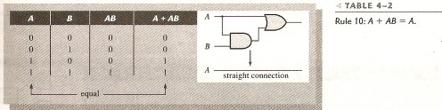
Sec.4.2 Laws and Rules of Boolean Algebra
Rules of Boolean Algebra
10. A + AB = A
A + AB = A ( 1+ B )
= A · 1
= A
CHAPTER 4

Slide 14

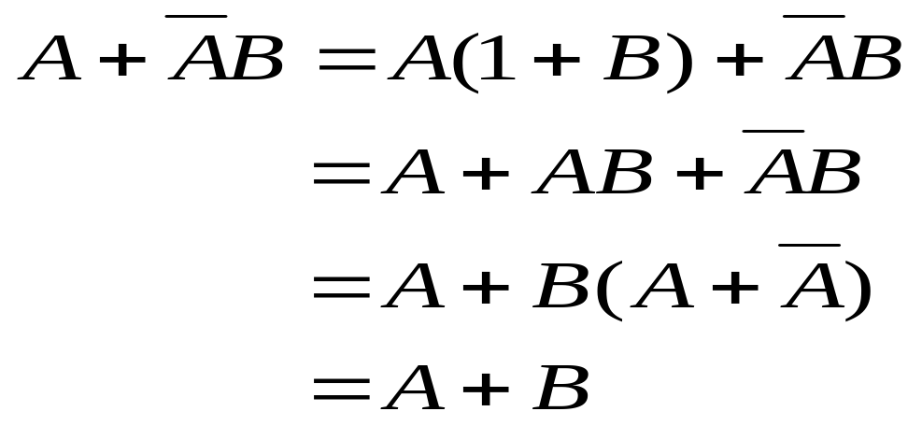
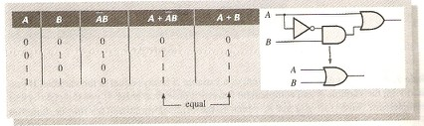
Sec.4.2 Laws and Rules of Boolean Algebra
Rules of Boolean Algebra
11.
CHAPTER 4

Slide 15
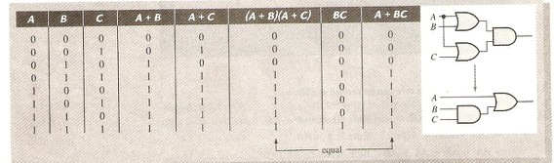
Sec.4.2 Laws and Rules of Boolean Algebra
Rules of Boolean Algebra
12. ( A + B ) ( A + C ) = A + BC
(A+B)(A+C)=AA+AC+AB+BC
=A+AC+AB+BC
=A(1+C+B)+BC
=A+BC
CHAPTER 4

Slide 16


Sec.4.3 DeMorgan’s Theorems
The complement of a product of variables is equal to the sum of the complements of the variables.
The complement of a sum of variables is equal to the product of the complements of the variables.
CHAPTER 4

Slide 17
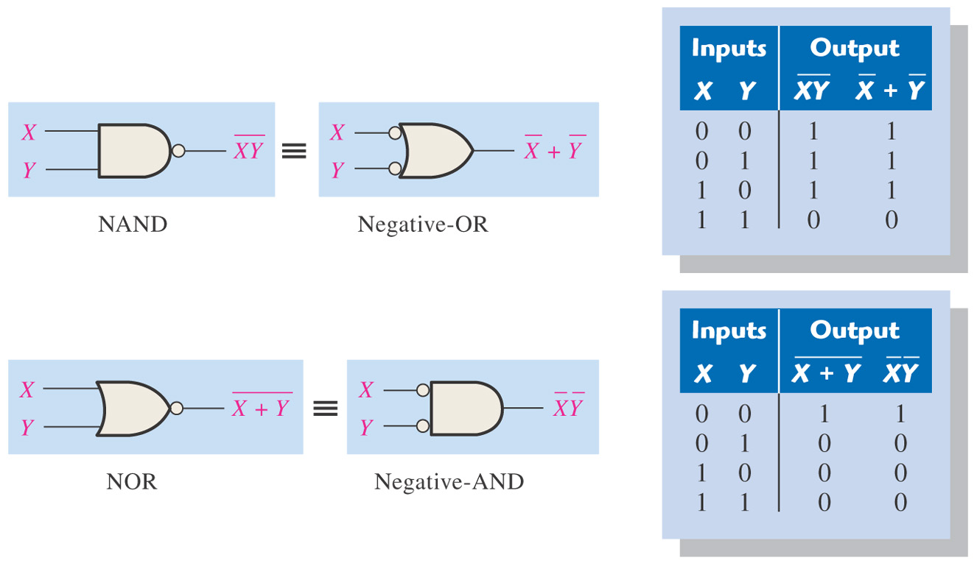
Sec.4.3 DeMorgan’s Theorems
CHAPTER 4

Slide 18
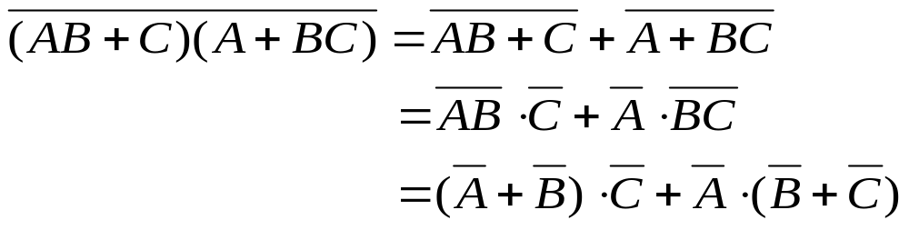
Sec.4.3 DeMorgan’s Theorems
Each variable in DeMorgan’s theorems can also represent a
combination of other variables.
CHAPTER 4

Slide 19

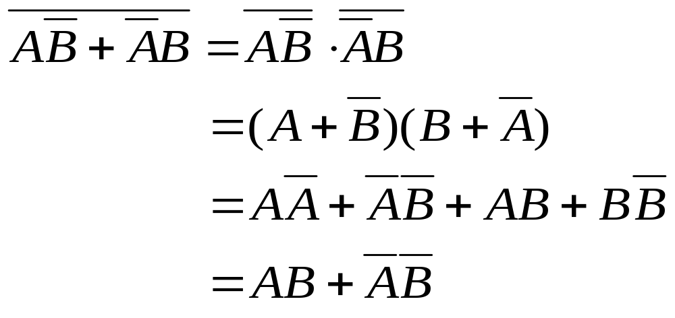
Sec.4.3 DeMorgan’s Theorems
Applying DeMorgan’s Theorems
Example 4-7 The Boolean expression for an exclusive-OR gate is
. With this as a starting point, develop the expression for the exclusive-NOR
gate.
Solution:
CHAPTER 4

Slide 20
Sec.4.4 Boolean Analysis of Logic Circuits
Boolean Expression for a Logic Circuit
The relationship between the input variable and output variable can be expressed by Boolean expression.
A logic circuit can be described by a Boolean equation.
To derive the Boolean expression for a given logic circuit, begin at the left-most inputs and work toward the final output, writing the
expression for each gate.
CHAPTER 4

Slide 21
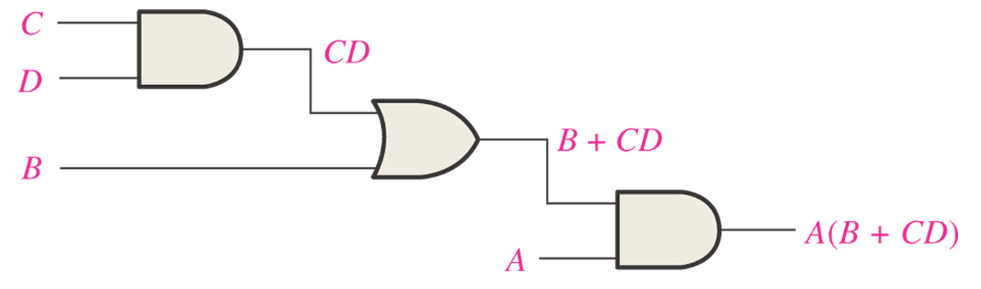
Sec.4.4 Boolean Analysis of Logic Circuits
Figure 4–16 A logic circuit showing the development of the Boolean expression for the output.
CHAPTER 4

Slide 22
Sec.4.4 Boolean Analysis of Logic Circuits
Constructing a Truth Table for a Logic Circuit
The logic circuit can be expressed by Boolean expression, truth
table, waveform and Karnaugh map.
Once the Boolean expression for a given logic circuit has been determined, a truth table that shows the output for all possible values of
the input variables can be developed.
If there are n input variables, there are 2^{n} combinations of values.
CHAPTER 4

Slide 23
Sec.4.4 Boolean Analysis of Logic Circuits
Constructing a Truth Table for a Logic Circuit
The truth table for X=A(B+CD)
Inputs |  |  |  | Output | Inputs |  |  |  | Output
A | B | C | D | A(B+CD) | A | B | C | D | A(B+CD)
0 | 0 | 0 | 0 | 0 | 1 | 0 | 0 | 0 | 0
0 | 0 | 0 | 1 | 0 | 1 | 0 | 0 | 1 | 0
0 | 0 | 1 | 0 | 0 | 1 | 0 | 1 | 0 | 0
0 | 0 | 1 | 1 | 0 | 1 | 0 | 1 | 1 | 1
0 | 1 | 0 | 0 | 0 | 1 | 1 | 0 | 0 | 1
0 | 1 | 0 | 1 | 0 | 1 | 1 | 0 | 1 | 1
0 | 1 | 1 | 0 | 0 | 1 | 1 | 1 | 0 | 1
0 | 1 | 1 | 1 | 0 | 1 | 1 | 1 | 1 | 1
CHAPTER 4

Slide 24
Sec.4.5 Simplification Using Boolean Algebra
Many times in the application of Boolean algebra, we have to reduce a particular expression to its simplest form or change its form to a
more convenient one to implement the expression most efficiently.
A simplified Boolean expression uses the fewest gates possible to
implement a given expression.
CHAPTER 4

Slide 25
Sec.4.5 Simplification Using Boolean Algebra
Example 4-8 Using Boolean algebra techniques, simplify this
expression: AB+A(B+C)+B(B+C)
Solution: AB+A(B+C)+B(B+C)
= AB+AB+AC+B+BC
=AB+AC+B(1+C)
=AB+AC+B
=B(1+A)+AC
=B+AC
CHAPTER 4

Slide 26
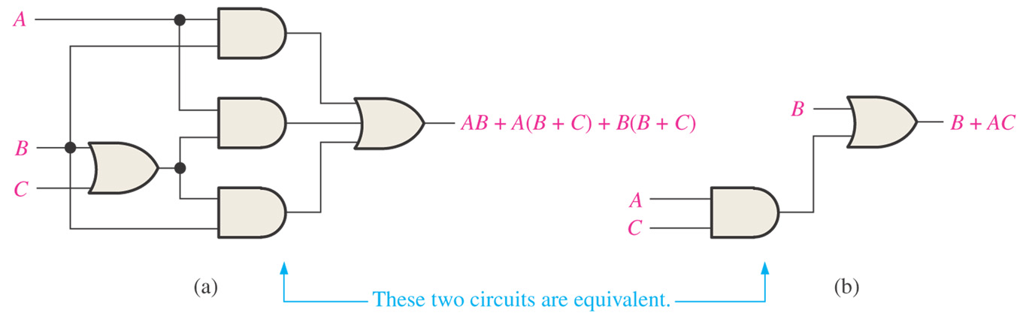
Sec.4.5 Simplification Using Boolean Algebra
Figure 4–17 Gate circuits for Example 4–8. Open file F04-17 to verify equivalency.
CHAPTER 4

Slide 27

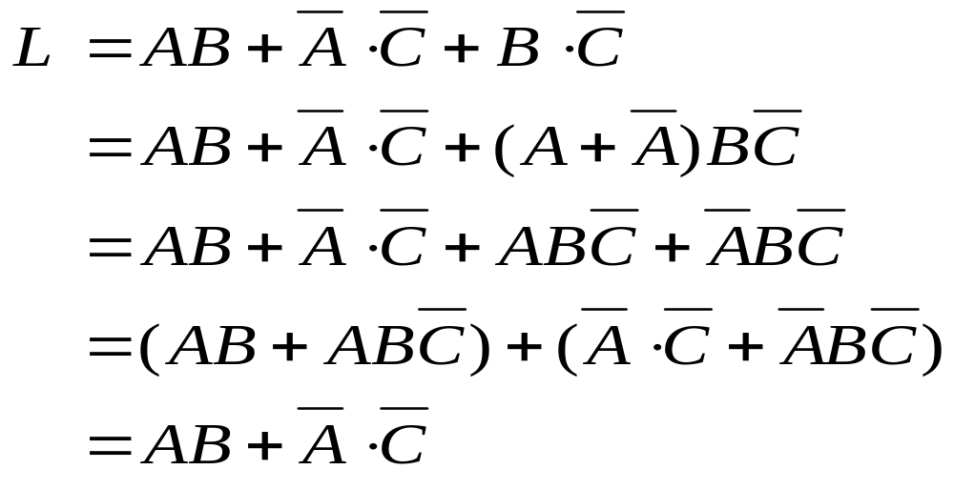
Sec.4.5 Simplification Using Boolean Algebra
Example Using Boolean algebra techniques, simplify this
expression:
Solution:
CHAPTER 4

Slide 28
Sec.4.6 Standard Forms of Boolean Expressions
All Boolean expressions, regardless of their form, can be converted into either of two standard forms: the sum-of-products form (AND -OR)
or the product-of-sum form (OR-AND).
Standardization makes the evaluation, simplification, and implementation of Boolean expressions much more systematic and
easier.
CHAPTER 4

Slide 29
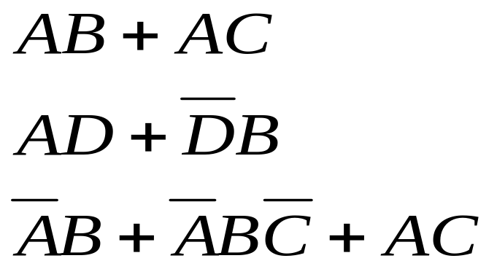
Sec.4.6 Standard Forms of Boolean Expressions
The Sum-of-Products (SOP) Form
An SOP expression can be implemented with one OR gate and two or more AND gates. For example:
CHAPTER 4

Slide 30
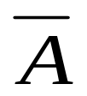
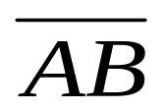
Sec.4.6 Standard Forms of Boolean Expressions
The Sum-of-Products (SOP) Form
The domain of a general Boolean expression is the set of variables contained in the expression in either complemented or uncomplemented for, such as A and .
can not be appeared in the form.
CHAPTER 4

Slide 31
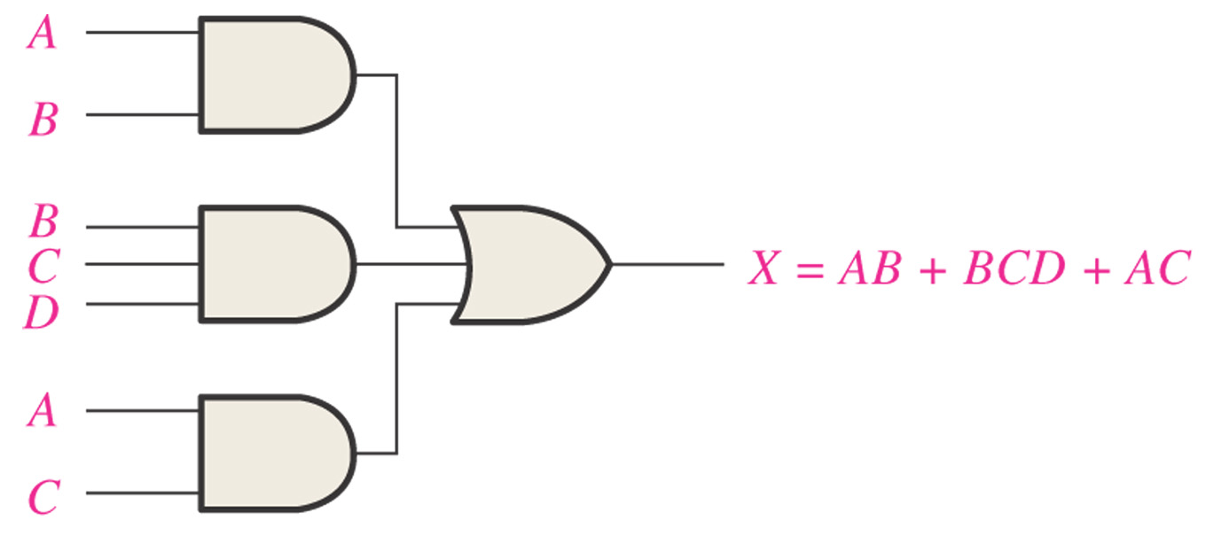
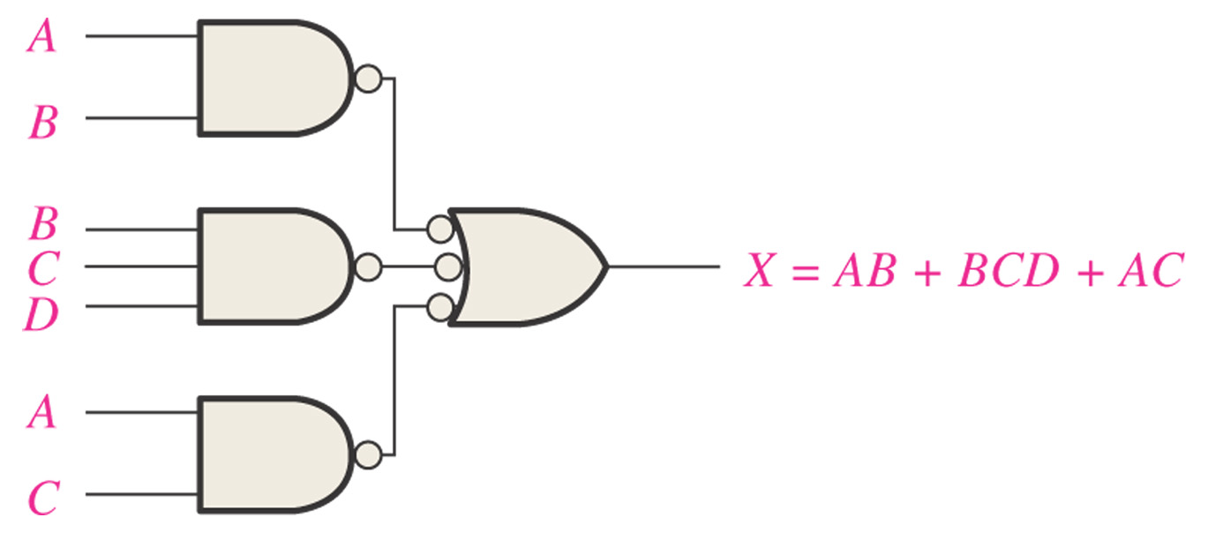
Sec.4.6 Standard Forms of Boolean Expressions
The Sum-of-Products (SOP) Form
The SOP form can be implemented by AND/OR or NAND/NAND circuits.
CHAPTER 4

Slide 32
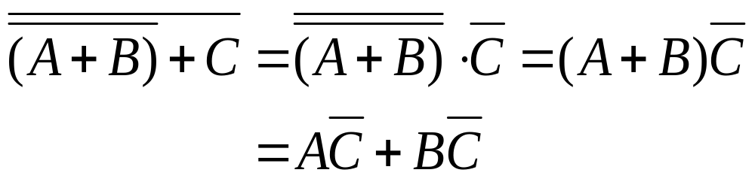
Sec.4.6 Standard Forms of Boolean Expressions
The Sum-of-Products (SOP) Form
Any logic expression can be changed into SOP form by applying
Boolean algebra techniques.
Example 4-12
CHAPTER 4

Slide 33
Sec.4.6 Standard Forms of Boolean Expressions
The Standard SOP Form
A standard SOP expression is one in which all the variables in the domain appear in each product term in the expression. There are 2^{n}
standard SOPs when there are n variables.
Any nonstandard SOP expression can be converted to the standard
form using Boolean algebra.
CHAPTER 4

Slide 34
Sec.4.6 Standard Forms of Boolean Expressions
Converting Product Terms to Standard SOP
Step 1. Multiply each nonstandard product term by a term made up of the sum of a missing variable and its complement.
Step 2. Repeat Step 1 until all resulting product terms contain all variables in the domain in either complemented or uncomplemented
form.
CHAPTER 4

Slide 35

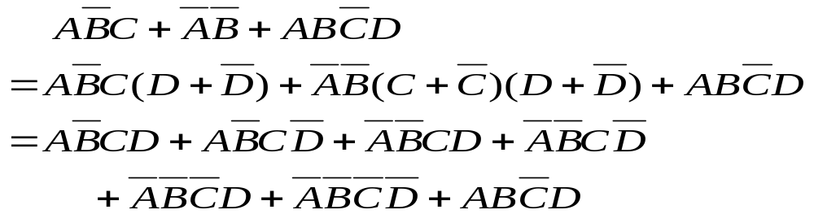
Sec.4.6 Standard Forms of Boolean Expressions
Converting Product Terms to Standard SOP
Example 4-13 Convert the following Boolean expression into standard SOP form.
Solution:
CHAPTER 4

Slide 36
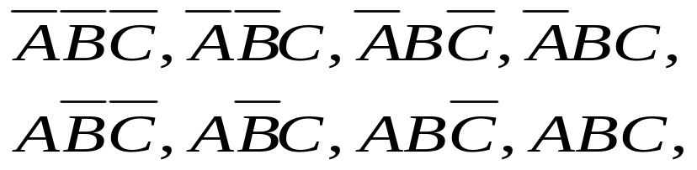
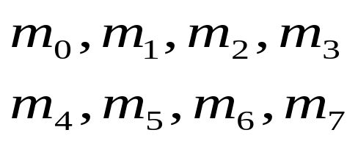
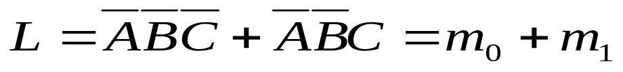
Sec.4.6 Standard Forms of Boolean Expressions
The binary Representation of SOP
For a three variables SOP, the SOP term can be
using binary expression, the SOP term is
CHAPTER 4

Slide 37








Sec.4.6 Standard Forms of Boolean Expressions
The binary expression of SOP
A | B | C
0 | 0 | 0 | 1 | 0 | 0 | 0 | 0 | 0 | 0 | 0
0 | 0 | 1 | 0 | 1 | 0 | 0 | 0 | 0 | 0 | 0
0 | 1 | 0 | 0 | 0 | 1 | 0 | 0 | 0 | 0 | 0
0 | 1 | 1 | 0 | 0 | 0 | 1 | 0 | 0 | 0 | 0
1 | 0 | 0 | 0 | 0 | 0 | 0 | 1 | 0 | 0 | 0
1 | 0 | 1 | 0 | 0 | 0 | 0 | 0 | 1 | 0 | 0
1 | 1 | 0 | 0 | 0 | 0 | 0 | 0 | 0 | 1 | 0
1 | 1 | 1 | 0 | 0 | 0 | 0 | 0 | 0 | 0 | 1
CHAPTER 4

Slide 38
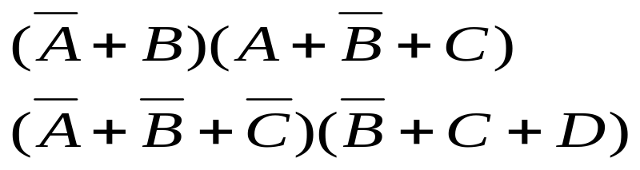
Sec.4.6 Standard Forms of Boolean Expressions
The product-of-Sums (POS) Form
A sum term consists of the sum (Boolean addition) of literals (variables or their complement). When two or more sum are multiplied,
the resulting expression is a product-of-sums (POS).
CHAPTER 4

Slide 39
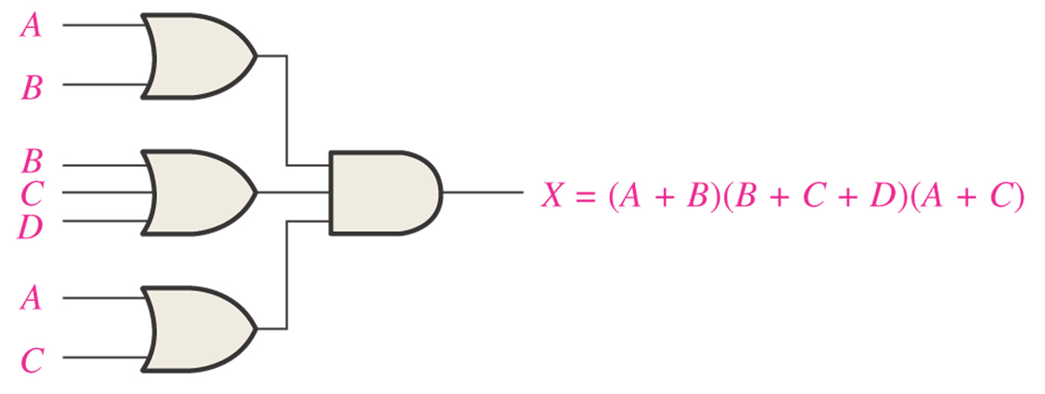
Sec.4.6 Standard Forms of Boolean Expressions
The product-of-Sums (POS) Form
Implementing a POS expression simply requires ANDing the outputs of two or more OR gates.
CHAPTER 4

Slide 40
Sec.4.6 Standard Forms of Boolean Expressions
The Standard POS Form
A standard POS expression is one in which all the variables in the domain appear in each sum term in the expression. For example,
Any nonstandard POS expression can be converted to the standard form using Boolean algebra.
CHAPTER 4

Slide 41
Sec.4.6 Standard Forms of Boolean Expressions
Converting a Sum Term to Standard POS
Step 1. Add to nonstandard product term a term made up of the
product of the missing variable and its complement.
Step 2. Apply A+BC=(A+B)(A+C)
Step 3. Repeat Step 1 until all resulting sum terms contain all variables in the domain in either complemented or uncomplemented form.
CHAPTER 4

Slide 42
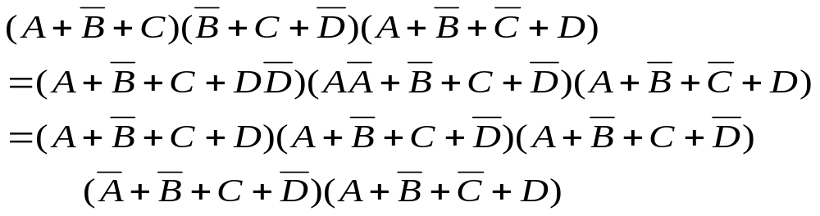
Sec.4.6 Standard Forms of Boolean Expressions
Converting a Sum Term to Standard POS
Example 4-15 Convert the following Boolean expression into standard POS form.
Solution:
CHAPTER 4

Slide 43

Sec.4.6 Standard Forms of Boolean Expressions
Binary Representation of a Standard Sum Term
A standard sum term is equal to 0 for only one combination of
variable values. For example,
Only when A=0, B=1, C=0, D=1, the sum term is 0. At any other combination, it is 1.
CHAPTER 4

Slide 44
Sec.4.6 Standard Forms of Boolean Expressions
Converting Standard SOP to Standard POS
Step 1. Evaluate each product term in the SOP expression. That is,
determine the binary numbers that represent the product terms.
Step 2. Determine all of the binary numbers not included in the
evaluation in step 1.
Step 3. Write the equivalent sum term for each binary number from
Step 2 and express in POS form.
CHAPTER 4

Slide 45
Sec.4.6 Standard Forms of Boolean Expressions
Converting Standard SOP to Standard POS
Example 4-17 Convert the following SOP expression to an equivalent POS expression:
Solution: The evaluation is as follows:
000+010+011+101+111
So the POS must contain the other three which are 001, 100 and 110.
The standard POS is
CHAPTER 4

Slide 46
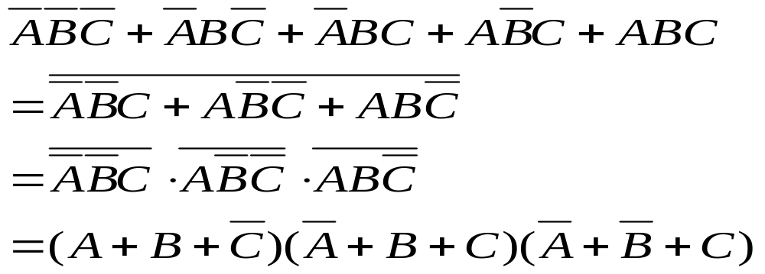
Sec.4.6 Standard Forms of Boolean Expressions
Converting Standard SOP to Standard POS
In fact, the standard SOP is the complement of standard POS.
CHAPTER 4

Slide 47
Sec.4.7 Boolean Expression and Truth Tables
All standard Boolean expression can be easily converted into truth table format using binary values for each term in the expression.
Standard SOP or POS expressions can be determined from a truth table.
CHAPTER 4

Slide 48



Sec.4.7 Boolean Expression and Truth Tables
Converting SOP Expressions to Truth Table Format
An SOP expression is equal to 1 only if at least one of the product terms is equal to 1. Example 4-18 Develop a truth table for the standard SOP expression
Inputs |  |  | Output | Product Term
A | B | C | X
0 | 0 | 0 | 0
0 | 0 | 1 | 1
0 | 1 | 0 | 0
0 | 1 | 1 | 0
1 | 0 | 0 | 1
1 | 0 | 1 | 0
1 | 1 | 0 | 0
1 | 1 | 1 | 1 | ABC
CHAPTER 4

Slide 49


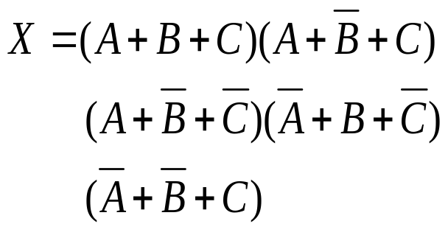


Sec.4.7 Boolean Expression and Truth Tables
Converting POS Expressions to Truth Table Format
A POS expression is equal to 0 only if at least one of the sum terms is equal to 0. Example 4-18 Develop a truth table for the standard POS expression
Inputs |  |  | Output | Sum Term
A | B | C | X
0 | 0 | 0 | 0 | A+B+C
0 | 0 | 1 | 1
0 | 1 | 0 | 0
0 | 1 | 1 | 0
1 | 0 | 0 | 1
1 | 0 | 1 | 0
1 | 1 | 0 | 0
1 | 1 | 1 | 1
CHAPTER 4

Slide 50

Sec.4.7 Boolean Expression and Truth Tables
Determine Standard Expressions from a Truth Table
To determine the standard SOP expression represented by a truth table, list the binary values of input variables for which the output is 1.
Convert each value to the corresponding product term.
Such as
CHAPTER 4

Slide 51

Sec.4.7 Boolean Expression and Truth Tables
Determine Standard Expressions from a Truth Table
To determine the standard POS expression represented by a truth table, list the binary values of input variables for which the output is 0.
Convert each value to the corresponding sum term.
Such as
CHAPTER 4

Slide 52
Sec.4.7 Boolean Expression and Truth Tables
Determine Standard Expressions from a Truth Table
Example 4-20 From the truth table, determine the standard SOP expression and the equivalent standard POS expression.
Inputs |  |  | Output
A | B | C | X
0 | 0 | 0 | 0
0 | 0 | 1 | 0
0 | 1 | 0 | 0
0 | 1 | 1 | 1
1 | 0 | 0 | 1
1 | 0 | 1 | 0
1 | 1 | 0 | 1
1 | 1 | 1 | 1
CHAPTER 4

Slide 53

Sec.4.7 Boolean Expression and Truth Tables
Determine Standard Expressions from a Truth Table
Solution: There are four 1s in the output column,
011, 100, 110, 111
So the standard SOP expression is
CHAPTER 4

Slide 54
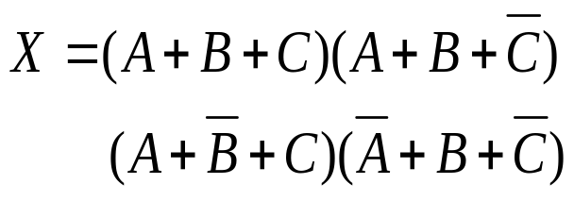
Sec.4.7 Boolean Expression and Truth Tables
Determine Standard Expressions from a Truth Table
Solution: There are four 0s in the output column,
000, 001, 010, 101
So the standard POS expression is
CHAPTER 4

Slide 55
Sec.4.8 The Karnaugh Map
Karnaugh map is an array of cells in which each cell represents a binary value of the variables. That is each standard SOP term is denoted by a cell. The cells are arranged in a way so that simplification of a given
expression is simply a matter of properly grouping the cells.
Karnaugh-map cells are arranged such that adjacent cells correspond to truth rows that differ in only one bit position (logical adjacency).
CHAPTER 4

Slide 56
Sec.4.8 The Karnaugh Map
An n-variable Karnaugh map has 2^{n} cells with each cell
corresponding to a row of an n-variable truth table.
Karnaugh map cells are labeled with the corresponding truth-table
row.
Karnaugh map can be used for expressions with two, three, four,
five and six variables.
CHAPTER 4

Slide 57
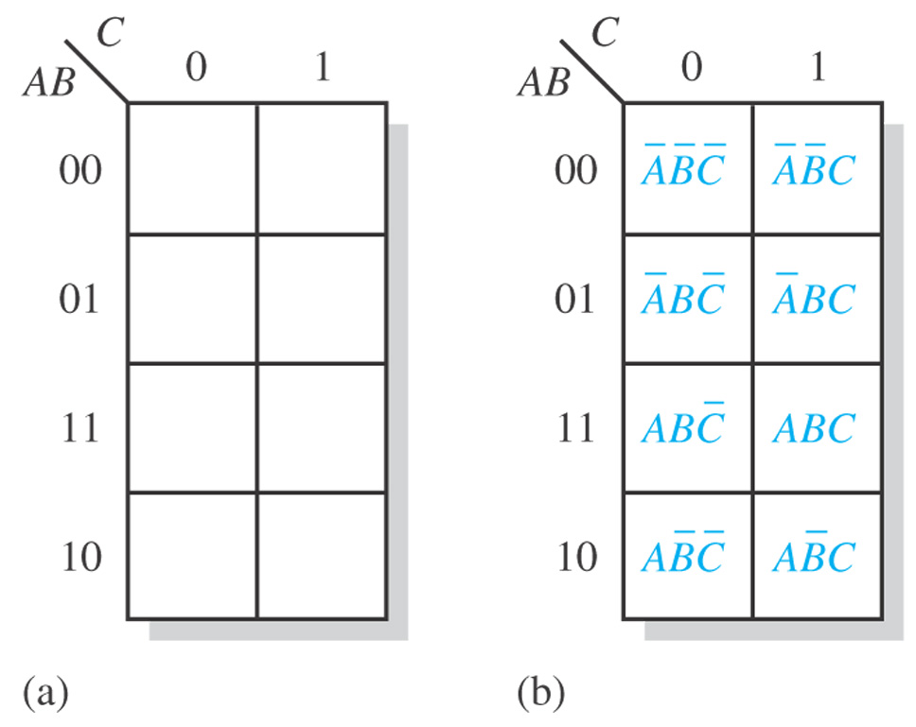
Sec.4.8 The Karnaugh Map
The 3-variable Karnaugh Map
CHAPTER 4

Slide 58
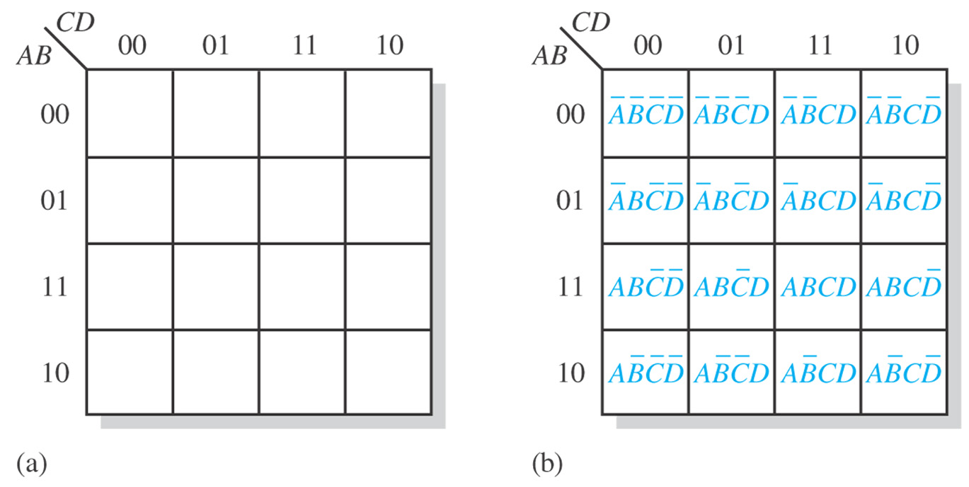
Sec.4.8 The Karnaugh Map
The 4-variable Karnaugh Map
CHAPTER 4

Slide 59
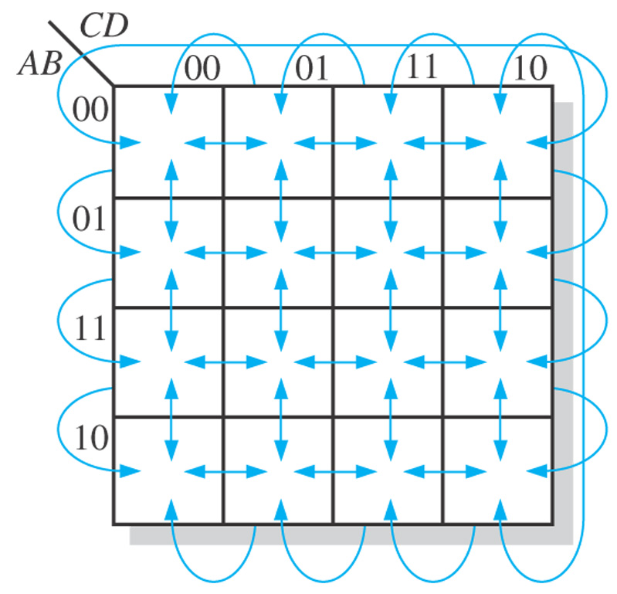
Sec.4.8 The Karnaugh Map
Cell Adjacency
Cells that differ by only
one variable are adjacent.
Cells with values that differ by more than one
variable are not adjacent.
CHAPTER 4

Slide 60
Sec.4.9 Karnaugh Map SOP Minimization
The Karnaugh map is used for simplifying Boolean expressions to their minimum form. A minimized SOP expression contains the fewest
possible terms with the fewest possible variables per term.
CHAPTER 4

Slide 61
Homework
15 d, 18 e, 20 e, 24 c, 36 d

