Slide 1

Review
Adder
Data Selector

Slide 2
Sec.6.1 Basic Adders
The Full-Adder
A full-adder accepts two input bits and an input carry and generates a sum and a carry output according to the binary addition.
Input |  |  | Output
A | B | C_{in} | C_{out} | ∑
0 | 0 | 0 | 0 | 0
0 | 0 | 1 | 0 | 1
0 | 1 | 0 | 0 | 1
0 | 1 | 1 | 1 | 0
1 | 0 | 0 | 0 | 1
1 | 0 | 1 | 1 | 0
1 | 1 | 0 | 1 | 0
1 | 1 | 1 | 1 | 1
CHAPTER 6

Slide 3
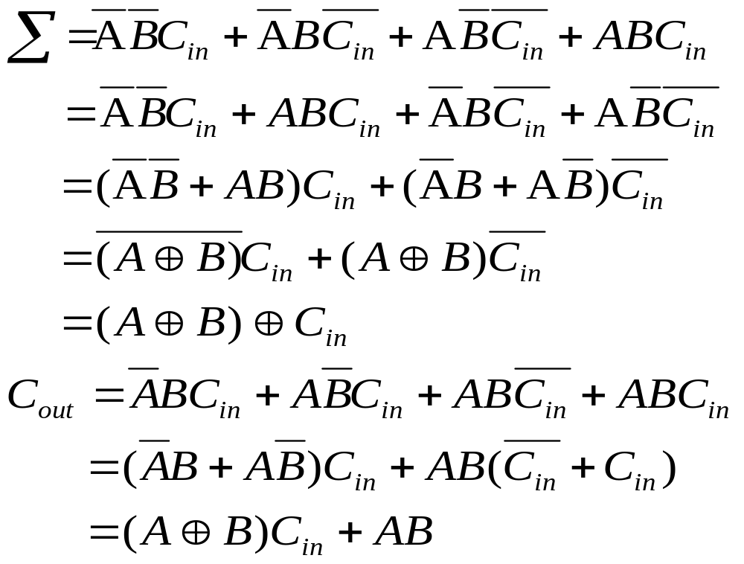
Sec.6.1 Basic Adders
The Full-Adder
Full-adder logic from the truth table,
CHAPTER 6

Slide 4
Sec.6.3 Ripple Carry versus Look-Ahead Carry Adders
The parallel adders can be placed into two categories based on the way in which internal carries from stage to stage are handled. Those
categories are ripple carry and look-ahead carry.
CHAPTER 6

Slide 5
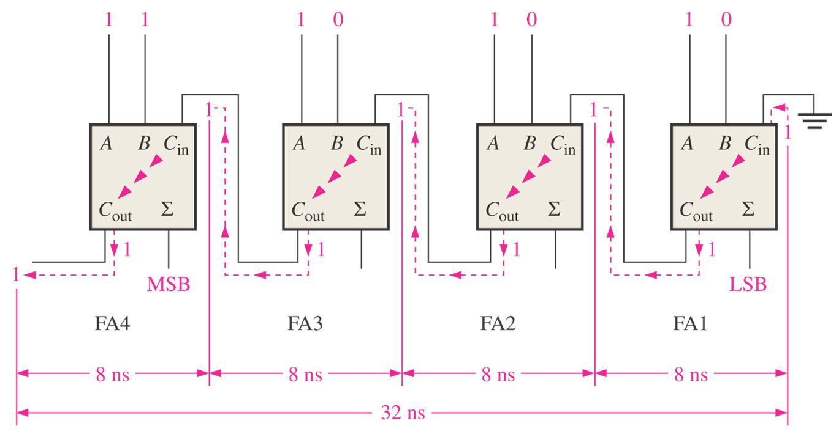
Sec.6.3 Ripple Carry versus Look-Ahead Carry Adders
The Ripple Carry Adder
A ripple carry adder is one in which the carry output of each full-
adder is connected to the carry input of the next higher-order stage.
CHAPTER 6

Slide 6
Sec.6.3 Ripple Carry versus Look-Ahead Carry Adders
The Look-Ahead Carry Adder
The look-ahead carry adder can eliminate the ripple carry delay. It anticipates the output carry of each stage, and based on the inputs,
produces the output carry by either carry generation or carry propagation.
CHAPTER 6

Slide 7
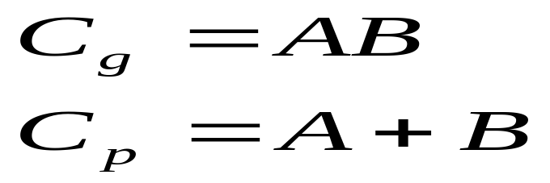
Sec.6.3 Ripple Carry versus Look-Ahead Carry Adders
The Look-Ahead Carry Adder
carry generation occurs when an output carry is produced. C_{g}
carry propagation occurs when the input carry is rippled to become the output carry. C_{p}
CHAPTER 6

Slide 8
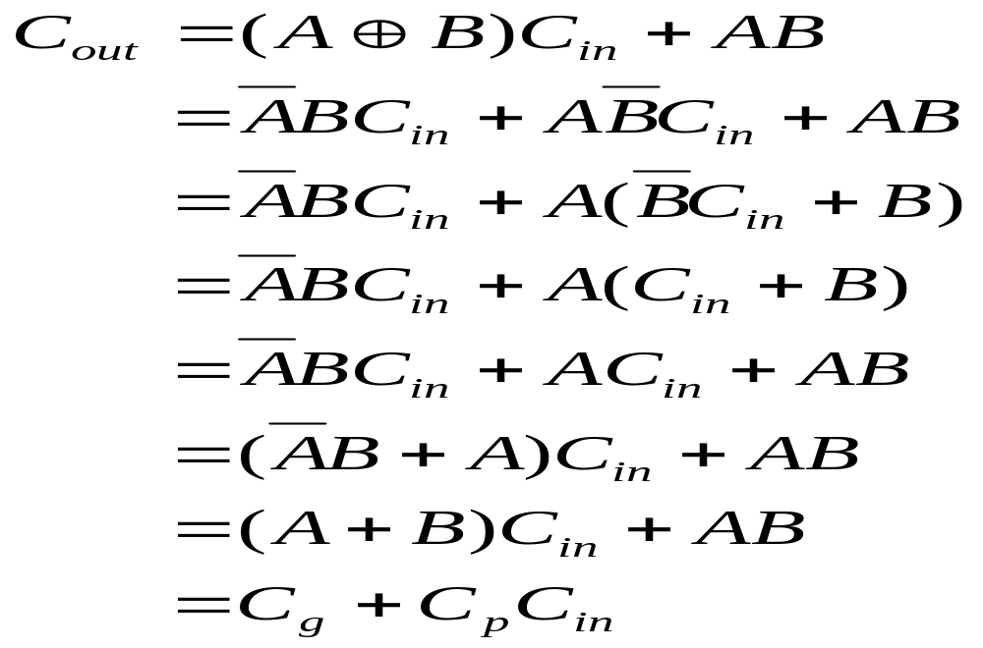
Sec.6.3 Ripple Carry versus Look-Ahead Carry Adders
The Look-Ahead Carry Adder
The output C_{out} of full-adder is
CHAPTER 6

Slide 9
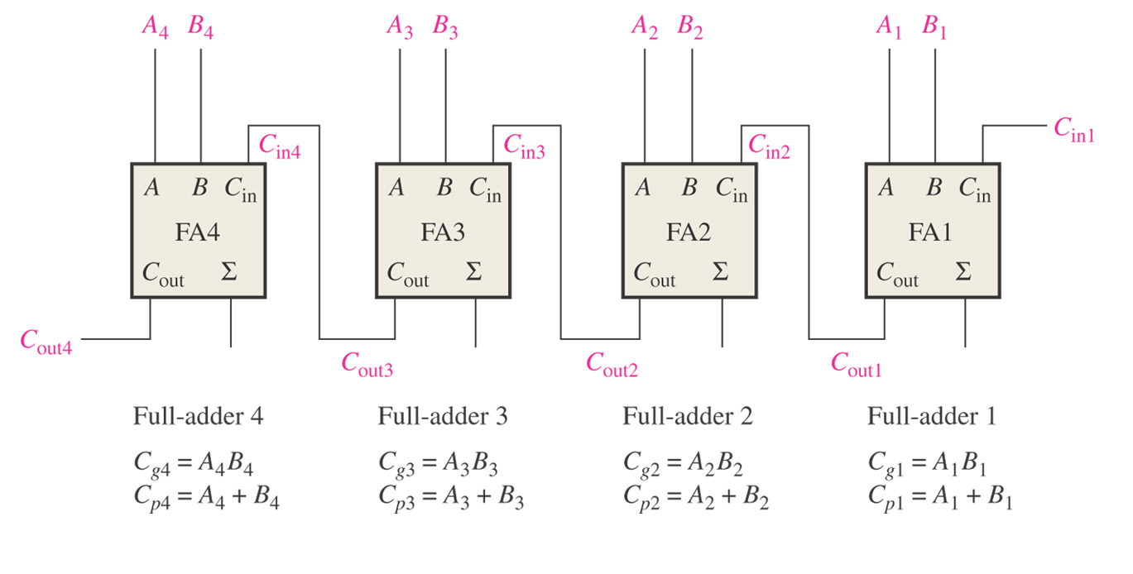
Sec.6.3 Ripple Carry versus Look-Ahead Carry Adders
The Look-Ahead Carry Adder
Consider the 4-bit adder
CHAPTER 6

Slide 10

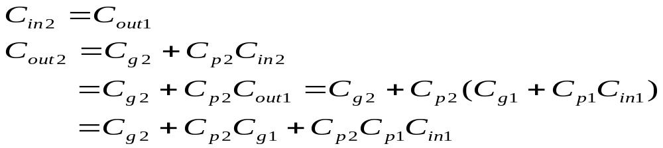
Sec.6.3 Ripple Carry versus Look-Ahead Carry Adders
The Look-Ahead Carry Adder
Full-adder 1:
Full-adder 2:
CHAPTER 6

Slide 11
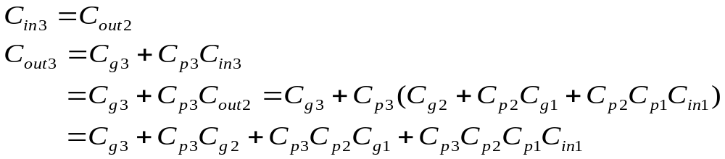
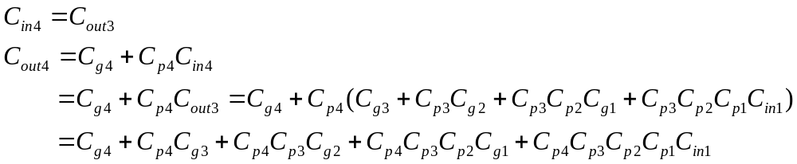
Sec.6.3 Ripple Carry versus Look-Ahead Carry Adders
The Look-Ahead Carry Adder
Full-adder 3:
Full-adder 4:
CHAPTER 6

Slide 12
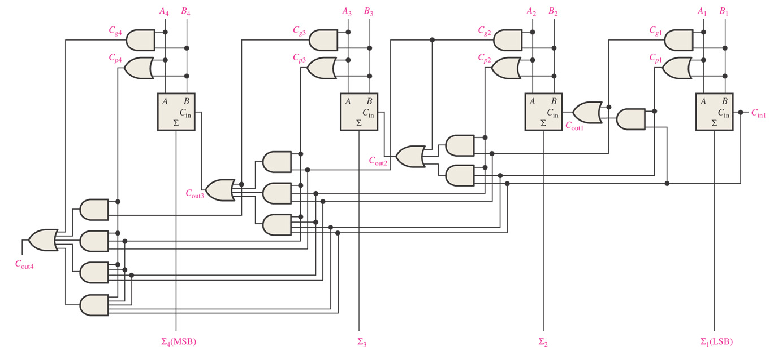
Sec.6.3 Ripple Carry versus Look-Ahead Carry Adders
The Look-Ahead Carry Adder
Logic diagram for a 4-stage look-ahead carry adder.
CHAPTER 6

Slide 13
Sec.6.3 Ripple Carry versus Look-Ahead Carry Adders
Combination Look-Ahead and Ripple Carry Adders
The 74LS283 4-bit adder is a look-ahead carry adder. When these adders are cascaded to expand their capability to handle binary numbers with more than four bits, the output carry of one adder is connected to the input carry of the next. This creates a ripple carry condition between
the 4-bit adders.
CHAPTER 6

Slide 14
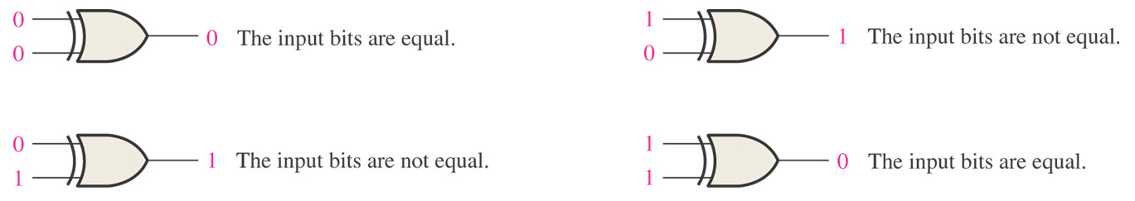
Sec.6.4 Comparators
The basic function of a comparator is to compare the magnitudes of two binary quantities to determine the relationship of those quantities.
The exclusive-OR gate can be used as a basic comparator because its output is a 1 if the two input bits are not equal and a 0 if the input bits
are equal.
CHAPTER 6

Slide 15
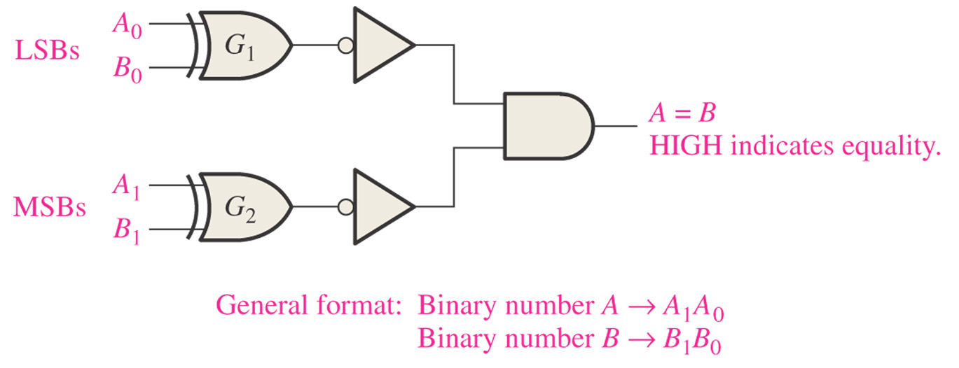
Sec.6.4 Comparators
CHAPTER 6

Slide 16
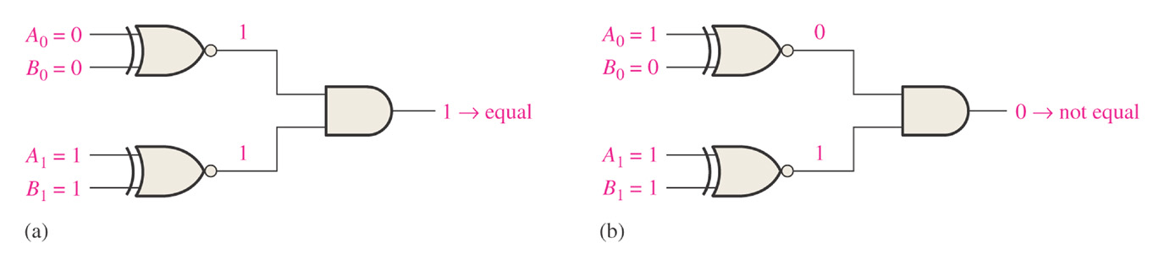
Sec.6.4 Comparators
Example 6-5 Apply each of the following sets of binary numbers to the comparator inputs in following figure, and determine the output.
(a) 10 and 10 (b) 11 and 10
Solution: (a) The output is 1 for inputs 10 and 10.
(b) The output is 0 for inputs 11 and 10.
CHAPTER 6

Slide 17
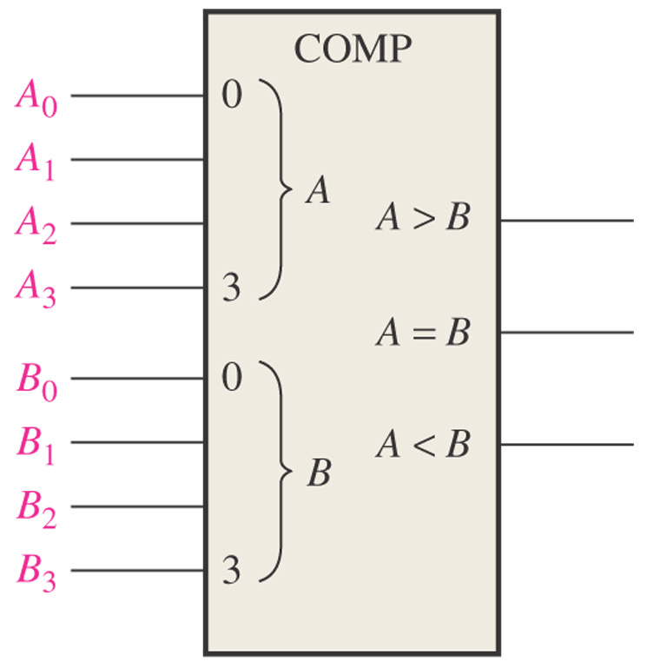
Sec.6.4 Comparators
Inequality
In addition to the equality output, many comparators provide additional outputs that indicate which of the two binary numbers being
compared is the larger.
CHAPTER 6

Slide 18
Sec.6.4 Comparators
Inequality
The truth table of 2-bit comparator
Input |  | Output
A | B | A>B | A=B | A<B
0 | 0 | 0 | 1 | 0
0 | 1 | 0 | 0 | 1
1 | 0 | 1 | 0 | 0
1 | 1 | 0 | 1 | 0
CHAPTER 6

Slide 19
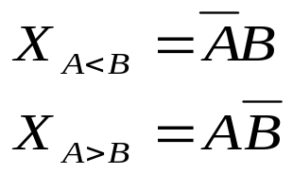
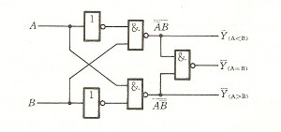
Sec.6.4 Comparators
Inequality
X_{A=B}=A⊙B
CHAPTER 6

Slide 20
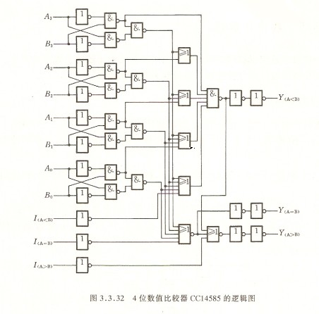
Sec.6.4 Comparators
Inequality
CHAPTER 6

Slide 21
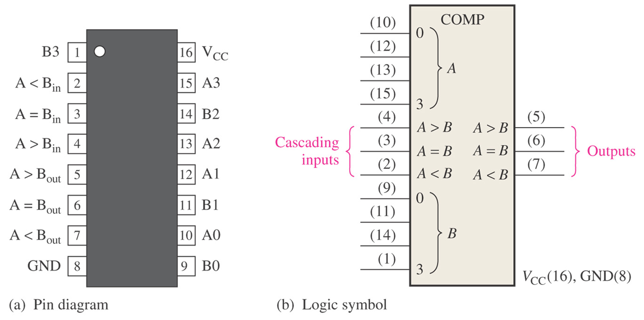
Sec.6.4 Comparators
Inequality
The 74HC85 4-bit magnitude comparator, has three cascading inputs: A<B, A=B, A>B.
CHAPTER 6

Slide 22
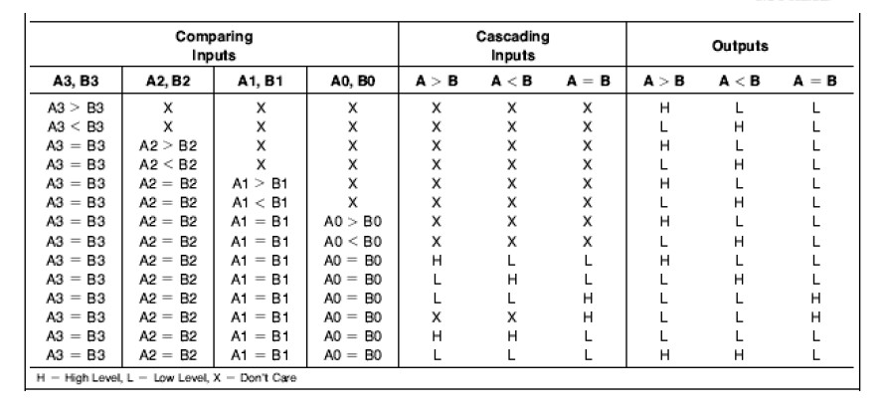
Sec.6.4 Comparators
Inequality
The function table of 74HC85
CHAPTER 6

Slide 23
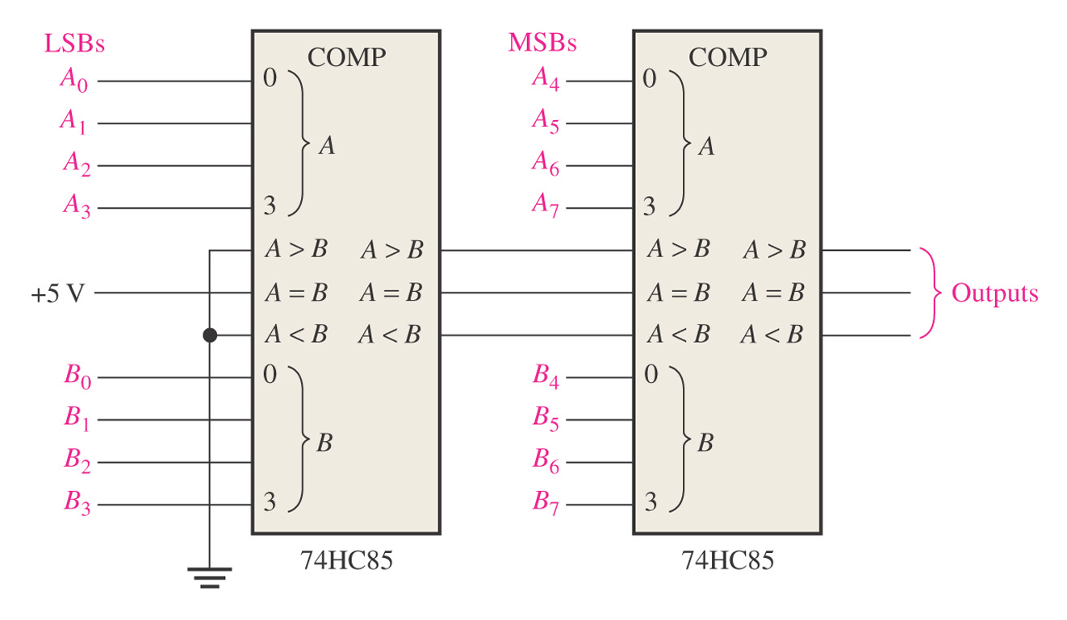
Sec.6.4 Comparators
Example 6-7 Use 74HC85 comparators to compare the
magnitudes of two 8-bit numbers.
Solution:
CHAPTER 6

Slide 24
Sec.6.5 Decoders
A decoder is a digital circuit that detects the presence of a specified combination of bits (code) on its inputs and indicates the
presence of that code by a specified output level.
CHAPTER 6

Slide 25
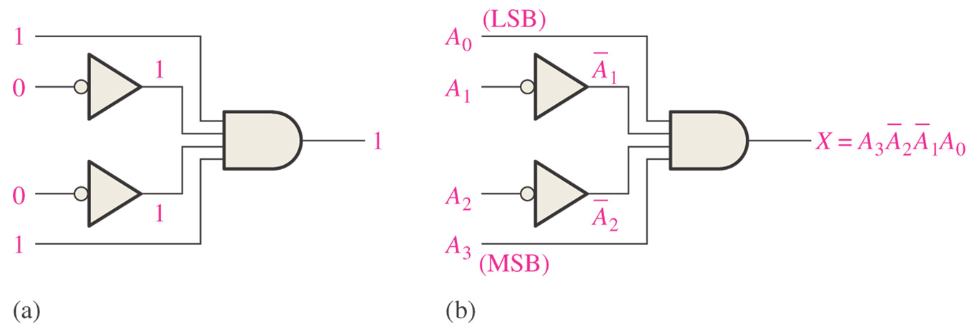
Sec.6.5 Decoders
The Basic Binary Decoder
Suppose we need to determine when a binary 1001 occurs on the inputs of a digital circuit. An AND gate can be used as the basic
decoding element.
CHAPTER 6

Slide 26
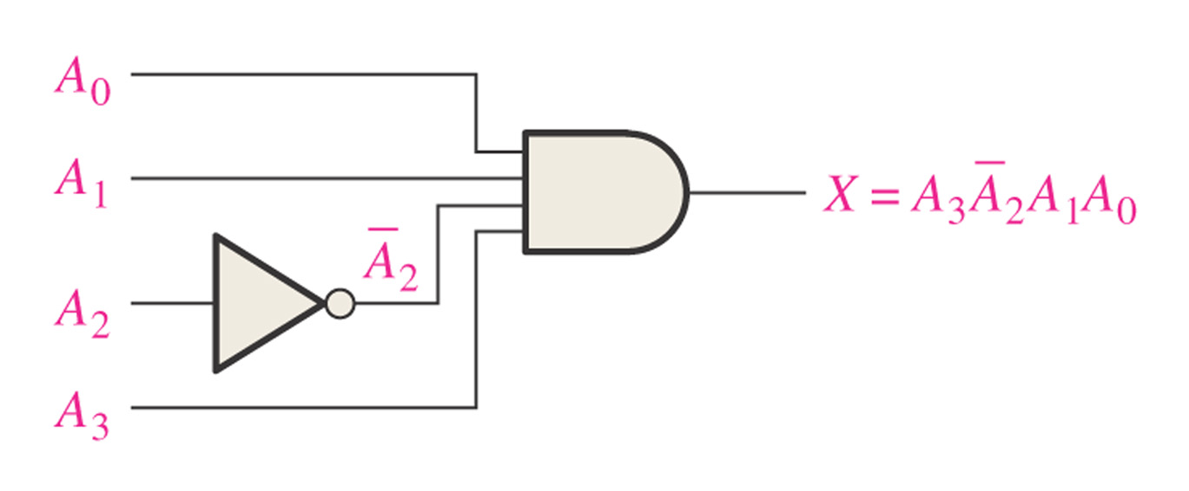
Sec.6.5 Decoders
The Basic Binary Decoder
Example 6-8 Determine the logic required to decode the binary
number 1011 by producing a HIGH level on the output.
Solution:
CHAPTER 6

Slide 27
Sec.6.5 Decoders
The 4-bit Decoder
In order to decode all possible combinations of four bits, sixteen decoding gates are required (2⁴=16). This type of decoder is commonly called either a 4-line-to-16-line decoder because there are four inputs and
sixteen outputs.
CHAPTER 6

Slide 28
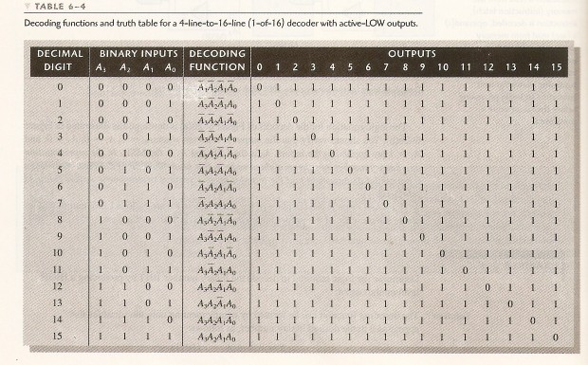
Sec.6.5 Decoders
The 4-bit Decoder
CHAPTER 6

Slide 29
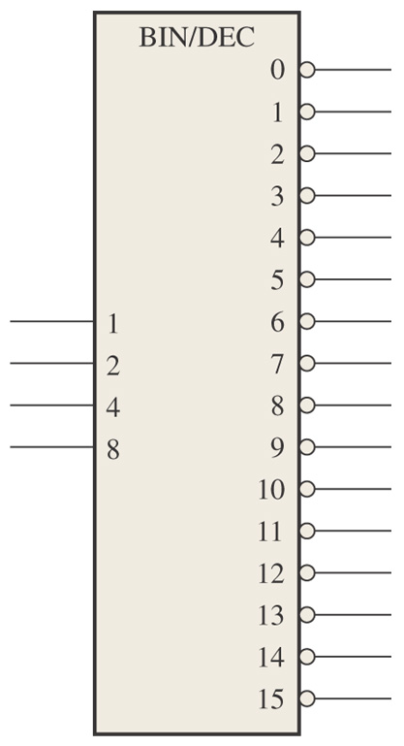
Sec.6.5 Decoders
The 4-bit Decoder
Figure 6–28 Logic symbol for a 4-line-to-16-line (1-of-16) decoder.
CHAPTER 6

Slide 30
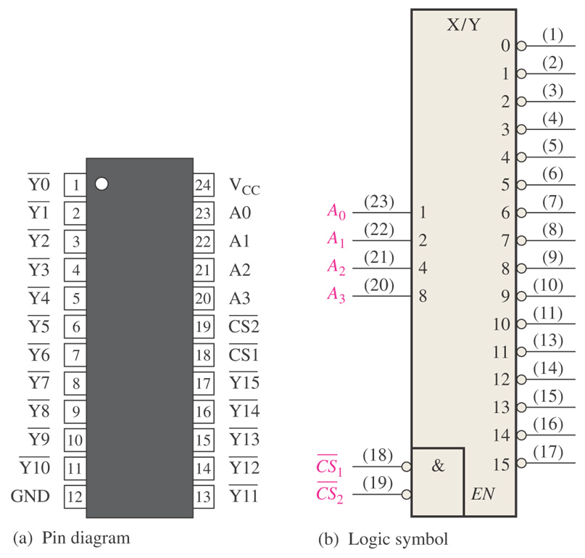
Sec.6.5 Decoders
The 74HC154 1-of-16 Decoder
CHAPTER 6

Slide 31
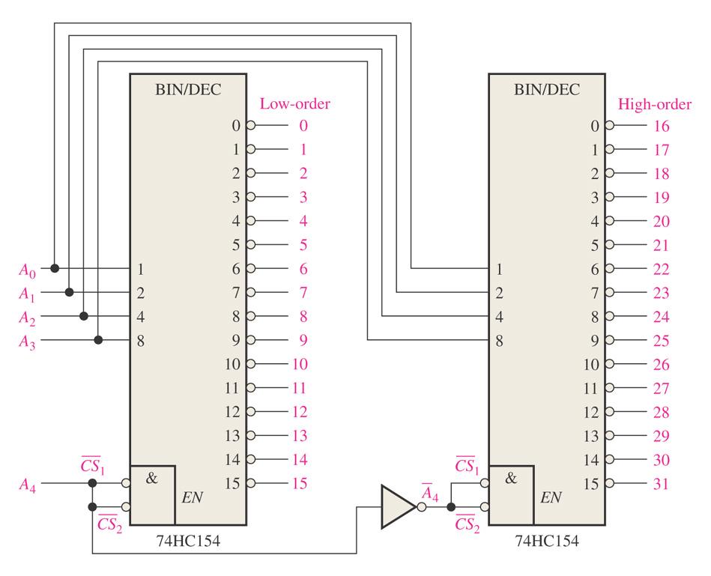
Sec.6.5 Decoders
Example 6-9 A certain application requires that a 5-bit number be decoded. Use 74HC154 decoders to implement the logic. The binary
number is A₄A₃A₂A₁A₀.
Solution:
CHAPTER 6

Slide 32
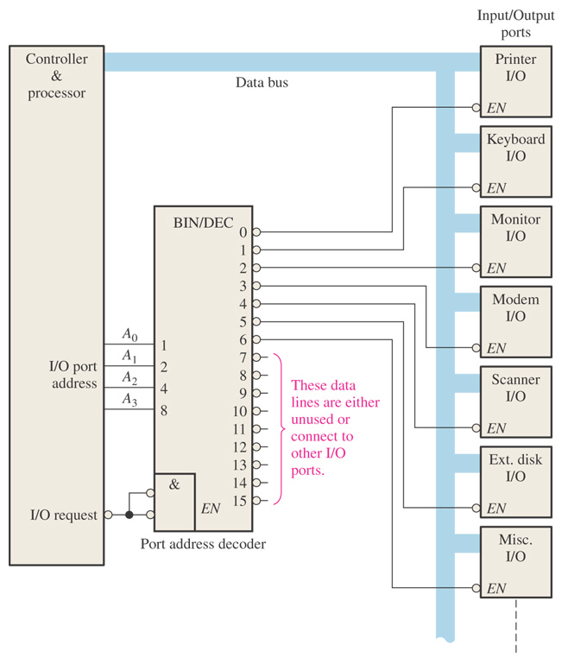
Sec.6.5 Decoders
An Application
One example of decoder is in computers for input/output selection.
CHAPTER 6

Slide 33
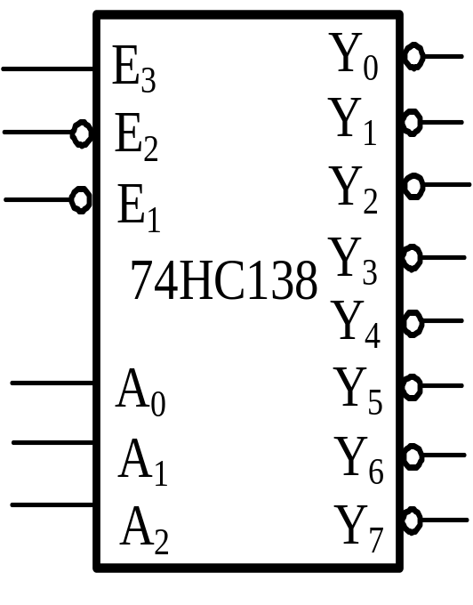
Sec.6.5 Decoders
74HC138
CHAPTER 6

Slide 34










Sec.6.5 Decoders
74HC138
Input
Output
E₃
A₂
A₁
A₀
×
H
×
×
×
×
H
H
H
H
H
H
H
H
×
×
H
×
×
×
H
H
H
H
H
H
H
H
L
×
×
×
×
×
H
H
H
H
H
H
H
H
H
L
L
L
L
L
L
H
H
H
H
H
H
H
H
L
L
L
L
H
H
L
H
H
H
H
H
H
H
L
L
L
H
L
H
H
L
H
H
H
H
H
H
L
L
L
H
H
H
H
H
L
H
H
H
H
H
L
L
H
L
L
H
H
H
H
L
H
H
H
H
L
L
H
L
H
H
H
H
H
H
L
H
H
H
L
L
H
H
L
H
H
H
H
H
H
L
H
H
L
L
H
H
H
H
H
H
H
H
H
H
L
CHAPTER 6

Slide 35
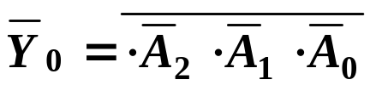
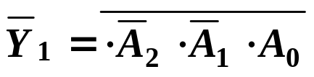
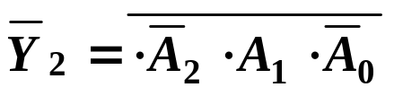
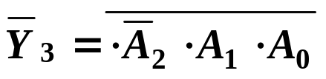
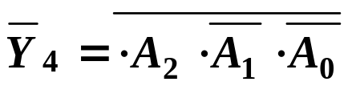
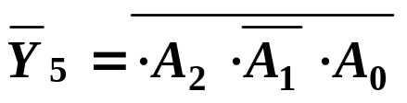
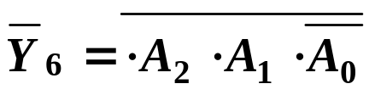
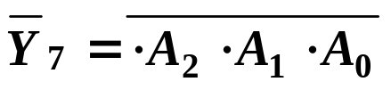
Input
Output
E₃
A₂
A₁
A₀
×
H
×
×
×
×
H
H
H
H
H
H
H
H
×
×
H
×
×
×
H
H
H
H
H
H
H
H
L
×
×
×
×
×
H
H
H
H
H
H
H
H
H
L
L
L
L
L
L
H
H
H
H
H
H
H
H
L
L
L
L
H
H
L
H
H
H
H
H
H
H
L
L
L
H
L
H
H
L
H
H
H
H
H
H
L
L
L
H
H
H
H
H
L
H
H
H
H
H
L
L
H
L
L
H
H
H
H
L
H
H
H
H
L
L
H
L
H
H
H
H
H
H
L
H
H
H
L
L
H
H
L
H
H
H
H
H
H
L
H
H
L
L
H
H
H
H
H
H
H
H
H
H
L

Slide 36
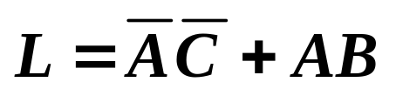
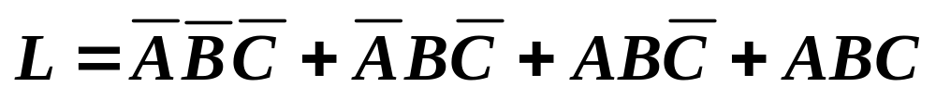
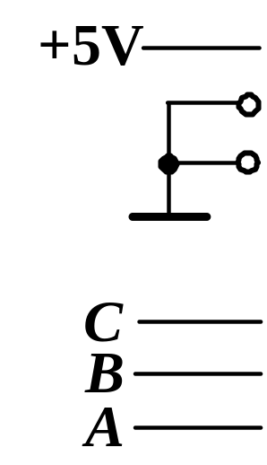
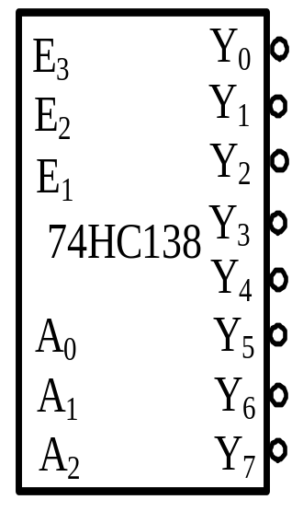
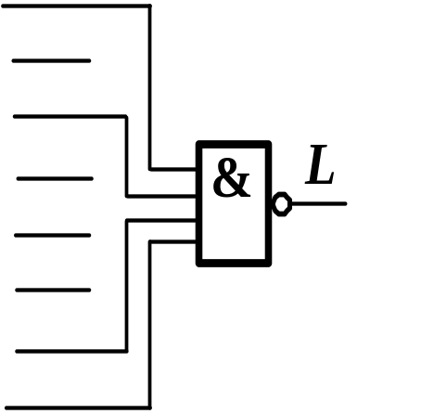
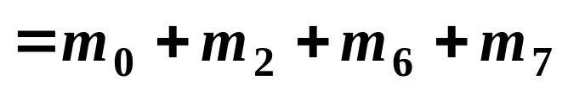
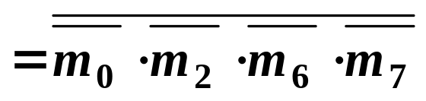
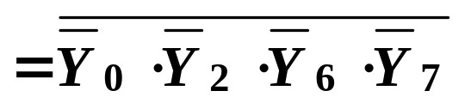
Sec.6.5 Decoders
74HC138
Using a chip of 74HC138 to generate
CHAPTER 6

Slide 37
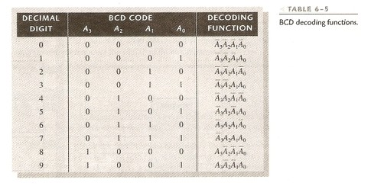
Sec.6.5 Decoders
The BCD-to-Decimal Decoder
The BCD-to-decimal decoder converts each BCD code (8421 code) into one of the ten possible decimal digit indications. It is frequently
referred as a 4-line-to-10-line decoder or a 1-og-10 decoder.
CHAPTER 6

Slide 38
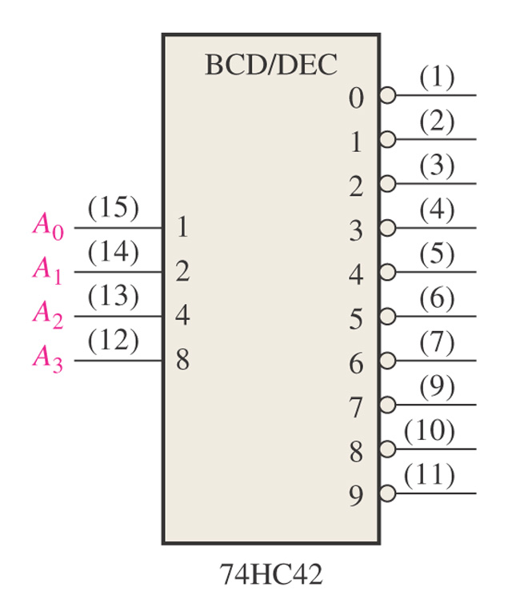
Sec.6.5 Decoders
The BCD-to-Decimal Decoder
Example 6-10 The 74HC42 is an integrated circuit BCD-to-decimal decoder. The logic symbol and output waveform are:
CHAPTER 6

Slide 39
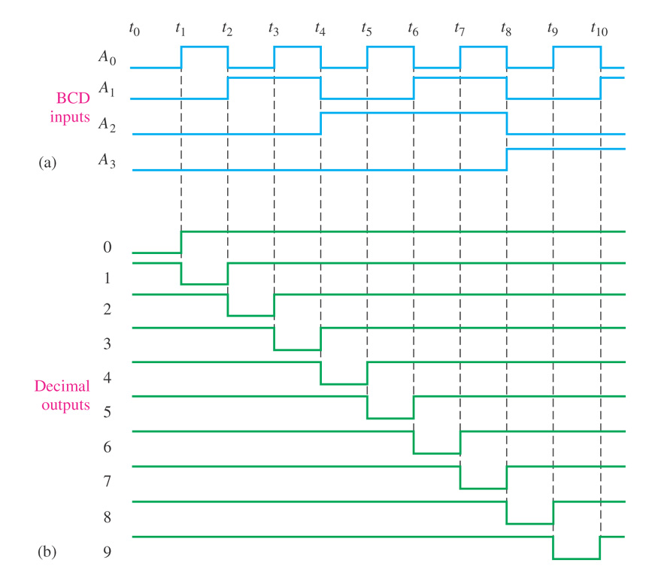
Sec.6.5 Decoders
The BCD-to-Decimal Decoder
Example 6-10
CHAPTER 6

Slide 40
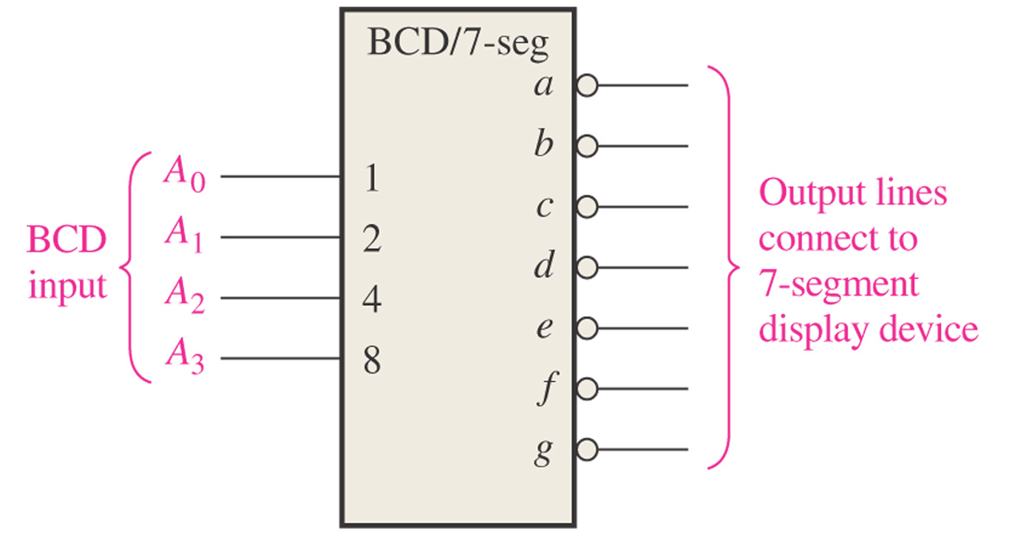
Sec.6.5 Decoders
The BCD-to-7-segment Decoder
The BCD-to-7-segment decoder accepts the BCD code on its inputs
and provides outputs to drive 7-segment display devices.
CHAPTER 6

Slide 41
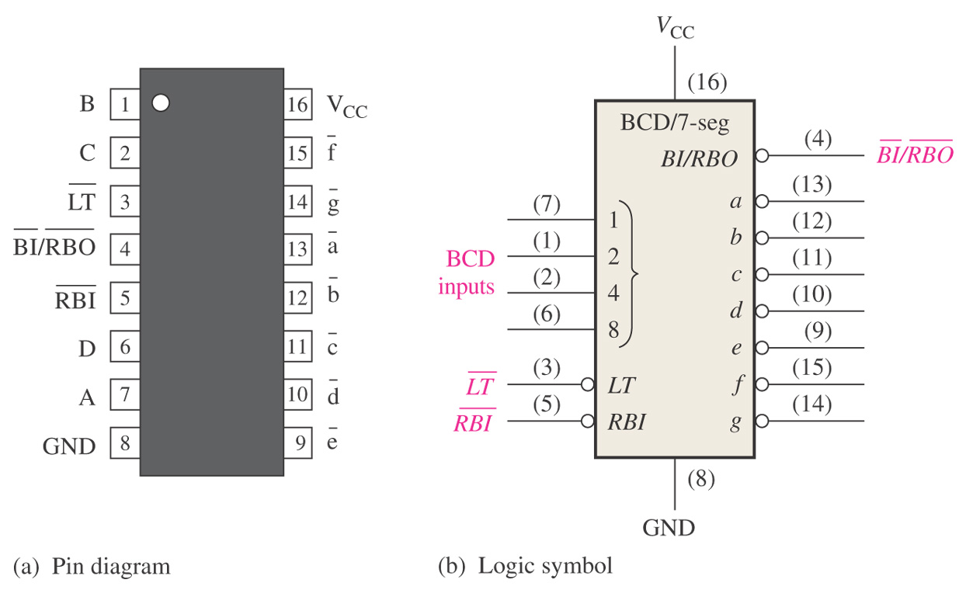
Sec.6.5 Decoders
The BCD-to-7-segment Decoder
The 74LS47 is an example of an IC device that decoders a BCD
input and drives a 7-segment display.
CHAPTER 6

Slide 42
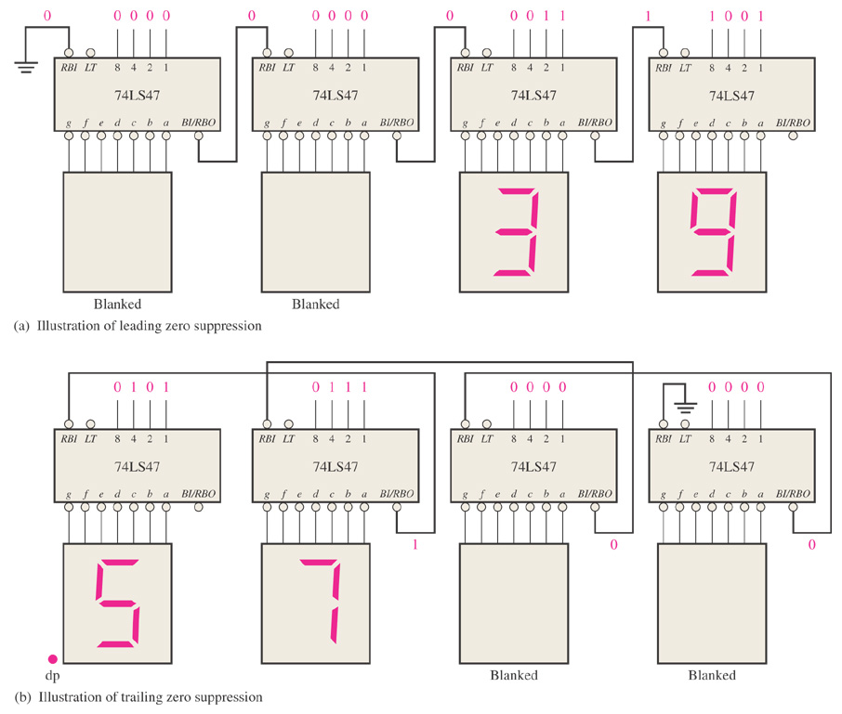
Sec.6.5 Decoders
The BCD-to-7-segment Decoder
CHAPTER 6

Slide 43
Sec.6.6 Encoders
An encoder is a combinational logic circuit that essentially performs a “reverse” decoder function. An encoder accepts an active level on one of its inputs representing a digit, such as a decimal or octal digit, and
converts it to a coded output, such as BCD or binary.
CHAPTER 6

Slide 44
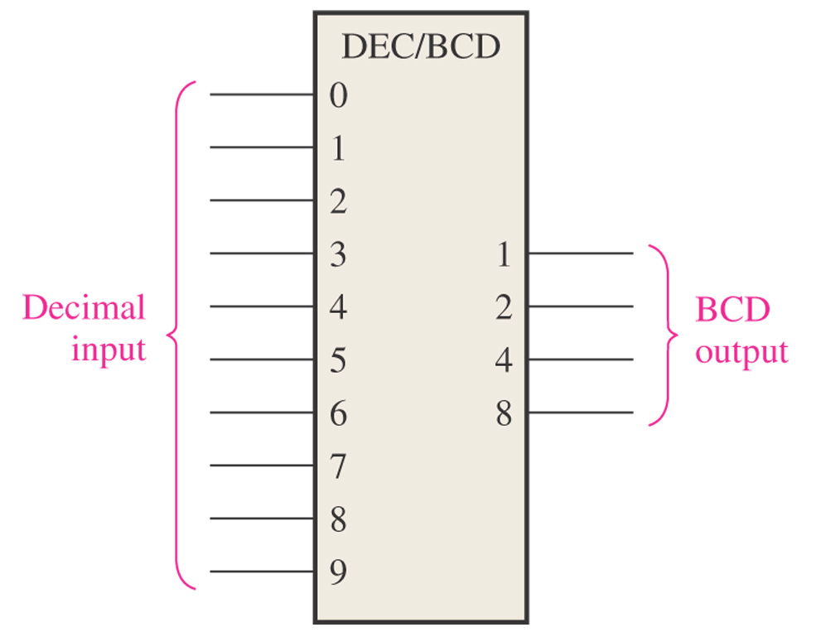
Sec.6.6 Encoders
The Decimal-to-BCD Encoder
This type of encoder has ten inputs---one for each decimal digit, and four outputs corresponding to the BCD code.
CHAPTER 6

Slide 45
Sec.6.6 Encoders
The Decimal-to-BCD Encoder
Decimal Digit | BCD Code
 | A₃ | A₂ | A₁ | A₀
0 | 0 | 0 | 0 | 0
1 | 0 | 0 | 0 | 1
2 | 0 | 0 | 1 | 0
3 | 0 | 0 | 1 | 1
4 | 0 | 1 | 0 | 0
5 | 0 | 1 | 0 | 1
6 | 0 | 1 | 1 | 0
7 | 0 | 1 | 1 | 1
8 | 1 | 0 | 0 | 0
9 | 1 | 0 | 0 | 1
CHAPTER 6

Slide 46


Sec.6.6 Encoders
The Decimal-to-BCD Encoder
According to the truth table, we can get the Boolean expression
CHAPTER 6

Slide 47
Sec.6.6 Encoders
The Decimal-to-BCD Encoder
When high level appear in ‘5’ and ‘6’, then A₃=0, A₂=1, A₁=1, A₀=1, the BCD output is 0111 (which represents decimal 7) .
The priority encoder needed to be introduced.
CHAPTER 6

Slide 48
Sec.6.6 Encoders
The Decimal-to-BCD Priority Encoder
The priority function means that the encoder will produce a BCD output corresponding to the highest order decimal digit input that is
active and will ignore any other lower-order active inputs.
If 6 and 3 inputs are both active, the BCD output is 0110.
CHAPTER 6

Slide 49
Sec.6.6 Encoders
The 74HC147 Decimal-to-BCD Priority Encoder
The 74HC147 is a priority encoder with active-LOW inputs (0) for decimal 1 through 9 and active-LOW BCD outputs as indicated in the
logic symbol. A BCD zero output is represented when none of the inputs is active.
CHAPTER 6

Slide 50

Sec.6.6 Encoders
The 74HC147 Decimal-to-BCD Priority Encoder
CHAPTER 6

Slide 51

Sec.6.6 Encoders
The 74HC147 Decimal-to-BCD Priority Encoder
CHAPTER 6

Slide 52
Sec.6.6 Encoders
The 74LS148 8-LINE-TO-3-LINE Encoder
The 74LS148 is a priority encoder that has eight active-LOW inputs and three active-LOW binary outputs. To enable the device, the EI must be LOW. It also has the EO and GS output for expansion purposes.
This device can be used for converting octal inputs to a 3-bit binary code.
CHAPTER 6

Slide 53

Sec.6.6 Encoders
The 74LS148 8-LINE-TO-3-LINE Encoder
Figure 6–40 Logic symbol for the 74LS148 8-line-to-3-line encoder.
CHAPTER 6

Slide 54

Sec.6.6 Encoders
The 74LS148 8-LINE-TO-3-LINE Encoder
CHAPTER 6

Slide 55

Sec.6.6 Encoders
Figure 6–41 A 16-line-to-4 line encoder using 74LS148s and external logic.
CHAPTER 6

Slide 56
Sec.6.6 Encoders
Example 6-11 If LOW levels appear on pins 1, 4 and 13 of the 74LS147 shown in the Figure 6-39, indicate the state of the four outputs.
All other inputs are HIGH.
CHAPTER 6

Slide 57

Sec.6.6 Encoders
Example 6-11 Solution:
Pin 4 is the highest-order decimal digit input having a LOW level and represents decimal 7. Therefore, the output levels indicate the BCD code for decimal 7 where
CHAPTER 6

Slide 58
Homework
12, 13， 14，19， 22

Slide 59
Next Lesson
Latches, Flip-Flops, and Timers
6-9～6-10， 7-1 ~ 7-2

