Slide 1

Review
Adder
Comparators
Decoders
Encoders

Slide 2
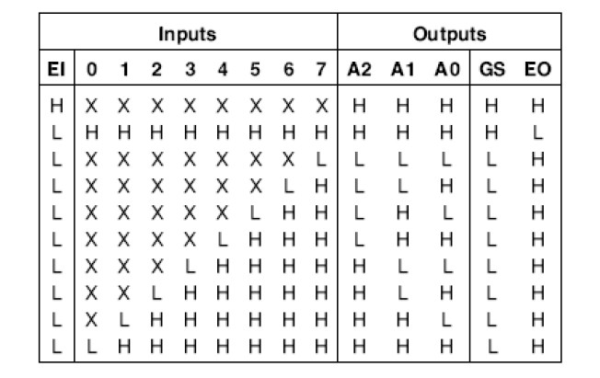
Sec.6.6 Encoders
The 74LS148 8-LINE-TO-3-LINE Encoder
CHAPTER 6

Slide 3
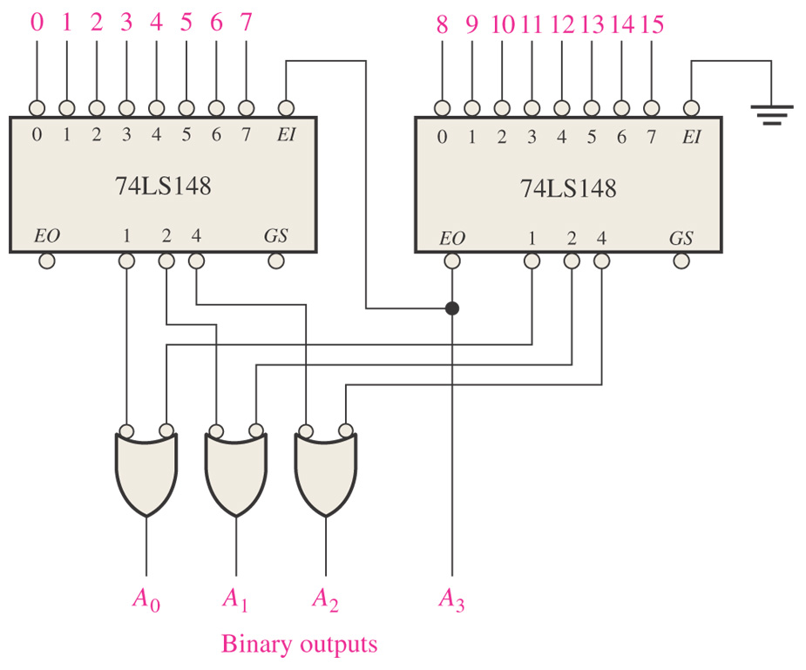
Sec.6.6 Encoders
Figure 6–41 A 16-line-to-4 line encoder using 74LS148s and external logic.
CHAPTER 6

Slide 4
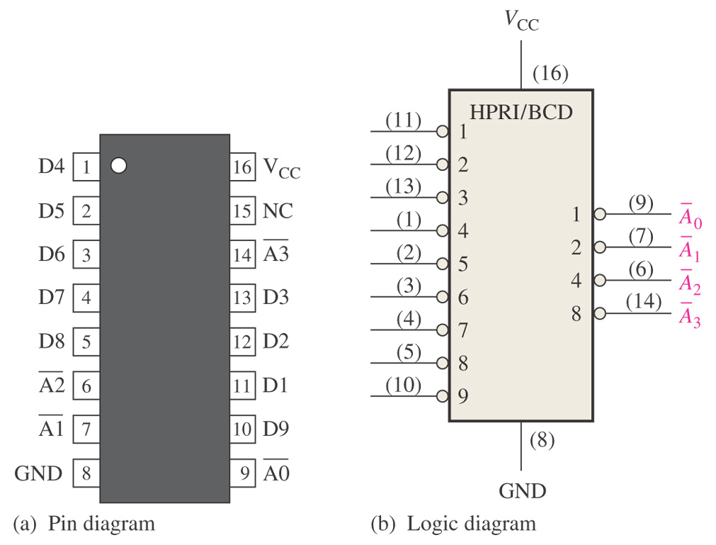
Sec.6.6 Encoders
Example 6-11 If LOW levels appear on pins 1, 4 and 13 of the 74LS147 shown in the Figure 6-39, indicate the state of the four outputs.
All other inputs are HIGH.
CHAPTER 6

Slide 5
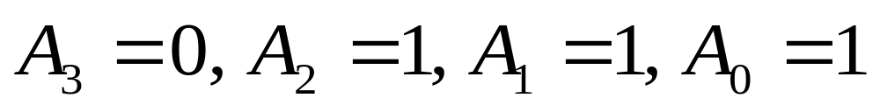
Sec.6.6 Encoders
Example 6-11 Solution:
Pin 4 is the highest-order decimal digit input having a LOW level and represents decimal 7. Therefore, the output levels indicate the BCD code for decimal 7 where
CHAPTER 6

Slide 6
Sec.6.7 Code Converters
The code converter is one of the encoders using combinational logic circuits to convert from one code to another.
BCD-to-Binary
Binary-to-Gray code
Gray code to Binary
CHAPTER 6

Slide 7
Sec.6.7 Code Converters
BCD-to-Binary Conversion
1. The value, or weight, of each bit in the BCD number is represented
by a binary number.
2. All of the binary representations of the weights of bits that are 1s
in the BCD number are added.
3. The result of this addition is the binary equivalent of the BCD
number.
CHAPTER 6

Slide 8
Sec.6.7 Code Converters
BCD-to-Binary Conversion
Example: Convert BCD code 1000 0111 to binary.
Tens Digit Units Digit
Weight 80 40 20 10 8 4 2 1
B₃ B₂ B₁ B₀ A₃ A₂ A₁ A₀
1 0 0 0 0 1 1 1
1000 0111_{BCD}= ( 80+4+2+1 )_{D}=01010111_{B}
CHAPTER 6

Slide 9
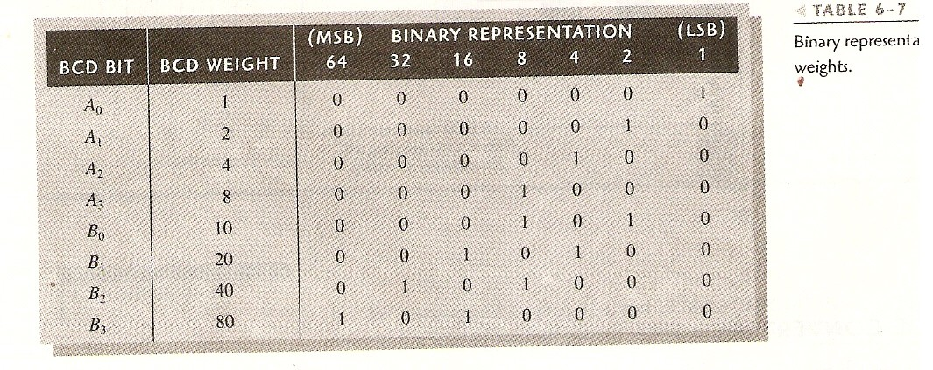
Sec.6.7 Code Converters
BCD-to-Binary Conversion
CHAPTER 6

Slide 10
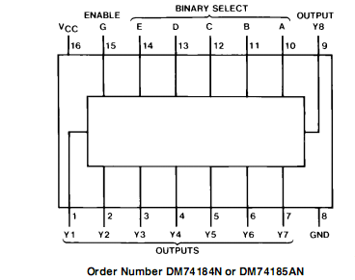
Sec.6.7 Code Converters
BCD-to-Binary and Binary-to-BCD Conversion
CHAPTER 6

Slide 11
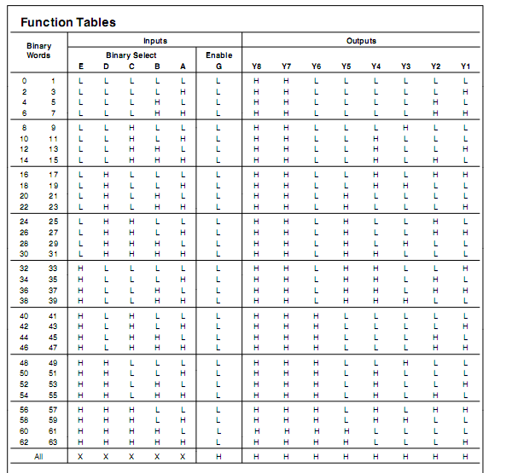
Sec.6.7 Code Converters
BCD-to-Binary and Binary-to-BCD Conversion
CHAPTER 6

Slide 12
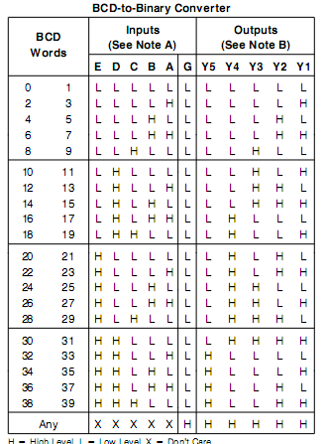
Sec.6.7 Code Converters
BCD-to-Binary and Binary-to-BCD Conversion
CHAPTER 6

Slide 13
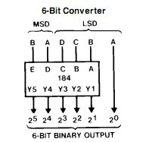
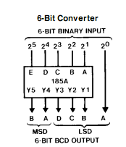
Sec.6.7 Code Converters
BCD-to-Binary and Binary-to-BCD Conversion
CHAPTER 6

Slide 14
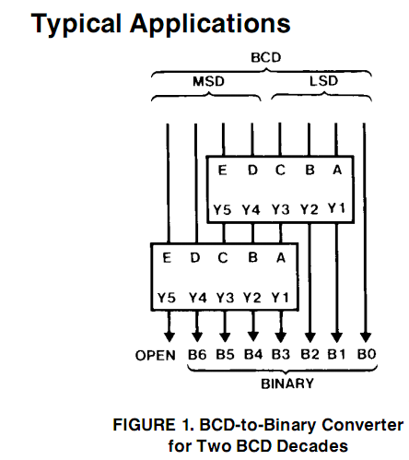
Sec.6.7 Code Converters
BCD-to-Binary and Binary-to-BCD Conversion
CHAPTER 6

Slide 15
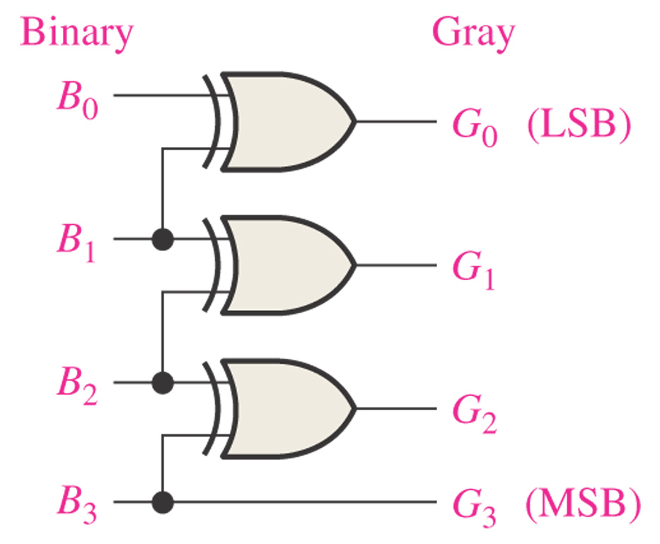
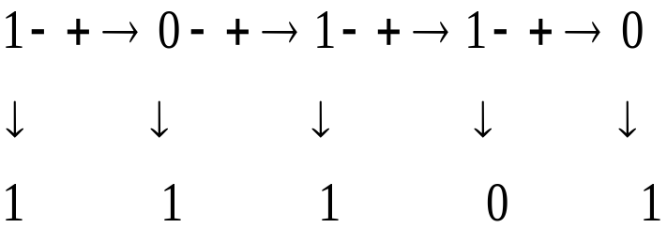
Sec.6.7 Code Converters
Binary-to-Gray Conversion
CHAPTER 6

Slide 16
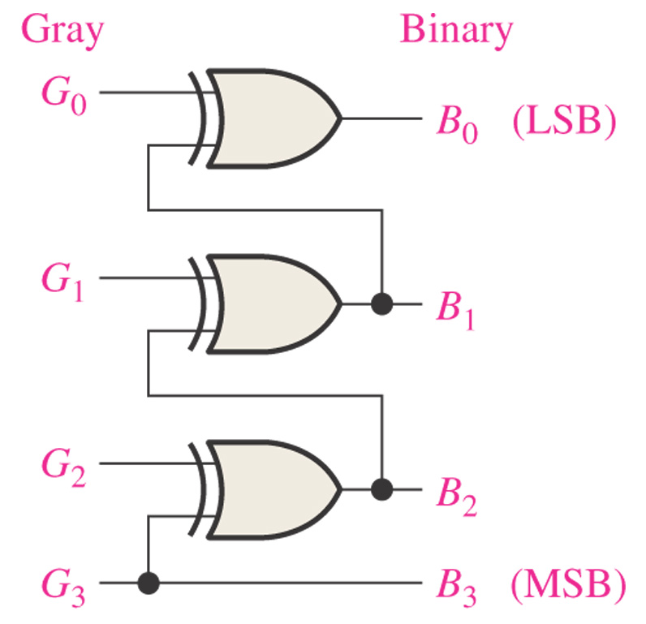
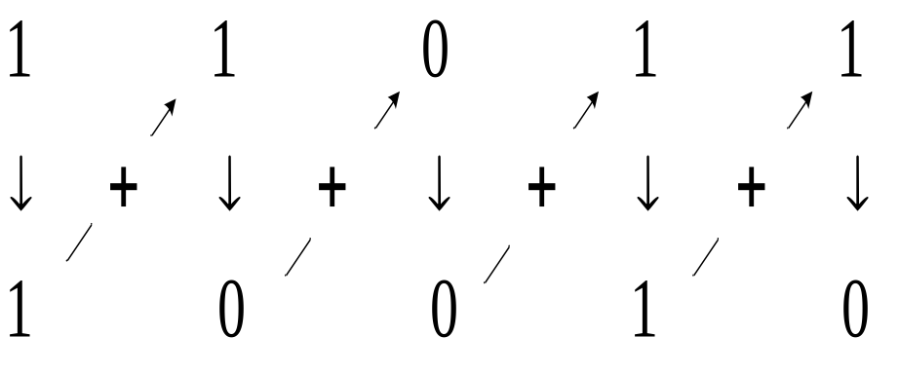
Sec.6.7 Code Converters
Gray-to-Binary Conversion
CHAPTER 6

Slide 17
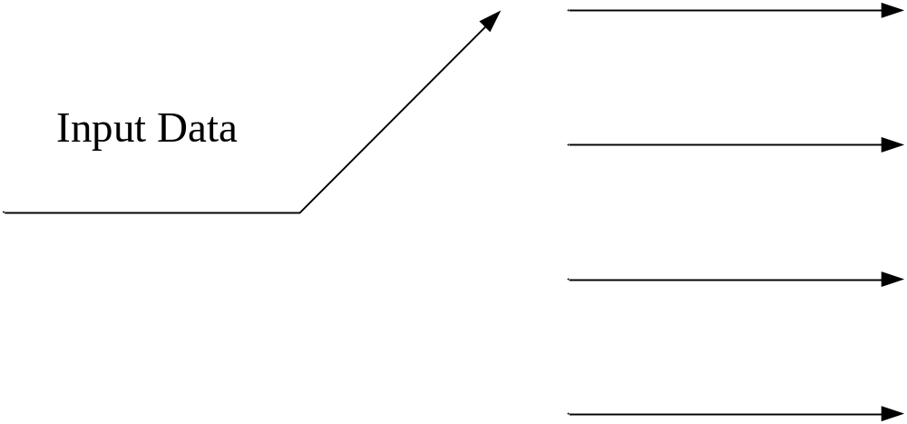
Sec.6.9 Demultiplexers
A demultiplexer basically reverses the multiplexing function. It takes digital information from one line and distributes it to a given number of
output lines.
CHAPTER 6

Slide 18
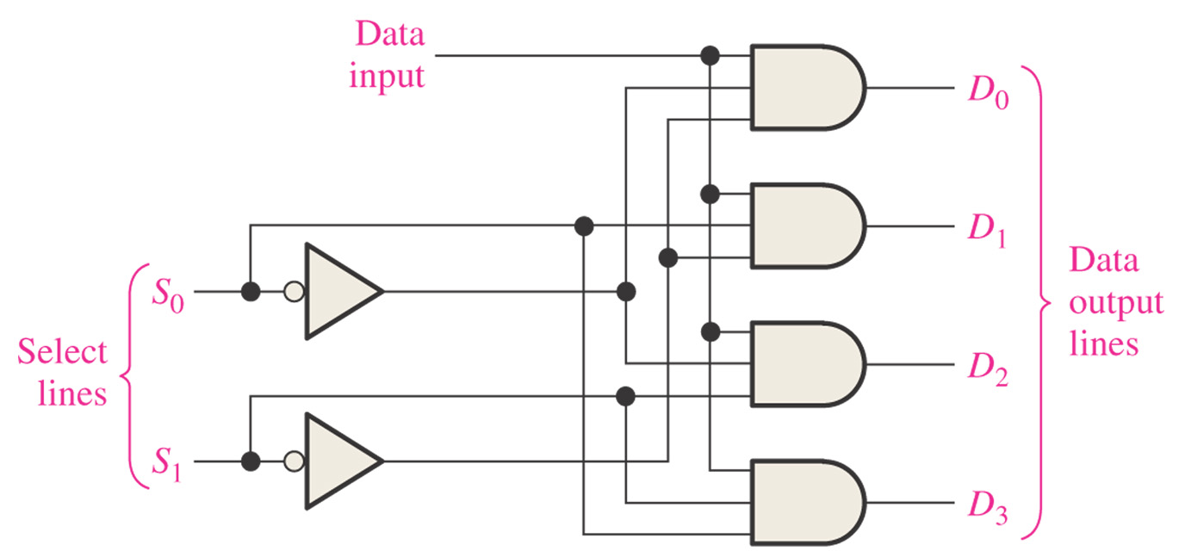
Sec.6.9 Demultiplexers
When S₀S₁=00, D₀= Data input
CHAPTER 6

Slide 19
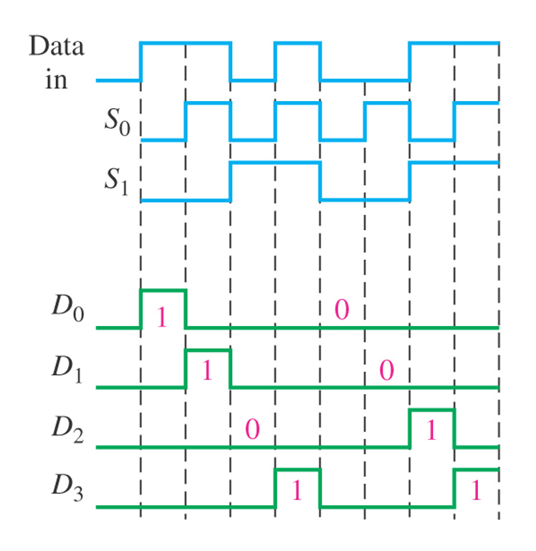
Sec.6.9 Demultiplexers
Example 6-18 Determine the data-output waveforms according the
1-line-to-4-line demultiplexer.
CHAPTER 6

Slide 20
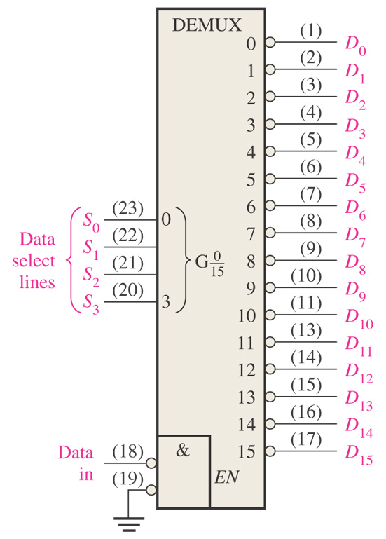
Sec.6.9 Demultiplexers
74HC154 Demultiplexer
74HC154 can be used as a 1-line-to-16-line demultiplexer.
CHAPTER 6

Slide 21
Sec.6.10 Parity Generators / Checkers
Basic Parity Logic
The sum (disregarding carries) of an even number of 1s is always 0, and the sum of an odd number of 1s is always 1.
The sum of two bits can be generated by an exclusive-OR gate. The sum of four bits can be formed by three exclusive-OR gates.
CHAPTER 6

Slide 22
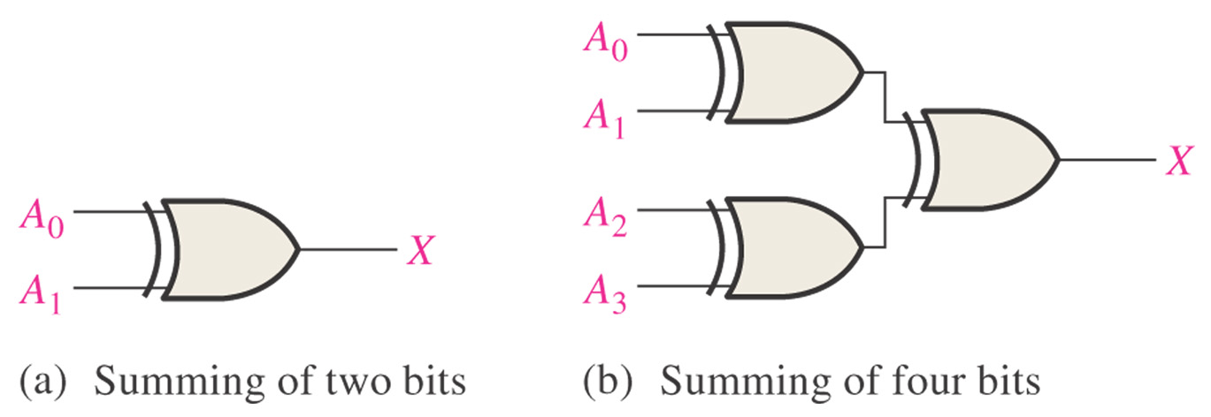
Sec.6.10 Parity Generators / Checkers
Basic Parity Logic
CHAPTER 6

Slide 23
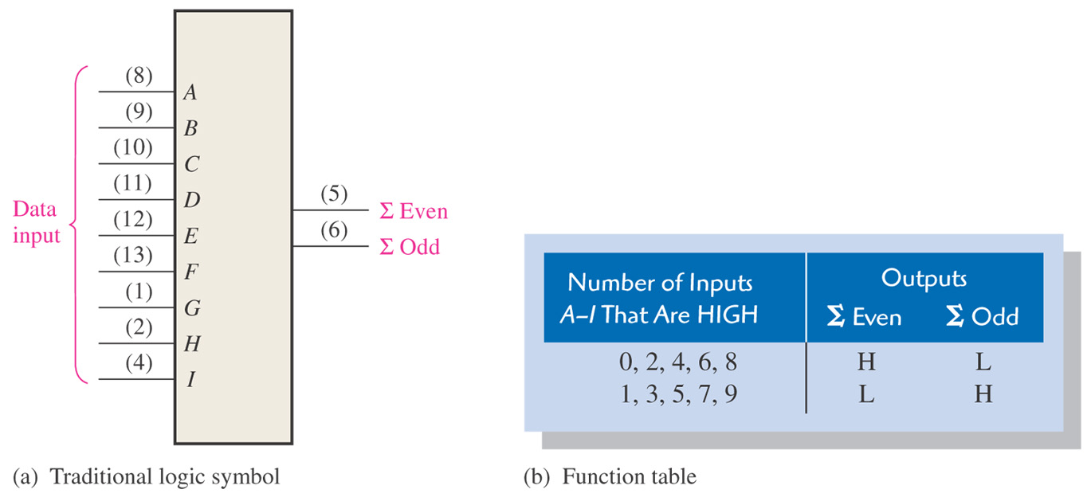
Sec.6.10 Parity Generators / Checkers
74LS280 9-Bit Parity Generator / Checker
CHAPTER 6

Slide 24
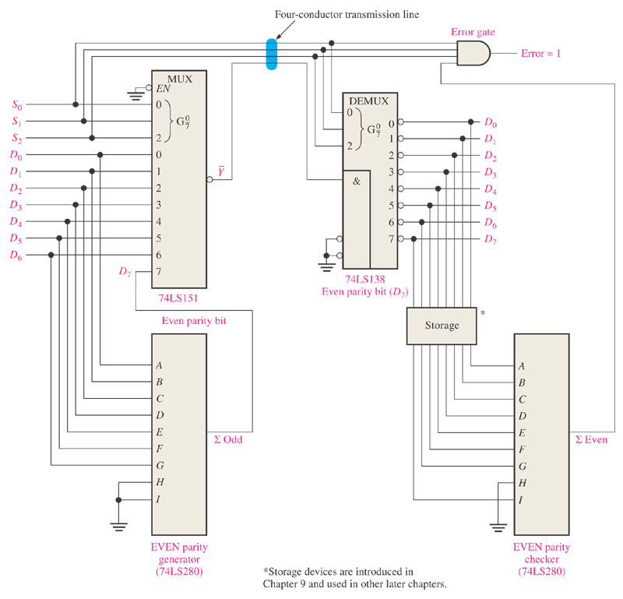
Sec.6.10 Parity Generators / Checkers
A data transmission system with error detection
CHAPTER 6

Slide 25
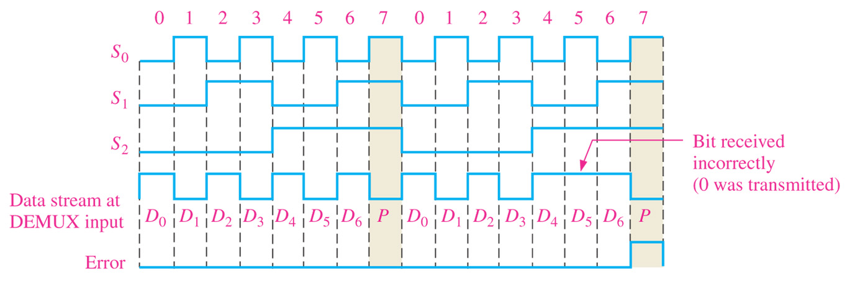
Sec.6.10 Parity Generators / Checkers
A data transmission system with error detection
CHAPTER 6

Slide 26
Timing Hazards in Combinational Logic Circuits
Hazards are undesirable changes in the output of a combinational logic circuit caused by unequal gate
propagation delays.
CHAPTER 6

Slide 27
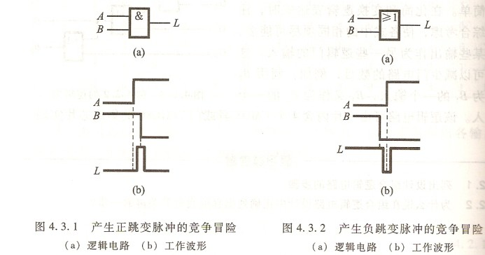
Timing Hazards in Combinational Logic Circuits
CHAPTER 6

Slide 28
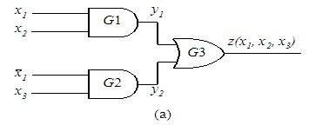
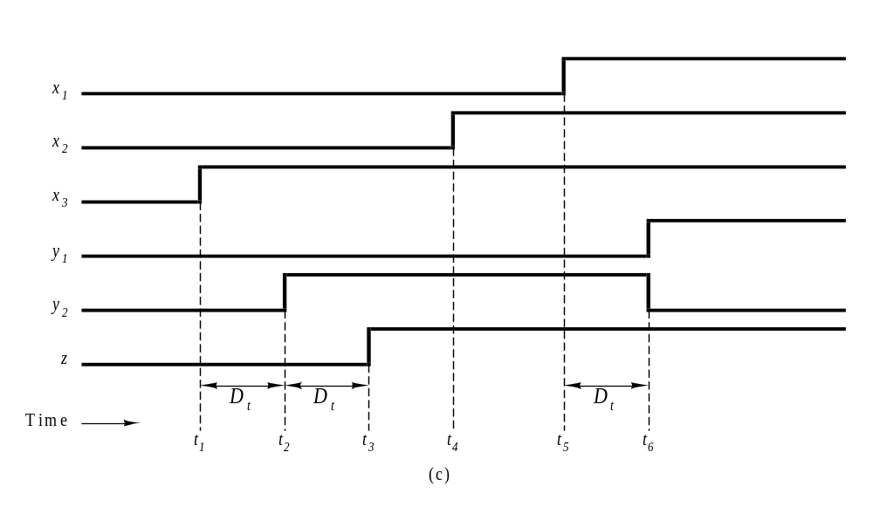
Timing Hazards in Combinational Logic Circuits
CHAPTER 6

Slide 29
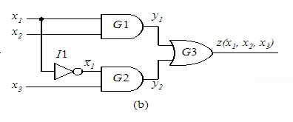
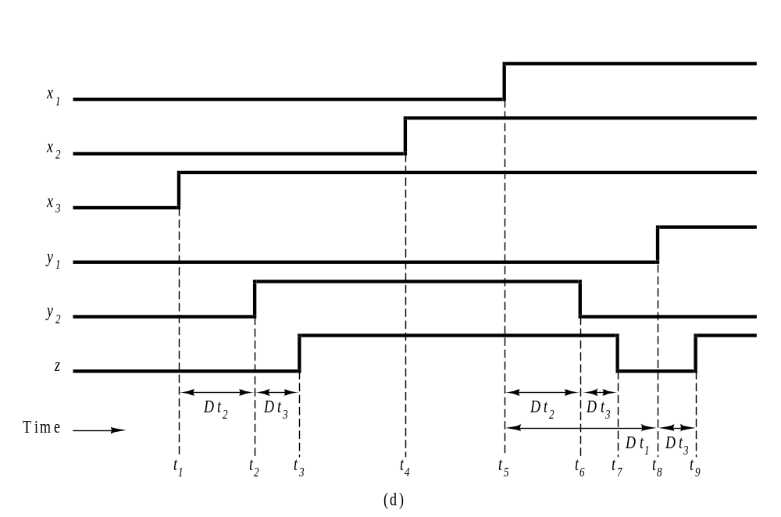
Timing Hazards in Combinational Logic Circuits
CHAPTER 6

Slide 30
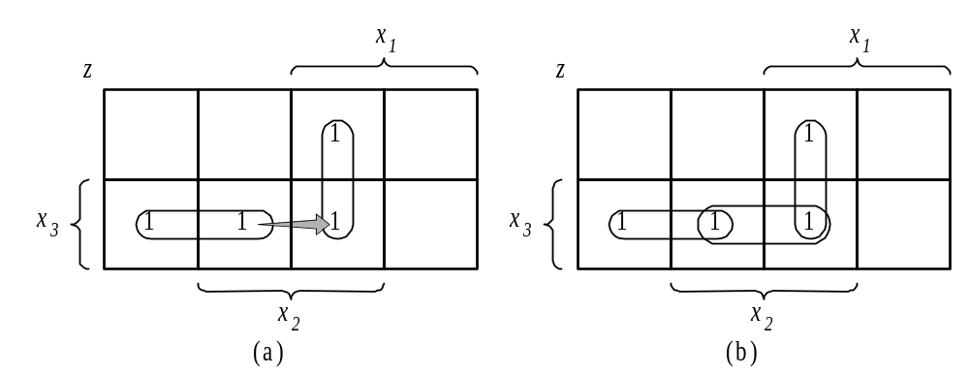
Timing Hazards in Combinational Logic Circuits
CHAPTER 6

Slide 31
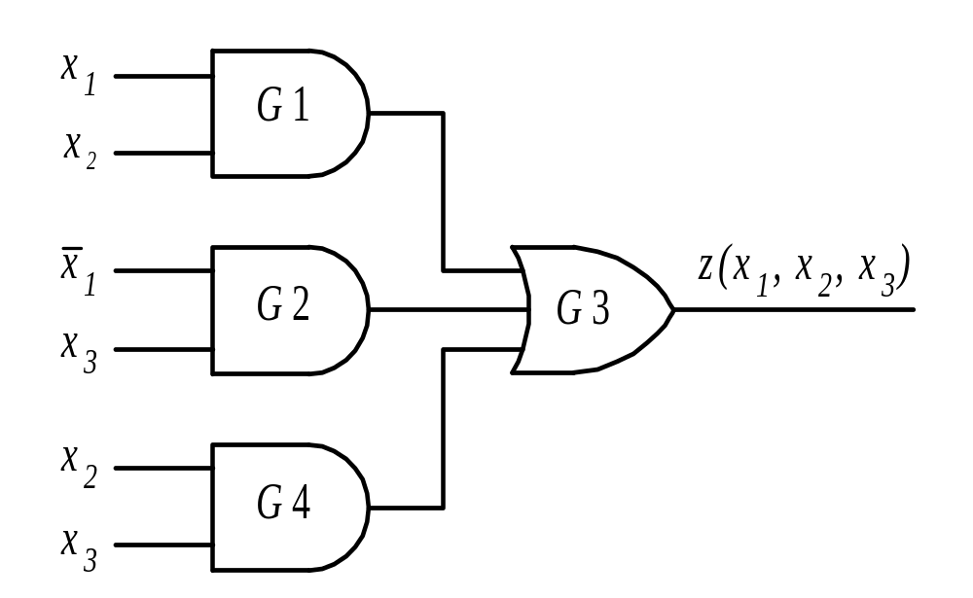
Timing Hazards in Combinational Logic Circuits
Hazard-free network.
CHAPTER 6

Slide 32
Chapter 7
Latches, Flip-Flops, and Timers

Slide 33
Main Contents
Latches
Edge-Triggered Flip-Flop
Flip-Flop Applications
One-Shots
The 555 Timer

Slide 34
Sec.7.1 Latches
The latch is a type of temporary storage device that has two stable states (bistable) and is normally placed in a category separate from that of flip-flops.
Latches are similar to flip-flops because they are bistable devices.
CHAPTER 7

Slide 35
Sec.7.1 Latches
It has two stable states that can voluntarily maintain, used to express the logical condition 0 and 1, or binary number 0 and 1.
May set 1 or 0 state according to the different input signal.
CHAPTER 7

Slide 36
Sec.7.1 Latches
The S-R (Set-Reset) Latch
A latch is a type of bistable logic device. A active-HIGH input S-R latch is formed with two cross-coupled NOR gates. An active-LOW
input S-R latch is formed with two cross-coupled NAND gates.
CHAPTER 7

Slide 37
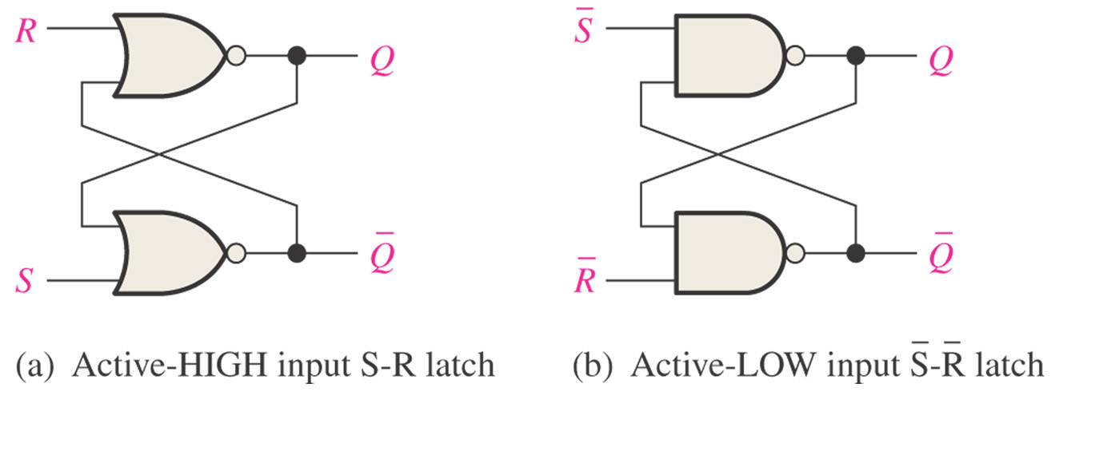
Sec.7.1 Latches
The S-R (Set-Reset) Latch
CHAPTER 7

Slide 38
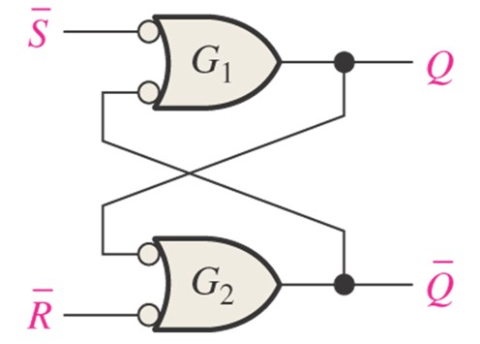
Sec.7.1 Latches
The S-R (Set-Reset) Latch
Negative-OR equivalent of the NAND gate S-R latch
CHAPTER 7

Slide 39
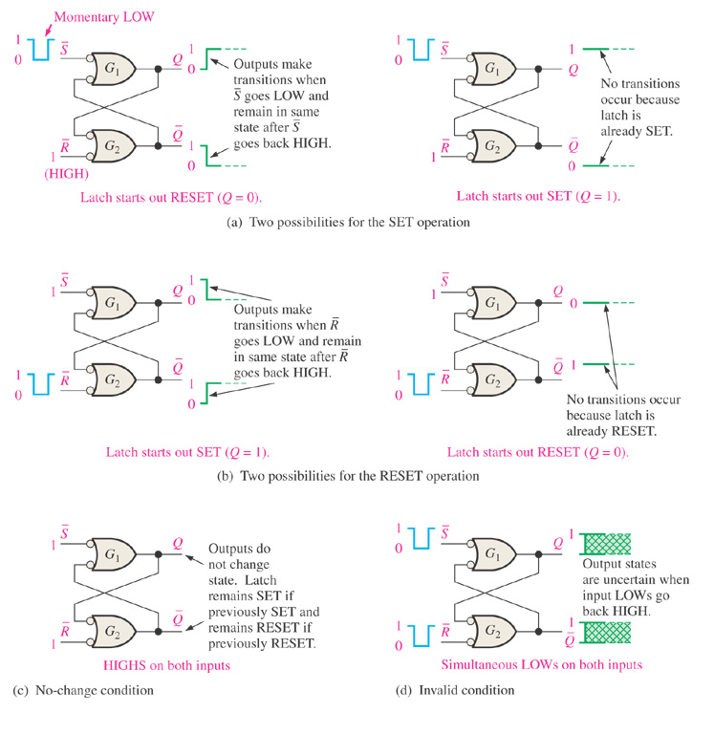
Sec.7.1 Latches
The S-R (Set-Reset) Latch
CHAPTER 7

Slide 40
Sec.7.1 Latches
The S-R (Set-Reset) Latch
Inputs |  | Outputs |  | Comments
S | R | Q | Q
1 | 1 | NC | NC | No change. Latch remains in present state.
0 | 1 | 1 | 0 | Latch Set
1 | 0 | 0 | 1 | Latch Reset
0 | 0 | 1 | 1 | Invalid condition
CHAPTER 7

Slide 41
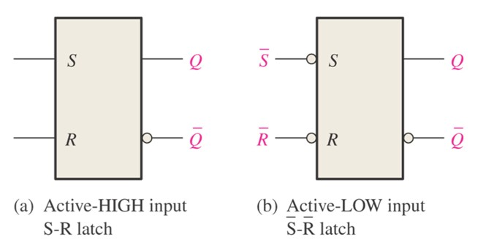
Sec.7.1 Latches
The S-R (Set-Reset) Latch
Figure 7-4 Logic symbols for the S-R and S- R latch.
CHAPTER 7

Slide 42
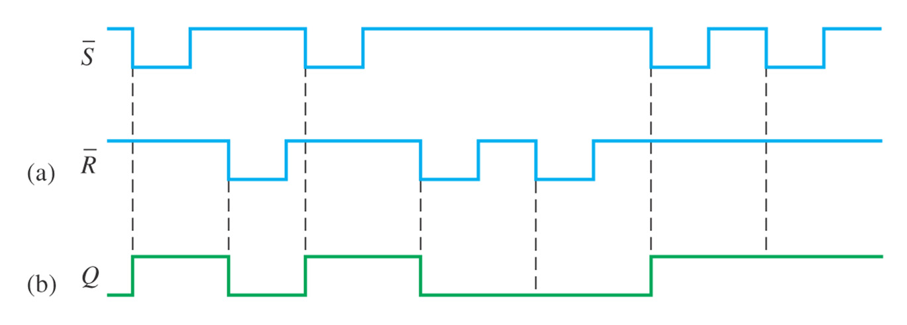
Sec.7.1 Latches
The S-R (Set-Reset) Latch
Example 7-1 If the S and R waveform in Figure 7-5(a) are applied to the inputs of the latch in Figure 7-4(b), determine the form that will be observed on the Q output. (Q is initially LOW)
CHAPTER 7

Slide 43
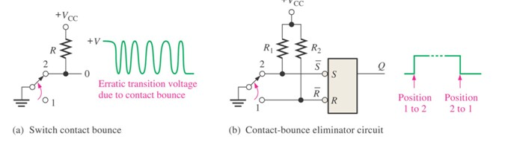
Sec.7.1 Latches
The S-R (Set-Reset) Latch
Application The Latch as a Contact-Bounce Eliminator
CHAPTER 7

Slide 44
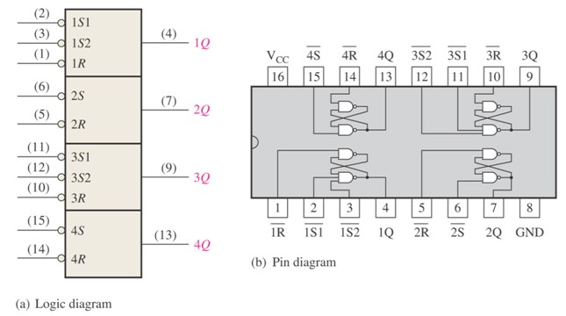
Sec.7.1 Latches
The 74LS279 Set-Reset Latch
The 74LS279 is a quad S-R latch. Two of the latches has two S inputs.
CHAPTER 7

Slide 45
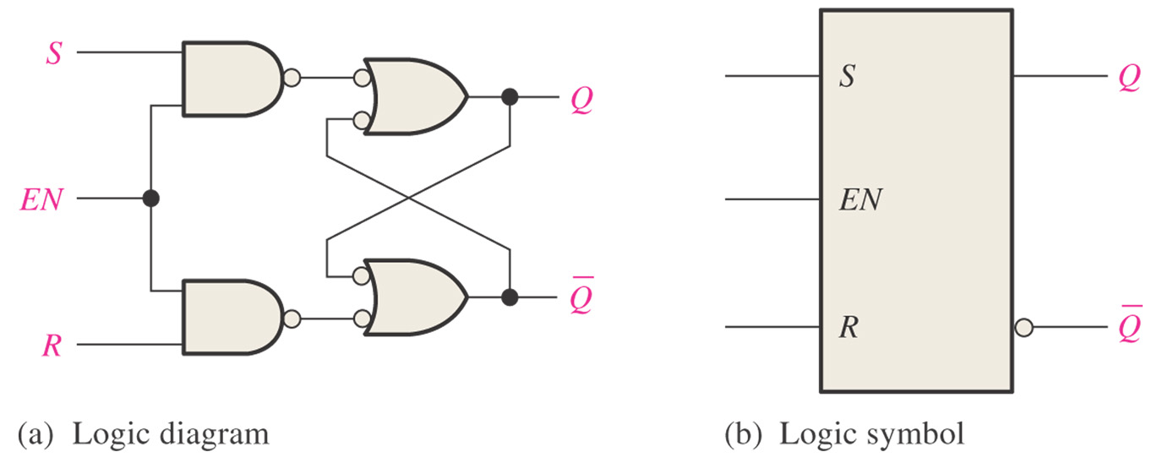
Sec.7.1 Latches
The Gated S-R Latch
A gated latch requires an enable input, EN ( G is also used to designate an enable input).
CHAPTER 7

Slide 46
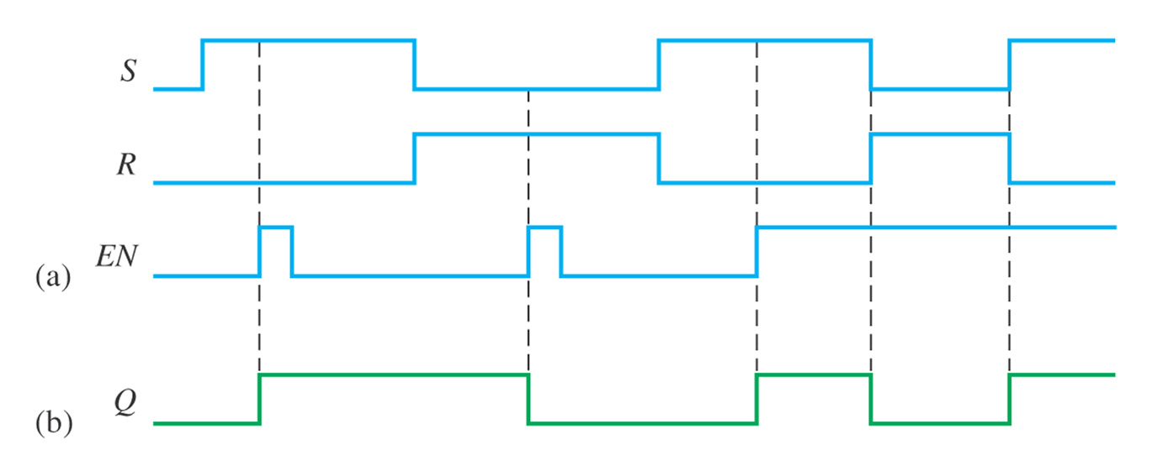
Sec.7.1 Latches
The Gated S-R Latch
Example 7-2 Determine the Q output of a gated S-R latch.
CHAPTER 7

Slide 47
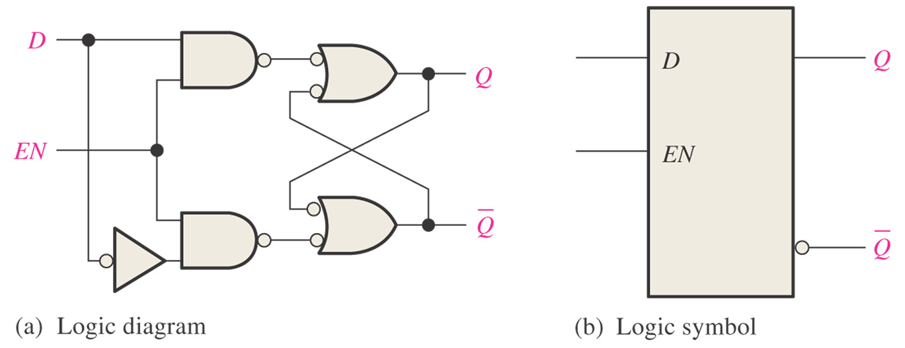
Sec.7.1 Latches
The Gated D Latch
D latch has only one input in addition to EN, this input is called the D (data) input.
CHAPTER 7

Slide 48
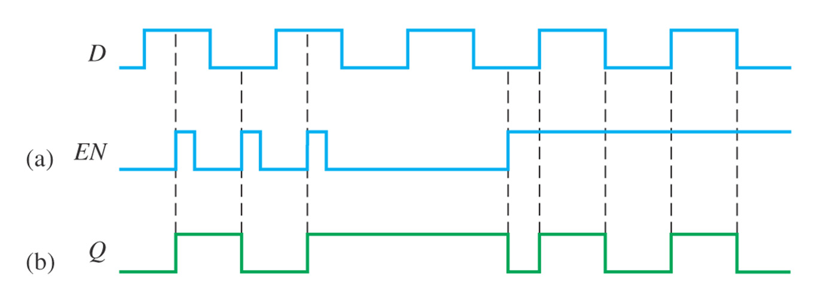
Sec.7.1 Latches
The Gated D Latch
Example 7-3 Determine the Q output waveform of the gated D latch.
CHAPTER 7

Slide 49
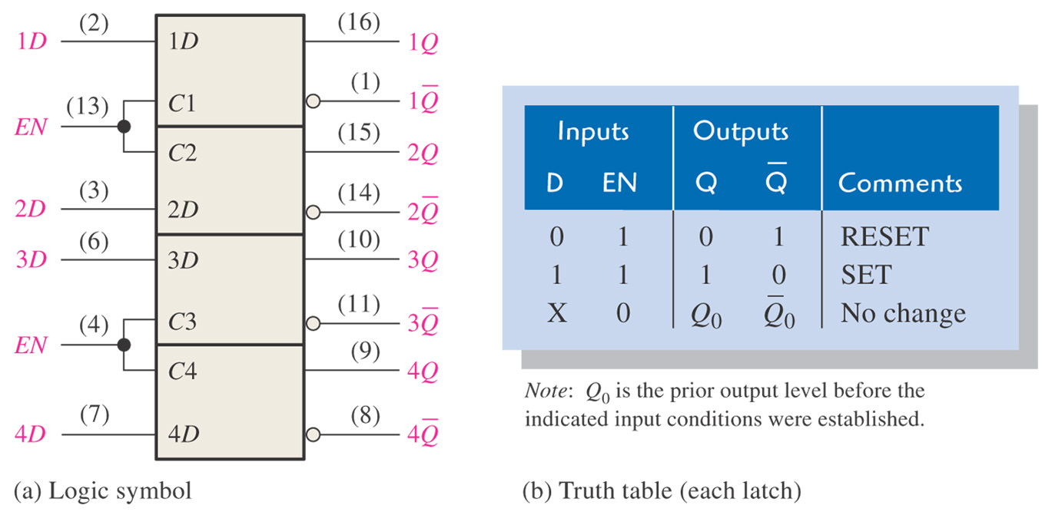
Sec.7.1 Latches
The 74LS75 D Latch
74LS75 is a gated D latch, has four D latches.
CHAPTER 7

Slide 50
Homework
Chapter 6
40, 41，42，43，44 (use 74184)

Slide 51
Next Lesson
Latches, Flip-Flops, and Timers
7-3 ~ 7-6

