Slide 1

Review
Demultiplexer
Parity Generators / Checkers

Slide 2
Chapter 7
Latches, Flip-Flops, and Timers

Slide 3
Main Contents
Latches
Edge-Triggered Flip-Flop
Flip-Flop Applications
One-Shots
The 555 Timer

Slide 4
Sec.7.1 Latches
The latch is a type of temporary storage device that has two stable states (bistable) and is normally placed in a category separate from that of flip-flops.
Latches are similar to flip-flops because they are bistable devices.
CHAPTER 7

Slide 5
Sec.7.1 Latches
It has two stable states that can voluntarily maintain, used to express the logical condition 0 and 1, or binary number 0 and 1.
May set 1 or 0 state according to the different input signal.
CHAPTER 7

Slide 6
Sec.7.1 Latches
The S-R (Set-Reset) Latch
A latch is a type of bistable logic device. A active-HIGH input S-R latch is formed with two cross-coupled NOR gates. An active-LOW
input S-R latch is formed with two cross-coupled NAND gates.
CHAPTER 7

Slide 7
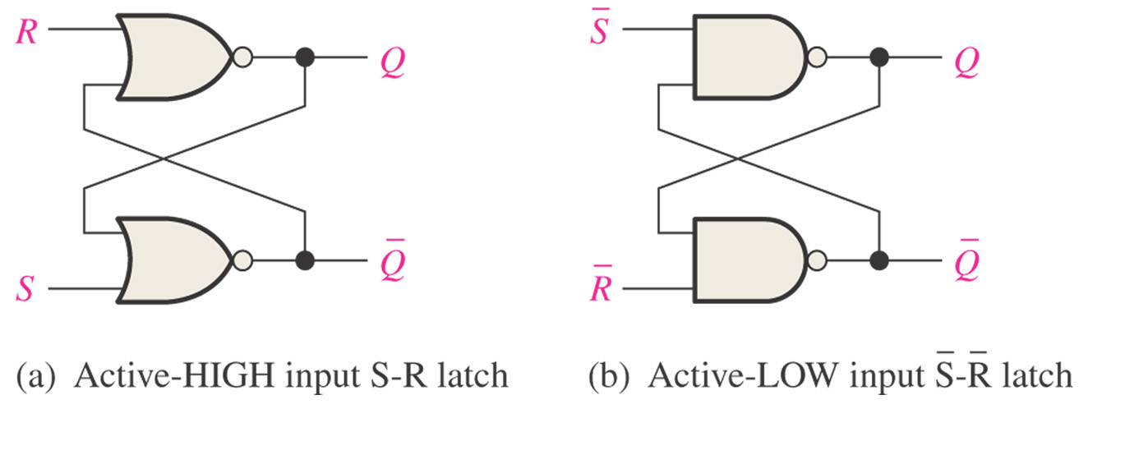
Sec.7.1 Latches
The S-R (Set-Reset) Latch
CHAPTER 7

Slide 8
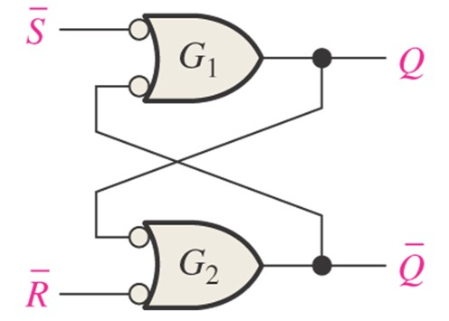
Sec.7.1 Latches
The S-R (Set-Reset) Latch
Negative-OR equivalent of the NAND gate S-R latch
CHAPTER 7

Slide 9
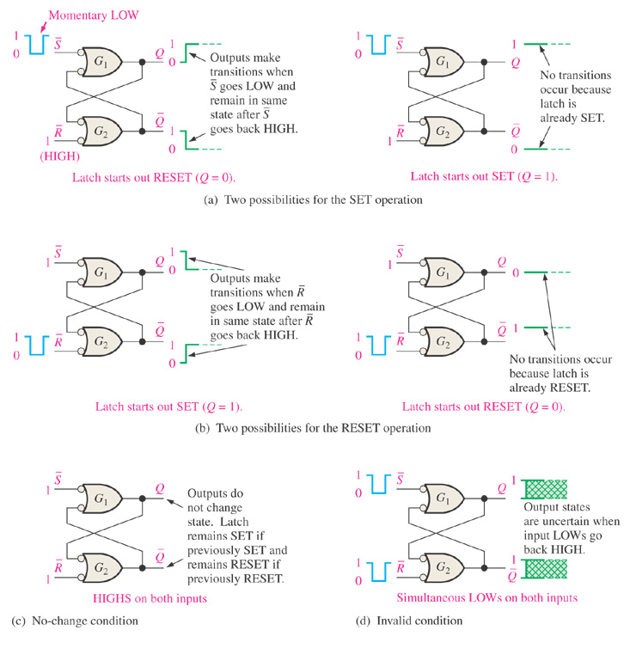
Sec.7.1 Latches
The S-R (Set-Reset) Latch
CHAPTER 7

Slide 10
Sec.7.1 Latches
The S-R (Set-Reset) Latch
Inputs |  | Outputs |  | Comments
S | R | Q | Q
1 | 1 | NC | NC | No change. Latch remains in present state.
0 | 1 | 1 | 0 | Latch Set
1 | 0 | 0 | 1 | Latch Reset
0 | 0 | 1 | 1 | Invalid condition
CHAPTER 7

Slide 11
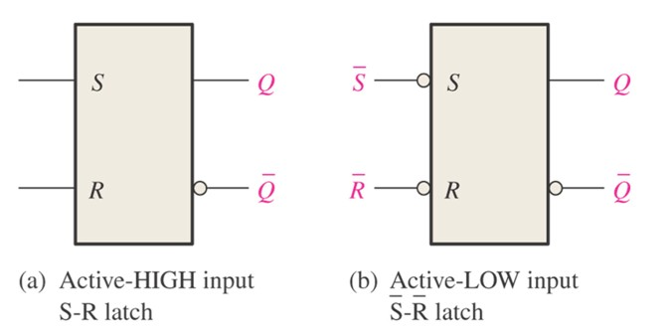
Sec.7.1 Latches
The S-R (Set-Reset) Latch
Figure 7-4 Logic symbols for the S-R and S- R latch.
CHAPTER 7

Slide 12
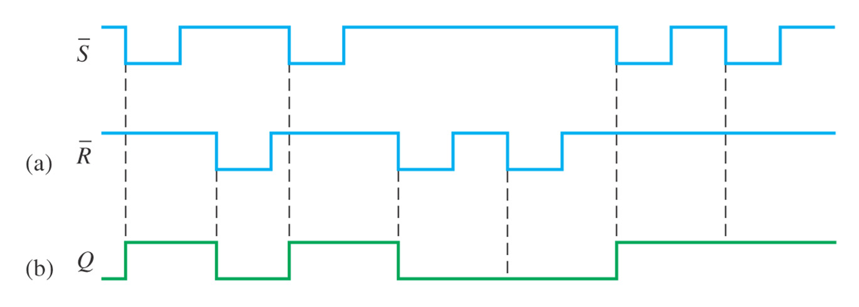
Sec.7.1 Latches
The S-R (Set-Reset) Latch
Example 7-1 If the S and R waveform in Figure 7-5(a) are applied to the inputs of the latch in Figure 7-4(b), determine the form that will be observed on the Q output. (Q is initially LOW)
CHAPTER 7

Slide 13
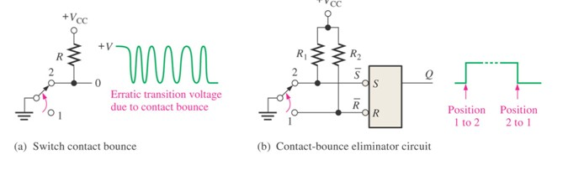
Sec.7.1 Latches
The S-R (Set-Reset) Latch
Application The Latch as a Contact-Bounce Eliminator
CHAPTER 7

Slide 14
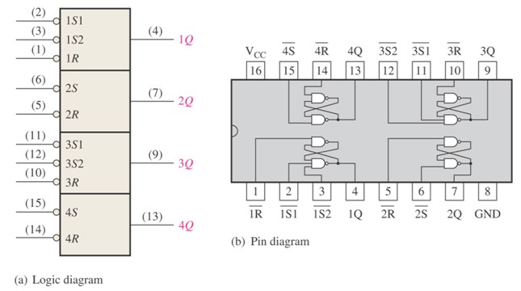
Sec.7.1 Latches
The 74LS279 Set-Reset Latch
The 74LS279 is a quad S-R latch. Two of the latches has two S inputs.
CHAPTER 7

Slide 15
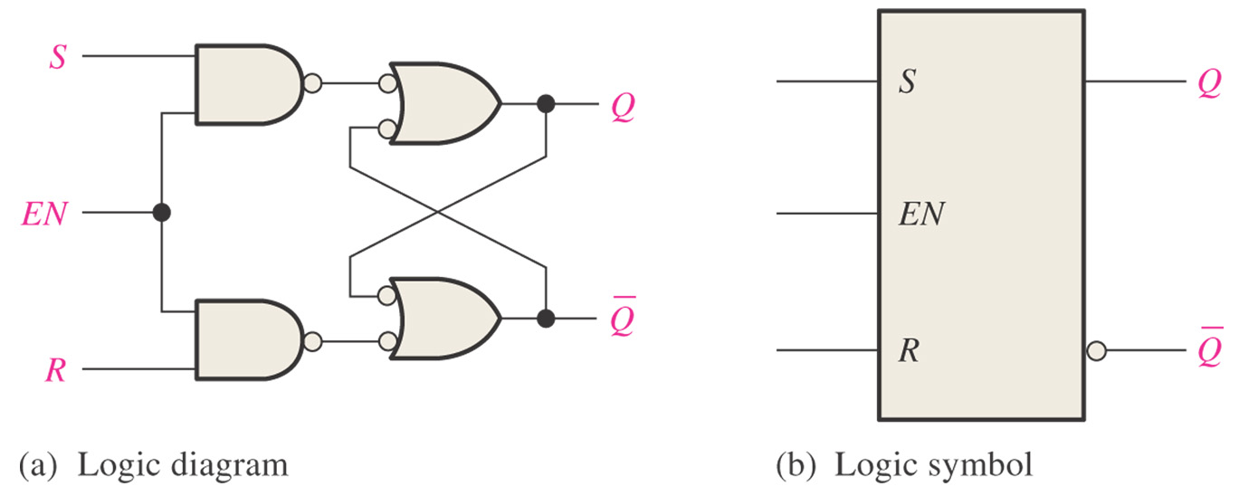
Sec.7.1 Latches
The Gated S-R Latch
A gated latch requires an enable input, EN ( G is also used to designate an enable input).
CHAPTER 7

Slide 16
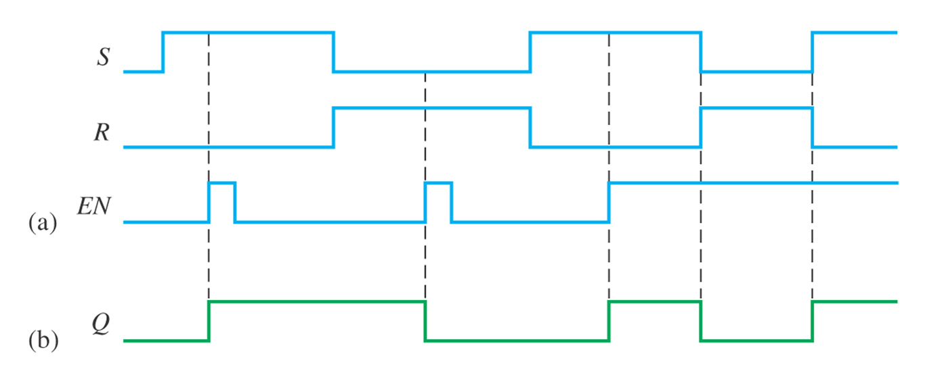
Sec.7.1 Latches
The Gated S-R Latch
Example 7-2 Determine the Q output of a gated S-R latch.
CHAPTER 7

Slide 17
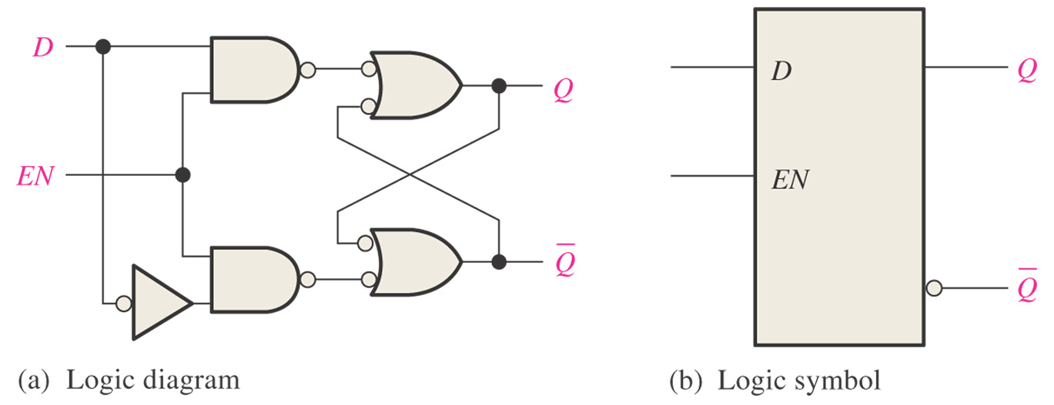
Sec.7.1 Latches
The Gated D Latch
D latch has only one input in addition to EN, this input is called the D (data) input.
CHAPTER 7

Slide 18
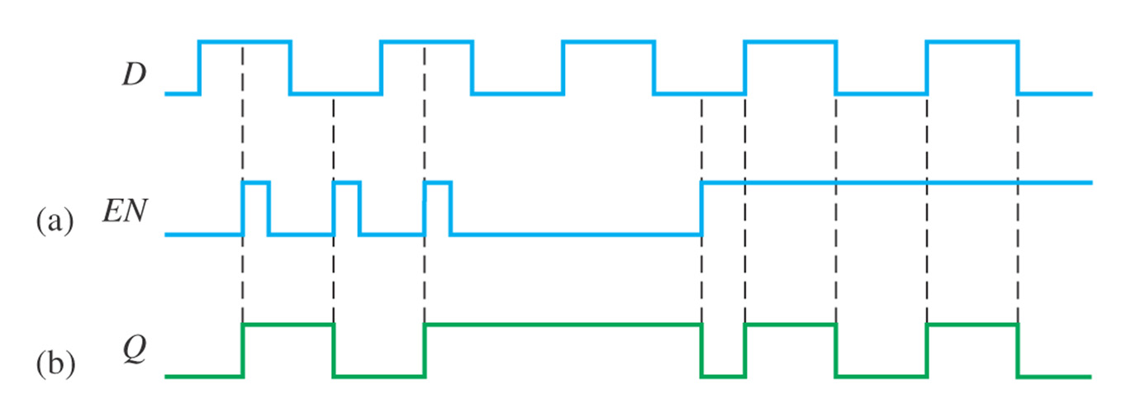
Sec.7.1 Latches
The Gated D Latch
Example 7-3 Determine the Q output waveform of the gated D latch.
CHAPTER 7

Slide 19
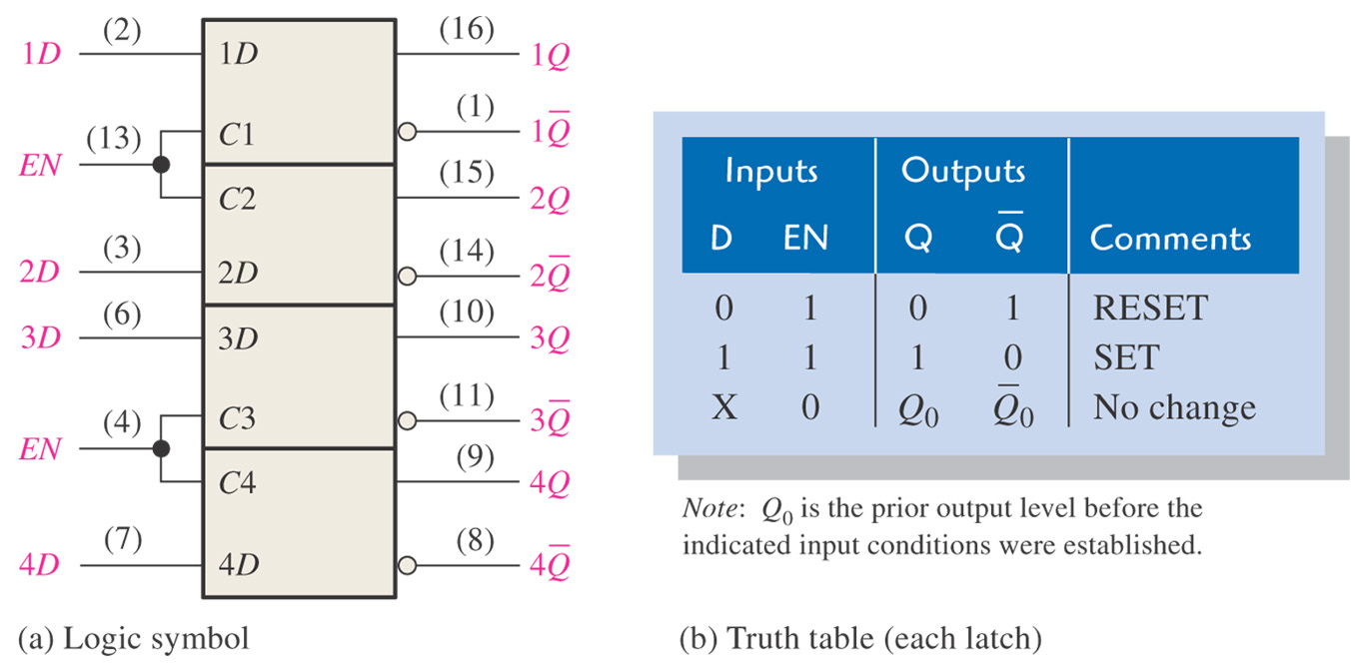
Sec.7.1 Latches
The 74LS75 D Latch
74LS75 is a gated D latch, has four D latches.
CHAPTER 7

Slide 20
Sec.7.2 Edge-Triggered Flip-Flops
Flip-flops are synchronous bistate devices. The output changes state only at a specified point on the triggering input called the clock (CLK),
which is designated as control input.
CHAPTER 7

Slide 21
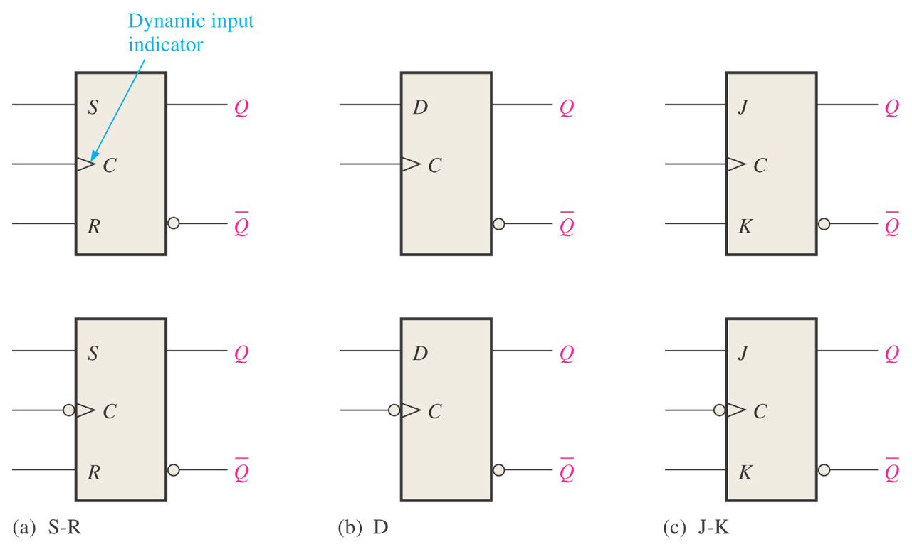
Sec.7.2 Edge-Triggered Flip-Flops
CHAPTER 7

Slide 22
Sec.7.2 Edge-Triggered Flip-Flops
The Edge-Triggered S-R Flip-Flop
An S-R flip-flop can not have both S and R inputs HIGH at the
same time.
The data on these inputs are transferred to the flip-flop’s output
only on the triggering edge of clock pulse.
CHAPTER 7

Slide 23
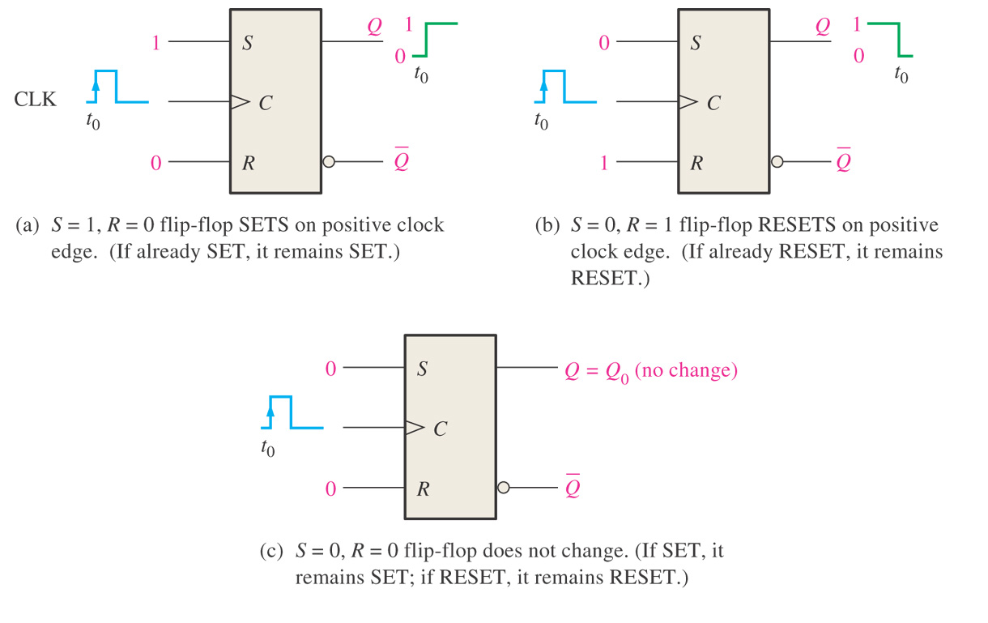
Sec.7.2 Edge-Triggered Flip-Flops
The Edge-Triggered S-R Flip-Flop
CHAPTER 7

Slide 24
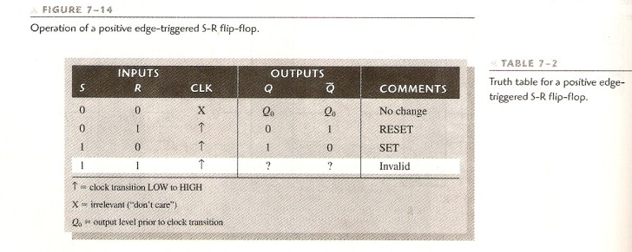
Sec.7.2 Edge-Triggered Flip-Flops
The Edge-Triggered S-R Flip-Flop
CHAPTER 7

Slide 25
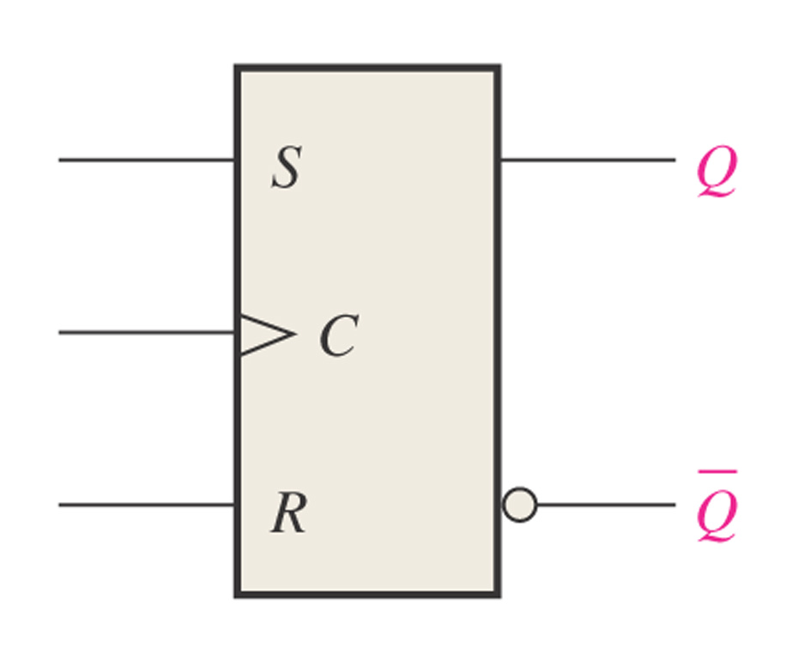
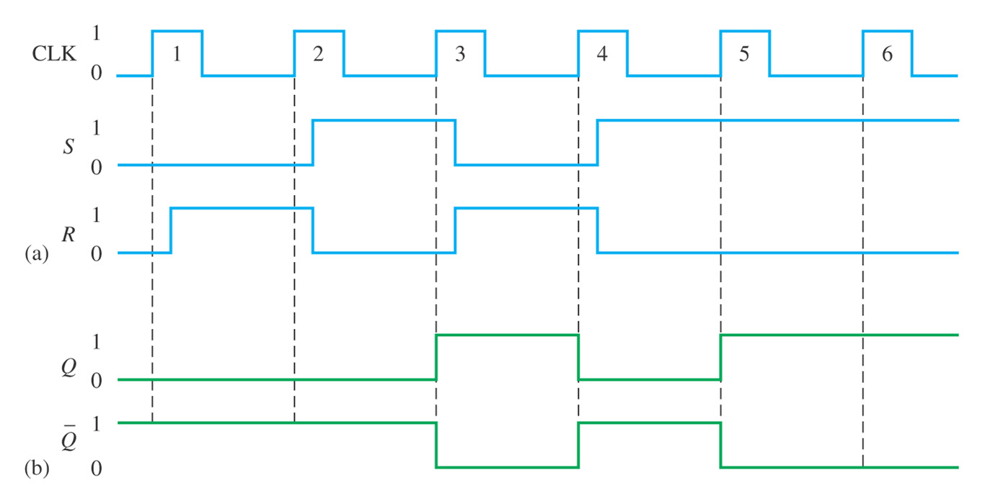
Sec.7.2 Edge-Triggered Flip-Flops
The Edge-Triggered S-R Flip-Flop
Example 7-4 Determine the Q and Q waveform.
CHAPTER 7

Slide 26
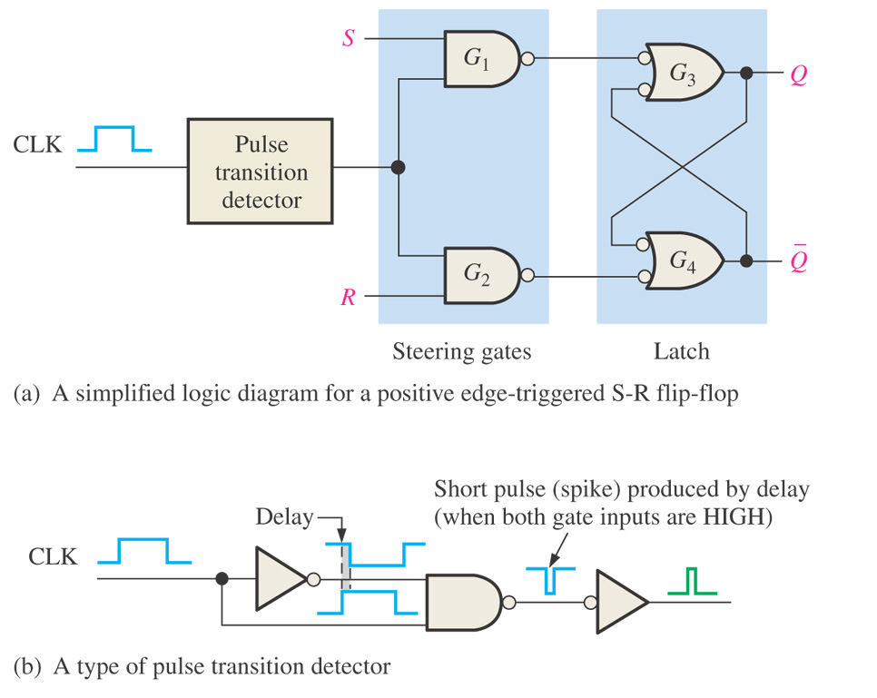
Sec.7.2 Edge-Triggered Flip-Flops
A Method of Edge-Triggering
CHAPTER 7

Slide 27
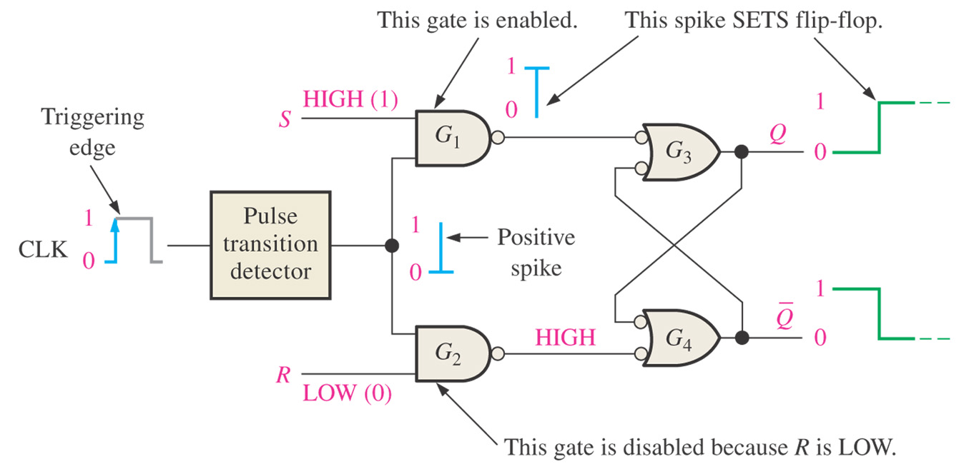
Sec.7.2 Edge-Triggered Flip-Flops
Figure 7–18 Flip-flop making a transition from the RESET state to the SET state on the positive-going edge of the clock pulse.
CHAPTER 7

Slide 28
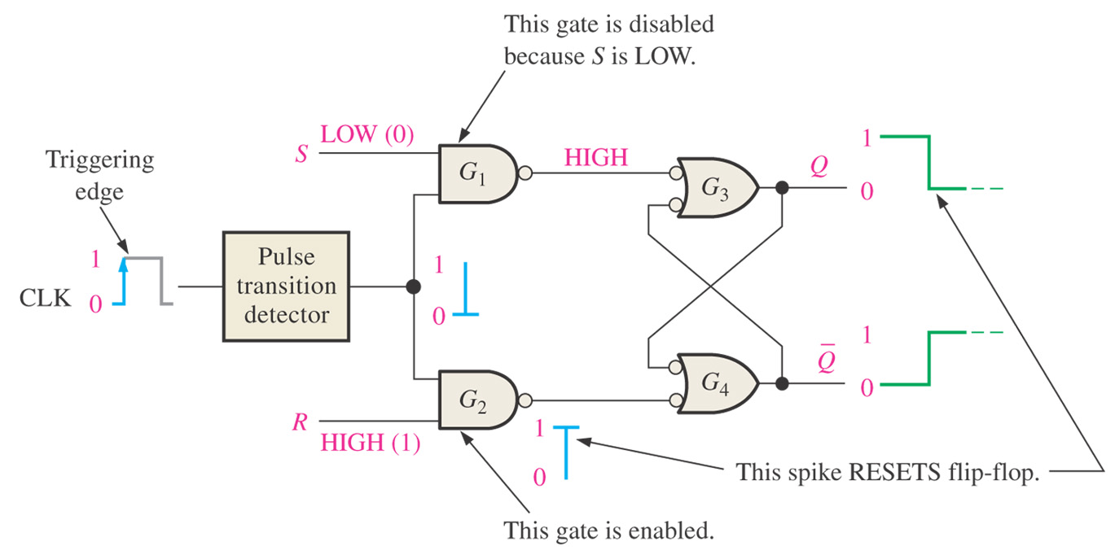
Sec.7.2 Edge-Triggered Flip-Flops
Figure 7–19 Flip-flop making a transition from the SET state to the RESET state on the positive-going edge of the clock pulse.
CHAPTER 7

Slide 29
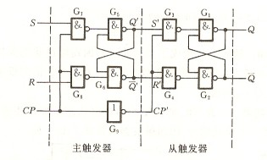
Sec.7.2 Edge-Triggered Flip-Flops
Another Method of Edge-Triggering
Master / Slave Flip-flop
CHAPTER 7

Slide 30
Sec.7.2 Edge-Triggered Flip-Flops
The Edge-Triggered D Flip-Flop
The Q output of a D flip-flop assume the state of the D input on the triggering edge of the clock.
The addition of an inverter to an S-R flip-flop creates a basic D
flip-flop.
CHAPTER 7

Slide 31
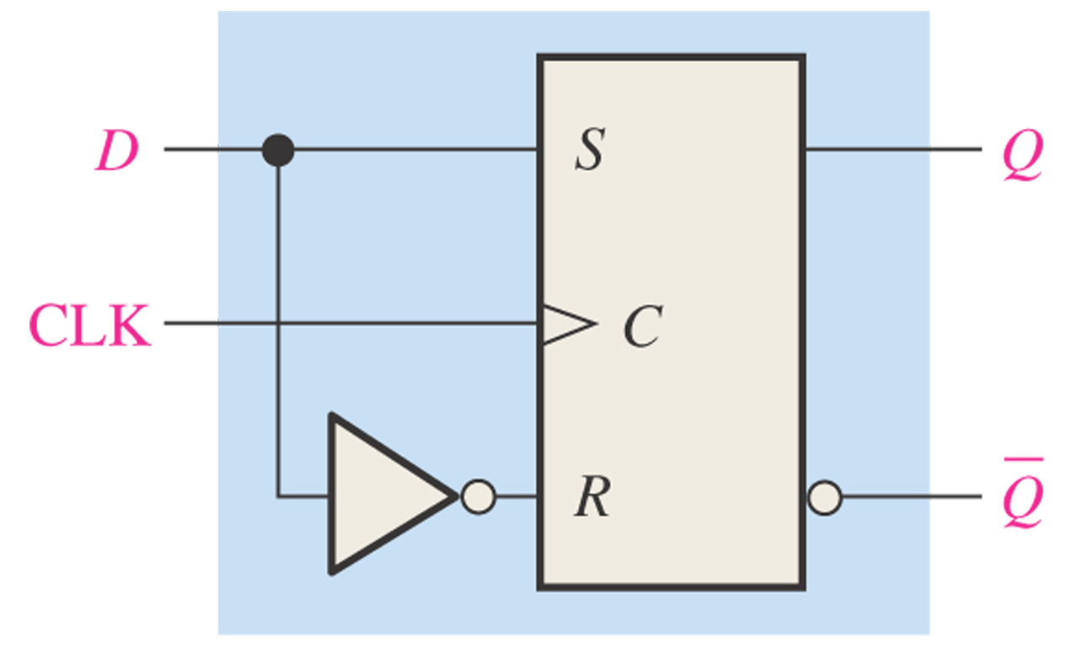
Sec.7.2 Edge-Triggered Flip-Flops
The Edge-Triggered D Flip-Flop
CHAPTER 7

Slide 32
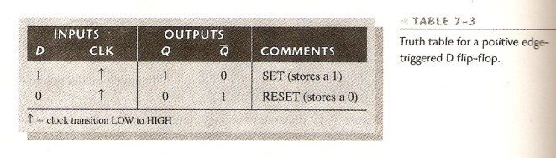
Sec.7.2 Edge-Triggered Flip-Flops
The Edge-Triggered D Flip-Flop
CHAPTER 7

Slide 33
Sec.7.2 Edge-Triggered Flip-Flops
The Edge-Triggered J-K Flip-Flop
The J-K flip-flop is versatile and is a widely used type of flip-flop. The functioning of the J-K flip-flop is identical to that of the S-R flip-
flop in the SET, RESET, and no-change conditions of operation.
The difference is that the J-K flip-flop has no invalid state.
CHAPTER 7

Slide 34
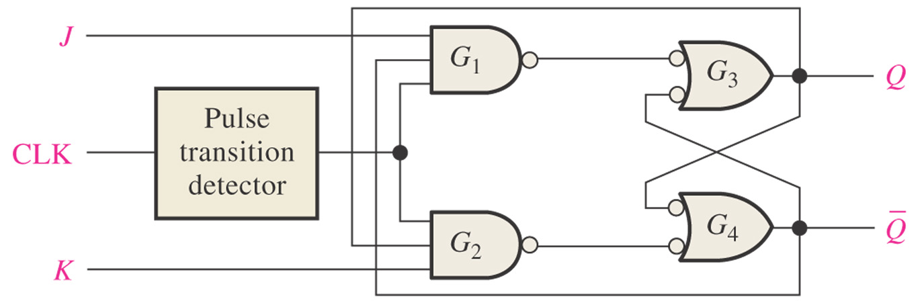
Sec.7.2 Edge-Triggered Flip-Flops
The Edge-Triggered J-K Flip-Flop
Figure 7–22 A simplified logic diagram for a positive edge-triggered J-K flip-flop.
CHAPTER 7

Slide 35
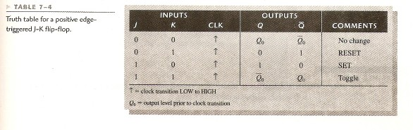
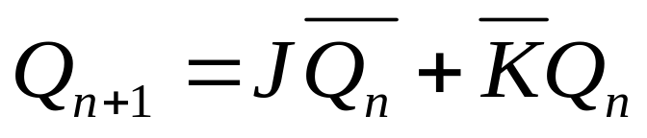
Sec.7.2 Edge-Triggered Flip-Flops
The Edge-Triggered J-K Flip-Flop
CHAPTER 7

Slide 36
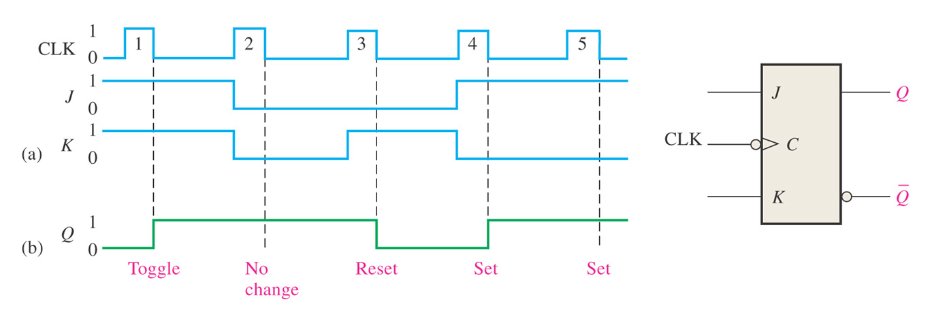
Sec.7.2 Edge-Triggered Flip-Flops
The Edge-Triggered J-K Flip-Flop
Example 7-6 Determine the Q output waveform according to the inputs waveform.
CHAPTER 7

Slide 37
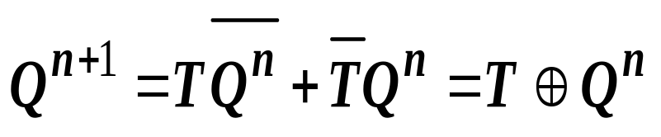
Sec.7.2 Edge-Triggered Flip-Flops
The Edge-Triggered T Flip-Flop
T flip-flop function description
Truth table
Behavioral table
Q^{n} T Q^{n+1}
T Q^{n+1}
0 Q^{n}
1 Q^{n}
0 0 0
0 1 1
0 1
1 1 0
Behavioral function
CHAPTER 7

Slide 38
Sec.7.2 Edge-Triggered Flip-Flops
Asynchronous Preset and Clear Inputs
Most integrated circuit flip-flops also have asynchronous inputs. These inputs that affect the state of the flip-flop independent of clock.
They are normally labeled preset (PRE) and clear (CLR).
CHAPTER 7

Slide 39
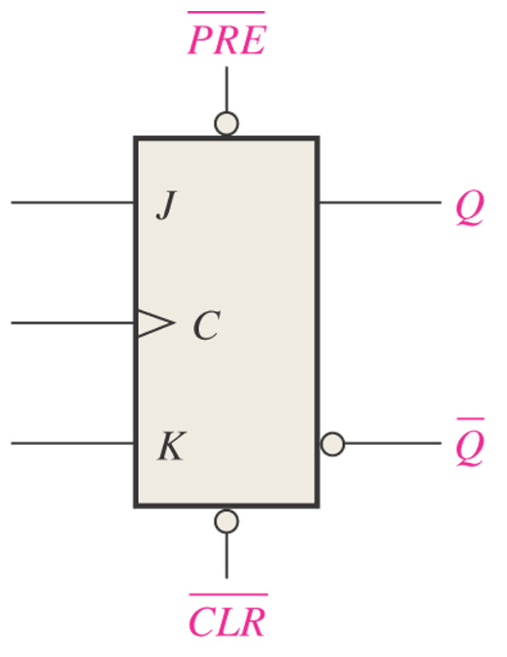
Sec.7.2 Edge-Triggered Flip-Flops
Asynchronous Preset and Clear Inputs
Figure 7–26 Logic symbol for a J-K flip-flop with active-LOW preset and clear inputs.
CHAPTER 7

Slide 40
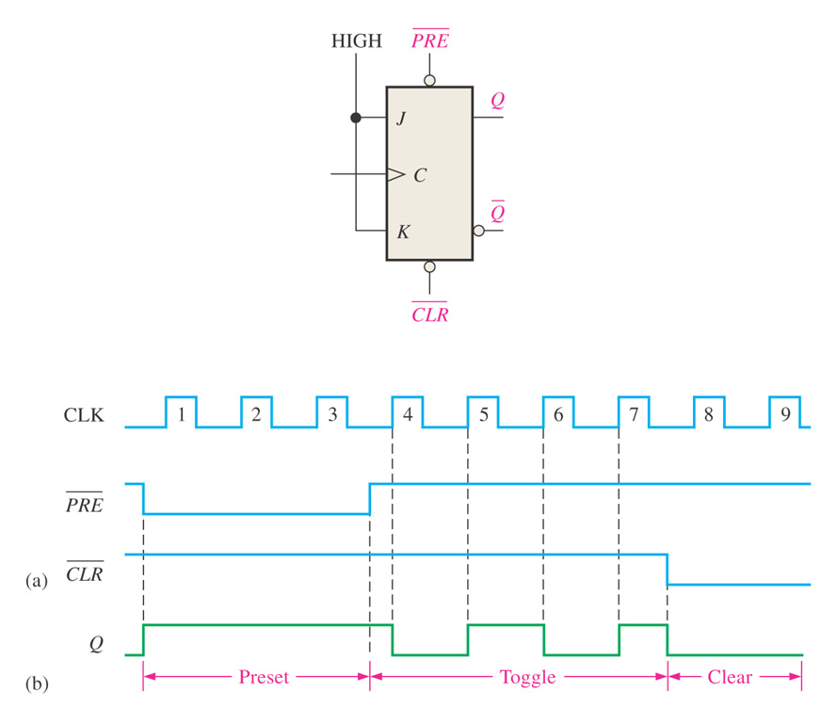
Sec.7.2 Edge-Triggered Flip-Flops
Asynchronous Preset and Clear Inputs
Example 7-8 For the positive edge-triggered J-K flip-flop with
preset and clear inputs in Figure 7-28, determine
the Q output.
CHAPTER 7

Slide 41
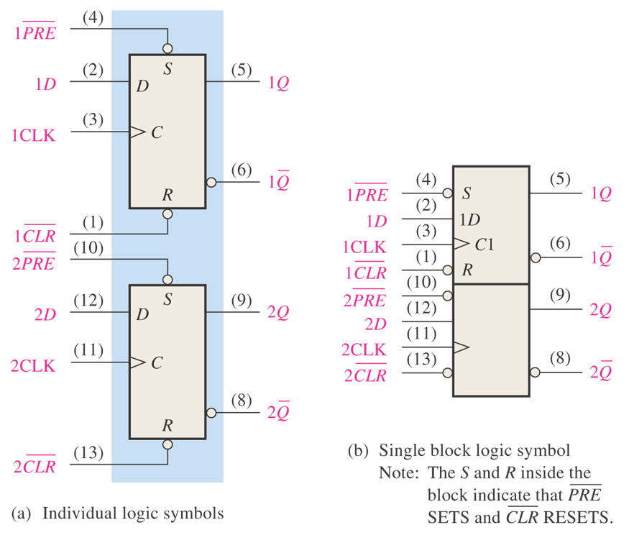
Sec.7.2 Edge-Triggered Flip-Flops
The 74HC74 Dual D Flip-Flop
CHAPTER 7

Slide 42
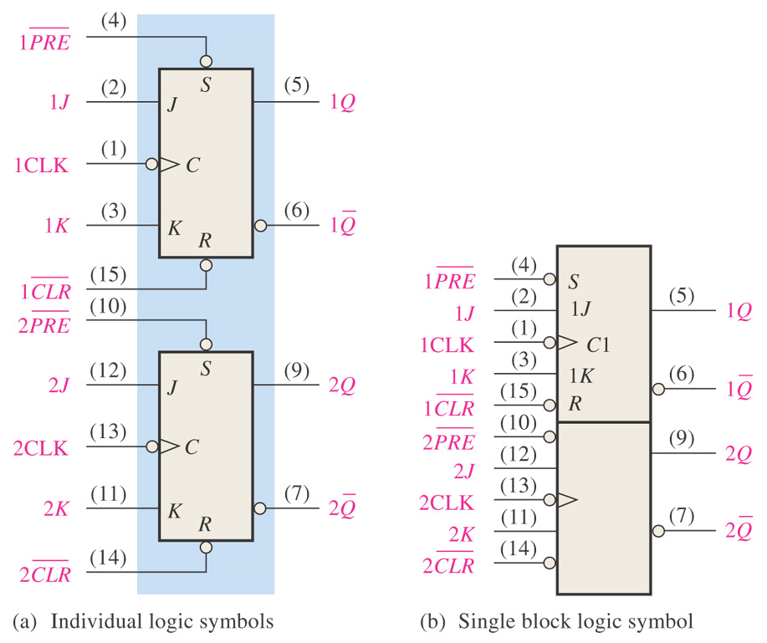
Sec.7.2 Edge-Triggered Flip-Flops
The 74HC112 Dual J-K Flip-Flop
CHAPTER 7

Slide 43
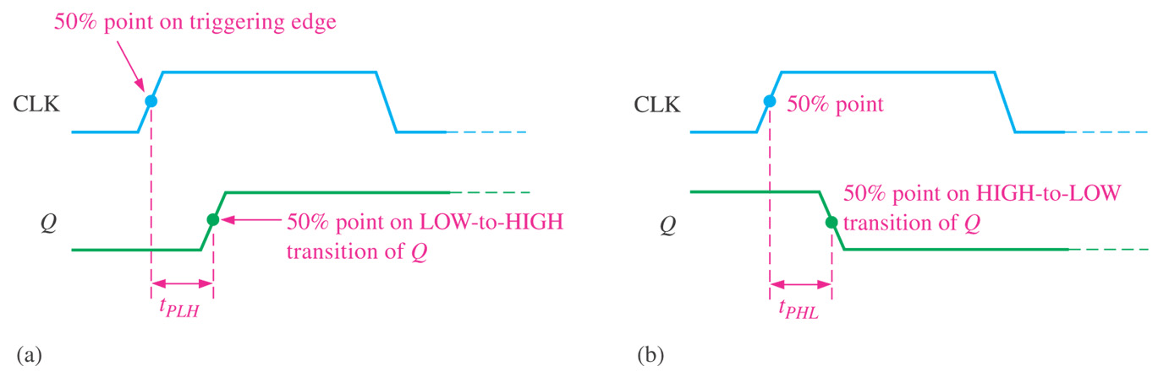
Sec.7.3 Flip-Flop Operating Characteristics
Propagation Delay Times
A propagation delay time is the interval of time required after an
input signal has been applied for the resulting output change to occur.
CHAPTER 7

Slide 44
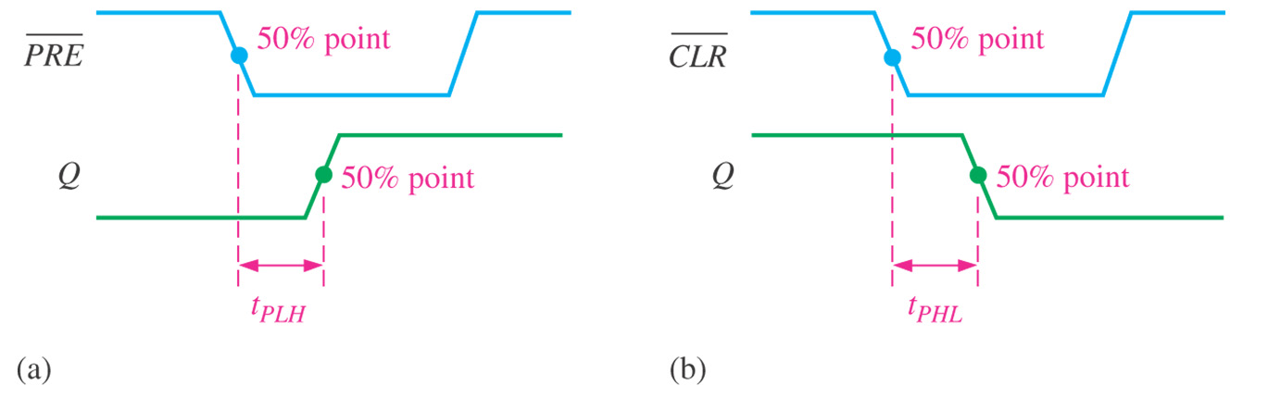
Sec.7.3 Flip-Flop Operating Characteristics
Propagation Delay Times
CHAPTER 7

Slide 45
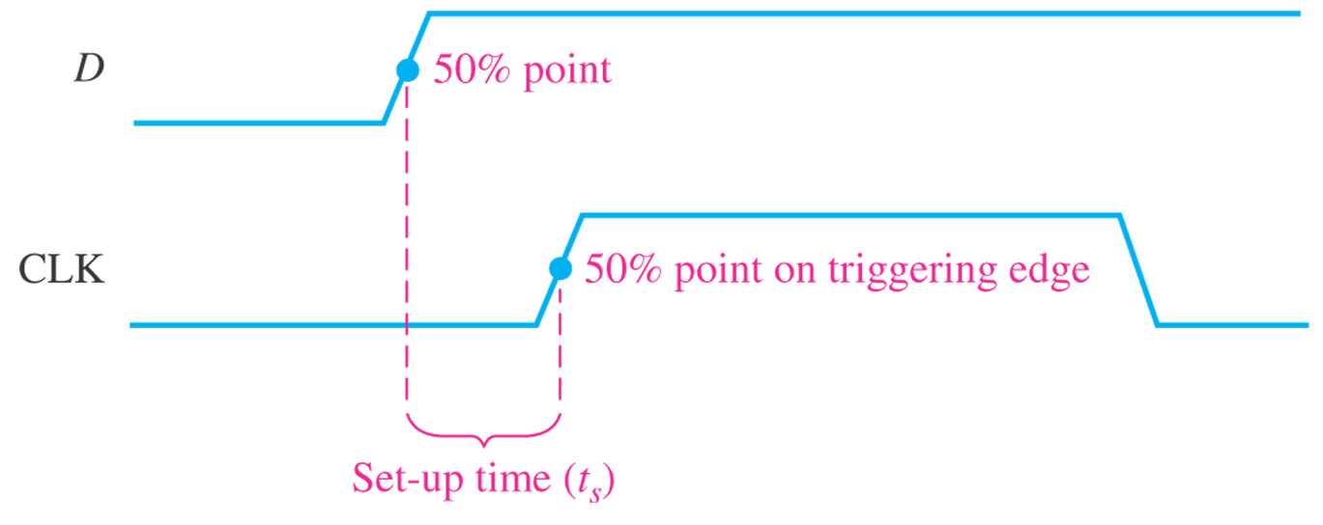
Sec.7.3 Flip-Flop Operating Characteristics
Set-up Time
The set-up time is the minimum interval required for the logic levels to be maintained constantly on the inputs prior to the triggering edge of the clock pulse in order for the levels to be reliably clocked into the flip-flop.
CHAPTER 7

Slide 46
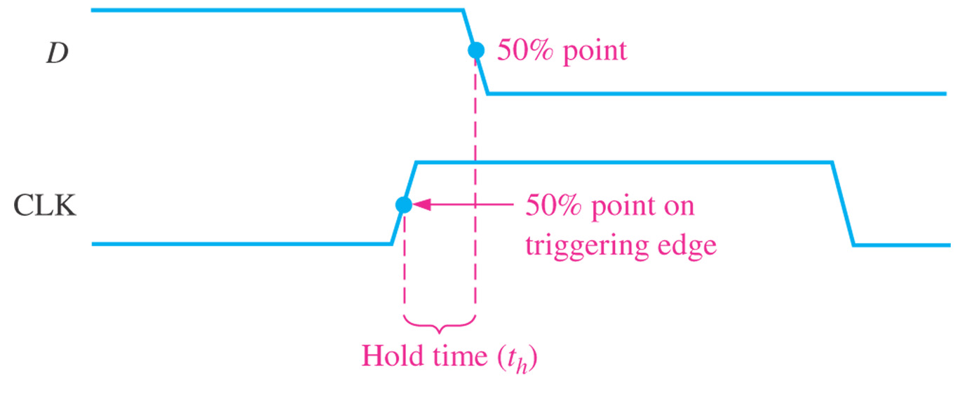
Sec.7.3 Flip-Flop Operating Characteristics
Hold Time
The hold time is the minimum interval required for the logic levels to remain on the inputs after the triggering edge of the clock pulse in
order for the levels to be reliably clocked into the flip-flop.
CHAPTER 7

Slide 47
Sec.7.3 Flip-Flop Operating Characteristics
Maximum Clock Frequency
The maximum clock frequency is the highest rate at which a flip-flop can be reliably triggered.
Pulse Widths
The minimum pulse widths for reliably operation are usually
specified by the manufacturer for the clock, preset, and clear inputs.
CHAPTER 7

Slide 48
Sec.7.3 Flip-Flop Operating Characteristics
Power Dissipation
The power dissipation of any digital circuit is the total power
consumption of the device.
The power dissipation is very important in most applications in
which the capacity of the dc supply is concern.
CHAPTER 7

Slide 49
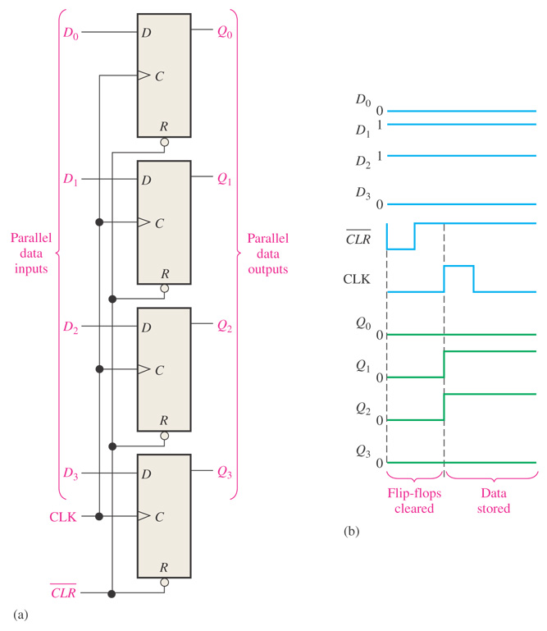
Sec.7.4 Flip-Flop Applications
Parallel Data Storage
A common requirement in digital systems is to store several bits of data from parallel lines simultaneously in a group of flip-
flops.
CHAPTER 7

Slide 50
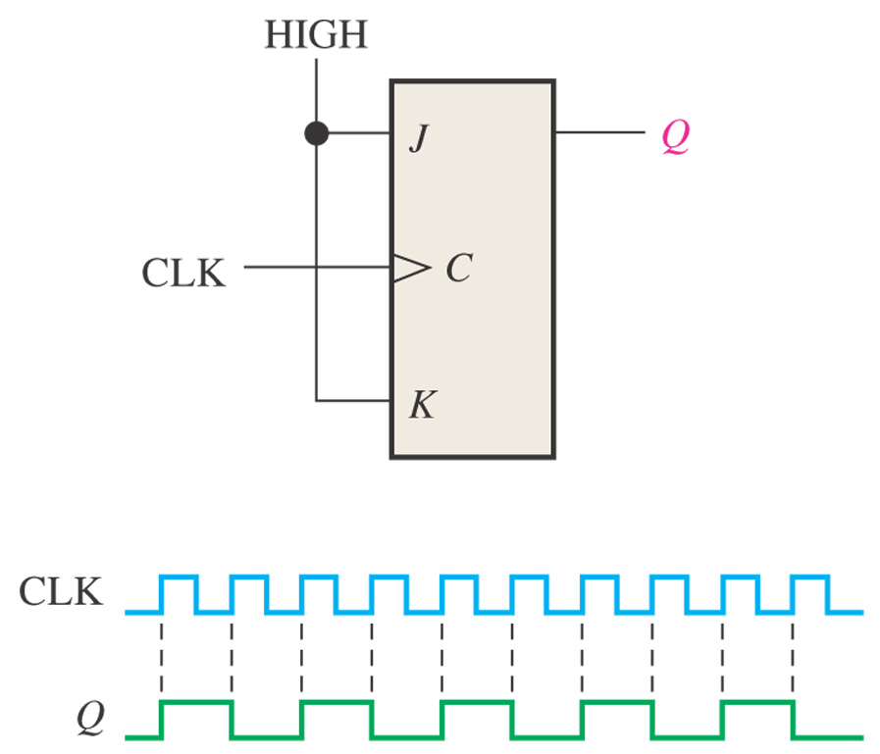
Sec.7.4 Flip-Flop Applications
Frequency Division
Dividing (reducing) the frequency of a periodic waveform
CHAPTER 7

Slide 51
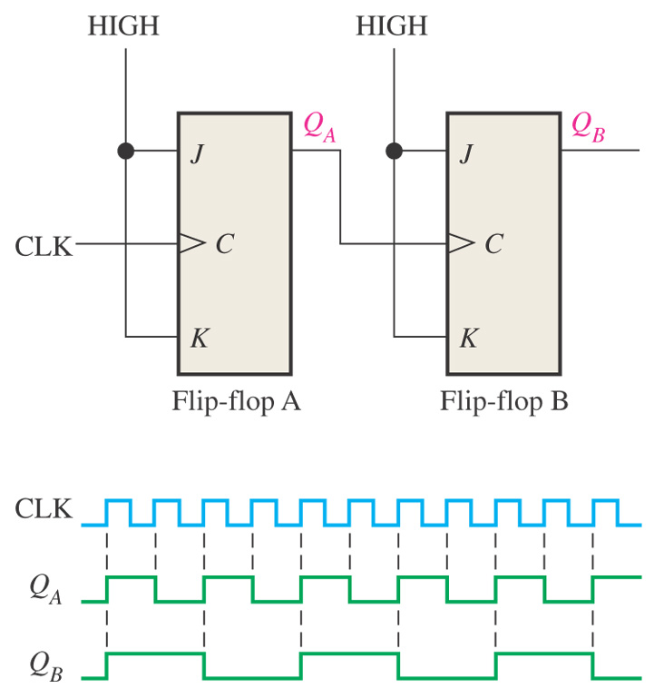
Sec.7.4 Flip-Flop Applications
Frequency Division
CHAPTER 7

Slide 52
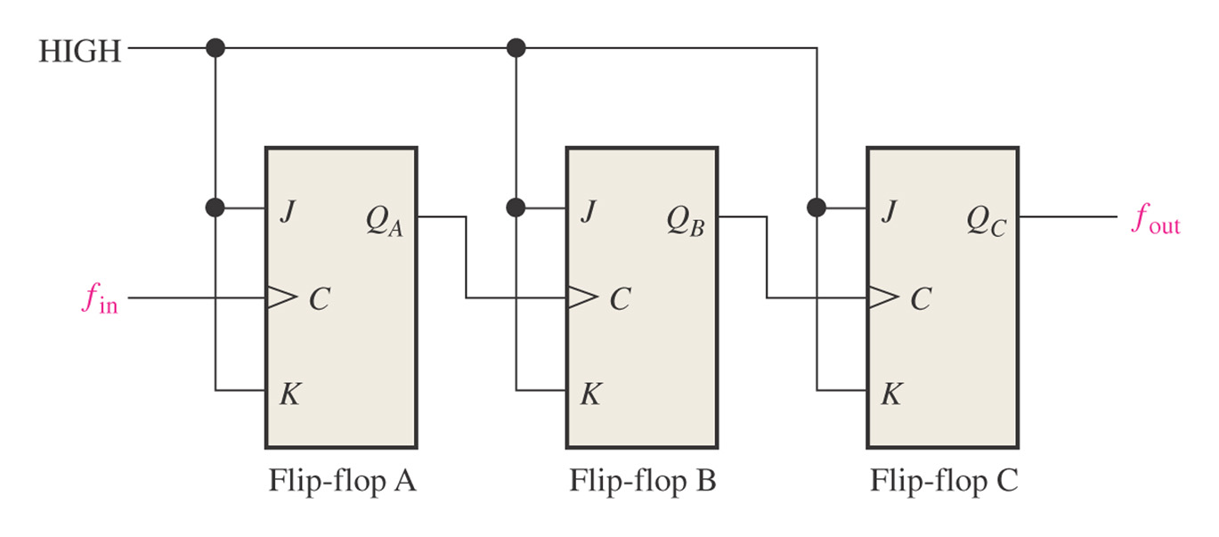
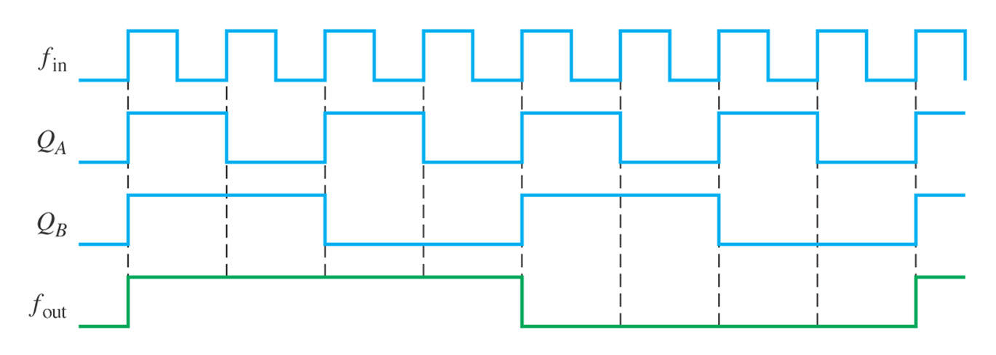
Sec.7.4 Flip-Flop Applications
Frequency Division
CHAPTER 7

Slide 53
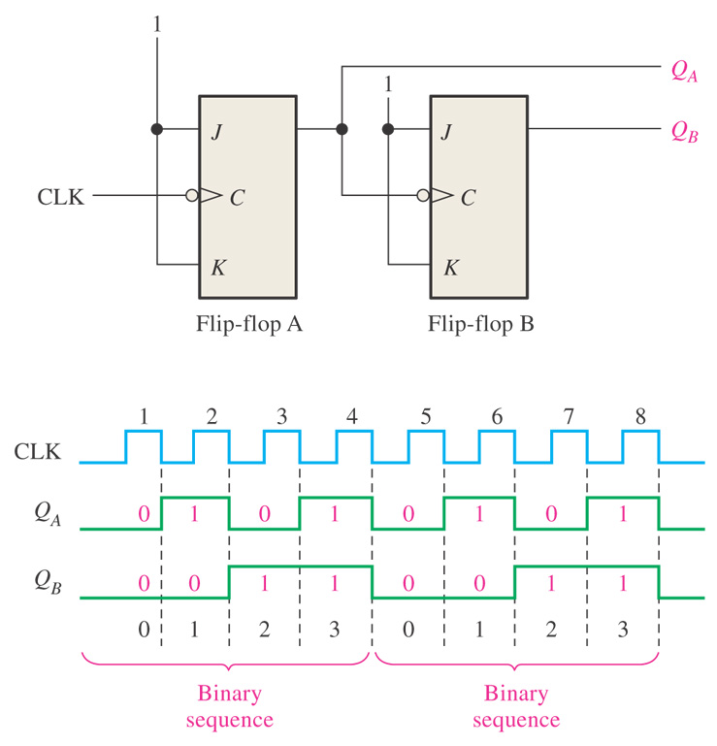
Sec.7.4 Flip-Flop Applications
Counting
Figure 7–41 Flip-flops used to generate a binary count sequence. Two repetitions (00, 01, 10, 11) are shown.
CHAPTER 7

Slide 54
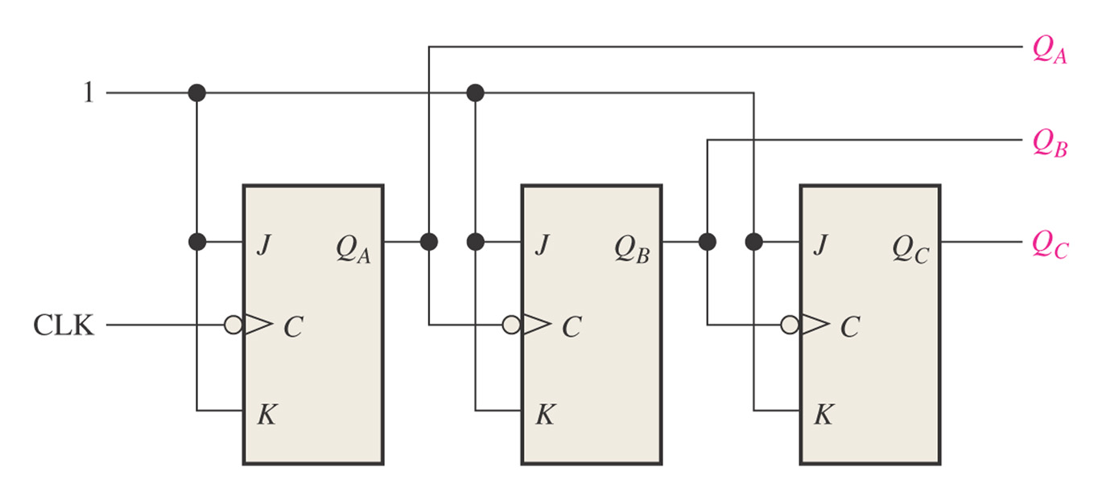
Sec.7.4 Flip-Flop Applications
Counting
Example 7-11 Determine the output waveforms.
CHAPTER 7

Slide 55
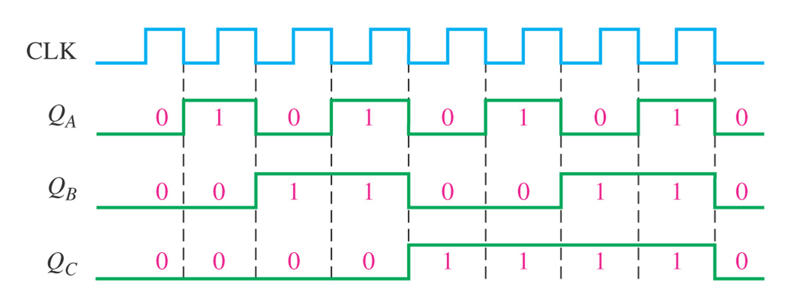
Sec.7.4 Flip-Flop Applications
Counting
CHAPTER 7

Slide 56
Homework
Using a chip of 74LS138 and a NAND gate to generate L=AB+AC+BC.
7. 4, 7.7, 7.9, 7.14

Slide 57
Next Lesson
8.1~8.5

