Slide 1

科技论文的阅读与写作
赖韩江
中山大学
http://www.scholat.com/laihanj
邮箱：laihanj3@mail.sysu.edu.cn

Slide 2
提纲
Semi-supervised Learning with GAN
方法部分--写作

Slide 3
阅读资料
A Short Introduction to Generative Adversarial Networks
Semi-supervised Learning with GANs

Slide 4
阅读资料
Li C, Xu K, Zhu J, et al. Triple generative adversarial nets[C]//Advances in Neural Information Processing Systems. 2017.
Dai Z, Yang Z, Yang F, et al. Good semi-supervised learning that requires a bad gan[C]//Advances in Neural Information Processing Systems. 2017: 6510-6520.
Mirza M, Osindero S. Conditional generative adversarial nets[J]. arXiv preprint arXiv:1411.1784, 2014

Slide 5




Semi-supervised Learning
Supervised Learning
Semi-supervised Learning
Unsupervised Learning
带标记的数量多， n: large
n: small value

Slide 6
Motivation
GAN can capture the underlying distributions of the data and synthesize new samples
可不可以用GAN来提升效果？

Slide 7
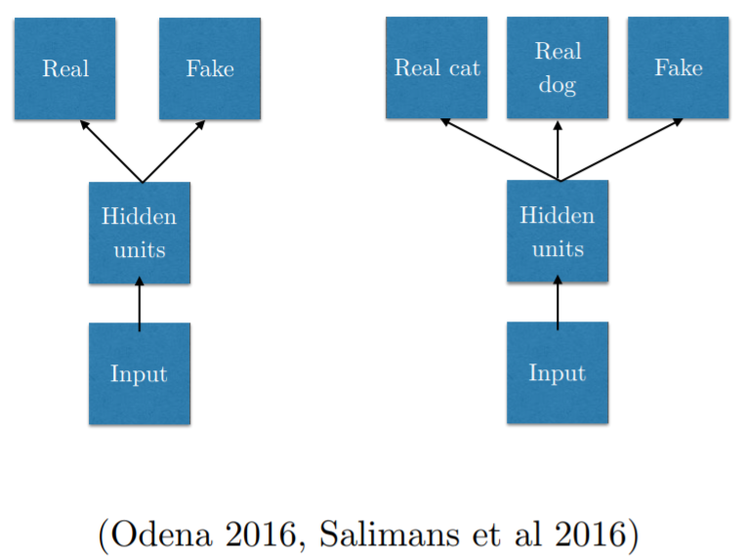
Related Work

Slide 8
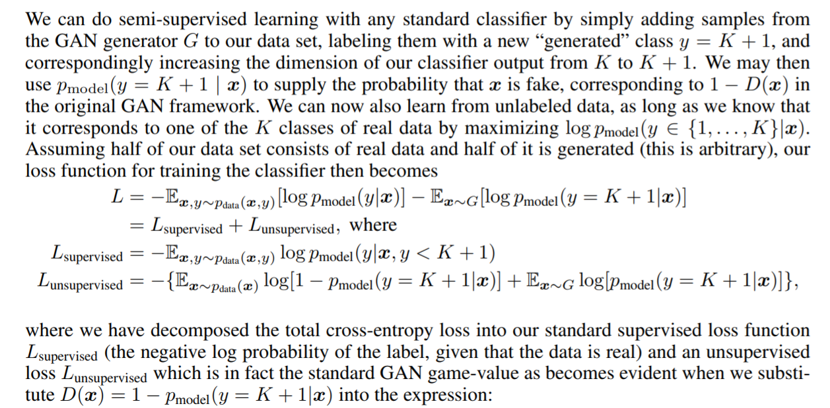
Related Work
Salimans T, Goodfellow I, Zaremba W, et al. Improved techniques for training gans[C]//Advances in Neural Information Processing Systems. 2016: 2234-2242.

Slide 9
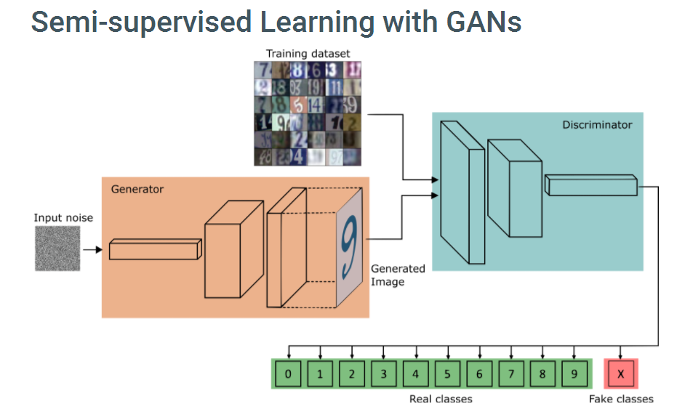
Related Work
Salimans T, Goodfellow I, Zaremba W, et al. Improved techniques for training gans[C]//Advances in Neural Information Processing Systems. 2016: 2234-2242.

Slide 10
Two problems
However, existing GANs in SSL have two problems:
  the generator and the discriminator (i.e. the classifier) may not be optimal at the same time;
  the generator cannot control the semantics of the generated samples.

Slide 11
Two problems
To solve two problems:
  (1) generator
  discriminator
  classifier
  (2) take a data-label pair as input.
  (see conditional GAN)

Slide 12
Triplet GAN
Triplet GAN
  Classifier: p(y|x)
  Generator: p(x|y)
  Discriminator: distinguishes whether a pair of data (x, y) comes from the true distribution p(x, y)

Slide 13
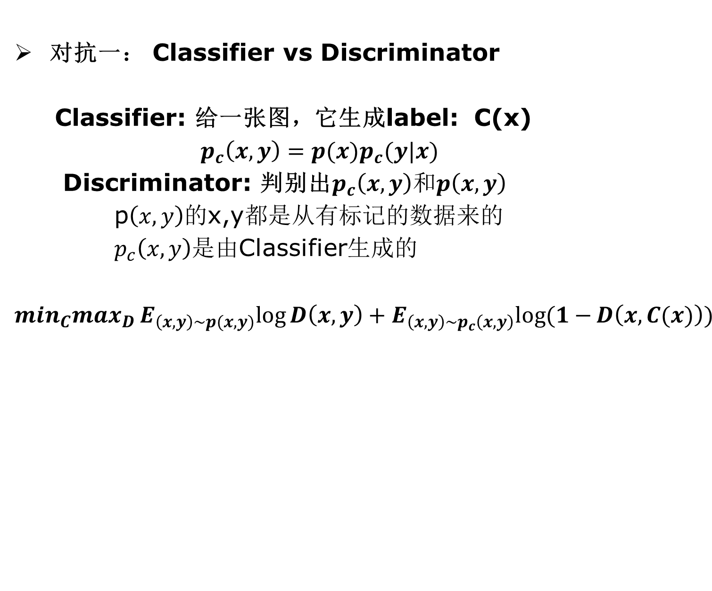
Triplet GAN

Slide 14
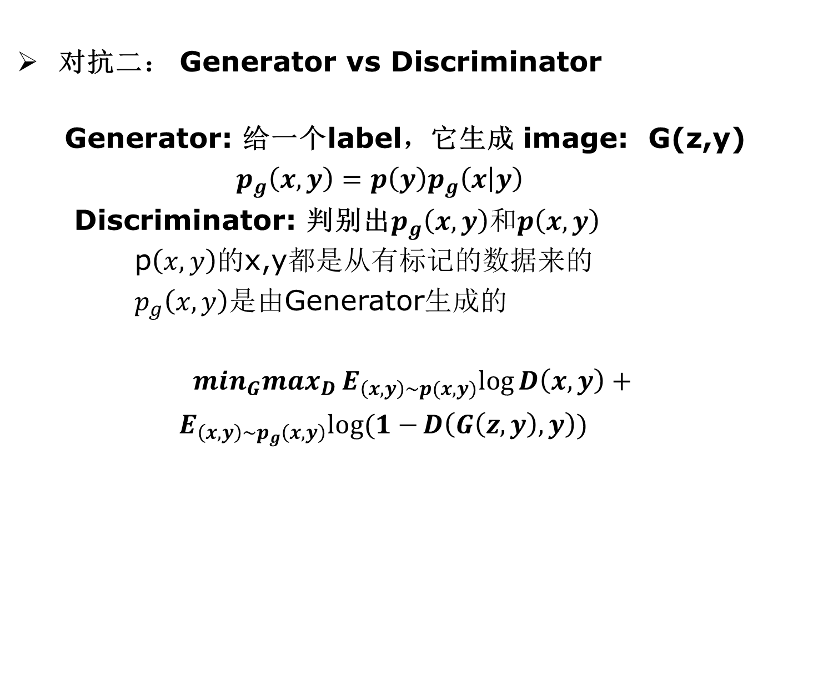
Triplet GAN

Slide 15
课后作业
Li C, Xu K, Zhu J, et al. Triple generative adversarial nets[C]//Advances in Neural Information Processing Systems. 2017.
扩展Triple GAN的方法部分
3 Method
3.1 A Game with Three Players
按期刊的方式去扩充内容。（会议扩期刊）
作业命名格式：学号_姓名_第x次作业.*

