Slide 1

科技论文的阅读与写作
赖韩江
中山大学
http://www.scholat.com/laihanj
邮箱：laihanj3@mail.sysu.edu.cn

Slide 2
提纲
Semi-supervised Learning with GAN
Abstract、Introduction-提出问题

Slide 3
阅读资料
Li C, Xu K, Zhu J, et al. Triple generative adversarial nets[C]//Advances in Neural Information Processing Systems. 2017.
Dai Z, Yang Z, Yang F, et al. Good semi-supervised learning that requires a bad gan[C]//Advances in Neural Information Processing Systems. 2017: 6510-6520.
Zheng Z, Zheng L, Yang Y. Unlabeled samples generated by gan improve the person re-identification baseline in vitro. arXiv preprint arXiv:1701.07717, 2017, 3.

Slide 4
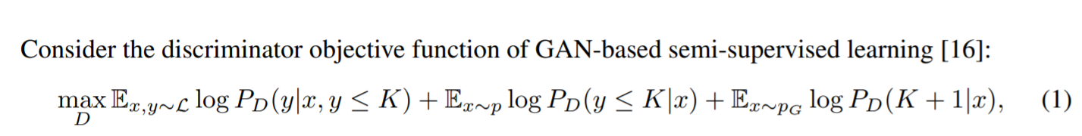
复习：SSL

Slide 5
复习：Triple GAN
Triplet GAN
  Classifier
  Generator
  Discriminator
Two problems:
  the generator and the discriminator (i.e. the classifier) may not be optimal at the same time;
  the generator cannot control the semantics of the generated samples.

Slide 6
复习Triple GAN
Triplet GAN
  它解决了什么
  有哪些没有解决
  没有更好地利用生成的图像（将生成的图像认为是k+1类？）

Slide 7
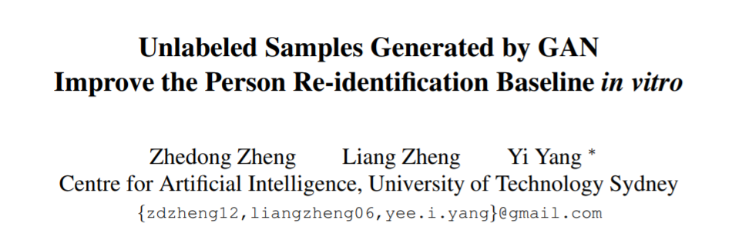
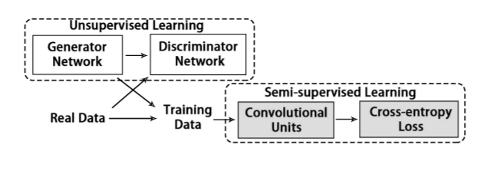
如何利用生成图像

Slide 8
半监督算法问题
问题
  It is challenging in 1) how to obtain more training data only from the training set and 2) how to use the newly generated data
GAN -> 生成更多数据
label smoothing regularization -> use data

Slide 9
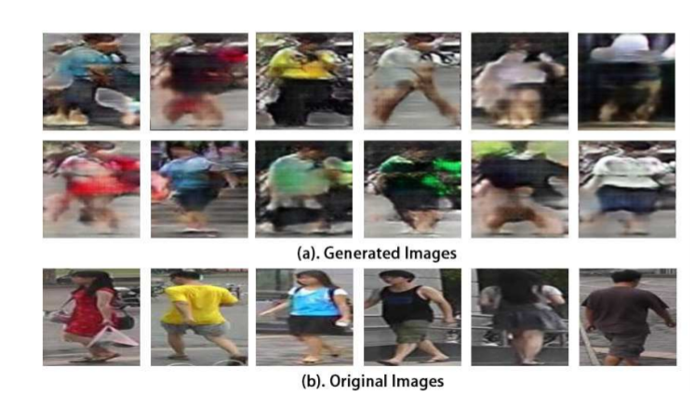
算法步骤
GAN -> 生成更多数据

Slide 10
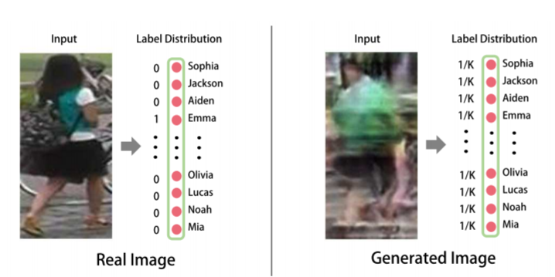
算法步骤
label smoothing regularization

Slide 11
算法步骤
为什么可以这么做？
Dai Z, Yang Z, Yang F, et al. Good semi-supervised learning that requires a bad gan[C]//Advances in Neural Information Processing Systems. 2017: 6510-6520.

Slide 12
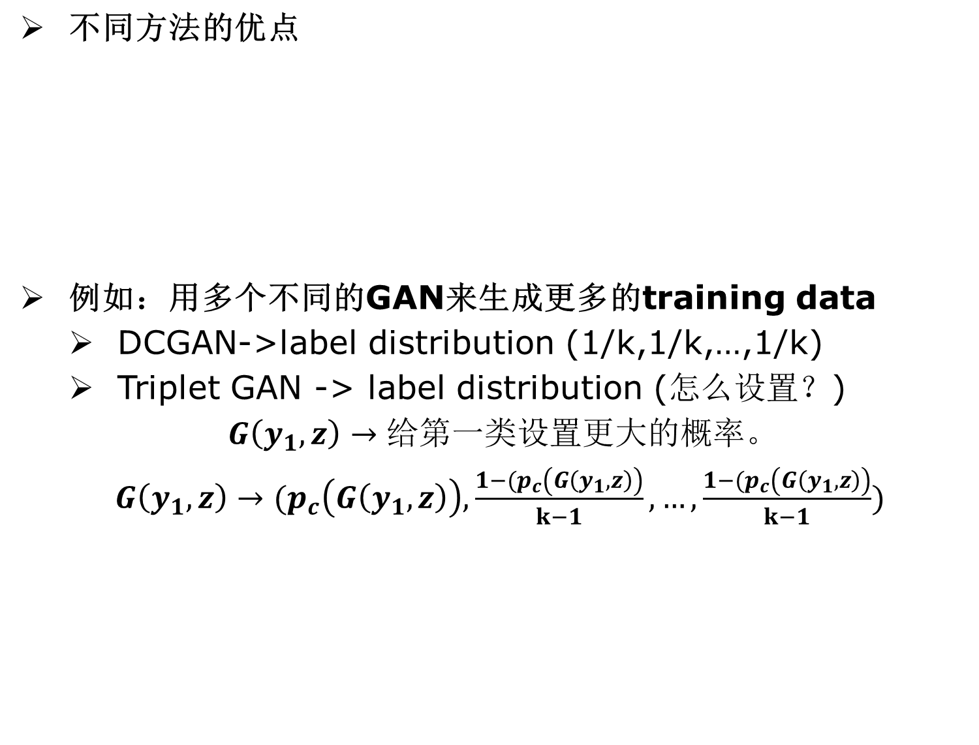
组合
 | Triple GAN | LSR
优点 | can control the semantics of the generated samples G(y,z) | Obtain and use more training data G(z)

Slide 13
作业
摘要、介绍 两部分写作
  按摘要和介绍的格式（1-2页）
  提出自己的新想法

Slide 14
摘要
摘要
  指南：好摘要要起到让读者在短时间内了解论文内容，起到导读作用
  名片：将论文中最闪光的部分呈现给读者
  地图：摘要是论文数据库的检索数据源，好的摘要可以帮助人们准确地找到相看的论文

Slide 15
摘要
报到性摘要
  它将创新点全部列出，简要概括研究目的、方法、结果、结论，并带有定性、定量信息，约200-300字
  作用：读后，基本可了解全文重要内容

Slide 16
摘要
常见摘要结构
  Problem-solution-results-conclusions
  直接跟目的、方法、结果、结论对应。Problem从问题角度给出了研究的目的，就是要解决什么问题。其它部分给出了解决方案、结果与结论。
  Introduction-problem-solution-evaluation-conclusions
  增加了简洁的背景知识。Evaluation对方法进行定量和定性的分析
  Problem-solution-Evaluation
  简洁

Slide 17
摘要1
Abstract. We present FusedGAN, a deep network for conditional image synthesis with controllable sampling of diverse images. Fidelity, diversity and controllable sampling are the main quality measures of a good image generation model. Most existing models are insufficient in all three aspects. The FusedGAN can perform controllable sampling of diverse images with very high fidelity. We argue that controllability can be achieved by disentangling the generation process into various stages. In contrast to stacked GANs, where multiple stages of GANs are trained separately with full supervision of labeled intermediate images, the FusedGAN has a single stage pipeline with a built-in stacking of GANs.

Slide 18
摘要1
Unlike existing methods, which require full supervision with paired conditions and images, the FusedGAN can effectively leverage more abundant images without corresponding conditions in training, to produce more diverse samples with high fidelity. We achieve this by fusing two generators: one for unconditional image generation, and the other for conditional image generation, where the two partly share a common latent space thereby disentangling the generation. We demonstrate the efficacy of the FusedGAN in fine grained image generation tasks such as text-to-image,and attribute-to-face generation.

Slide 19
摘要2
Visual object tracking is a fundamental and time critical vision task. Recent years have seen many shallow tracking methods based on real-time pixel-based correlation filters, as well as deep methods that have top performance but need a high-end GPU. In this paper, we learn to improve the speed of deep trackers without losing accuracy. Our fundamental insight is to take an adaptive approach, where easy frames are processed with cheap features (such as pixel values), while challenging frames are processed with invariant but expensive deep features.

Slide 20
摘要2
We formulate the adaptive tracking problem as a decision-making process, and learn an agent to decide whether to locate objects with high confidence on an early layer, or continue processing subsequent layers of a network. This significantly reduces the feed-forward cost for easy frames with distinct or slow-moving objects. We train the agent offline in a reinforcement learning fashion, and further demonstrate that learning all deep layers (so as to provide good features for adaptive tracking) can lead to near real-time average tracking speed of 23 fps on a single CPU while achieving state-of-the-art performance. Perhaps most tellingly, our approach provides a 100X speedup for almost 50% of the time, indicating the power of an adaptive approach.

Slide 21
摘要3
Abstract. While deeper convolutional networks are needed to achieve maximum accuracy in visual perception tasks, for many inputs shallower networks are sufficient. We exploit this observation by learning to skip convolutional layers on a per-input basis. We introduce SkipNet, a modified residual network, that uses a gating network to selectively skip convolutional blocks based on the activations of the previous layer. We formulate the dynamic skipping problem in the context of sequential decision making and propose a hybrid learning algorithm that combines supervised learning and reinforcement learning to address the challenges of non-differentiable skipping decisions. We show SkipNet reduces computation by 30 − 90% while preserving the accuracy of the original model on four benchmark datasets and outperforms the state-of-the-art dynamic networks and static compression methods. We also qualitatively evaluate the gating policy to reveal a relationship between image scale and saliency and the number of layers skipped.

Slide 22
摘要
避免下面的摘要
  残缺摘要：例如只给出研究的问题，读者很难判断论文的价值。问题、方法、结果不完整，读者搞不清楚论文是做什么的。
  外星摘要：大量使用自造的术语、生僻的缩略语、符号定义，甚至引用参考文献。注意，在不查阅其它文献或资料下，读者也要能读懂。
  唐曾摘要：太啰嗦
  科普摘要：花大多的内容去介绍背景知识。

