Slide 1
Interpolation and Polynomial Approximation
--------Chebyshev Polynomials

Slide 2
Review
In cases where data are known to a high degree of precision, the collocation(组合) polynomial is sometimes used to find a polynomial that passes through the given data points. A variety of methods can be used to construct the collocation polynomial:
Solving a linear system for its coefficients
The use of Lagrange coefficient polynomials
The construction of a divided differences table and the coefficients of the Newton polynomial
Chebyshev Polynomials

Slide 3
Main Point
Properties of Chebyshev Polynomials
Chebyshev’s effort on minimizing the upper bound for |EN (x)|.
Transform the Interval to achieve Lagrange-Chebyshev Approximation Polynomial
Chebyshev Approximation

Slide 4

PART I
Properties of Chebyshev Polynomials

Slide 5
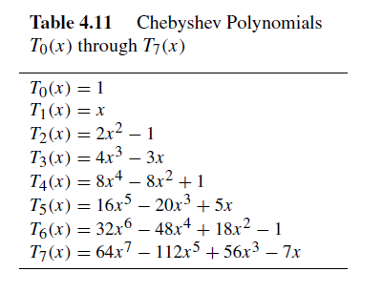
The first eight Chebyshev polynomials listed in Table 4.11. (P133 Table 3.11)

Slide 6
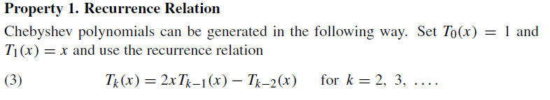
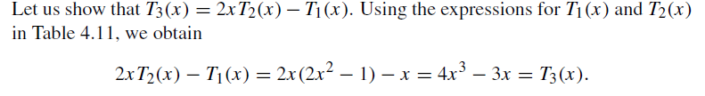
Properties of Chebyshev Polynomials
Property 1 is often used as the definition for higher-order Chebyshev polynomials.

Slide 7
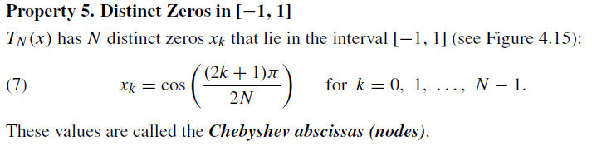

Slide 8
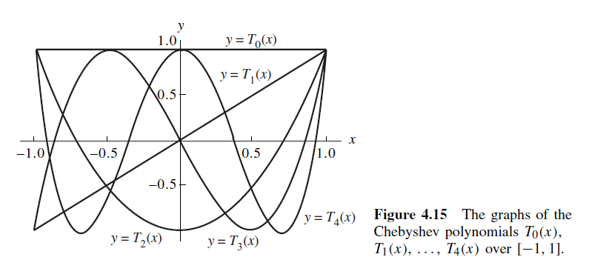
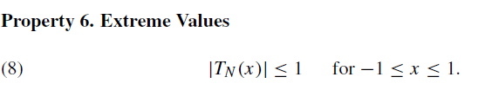

Slide 9
PART II
Chebyshev’s effort on minimizing the upper bound for |EN (x)|.

Slide 10
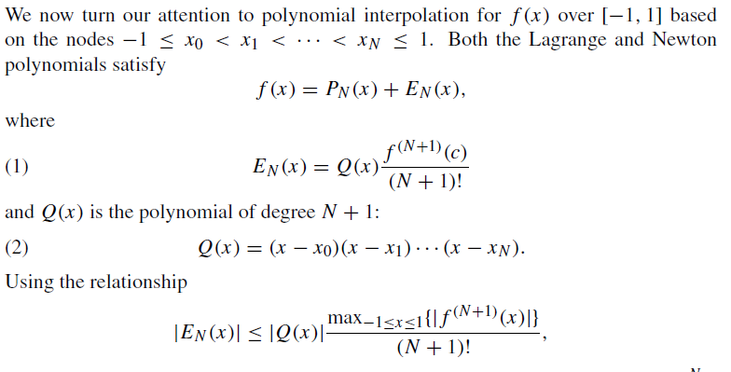
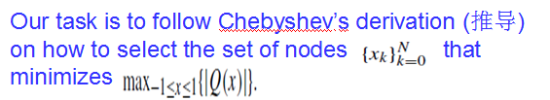
Minimax

Slide 11
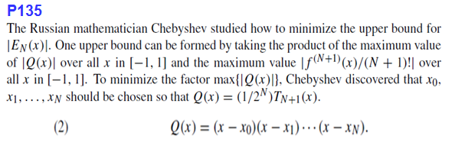
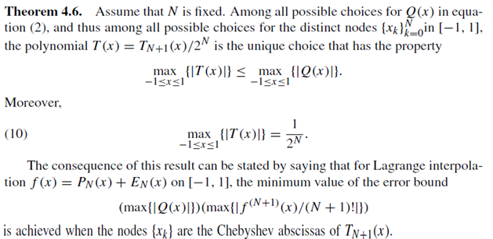

Slide 12
As an illustration, we look at the Lagrange coefficient polynomials that are used in forming P3(x). Recall that the Lagrange polynomial of degree N = 3 has the form:

Slide 13
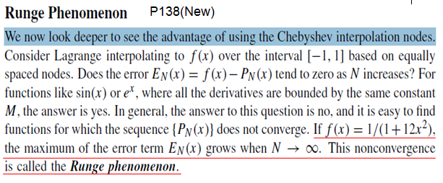

Slide 14
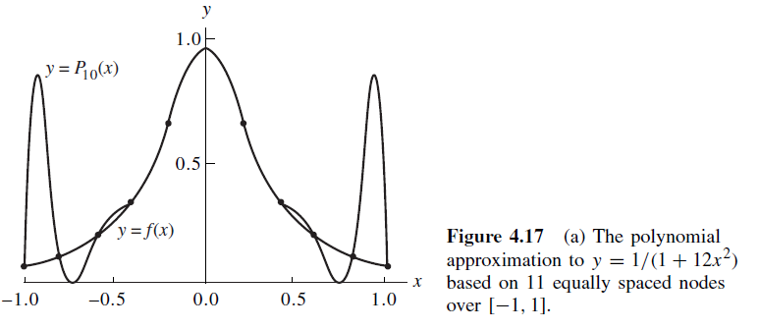
Wild oscillations occur near the end of the interval. If the number of nodes is increased, then the oscillations become larger. This problem occurs because the nodes are equally spaced!

Slide 15
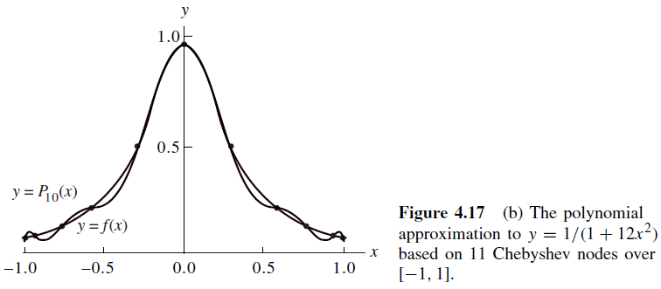
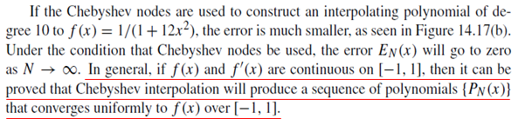

Slide 16
PART III
Transform the Interval to achieve Lagrange-Chebyshev Approximation Polynomial

Slide 17
PART IV
Chebyshev Approximation

