Slide 1
Eigenvalues and Eigenvectors
(Page 585)

Slide 2
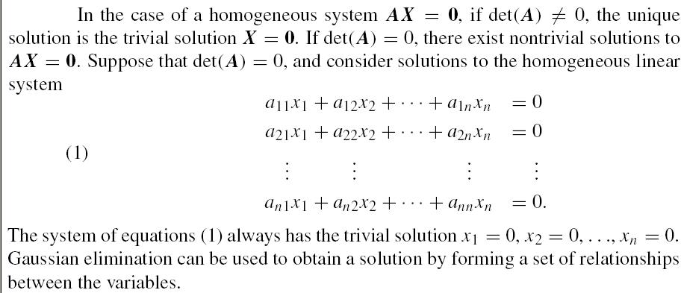
Homogeneous System (p586)

Slide 3
Reading
Page 586 – Example 11.1

Slide 4
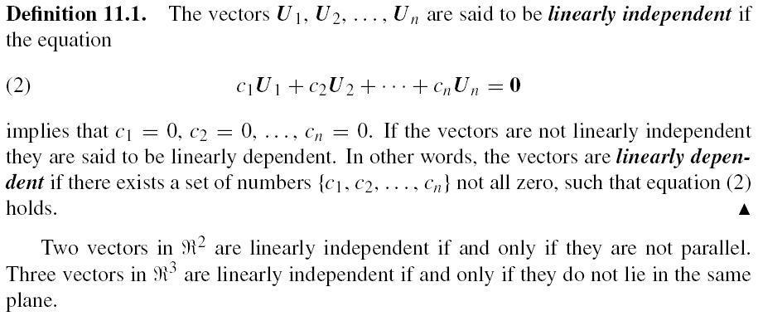
Linearly independent (p587)

Slide 5
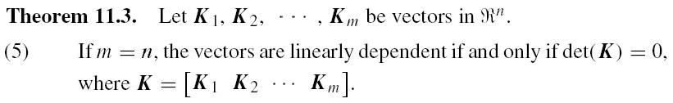
Linearly independent (p588)

Slide 6
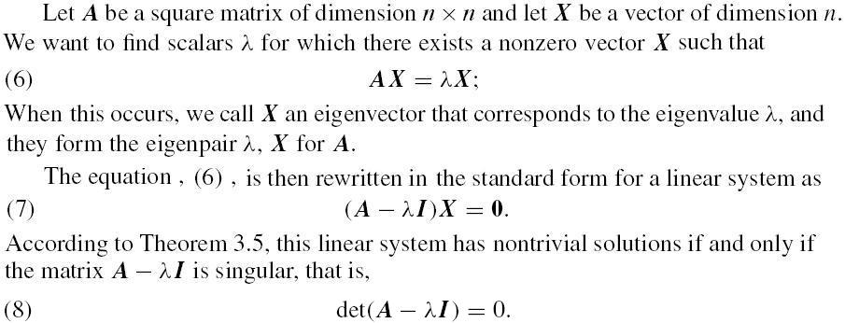
Eigenvalue and Eigenvector (p588)

Slide 7
Reading
Page 590 – Example 11.2

Slide 8
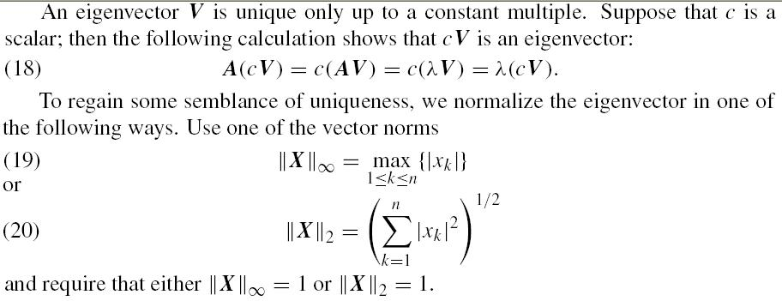
Uniqueness of eigenvectors (p592)

Slide 9
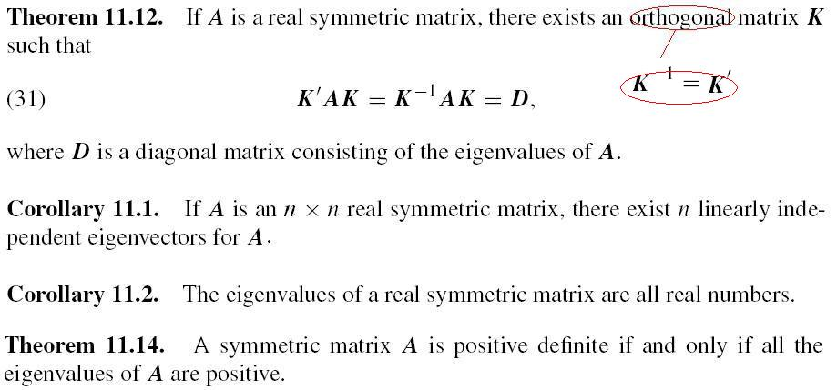
Diagonalizable

Slide 10
Home Assignment
Page 597 – Exercise 1(d)

Slide 11
Power Method
Tthe power method for computing the dominant eigenpair.
Its extension to the inverse power method is practical for finding any eigenvalue provided that a good initial approximation is known.
Some schemes for finding eigenvalues use other methods that converge fast, but have limited precision.
The inverse power method is then invoked to refine the numerical values and gain full precision.

Slide 12

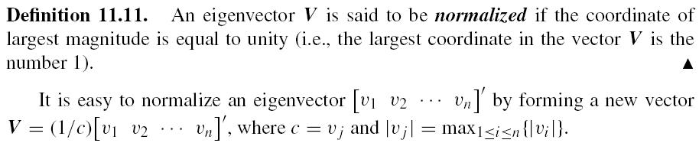
Concepts (p598)

Slide 13
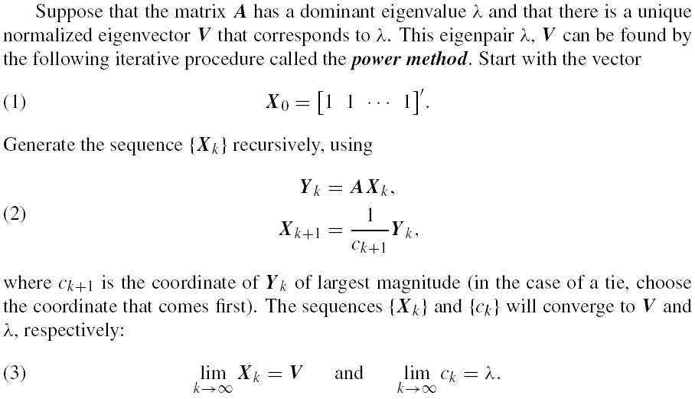
Power Method

Slide 14
Reading
Page 599 – Example 11.5

Slide 15
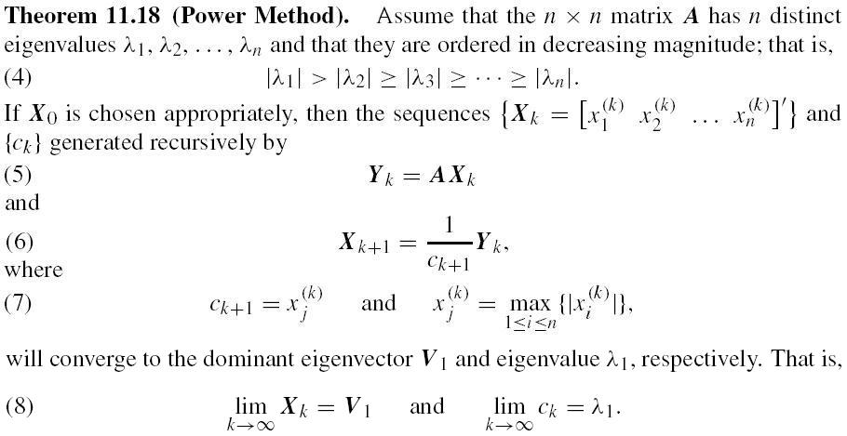
Power Method (P600)

Slide 16
Shifted-Inverse Power Method
The shifted inverse power method requires a good starting approximation for an eigenvalue, and then iteration is used to obtain a precise solution.
Other procedures such as the QM and Givens’ method are used first to obtain the starting approximations.
Cases involving complex eigenvalues, multiple eigenvalues, or the presence of two eigenvalues with the same magnitude or approximately the same magnitude will cause computational difficulties and require more advanced methods.
Our illustrations will focus on the case where the eigenvalues are distinct.

Slide 17
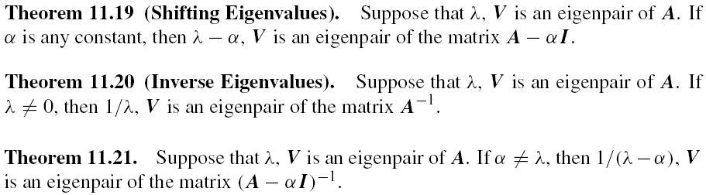
Page 603

Slide 18
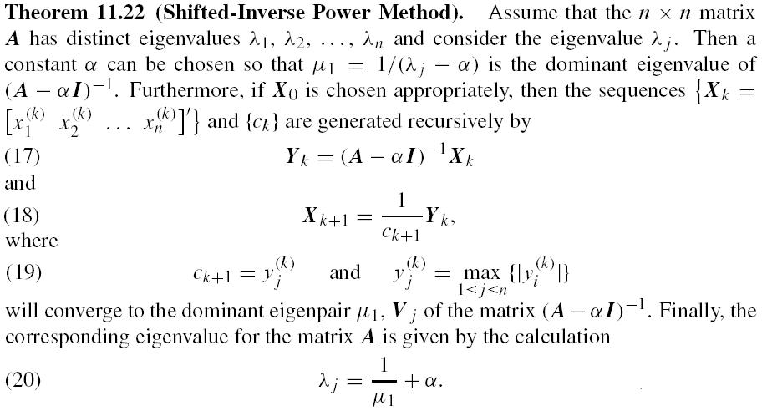
Shifted-Inverse Power Method

Slide 19
Reading
Page 605 – Example 11.6

Slide 20
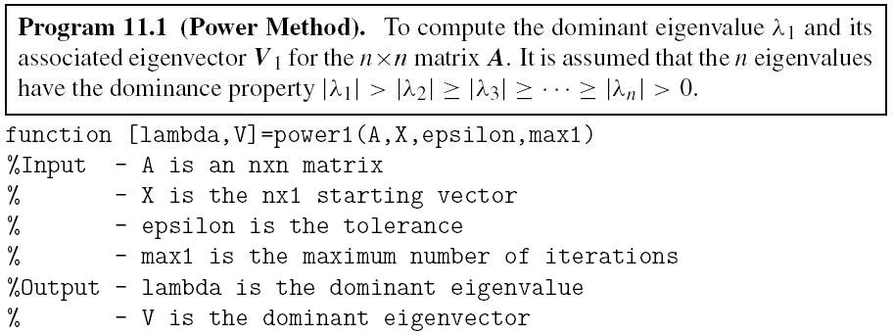
MATLAB Code (p607)

Slide 21
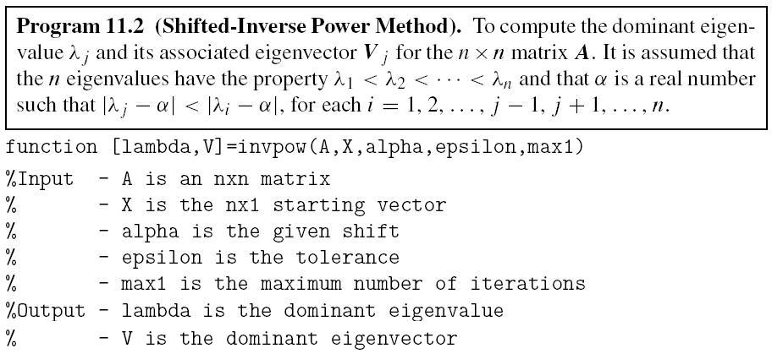
MATLAB Code (p607)

Slide 22
Home Assignment
Page 609 – Exercises 1 and 3

Slide 23
Jacobi’s Method (p611)
Jacobi’s method is an algorithm for finding all eigenpairs for a symmetric matrix. It is a reliable method that produces uniformly accurate answers for the results.
For matrices of order up to 10×10, the algorithm is competitive with more sophisticated ones. If speed is not a major consideration, it is quite acceptable for matrices up to order 20×20.
A solution is guaranteed for all real symmetric matrices when Jacobi’s method is used.

Slide 24
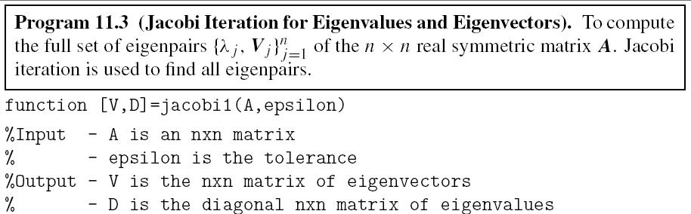
MATLAB Code (p620)

Slide 25
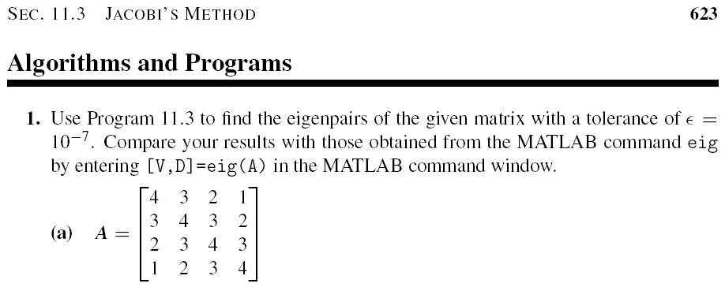
Home Assignment
Page 623 – Exercise 1(a)

