Slide 1
NP-Completeness: Preliminary
Computational Complexity
Topics:
-- Computability
-- Analysis of Algorithms

Slide 2
Computability: undecidable Problems
In computability theory and computational complexity theory, an undecidable problem is a decision problem for which it is known to be impossible to construct a single algorithm that always leads to a correct yes-or-no answer.
Notes:
devise：设计
multivariate:多元的
polynomial：多项式

Slide 3
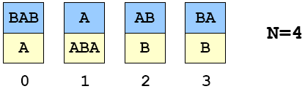
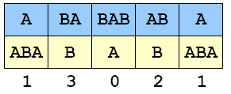
Post’s Correspondence Problem
Given a set of cards:
-- N card types (can use as many of each type as possible)
-- Each card has a top string and bottom string.
Example 1:
Puzzle:
-- Is it possible to arrange cards so that top and bottom strings are the same?
Solution 1:

Slide 4
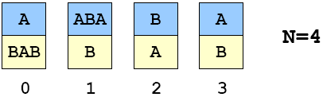
A Puzzle (“Post’s Correspondence Prob.”)
Given a set of cards:
-- N card types (can use as many of each type as possible)
-- Each card has a top string and bottom string.
Example 2:
Puzzle:
-- Is it possible to arrange cards so that top and bottom strings are the same?
Solution 2: ?
Notes:
波斯特对应问题

Slide 5
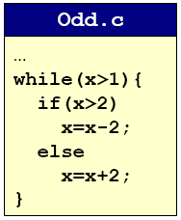
Undecidable Problems
Post’s Correspondence Problem.
Halting Problem
Halting Problem.
  Write a C program that reads in another program and its inputs, and decides whether or not it goes into an infinite loop.
    loop infinite often signifies a bug
  Program 1.
    8 6 4 2 4 2 4 2 4 2 4 2 4 2 4
    9 7 5 3 1

Slide 6
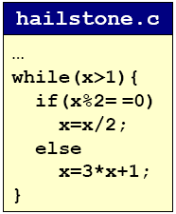
Undecidable Problems
Hilbert’s 10th Problem.
Post’s Correspondence Problem.
Halting Problem.
  Write a C program that reads in another program and its inputs, and decides whether or not it goes into an infinite loop.
    loop infinite often signifies a bug
  Program 2.
    8 4 2 1
    7 22 11 34 17 52 26 13 40
    20 10 5 16 8 4 2 1

Slide 7
Undecidable Problems
Hilbert’s 10th Problem.
Post’s Correspondence Problem.
Halting Problem.
Program Equivalence.
Optimal Data Compression.
Virus Identification.
Impossible to write C program to solve any of these problem!

Slide 8
Church-Turing Thesis
Church-Turing thesis (1936).
  Q. Which problems can a Turing machine (TM) solve?
  A. Any problem that any real computer can solve.
“Thesis” and not a mathematical theorem.
Implications:
  Provides rigorous definition for algorithm.
  Universality among computational models.
  If a problem can be solved by TM, then it can be solved on EVERY general-purpose computer.
  If a problem can’t be solved by TM, then it can’t be solved on ANY physical computer.
Notes:
thesis：命题，not theorem

Slide 9
Halting Problems
Halting problem.
  Devise a TM that reads in another TM (encoded in binary) and its initial tape, and determine whether or not that TM would ever reach a yes or no state.
  Write a C program that reads in another program and its inputs, and decides whether or not it goes into an infinite loop.
Theorem (Alan Turing, 1937). Halting problem is undecidable.
  No TM can solve the halting problem. (not possible to write a C program either)
Proof intuition.
  Self-reference.
Notes:
paradox：悖论

Slide 10
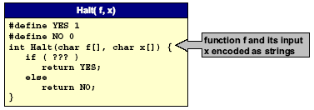
Halting Problem Proof
Assume the existence of Halt(f, x) that takes as input: any function f and its input x, and outputs yes if f(x) halts, and not otherwise.
  We prove Halt(f, x) can’t exist by contradiction.
  Note: Halt(f, x) always returns yes or no.
  (infinite loop not possible)

Slide 11
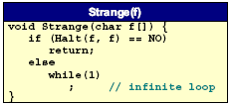
Halting Problem Proof
Assume the existence of Halt(f,x) that takes as input: any function f and its input x, and outputs yes if f(x) halts, and not otherwise.
  Construct program Strange(f) as follows:.
    calls Halt(f,f)
    halts if Halt(f,f) outputs no
    goes into infinite loop if Halt(f,f) outputs yes
  In other words:
    if f(f) does not halt then Strange(f) halts
    if f(f) halts then Strange(f) does not halt

Slide 12
Halting Problem Proof
Assume the existence of Halt(f,x) that takes as input: any function f and its input x, and outputs yes if f(x) halts, and not otherwise.
  Construct program Strange(f) as follows:.
    calls Halt(f,f)
    halts if Halt(f,f) outputs no
    goes into infinite loop if Halt(f,f) outputs yes
  In other words:
    if f(f) does not halt then Strange(f) halts
    if f(f) halts then Strange(f) does not halt
  Call Strange with ITSELF as input.
    if Strange(Strange) does not halt then Strange (Strange) halts
    if Strange(Strange) halts then Strange (Strange) does not halts
  Either way, a contradiction. Hence Halt(f, x) cannot exist.

Slide 13
Consequences
Halting problem is “not artificial.”
  Undecidable problem reduced to simplest form to simplify proof.
  Closely related to practical problems.
  Hilbert’s 10th problem, Post’s correspondence problem, program equivalence, optimal data compression
How to show new problem X is undecidable?
  Use fact that Halting problem is undecidable.
  Design algorithm to solve Halting problem, using (alleged) algorithm for X as a subroutine.
  Reduction
Notes:
alleged：所谓的

Slide 14
Implications
Practical:
  Work with limitations.
  Recognize and avoid unsolvable problems.
  Learn from structure.
    Same theory tells us about efficiency of algorithms
Philosophical (caveat: ask a philosopher):
  We “assume” that any step-by-step reasoning will solve any technical or scientific problem.
  “Not quite” says the halting problem.
  Anything that is like (could be) a computer has the same flaw.
Notes:
caveat:警告

Slide 15
Summary
What is an algorithm?
  Informally: a step-by-step procedure for solving a problem.
  Formally: a Turing machine
Is it possible, in principle, to write a program to solve any problem?
  No.

Slide 16
Analysis of Algorithm
For many problems, there may be several competitive algorithms.
  Which one should I use?
Analysis of algorithms.
  framework for comparing algorithms and performance prediction.
  case study: sorting
Computational complexity.
  framework for studying intrinsic difficulty of problems.

Slide 17



Linear Growth
Grade school addition.
  Work is proportional to number of digits N.
  Linear growth: k N for some constant k.
Notes:
Majority operation:多数决定运算（操作数都是0或1，此处有三个操作数，只有当半数以上都是1时，结果才为1）

Slide 18
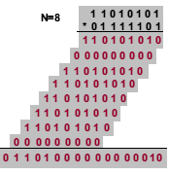
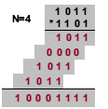

Quadratic Growth
Grade school multiplication.
  Work is proportional to square of number of digits N.
  Quadratic growth: k N² for some constant k.
Notes:
Quadratic:平方、二次方

Slide 19
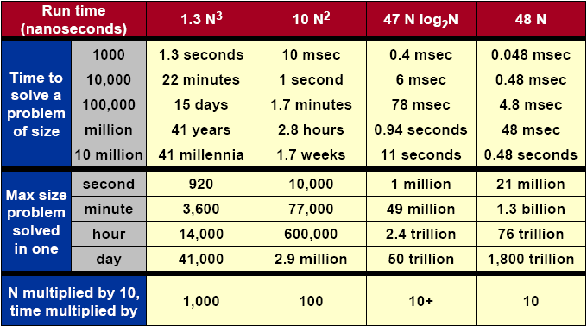
What Does It Matter?
Notes:
millennia:千年

Slide 20
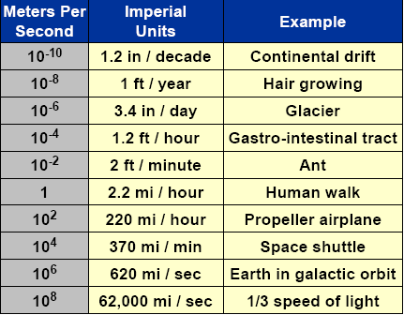
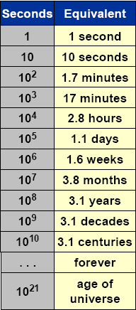

Orders of Magnitude

Slide 21
Historical Quest for Speed
Multiplication: a * b.
  Naïve: add a to itself b times. N 2^{N} steps
  Grade school. N² Steps.
  Divide–and–conquer (Karatsuba, 1962). N^{1.58} steps
  Ingenuity (Schonhage and Strassen, 1971).
  N log N log log N steps
Greatest common divisor: gcd(a,b).
  Naïve: factor a and b, and find gcd(a,b). 2√N steps
  Euclid (20 BCE): gcd(a,b)= gcd(b, a mod b). lg N steps
Notes:
Ingenuity：独创性、机智
Euclid：欧几里得

Slide 22
Better Machines vs. Better Algorithms
New machine.
  Costs $$$ or more.
  Makes “everything” finish sooner.
  Incremental quantitative improvements (Moore’s Law).
  May not help much with some problems.
New algorithm.
  Costs $ or less.
  Dramatic qualitative improvements possible! (million time faster)
  May make the difference, allowing specific problem to be solved.
  May not help much with some problems.

Slide 23
Impact of Better Algorithms
Example 1: N-body-simulation.
  Simulate gravitational interactions among N bodies.
    physicists want N = # atoms in universe
  Brute force method: N² steps.
  Appel (1981). N log N steps, enables new research.
Notes:
gravitational：引力的、重力的

Slide 24
Impact of Better Algorithms
Example 2: Discrete Fourier Transform (DFT).
  Breaks down waveforms (sound) into periodic components.
    foundation of signal processing
    CD players, JPEG, analyzing astronomical data, etc.
  Grade school method: N² steps.
  FFT algorithm: N log N steps, enables new technology.
Notes:
astronomical：天文学的、天文的

Slide 25
Implementation of Algorithms
Algorithm.
  “Step-by-step recipe” used to solve a problem.
  Generally independent of programming language or machine on which it is to be executed.
Design.
  Find a method to solve the problem.
Analysis.
  Evaluate its effectiveness and predict theoretical performance.
Implementation.
  Write actual code and test your theory.
Notes:
方法，烹饪法

