Slide 1

Chapter 9 and Chapter 11
8088, 80286 Microprocessors and ISA Bus
I/O and The 8255; ISA Bus Interfacing

Slide 2
Main Contents
State the function of the pins of the 8088
List the functions of the 8088 data, address, and control buses
State the differences in the 8088 microprocessor in maximum mode
versus minimum modes
Explain how bus arbitration between the CPU and DMA is
accomplished

Slide 3
Main Contents
State the function of I/O ports
Read and write data to and from I/O ports
Design of peripheral I/O using the 74LS373 output latch and the
74LS244 input buffer
I/O address map of 80x86 PCs
The purpose of the 8255 chip
Code Assembly language instructions to perform I/O through the
8255

Slide 4
Sec.9.1 8088 Microprocessor
8088 Microprocessor
The first IBM PC used the 8088 microprocessor, and modern PCs still carry that legacy. The 8088 is internally identical to the 8086, but has only an 8-bit external data bus.
The 8088 is a 40-pin microprocessor that can work in two modes: minimum mode and maximum mode. Maximum mode is used when we need to connect the 8088 to an 8087 math
coprocessor.

Slide 5
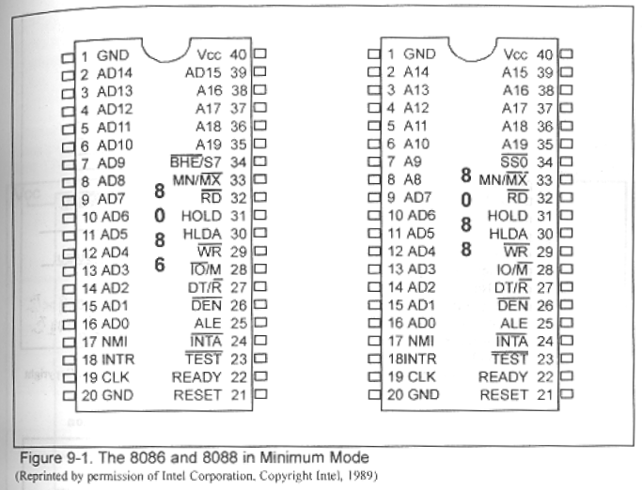
Sec.9.1 8088 Microprocessor
Data bus in 8088

Slide 6
Sec.9.1 8088 Microprocessor
Data bus in 8088
8088 has 8-bit external data bus, pins 9~16 (AD0~AD7) are used for both data and addresses. At the time of design of this microprocessor in the late 1970s, due to IC chip packaging limitations, there was a great effort to use the minimum number of pins for
external connections.

Slide 7
Sec.9.1 8088 Microprocessor
Data bus in 8088
The ALE pin signals whether the information on pins AD0~AD7 is address or data.
When ALE=1, it indicate that the information on the pins AD0~AD7 is the address (A0~A7). When ALE=0, it indicate that
the information on the pins AD0~AD7 is the data (D0~D7).

Slide 8
Sec.9.1 8088 Microprocessor
Address bus in 8088
The 8088 has 20 address pins (A0~A19) allowing it to address a maximum of one megabyte of memory (1M). Pins AD0~AD7 provide the A0~A7 addresses with the assistance of a latch. To demultiplex the address signals from the address/data pins, a latch must be used to
grab the addresses.

Slide 9
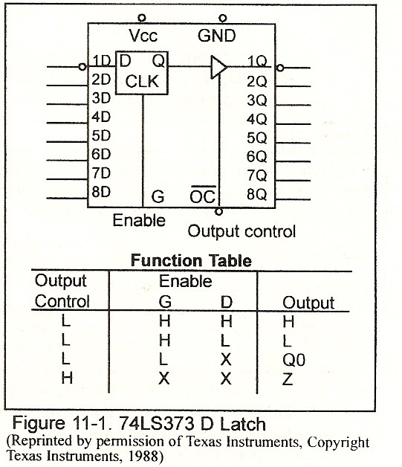
Sec.9.1 8088 Microprocessor
Address bus in 8088

Slide 10
Sec.9.1 8088 Microprocessor
Address bus in 8088
A₁₉/S₆~A₁₆/S₃ The address/data bus bits are multiplexed to provide address signals A₁₉-A₁₆ and also status bits S₆-S₃. Status bit S₆ is always a logic 0, bit S₅ indicates the condition of IF flag bit, and S₄ and S₃ show which segment is accessed during the current bus cycle.
S₄ | S₃ | Function
0 | 0 | Extra segment
0 | 1 | Stack segment
1 | 0 | Code or no segment
1 | 1 | Data segment

Slide 11
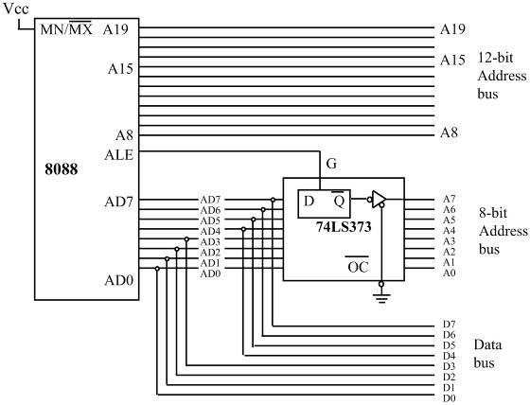
Sec.9.1 8088 Microprocessor
Address bus in 8088

Slide 12

Sec.9.1 8088 Microprocessor
8088 Control bus (Reading and writing)
The 8088 can access both memory and I/O devices for read and write operations. This gives us four operations for which we need four control signals: MEMR (memory read), MEMW (memory write), IOR (I/O read), and IOW (I/O write). The four control signals are relative
to three pins ( ).

Slide 13
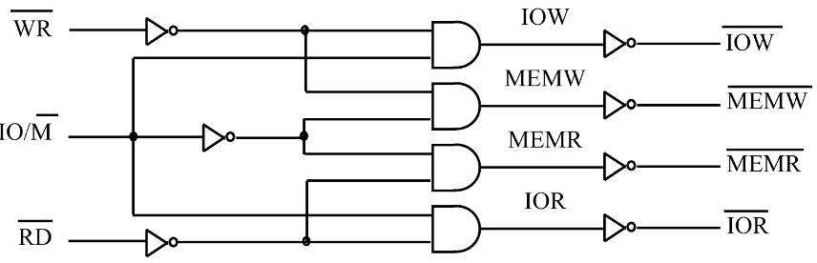
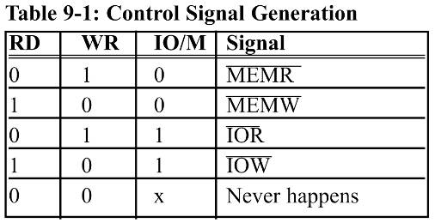
Sec.9.1 8088 Microprocessor
8088 Control bus
Fig. 9-4 Control signal generation
  Four control signals
  are generated:
  IOR; IOW;
  MEMR; MEMW.
  All of these signals
  must be active-low.

Slide 14
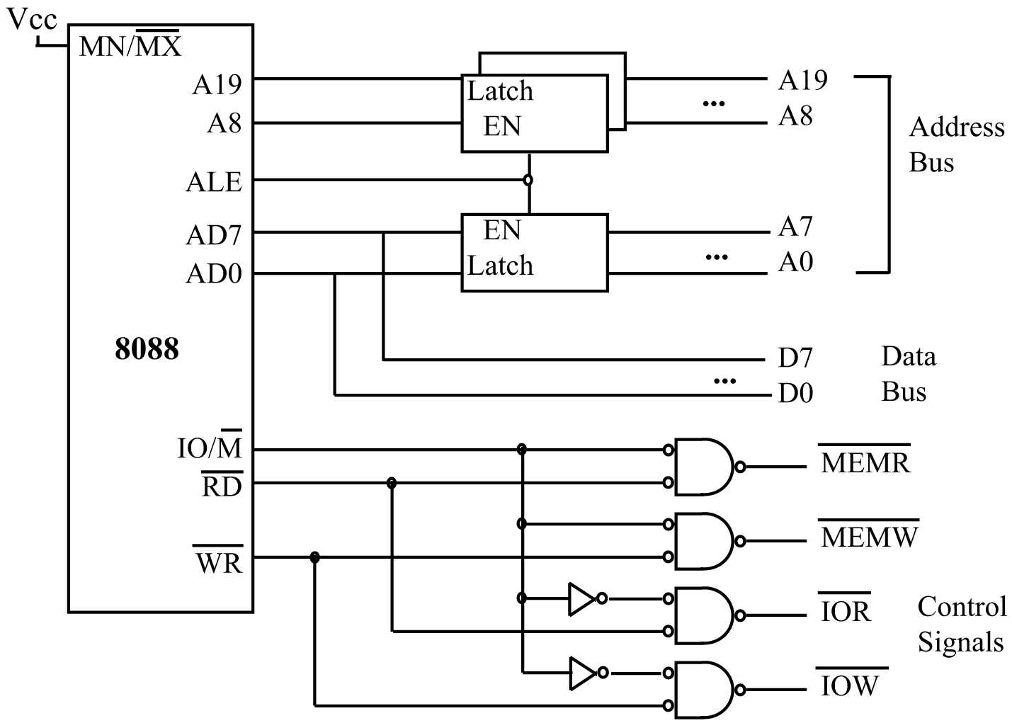
Sec.9.1 8088 Microprocessor
8088 Control bus
In any system, all addresses must be latched to provide
a stable, high-drive-capability address bus.
Fig. 9-5 Address,Data,and Control Buses in 8088-based System

Slide 15
Sec.9.1 8088 Microprocessor
Bus timing of 8088
The clock frequency is 5MHz in 8088, so the period of clock cycle is 200ns.
In IBM PC, the clock frequency is 4.77MHz, so the period of clock cycle is 210ns.
The basic bus cycle in 8088 includes 4 clock cycles.

Slide 16
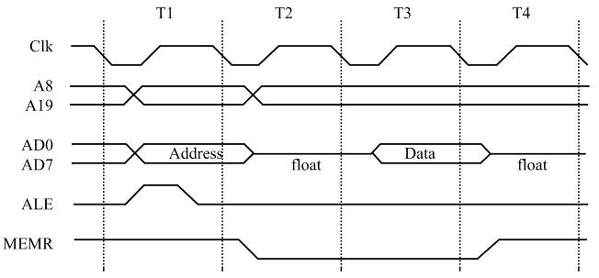
Sec.9.1 8088 Microprocessor
Bus timing of 8088
In Figure 9-6 the timing for ALE is shown. The 8088 uses 4
clocks for memory and I/O bus activities.
If reading/writing takes more than
4 clocks, wait
states (WS) can
be requested
from the CPU.
Fig. 9-6 ALE Timing

Slide 17
Sec.9.1 8088 Microprocessor
Other 8088 pins
Pin | Name
24 | INTA
25 | ALE
26 | DEN
27 | DT/R
28 | IO/M
29 | WR
30 | HLDA
31 | HOLD
32 | RD
Pins 24-32 of the 8088 have
different functions depending on
whether the 8088 is used in minimum
mode or maximum mode. As stated
earlier, maximum mode is used only
when we want to connect the 8088 to
an 8087 math coprocessor. Table 9-2
lists the functions of pins 24-32 of the
8088 in minimum mode.

Slide 18
Sec.9.1 8088 Microprocessor
Other 8088 pins
INTA: interrupt acknowledge, Active-low output signal.
ALE: address latch enable, Active-high output signal.
DEN: data enable, Active-low output signal.
DT/R: data transmit / receive, output signal. Active-low indicates CPU receives data, Active-high indicates CPU sends data.
IO/M: input-output or memory, indicates whether address bus is accessing memory or IO device.
WR: write, Active-low, output signal
RD: read, Active-low, output signal
HOLD: Active-high input signal from DMA.
HLDA: hold acknowledge, Active-high output signal.

Slide 19
Sec.9.1 8088 Microprocessor
Other 8088 pins
MN/MX: minimum / maximum, Active-low indicate maximum mode.
NMI: nonmaskable interrupt, this is a edge-triggered (going from low to high) input signal.
INTR: interrupt request, Active-high input signal.
CLOCK: Clock is an input signal and is connected to 8284 clock generator.
Ready: is an input signal used to insert a wait state for slower memories and I/O.
TEST: In maximum mode, is an input from the 8087.
RESET: to terminate the present activities of the microprocessor, Active-high, input signal
SS0: is equivalent to the S0 pin in maximum mode.

Slide 20
Sec.9.1 8088 Microprocessor
IP and Segment register Contents after Reset
Register | Contents
CS | FFFF
IP | 0000
DS | 0000
ES | 0000
SS | 0000

Slide 21
Sec.11.1 8088 Input/Output instructions
All 80x86 microprocessors, from the 8088 to the Pentium, can access external devices called ports. This is done using I/O instructions. The 80x86 CPU is one of the few processors that
have I/O space in addition to memory space.
There are two instructions for this purpose: “OUT” and “IN”. These instructions can send data from the accumulator (AL or AX) to ports or bring data from ports into the
accumulator.

Slide 22
Sec.11.1 8088 Input/Output instructions
One external device can have several ports, each device has three types information: control / status / data. Each type
information may occupy one or several ports.
The addressing of CPU is port, not actual device.

Slide 23
Sec.11.1 8088 Input/Output instructions
The 8-bit port uses the D0~D7 data bus to communicate with I/O devices. In 8-bit port programming. Register AL is
used.
The 8-bit port address is carried on address bus A0~A7, up to 256 ports. The 16-bit port address is carried on address bus
A0~A15, up to 65536 ports.

Slide 24
Sec.11.1 8088 Input/Output instructions
8-bit data ports
Instructions OUT and IN have the following formats:
Inputting Data Outputting Data
Format: IN dest, source OUT dest, source
IN AL, port# OUT port#, AL
MOV DX, port# MOV DX, port#
IN AL, DX OUT DX, AL

Slide 25
Sec.11.1 8088 Input/Output instructions
How to use I/O instructions
The following program sends a byte of data to a fixed port
address of 43H.
MOV AL, 36H
OUT 43H, AL
To use the 16-bit port address, register indirect addressing
mode must be used.
BACK: MOV DX, 300H
MOV AL, 55H
OUT DX, AL
MOV AL, 0AAH
OUT DX, AL
JMP BACK

Slide 26
Sec.11.2 I/O Address decoding and design
The main purpose of address decoding is to choose the external device, so CPU can communicate with the appointed device. When CPU communicates with the external device,
there are several problems:
1. The speed do not match, CPU runs faster than external
device.
2. The control and data bus of external device can not
connect with the data and control bus of CPU directly.
3. The format of data in external devices are different.

Slide 27
Sec.11.2 I/O Address decoding and design
In every computer, whenever data is sent out by the CPU via the data bus, the data must be latched by the receiving
device. The widely used chip is 74LS373.
When data is coming in by way of a data bus, it must come in through a three-state buffer. The widely used chip is
74LS244.

Slide 28
Sec.11.2 I/O Address decoding and design
The address bus decoding has the following steps:
1. The control signals IOR and IOW are used along with the
decoder.
2. For an 8-bit port address, A0~A7 is decoded.
3. If the port address is 16-bit (using DX), A0~A15 is decoded.

Slide 29
Sec.11.2 I/O Address decoding and design
Using the 74LS373 in an output port design
While memories have an internal latch to grab the data, a latching system must be designed for simple I/O ports.
In order to make 74lS373 work as a latch, the OC pin must be grounded. For an output latch, it is common to AND the output of the address decoder with the control signal IOW to
provide the latching action.

Slide 30
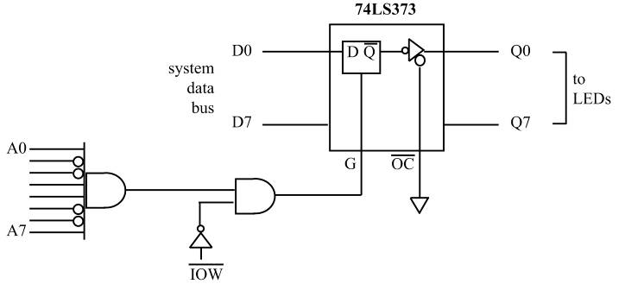
Sec.11.2 I/O Address decoding and design
Using the 74LS373 in an output port design
Figure 11-2 Design
for “OUT 99H, AL”.

Slide 31
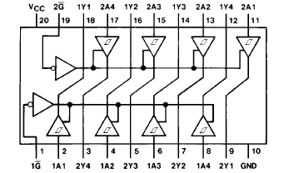
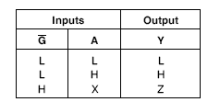
Sec.11.2 I/O Address decoding and design
IN port design using the 74LS244

Slide 32
Sec.11.2 I/O Address decoding and design
IN port design using the 74LS244
For the simple input ports we use 74LS244 chip to be the tri-state buffer. G1 and G2 each control only 4 bits of the 74LS244, they both must be activated for the 8-bit input. The address decoding signal Anded with the IOR to activate the G
pin of 74LS244.
The 74LS244 not only plays the role of buffer, but also provides the incoming data with sufficient driving capability to
travel all the way to the CPU.

Slide 33
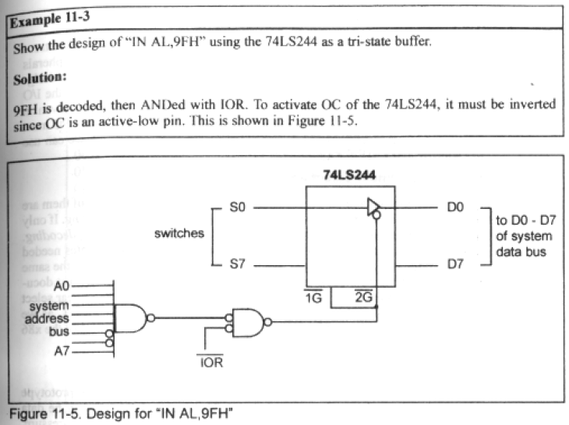
Sec.11.2 I/O Address decoding and design
IN port design using the 74LS244

Slide 34
Sec.11.2 I/O Address decoding and design
Memory Mapped I/O
There are two types of I/O, one is peripheral I/O, the other is memory-mapped I/O.
The microprocessor communicates with I/O devices using IN or OUT instructions in peripheral I/O.
In memory-mapped I/O, a memory location is assigned to be input or output port.

Slide 35
Sec.11.2 I/O Address decoding and design
The difference between Memory Mapped I/O and Peripheral I/O
In memory-mapped I/O, we must use instructions accessing memory locations to
access the I/O ports instead of IN and OUT instructions.
In memory-mapped I/O, the entire 20-bit address, A0~A19, must be decoded.
In memory-mapped I/O circuit interfacing, control signals MEMR and MEMW are
used.
In peripheral I/O we are limited to 65536 ports. In memory-mapped I/O, the number of ports can be 1048576 (2²⁰).
In memory-mapped I/O, one can perform arithmetic and logic operations on I/O data directly.
One major and severe disadvantage of memory-mapped I/O is that it uses memory
address space, which could lead to memory space fragmentation.

Slide 36
Sec.11.3 I/O Address map of X86 PCs
Designers of the original IBM PC assigned different port addresses to various peripherals such as LPT and COM ports. The list of the designated I/O port addresses is referred to as the
I/O map.
The I/O address 300~31F have not been used by the
designers, they are called prototype card, we can use it.

Slide 37
Sec.11.3 I/O Address map of X86 PCs
Hex Range | Device
000~01F | DMA controller 1
020~03F | Interrupt controller 1
040~05F | Timer
060~06F | 8042 (keyboard)
070~07F | Real-time clock, NMI mask
080~09F | DMA page register
0A0~0BF | Interrupt controller 2
0C0~0DF | DMA controller 2
0F0 | Clear math coprocessor busy
0F1 | Reset math coprocessor
0F8~0FF | Math coprocessor
1F0~1F8 | Fixed disk
…… | ……
300~31F | Prototype card
…… | ……

Slide 38
Sec.11.3 I/O Address map of X86 PCs
Absolute vs. linear select address decoding
In decoding addresses, either all of them or a selected number of them are decoded. If all the address lines(A0~A15) are decoded, it is called absolute decoding. If only selected address pins (A0~A9) are used for decoding, it is called linear
select decoding.

Slide 39
Sec.11.3 I/O Address map of X86 PCs
Prototype addresses 300~31FH in x86 PC
In the x86 PC, the address range 300H~31FH is set aside for prototype cards to be plugged into the expansion slot. It uses the following signals,
1. IOR and IOW, both are active low.
2. AEN signal, AEN=0 when the CPU is using the bus.
3. A0~A9 for address decoding.

Slide 40
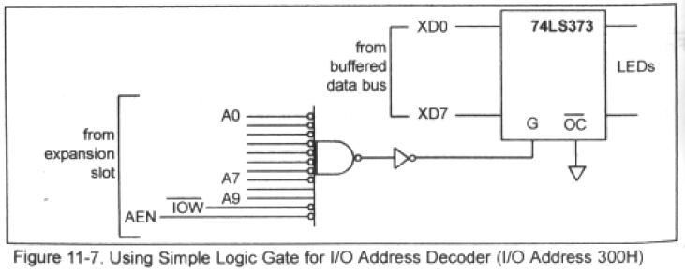
Sec.11.3 I/O Address map of X86 PCs
Use of simple logic gates as address decoders

Slide 41
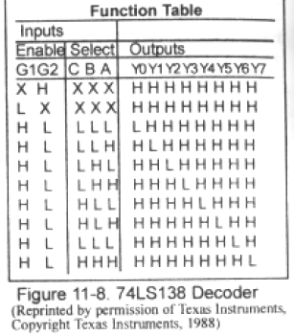
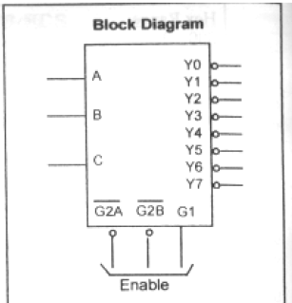
Sec.11.3 I/O Address map of X86 PCs
Use of 74LS138 as decoder

Slide 42
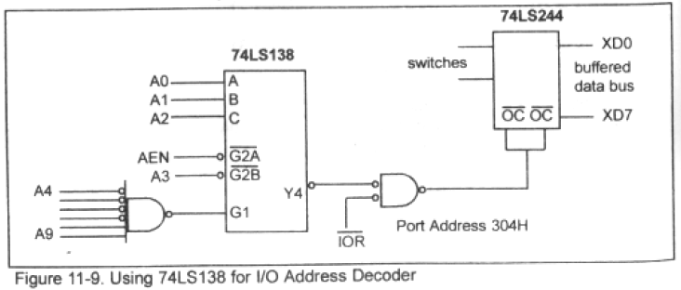
Sec.11.3 I/O Address map of X86 PCs
Use of 74LS138 as decoder

Slide 43
Sec.11.3 I/O Address map of X86 PCs
Port 61H and time delay generation
I/O ports has eight bits (D0~D7), bit D4 is of particular interest to us. In all 286 and higher PCs, bit D4 of port 61H changes its state every 15.085 microseconds (μs). It stays low for 15.085 μs, then changes to high and stays high for the same
amount of time before it goes low again.

Slide 44
Sec.11.3 I/O Address map of X86 PCs
Port 61H and time delay generation
Toggling all bits of port 310H every 0.5 sec
MOV DX, 310H
HERE: MOV AL, 55H
MOV CX, 33144 ;Delay = 33144*15.085 us=0.5sec
CALL TDELAY
MOV AL, 0AAH
OUT DX, AL
MOV CX, 33144
CALL TDLAY
JMP HERE

Slide 45
Sec.11.3 I/O Address map of X86 PCs
Port 61H and time delay generation
;CX=COUNT OF 15.085 MICROSEC
TDLAY PROC NEAR
PUSH AX
W1: IN AL, 61H
AND AL, 00010000B
CMP AL, AH
JE W1
MOV AH, AL
LOOP W1
POP AX
RET
TDLAY ENDP

Slide 46
Sec.11.4 8255 PPI chip
8255 chip is one of the most widely used I/O chips. It is a 40-pin DIP chip, has three separately accessible ports, A, B, C, which can be programmed. So it is called PPI (programmable peripheral interface.)
They can be changed dynamically.

Slide 47
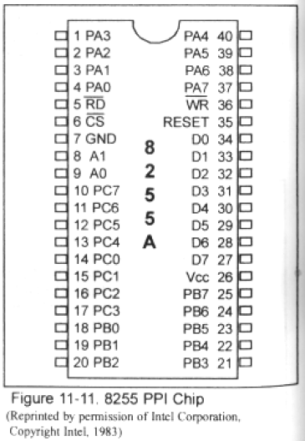
Sec.11.4 8255 PPI chip
Function | pins
PA, PB, PC | 24
Data | 8
Power, GND | 2
Control | 6

Slide 48
Sec.11.4 8255 PPI chip
Port A (PA0~PA7) can be programmed all as input or all as output.
Port B (PB0~PB7) can be programmed all as input or all as output.
Port C (PC0~PC7) can be programmed all as input or all as output, it can also be split into two parts, CU (upper bits PC4~PC7) and CL (lower bits PC0~PC3). Each can be used for input or output. Any of PC0 to PC7 can be programmed individually.

Slide 49
Sec.11.4 8255 PPI chip
8255 has a control register, which must be programmed to select
the operation mode of the three ports A, B, and C.
A0, A1, and CS
CS selects the entire chip. Address pins A0 and A1 select the specific port within the 8255. These three pins are used to access ports
A, B, C or the control register.

Slide 50
Sec.11.4 8255 PPI chip
8255 Port Selection
CS | A1 | A0 | Selects
0 | 0 | 0 | Port A
0 | 0 | 1 | Port B
0 | 1 | 0 | Port C
0 | 1 | 1 | Control Register
1 | x | x | Not selected

Slide 51
Sec.11.4 8255 PPI chip
D0~D7
D0~D7 are connected to system data bus.
There is a data buffer in 8255, used to connect to system data bus.
RD and WR
These two active-low control signals are input to the 8255.
RESET
This is an active-high signal input into the 8255 used to clear the control register. When RESET is activated, all ports are initialized as input ports. This pin must be connected to the RESET output of the
system bus or ground.

Slide 52
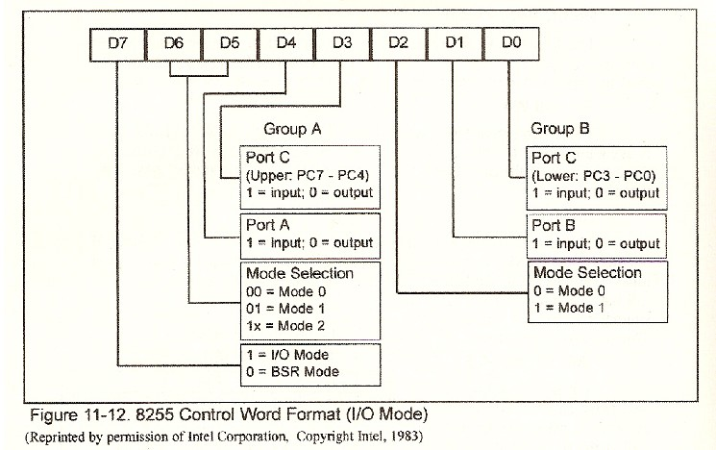
Sec.11.4 8255 PPI chip
Mode selection of the 8255A

Slide 53
Sec.11.4 8255 PPI chip
Mode selection of the 8255A
The ports of the 8255 can be programmed in any of the
following modes.
Mode 0, simple I/O mode.
Mode 1. Port A and Port B can be used as input or output ports with handshaking capabilities.
Mode 2. Port A can be used as a bidirectional I/O.

Slide 54
Sec.11.4 8255 PPI chip
Mode 0 Operation
In this mode, any of the ports A, B, CL, and CU can be programmed as input or output. In this mode, all bits are out or
all are in. There is no control of individual bits.
Mode 0 operation causes 8255 to function either as a buffered input or as a latched output device. Mode 0 is most
widely used mode in current system I/O interfacing design.

Slide 55
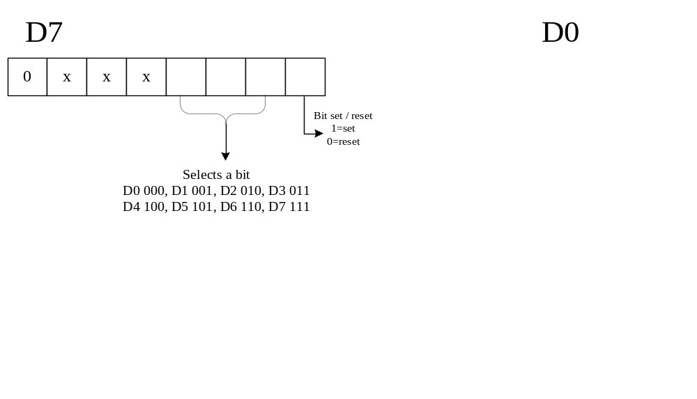
Sec.11.4 8255 PPI chip
BSR (Bits set or reset)

Slide 56
Sec.11.4 8255 PPI chip
BSR (Bits set or reset)
The address of 8255 is 320H~323H
MOV AL, 0FH ; Set PC7=1
MOV DX, 323H
OUT DX, AL
MOV AL, 06H ; Set PC3=0
OUT DX,AL

Slide 57
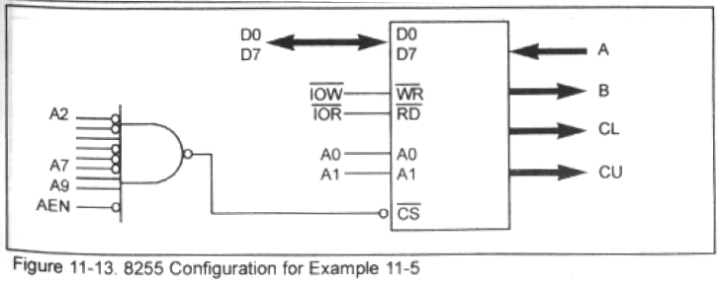
Sec.11.4 8255 PPI chip
Example 11-5
The 8255 shown in Figure 11-13 is configured as follows: port A as
input, B as output, and all the bits of port C as output.
Find the port addresses assigned to A, B, C and the control registers.
Find the control byte (word) for this configuration.
Program the ports to input data from port A and send it to both ports B and C.

Slide 58
Sec.11.4 8255 PPI chip
Example 11-5
Solution:
The port addresses are as follows:
CS A1 A0 Address Port
11 0001 00 0 0 310H Port A
11 0001 00 0 1 311H Port B
11 0001 00 1 0 312H Port C
11 0001 00 1 1 313H Control register
(b) The control word is 90H, or 1001 0000.
(c) One version of the program is as follows:
MOV AL, 90H ;control byte PA=in, PB=out, PC=out
MOV DX, 313H
OUT DX, AL
MOV DX, 310H
IN AL, DX
MOV DX, 311H MOV DX, 312H
OUT DX, AL OUT DX, AL

Slide 59
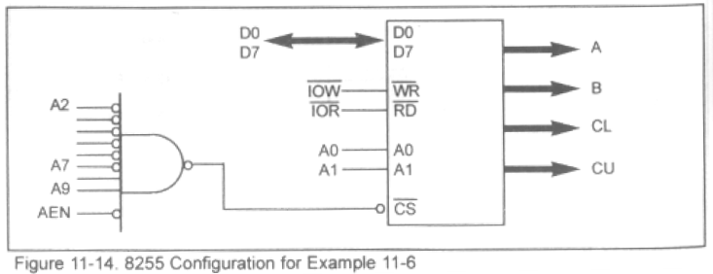
Sec.11.4 8255 PPI chip
Example 11-6
Show the address decoding where port A of the 8255 has an I/O
address of 300H, then write a program to toggle all bits of PA
continuously with a ¼ second delay. Use INT 16H to exit if there is a
keypress.

Slide 60
Sec.11.4 8255 PPI chip
Example 11-6
Solution:
The address decoding for the 8255 is shown in Figure 11-14. The
control word for all ports as output is 80H. The program below will
toggle all bits of PA indefinitely with a delay in between. To prevent
locking up the system, we press any key to exit to DOS.
MOV DX, 303H ;CONTROL REG ADDRESS
MOV AL, 80H ;ALL PORTS AS OUTPUT
OUT DX, AL
AGAIN: MOV DX, 300H
MOV AL, 55H
OUT DX, AL
CALL QSDELAY ;1/4 SEC DELAY
MOV AL, 0AAH ;TOGGLE BIT
OUT DX, AL
CALL QSDELAY

Slide 61
Sec.11.4 8255 PPI chip
MOV AH, 01
INT 16H
JZ AGAIN ;CHECK KEYPRESS
MOV AH, 4CH ;PRESS ANY KEY TO EXIT
INT 21H ;EXIT
QSDELAY PROC NEAR
MOV CX, 16572 ;16572*15.085 USEC = ¼ SEC
PUSH AX
W1: IN AL, 61H
AND AL, 00010000B
CMP AL, AH
JE W1
MOV AH, AL
LOOP W1
POP AX
RET
QSDELAY ENDP

Slide 62
Sec.11.4 8255 PPI chip
Application of 8255A
Design a interfacing circuit, using 8088 and 8255, the port address of 8255 is 180H~183H.
Three LEDs can be lightened in turn.
Solution:
Port A is in output status, when PA0~PA2 are logic 1 level, the Leds will light.

Slide 63
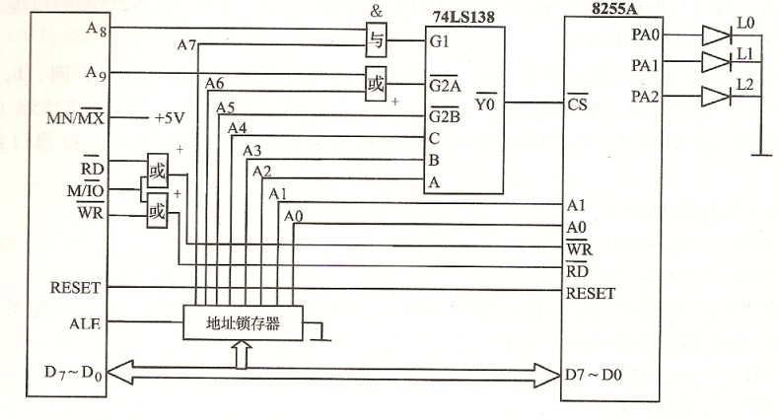
Sec.11.4 8255 PPI chip
Application of 8255A
RD
WR

Slide 64
Sec.11.4 8255 PPI chip
Application of 8255A
CODE SEGMENT
ASSUME CS:CODE
START: MOV AL, 80H ; control word
MOV DX,183H
OUT DX, AL
LP1: MOV AL, 00000001B
LP2: MOV DX,180H
OUT DX, AL
MOV CX, 8FFFH
LP3: MOV AH,01H
INT 16H
JZ LP4
LOOP LP3
SHL AL,1
CMP AL,00001000B
JNZ LP2
JMP LP1
LP4: MOV AH,4CH
INT 21H
CODE ENDS
END START

Slide 65
Chapter 13
8253/8254 Timer and Music

Slide 66
Main Contents
The function of each pin of the 8253/54
Program the three counters of the 8253/54 by use of the chip’s
control word
Diagram how the 8253/54 timer is connected in the IBM PC

Slide 67
Sec.13.1 8253/8254 Timer description and initialization
The 8253 chip was used in the IBM PC/XT, but starting with the IBM PC/AT, the 8254 replaced the 8253. 8254 and 8253 have exactly
the same pinout.
Inside the 8253/54 timer, there are three counters. Each works independently and is programmed separately to divide the input
frequency by a number from 1 to 65536.

Slide 68
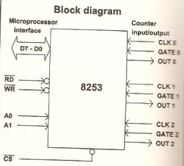
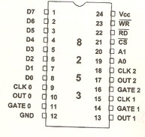
Sec.13.1 8253/8254 Timer description and initialization

Slide 69
Sec.13.1 8253/8254 Timer description and initialization
Initialization of the 8253/8254
Each counter and control register are assigned an individual port address. As the same as 8255, four port addresses are needed for a
single 8253/54 timer. The ports are addressed by A0, A1, and CS.
CS | A1 | A0 | Port
0 | 0 | 0 | Counter 0
0 | 0 | 1 | Counter 1
0 | 1 | 0 | Counter 2
0 | 1 | 1 | Control register
1 | x | x | 8253/54 is not selected

Slide 70
Sec.13.1 8253/8254 Timer description and initialization
Initialization of the 8253/8254
CLK is the input clock frequency, which can range between 0 and
2MHz for 8253; 0~8MHz for 8254; 0~10MHz for 8254-2.
OUT is the output signal of the counter, the shape of the output frequency coming from the OUT pin after being divided can be
programmed.
GATE is used to enable or disable the counter, depending on the
modes of operation.

Slide 71
Sec.13.1 8253/8254 Timer description and initialization
Initialization of the 8253/8254
D0~D7 is bidirectional data bus, connected to the system data bus.
When CS is logic 1 level, 8253/54 is not selected, D0~D7 is in high
impedance state, the pins D0~D7 have been isolated.

Slide 72
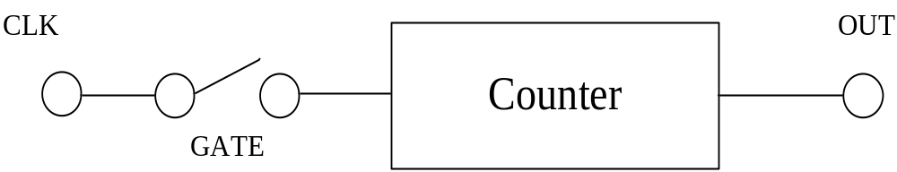
Sec.13.1 8253/8254 Timer description and initialization
Initialization of the 8253/8254

Slide 73
Sec.13.1 8253/8254 Timer description and initialization
Initialization of the 8253/8254
Each of the three counters of the 8253/8254 must be programmed separately. In order to program any of the three counters, the control byte must first be written into the control register. In addition, the number that the input clock should be
divided by must be written into that counter of the 8253/8254.

Slide 74
Sec.13.1 8253/8254 Timer description and initialization
Initialization of the 8253/8254
Since the number can be as high as FFFF (16-bit data) and the data bus for the 8253/54 timer is only 8 bits wide, the
divisor must be sent in one byte at a time. If the number is 16
bits, the lower byte is sent first, then the higher byte.

Slide 75
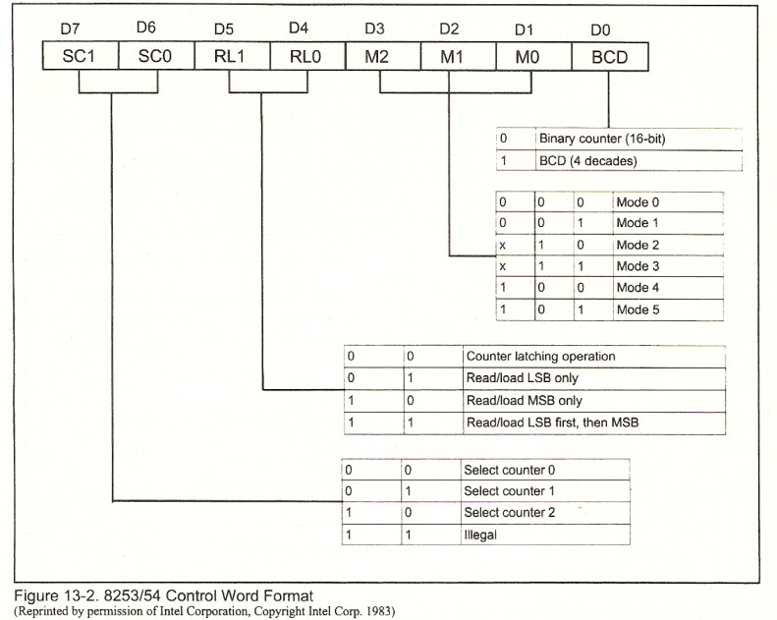
Sec.13.1 8253/8254 Timer description and initialization
Control word

Slide 76
Sec.13.1 8253/8254 Timer description and initialization
Initialization of the 8253/8254
D0=0, choose the binary number divisor, 0000H~FFFFH
D0=1, choose the BCD divisor of 0000~9999.
To get the highest count (65536 decimal and 10000 BCD), the counter is loaded with zeros.

Slide 77
Sec.13.1 8253/8254 Timer description and initialization
Control word
Example 13-2
Use the port addresses 94H~97H to program:
Counter 0 for binary count of mode 3 (square wave) to divide CLK0 by number 4282 (BCD)
Counter 2 for binary count of mode 3 (square wave) to divide CLK2 by number C26A hex.
Find the frequency of OUT0 and OUT2 in (a) and (b) if CLK0=1.2MHz, CLK2=1.8MHz.

Slide 78
Sec.13.1 8253/8254 Timer description and initialization
Control word
Example 13-2
Solution:
(a) the control word is 00110111
MOV AL, 37H
OUT 97H, AL
MOV AX, 4282H
OUT 94H, AL
MOV AL,AH
OUT 94H,AL
(c) The output frequency is 1.2MHz / 4282= 280Hz
The other is 1.2MHz /49770=36Hz
C26AH=49770 in decimal
(b) the control word is 10110110
MOV AL, 0B6H
OUT 97H, AL
MOV AX, 0C26AH
OUT 96H, AL
MOV AL,AH
OUT 96H,AL

Slide 79
Sec.13.4 Shape of 8253/8254 outputs
The 8253/54 has a total of six modes of operation, modes 0 through 5. These six modes of operation are available to each of
the three counters inside the 8253/54.
The 6 modes fall into two categories as far as activation is concerned. OUT will have the desired output only if GATE=1. The other is that OUT will have the desired OUT only if a 0-to-
1 pulse is applied to the GATE.

Slide 80
Sec.13.2 IBM PC 8253/54 Timer connections and programming
In IBM PC I/O addresses maps, we can see that the addresses 040H~05FH have been assigned to timer (8253/54).
The IBM PC uses a 74LS138 to decode addresses for CS of 8253 as shown in Figure 13-3. The port addresses are
selected as indicated in Table 13-2.

Slide 81
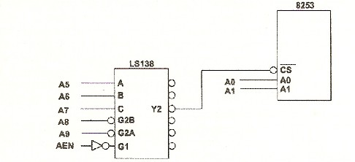
Sec.13.2 IBM PC 8253/54 Timer connections and programming
Figure 13-3

Slide 82
Sec.13.2 IBM PC 8253/54 Timer connections and programming
Binary Address |  |  | Hex Address | Function
AEN A9 A8 | A7 A6 A5 A4 | A3 A2 A1 A0
1 0 0 | 0 1 0 x | x x 0 0 | 40 | Counter 0
1 0 0 | 0 1 0 x | x x 0 1 | 41 | Counter 1
1 0 0 | 0 1 0 x | x x 1 0 | 42 | Counter 2
1 0 0 | 0 1 0 x | x x 1 1 | 43 | Counter register
Table 13-2 8253/54 Port Address Calculation in the PC

Slide 83
Next Lesson
Interrupts and the 8259 Chip

Slide 84
Homework
11.17, 11. 23, 11. 49

