Slide 1

Chapter 14
Interrupts and the 8259 Chip

Slide 2
Main Contents
Describe the differences between hardware and software interrupts
Describe the function of each pin of the 8259
Explain the purpose of each of the 4 initialization control words of
8259, 3 operation command words, and how they are programmed
Diagram how the 8259 is interfaced in the IBM PC/XT
Diagram how the 8259 is interfaced in the IBM PC/AT

Slide 3
Sec.14.1 8088/8086 Interrupts
Hardware interrupts
There are three pins in the 80x86 that are associated with hardware interrupts. They are INTR (interrupt request), NMI (nonmaskable interrupt), and INTA (interrupt
acknowledge).
INTR and NMI are activated externally by putting 5V
on the pins of NMI and INTR of the 80x86 microprocessors.

Slide 4
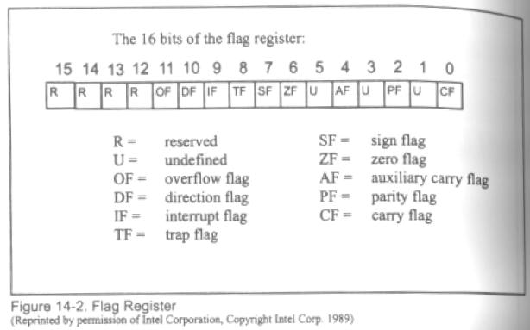
Sec.14.1 8088/8086 Interrupts
Interrupts and the flag register
Among bit D0 to D15 of the flag register, there are two
bits that are associated with the interrupt: D9, or IF
(interrupt enable flag), and D8, or TF (trap or single-step
flag).

Slide 5
Sec.14.1 8088/8086 Interrupts
Hardware Interrupts
Intel has embedded “INT 02H” into the 80x86 microprocessor to be used only for NMI. Memory locations 00008, 00009, 0000A, 0000B contain the 4 bytes of CS:IP of the ISR belong to NMI. In contrast, there is not the case for the other hardware pin, INTR. There is no specific location in the vector
table assigned to INTR.

Slide 6
Sec.14.1 8088/8086 Interrupts
INT 00 (divide error)
One such situation is an attempt to divide a number by zero.
MOV AL, 92
SUB CL, CL
DIV CL
INT 0 is also invoked if the quotient is too large to fit into the
assigned register when executing a DIV instruction.
MOV AX, 0FFFFH
MOV BL, 2
DIV BL ;65536/2=32767 large than 255,
maximum capacity of AL
Prog INT 0 Prog INT 0 EXE
Prog INT 0-1 Prog INT 0_1 EXE
Prog INT 0_2 Prog INT 0_2 EXE

Slide 7
Sec.14.1 8088/8086 Interrupts
INT 01 (single step)
To single-step, the trap flag (TF), D8 of the flag register, must be set to 1. Then after execution of each instruction, the 8086/88 automatically jumps to physical location 00004 to fetch the 4 bytes for CS:IP of the interrupt service routine, whose job is , among other
things, to dump the registers onto the screen.

Slide 8
Sec.14.1 8088/8086 Interrupts
INT 01 (single step)
the trap flag set
PUSHF
POP AX
OR AX, 0100H
PUSH AX
POPF
and reset is
PUSHF
POP AX
AND AX, FEFFH
PUSH AX
POPF
Prog INT01 Prog INT01_exe
Prog INT01_2 Prog INT01_2_exe

Slide 9
Sec.14.1 8088/8086 Interrupts
INT 03 (breakpoint)
A breakpoint is used to examine the CPU and memory after
the execution of a group of instructions.
Prog INT03 ProgINT03_exe

Slide 10
Sec.14.1 8088/8086 Interrupts
INT 04 (signed number overflow)
If the instruction INTO is placed after a signed number arithmetic or logic operation such as IMUL or ADD, the CPU will activate INT 04 if OF=1. In cases where OF=0, the INTO instruction is not executed but is bypassed and acts as a NOP (no operation) instruction.
MOV AL, DATA1
MOV BL, DATA2
ADD AL, BL ;add BL to AL
INTO
Prog INT04
ProgINT04_1

Slide 11
Sec.14.1 8088/8086 Interrupts
Storing an Interrupt in the Vector Table
The following example shows how a new vector is added to the
interrupt vector table by using the assembler and a DOS function call.
Using the new interrupt function to replace the old interrupt function, we can define our own interrupt.
AH=35H of INT 21H, Get the interrupt vector address
AH=25H of INT 21H, Set interrupt vector
Prog SETINT
Prog SETINT_exe

Slide 12
Sec.14.1 8088/8086 Interrupts
Interrupt Mask Bit
Suppose a 4-level interrupt system, the default interrupt priority is 1→2→3→4.
 | L1 | L2 | L3 | L4
L1 | 1 | 1 | 1 | 1
L2 | 0 | 1 | 1 | 1
L3 | 0 | 0 | 1 | 1
L4 | 0 | 0 | 0 | 1

Slide 13
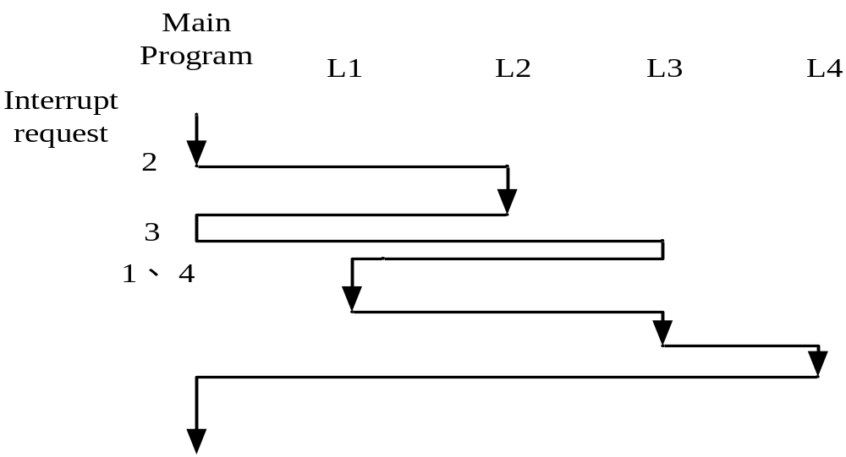
Sec.14.1 8088/8086 Interrupts
Interrupt Mask Bit
Suppose a 4-level interrupt system, the default interrupt priority is 1→2→3→4.

Slide 14
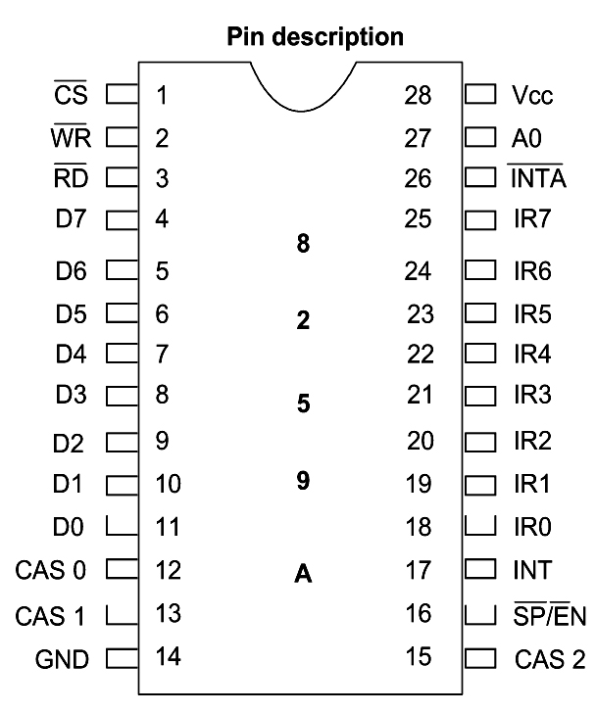
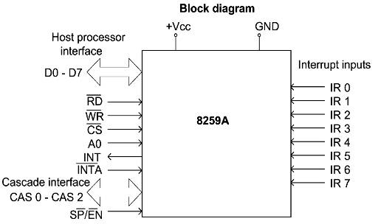
Sec.14.3 8259 Programmable interrupt controller
8259 Chip
Figure 14-3 8259A Programmable Interrupt Controller

Slide 15
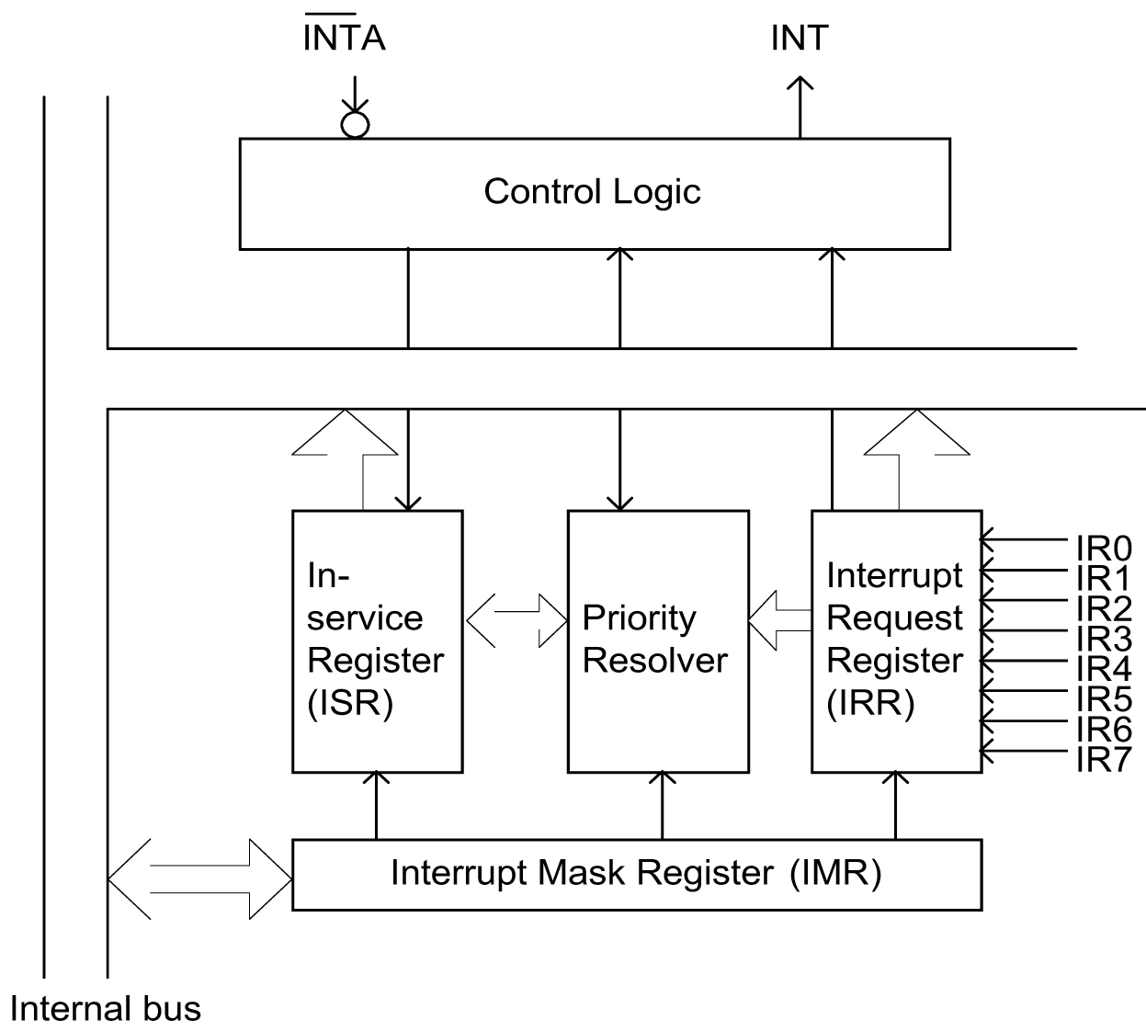
Sec.14.3 8259 Programmable interrupt controller
8259 Chip

Slide 16
Sec.14.3 8259 Programmable interrupt controller
8259 Chip Status Register
There are three status registers in the 8259, interrupt request register (IRR), in-service register (ISR), and interrupt mask register
(IMR).
The IRR is an 8-bit register that indicates which interrupt request are active.
The ISR is an 8-bit register that contains the level of interrupt being serviced.
The IMR is an 8-bit register that holds the interrupt mask bits and indicates which interrupts are masked off.

Slide 17
Sec.14.3 8259 Programmable interrupt controller
8259 Chip Pins
IR0~IR7, Interrupt request inputs are used to request an interrupt. When a HIGH is put on any of IR0~IR7, the 8088/8086 will jump to
a vector location.
CS, active-low input signal, Chip select enables the 8259 for
programming and control.
WR, The write input connects to the write strobe signal IOWC.
RD, The read input connects to the IORC signal.

Slide 18
Sec.14.3 8259 Programmable interrupt controller
8259 Chip Pins
D0~D7, The tri-state bidirectional data connections are normally
connected to the data bus on the microprocessor.
INT, The interrupt output connects to the INTR pin on the microprocessor from the master and is connected to a master IR pin
on a slave.
INTA, The interrupt acknowledge is an input that connects to the
INTA signal on the system.

Slide 19
Sec.14.3 8259 Programmable interrupt controller
8259 Chip Pins
CAS0~CAS2, The cascade lines are used as outputs from the master to the slave for cascading multiple 8259s in a system. CAS0, CAS1, CAS2 can be used to set up several 8259 chips to expand the number of hardware interrupts of the 8088/86 up to 64 by cascading
the 8259 chips in a master-slave configuration.

Slide 20
Sec.14.3 8259 Programmable interrupt controller
8259 Chip Pins
SP/EN, Slave programming / enable buffer, is a dual-function pin. When the 8259 is in buffered mode, this is an output that controls the data bus transceivers in a large microprocessor-based system. When the 8259 is not in the buffered mode, this pin
programs the device as a master (1) or a slave (0).

Slide 21
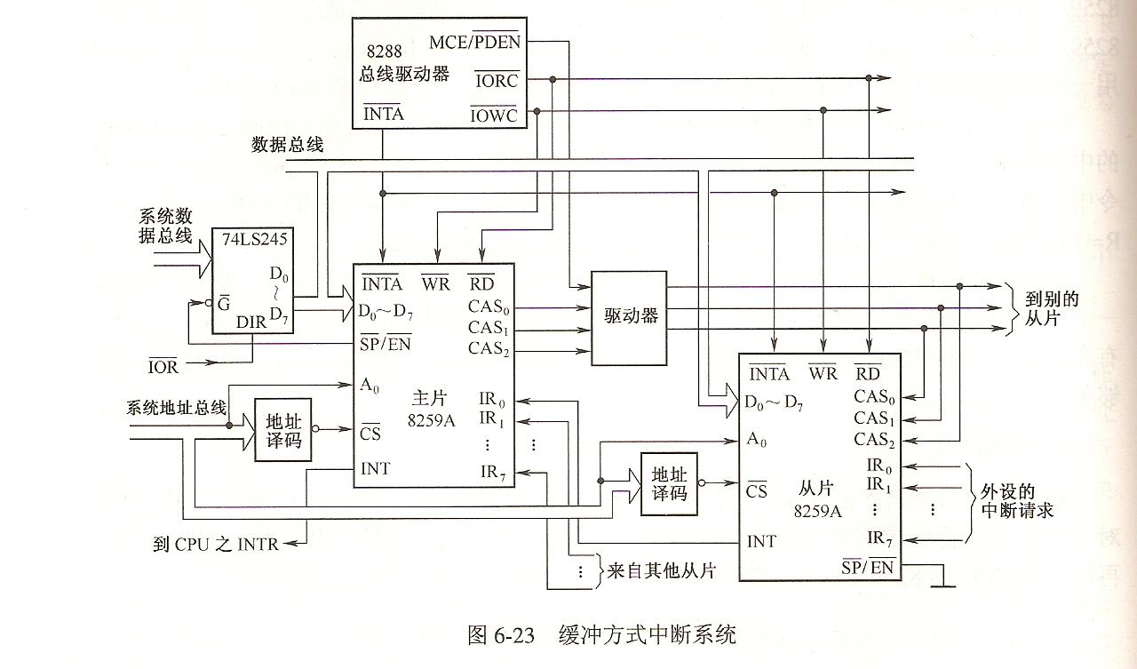
Sec.14.3 8259 Programmable interrupt controller
Buffered Mode

Slide 22
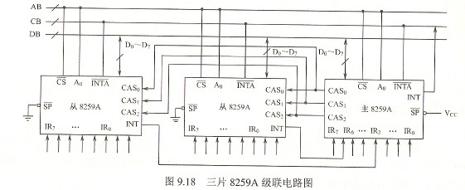
Sec.14.3 8259 Programmable interrupt controller
Not in Buffered Mode

Slide 23
Sec.14.3 8259 Programmable interrupt controller
8259 control words and ports
The 8259 has four ICWs (initialization command word), are programmed before the 8259 is able to function in the system and dictate the basic operation of the 8259. 3 OCWs (operation command
word) are programmed during the normal course of operation.

Slide 24
Sec.14.3 8259 Programmable interrupt controller
8259 Read/Write Operation
A0 | D4 | D3 | RD | WR | CS | Operation
0 |  |  | 0 | 1 | 0 | IRR / ISR / Interrupt Level to data bus
1 |  |  | 0 | 1 | 0 | IMR to Data Bus
0 | 0 | 0 | 1 | 0 | 0 | Data Bus to OCW2
0 | 0 | 1 | 1 | 0 | 0 | Data Bus to OCW3
0 | 1 | x | 1 | 0 | 0 | Data Bus to ICW1
1 | x | x | 1 | 0 | 0 | Data Bus to OCW1, ICW2, ICW3, ICW4
x | x | x | x | x | 1 | High Impedance

Slide 25
Sec.14.3 8259 Programmable interrupt controller
8259 control words and ports
CS | A0 | Initialization
0 | 0 | ICW1
0 | 1 | ICW2, ICW3, ICW4
1 | x | 8259 is not addressed
Example 14-7
Find the address for ICW1-ICW4 if chip select is activated by
A7~A1=0010011.
A7 A6 A5 A4 A3 A2 A1 A0
0 0 1 0 0 1 1 0
0 0 1 0 0 1 1 1
Solution:
The above shows 26H to be the port for ICW1 and 27H for
ICW2, ICW3, ICW4.

Slide 26
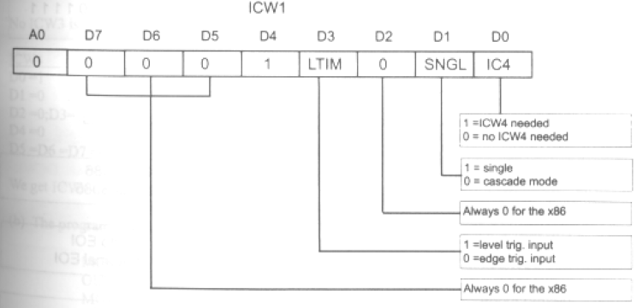
Sec.14.3 8259 Programmable interrupt controller
ICW1

Slide 27
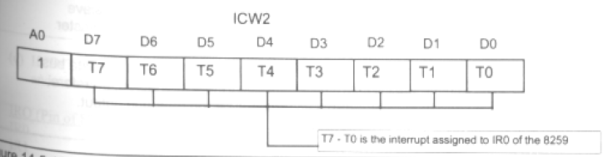
Sec.14.3 8259 Programmable interrupt controller
ICW2
It is the function of ICW2 to assign interrupt numbers to IR0-
IR7. While the lower three bits, D0, D1, and D2, vary from 000 to
111, they, along with D3-D7 (T3 through T7), form the 8-bit INT
type number assigned to the corresponding IR0 through IR7.

Slide 28
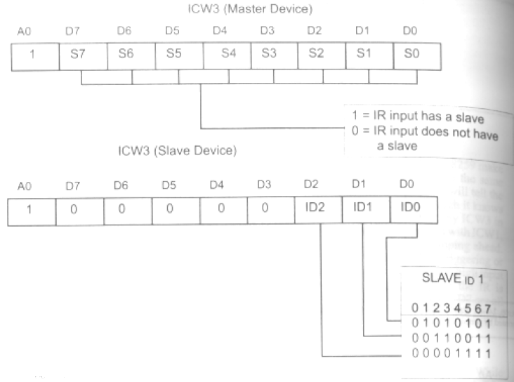
Sec.14.3 8259 Programmable interrupt controller
ICW3
ICW3 is used only when 2 or more 8259s are cascaded.

Slide 29
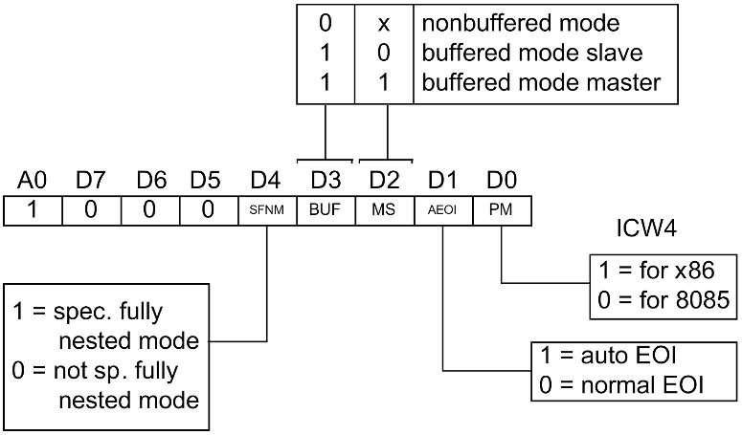
Sec.14.3 8259 Programmable interrupt controller
ICW4
SFNM, special fully nested mode must be used when
8259 is in master mode,

Slide 30
Sec.14.3 8259 Programmable interrupt controller
The initialization sequence of ICW
D0 (ICW1) | D1(ICW1) | Sequence
0 | 0 | ICW1,ICW2,ICW3
0 | 1 | ICW1,ICW2
1 | 0 | ICW1,ICW2,ICW3,ICW4
1 | 1 | ICW1,ICW2,ICW4

Slide 31
Sec.14.3 8259 Programmable interrupt controller
Fully Nested Mode
This mode is selected when a logic 0 level is placed in D4 of ICW4. This assigns the highest priority to IR0 and the lowest to IR7. In this case, if IR3 and IR5 are activated at the same time, first
IR3 is served and then IR5.
When IR3 is being served, IR2 request service. Then IR3 is
put on hold, IR2 is served. After IR2 is served, IR3 will continue.

Slide 32
Sec.14.3 8259 Programmable interrupt controller
Special Fully Nested Mode (SFNM)
This mode is selected when a logic 1 level is placed in D4 of
ICW4.
Compared with the “Fully Nested Mode”, SFNM can request the same level interrupt request. In “Fully Nested Mode”, when a IRQ is being served, only the higher lever interrupt
can be served.
In master-slave mode, SFNM is usually used in master 8259.

Slide 33
Sec.14.3 8259 Programmable interrupt controller
End of Interrupt (EOI)
When the CPU acknowledges IR3, the 8259 marks (sets to 1) the bit associated with IR3 in its ISR (in-service register ) to indicate that this is being serviced now. Issuing EOI to the 8259 indicates that servicing IR3 is now complete and the bit associated
with IR3 in register ISR can be reset to zero.
Therefore IR3 can be allowed to come in again.

Slide 34
Sec.14.3 8259 Programmable interrupt controller
Example 14-8
Find the ICWs of the 8259 if it is used with an 8088/86 CPU, single, level triggering IRs, and IR0 is assigned “INT 50H”. The 8259 is in slave buffered mode with normal EOI.
Show the program to initialize the 8259 using the port addresses in Example 14-7.
Find the addresses associated with IR0, IR1, and IR2 in the interrupt vector table.
Solution:
From Figure 14-5, we get the following for each of the ICWs:
ICW1
D0=1 ICW4 needed; D1=1 single
D2=0 this is always zero for 80x86 CPUs
D3=1 level triggering D4=1 required by the ICW1 itself
D5=D6=D7=0 this is always zero for 80x86 CPUs

Slide 35
Sec.14.3 8259 Programmable interrupt controller
Example 14-8
This gives ICW1=00011011=1BH. To get ICW2, look at Table 14-4.
Always equate ICW2 to the INT # assigned to IR0: ICW2=01010000=
50H. Notice that “INT nn”, assigned to IR0, can decide only bits D7-D3
(T7-T3 in Figure 14-5) of ICW2. This means that the “INT nn” assigned
to IR0 must have the lower three bits=000; therefore, it can take either
values of X0H or X8H, where X is a hex number. Fore example “INT
45H” cannot be assigned to IR0.
No ICW3 is needed since it is single and not cascaded.
ICW4
D0=1 8088/86;
D1=0 normal (we must issue EOI before IRET instruction)
D2=0; D3=1 slave buffered mode
D4=0 not nested
D5=D6=D7=0 required by the ICW4
We get ICW4=00001001=09H

Slide 36
Sec.14.3 8259 Programmable interrupt controller
Example 14-8
(b) The program is as follows:
MOV AL, 1BH ;ICW1
OUT 26H, AL ;TO PORT 26H
MOV AL, 50H ;ICW2
OUT 27H, AL ;TO PORT 27H
MOV AL, 09 ;ICW4
OUT 27H, AL ;TO PORT 27H
(c) If “INT 50H” is assigned to IR0, then IR1 and IR2 have “INT 51H” and “INT 52H”, respectively, and so on.
IRQ (Pin of 8259) INT Logical address Physical address
IR0 50H 0000:0140-0143H 00140-00143H
IR1 51H 0000:0144-0147H 00144-00147H
IR2 52H 0000:0148-014BH 00148-0014BH

Slide 37
Sec.14.3 8259 Programmable interrupt controller
OCW (operation command word)
With the help of OCWs, a programmer can dynamically change the priority associated with each of IR0-IR7, or mask any of them.
CS | A0 | Operation Command Word
0 | 0 | OCW2, OCW3
0 | 1 | OCW1
1 | X | 8259 is not addressed

Slide 38
Sec.14.3 8259 Programmable interrupt controller
OCW (operation command word)
Example 14-9
Find the port address for the OCWs of the 8259 in Example 14-7.
Solution:
From Table 14-5 and Example 14-7:
A7 A6 A5 A4 A3 A2 A1 A0
0 0 1 0 0 1 1 0 =26H Port for OCW2 and OCW3
0 0 1 0 0 1 1 1 =27H Port for OCW1
OCW2, OCW3, and ICW1 have the same port address, they are distinguish from each other by the bit of D4.
D4=1, ICW1

Slide 39
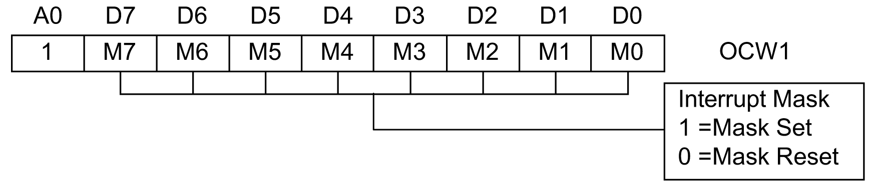
Sec.14.3 8259 Programmable interrupt controller
OCW1

Slide 40
Sec.14.3 8259 Programmable interrupt controller
OCW1
OCW1 is used to mask any of IR0-IR7. Logic 1 is for
masking (disabling) and 0 for unmasking (enabling).
Example 14-10
Write the code to unmask (enable) IR0-IR7.
Solution:
To enable IR0-IR7, use 0 for M0-M7 in OCW1 of Figure 14-7.
OCW1=0000 0000 = 00H
MOV AL, 00 ;OCW1 to unmask IR0-IR7
OUT 27H, AL ;issue OCW1 to IMR

Slide 41
Sec.14.3 8259 Programmable interrupt controller
OCW1
There are occasions when one needs to know which IR is disabled and which one is enabled. In that case, simply read OCW1, which is the contents of IMR.
IN AL, 27H

Slide 42
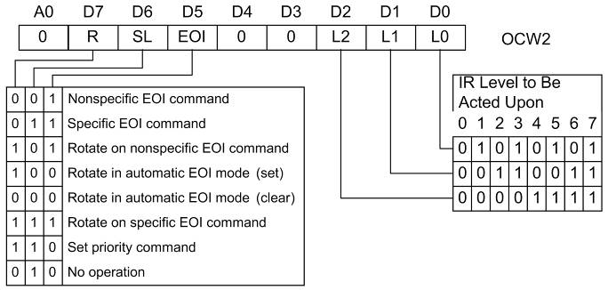
Sec.14.3 8259 Programmable interrupt controller
OCW2
This command word is used to assign a specific priority to the IRs.

Slide 43
Sec.14.3 8259 Programmable interrupt controller
OCW2
The EOI commands of OCW2 are used only if the AEOI mode is not selected by ICW4. If AEOI is selected, the interrupt automatically resets the interrupt bit and does not modify priority.
Programmed only when the AEOI mode is not selected for 8259. In this case, the OCW2 selects the way that 8259 responds to
the interrupt.

Slide 44
Sec.14.3 8259 Programmable interrupt controller
Nonspecific End-of-Interrupt (D7~D5=001 in OCW2)
A command sent by the interrupt service procedure to signal the end of the interrupt. The 8259 automatically determines which interrupt level was active and resets the correct bit of the interrupt status register. Resetting the status bit allows the interrupt to take
action again or a lower priority interrupt to take effect.
……
MOV AL, 20H
OUT 26H, AL ; write OCW2
IRET
…..

Slide 45
Sec.14.3 8259 Programmable interrupt controller
Specific End-of-Interrupt (D7~D5=011 in OCW2)
A command that allows a specific interrupt request to be reset. The exact position is determined with bits D2~D0 of OCW2.
……
MOV AL, 66H
OUT 26H, AL ; write OCW2
IRET
…..

Slide 46
Sec.14.3 8259 Programmable interrupt controller
Rotate on Nonspecific EOI (D7~D5=101 in OCW2)
A command that functions exactly like the Nonspecific EOI command, except that it rotates interrupt priorities after resetting the interrupt status register bit. The level reset by this command
becomes the lowest-priority interrupt.
For example, if IR4 was just serviced by this command, it becomes the lowest-priority interrupt input and IR5 becomes the
highest priority.

Slide 47
Sec.14.3 8259 Programmable interrupt controller
Rotate on Specific EOI (D7~D5=111 in OCW2)
Functions as the specific EOI, except that it selects rotating
priority.
In this scheme the 8259 can be programmed to make the rotation follow a specific sequence rather than IR0 to IR7, which
is the case for the automatic rotation mode.

Slide 48
Sec.14.3 8259 Programmable interrupt controller
D0~D2 of OCW2
D0~D2 have two functions, one is that it indicates which the
specific bit of ISR will be resetted when the interrupt ends.
The other function is indicate the priorities of interrupt request
when OCW2 is in Rotate on Specific EOI.
The D6 bit must be 1, then D0~D2 can be activated.

Slide 49
Sec.14.3 8259 Programmable interrupt controller
OCW2
Set Rotate in automatic EOI mode, the D7~D5 is 100. In IBM PC, it was initialized in Non-automatic mode, this mode is not used. If this mode must be turned off when it is used, we can use clear command ( D7~D5=000 Clear Rotate automatic mode).
Set priority (D7~D5=110) allows the programmer to set the
priority interrupt input using D0~D2.

Slide 50
Sec.14.3 8259 Programmable interrupt controller
Importance of the EOI (end of interrupt) command
INT_SERV PROC FAR ;routine for IR1
… …
MOV AL, 20H ;the EOI byte for OCW2
OUT 26H, AL ;to port designed for OCW2
IRET ;return from ISR to the main
program
INT_SERV PROC FAR ;routine for IR1
… …
MOV AL, 66H ;the EOI byte for OCW2
OUT 26H, AL ;to port designed for OCW2
IRET ;return from ISR to the main
program

Slide 51
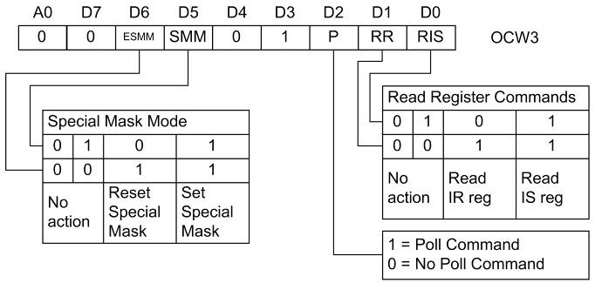
Sec.14.3 8259 Programmable interrupt controller
OCW3

Slide 52
Sec.14.3 8259 Programmable interrupt controller
Special Mask Mode
When D6D5=11 of OCW3, the special mask mode is set. In this case, the lower priority interrupt can be served when a higher interrupt is served. The Special mask mode is set, the ISR bit associated the interrupt being served will be resetted. So the
lower priority interrupt can be activated.

Slide 53
Sec.14.3 8259 Programmable interrupt controller
Example of the Special Mask Mode
Suppose that the even address of 8259 is 80H，odd address is 81H, The IR4 is being served.
…
CLI ;in order to set the mode，clear the IF
MOV AL, 68H ;Set Special Mask mode using OCW3
OUT 80H, AL
IN AL, 81H ;Read IMR
OR AL, 10H ;Set IR4 IMR bit
OUT 81H, AL ;Write to IMR
STI ;Set IF
… ;continue to process IR4
… ;IF IR7 request, process IR7, after finish IR7 request, return to process IR4
… ;continue to serve IR4

Slide 54
Sec.14.3 8259 Programmable interrupt controller
Example of the Special Mask Mode
CLI ; in order to set the mode，clear the IF
IN AL,81H ;Read IMR
AND AL, 0EFH ;Clear IR4 bit of IMR
OUT 81H, AL ;resume the IMR
MOV AL, 48H ;clear special mask mode using OCW3
OUT 80H, AL
STI ;Set IF
… ;continue to serve IR4
MOV AL,20H ;End of Interrupt
OUT 80H,AL
IRET

Slide 55
Sec.14.3 8259 Programmable interrupt controller
OCW3
If polling is selected, the P bit (D2) must be set and then output to the 8259. The next read operation will read the poll word. The rightmost three bits of the poll word indicate the active interrupt request with the highest priority. The leftmost bit indicates whether
there is an interrupt.
D7 D6 D5 D4 D3 D2 D1 D0
  I x x x x R₂ R₁ R₀

Slide 56
Sec.14.3 8259 Programmable interrupt controller
Read Operation in 8259
Read the signal from odd address in 8259, we can get the IMR
content.
Read the signal from even address in 8259, we can get the status of 8259 (polling command), or ISR and IRR contents. They are
read by programming OCW3 (depending on the bits of D2~D0).

Slide 57
Sec.14.3 8259 Programmable interrupt controller
Read Operation in 8259
IN AL, 26H after this instruction executed, the content of AL register depends on the D0~D2 of OCW3.
D2=1, D1=1 the AL includes the polling information.
D2=0, D1=1, D0=1, the AL register will get the ISR value.
D2=0, D1=1, D0=0, the AL register will get the IRR value.

Slide 58
Sec.14.3 8259 Programmable interrupt controller
OCW3
Example：read the status of 8259. There are two steps, first set the OCW3, then read the status of 8259
If OCW3 is 00001010B，it will read IRR；
If OCW3 is 00001011B，it will read ISR.
MOV AL, 0BH ；OCW3 indicate read ISR
OUT 20H, AL ；20H is OCW3 port address
NOP ；
IN AL, 20H ；read ISR
MOV AH, AL ；save ISR to AH
OR AL, AH ；check whether some interrupt is being served？
JNZ AW-INT ；
…

Slide 59
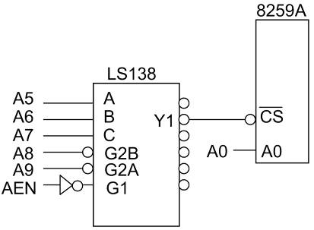
Sec.14.4 Use of the 8259 chip in the IBM PC/XT
Interfacing the 8259 to the 8088 in IBM PC/XT computers

Slide 60
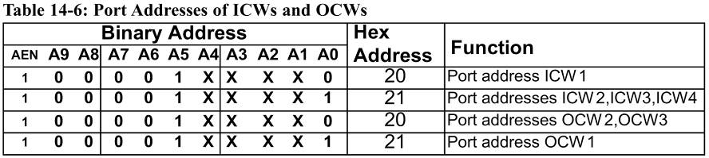
Sec.14.4 Use of the 8259 chip in the IBM PC/XT
Interfacing the 8259 to the 8088 in IBM PC/XT computers

Slide 61
Sec.14.4 Use of the 8259 chip in the IBM PC/XT
Initialization words of the 8259 in the IBM PC/XT
The following configuration for the control words ICW1, ICW2, and
ICW4 can be calculated:
ICW1 IBM PC/XT Configuration
D0=1 ICW4 needed
D1=1 single
D2=0 for 80x86 this must be zero
D3=0 edge triggering
D4=1 required by ICW1 itself
D5=D6=D7=0 0s for 8088/86 based systems
ICW1 = 00010011 = 13H

Slide 62
Sec.14.4 Use of the 8259 chip in the IBM PC/XT
Initialization words of the 8259 in the IBM PC/XT
ICW2 is the interrupt number for IR0, which in the case of the IBM
PC/XT and compatibles in INT 08.
D7 D6 D5 D4 | D3 D2 D1 D0 | Interrupt Input | INT type
0 0 0 0 | 1 0 0 0 | IR0 | INT 08
0 0 0 0 | 1 0 0 1 | IR1 | INT 09
0 0 0 0 | 1 0 1 0 | IR2 | INT 0A
0 0 0 0 | 1 0 1 1 | IR3 | INT 0B
0 0 0 0 | 1 1 0 0 | IR4 | INT 0C
0 0 0 0 | 1 1 0 1 | IR5 | INT 0D
0 0 0 0 | 1 1 1 0 | IR6 | INT 0E
0 0 0 0 | 1 1 1 1 | IR7 | INT 0F

Slide 63
Sec.14.4 Use of the 8259 chip in the IBM PC/XT
Initialization words of the 8259 in the IBM PC/XT
ICW3 is used only when multiple 8259 chips are connected in
master/slave mode, which is the case in 80286, 386, 486, and Pentium
PCs. Next the ICW4 configuration will be examined.
ICW4 IBM PC/XT Configuration
D0=1 8088/86
D1=0 normal (issue EOI before IRET)
D2=0, D3=1 slave buffered mode
D4=0 not nested
D5=D6=D7=0 required by ICW4
ICW4 = 0000 1001 = 09H

Slide 64
Sec.14.4 Use of the 8259 chip in the IBM PC/XT
Initialization words of the 8259 in the IBM PC/XT
This gives the following code for 8259 initialization:
MOV AL, 13H ;the ICW1
OUT 20H, AL
MOV AL, 8 ;the ICW2
OUT 21H, AL
MOV AL, 9 ;the ICW4
OUT 21H, AL

Slide 65
Sec.14.4 Use of the 8259 chip in the IBM PC/XT
Initialization words of the 8259 in the IBM PC/XT
The IBM PC/XT BIOS version of the above program is as follows:
INTA00 EQU 20H
INTA01 EQU 21H
… … …
C21:
MOV AL, 13H
OUT INTA00, AL
MOV AL, 8
OUT INTA01, AL
MOV AL, 09
OUT INTA01,AL

Slide 66
Sec.14.4 Use of the 8259 chip in the IBM PC/XT
Sequences of hardware interrupts with the 8259
After an IR is activated, the 8259 will respond by putting a high on INTR, thereby signaling the CPU for an interrupt request.
The 8088/86 puts the appropriate signals on S0, S1, and S2 (S0=0, S1=0, and S2=0), indicating to the 8288 that an interrupt has been requested.
The 8288 issues the first INTA to the 8259.
The 8259 receives the first INTA and does internal housekeeping, which includes resolution of priority (if more than one IR has been activated) and resolution of cascading.
The 8288 issues the second INTA to 8259.
The second INTA pulse makes the 8259 to put a signal interrupt vector byte on the data bus which the 8088/86 will latch in. The value of the single depends on ICW2 and which IR has been activated.
If it is in AEOI mode, the corresponding bit of ISR will be resetted.

Slide 67
Sec.14.4 Use of the 8259 chip in the IBM PC/XT
Sequences of hardware interrupts with the 8259
7. The 8088/86 uses this type to calculate the vector, which is four times the value of the INT type.
8. The 8088/86 pushes the flag register onto the stack, clears IF (Interrupt Flag) and TF (Trap Flag), thereby disabling further external interrupt requests and disabling single-step mode, and finally pushes the present CS:IP registers onto the stack.
9. The 8088/86 reads CS:IP of the interrupt service routine from the vector table and begins execution of the interrupt routine.

Slide 68
Sec.14.4 Use of the 8259 chip in the IBM PC/XT
Sources of hardware interrupts in the IBM PC/XT
Of the 8 interrupts for the 8259, IBM has used two of them, IR0 and
IR1, for internal use of the system. The other six, IR2 through IR7, are
available through the expansion slots.
INT 08 IRQ0 channel 0 of 8253 timer to update TOD
INT 09 IRQ1 keyboard input data
INT 0AH IRQ2 reserved
INT 0BH IRQ3 serial COM2
INT 0CH IRQ4 serial COM1
INT 0DH IRQ5 alternative printer
INT 0EH IRQ6 floppy disk
INT 0FH IRQ7 parallel printer LPT1

Slide 69
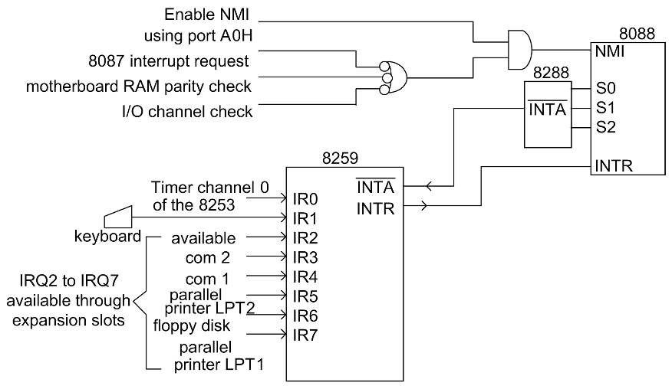
Sec.14.4 Use of the 8259 chip in the IBM PC/XT
Sources of hardware interrupts in the IBM PC/XT

Slide 70
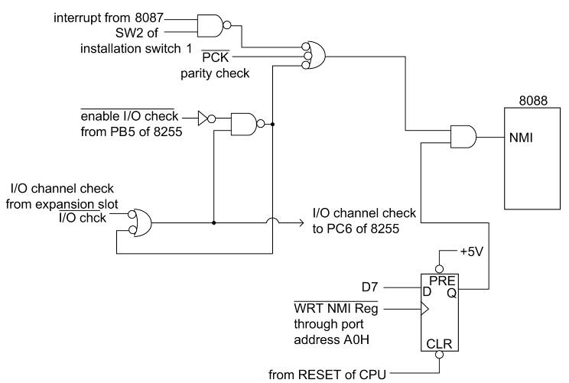
Sec.14.4 Use of the 8259 chip in the IBM PC/XT
Sources of NMI in the IBM PC

Slide 71
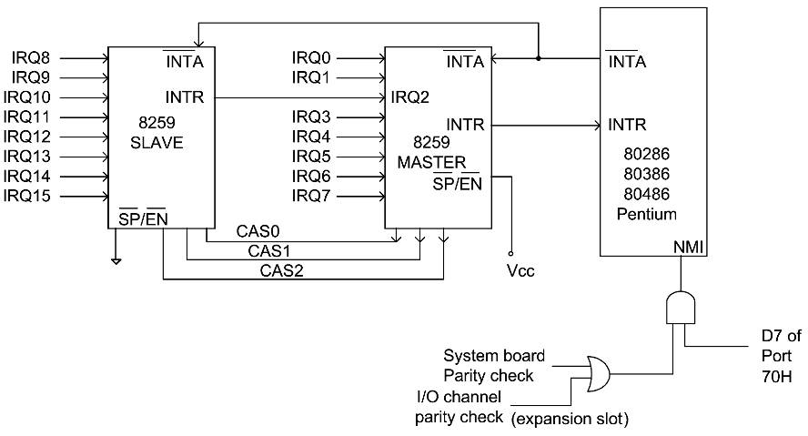
Sec.14.5 Interrupts on 80286 and higher 80x86 PCs
IBM PC AT hardware interrupts

Slide 72
Sec.14.5 Interrupts on 80286 and higher 80x86 PCs
8259 in master mode
The port addresses assigned to the master are the same as the port
addresses in the PC/XT, 20H and 21H. The following is a program to
initialize the 8259 master from the IBM PC/XT BIOS Technical
Reference, with slight modifications for the sake of clarity:
MOV AL, 11H ;ICW1-EDGE, MASTER, ICW4
OUT 20H, AL
MOV AL, 8 ;SETUP ICW2 – INTERRUPT TYPE 8 (8-F)
OUT 21H, AL
MOV AL, 04H ;SETUP ICW3 – MASTER LEVEL 2
OUT 21H, AL
MOV AL, 01H ;SETUP ICW4 – MASTER X86 MODE
OUT 21H, AL

Slide 73
Sec.14.5 Interrupts on 80286 and higher 80x86 PCs
8259 in slave mode
Port | ICWs | OCWs
A0H | ICW1 | OCW2, OCW3
A1H | ICW2, ICW3, ICW4 | OCW1
The following is a program to initialize the 8259 master from the
IBM PC/XT BIOS Technical Reference, with slight modifications for
the sake of clarity:
MOV AL, 11H ;ICW1-EDGE, MASTER, ICW4
OUT A0H, AL
MOV AL, 70H ;SETUP ICW2–INTERRUPT TYPE 70h (70-77)
OUT A1H, AL
MOV AL, 02H ;SETUP ICW3 – SLAVE LEVEL 2
OUT A1H, AL
MOV AL, 01H ;SETUP ICW4 –X86 MODE SLAVE
OUT A1H, AL

Slide 74
Sec.14.5 Interrupts on 80286 and higher 80x86 PCs
AT-type computers interrupt assignment
;Hardware INT 71H—(IRQ Level 9) to INT 0AH (IRQ 2)
;Redirect slave interrupt 9 to interrupt level 2
RE_DIRECT PROC NEAR
PUSH AX
MOV AL, 20H
OUT 0A0H, AL
POP AX
INT 0AH
IRET
RE_DIRECT ENDP

Slide 75
Sec.14.5 Interrupts on 80286 and higher 80x86 PCs
If any of IRQ8~IRQ15 is activated, an EOI must be issued to both 8259s. The EOI must be sent to the slave 8259 since it originates the interrupt request but also to the master 8259 since the slave sends the request through IRQ2 of the
master.
……
MOV AL, 20H
OUT 0A0H, AL
OUT 20H, AL
IRET
….

Slide 76
Sec.14.5 Interrupts on 80286 and higher 80x86 PCs
Hardware Interrupt Assignment for ISA PCs
IRQ0 | INT 08 8254 TIMER OUT0 | IRQ8 | INT 70H CMOS real-time clock
IRQ1 | INT 09H Keyboard | IRQ9 | INT 71H Software redirected to INT 0AH
IRQ2 | INT 0AH Interrupt from 8259 #2 | IRQ10 | INT 72H Available
IRQ3 | INT 0BH Serial port COM2 | IRQ11 | INT 73H Available
IRQ4 | INT 0CH Serial port COM1 | IRQ12 | INT 74H PS/2 mouse
IRQ5 | INT 0DH Parallel port 2: LPT2 | IRQ13 | INT 75H Math coprocessor
IRQ6 | INT 0EH Floppy disk Controller | IRQ14 | INT 76H Hard disk
IRQ7 | INT 0FH Parallel port 1: LPT1 | IRQ15 | INT 77H Available

Slide 77
Sec.14.5 Interrupts on 80286 and higher 80x86 PCs
Interrupt priority
Order | Interrupt
1 | INT instruction or exception
2 | Single step
3 | NMI
4 | Processor extension segment overrun
5 | INTR
IRQ0, IRQ1, IRQ8, IRQ9, IRQ10, IRQ11, IRQ12, IRQ13, IRQ14, IRQ15, IRQ3, IRQ4, IRQ5, IRQ6, IRQ7

Slide 78
Next Lesson
Memory and Memory Interfacing

