Slide 1

Chapter 10
Memory and Memory Interfacing

Slide 2
Main Contents
Capacity, organization, and speed as used in semiconductor
memories
Methods of address decoding for memory chips
The memory map of IBM PC
Data integrity in ROM and RAM
16-bit memory design and related issues

Slide 3
Sec.10.1 Semiconductor memory fundamentals
In the design of all computers, semiconductor memories are used as primary storage for code and data. Semiconductor memories are connected directly to the CPU and they are the
memory that the CPU first asks for information (code and data).
Semiconductor memories are sometimes referred to as primary memory. The main requirement of primary memory is that it must
be fast in responding to the CPU.

Slide 4
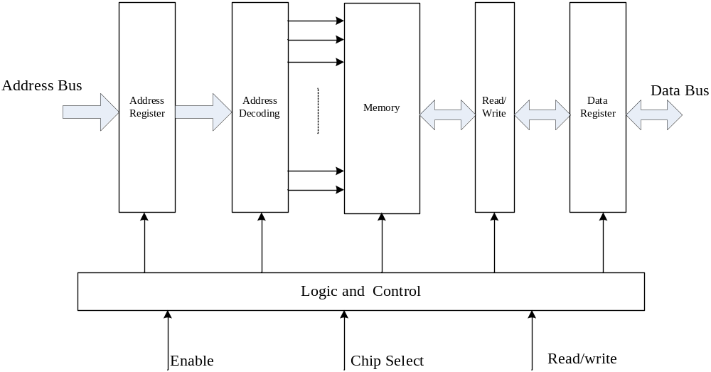
Sec.10.1 Semiconductor memory fundamentals

Slide 5
Sec.10.1 Semiconductor memory fundamentals
Memory capacity
The number of bits that a semiconductor memory chip can
store is called its chip capacity. It can be in units of Kbits
(kilobits), Mbits (megabits), and so on. This must be
distinguished from the storage capacity of computers.

Slide 6
Sec.10.1 Semiconductor memory fundamentals
Memory organization
Memory chips are organized into a number of locations within the IC. Each location can hold 1 bit, 4 bits, 8 bits, or
even 16 bits, depending on how it is designed internally.
The number of bits that each location within the memory chip can hold is always equal to the number of data pins on
the chip.

Slide 7
Sec.10.1 Semiconductor memory fundamentals
Memory organization
Each memory chip contains 2^{x} locations, where x is the number of address pins on
the chip.
Each location contains y bits, where y is the number of data pins on the chip.
The entire chip will contain 2^{x}×y bits, where x is the number of address pins and y
is the number of data pins on the chip.
4. The 2^{x}×y is referred to as the organization of the memory chip, where x is number of address pins and y is the number of data pins on the chip.
2¹⁰=1024=1K. Notice that in common speech, 1K is 1000 (as in discussing salaries
or distance), but in computer terminology it is 1024.

Slide 8
Sec.10.1 Semiconductor memory fundamentals
Byte Addressability
We have three basic information quantities to deal with: the bit, byte, and word. A byte is always 8 bits, but the word length typically ranges from 16 to 64 bits.
The most practical assignment is to have successive addresses refer to successive byte location in the memory.
The term byte-addressable memory is used for this assignment.

Slide 9
Sec.10.1 Semiconductor memory fundamentals
Byte Addressability
Example：
The word length of a processor is 32 bits, the capacity of memory is 16MB. The doubleword-addressable range is
16MB/64=2M

Slide 10
Sec.10.1 Semiconductor memory fundamentals
Speed
One of the most important characteristics of a memory chip is the speed at which data can be accessed from it. To access the data, the address is presented to the address pins, and after a certain amount of time has elapsed, the data shows up at the data pins. The speed of the memory chip is
commonly referred to as its access time.

Slide 11
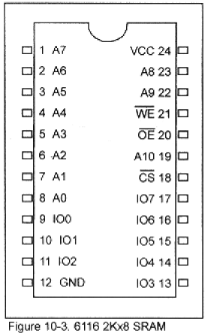
Sec.10.1 Semiconductor memory fundamentals
SRAM (static RAM)
Storage cells in static RAM memory are made of flip-flops and
therefore do not require refreshing in order to keep their data.
Figure 10-3 shows the pin
Diagram for the 6116 SRAM
Chip. The 6116 has an
Organization of 2K×8.
WE (write enable)
OE (output enable)
CS (chip select)

Slide 12
Sec.10.1 Semiconductor memory fundamentals
DRAM (dynamic RAM)
In 1970s, Intel Corporation introduced the first dynamic RAM (random access memory). Its density (capacity) was 1024 bits and it used a capacity to store each bit. The use of a capacitor as a means to store data cuts down the number of transistors needed to build the cell;
however, it requires constant refreshing due to leakage.

Slide 13
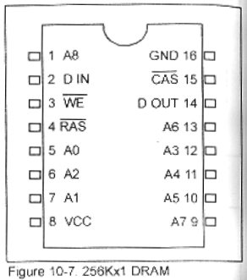
Sec.10.1 Semiconductor memory fundamentals
Packaging issue in DRAM
To reduce the number of pins needed for
addresses, multiplexing/demultiplexing is
used. The method used is to split the address
into halves and send in each half of the
address through the same pins, thereby
requiring fewer address pins. Internally, the
DRAM structure is divided into a square of
rows and columns. The first half of the
address is called the row and the second half
is called the column.

Slide 14
Sec.10.2 Memory address decoding
Address decoding
We also can use the simple logic gates to accomplish address decoding, The CPU provides the address of the data desired, the decoding circuitry locate the memory chip where
the desired data is stored.
Just as the decoding circuitry of I/O ports, the decoding
circuitry also need address bus signal and control bus signal.

Slide 15
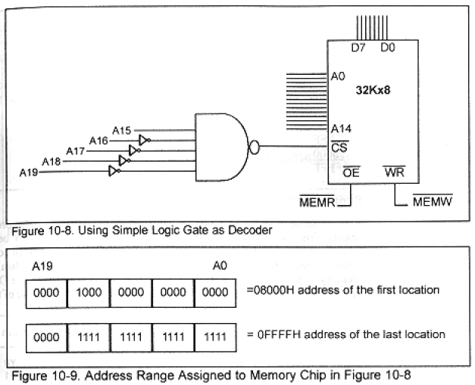
Sec.10.2 Memory address decoding
Address decoding

Slide 16
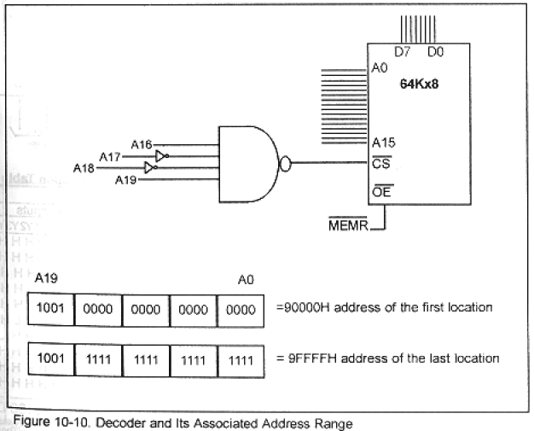
Sec.10.2 Memory address decoding
Example 10-6

Slide 17
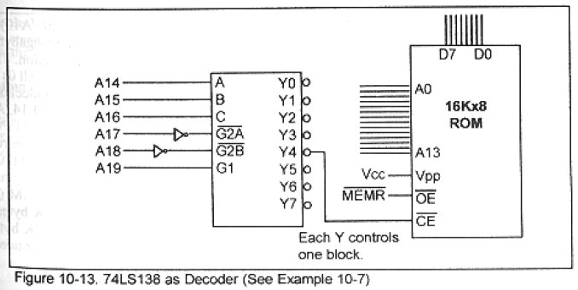
Sec.10.2 Memory address decoding
Example 10-7
The address range for Y4 F0000H~F3FFFH
A19~A14 1111 00
The address range for Y2 E8000H~EBFFFH
A19~A14 1110 10

Slide 18
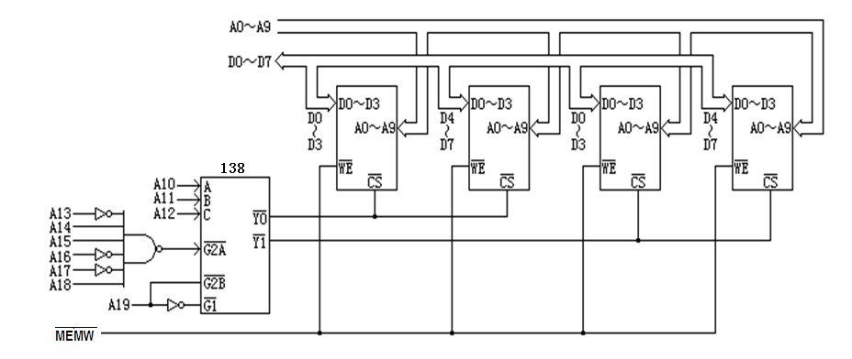
Sec.10.2 Memory address decoding
Using Intel 2114 (1K×4) and 74LS138, design the memory decoding circuitry, the address range is 4C000H~4C7FFH, memory organization is 2K×8.

Slide 19
Sec.10.3 IBM PC Memory Map
All x86 CPUs in real mode provide 20 address bits (A0~A19). Therefore the maximum amount of memory that they can access is
one megabyte (1M).
Of the 1024K bytes (1M), the designers of the original IBM PC decided to set aside 640K for RAM, 128K for video display RAM,
and 256K for ROM.

Slide 20
Sec.10.3 IBM PC Memory Map
How MS-DOS manages the memory of the IBM PC and x86 compatibles. Memory has several types in IBM PC, conventional memory, upper memory block (UMB), high memory area (HMA),
expanded memory and extended memory.

Slide 21
Sec.10.3 IBM PC Memory Map
Conventional memory
The designers of the original IBM PC set aside only the first 640K of the 1024K address space for RAM. The first 640K bytes of memory are located at the contiguous address range of 00000H to 9FFFFH, is called conventional memory. Some refer to this as
lower memory.

Slide 22
Sec.10.3 IBM PC Memory Map
Upper memory area
The term Upper Memory Area refers to the address range
A0000H~FFFFFH, a total of 384K.
The designers of the first IBM PC set aside 128K, from A0000H~BFFFFH, for video RAM. From address
C0000H~FFFFFH, a total of 256K, was set aside for ROM.

Slide 23
Sec.10.3 IBM PC Memory Map
High memory area (HMA)
In real mode, all processors provide only 1M of memory space. For 286, 386, 486 and Pentium processors can access 65520 bytes
of memory from 100000H~10FFEFH in real mode.
In other words, the CPU in real mode can access another 65520 bytes of memory beyond the 1M address space. The memory
address space is called high memory area.

Slide 24
Sec.9.5 8-Bit and 16-Bit ISA BUS
A20 gate and the case of high memory area (HMA)
A20 is an anomaly associated with 286 and higher microprocessor.
In the 8088, when the segment register added to the offset is more than
FFFFFH, it automatically wraps around and starts at 00000H.
In 80286 and higher microprocessor, in real mode, such a wrap-around will not occur. In stead, the result will be 100000H, making A20=1.

Slide 25
Sec.9.5 8-Bit and 16-Bit ISA BUS
A20 gate and the case of high memory area (HMA)
Example 9-1 If the A20 gate is enabled, show the highest address that 286 can access while still
in real mode. How far high above 1M is this address.
Solution:
To access the highest physical location in real mode, we must have CS=FFFFH and
IP=FFFFH, then the highest address is FFFF0H+FFFFH=10FFEFH.
Therefore, the addresses FFFF0H~10FFEFH are the range that the CPU can access while is in real mode.
(b) Accessible memory locations above 1M are 100000H to 10FFEFH.

Slide 26
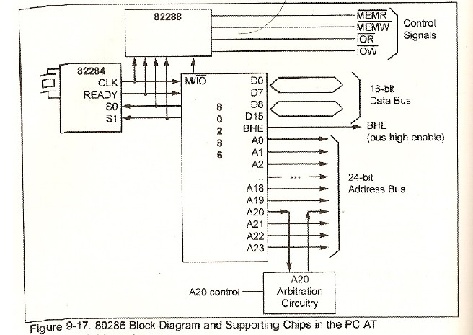
Sec.9.4 80286 Microprocessor
80286 Block Diagram and Supporting Chips in the PC/AT

Slide 27
Sec.10.3 IBM PC Memory Map
Expanded Memory
IBM PC designers set aside only 640K for RAM, and the rest
was set aside for video memory and ROM.
This limited the use of application program. In order to solve the problem of memory limitation due to the 640K barrier. Expanded Memory was proposed, (expanded memory specifications). In expanded memory, it allow the microprocessor
to access information beyond the 640K barrier.

Slide 28
Sec.10.3 IBM PC Memory Map
Extended Memory
With the introduction of the 80286-based IBM PC AT, the
actual memory space is 16M, 80386 is 4GB.
In order to access the memory beyond 1M, the extended memory specification (XMS) standard was developed in 1988. The
memory space beyond 1M (100000H) is called extended memory.

Slide 29
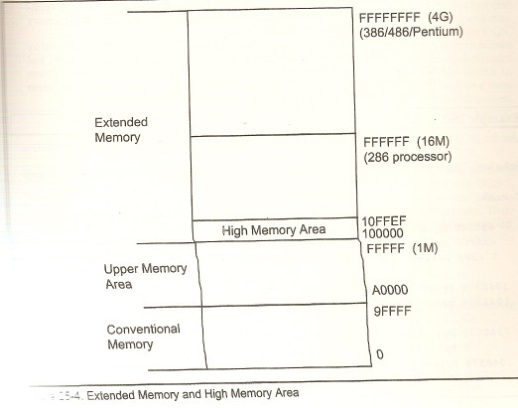
Sec.10.3 IBM PC Memory Map

Slide 30
Sec.10.3 IBM PC Memory Map
Conventional memory: 640K of RAM
Of the 640K conventional memory, some is used by the MS-DOS operating system and the rest of the available RAM is used by
utilities and application programs.
The first 1K (00000 to 003FF) 1024bytes, is set aside for the interrupt vector table. 00400 to 004FF is set aside for the BIOS temporary data area, certain number of kilobytes is occupied by the
operating system itself.

Slide 31
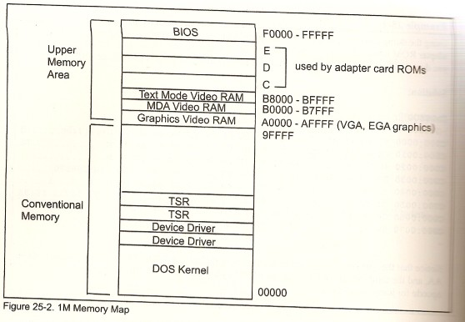
Sec.10.3 IBM PC Memory Map
1M Memory Map

Slide 32
Sec.10.3 IBM PC Memory Map
ROM Address and Cold Boot in the PC
The first code executed by the CPU must be stored in nonvolatile memory. 256K in the upper memory block (C0000H~ FFFFFH) are set aside for ROM. The 8088 starts to fetch information from CS:IP of FFFF:0000, which gives the physical
address FFFF0H.

Slide 33
Sec.10.4 Data Integrity in RAM and ROM
When storing data, one major concern is maintaining data integrity. That is, ensuring that the data retrieved is the same as the
data stored.
There are many ways to ensure data integrity depending on the type of storage.
Checksum, Parity bit, CRC (cyclic redundancy check)

Slide 34
Sec.10.4 Data Integrity in RAM and ROM
Checksum byte
The checksum byte is an extra byte that is tagged to the end of a series of bytes of data. To calculate the checksum byte of a series of bytes of data, the following steps can be taken.
1. Add the bytes together and drop the carries.
2. Take the 2’complement of the total sum, and that is the checksum bytes, which becomes the last byte of the stored
information.

Slide 35
Sec.10.4 Data Integrity in RAM and ROM
Checksum byte
To perform the checksum operation, add all the bytes, including the checksum byte. The result must zero. If it is not zero, one or
more bytes of data have been changed.

Slide 36
Sec.10.4 Data Integrity in RAM and ROM
Checksum Program
When the PC is turned on, one of the first thing the BIOS does is to test the system ROM.
ROS_CHECKSUM PROC NEAR
MOV CX, 8192 ; NUMBER OF BYTES TO ADD
ROS_CHECKSUM_CNT:
XOR AL, AL
C26: ADD AL, DS:[BX]
INC BX ; POINT TO NEXT BYTE
LOOP C26 ; ADD ALL BYTES IN ROS MODULE
OR AL, AL ; SUM=0?
RET
ROS_CHECKSUM ENDP

Slide 37
Sec.10.4 Data Integrity in RAM and ROM
Use of Parity bit in DRAM error detection
The data stored in ROM is fixed, usually can not be changed for a long time. The data stored RAM are updated at any moment, in order to keep the integrity of the input data and output data, parity bit is added into the data. If the data have even 1 bits, then the added bit is logic 1 level; if the data have odd 1 bits, the added bit is
logic 0 level.

Slide 38
Sec.10.4 Data Integrity in RAM and ROM
Parity bit generator/checker in the IBM PC
When a single bit is changed from 1 to 0, or from 0 to 1, a parity bit is used to detect such errors. Including a parity bit to ensure data integrity in RAM is the most widely used method since it is the
simplest and cheapest.
In IBM PC, 74LS280 parity bit generator and checker is used
to implement the concept of the parity bit.

Slide 39
Sec.10.4 Data Integrity in RAM and ROM
74LS280 Parity Check
 | Inputs |  | Outputs
Case | A-H | I | Even | Odd
1 | Even | 0 | 1 | 0
2 | Even | 1 | 0 | 1
3 | Odd | 0 | 0 | 1
4 | Odd | 1 | 1 | 0

Slide 40
Sec.10.4 Data Integrity in RAM and ROM
Parity bit generator/checker in the IBM PC
In Figure 10-19, inputs A-H are connected to the data bus, which is 8 bits, or one byte. The I input is used as a parity bit to check the correctness of the byte of data read from memory. When a byte of information is written to a given memory location in DRAM, the even-parity bit is generated and saved on the ninth
DRAM chip as a parity bit with use of control signal MEMW.

Slide 41
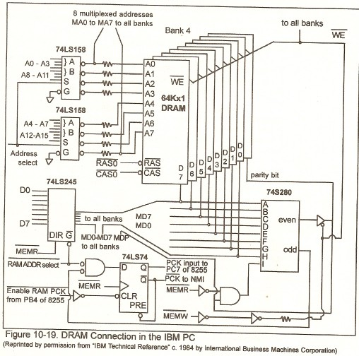
Sec.10.4 Data Integrity in RAM and ROM
Parity bit generator/checker
in the IBM PC

Slide 42
Sec.9.4 80286 Microprocessor
General Description of 80286
80286 can work in one of two modes: real mode or protected mode. In real mode, the maximum memory it can access is 1M. To access the entire 16M bytes of memory, it must work in protected
mode.

Slide 43
Sec.9.4 80286 Microprocessor
General Description of 80286
Pins A0~A23
These output signals provide a 24-bit address to be used by the
decoding circuitry to locate memory or I/O.
When providing an address for memory, all 24 pins must be used (A0~A23). When access an I/O address, only A0~A15 or A0~A7 are used depending on the number of I/O address, which is
16-bit or 8-bit address.

Slide 44
Sec.9.4 80286 Microprocessor
General Description of 80286
Pins D0~D15
These pins provide the 16-bit path for data to be transferred in and out of the CPU. Unlike the 8088, the data bus is not multiplexed. The use of separate pins for address and data saves time since it eliminates
the need for a demultiplexer.

Slide 45
Sec.9.4 80286 Microprocessor
General Description of 80286
Pins BHE (bus high enable)
This is an active-low output signal used to indicate the data is being transferred on D8~D15. The 80286 coordinates the activity on
the D0~D15 data bus with the help of A0 and BHE.

Slide 46
Sec.9.4 80286 Microprocessor
General Description of 80286
BHE, A0 and Byte Selection in the 80286
BHE | A0 | Data Bus Status
0 | 0 | Transferring 16-bit data on D0~D15
0 | 1 | Transferring a byte on the upper half of data bus D8~D15
1 | 0 | Transferring a byte on the lower half of data bus D0~D7
1 | 1 | Reserved ( the data bus is idle )

Slide 47
Sec.9.4 80286 Microprocessor
General Description of 80286
Pin RESET This is an input signal and is active high. When there is a low-to-high transition on RESET ( and it stays high for at least 16
clocks), the 80286 initializes all registers to their predefined values.
As long as the RESET pin is high, no instruction or bus activity is allowed. We must pay more attention on the following signals.

Slide 48
Sec.9.4 80286 Microprocessor
General Description of 80286
Bus | Signal Level during Reset
D0~D15 | High Impedance
A0~A23 | high
W/R | Low
M/IO | High
Register | Contents
CS | F000
IP | FFF0
DS | 0000
SS | 0000
ES | 0000

Slide 49
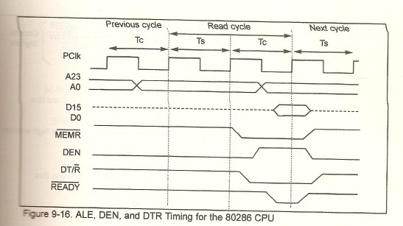
Sec.9.4 80286 Microprocessor
Timing for the 80286 CPU

Slide 50
Sec.10.5 16-bit Memory Interfacing
Odd and Even Banks
In a 16-bit CPU such as the 80286, memory locations 000000~FFFFFFH are designated as odd and even bytes. To distinguish between odd and even bytes, the CPU provides a signal called BHE. BHE in association with A0 is used to select the odd or
even byte.

Slide 51
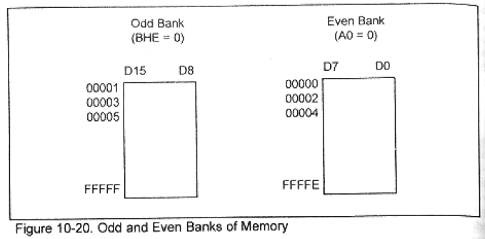
Sec.10.5 16-bit Memory Interfacing
Odd and Even Banks
BHE | A0
0 | 0 | Even word | D0-D15
0 | 1 | Odd byte | D8-D15
1 | 0 | Even byte | D0-D7
1 | 1 | None

Slide 52
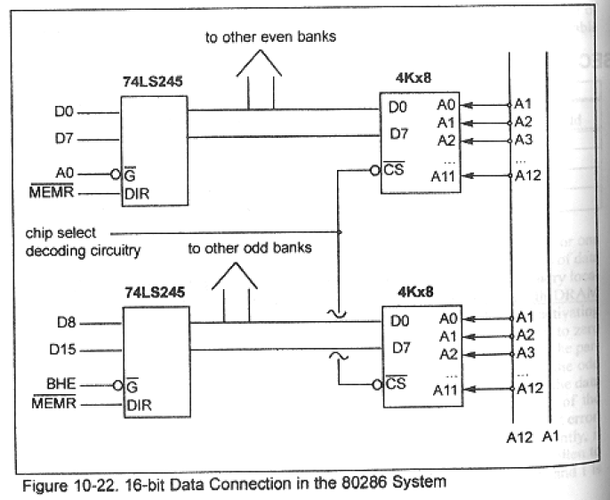
Sec.10.5 16-bit Memory Interfacing
Odd and Even Banks
Figure 10-22 shows the connection for the 16-bit data bus. In Figure 10-22, the use of A0 and BHE as bank selectors. The use of the 74LS245 chip as a data bus buffer.640KB of DRAM for 16-bit
buses.

Slide 53
Sec.10.5 16-bit Memory Interfacing
Accessing Even and Odd Words
One word has two bytes, the address of a word can start at an even or odd number. In 8088, accessing a byte takes one memory
cycle, accessing any word will take 2 memory cycles.
In 80286 or higher processor, accessing a word with an even address takes one memory cycle, accessing a word with an odd
address requires two memory cycles.

Slide 54
Sec.10.5 16-bit Memory Interfacing
Accessing Even and Odd Words
On a 16-bit system, it is best to try to put any words on an even address. Indeed this is so important that there is a directive specifically designed for this purpose. It is the EVEN directive and
is used as follows:
EVEN
VALUE1 DW ?

Slide 55
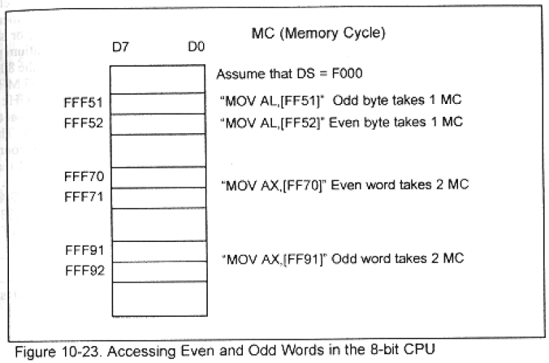
Sec.10.5 16-bit Memory Interfacing
Accessing Even and Odd Words

Slide 56
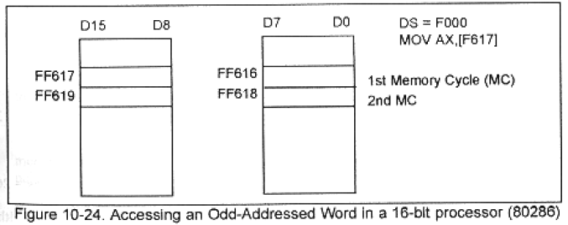
Sec.10.5 16-bit Memory Interfacing
Accessing Even and Odd Words

Slide 57
Interfacing 8-bit peripherals to a 16-bit data bus
I/O Bus Bandwidth for ISA
16-bit data ports instruction
Inputting Data Outputting Data
(1) IN AX, port# OUT port#, AX
(2) MOV DX, port# MOV DX, port#
IN AX, DX OUT DX, AX
Example: MOV DX, 310H
MOV AX, 98F6H
OUT DX, AX ; send out AX to port 310H & 311H

Slide 58
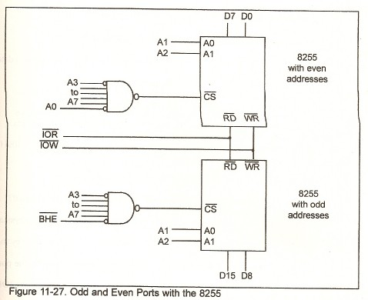
Interfacing 8-bit peripherals to a 16-bit data bus

Slide 59
Sec.15.1 Concept of DMA
Concept of DMA
In a computer, the widely used methods to transfer data from I/O to memory is
1) Inquiry
2) Interrupt
3) DMA

Slide 60
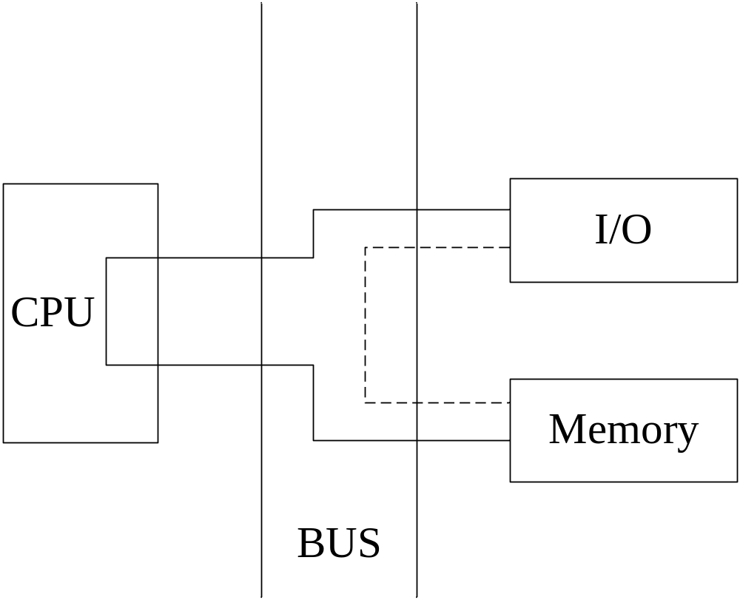
Sec.15.1 Concept of DMA
Concept of DMA

Slide 61
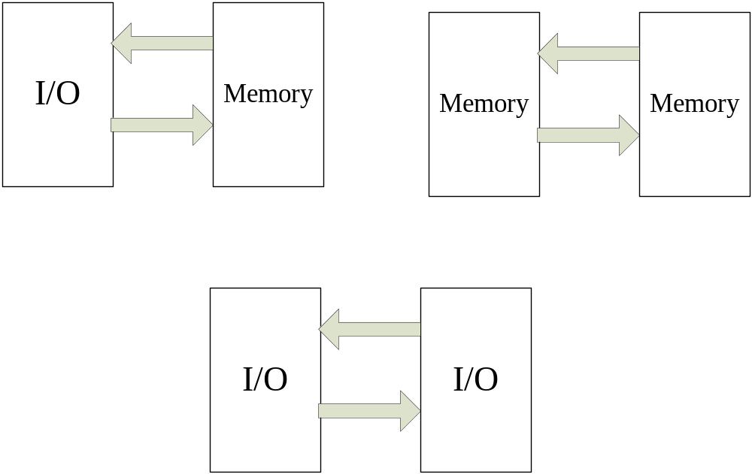
Sec.15.1 Concept of DMA
Concept of DMA

Slide 62
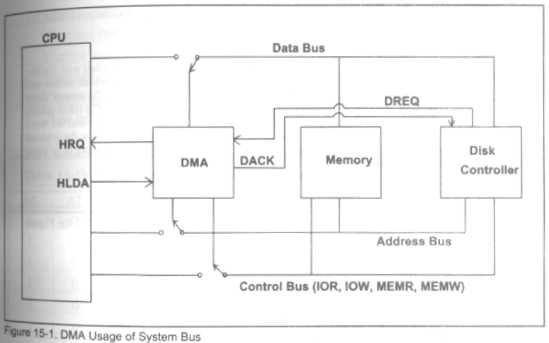
Sec.15.1 Concept of DMA
Concept of DMA

Slide 63
Sec.15.1 Concept of DMA
Transfer Data to I/O Device from Memory
1) The peripheral device will request the service of DMA by polling DREQ high.
2) The DMA will put a high on its HRQ (hold request), signaling the CPU through its HOLD pin that it needs to use the buses.
3) The CPU will finish the present bus cycle and respond to the DMA request by putting high on its HLDA, thus telling the 8237 DMA that it can go ahead and use
the buses to perform its task.
4) DMA will activate DACK which tells the peripheral device that it will start to
transfer the data.

Slide 64
Sec.15.1 Concept of DMA
Transfer Data to I/O Device from Memory
5) DMA starts to transfer the data from memory to peripheral by putting the address of the first byte of the block on the address bus and activating MEMR, thereby reading the byte from memory into the data bus; it then activates IOW to write it to the peripheral. The DMA decrements the counter and increments the address pointer
and repeats this process until the counter reaches zero and the task is finished.
6) After the DMA has finished its job it will deactivates HRQ, signaling the CPU that
it can regain control over its bus.

Slide 65
The End
Thanks!

