Slide 1


Principles of Computer Organization and Interfacing
THE 80x86 IBM PC AND COMPATIBLE COMPUTERS

Slide 2
Feature of the Course
Major Basic Course
Specialized Course
Preliminary knowledge
C Language
Digital Circuit

Slide 3
What will we learn?
The lesson includes four parts, computer organization, computer architecture, assembly language programming, 80x86 PC interfacing.
The computer organization
The computer architecture
The instruction functions with Intel family of microprocessors
Basic I/O interface
Interrupts
Direct Memory Access (DMA)

Slide 4
Application
Industry Control
Transaction Processing
CAD/CAM
Education and Learning
Home Entertainment
Computation of Science and Project
Artificial Intelligence

Slide 5
Textbook
THE x86 ASSEMBLY LANGUAGE, DESIGN, AND INTERFACING. 5th Edition, Muhammad Ali Mazidi,
ISBN 978-7-121-09770-6 电子工业出版社

Slide 6
References
1. 微机原理、汇编语言及接口技术 ，周杰英、张萍等编，人民邮电出版社
2. The Intel Microprocessors 8086/8088, 80186/80188, 80286, 80386, Pentium, Architecture, Programming, and Interfacing (Seventh
Edition) , Barry B. Brey
3. 微机原理与接口技术 （第2版）， 朱晓华等编著， 电子工业
出版社
4. Computer Organization （Fifth Edition）Carl Hamacher
ISBN 7-111-10346-7 机械工业出版社

Slide 7
References
5. 计算机组成与体系结构 （美）Linda Null 著 黄河等译 机械工业出版社
6. 计算机组成原理（第2 版） 唐朔飞 编著 高等教育出版社

Slide 8
Chapter 0
Introduction to Computing
THE 80x86 IBM PC AND COMPATIBLE COMPUTERS

Slide 9
Main Content
Convert any number from base 2, base 10, or base 16 to any other two bases
Add and subtract binary and hex numbers
binary number in 2’s complement
ASCII code
Definitions of KB, MB, GB, TB
Digital Primer
Architecture of Microprocessor
CHAPTER 0

Slide 10
Sec.0.1 Numbering and coding systems
Converting from decimal to binary
Example 0-1
Convert 25₁₀ to binary.
Solution:
Quotient Remainder
25/2 = 12 1 LSB (Least significant bit)
12/2 = 6 0
6/2 = 3 0
3/2 = 1 1
1/2 = 0 1 MSB (most significant bit)
Therefore, 25₁₀ = 11001₂.
CHAPTER 0

Slide 11
Sec.0.1 Numbering and coding systems
Converting from binary to decimal
Example 0-2
Convert 11001₂ to decimal.
Solution:
Weight: 16 8 4 2 1
Digits: 1 1 0 0 1
Sum: 16+ 8+ 0 0 1 = 25₁₀
Example 0-3
Use the concept of weight to convert 39₁₀ to binary.
Solution:
Weight: 32 16 8 4 2 1
Digits: 1 0 0 1 1 1
Sum: 32+ 0+ 0+ 4+ 2+ 1 = 39
CHAPTER 0

Slide 12
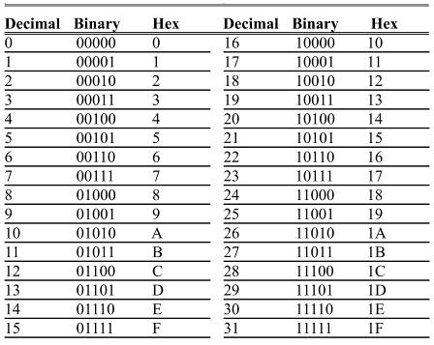
Sec.0.1 Numbering and coding systems
Table 0-2 shows the relationship between all three bases in the sequence of numbers from 0 to 31 in decimal, with equivalent binary & hex numbers.
In each base, when one
more is added to the
highest digit, that digit
becomes zero.
A 1 is carried to the next-
highest digit position.
CHAPTER 0

Slide 13
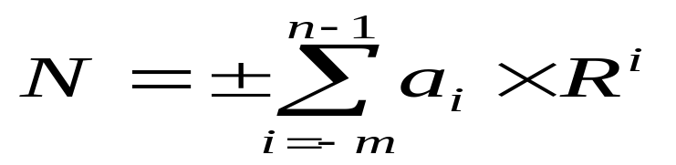

Sec.0.1 Numbering and coding systems
Converting number from base R to base 10
CHAPTER 0

Slide 14
Sec.0.1 Numbering and coding systems
Converting number from base 10 to base R
When convert number from base 10 to base R, the integer and decimal fraction need to be calculated
respectively.
Dividing the integer by R repeatedly, keeping track of the remainders, this process continues until the quotient
becomes zero.
CHAPTER 0

Slide 15
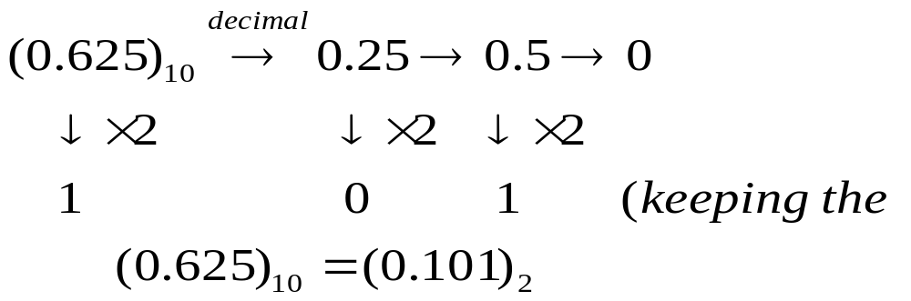
Sec.0.1 Numbering and coding systems
Converting number from base 10 to base R
Multiplying decimal by R repeatedly, keeping the integer, this process continues until the product is zero or
depending on the request.
integer )
CHAPTER 0

Slide 16
Sec.0.1 Numbering and coding systems
Expression of the signed number
The most significant digit (MSB) denotes the sign, the other digits are aside for the magnitude of the number.
If the MSB=1, it denotes negative,
If the MSB=0, it denotes positive.
+81=01010001 -81=11010001
A 8 bits binary number ( 00000000~11111111) is one of the numbers (0~255) for unsigned, (-128~127) for signed.
CHAPTER 0

Slide 17
Sec.0.1 Numbering and coding systems
Expression of the signed number
For a positive, the 1’s complement and 2’s complement are same as the signedmagnitude representation.
For a negative, the 1’s complement and 2’s complement can be gotten as following:
1’s complement
Changing all 1s and 0s to 0s and 1s.
2’s complement
Invert all the bits and then add 1 to the result.
CHAPTER 0

Slide 18
Sec.0.1 Numbering and coding systems
ASCII code
Because all information in the computer must be represented by 0s & 1s, binary patterns must be assigned to letters and other characters.
In the 1960s, a standard representation called ASCII was established.
  Named for the American Standard Code for
  Information Interchange
It assigns binary patterns for numbers 0 to 9, and
all English alphabet letters, upper- and lower-case.
  Also many control codes & punctuation marks.
CHAPTER 0

Slide 19
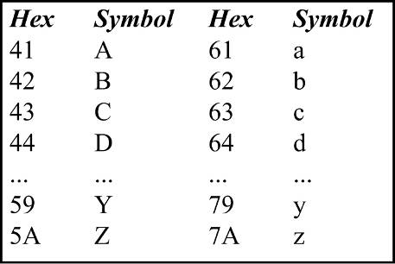
Sec.0.1 Numbering and coding systems
ASCII code
ASCII code is used by most computers, so information can be shared among them.
  ASCII uses a total of 7 bits to represent each code.
Often, a zero is placed
in the most-significant
bit position to make it
an 8-bit code.
CHAPTER 0
Figure 0-1 Selected ASCII Codes

Slide 20
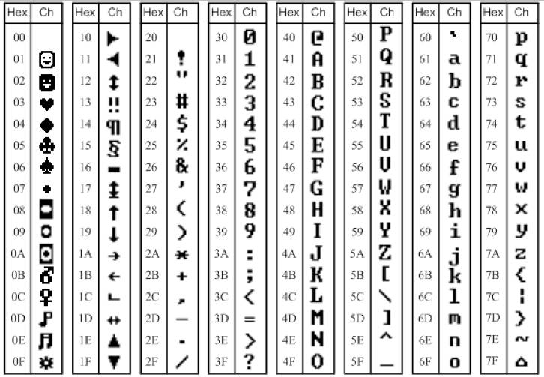
Sec.0.1 Numbering and coding systems
ASCII code
CHAPTER 0

Slide 21
Sec.0.2 Inside the computer
Some important terminology
Bit 1 bit
Nibble 4 bits
Byte 8 bits
Word 16 bits
Kilobyte 2¹⁰ bytes
Megabyte 2²⁰ bytes
Gigabyte 2³⁰ bytes
Terabyte 2⁴⁰ bytes
CHAPTER 0

Slide 22
Computer Architecture
Computer architecture refers to those attributes of the system that are visible to a programmer -- those attributes that have a direct impact on the execution of a program
  Instruction sets
  Number of bits used for data representation
  Addressing techniques
  I/O mechanisms
  e.g. Is there a multiply instruction?

Slide 23
Computer Organization
We will use computer organization to mean the underlying implementation of the architecture
(Computer organization is a computer architecture logical implementation )
Transparent to the programmer
An architecture can have a number of organizational implementations
  Control signals
  Interfaces
  memory technology.
  e.g. Is there a hardware multiply unit or is it done by repeated addition?

Slide 24
Architecture & Organization
All Intel x86 family share the same basic architecture
The IBM System/370 family share the same basic architecture
This gives code compatibility
  At least backwards
Organization differs between different versions

Slide 25
What Is A Computer?
Historically, a computer was a job title, not a piece of equipment!
Requirements of a computer:
  Process data
  Store data
  Move data between the computer and the outside world
  Control the operation of the above

Slide 26

Operations (1) Data movement

Slide 27
Operations (2) Storage

Slide 28
Operations (3) Processing from/to storage

Slide 29
Operations (4) Processing from/to I/O

Slide 30
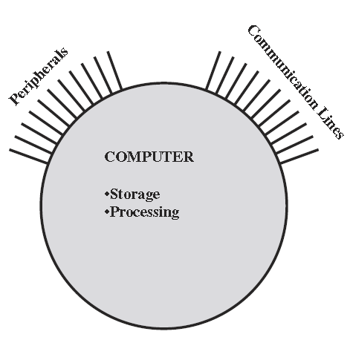
Computer Structure
Simplest possible depiction of a computer

Slide 31
Computer Structure
Peripherals
Computer
Central
Processing
Unit
Main
Memory
Computer
Systems
Interconnection
Input
Output
Communication
lines

Slide 32
The CPU
CPU
Computer
Arithmetic
and
Logic Unit
I/O
Registers
System
Bus
CPU
Internal CPU
Interconnection
Memory
Control
Unit

Slide 33
A Brief History of Computer
Mechanical Era (1600s-1940s)
The Electronic Era
  Performance ↑
  Capacity ↑
  Size ↓
  Cost ↓

Slide 34
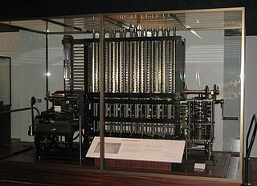
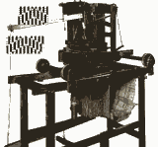
Mechanical Era (1600s-1940s)
Babbage’s difference machine
Pascal’s add machine

Slide 35
The Electronic Era (1946-)
1. Vacuum tube - 1946-1957
2. Transistor - 1958-1964
3. Small & Medium scale integration – 1965-1971
  Up to 3,000 devices on a chip
4. Large scale integration - 1971-1977
  3,000 - 100,000 devices on a chip
5. Very large scale integration - 1978 to date
  100,000 - 100,000,000 devices on a chip
6. Ultra large scale integration - future
  Over 100,000,000 devices on a chip

Slide 36
Moore’s Law
Increased density of components on chip
Gordon Moore – co-founder of Intel
Number of transistors on a chip will double every year

Slide 37
Brief History of the CPU
Manufacturer
Part Number
Data Bus Width
Memory Size
Intel
4004
4
4K
8008
8
16K
8080
8
64K
8086
16
1M
8088
8
1M
80286
16
16M
80386DX
32
4G
80486DX
32
4G+8K Cache
Pentium
64
4G+16K Cache
CHAPTER 0

Slide 38
Brief History of the CPU
Manufacturer
Part Number
Data Bus Width
Memory Size
Intel
Pentium II
64
64G+32K L1Cache+256K L2 Cache
Pentium III
64
64G+32K L1Cache+256K L2 Cache
Pentium 4
64
64G+32K L1Cache+256K L2 Cache
Motorola
6800
8
64K
68000
16
16M
68010
16
16M
68020
32
4G
68060
64
4G + 16K Cache
PowerPC
64
4G + 32K Cache
CHAPTER 0

Slide 39
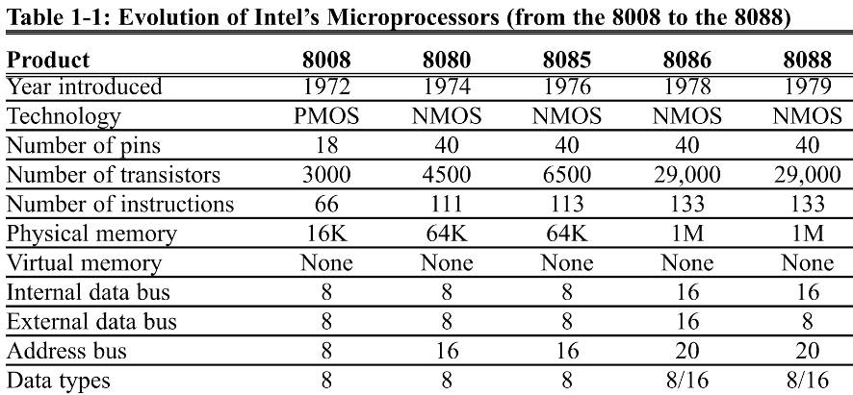
Brief history of the 80x86 family
the evolution of Intel’s family of microprocessors from the late 1970s,
14

Slide 40
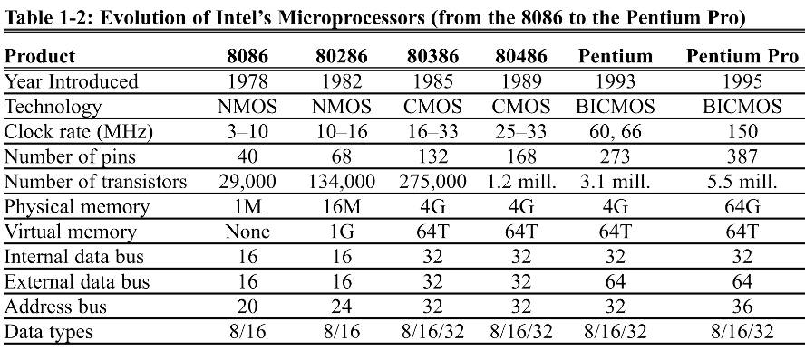
Brief history of the 80x86 family
the evolution of Intel’s family of microprocessors from the late 1970s,
CHAPTER 1

Slide 41
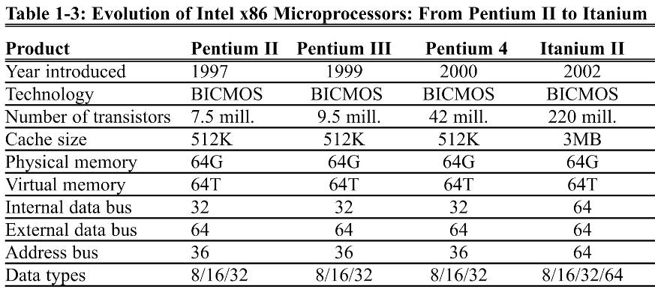
Brief history of the 80x86 family
the evolution of Intel’s family of microprocessors from the late 1970s,
2⁶⁴
CHAPTER 1

Slide 42
Von Neumann Machine
Developed by John von Neumann, publication 1945.
Alan Turing developed the same idea at about same time.
IAS (Institute for Advanced Studies) computer
  Stored-Program concept
  Main memory stores both data and instructions

Slide 43

Von Neumann Machine
IAS (Institute for Advanced Studies) computer
  Arithmetic and logic unit (ALU) capable of operating on binary data
  Control unit, which interprets and executes the instructions in memory
  Input and output (I/O) equipment operated by the control unit

Slide 44
Sec.0.2 Inside the computer
ROM and RAM
Two types of memory commonly used in microcomputers
are RAM and ROM.
RAM is ‘random access memory’, ( sometimes called
read/write memory).
ROM is ‘read only memory’, contains programs and
information essential to operation of the computer.
CHAPTER 0

Slide 45
Sec.0.2 Inside the computer
CPU (microprocessor) – performs arithmetic, logic, and data transfers
Memory – stores program and data
I/O – communicates to humans and machines
CHAPTER 0

Slide 46
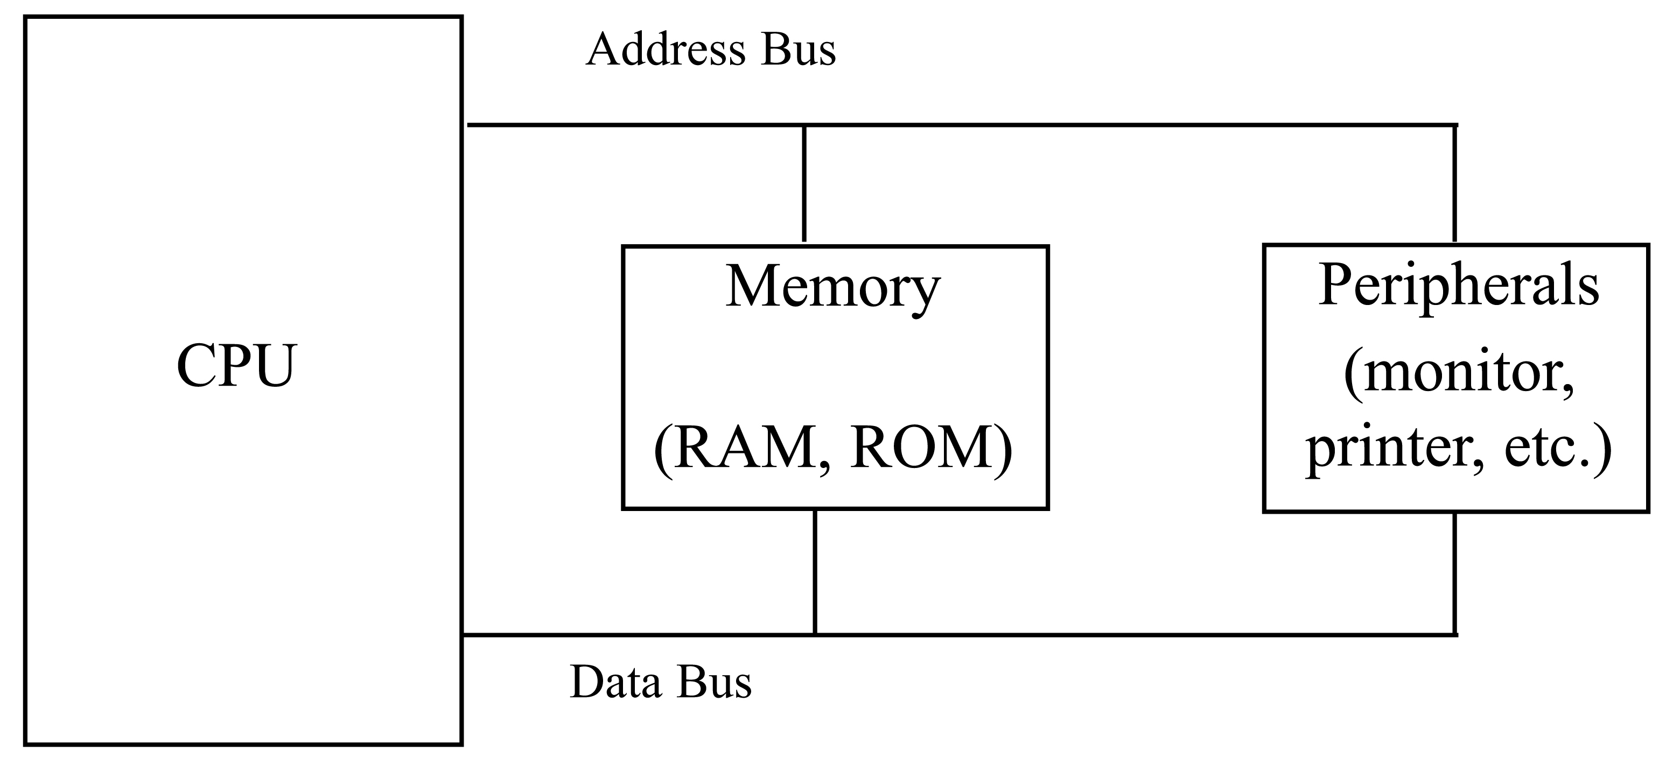
Sec.0.2 Inside the computer
Internal organization of computers
The internal working of every computer can be broken down
into three parts: CPU, memory, and I/O devices.
In every computer there are three types of buses: address
bus, data bus, and control bus.
Figure 0-9 Inside the
Computer
CHAPTER 0

Slide 47
Sec.0.2 Inside the computer
Internal organization of computers
Address Bus – selects a location in the memory or a specific I/O device
Data Bus – transfers data between the microprocessor and the memory or I/O
Control Bus – selects I/O or memory and causes a read or a write
CHAPTER 0

Slide 48
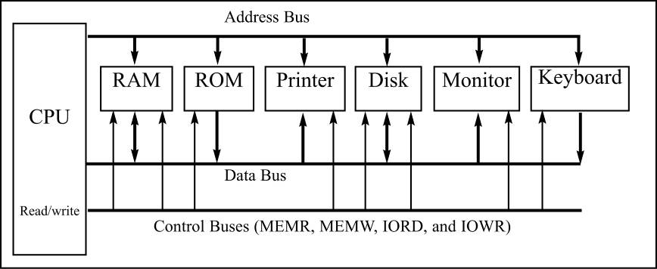
Sec.0.2 Inside the computer
More about the data bus
The average size of data buses in CPUs varies between 8
and 64. Data buses are bidirectional, since the CPU must use
them either to receive or to send data.
CHAPTER 0

Slide 49
Sec.0.2 Inside the computer
More about the address bus
The more address buses available, the larger the number of devices that can be addressed.
The address bus is a unidirectional bus, which means that the CPU uses the address bus only to send out addresses.
The total number of memory locations addressable by a given CPU is always equal to 2^{x} where x is the number of address bits, regardless of the size of the data bus.
CHAPTER 0

Slide 50

Sec.0.2 Inside the computer
In the simplest form, instruction processing consists of two steps:
  reads (fetches) instructions from memory one at a time
  executes each instruction
CHAPTER 0

Slide 51
Sec.0.2 Inside the computer
Inside CPUs
A program stored in memory provides instructions to the CPU to perform an action. It is the function of the CPU to fetch these instructions from memory and execute them. To perform the actions of fetch and execute, all CPUs are equipped with
resources such as follows.
CHAPTER 0

Slide 52
Sec.0.2 Inside the computer
Inside CPUs
Register
ALU (arithmetic/logic unit )
Program counter
Instruction decoder
CHAPTER 0

Slide 53
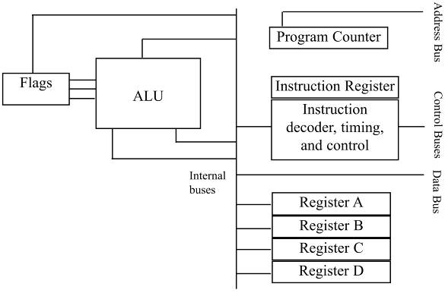
Sec.0.2 Inside the computer
Inside CPUs
Function of the CPU is to
fetch these instructions
from memory and then
execute them.
Figure 0-19 Internal Block Diagram of a CPU
CHAPTER 0

Slide 54
Sec.0.2 Inside the computer
Inside CPUs
Foremost among the resources at the disposal of the CPU are a number of registers. The CPU uses registers to store information temporarily.
The CPU also has what is called ALU (arithmetic/logic unit). The ALU section of the CPU is responsible for performing arithmetic functions such as add, subtract, multiply, and divide, and logic function such as AND, OR, and NOT.
CHAPTER 0

Slide 55
Sec.0.2 Inside the computer
Inside CPUs
Every CPU has what is called a program counter. The function of the program counter is to point to the address of the next instruction to be executed. It is the contents of the program counter that are placed on the address bus to find and fetch the desired instruction. In the IBM PC, the program counter is a register called IP, or the instruction pointer.
The function of the instruction decoder is to interpret the instruction fetched into the CPU.
CHAPTER 0

Slide 56
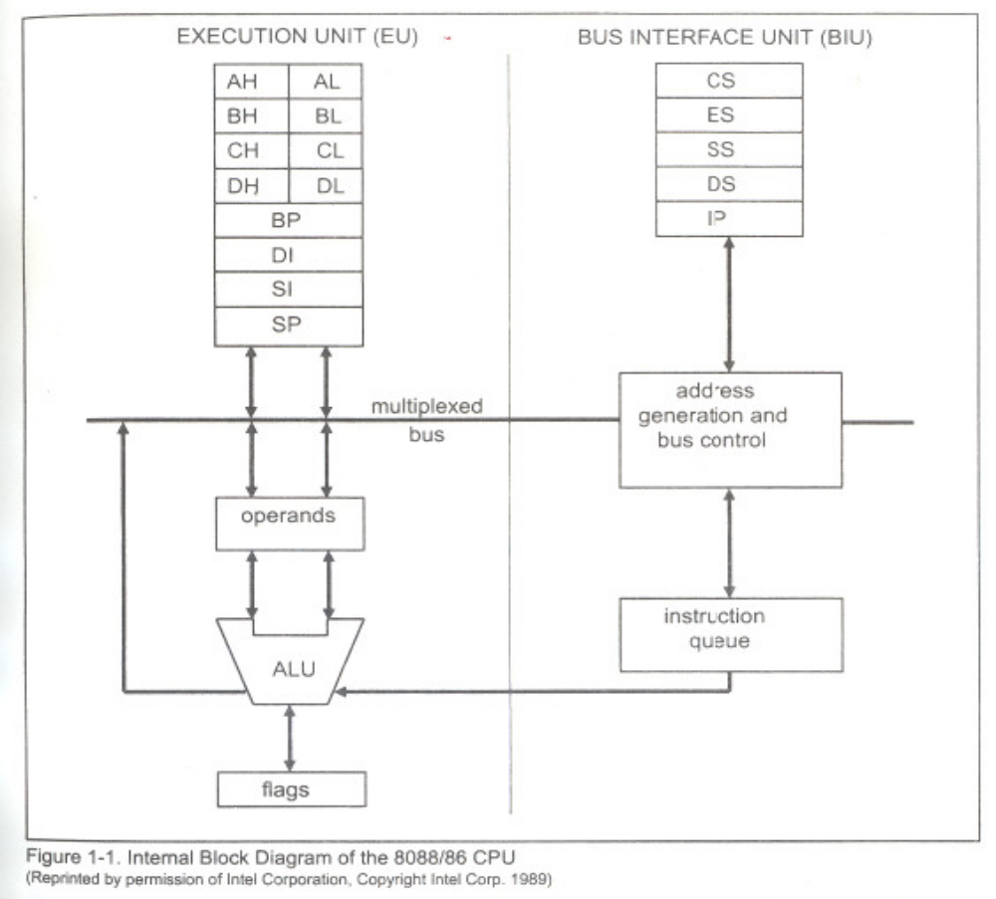
CHAPTER 0

Slide 57
Sec.0.2 Inside the computer
Internal working of computers
The action to be performed by the CPU is to put hexadecimal value 21 into
register A, and then add to register A values 42H and 12H.
Action Code Data
Move value 21H into register A B0H 21H
Add value 42H to register A 04H 42H
Add value 12H to register A 04H 12H
If the program to perform the actions listed above is stored in memory
locations starting at 1400H, the following would represent the contents for each
memory address location.
Memory address Contents of memory address
1400 (B0) the code for moving a value to register A
1401 (21) the value to be moved
1402 (04) the code for adding a value to register A
1403 (42) the value to be moved
1404 (04) the code for adding a value to register A
(12) the value to be moved
(F4) the code for halt
CHAPTER 0

Slide 58
Review Questions (思考题)
1. What is a “stored program computer” (the von Neumann Machine)?
2. What is the “computer architecture” and what is the “computer organization”?
CHAPTER 0

Slide 59
Next Lesson
Instruction Sets （指令集）
CHAPTER 0

