Slide 1

Review
Computer Architecture
Computer Organization
Stored Program Computer

Slide 2
Main Content
Instruction Sets: Characteristics and functions
Instruction Sets: Addressing

Slide 3
What is an Instruction Set?
The complete collection of instructions that the CPU can execute (or understand) is called instruction set
Instruction set is the interface (boundary) between computer designer and computer programmer
The operation of the CPU is determined by the instruction set it can executes
Instruction set
  Machine Code
  Binary representation
  Usually represented by assembly codes

Slide 4
Elements of an Instruction
Operation code (Opcode)
  Specifies the operation to be performed
Source Operand reference
  Operands that are inputs for the operation
Result Operand reference
  Store the result produced by operation
Next Instruction Reference
  Tells the CPU where to fetch the next instruction after the execution of this instruction is complete
Notes:
3

Slide 5
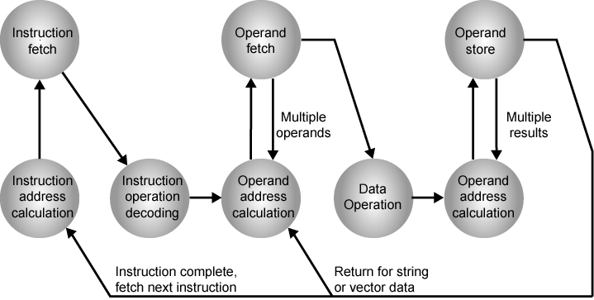
Instruction Cycle State Diagram

Slide 6
Operands can be stored in:
Main memory (or virtual memory or cache)
  The main or virtual memory address must be supplied
CPU register
  If only one register exists, reference to it may be implicit
  If more than one register exists, each register is assigned a unique number, the instruction must contain the desired register’s number
I/O device
  Instruction specify the I/O module/device
  Memory mapped I/O, as memory address
Notes:
4

Slide 7
Instruction Representation
In machine code each instruction has a unique bit pattern
For human consumption, a symbolic representation is used
  e.g. ADD, SUB, LOAD
Opcode are represented by abbreviation, called mnemonics, that indicate the operation
  e.g. ADD(Add), SUB(Subtract)…
Operands are also represented symbolically.
  e.g. ADD R, Y
Op code
Operands
Notes:
5

Slide 8
Instruction Types
A high-level language instruction
  X = X + Y
This operation could be accomplished with three machine instructions as following:
  Load a register with the contents of memory location X;
  Add the contents of memory location Y to the register;
  Store the contents of the register in memory location X;
…
X
Y
…
The set of machine instructions must be sufficient to express any of the instructions from a high-level language
Notes:
6

Slide 9
Instruction Types
Data processing
  Arithmetic instructions: provide computational capabilities for processing numeric data
  logic instructions: operate on the bits of a word as bits rather than as numbers
Data storage (main memory)
  Memory instructions: move data between memory and the registers
Data movement (I/O)
  I/O instructions: transfer programs and data into memory and the results of computations back out to the user
Control
  Test instructions: test the value of a data word or the status of a computation
  Branch instructions: branch to a different set of instructions depending on the decision made
Notes:
6

Slide 10
Number of Addresses
What is the maximum number of addresses one might need in an instruction?
Evidently, arithmetic and logic instructions which include unary or binary operations will require the most operands
For binary operations, the number of operands should be include:
  Two addresses to reference operands
  One address to reference computation result
  One address to reference next instruction
Op code
Result
Operand 1
Operand 2
Next instruction
address
Instruction containing four address references
Notes:
7

Slide 11
Number of Addresses (a)
In practice, four-address instruction are extremely rare
  The address of the next instruction can be implicit (obtained from the program counter)
3 addresses (implicit next instruction)
  Operand 1, Operand 2, Result
  ADD a, b, c (a b + c)
  May be a forth - next instruction (usually implicit)
  Not common
  Needs very long words to hold everything

Slide 12
Number of Addresses (b)
2 addresses
  One address doubles as operand and result
  a = a + b
  Reduces length of instruction
  Requires some extra work
    Temporary storage to hold some results
1 address
  Implicit second address
  Usually a register (accumulator)
  Common on early machines
Notes:
8

Slide 13
Number of Addresses (c)
0 (zero) addresses
  All addresses implicit
  Uses a stack
  e.g. push a
  push b
  add
  pop c
  c = a + b
Notes:
10

Slide 14
How Many Addresses
More addresses
  More complex instructions
  More registers
    Inter-register operations are quicker
  Fewer instructions per program
Fewer addresses
  Less complex instructions
  More instructions per program
  Faster fetch/execution of instructions
Notes:
11

Slide 15
Instruction Set Design
The instruction set defines many of the functions performed by the CPU and thus has a significant effect on the implementation of the CPU
Operation repertoire
  How many ops?
  What can they do?
  How complex are they?
Data types
  The various types of data upon which operations are performed
Notes:
12

Slide 16
Instruction Set Design
Instruction formats
  Length of op code field
  Number of addresses
Registers
  Number of CPU registers available
  Which operations can be performed on which registers?
Addressing modes
  The mode or modes by which the address of an operand is specified.
RISC v CISC
Notes:
13

Slide 17
Types of operands
Addresses
Numbers
Characters
Logical data

Slide 18
Types of Operand
Addresses
  Can be considered to be unsigned integers
Numbers
  Integer or fixed point
  floating point
  Decimal
Characters
  ASCII –American Standard Code for Information Interchange (IRA – International Reference alphabet)
  EBCDIC – Extended Binary Coded Decimal Interchange Code ( IBM S/370 )
Logical Data
  Bits: store an array of Boolean or binary data items, in which each item can take on only values 1 or 0
  Flags: representation of status for a instruction execution
Notes:
14

Slide 19
Pentium Data Types
8 bit Byte
16 bit word
32 bit double word
64 bit quad word
Addressing is by 8 bit unit
A 32 bit double word is read at addresses divisible by 4
Notes:
15

Slide 20
PowerPC Data Types
8 (byte), 16 (halfword), 32 (word) and 64 (doubleword) length data types
Some instructions need operand aligned on 32 bit boundary
Can be big- or little-endian
Fixed point processor recognises:
  Unsigned byte, unsigned halfword, signed halfword, unsigned word, signed word, unsigned doubleword, byte string (<128 bytes)
Floating point
  IEEE 754
  Single or double precision

Slide 21
Types of Operation
The number of different opcodes varies widely form machine to machine
The same general types of operations are found on all machines, as following
  Data Transfer
  Arithmetic
  Logical
  Conversion
  I/O
  System Control
  Transfer of Control
Notes:
18

Slide 22
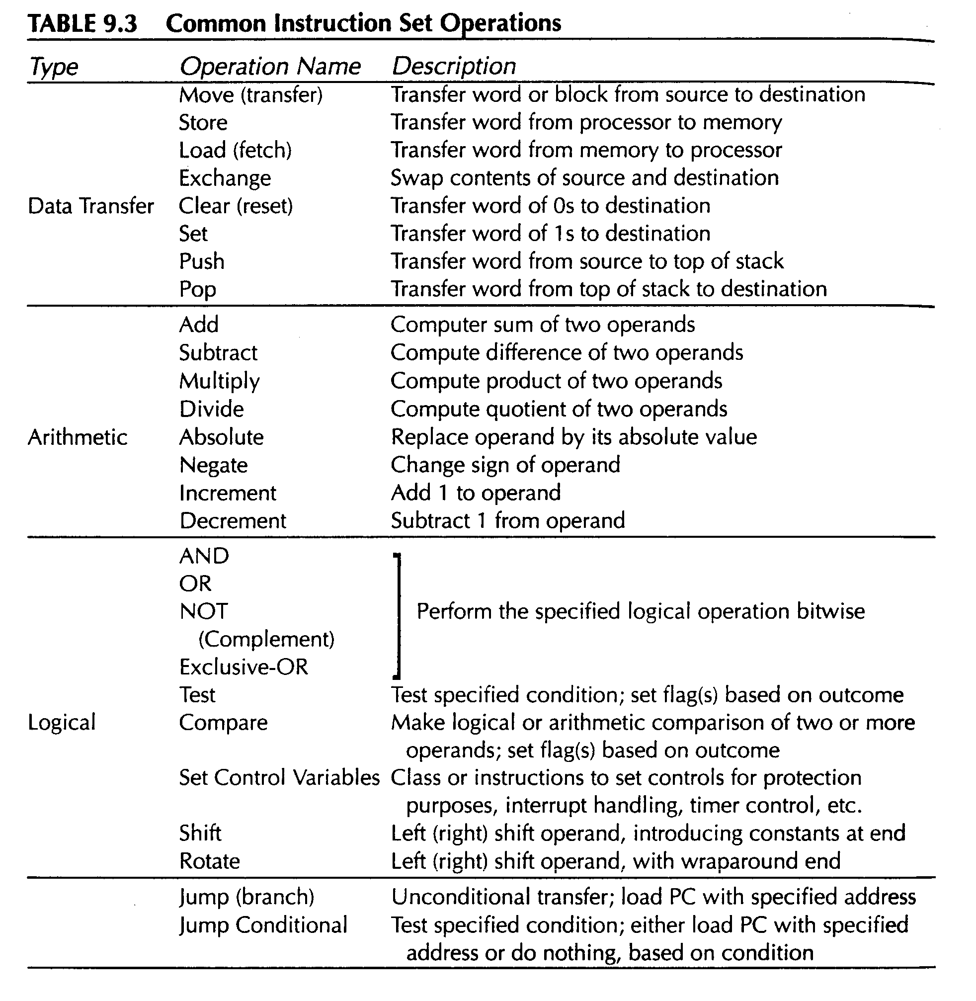

Slide 23
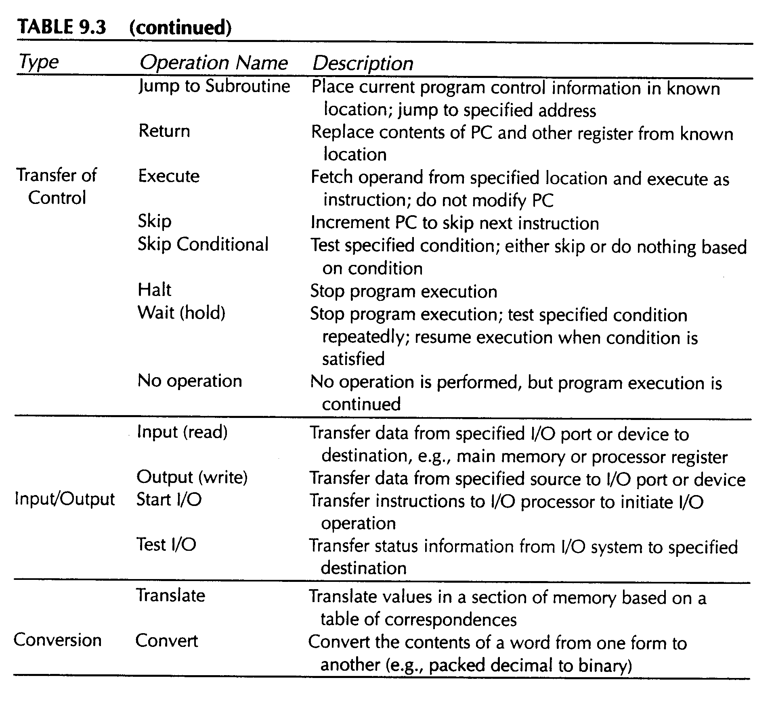


Slide 24
Data Transfer
The most fundamental type of machine instruction, it must specify:
  Source
  Destination
  Amount of data (length of data)
  The mode of addressing for each operand
May be different instructions for different movements
  e.g. IBM 370
Or one instruction and different addresses
  e.g. VAX
Notes:
19

Slide 25
Arithmetic
Add, Subtract, Multiply, Divide
  For signed integer, floating point, packed decimal
Single-operand instructions:
  Increment: add 1 to the operand
  Decrement: subtract 1 from the operand
  Negate: negate the operand
  Absolute: take the absolute value of the operand
May involve data transfer operations
Notes:
20

Slide 26
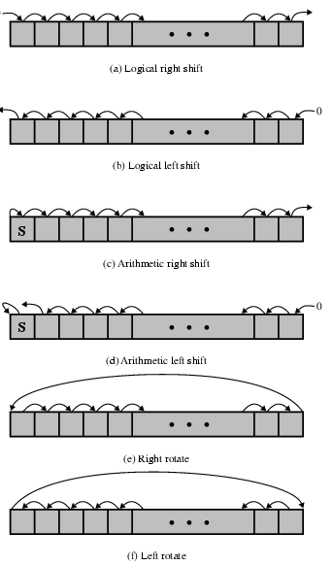
Logical
Bit level operations
AND, OR, NOT, XOR
Shift and rotate
  logical shift
  Arithmetic shit
  rotate
May involve data transfer operations

Slide 27
Conversion
Change the format or operate on the format of data
  E.g. Binary to Decimal
  IBM S/390 TR instruction
Notes:
22

Slide 28
Input/Output
May be specific instructions
  E.g. intel X86 instruction “in” and “out”
May be done using data movement instructions (memory mapped)
May be done by a separate controller (DMA) or I/O processor
Notes:
23

Slide 29
Systems Control
Privileged instructions: Are those that can be executed only while the processor is in a certain privileged state or is executing a program in a special privileged area of memory
CPU needs to be in specific state
For operating systems use
Notes:
24

Slide 30
Transfer of Control
Why transfer of control
  Some instruction block may be executed more than once and perhaps many thousands of times
  All programs involve some decision making, make CPU to do one thing if one condition holds, and another thing if another condition holds
  For breaking the task up into smaller pieces that can be worked on one at a time
Notes:
25

Slide 31
Transfer of Control
Branch
  Jump to an instruction other than the next instruction
  e.g. branch to x if result is zero
Skip
  Skip the next instruction
  e.g. increment and skip if zero
Subroutine call
  Call another program
  Interrupt call
Notes:
25

Slide 32
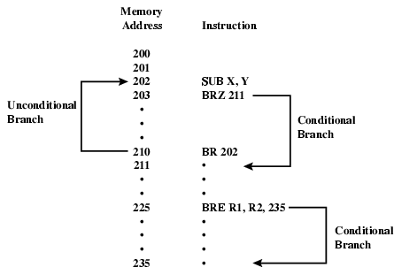
Branch Instruction

Slide 33
Procedure Calls
The most important innovation in the development of programming language is the procedure.
The procedure mechanism involves two basic instructions:
  A call instruction that branches from the present location to the procedure
  A return instruction that returns from the procedure to the place from which it was called

Slide 34
Procedure Calls
Points are worth noting
  A procedure can be called from more than one location
  A procedure call can appear in a procedure (nesting of procedure)
  Each procedure call is matched by a return in the called program
Common places for storing the return address
  Register
  Start of called procedure
  Top of stack

Slide 35
Byte Order (A portion of chips?)
What order do we read numbers that occupy more than one byte
e.g. (numbers in hex to make it easy to read)
12345678 can be stored in 4x8bit locations as follows
Notes:
27

Slide 36
Byte Order (example)
Address Value (1) Value(2)
184 12 78
185 34 56
186 56 34
187 78 12
i.e. read top down or bottom up?
Notes:
28

Slide 37
Byte Order Names
The problem is called Endian
The system has the least significant byte in the lowest address, this is called little-endian
The system has the least significant byte in the highest address, this is called big-endian
Notes:
29

Slide 38
Standard…What Standard?
Pentium (80x86), VAX are little-endian
IBM 370, Moterola 680x0 (Mac), and most RISC are big-endian
Internet is big-endian
  Makes writing Internet programs on PC more awkward!
  WinSock provides htoi and itoh (Host to Internet & Internet to Host) functions to convert
Notes:
30

Slide 39
Addressing modes
Specify the operands address of the instruction
Specify the address of the next instruction
Instruction addressing
Addressing modes
Operands addressing

Slide 40
Instruction addressing
Sequence:
( PC ) + 1 PC
Jump:
Specified by jump instructions
address
instruction
Instruction addressing modes
PC
0
LDA 1000
+1
1
sequence
1
ADD 1001
2
sequence
2
DEC 1200
3
JMP 7
sequence
3
4
LDA 2000
5
SUB 2001
6
INC
7
STA 2500
skip
7
8
LDA 1100
sequence
8
9
...

Slide 41
Operands addressing
OPCode
AM
A
A
Address field in the instruction
AM
Operand addressing mode
EA
Actual (effective) address of the operand
R
Address field in the instruction refers to a register
(X)
Contents of memory location X or register X
The address field(s) in a typical instruction format are relatively small.
How to reference a large range of operands locations in main memory or, for some systems, virtual memory?

Slide 42
Addressing Modes
Usually more than one addressing modes are used
  Different opcodes use different addressing modes
  Mode field in instruction indicates addressing mode
Common addressing techniques:
Immediate (立即寻址)
Direct (直接寻址)
Indirect (间接寻址)
Register (寄存器寻址)
Register Indirect (寄存器间接寻址)
Displacement (Indexed) (偏移寻址)
Stack (堆栈寻址)
Notes:
2

Slide 43
Immediate Addressing
Operand = A (address field)
Operand is part of instruction
Data (Operand) is a constant at run time
e.g. ADD 5
  Add 5 to contents of accumulator
  5 is operand
Fast, No memory reference to fetch data
Limited range (address field is usually smaller than the word length)
Instruction
Opcode
Operand
Notes:
3

Slide 44
Direct Addressing
EA = A
Address field contains address of operand
e.g. ADD A
  Add contents of cell A to accumulator
  Look in memory at address A for operand
Single memory reference to access data
No additional calculations to work out effective address
Limited address space (memory space cannot exceed the length of address field)
Notes:
5

Slide 45
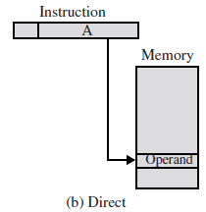
Direct Addressing Diagram
LDA 1001
AM
Memory
LDA
1001
1001
operand
ACC
Notes:
6

Slide 46
Indirect Addressing (1)
EA = (A)
The address field in the instruction specifies a memory location which contains the address of the data
At least two memory accesses are required
  The first to fetch the effective address
  The second to fetch the operand itself
Range of effective addresses is equal to 2^{n}, where n is the width of the memory data word
Number of locations that can be used to hold the effective address is constrained to 2^{k}, where k is the width of the instruction’s address field
Notes:
7

Slide 47
Indirect Addressing (2)
e.g. ADD (A)
  Add contents of cell pointed to by contents of A to accumulator
Large address space (2^{n},n=word length)
May be nested, multilevel, cascaded
  e.g. EA = (((A)))
Multiple memory accesses to find operand
Hence slower
Notes:
8

Slide 48
Indirect Addressing Diagram
AM
Memory
AM
Memory
OP
A
OP
A
A
EA
A
A₁
1
EA
operand
EA
A₁
0
Once indirect addressing
EA
operand
Multilevel indirect addressing
Notes:
9

Slide 49
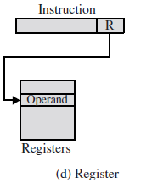
Register Addressing
EA = R
Operand is held in register named in address field
Limited number of registers
Very small address field needed
  Shorter instructions
  Faster instruction fetch
No memory access
Very fast execution
Very limited address space
Notes:
10

Slide 50
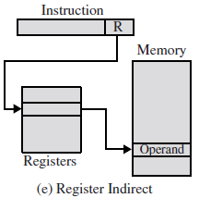
Register Indirect Addressing
EA = (R)
Operand is in memory cell pointed to by contents of register R
Large address space (2^{n})
One less memory reference than indirect addressing
Notes:
13

Slide 51
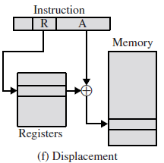
Displacement Addressing
EA = A + (R)
Combines the capabilities of direct addressing and register indirect addressing
Address field hold two values, at least one of which is explicit
  A = base value (explicit)
  R = register that holds displacement (implicit)
  or vice versa
Three of the most common
displacement addressing
  Relative addressing
  Base-register addressing
  Indexing
Notes:
15

Slide 52
Base-Register Addressing using special register
EA = ( BR ) + A
BR – special base register
AM
OP
A
Memory
BR
ALU
operand
Easy to move all program code in the memory
Content of BR is specified by OS
Program can change the content of A, but not of BR
Notes:
18

Slide 53
Displacement Addressing
--Indexed Addressing
Address field contains a main memory address
Referenced register contains a positive displacement from that address
EA = A + (R)
An important use of indexing is to provide an efficient mechanism for performing iterative operations.
Good for accessing arrays
  EA = A + (R)
  R++
Notes:
19

Slide 54
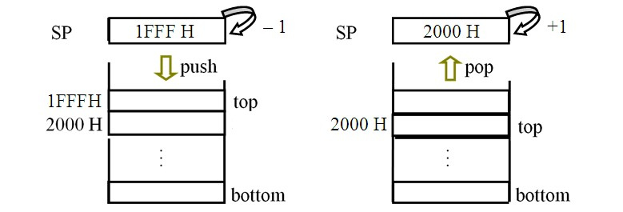
Stack Addressing
Operand is (implicitly) on top of stack
Stack characteristic:
  Hardware stack (composed by multi registers)
  Software stack (specified memory block)
  FILO, SP register = stack top pointer
Push: （SP）– 1 SP
Pop: （SP）+ 1 SP
Notes:
21

Slide 55
Implicit Addressing
Operand is (implicitly) coded in the opcode
AM
Memory
ADD
A
ACC
A
operand
An other operand is in the ACC register (implicitly)
ALU
e.g. 8086
MUL instruction
Multiplicand is in AX（16bit）or AL（8bit）
Notes:
21

Slide 56
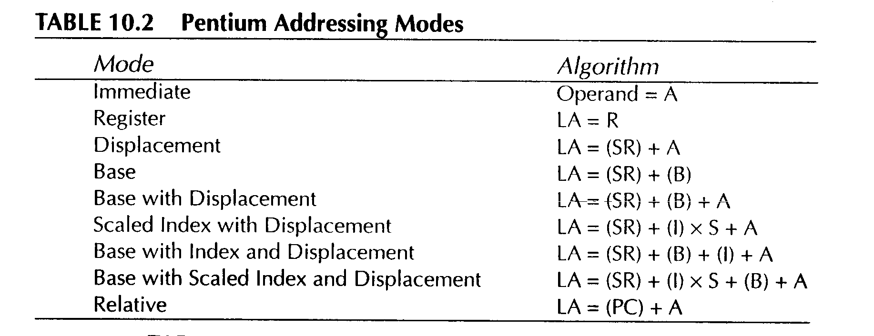
Pentium Addressing Modes

Slide 57
Instruction Formats
The instruction format defines the layout of instruction word in terms of its constituent parts
An instruction format must include an opcode and, implicitly or explicitly, zero or more operands
The format must, implicitly or explicitly, indicate the addressing mode for each operand
Usually more than one instruction format in an instruction set

Slide 58
Instruction Length Consideration
Affected by and affects:
  Memory size
  Memory organization
  Bus structure
  CPU complexity
  CPU speed
Trade off between powerful instruction repertoire and saving space

Slide 59
Variable-length Instructions
Provide a variety of instruction formats of different lengths
Variable-length instruction format can
  Easy to provide a large repertoire of opcodes, with different opcode length
  Provide more flexible addressing, with various combinations of register and memory references plus addressing mode
Variable-length format example
Single word
Double word
Three word
opcode
opcode
operand
opcode
operand
operand

Slide 60
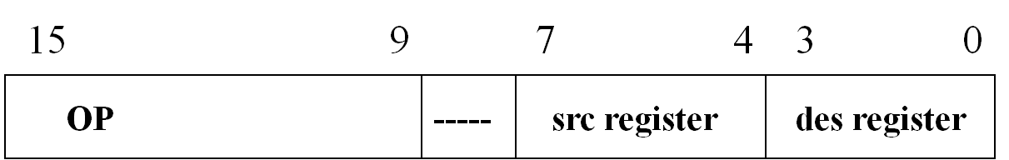
Analysis instruction format
(1)single word length instruction。
(2)opcode field can provide 2⁷=128 instructions
(3)source operand: provide registers 2⁴=16
(4)destination operand: provide registers 2⁴=16
(5)the instructions are usually used arithmetic and logic computation

Slide 61
Number of Operands and Instruction Length
Fixed Length: Wastes space but is fast and results in better performance when instruction-level pipelining is used.
Variable Length: More complex to decode but saves storage space.

Slide 62
Expanding Opcode
Expanding opcodes represent a compromise between the need for a rich set of opcodes and the desire to have short opcodes, and thus short instructions.
There are longer opcodes with fewer operands as well as shorter opcodes with more operands.
Each instruction must be unique.

Slide 63
Expanding Opcode
Example: Consider a machine with 32-bit instructions. The following formats are designed
Opcode only (zero address)
Opcode + 1 address
Opcode + 2 addresses
The size of address field is 12 bits. One shorter opcode is reserved for the expanding opcode.
How many 0-addesss, 1-address and 2-address instructions can be formulated?

Slide 64
Expanding Opcode
Solution:
2-address instructions (2⁸-1)
0000 0000 A1 (12bits) A2(12bits)
… … … …
1111 1110 A1(12bits) A2(12bits)
1-address instructions (2¹²-1)
1111 1111 0000 0000 0000 A1(12bits)
… … … …
1111 1111 1111 1111 1110 A1(12bits)
0-address instructions (2¹²)
1111 1111 1111 1111 1111 0000 0000 0000
… … … …
1111 1111 1111 1111 1111 1111 1111 1111

Slide 65
Review Questions (思考题)
1. Explain the difference between register-to-register, register-to-memory, memory-to-memory instructions.
2. Give examples of immediate, direct, register, indirect, register indirect, and indexed addressing.
CHAPTER 0

Slide 66
Next Lesson
Pipelining
RISC and CISC
CHAPTER 0

